Slide 1
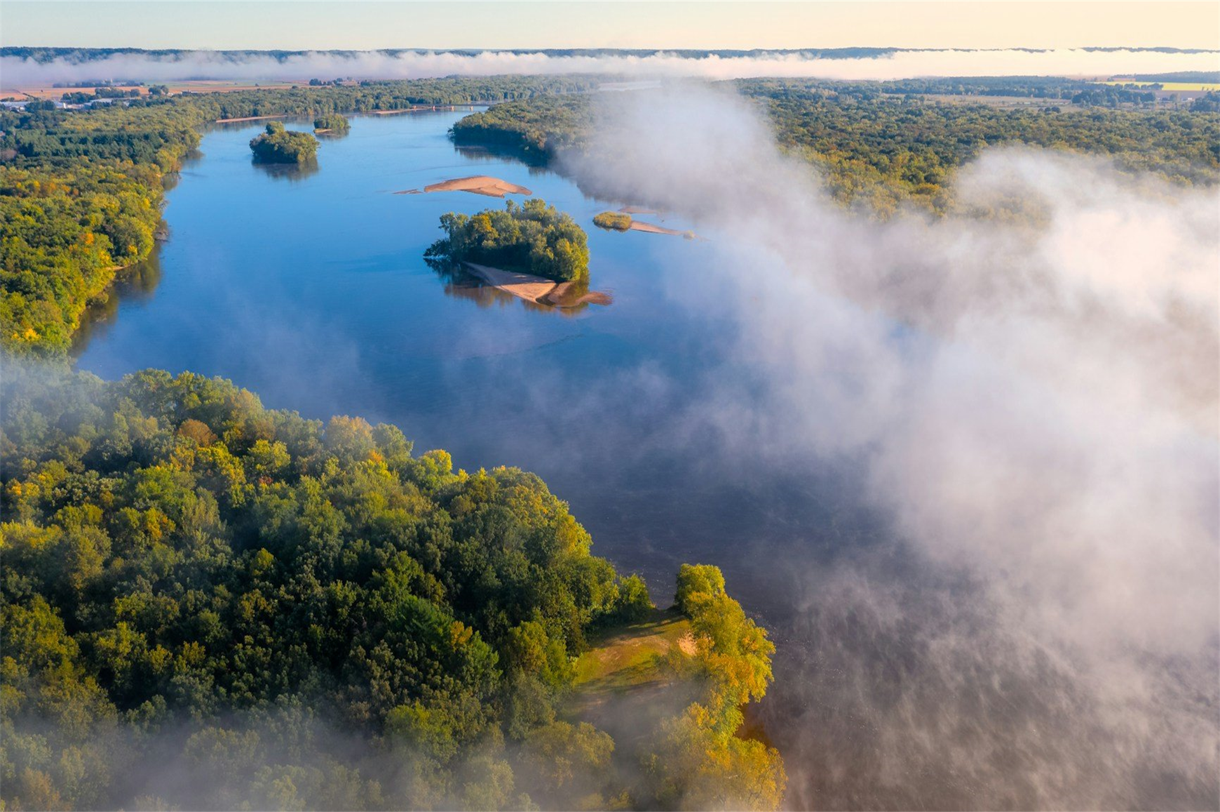

Freshwater
Last updated August 2026 | systemschangelab.org/freshwater
Photo by David Hoefler/Unsplash
Notes:
Photo by David Hoefler/Unsplash

Slide 2
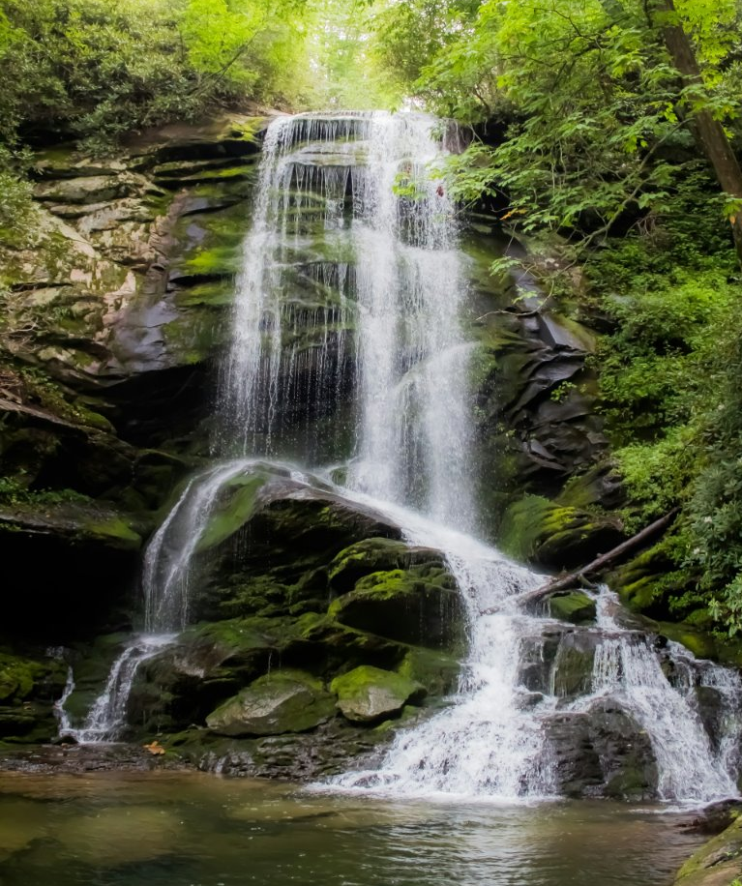
Systems Change Lab
It’s time to change the way we think about changing the world.
Systems Change Lab monitors, learns from and mobilizes action toward the transformational shifts needed to protect both people and the planet.
The data platform identifies and tracks key shifts in our global systems that, when achieved together, can spur transformational change.
Photo by Nicole King/Unsplash ​
Notes:
Photo by Nicole King/Unsplash

Slide 3














Interconnected systems
Power
Industry
Transport
Cities
Buildings
Carbon Removal
Forests & Land
Ocean
Freshwater
Food & Agriculture
Finance
Circular
Economy
Governance
Economics

Slide 4
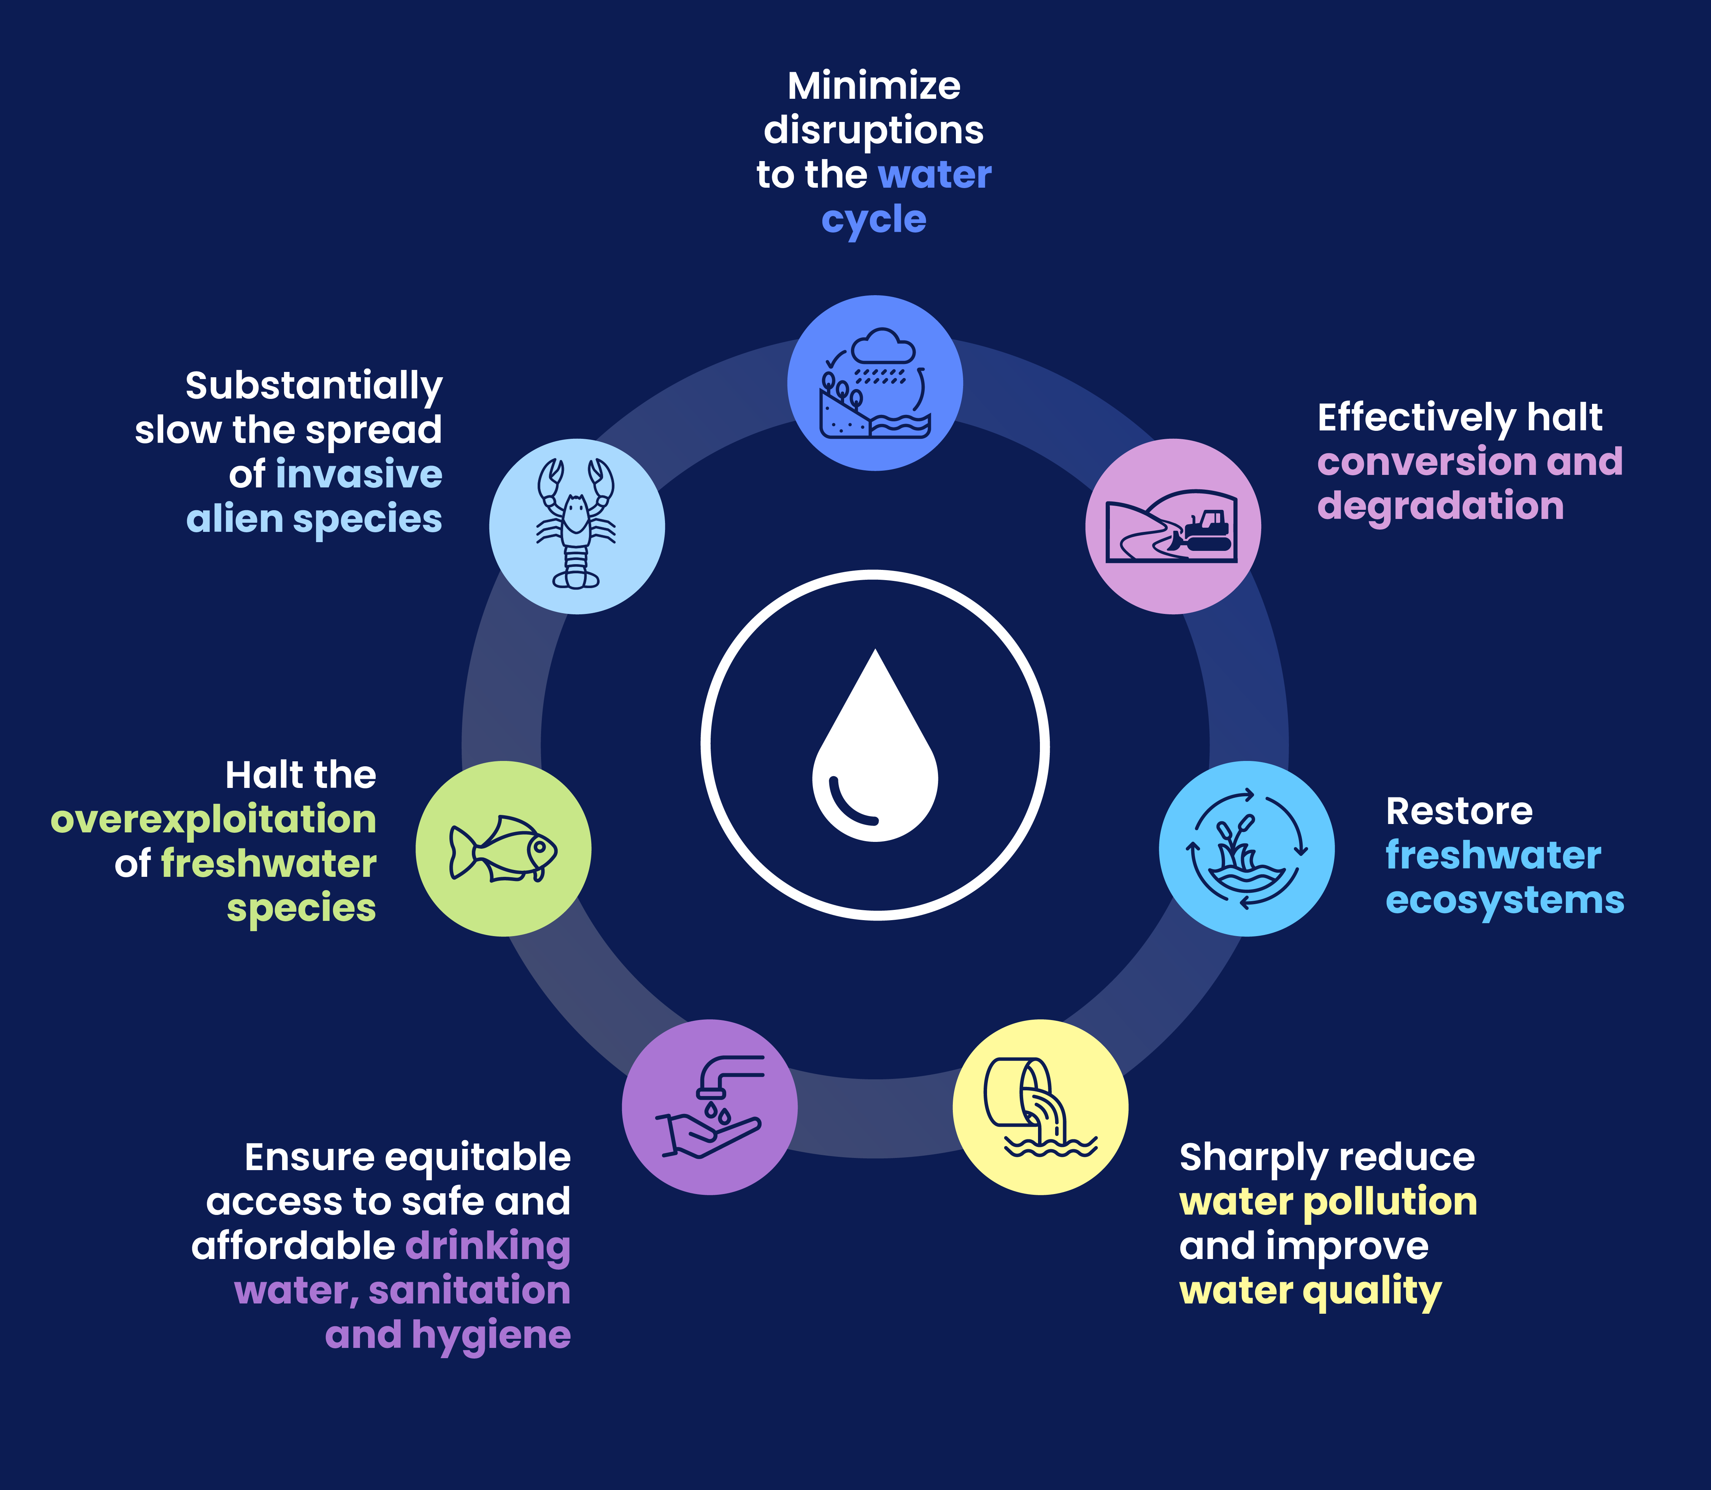
The critical shifts needed to transform the freshwater system
(forthcoming)

Slide 5
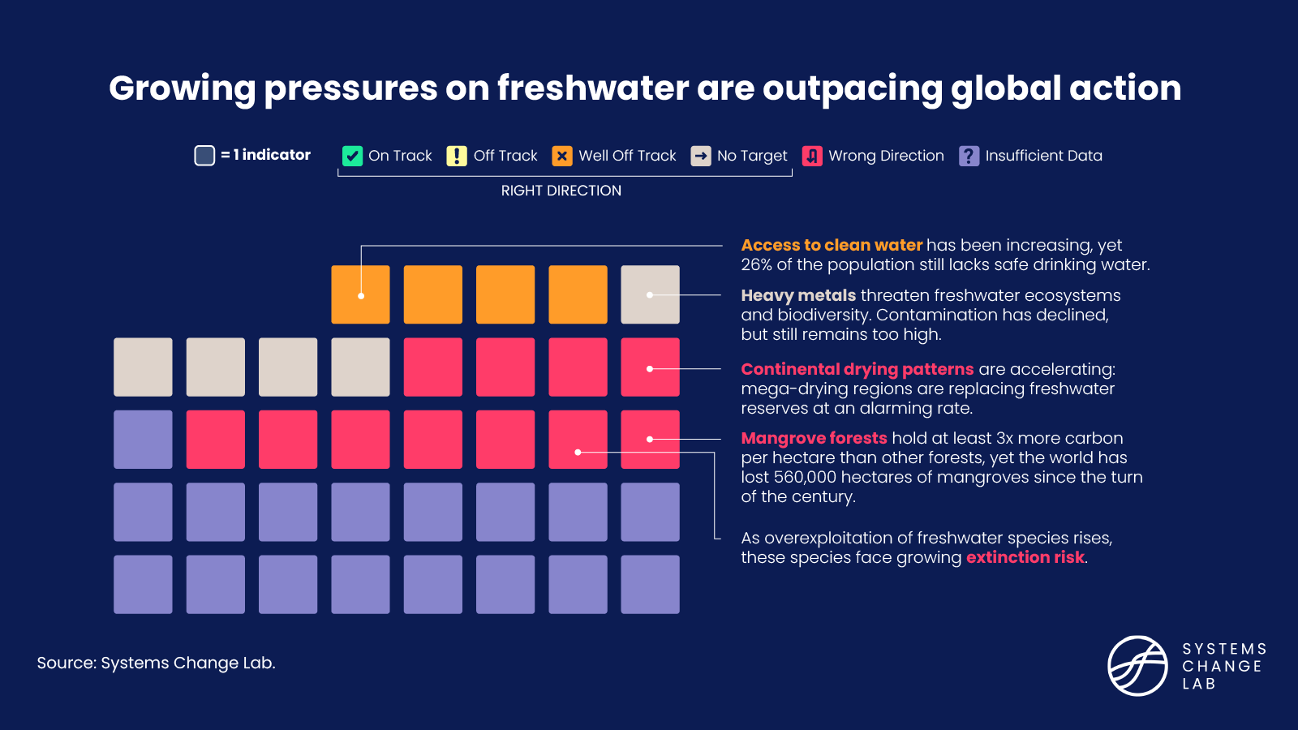

Slide 6
Freshwater sustains life on Earth
Yet growing pressures on the world’s freshwater system are outpacing global action, threatening ecosystems, economies and human well-being.
26%
30%
20%
of the world’s population lacks access to safe drinking water.
of carbon-rich freshwater ecosystems have disappeared since 1970.
of freshwater species are threatened with extinction.

Slide 7
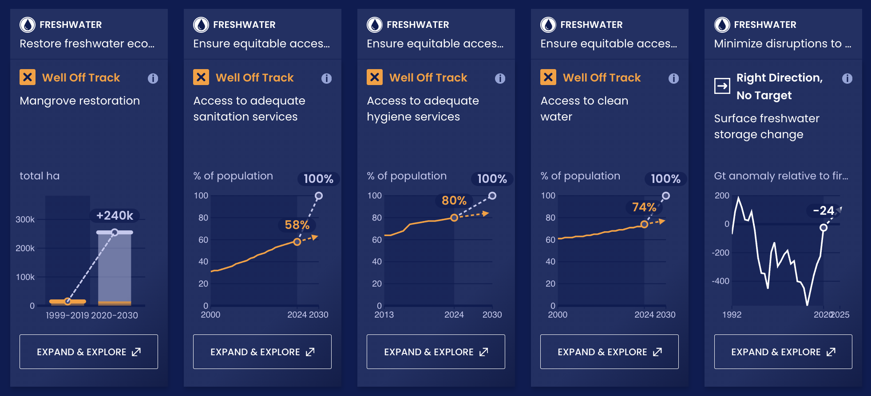
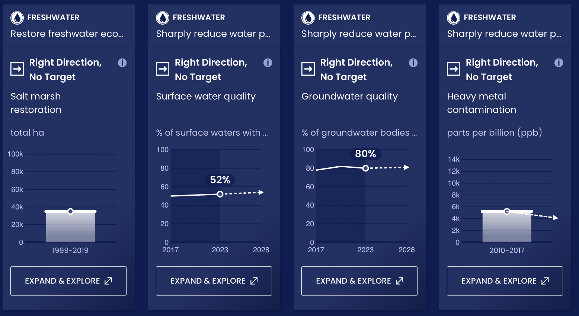
Progress toward targets
In this system, we have identified 37 outcome indicators.
Out of the 37 outcomes we've evaluated, 9 are moving in the right direction.

Slide 8
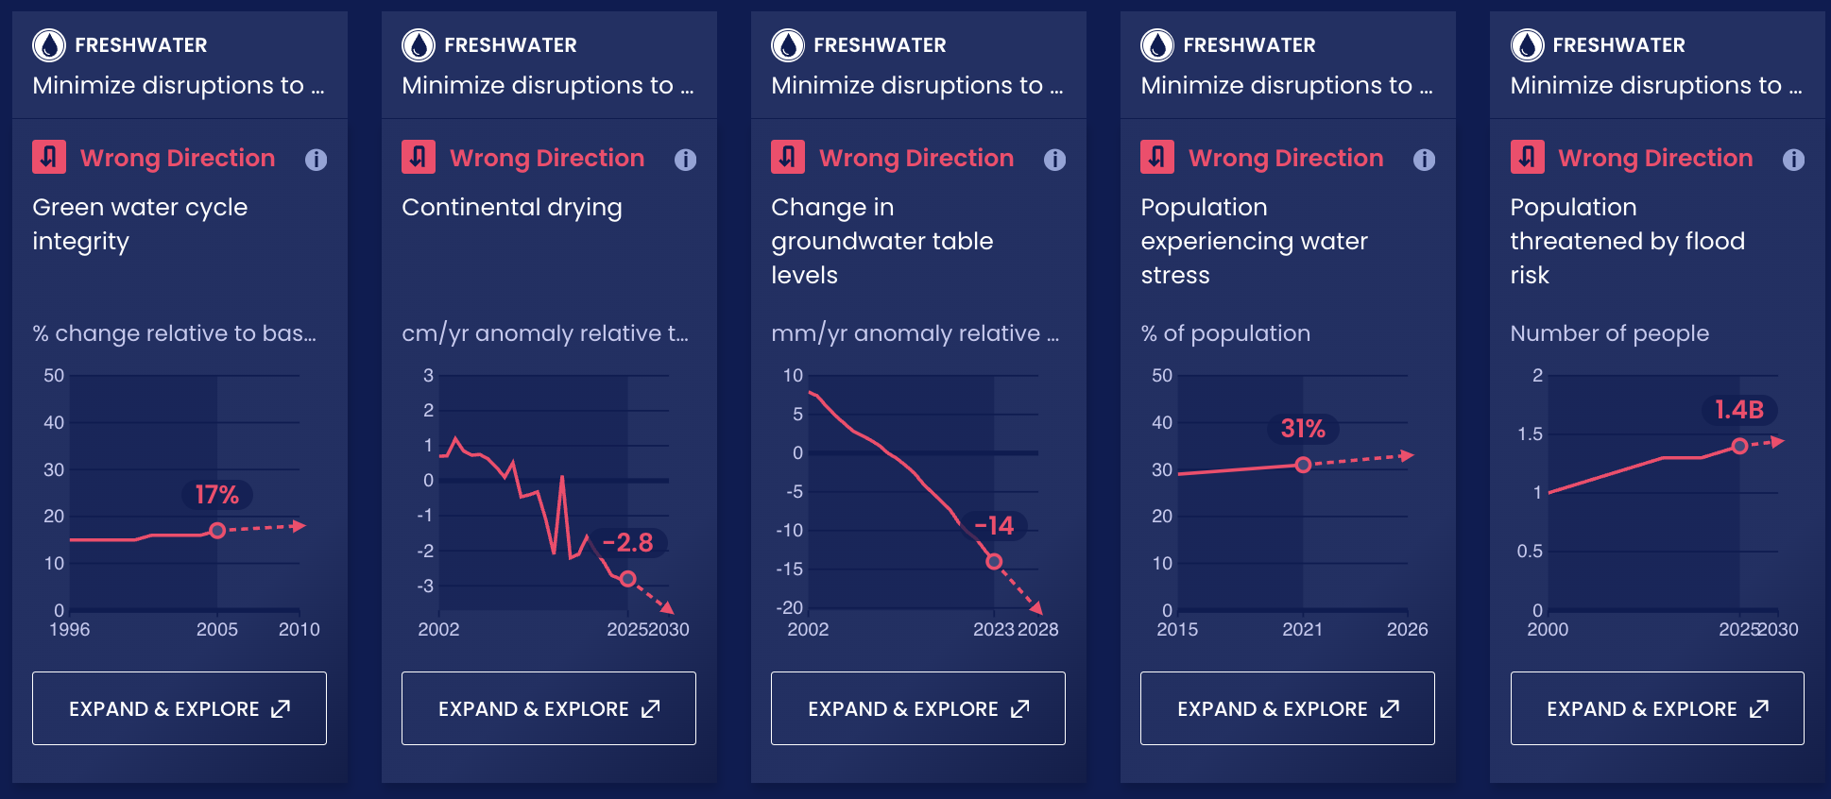
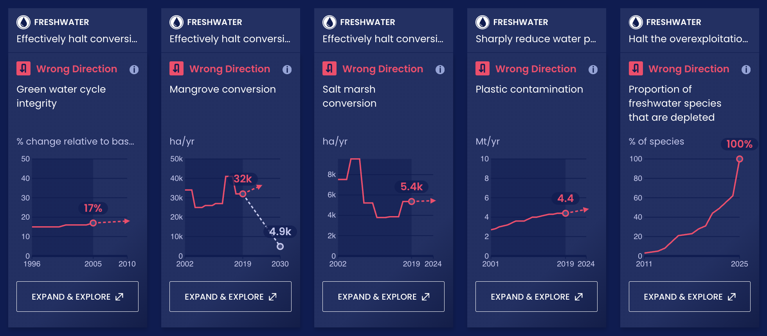
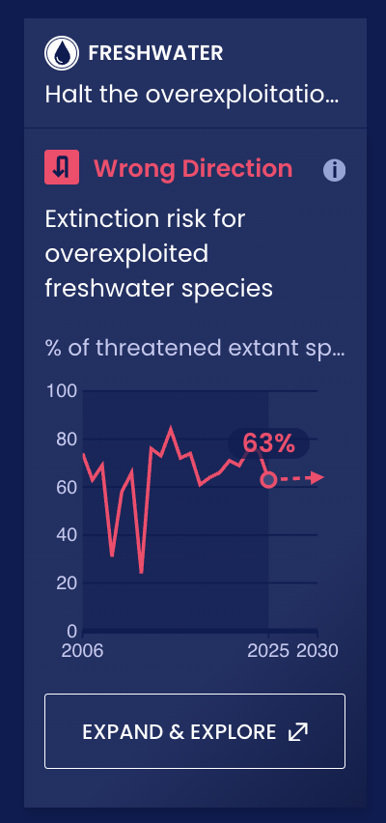
Progress toward targets
Out of the 37 outcomes we've evaluated, 11 are moving in the wrong direction.
The final 17 indicators have insufficient data.

Slide 9
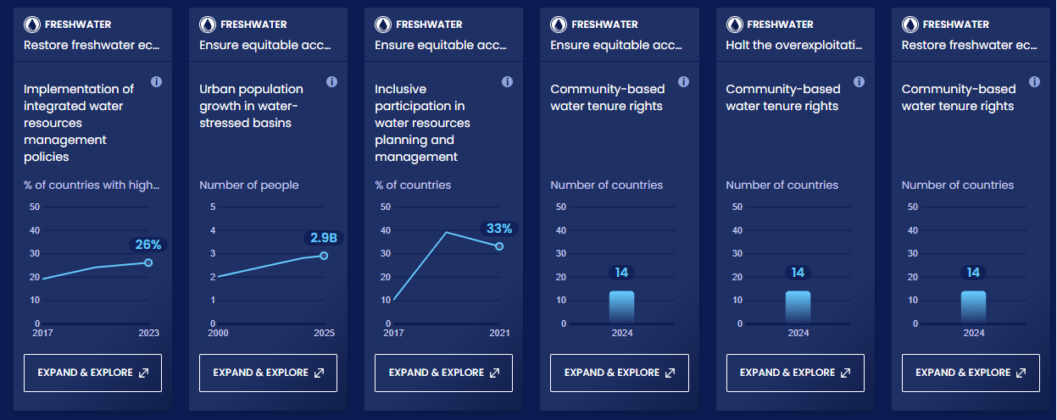
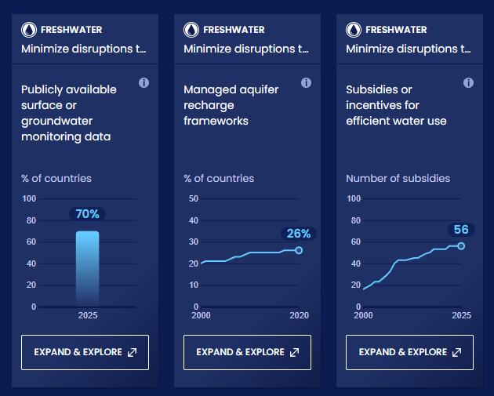
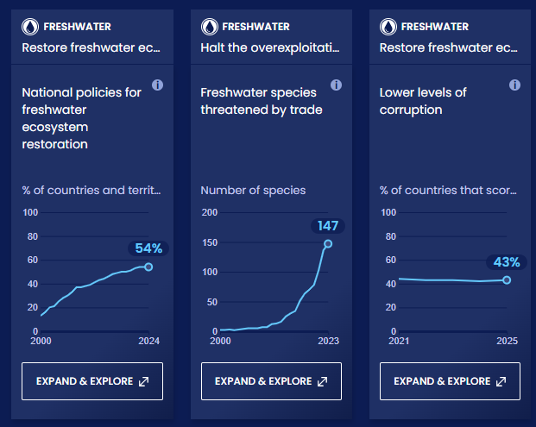
Enablers and barriers
In this system, we have identified 81 enablers and barriers to change. Data is available for 63 indicators, while no publicly available data source was identified for 18 others, highlighting the need for greater data transparency.

Slide 10
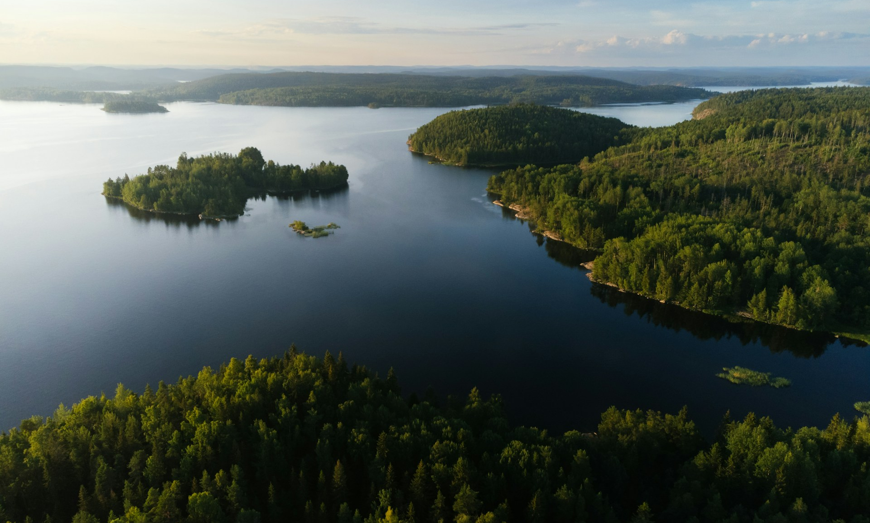
Minimize disruptions to the water cycle
SHIFT
Photo by Michail Dementiev/Unsplash
Notes:
Michail Dementiev/Unsplash

Slide 11
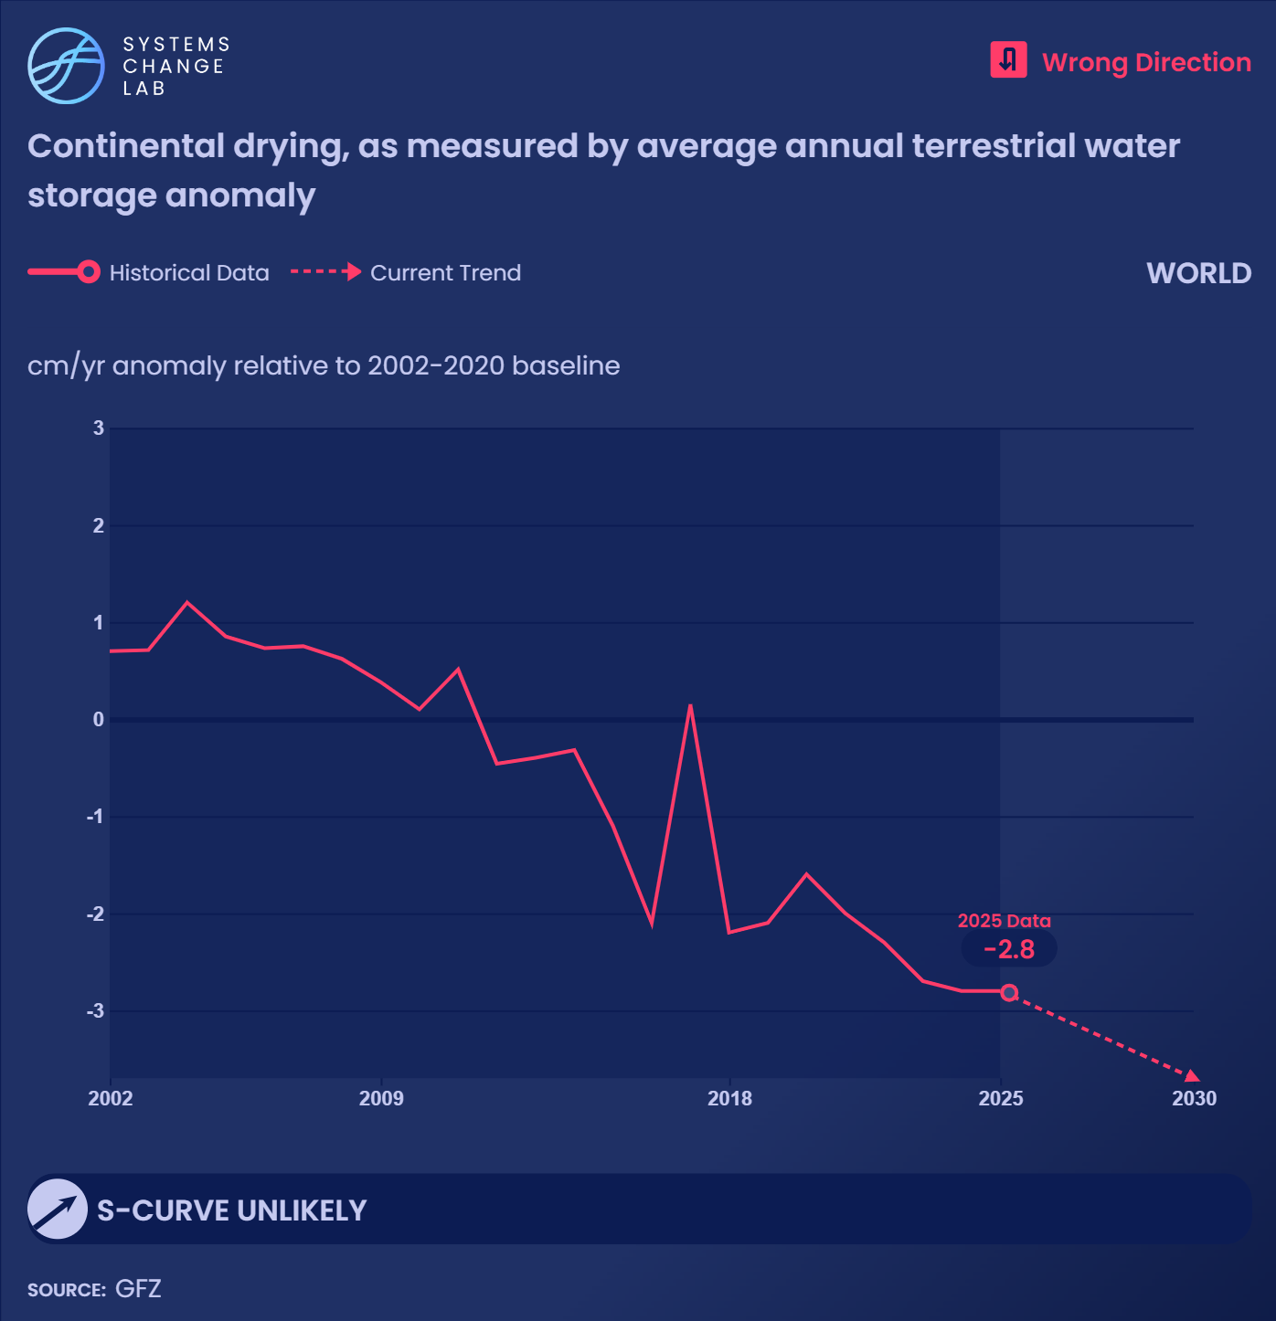
Continental drying
patterns are accelerating, with mega-drying regions replacing freshwater reserves at alarming rates.

Slide 12
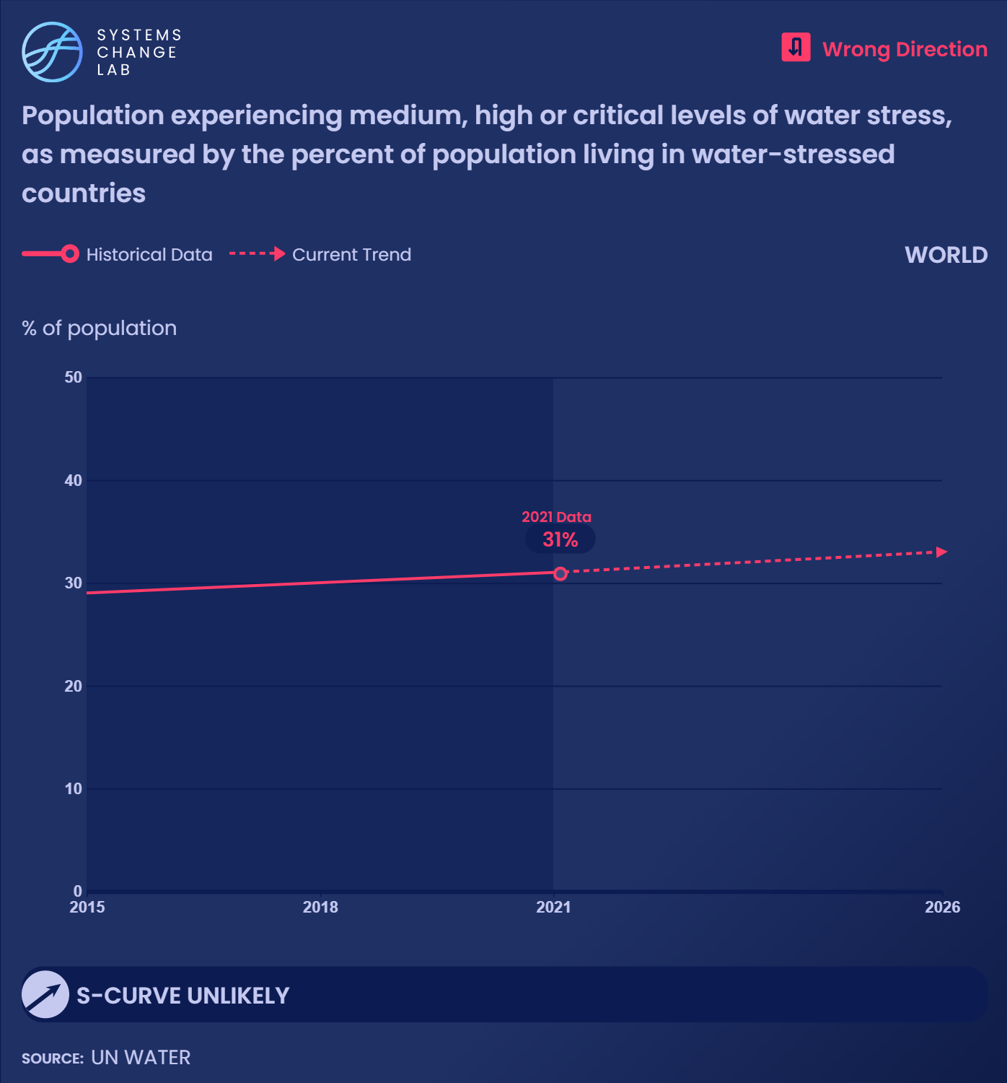
Global demand for freshwater has more than doubled since 1960 and continues to exceed what’s available.
In 2021, 31% of the global population lived in countries facing medium, high and critical water-stress, with 8% facing critical levels.

Slide 13
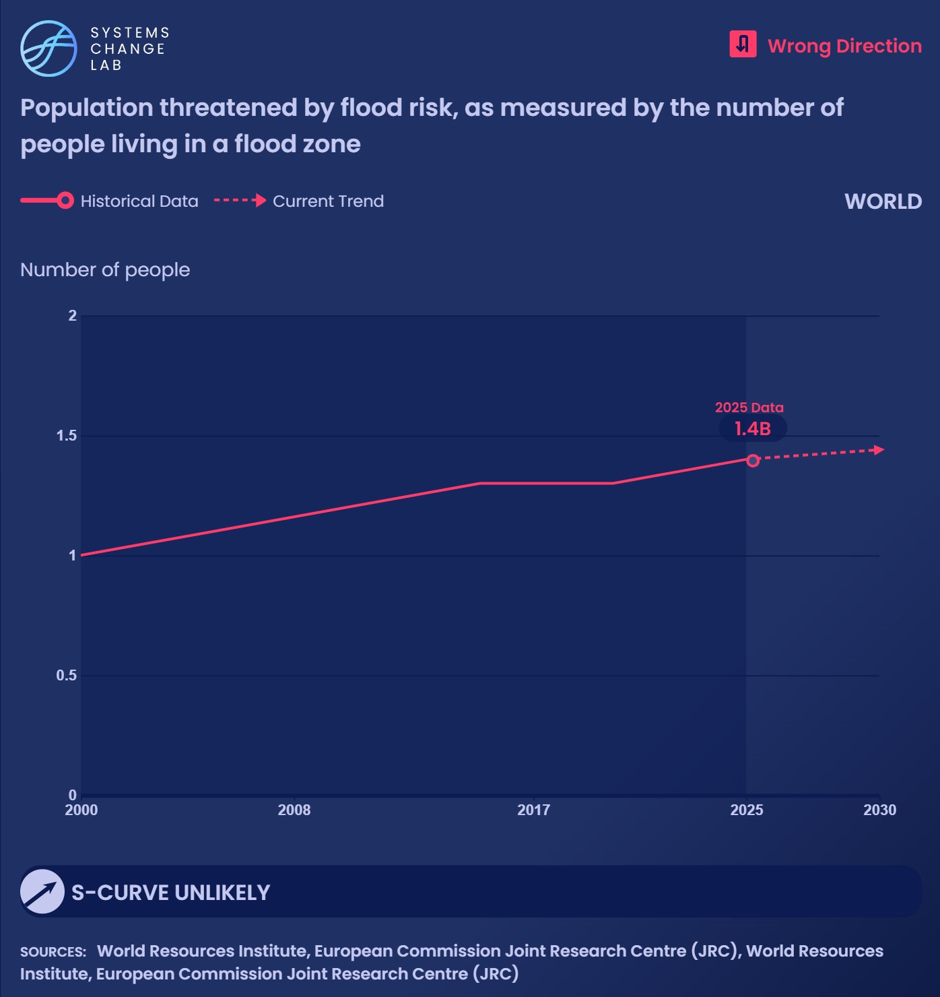
Approximately, 1.4 billion people were estimated to be living in a flood zone in 2025, up from 1 billion in 2000.

Slide 14
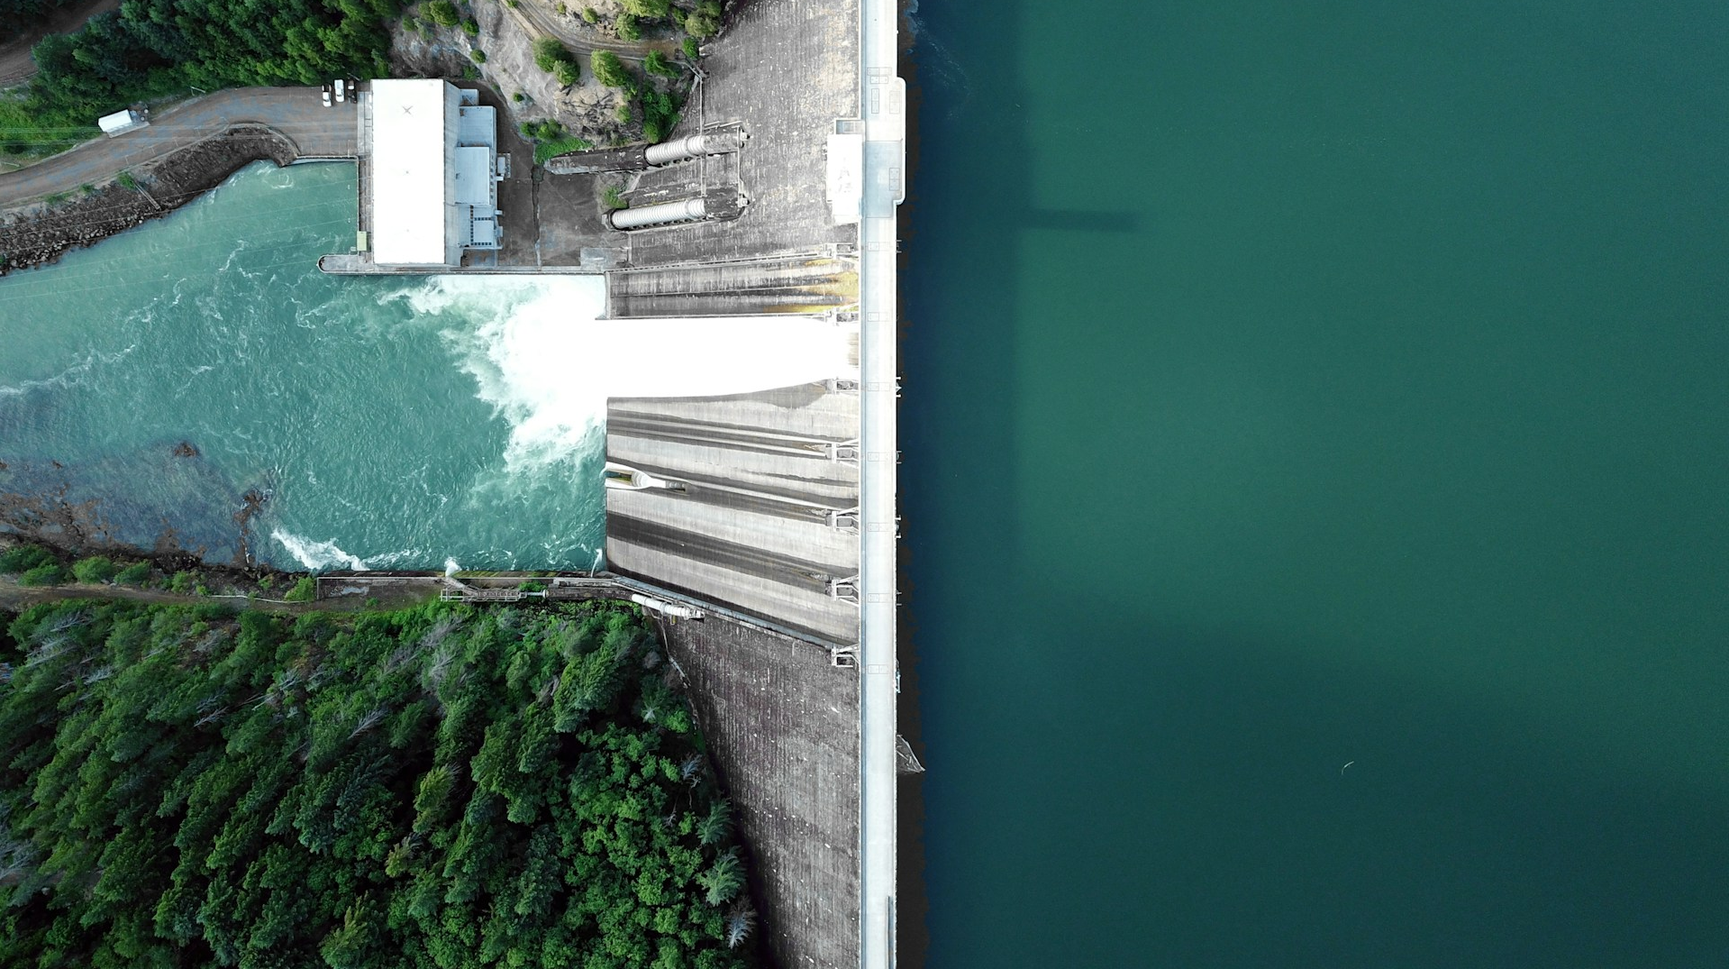
Effectively halt conversion and degradation
SHIFT
Photo by Dan Myers/Unsplash
Notes:
Dan Meyers/Unsplash

Slide 15
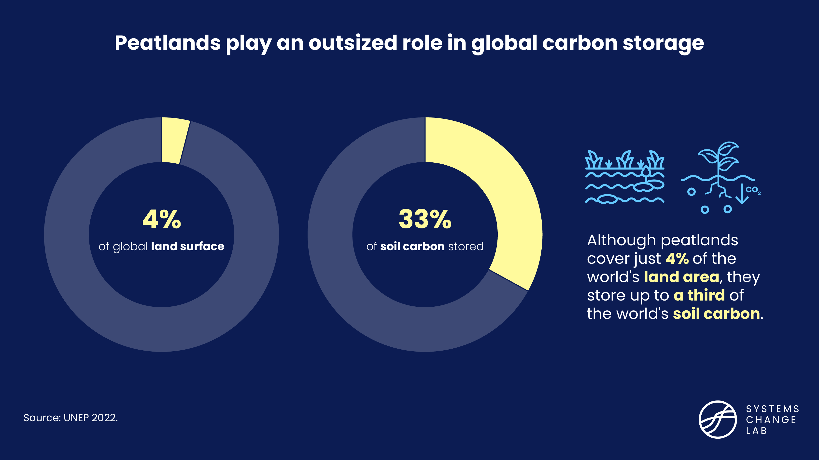

Slide 16
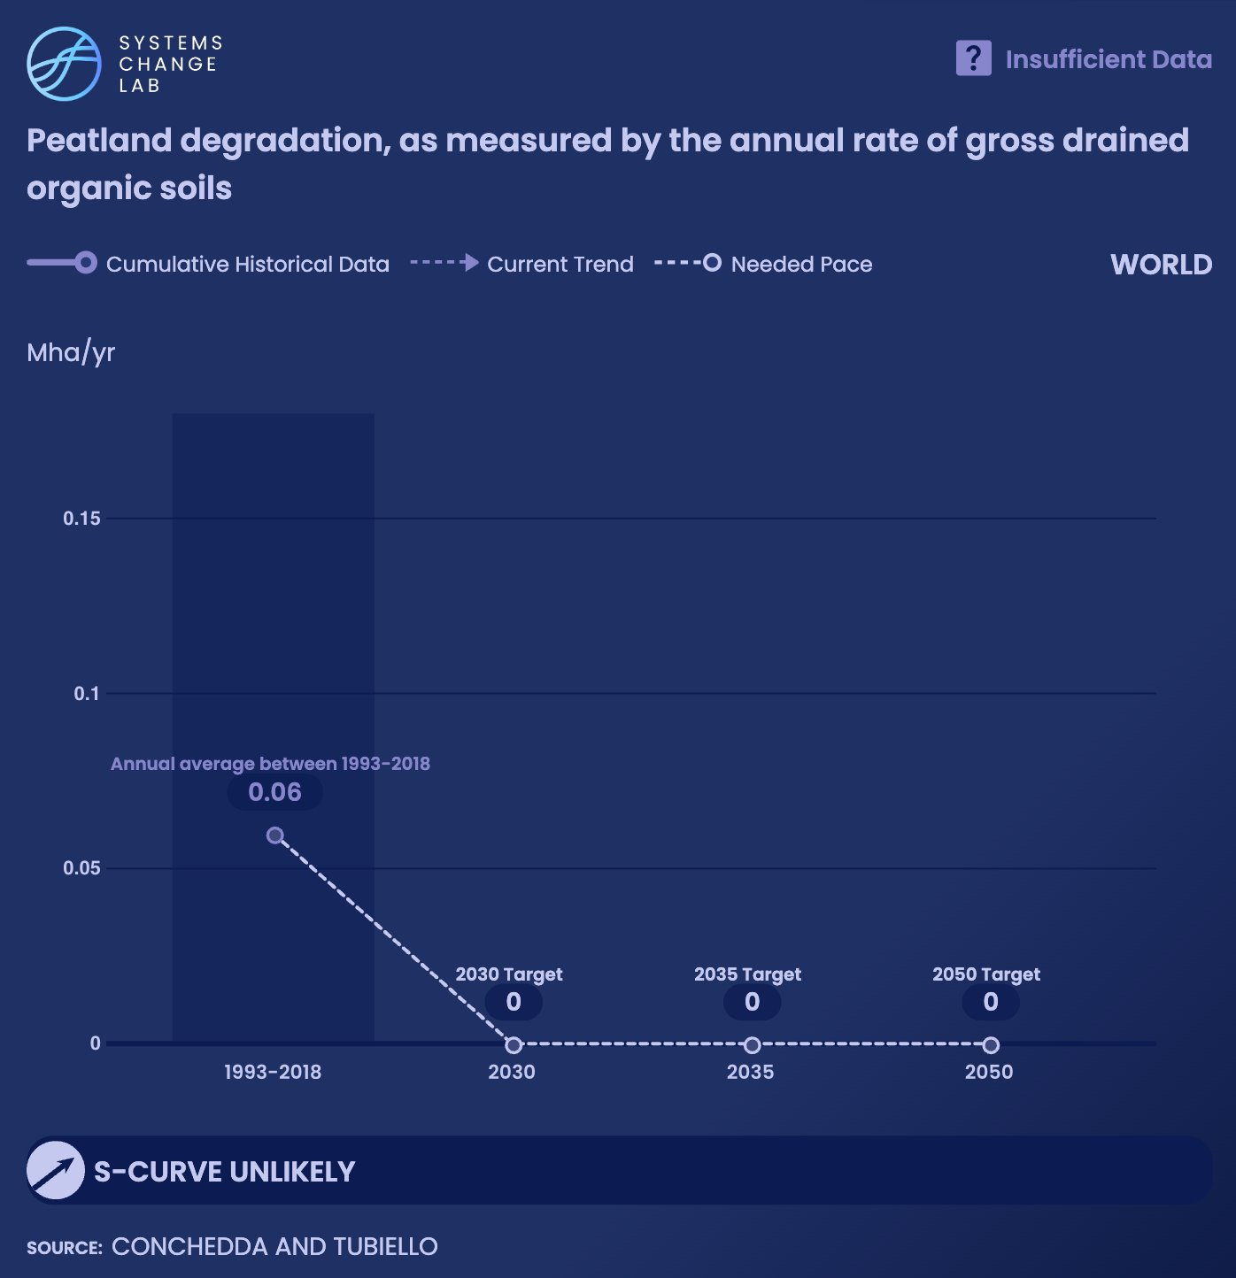
Global estimates show that ~0.06 Mha of organic soils were drained each year for crop cultivation and grazing between 1993 and 2018.
In total, 57 Mha of peatlands are currently degrading.

Slide 17
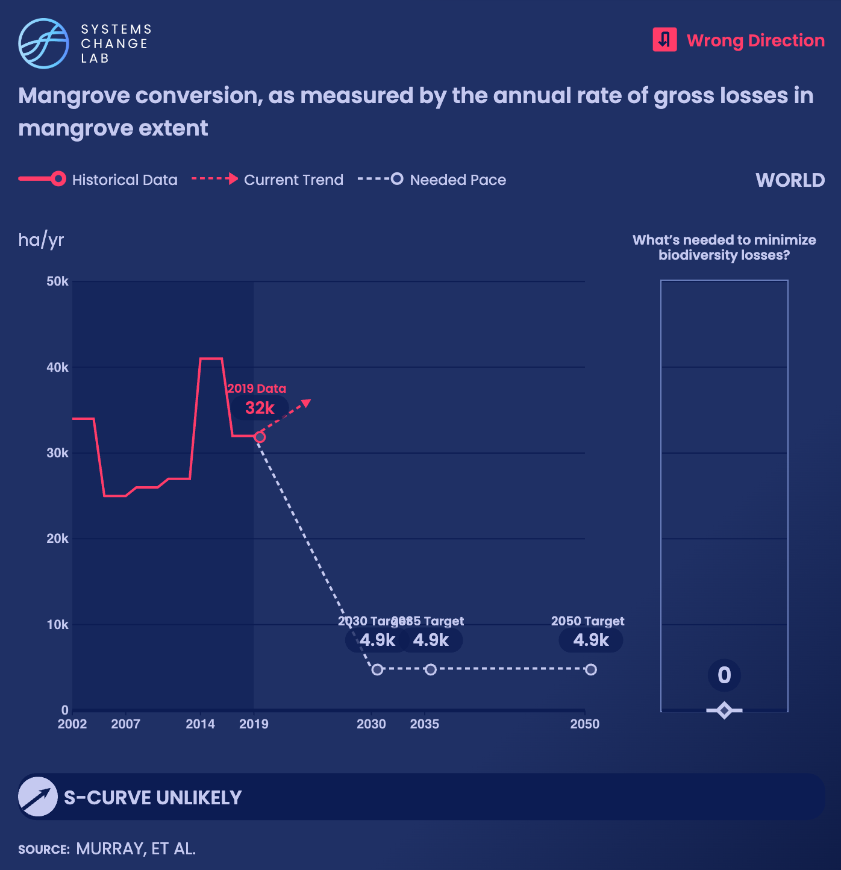
The world’s shorelines have lost a total of 560,000 hectares of mangroves since 2000, and between 2008 to 2019, these losses increased at an average annual rate of almost 950 ha per yr.

Slide 18
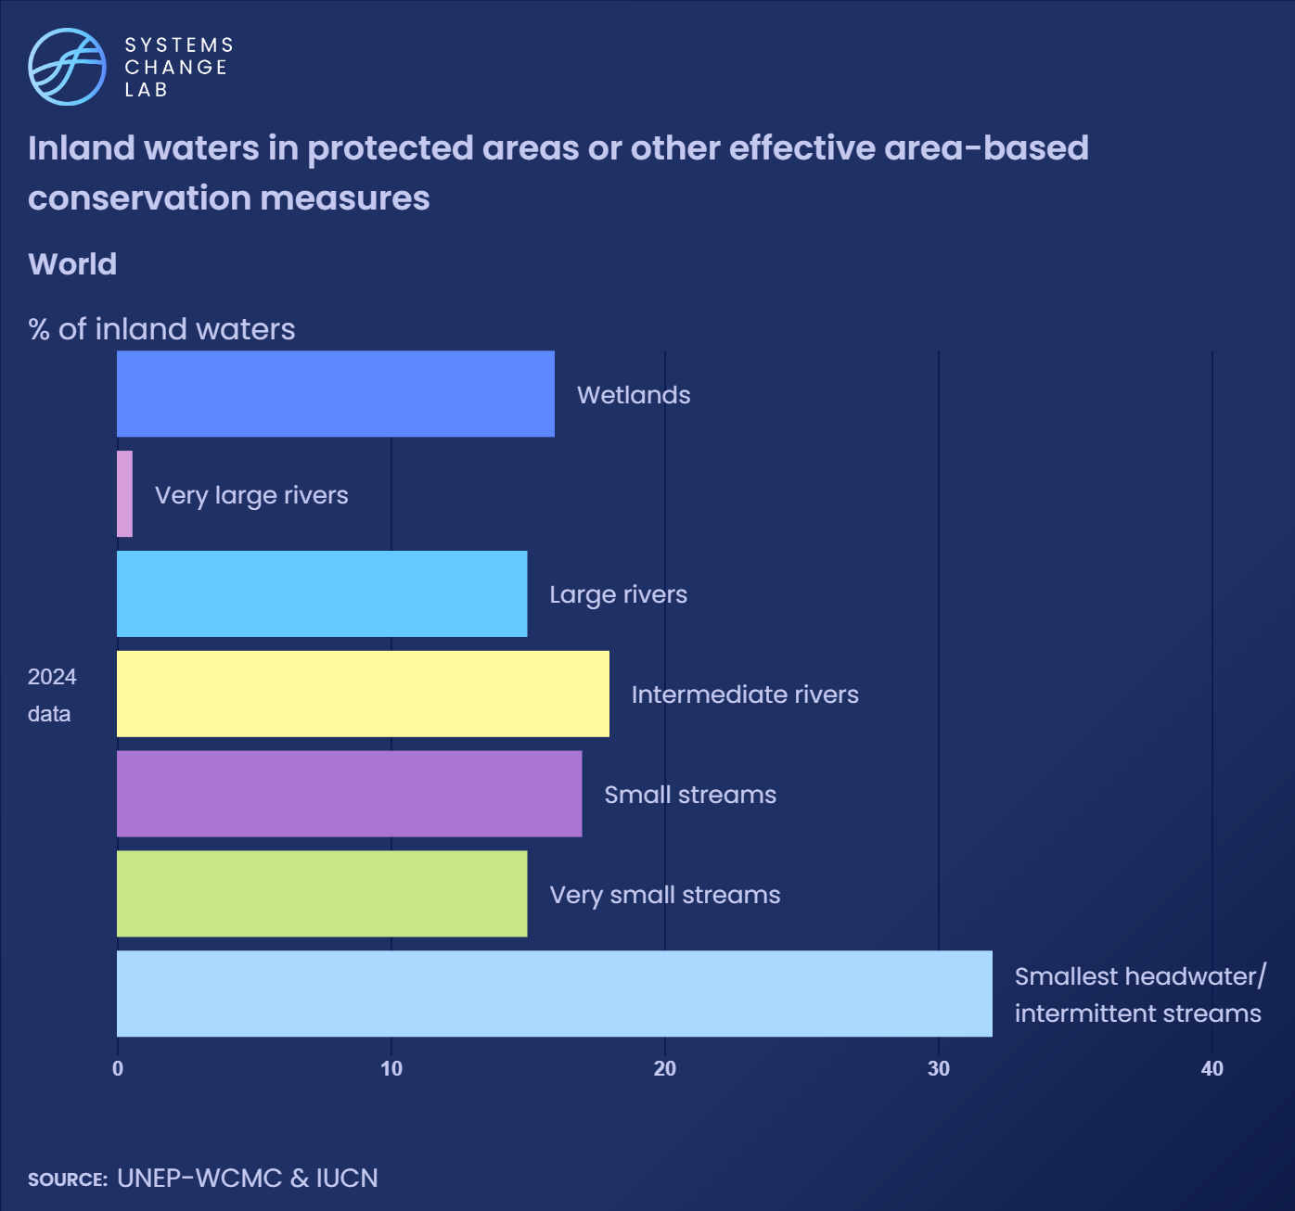
Only 16% of wetlands and 15% of large rivers are currently protected, leaving many critical freshwater ecosystems vulnerable to continued conversion and degradation.

Slide 19
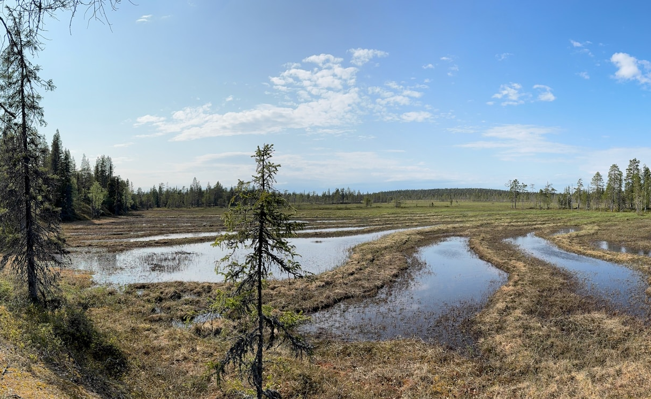
Restore freshwater ecosystems
SHIFT
Photo by Harri P/Unsplash
Notes:
Harri P/Unsplash

Slide 20
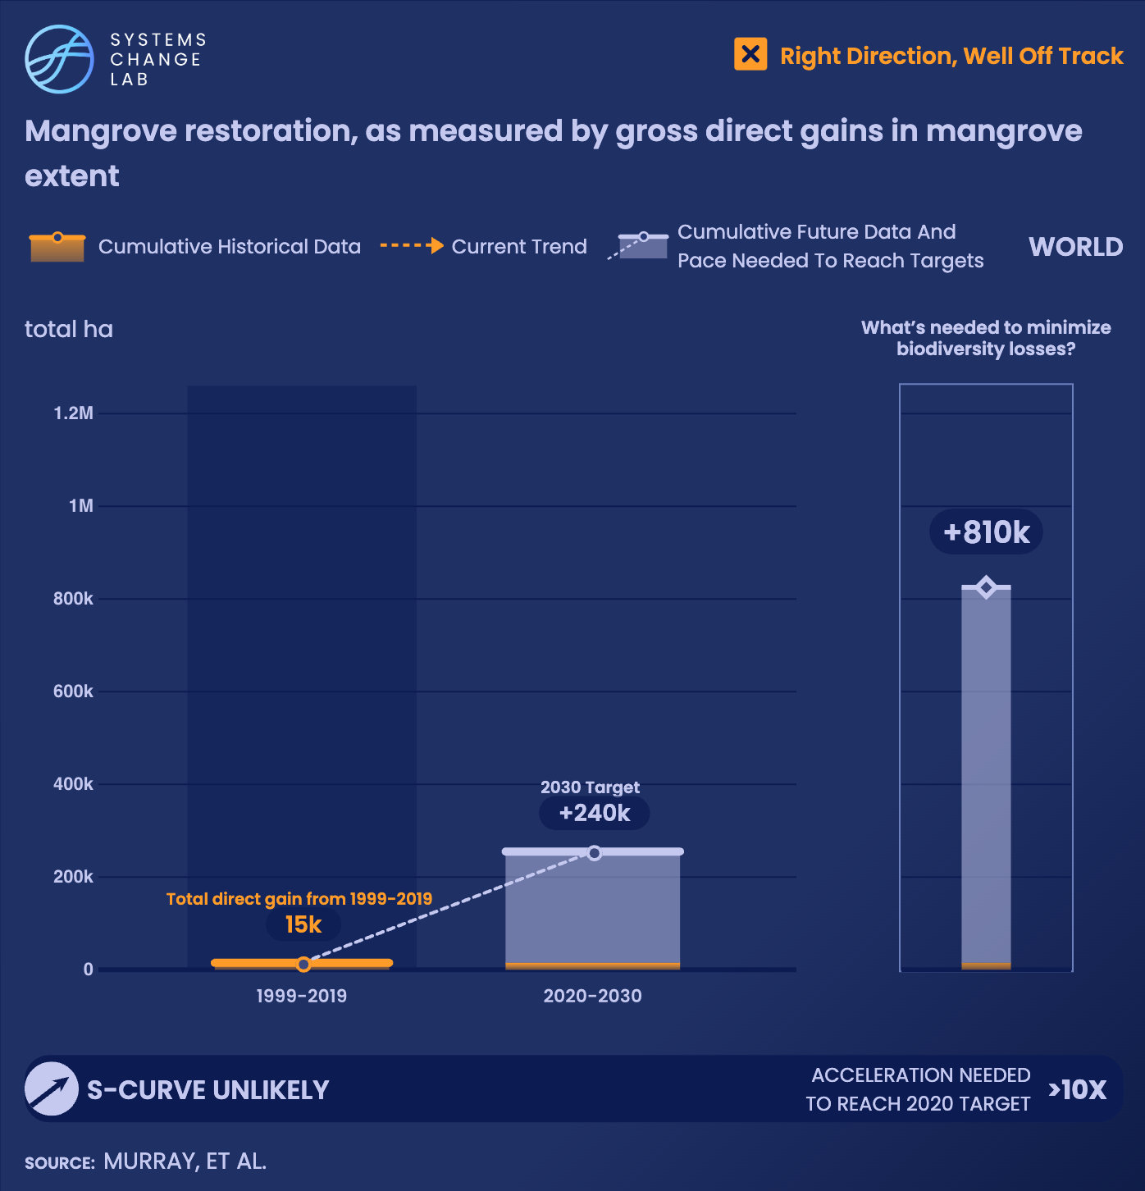
Restoring 240,000 hectares of mangrove forests by 2030 will require restoration efforts to accelerate more than tenfold.

Slide 21
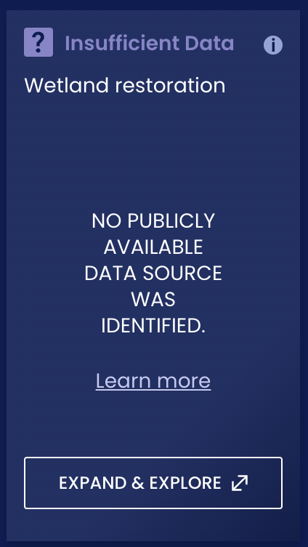
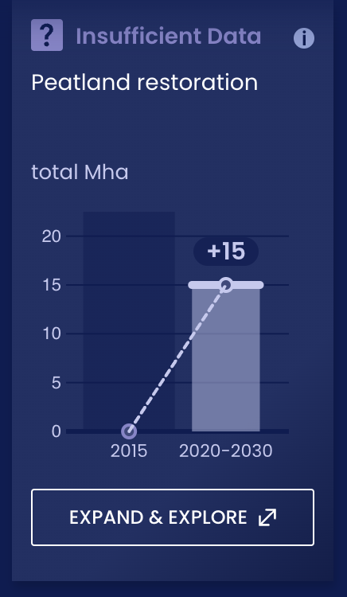
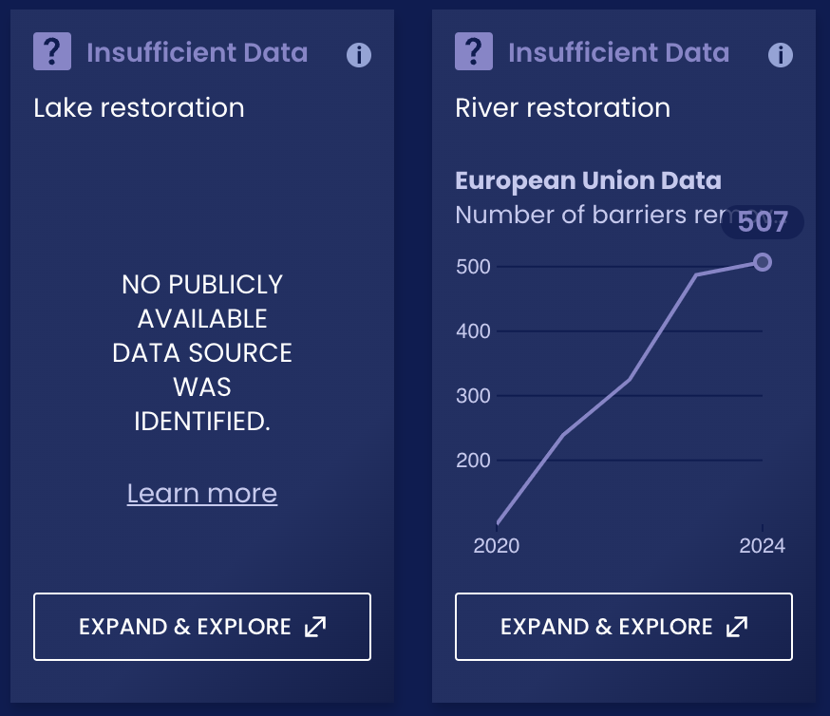
Global data is too limited to assess restoration progress across many freshwater ecosystems

Slide 22
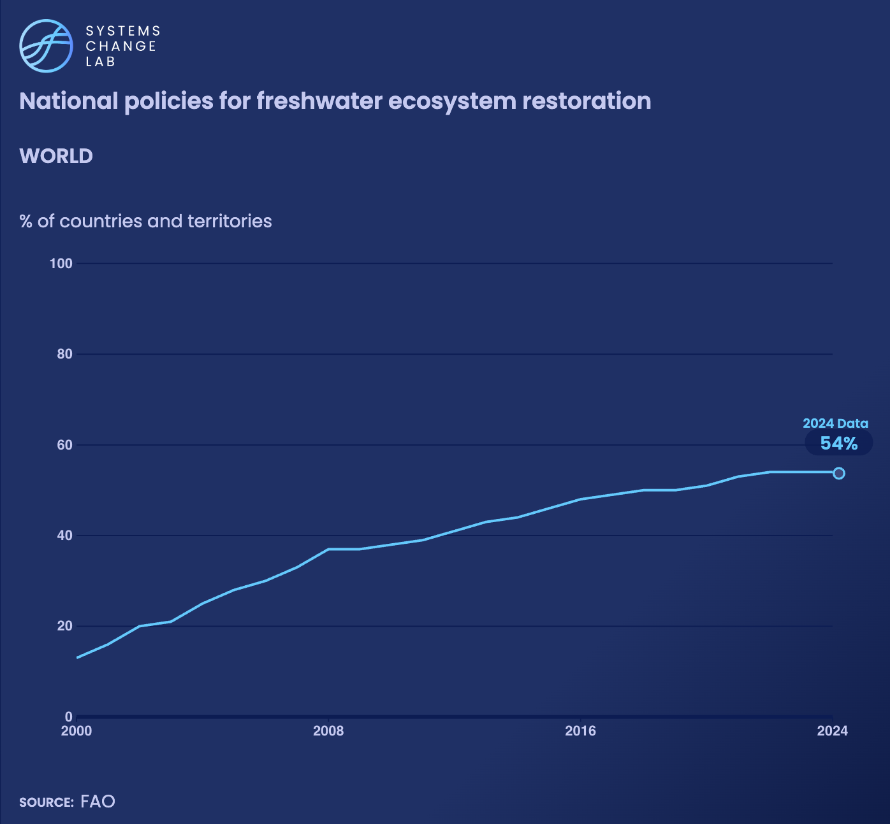
Successfully scaling up freshwater restoration will require coordinated international action.
Only 54% of countries and territories have at least one documented legal or policy instrument focused on freshwater ecosystem restoration.

Slide 23
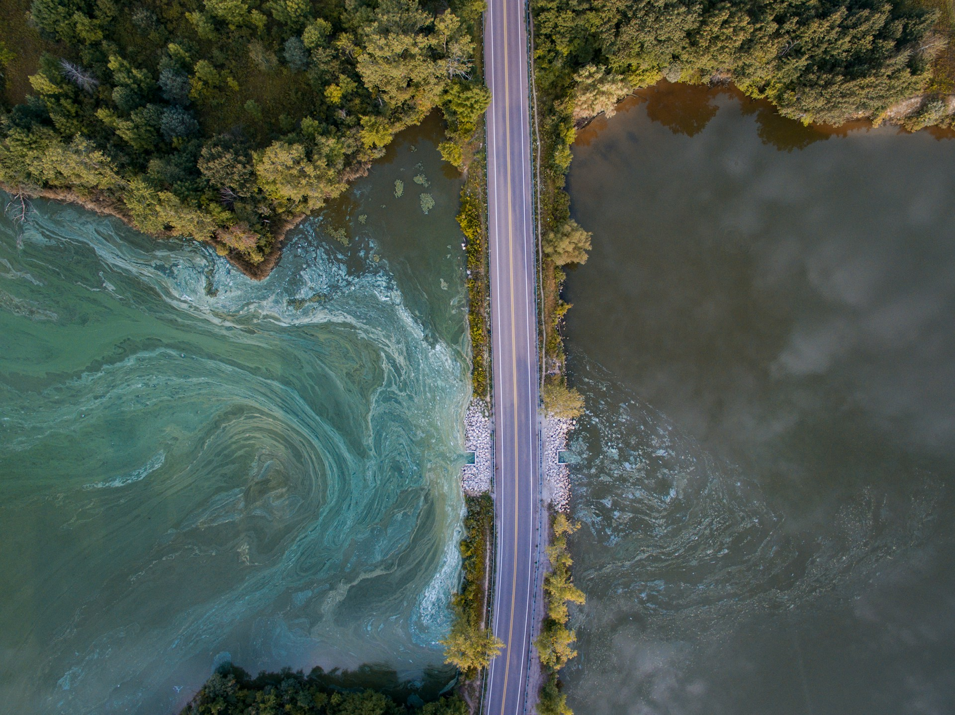
Sharply reduce water pollution and improve water quality
SHIFT
Photo by Aaron Burden/Unsplash
Notes:
Aaron Burden/Unsplash

Slide 24
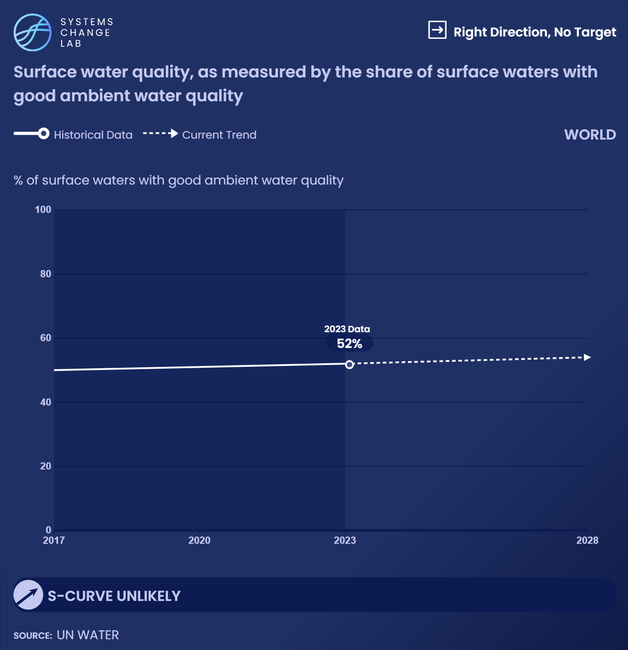
As of 2023, only 52% of assessed surface water bodies were classified as having good ambient water quality. Greater efforts are needed to improve surface water quality globally.

Slide 25
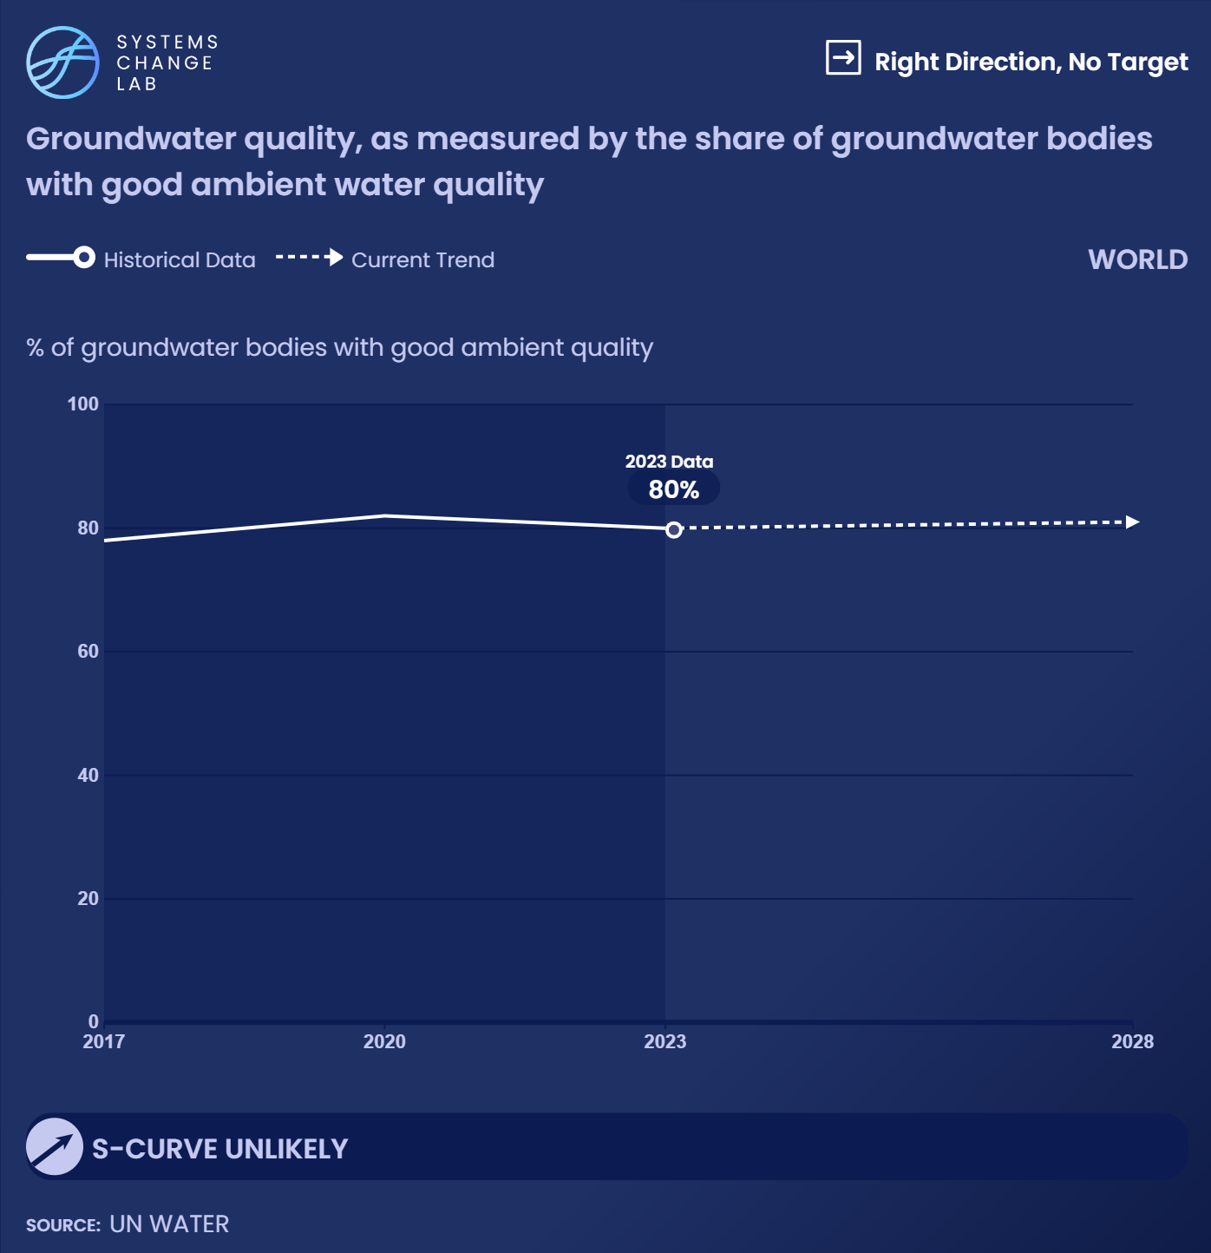
In 2023, 80% of assessed groundwater bodies were classified as having good
ambient water quality, although progress has largely stalled since 2020.

Slide 26
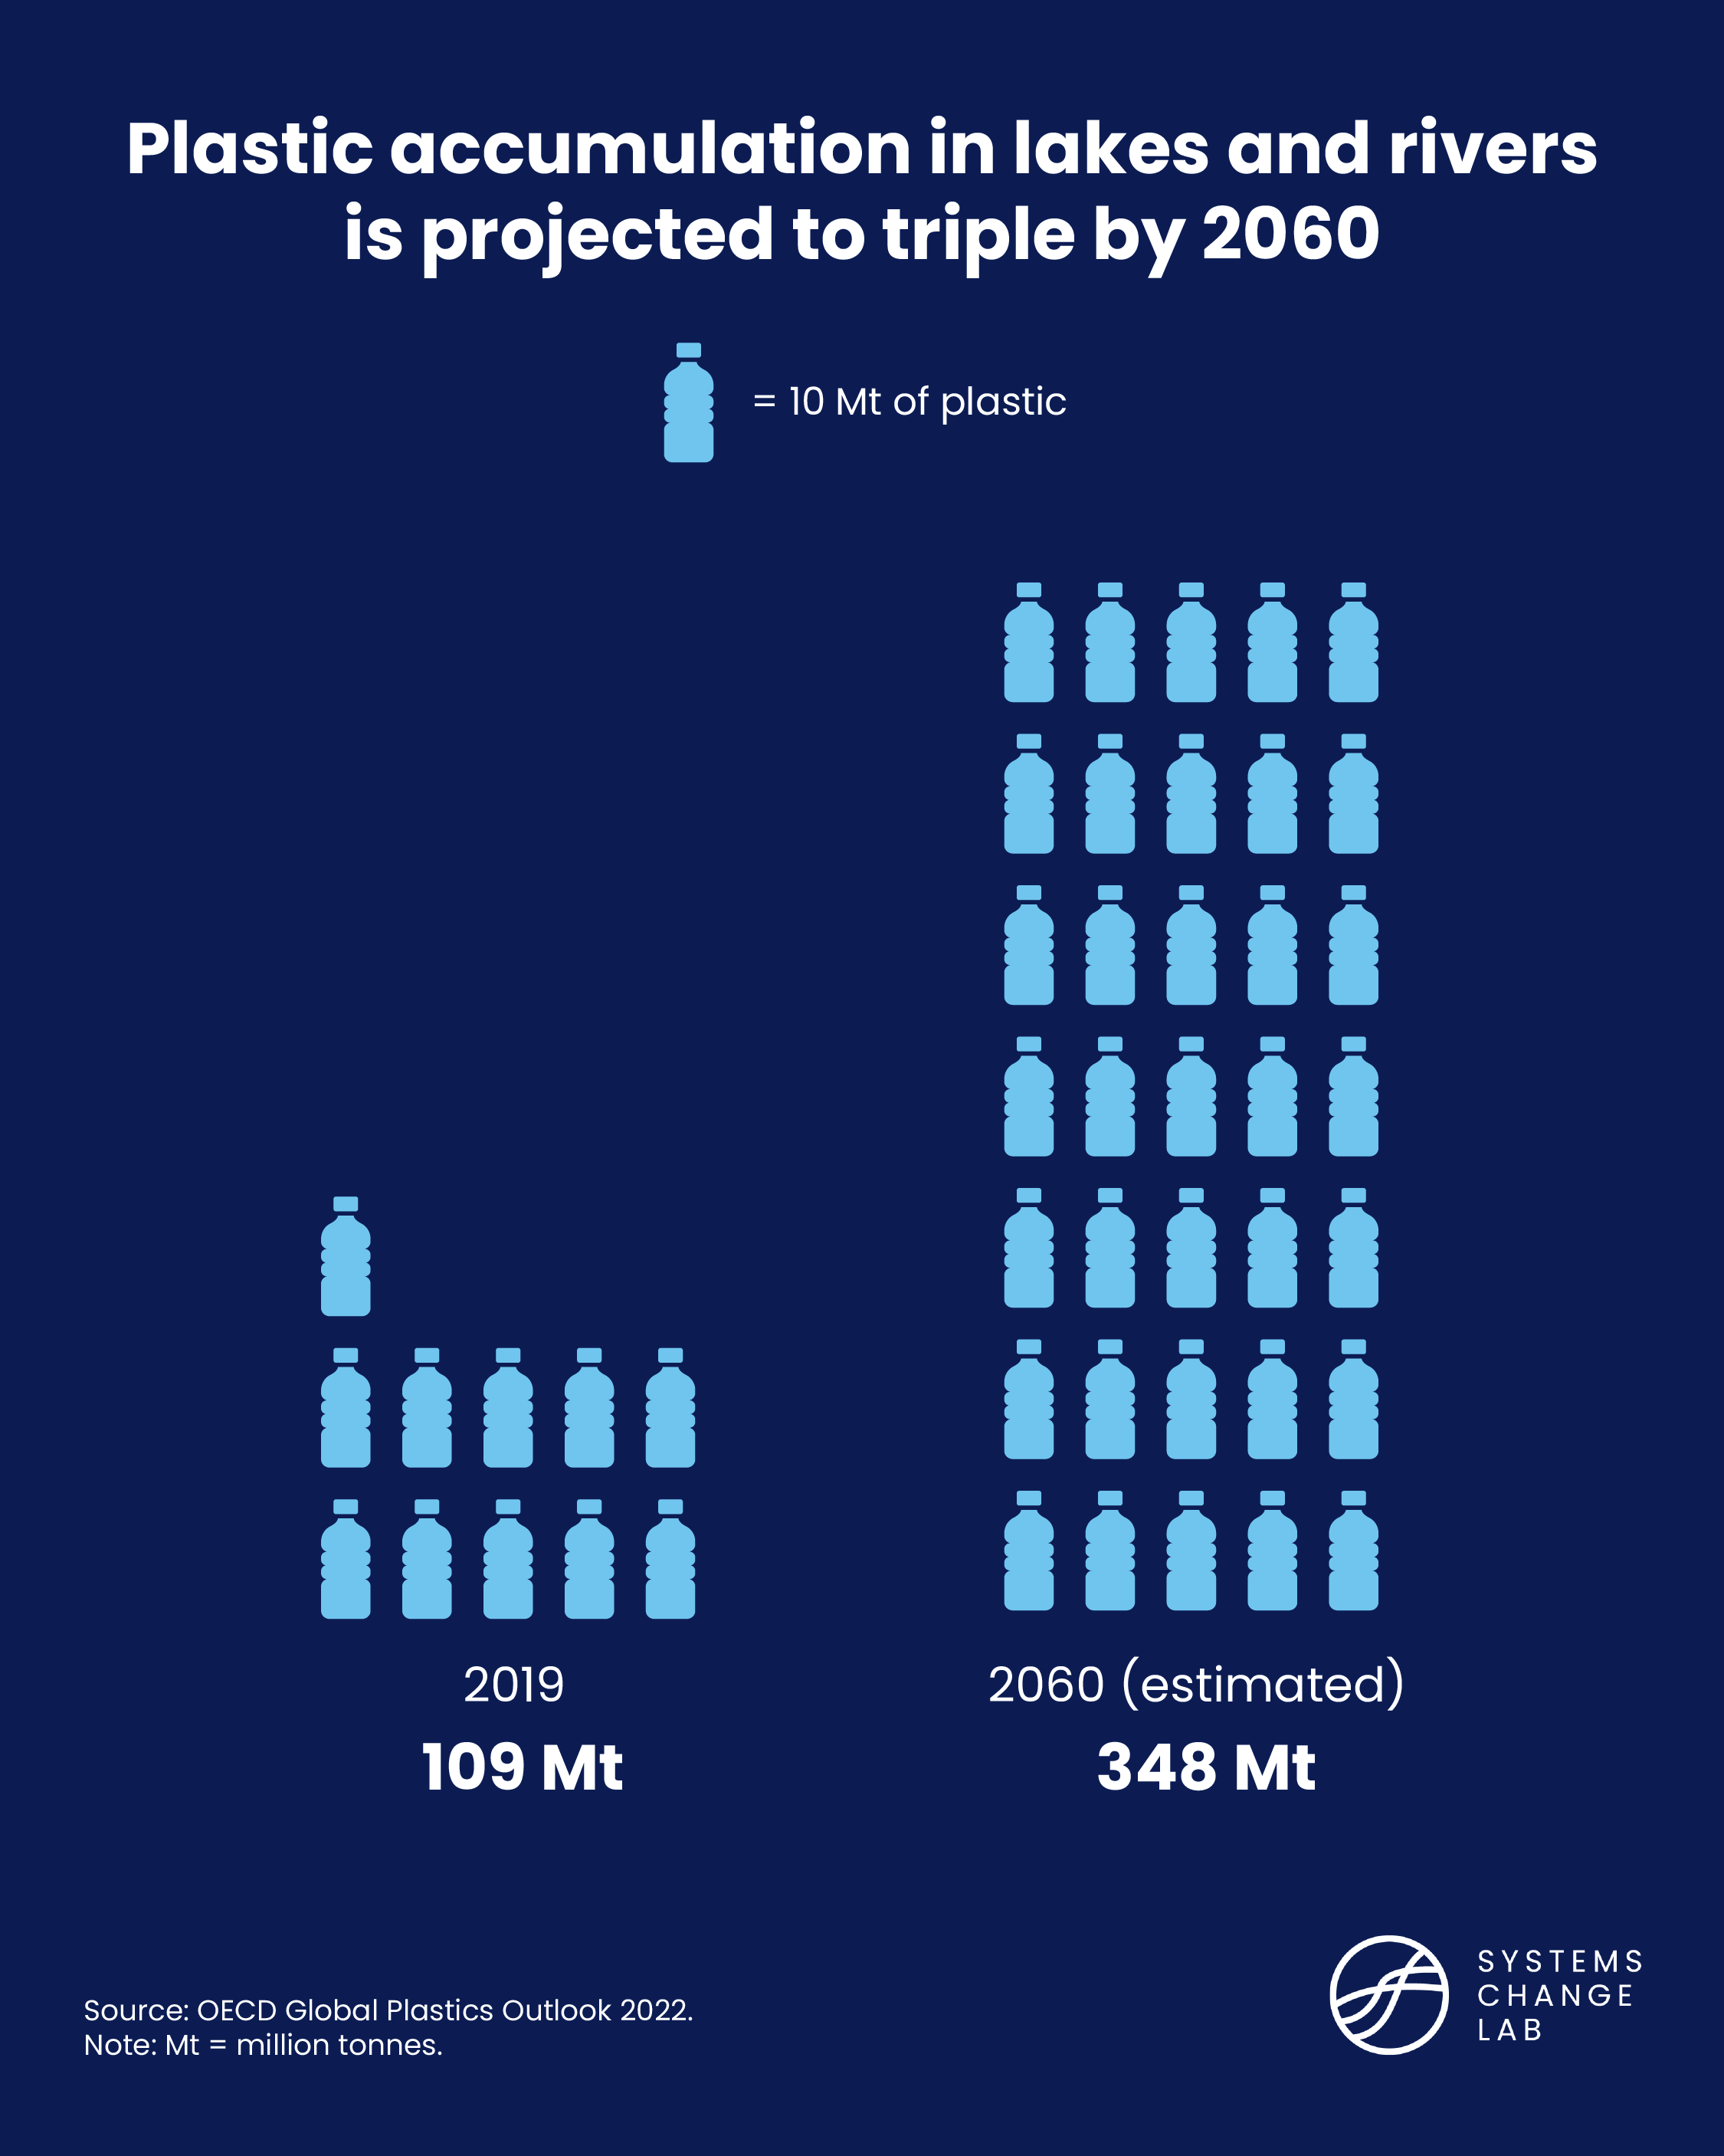
The global mass
of produced plastic is already greater than global
living biomass

Slide 27
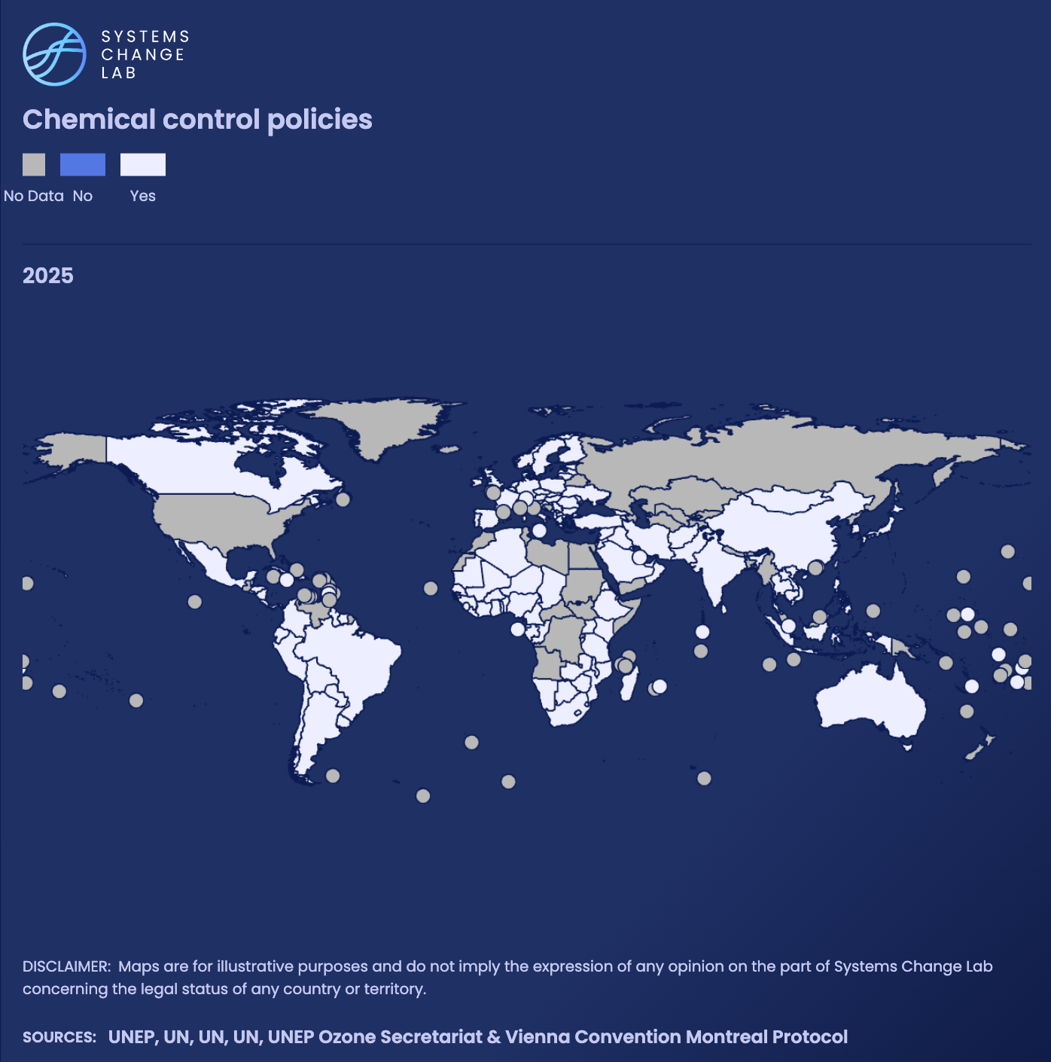
Only 67% of parties are signatories to all five major conventions safeguarding freshwater from hazardous waste and toxic chemicals, leaving a third of the world without full commitments to the frameworks meant to protect water sources.

Slide 28
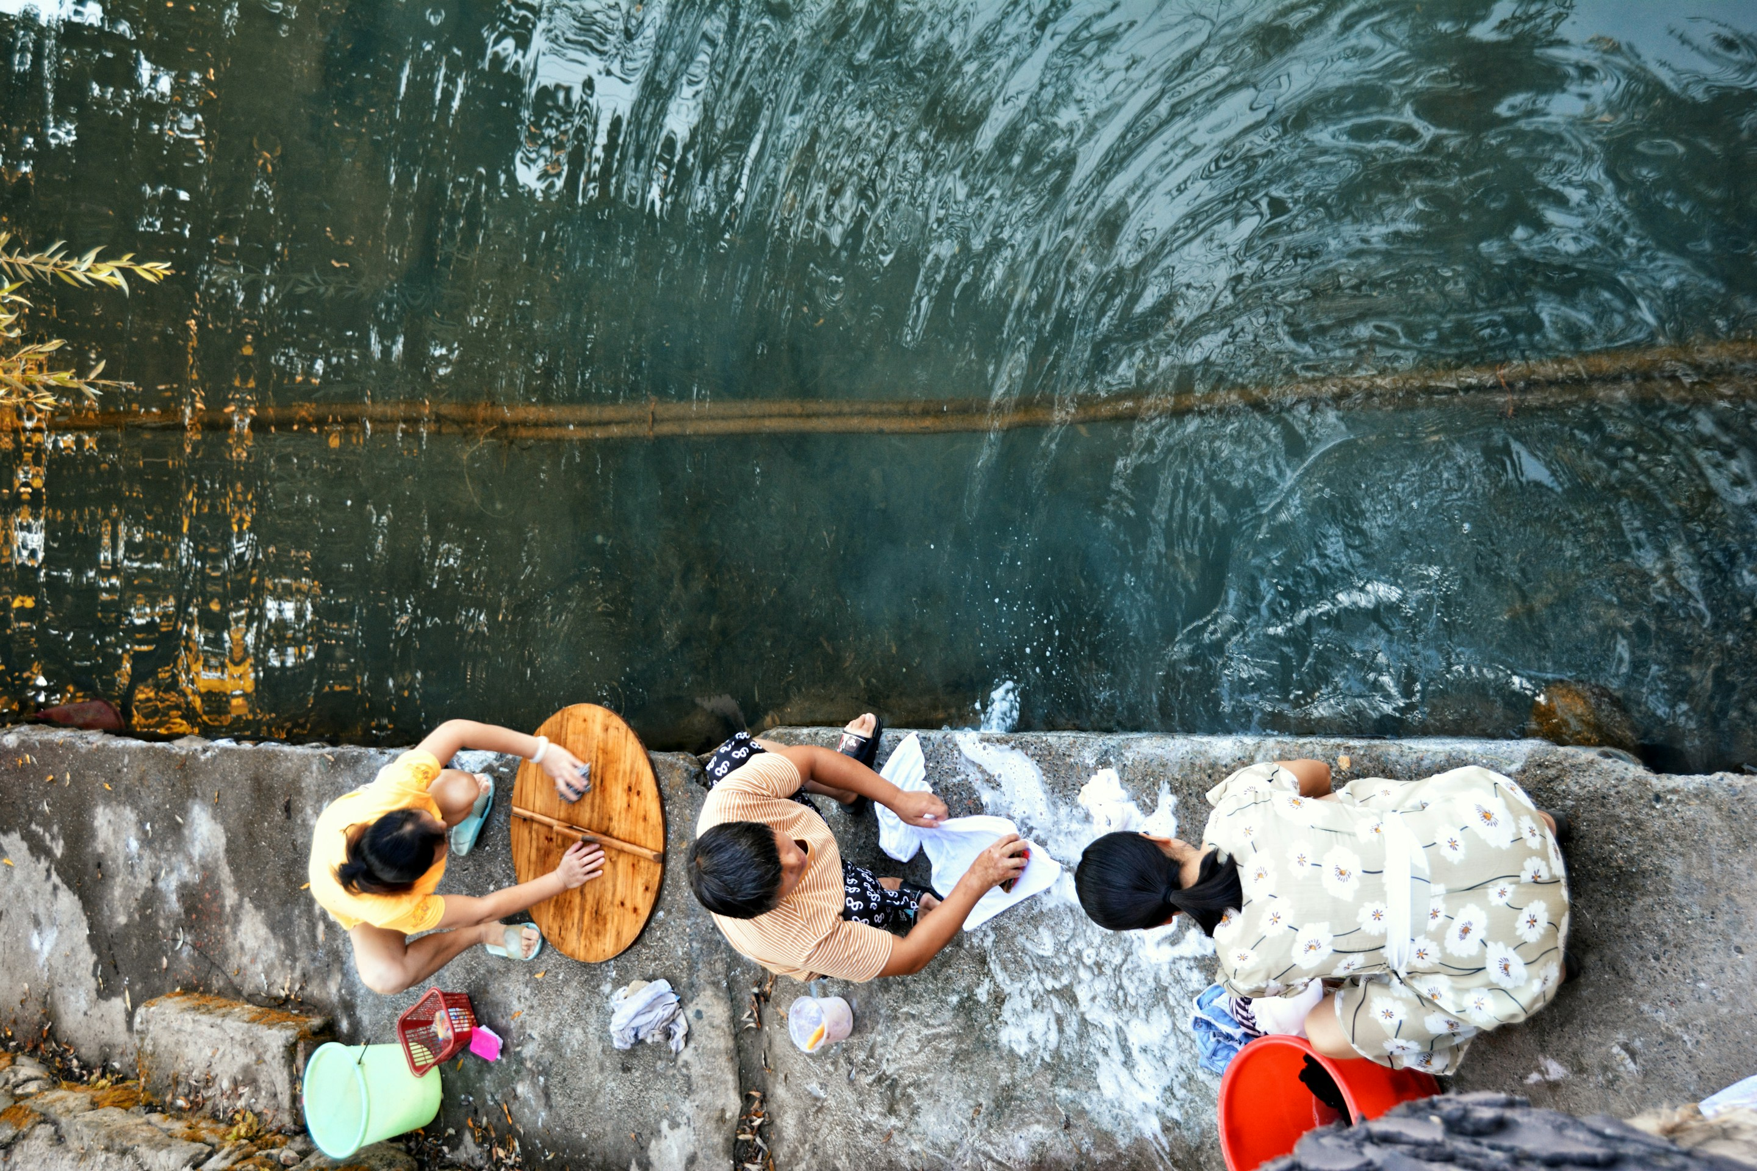
Ensure equitable access to safe and affordable drinking water, sanitation and hygiene
SHIFT
Photo by Bruce Hong/Unsplash
Notes:
Bruce Hong/Unsplash

Slide 29
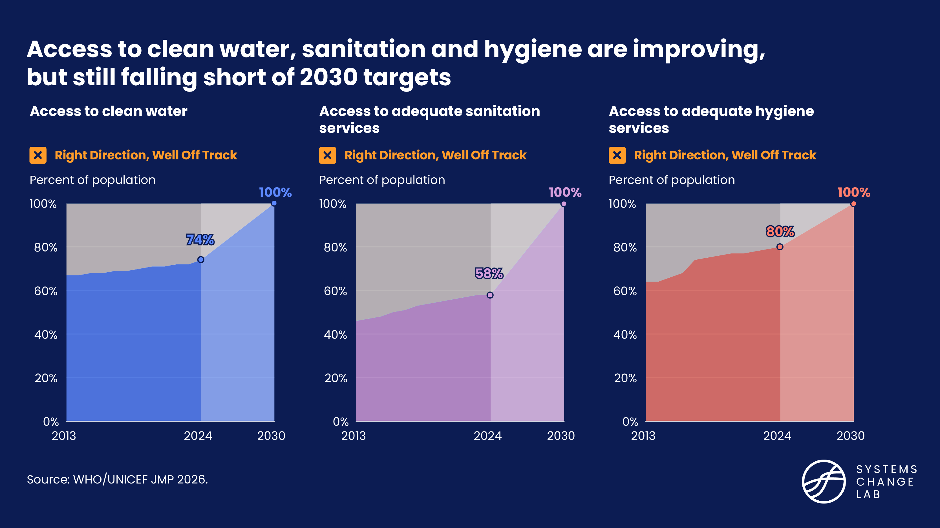

Slide 30
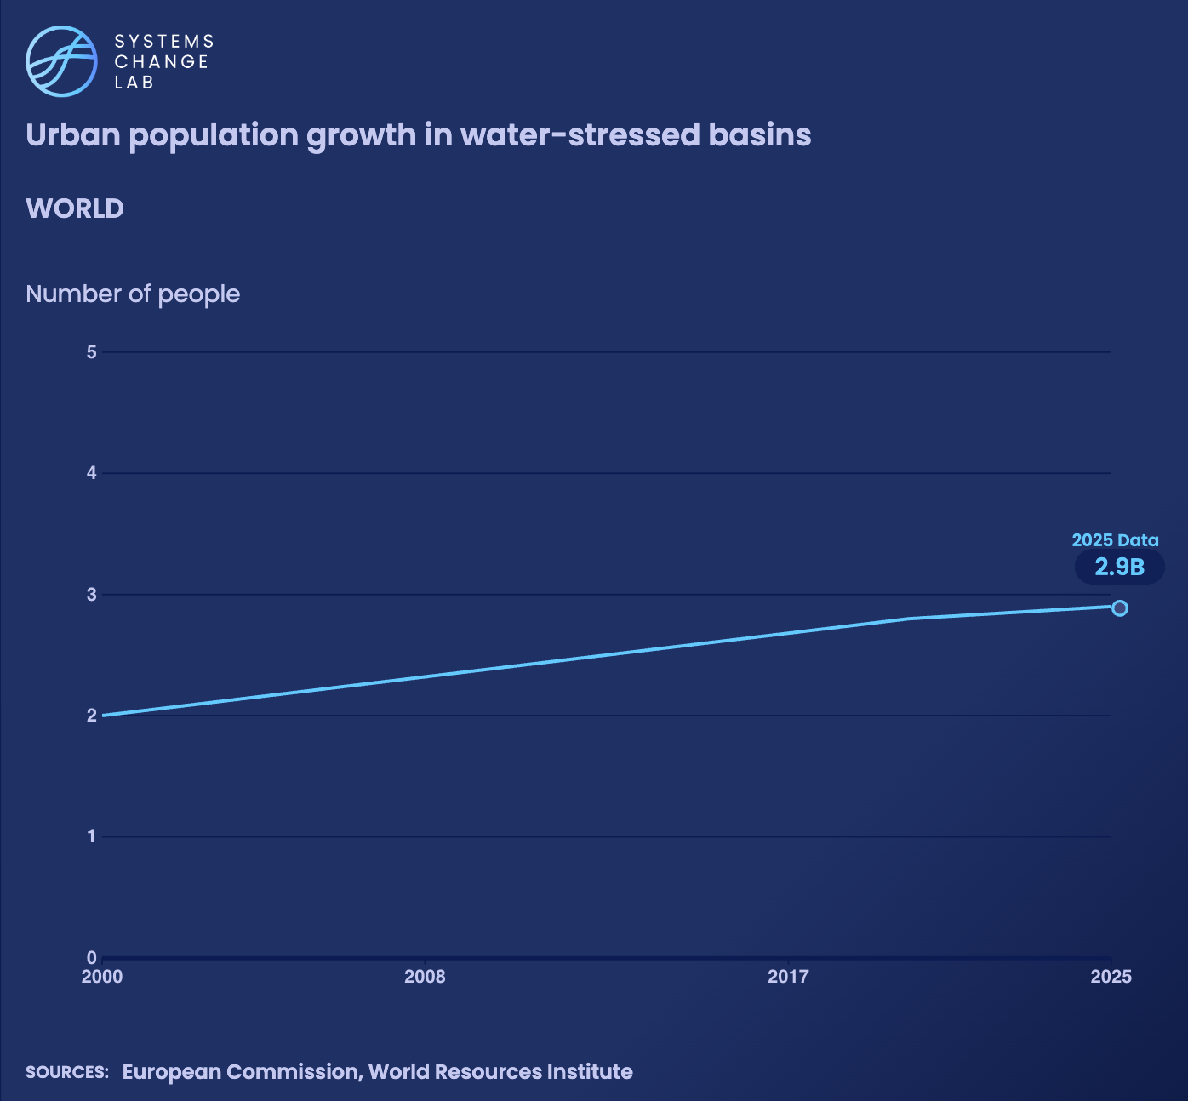
Rapid urban growth is increasing pressure on already stressed water systems.
In 2025, 2.9 billion people were estimated to live in cities within water-stressed basins, up from 2 billion in 2000.

Slide 31
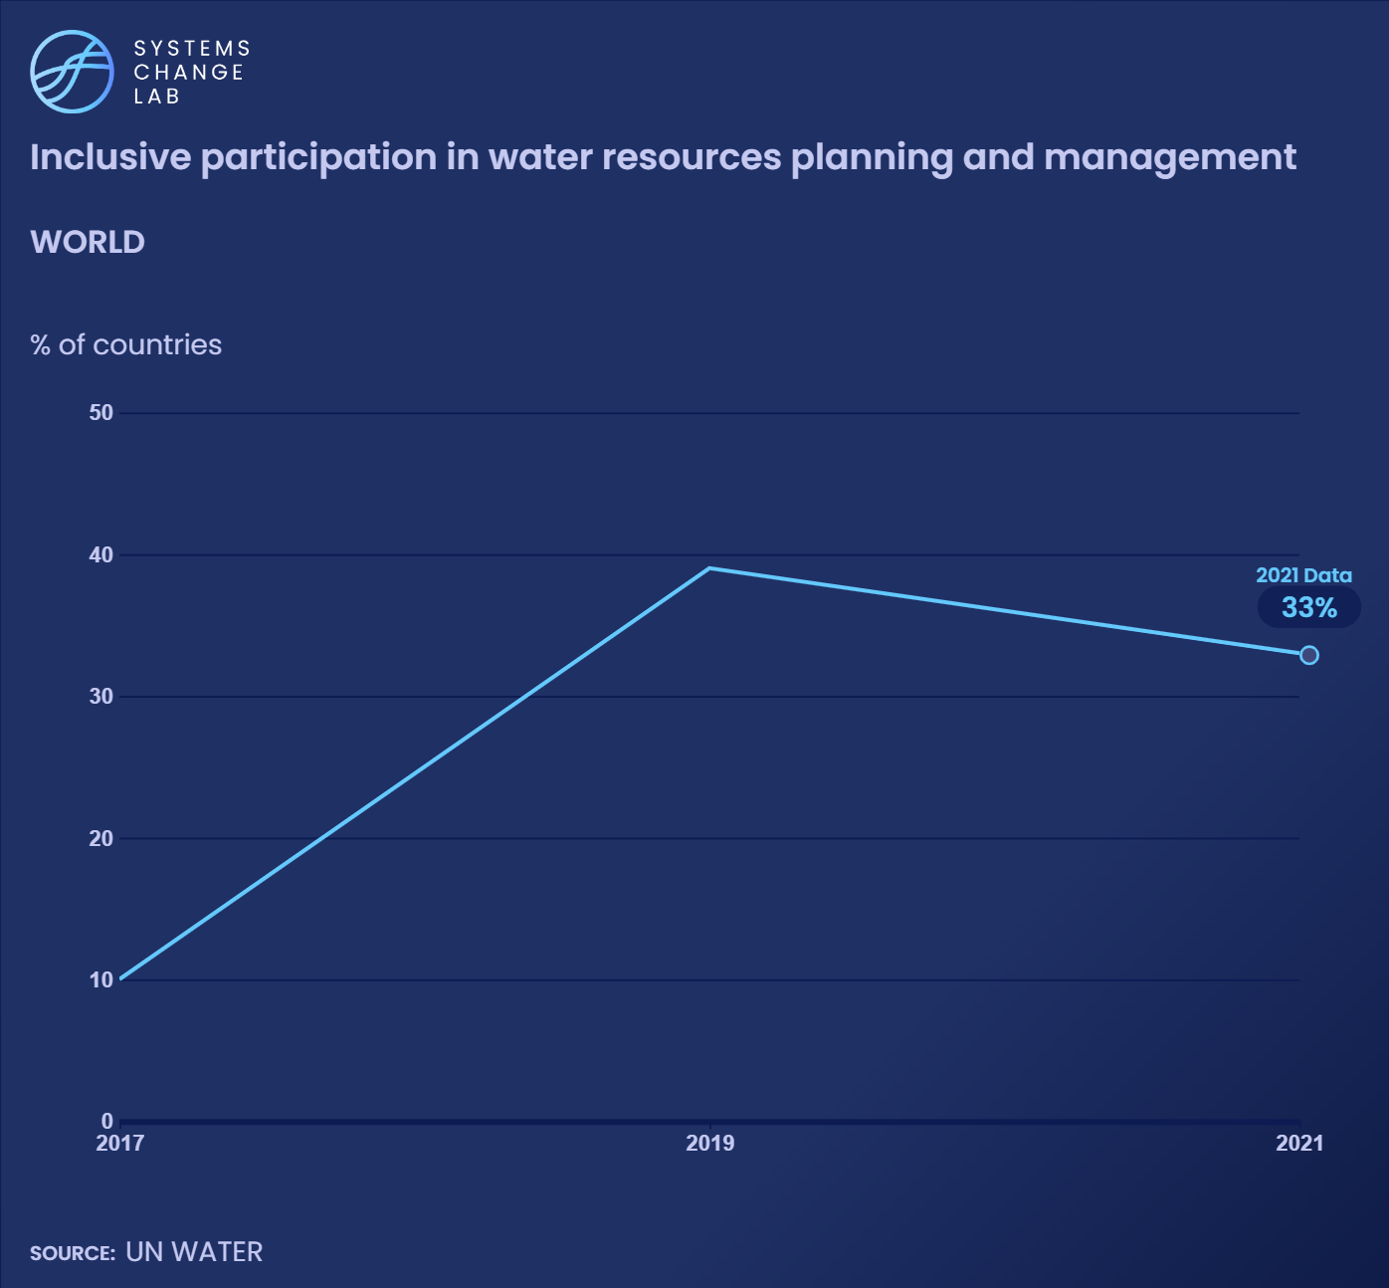
In 2021, nearly one-third of reporting countries disclosed high levels of user and community participation in water resources planning and management. Yet local communities often dispute these figures, citing discrepancies between formal reporting, lived experiences, and the quality of engagement.

Slide 32
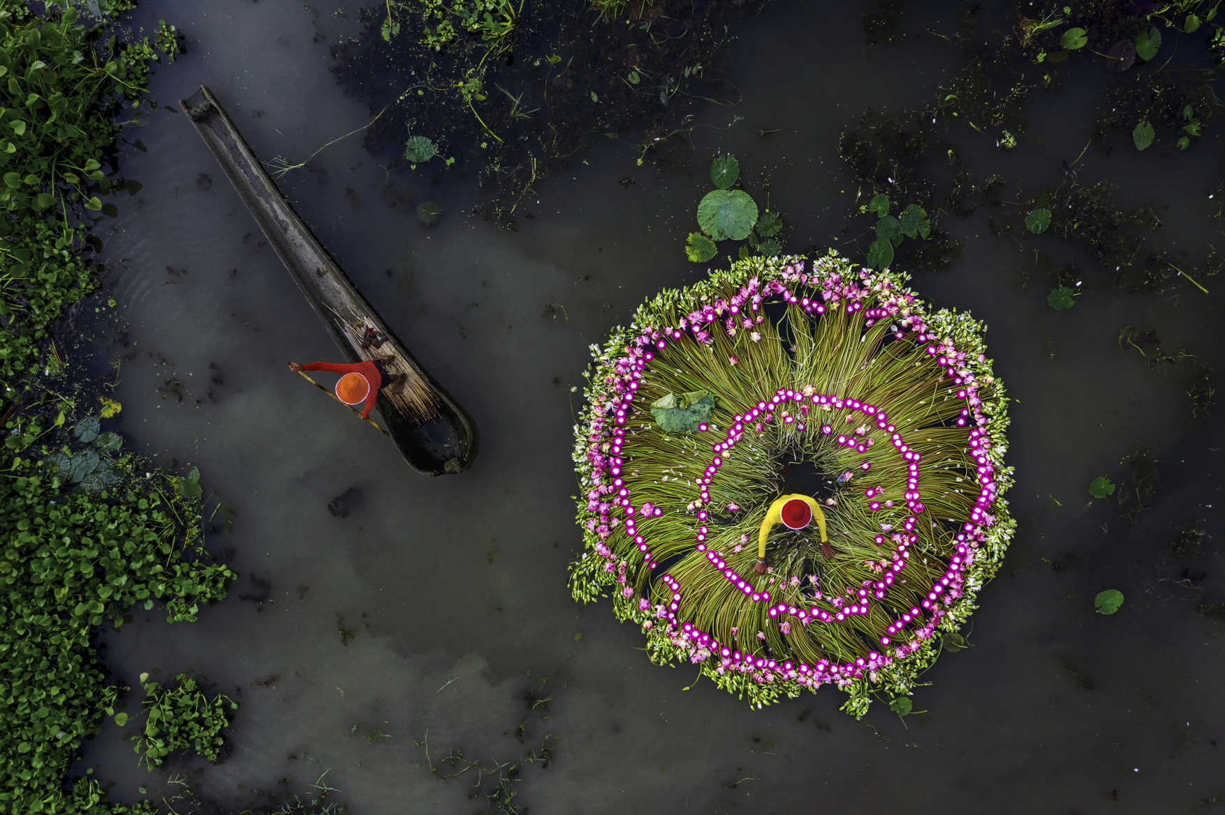
Halt the overexploitation of freshwater species
SHIFT
Photo by Shibasish Saha/Climate Visuals Countdown
Notes:
Photo by Shibasish Saha via Climate Visuals Countdown

Slide 33
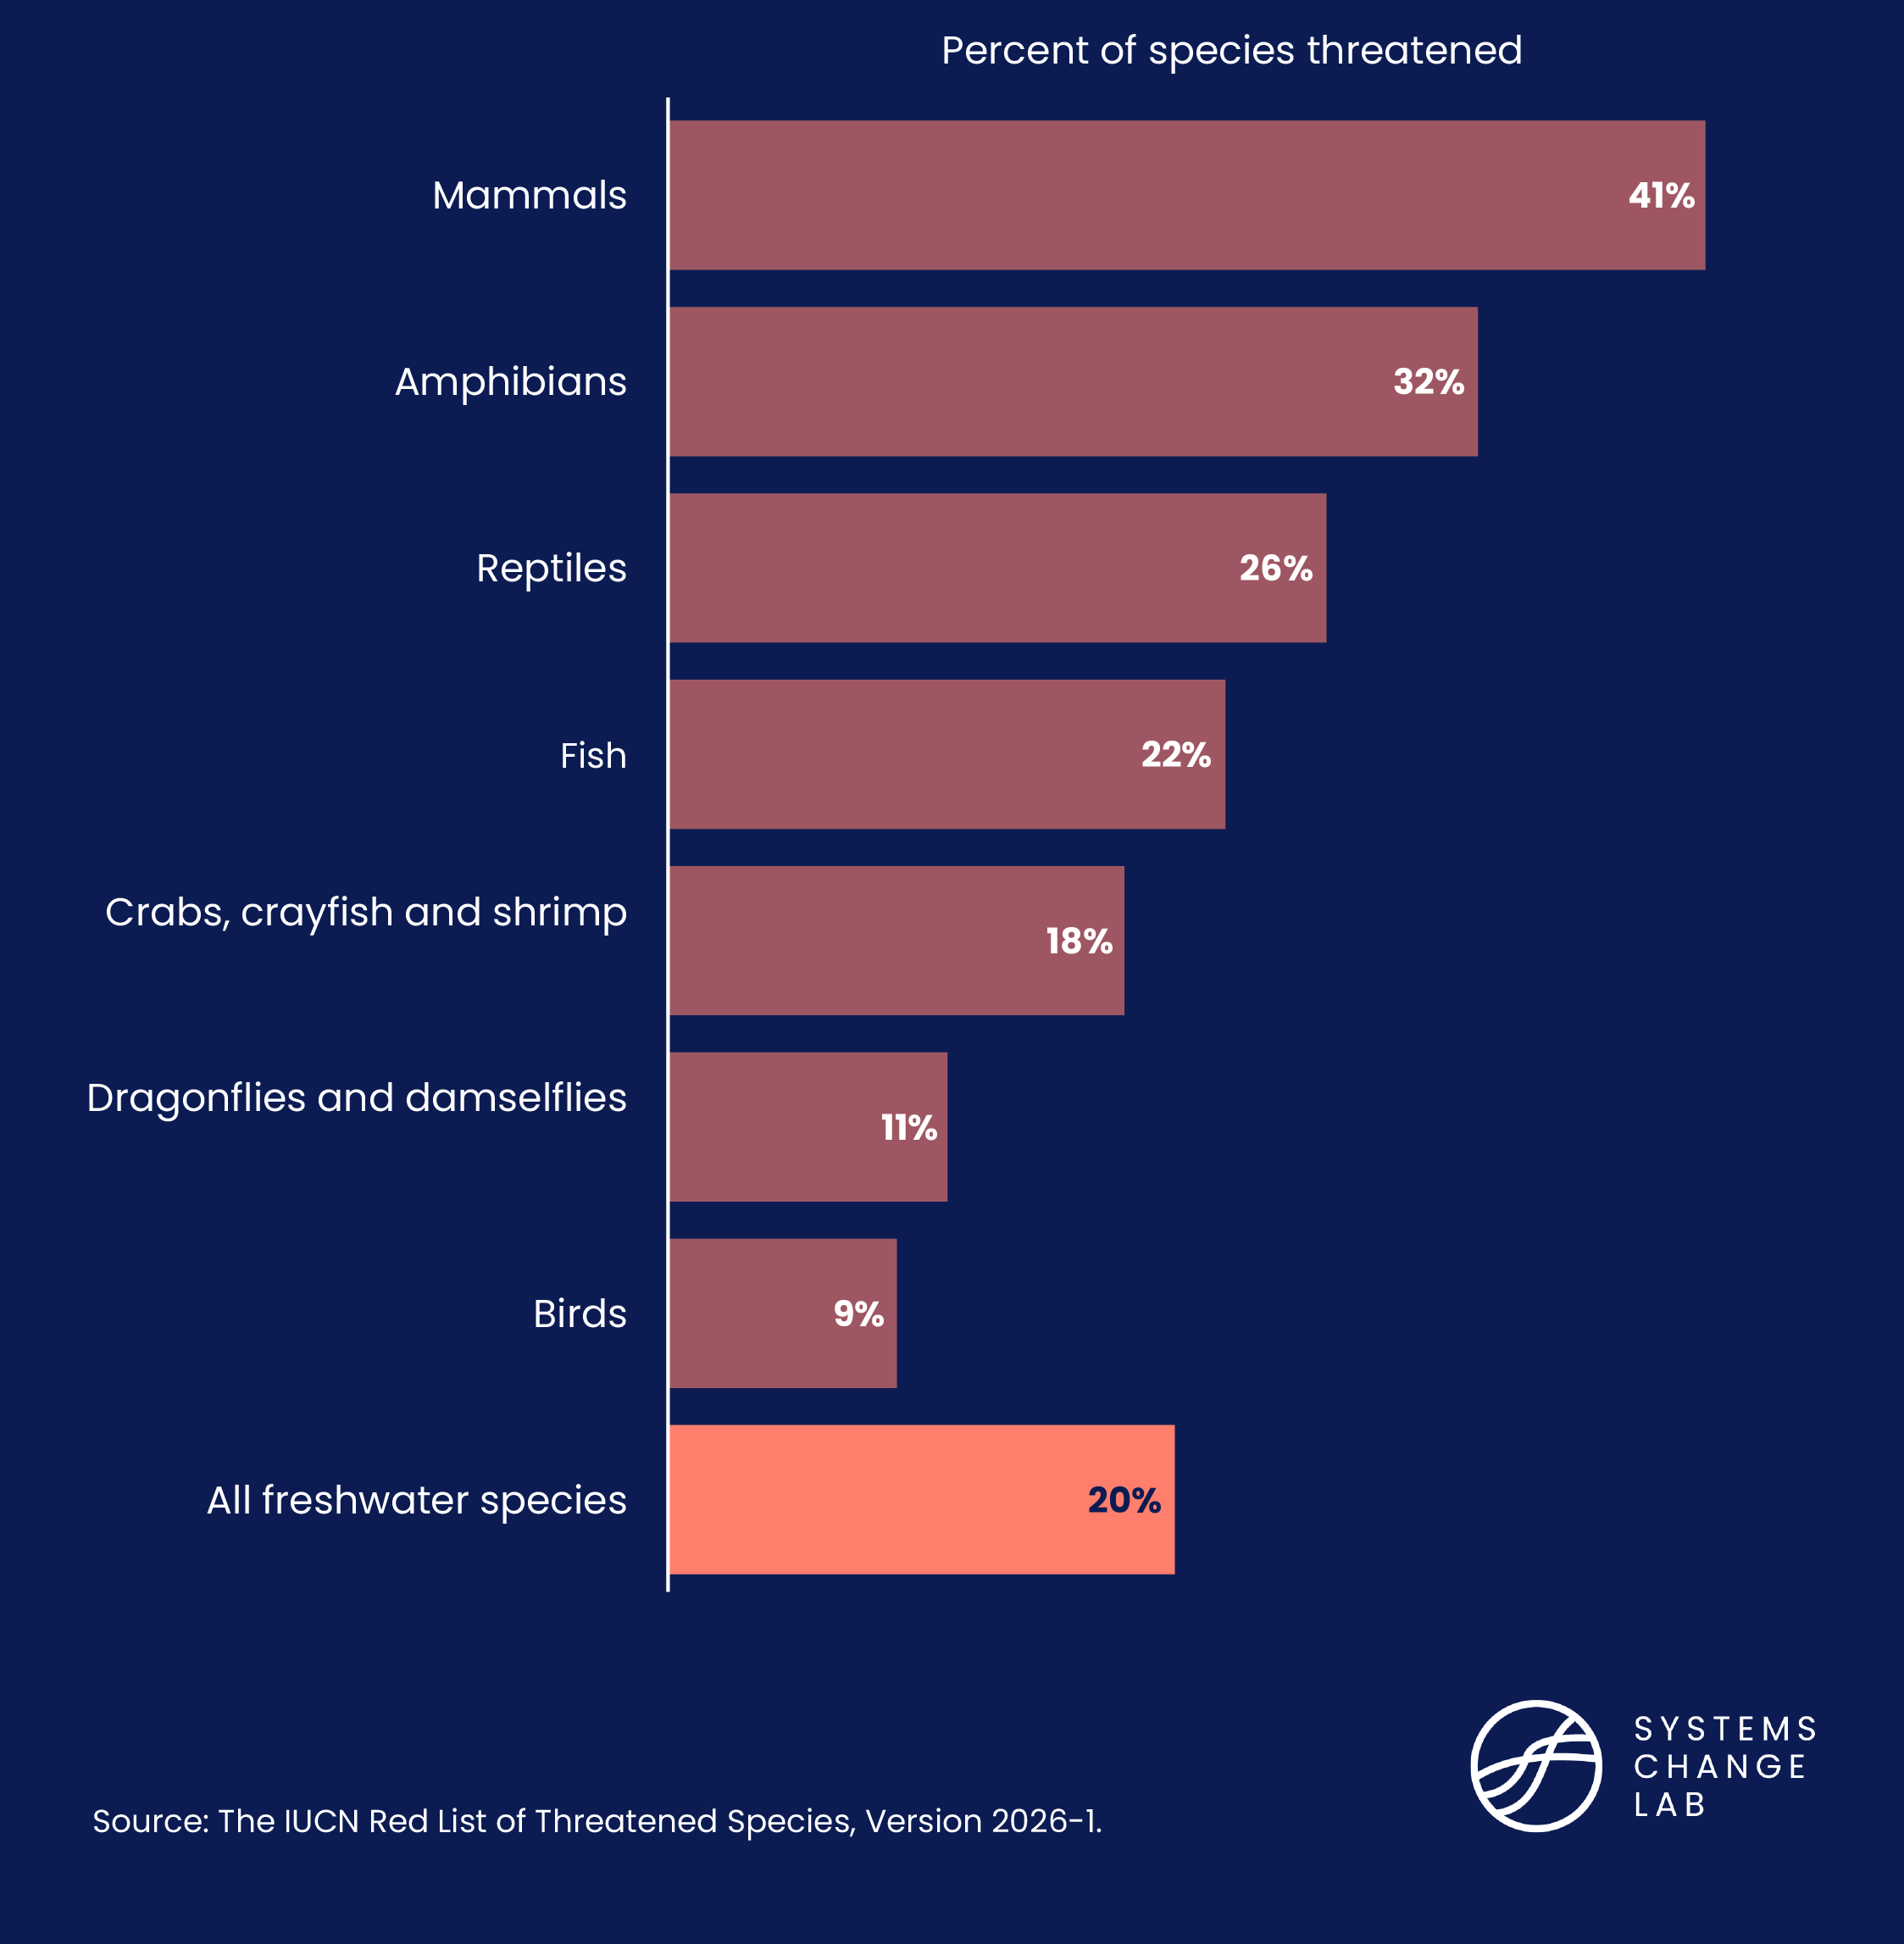
20% of freshwater species are threatened with extinction

Slide 34
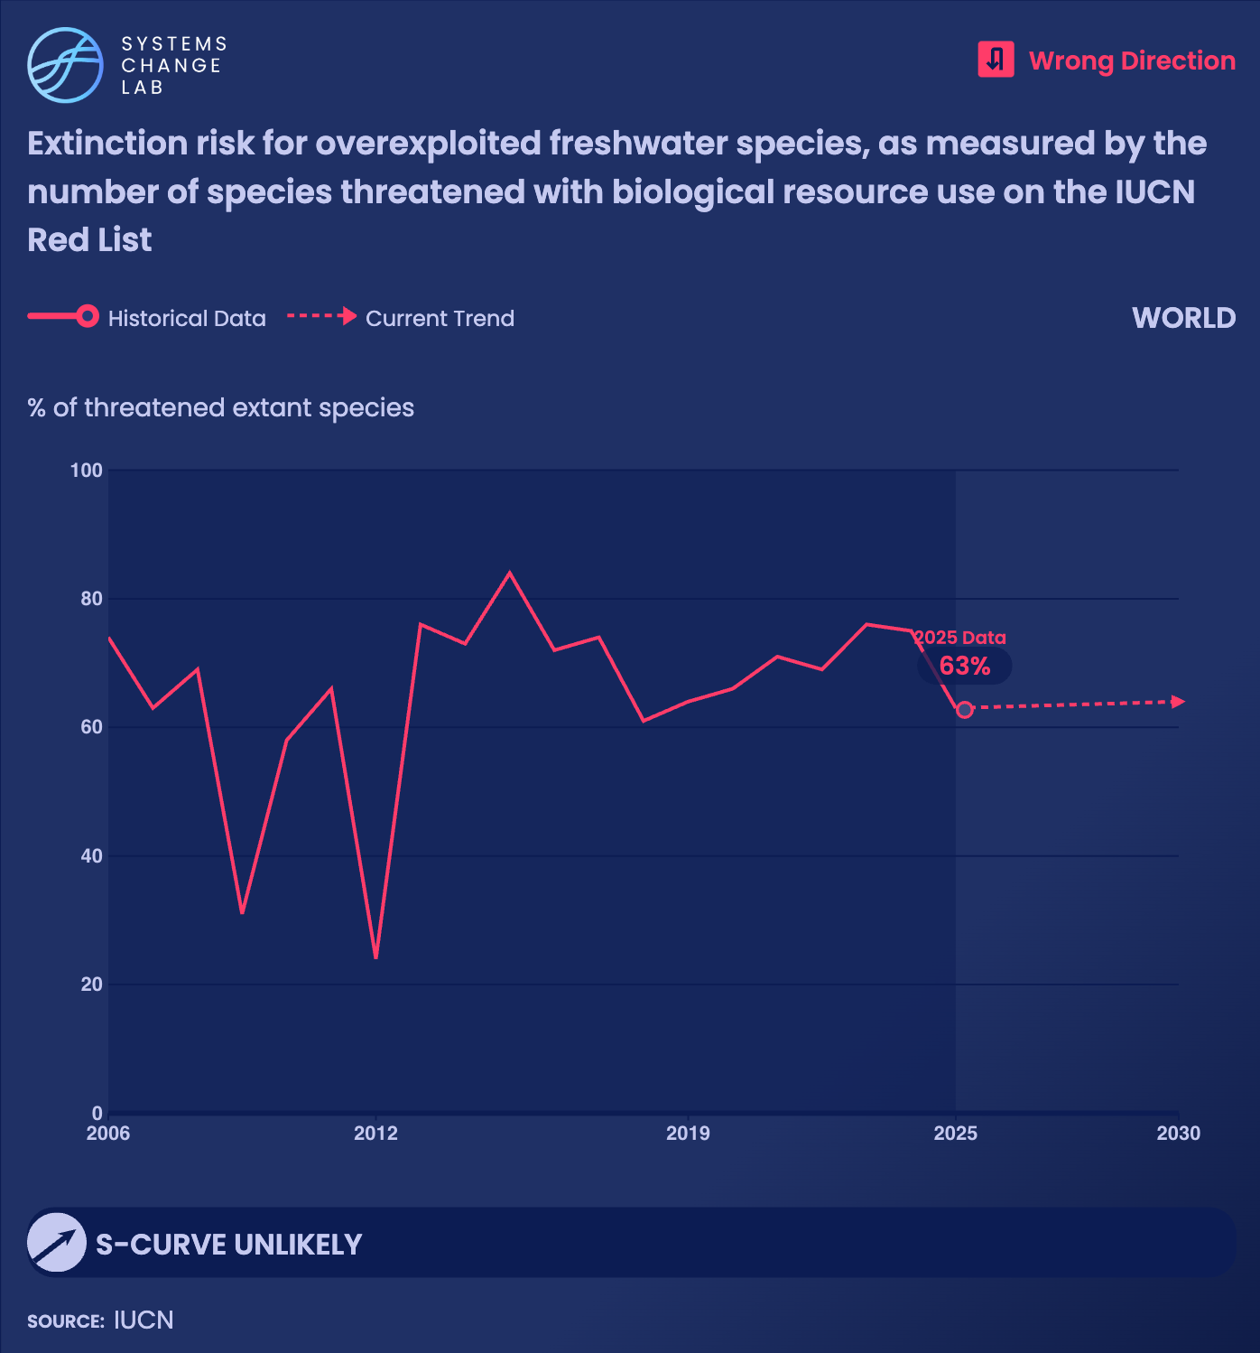
The proportion of assessed freshwater species threatened with extinction due to overexploitation rose from 24% in 2012 to 63% in 2025. The true figure is likely higher, as many freshwater species have not yet been assessed by the IUCN Red List and many others remain unknown to science.

Slide 35
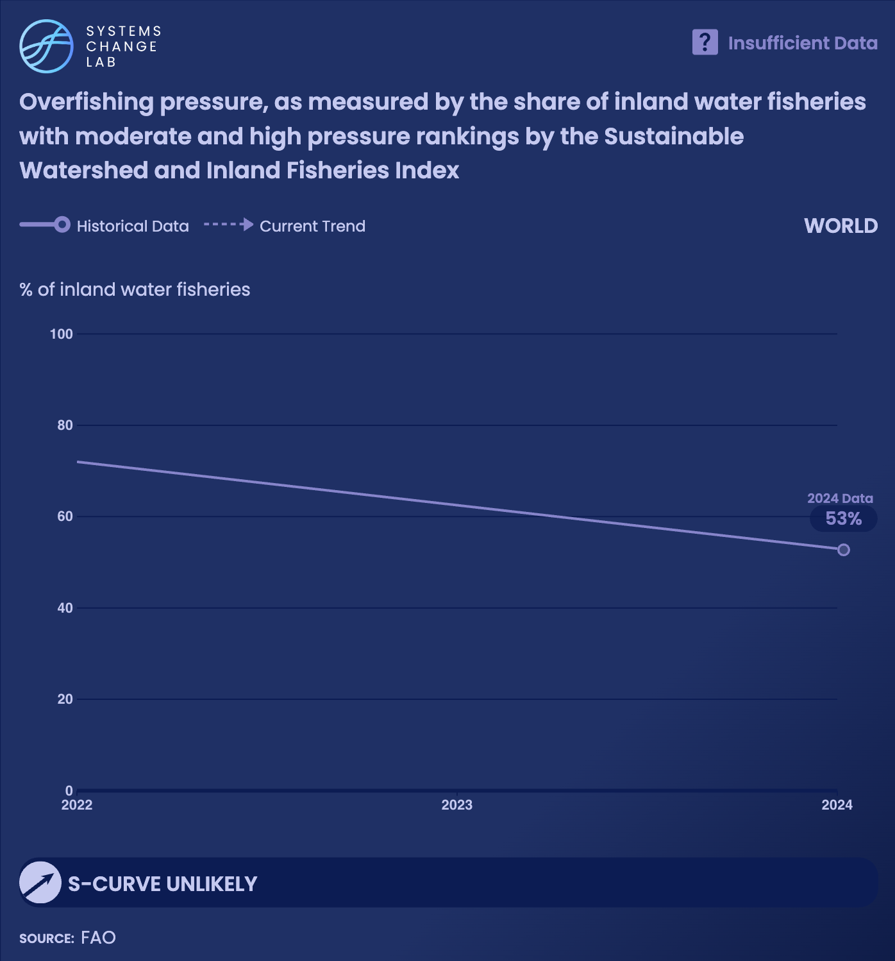
Fishing pressure on major inland water basins has eased since 2022. Among basins crucial to inland fisheries, the share facing high fishing pressure fell from 17% in 2022 to 13% in 2024, while those facing moderate pressure dropped from 55% to 40% over the same period.

Slide 36
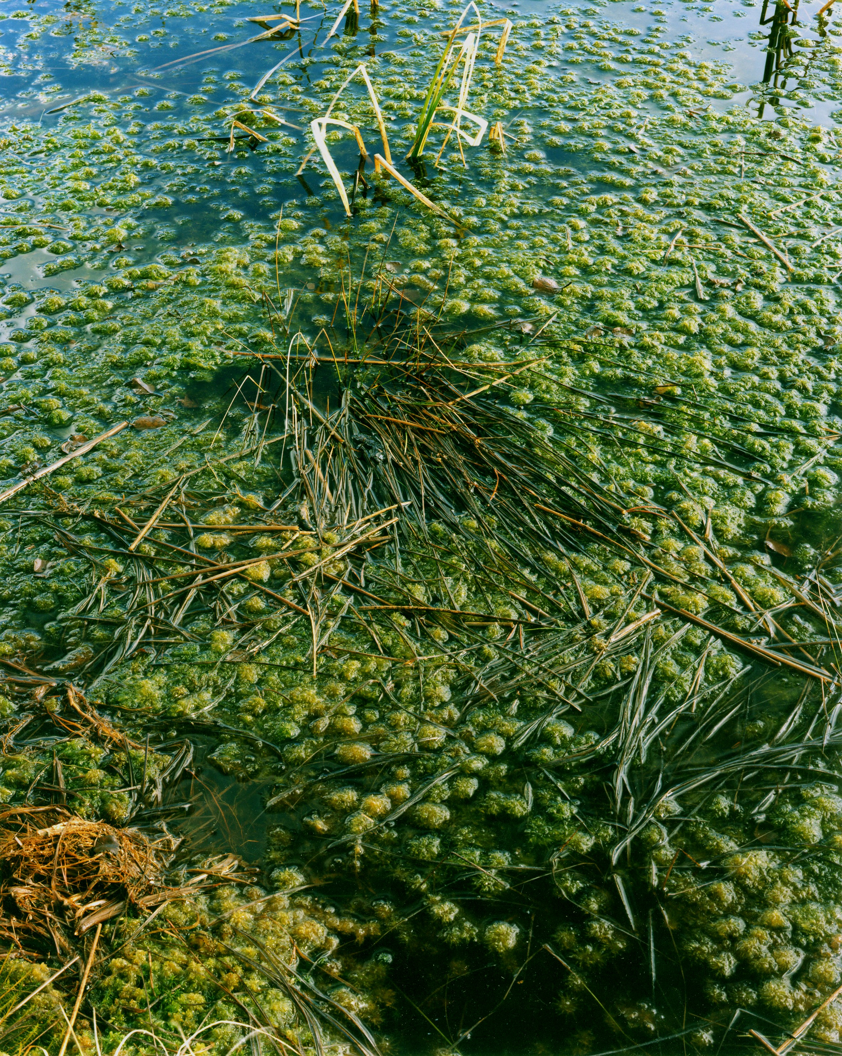
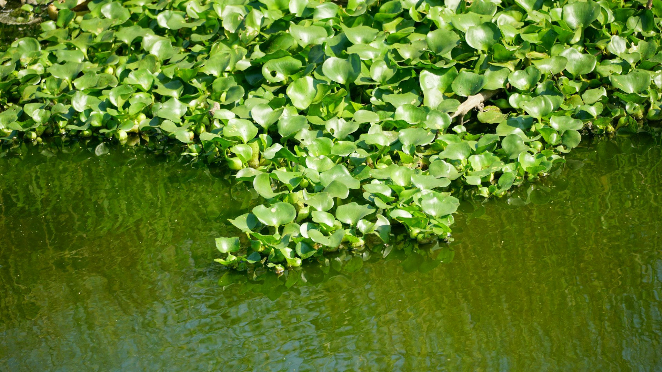
Dramatically slow the spread of invasive, alien freshwater species
COMING SOON
Photo by Dey Le Duc/Unsplash
Notes:
Duy Le Duc/Unsplash

Slide 37
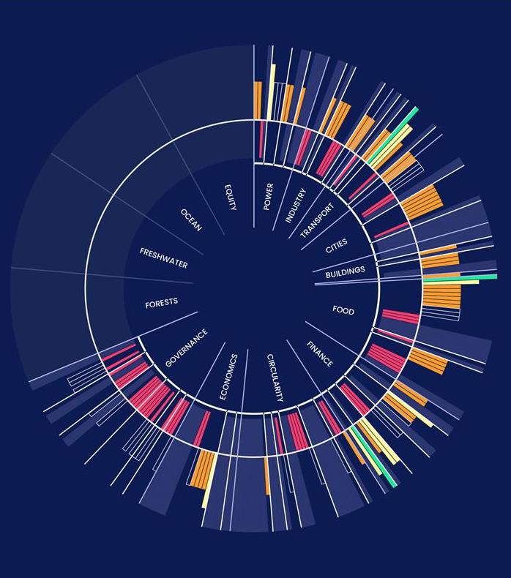
QUICK TIPS
LEARN HOW TO USE THE SYSTEMS CHANGE LAB DATA PLATFORM TO
FIND AND HIGHLIGHT INDICATORS

Slide 38


Slide 39
FOR MORE INFORMATION
SYSTEMSCHANGELAB.ORG/FRESHWATER
CONTACT@SYSTEMSCHANGELAB.ORG

