Slide 1
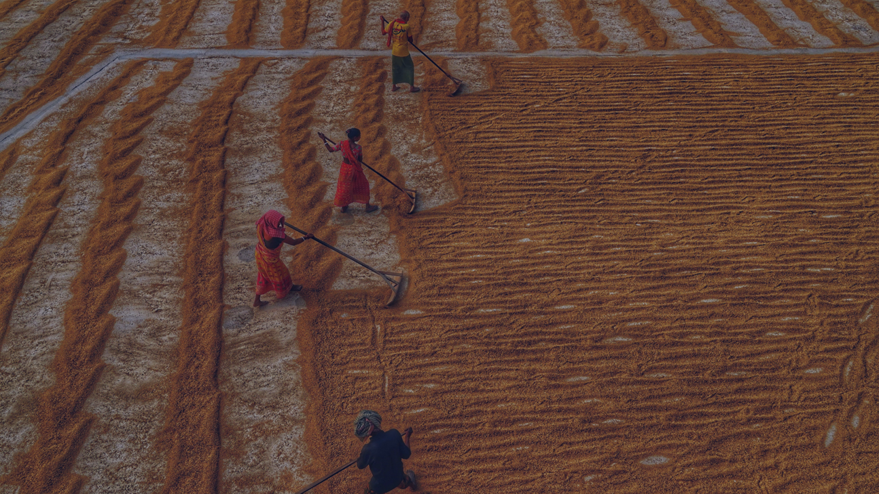

Food and Agriculture
Last updated June 2025 | systemschangelab.org/food-and-agriculture
Notes:
Photo by Dibakar Roy: https://unsplash.com/photos/a-group-of-people-working-in-a-field-UHUmHx11kSI

Slide 2

Systems Change Lab
It’s time to change the way we think about changing the world.
Systems Change Lab monitors, learns from and mobilizes action toward the transformational shifts needed to protect both people and the planet.
The data platform identifies and tracks key shifts in our global systems that, when achieved together, can spur transformational change.

Slide 3















Interconnected systems
Power
Industry
Transport
Cities
Buildings
Carbon Removal
Land & Forests
Ocean
Freshwater
Food &
Agriculture
Finance
Circular
Economy
Governance
Social Inclusion & Equity
Economics

Slide 4
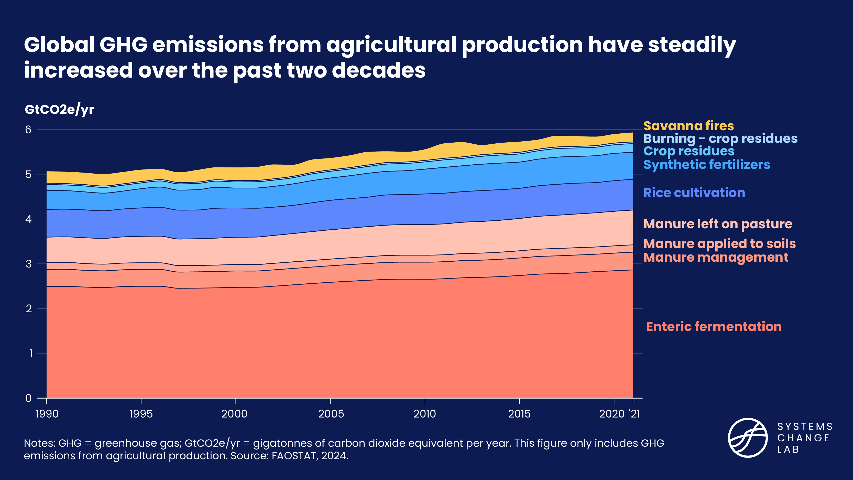
The food and agriculture system

Slide 5
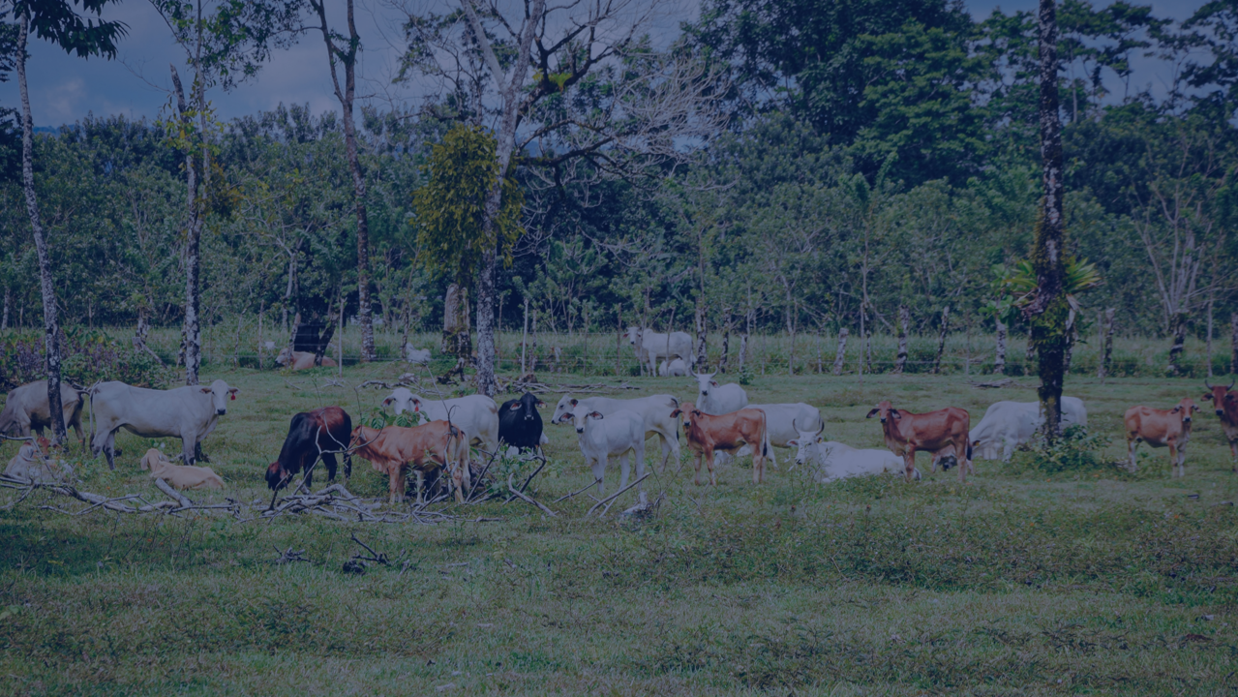
The three shifts needed to transform
the food and agriculture system
Increase agricultural productivity sustainably, resiliently and without expanding into high-carbon, biodiverse ecosystems
Ensure access to and adoption of healthier, more sustainable diets for all
Reduce food loss and waste
Notes:
Increase agricultural productivity sustainably, resiliently and without expanding into high-carbon, biodiverse ecosystems
To meet the food and nutrition demands of a growing population, it will be necessary to increase agricultural productivity sustainably and resiliently and reduce emissions and biodiversity impacts from farming, while also supporting farmer livelihoods.
Reduce food loss and waste
Today, one-third of food produced globally goes uneaten. The global community has agreed to reduce food losses and halve food waste by 2030. This will help decrease the biodiversity harms and greenhouse gas emissions associated with producing, transporting, and disposing of uneaten foods.
Ensure access to and adoption of healthier, more sustainable diets for all
Dietary shifts are necessary to equitably feed a growing global population, decrease biodiversity loss and limit global warming to 1.5°C. This entails improving nutrition and food security in low-income and under-consuming populations alongside improving nutrition and moderating consumption of emissions- and land-intensive foods like beef among high-consuming populations.
Photo by Frames For Your Heart via Unsplash: https://unsplash.com/photos/a-herd-of-cattle-standing-on-top-of-a-lush-green-field-9EAEOis7TCI

Slide 6
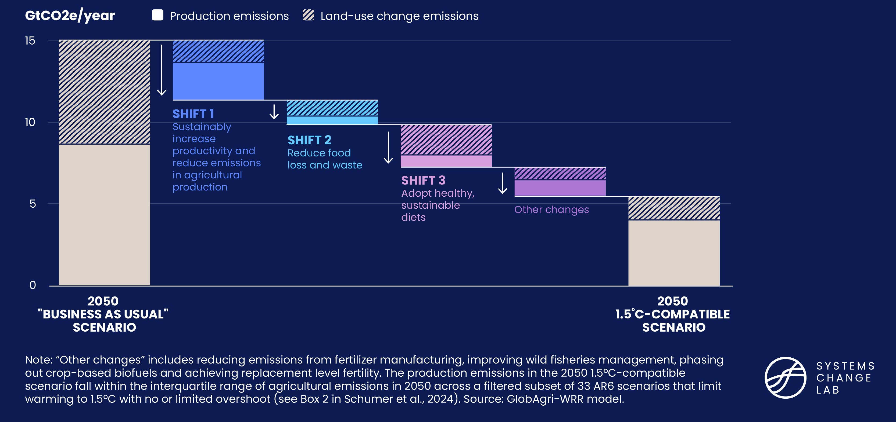
Key shifts needed to align the food system with 1.5°C pathways
Notes:
Our research and analysis is centered around 3 major shifts, that together, can help bring our projected emissions from agricultural production and agriculture-related land use change down from a business-as-usual scenario of around 15 GtCO2e/year to scenarios compatible with pathways that limit global warming to 1.5 degrees C.
The first shift focuses on increasing agricultural productivity sustainably, resiliently and without expanding into high-carbon, biodiverse ecosystems
To meet the food and nutrition demands of a growing population, it will be necessary to increase agricultural productivity sustainably and resiliently, reduce emissions and biodiversity impacts from farming, while also supporting farmer livelihoods.
Reduce food loss and waste
Second, we need to reduce food loss and waste. You’ll hear more about this from Brian in a few minutes, but wanted to call out here that this shows the emissions reductions associated with cutting food loss and waste in half.
Ensure access to and adoption of healthier, more sustainable diets for all
And third, dietary shifts are necessary to equitably feed a growing global population, decrease biodiversity loss and limit global warming to 1.5°C. This entails improving nutrition and food security in low-income and under-consuming populations alongside improving nutrition and moderating consumption of emissions- and land-intensive foods like beef among high-consuming populations.

Slide 7
Highlights
Agricultural production accounts for 11% of global GHG emissions. Including food-related emissions associated with land-use change and other sectors across the supply chain, food system emissions total roughly one-third of global emissions.
Agricultural land expansion is the leading driver of terrestrial biodiversity loss, including driving at least 90% of tropical deforestation.
One-third of food produced goes uneaten. Global rates of food loss and waste are not yet moving in the right direction.
29% of the global population faces food insecurity and 9% is chronically hungry. Alongside improving nutrition, a course correction is needed to reverse trends in food insecurity and hunger, which remain at the highest levels in nearly a decade.

Slide 8
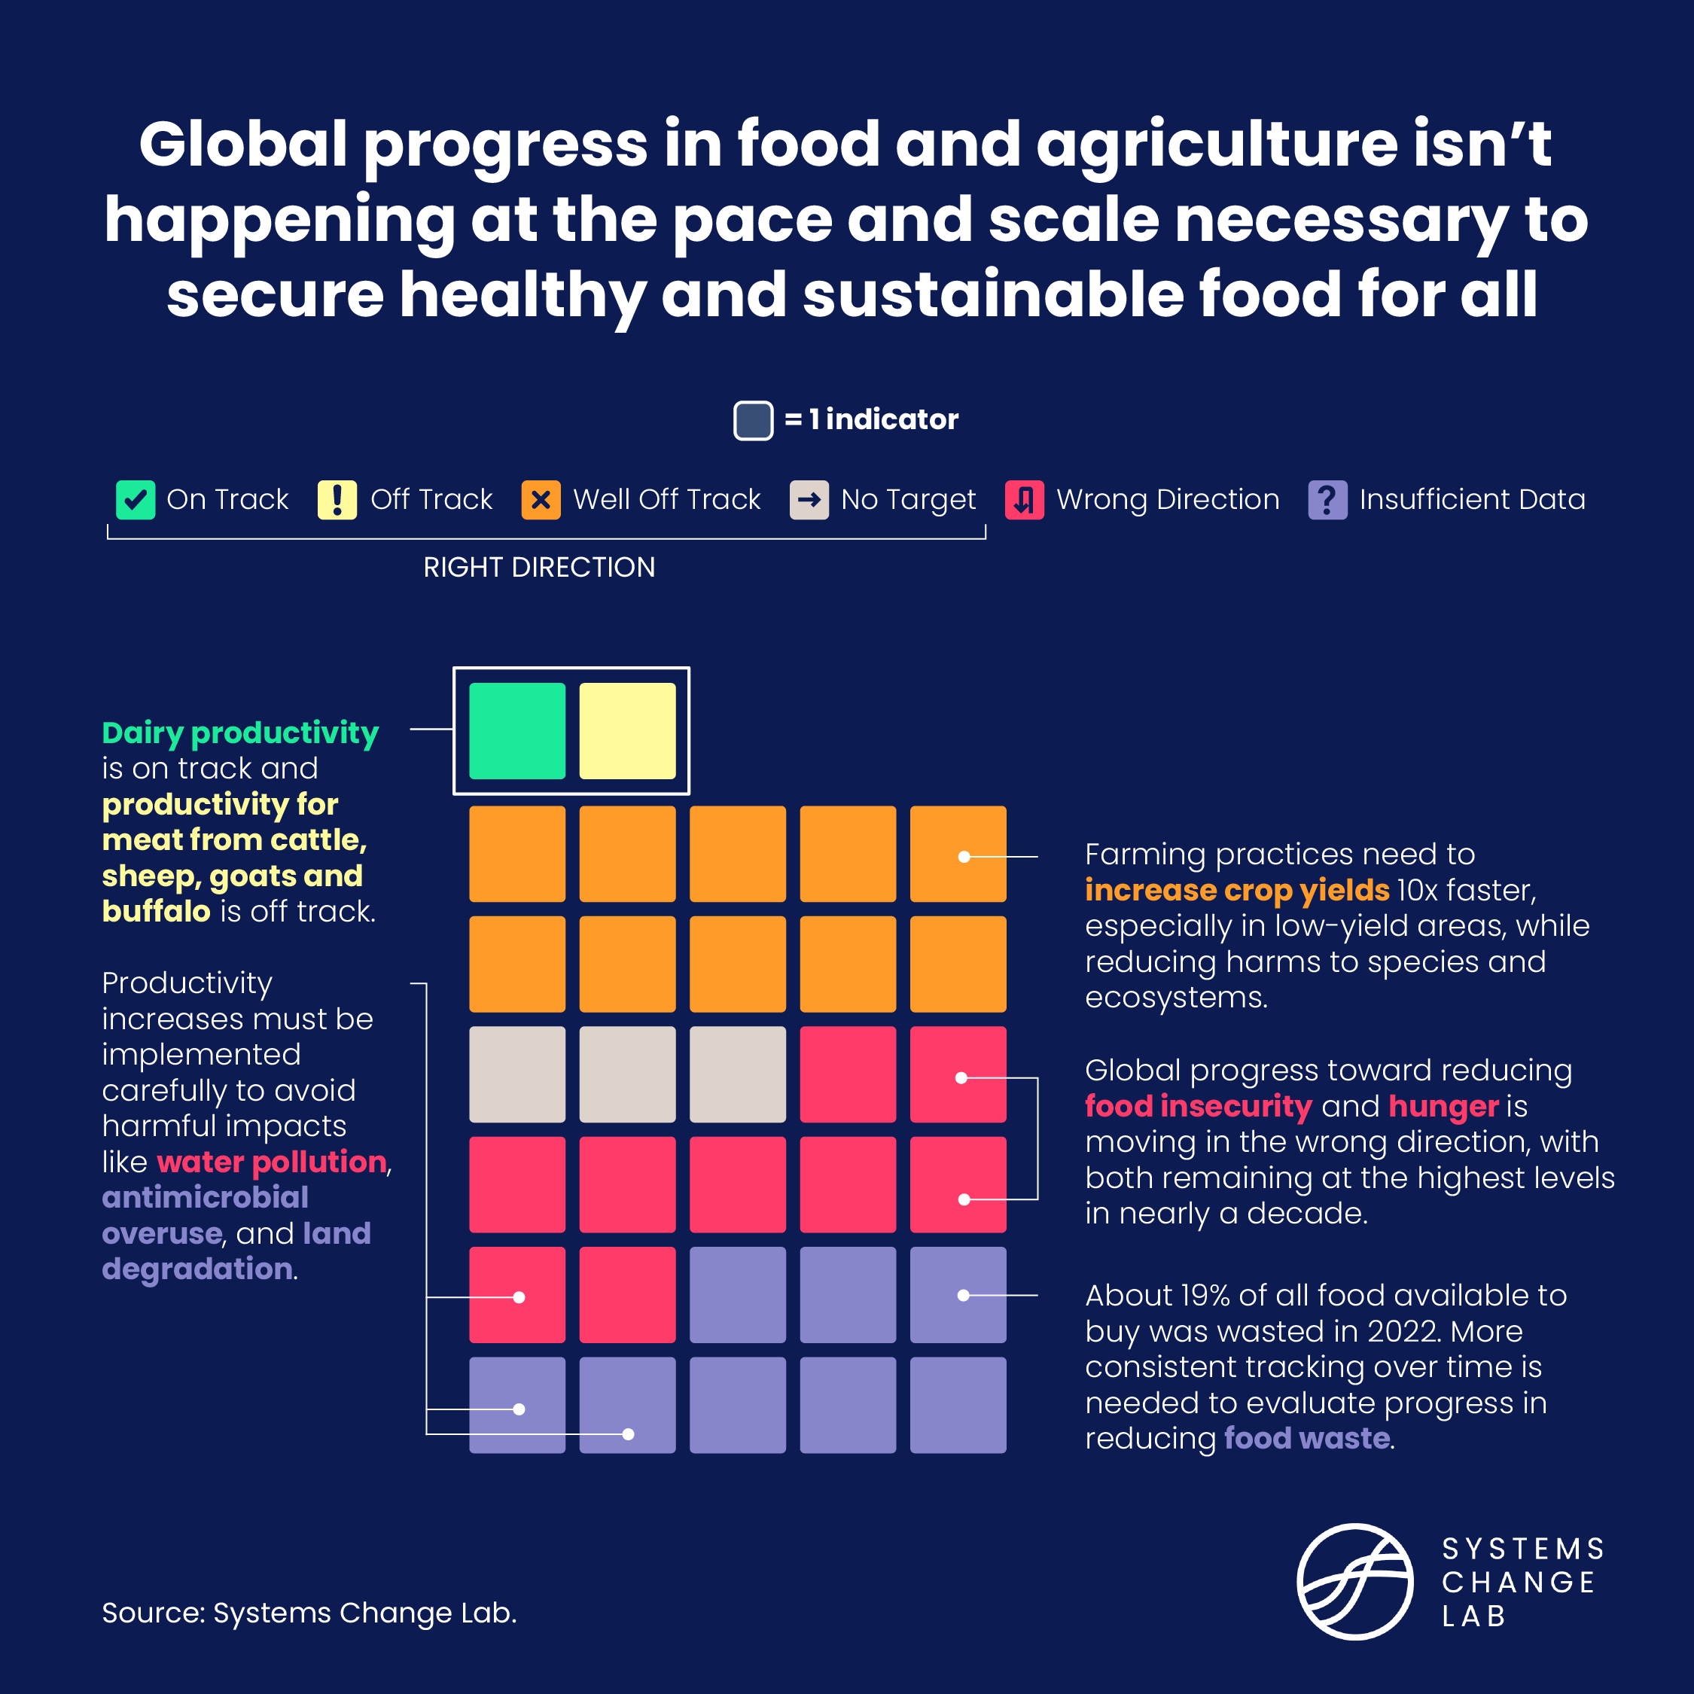
Progress toward targets
In this system, we have identified 32 outcome indicators to meet climate, nature and equity goals.

Slide 9
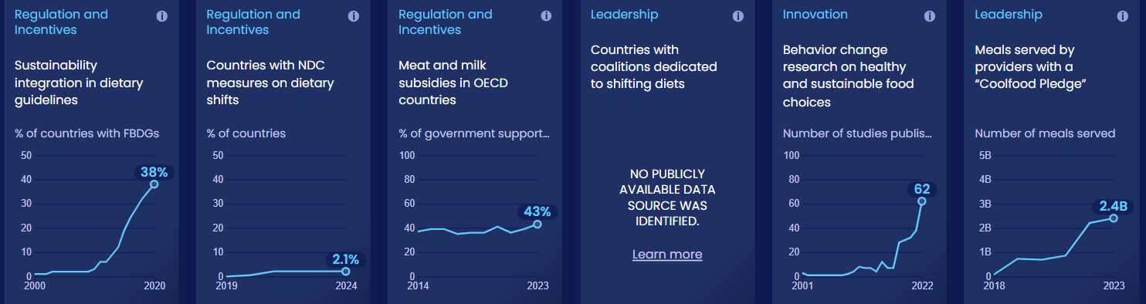
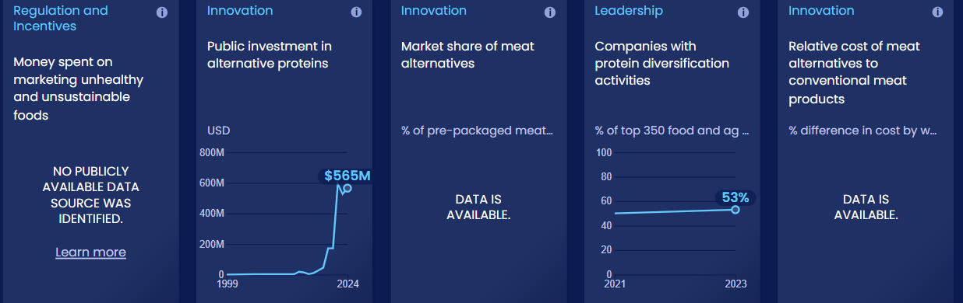
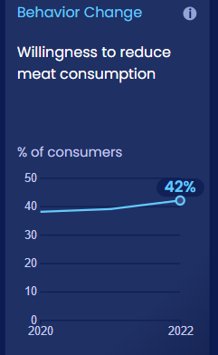
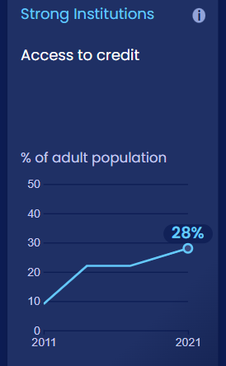
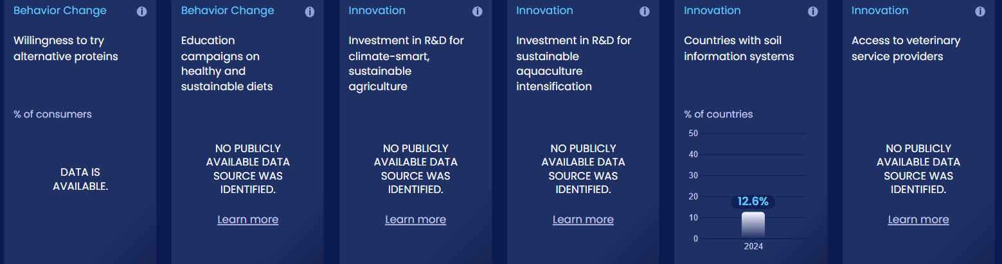
Enablers and barriers
In this system, we have identified 58 enablers and barriers to change.

Slide 10
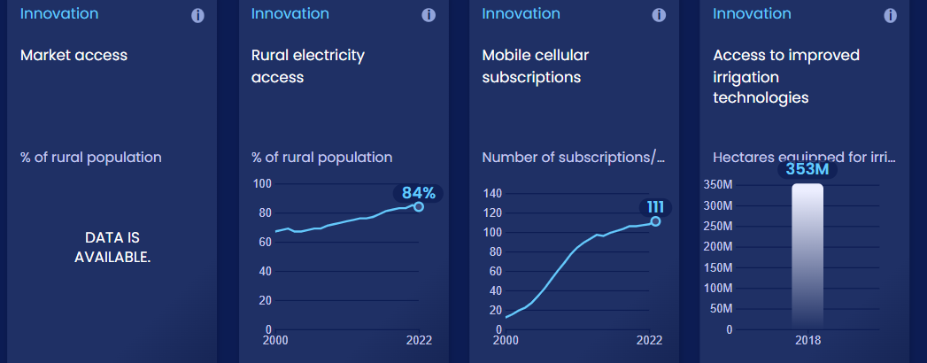
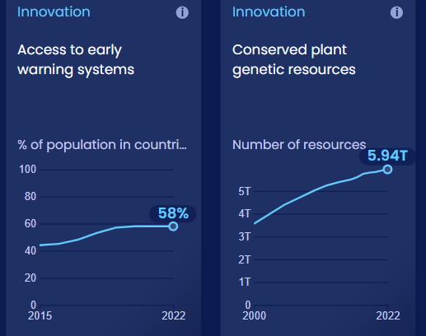
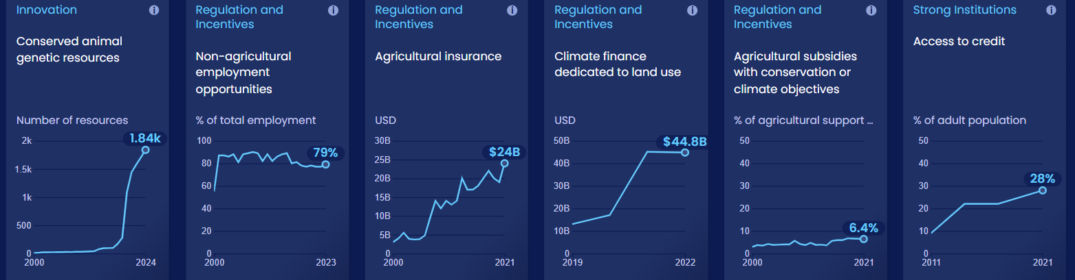
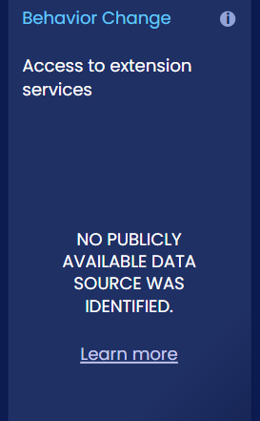
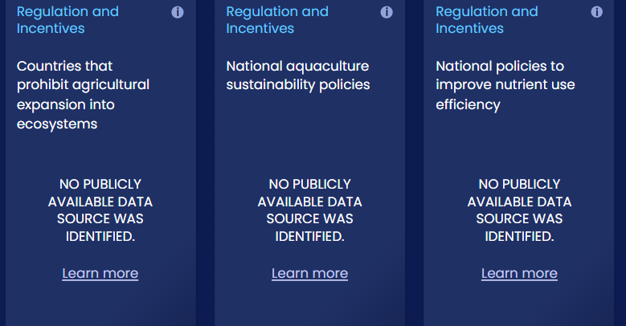
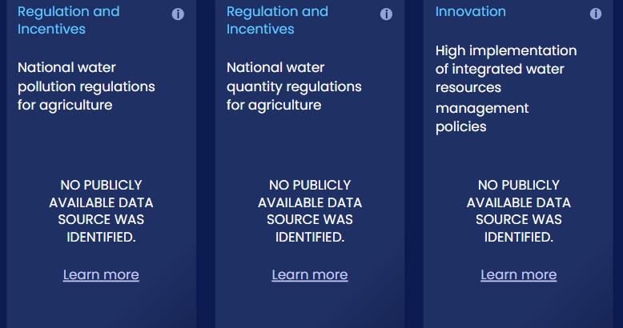
Enablers and barriers
In this system, we have identified 58 enablers and barriers to change.

Slide 11
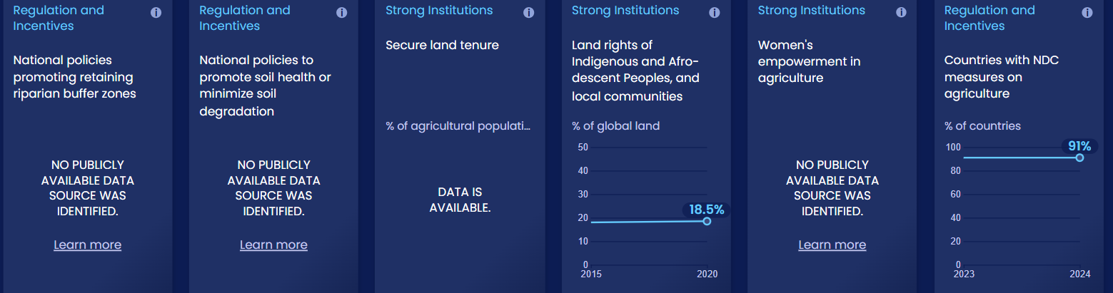
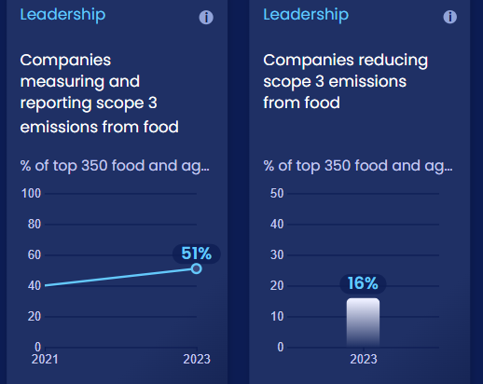
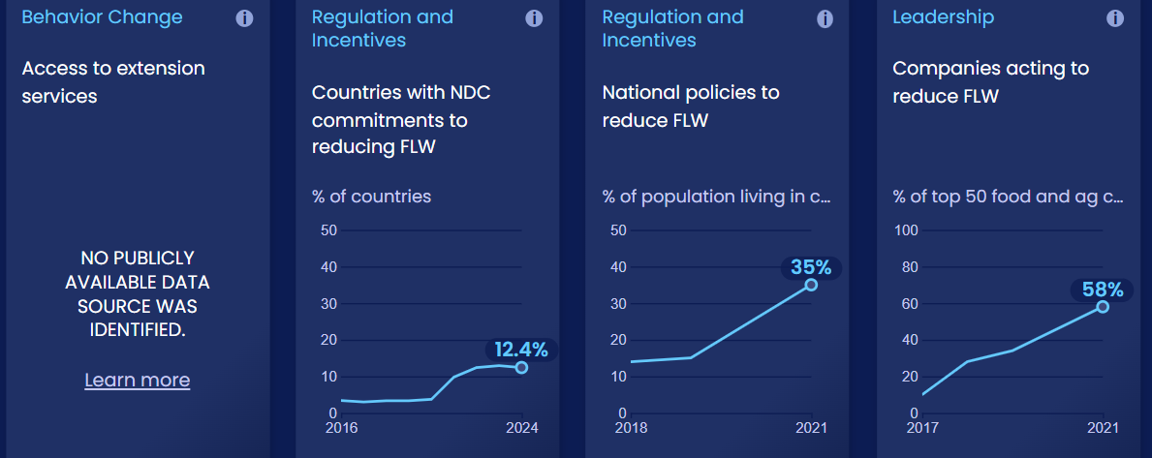
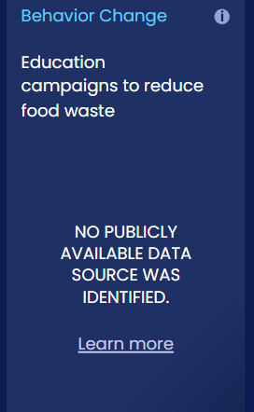
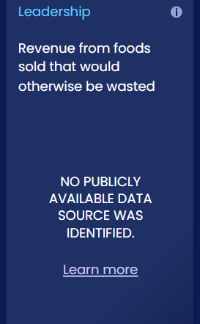
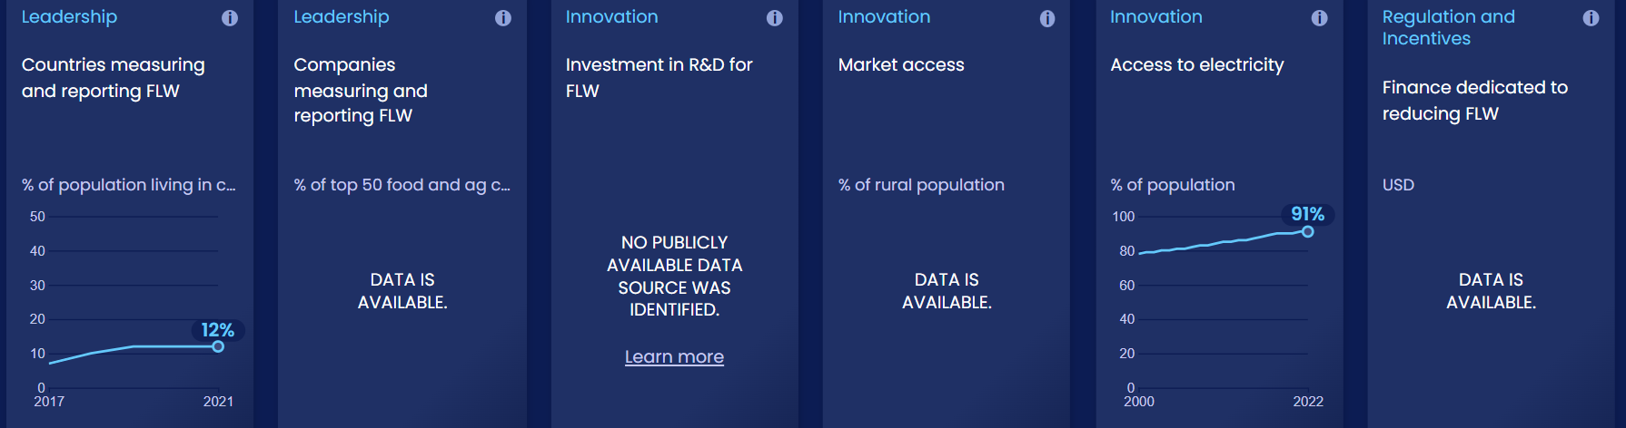
Enablers and barriers
In this system, we have identified 58 enablers and barriers to change.

Slide 12
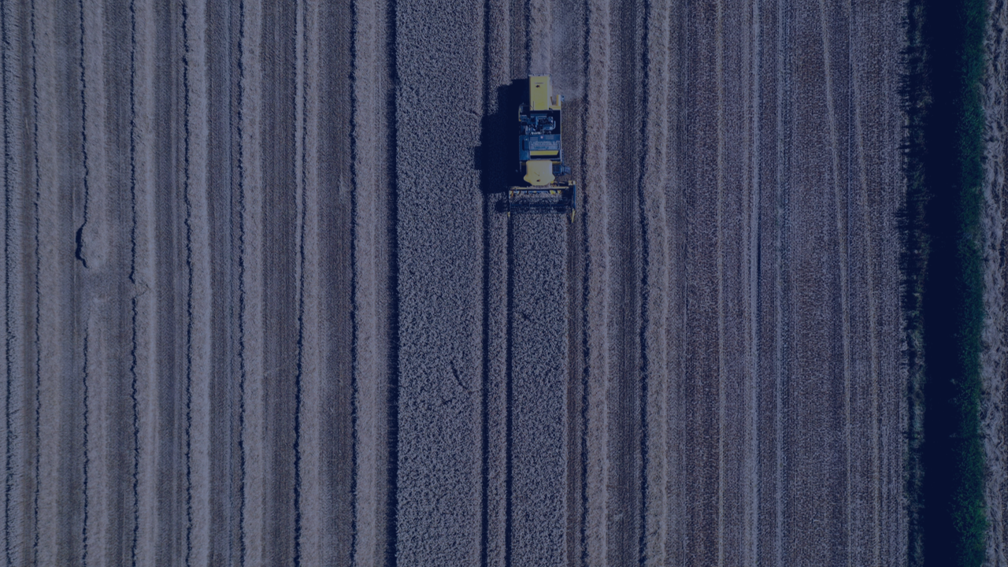
Increase agricultural productivity sustainably, resiliently and without expanding into high-carbon, biodiverse ecosystems
SHIFT
Notes:
Photo by ScotGov Rural via Flickr: https://flickr.com/photos/scotgovrural/52280730586/in/dateposted/

Slide 13
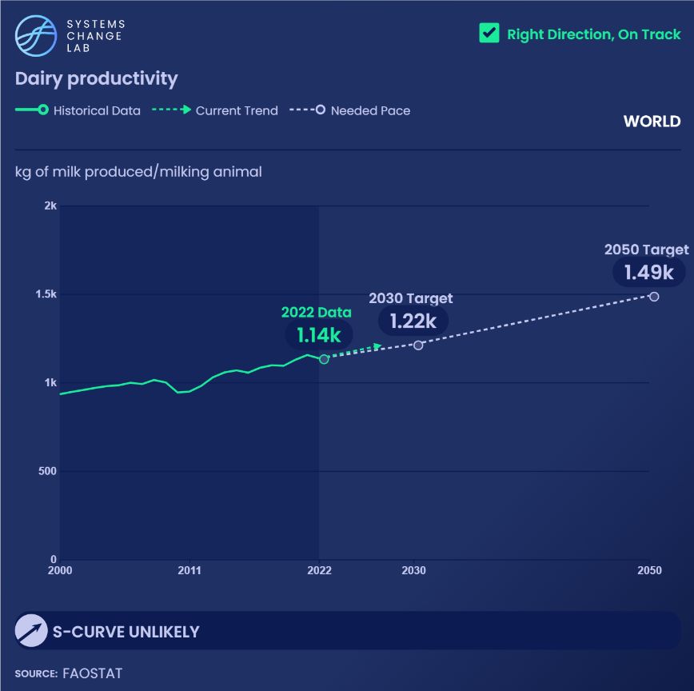
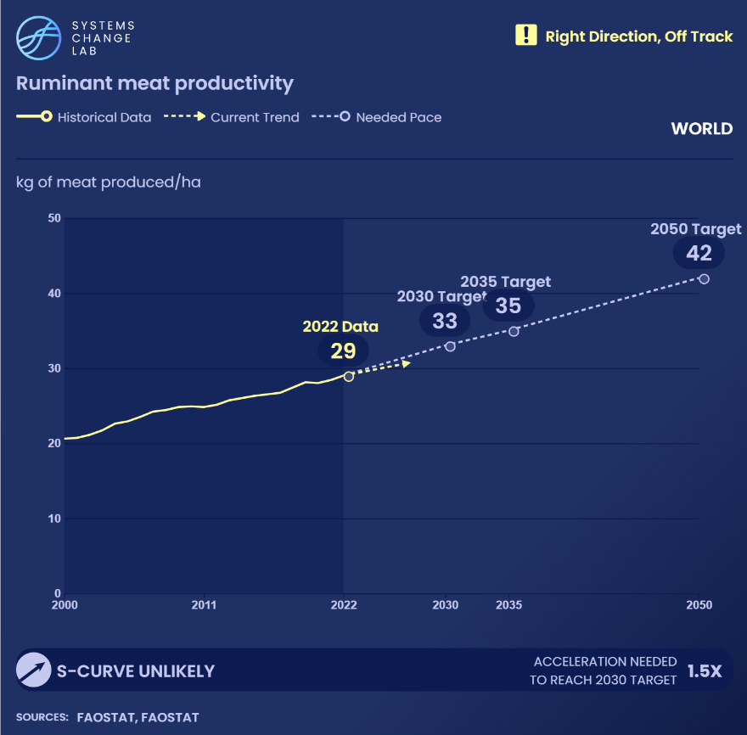
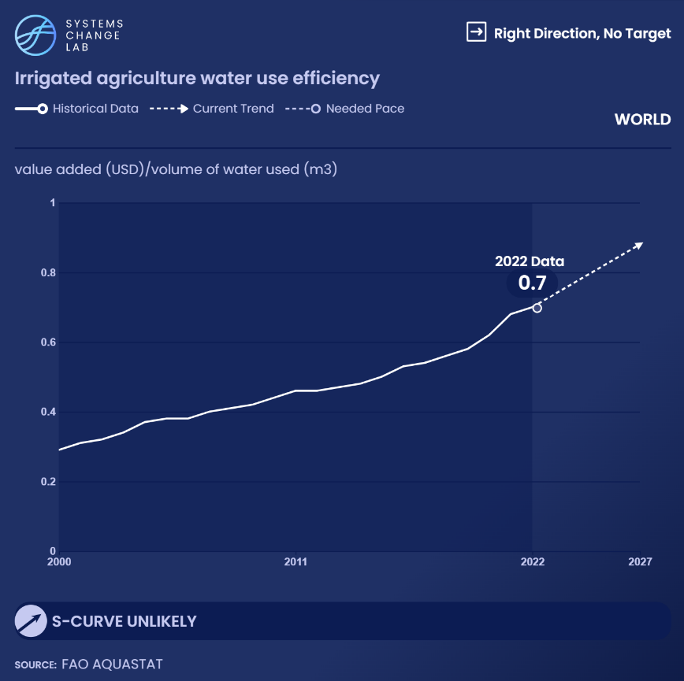
WHAT IS PROMISING:
Progress in agricultural efficiency and productivity

Slide 14
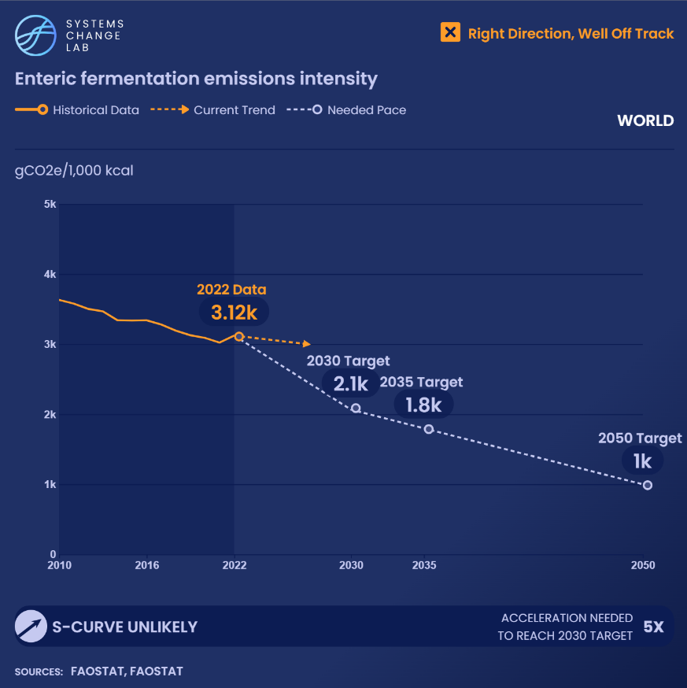
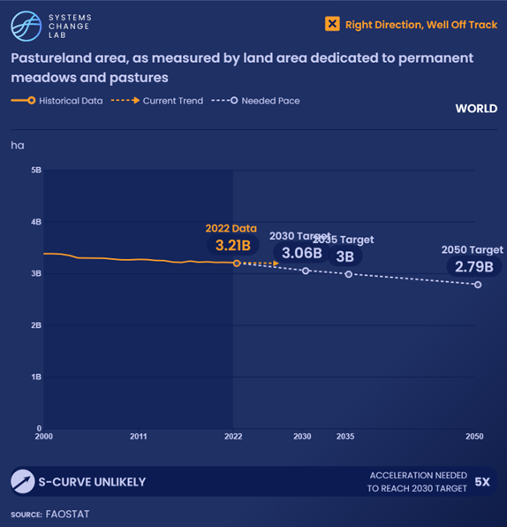
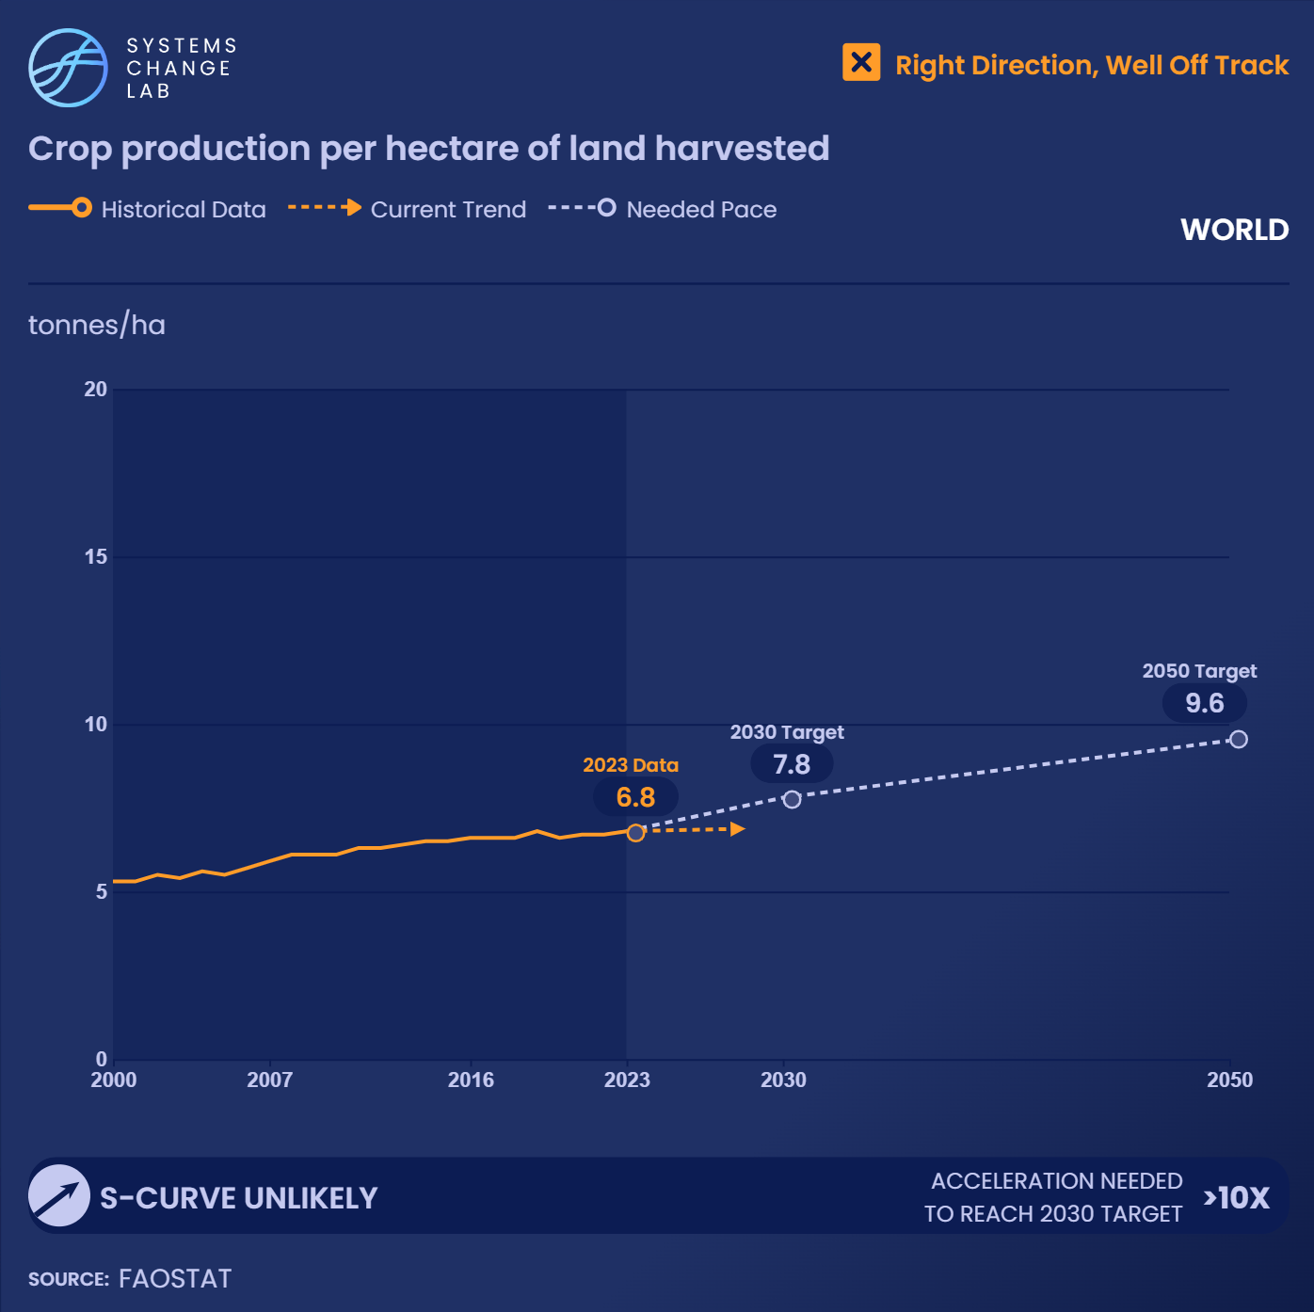
Progress needs to happen faster

Slide 15
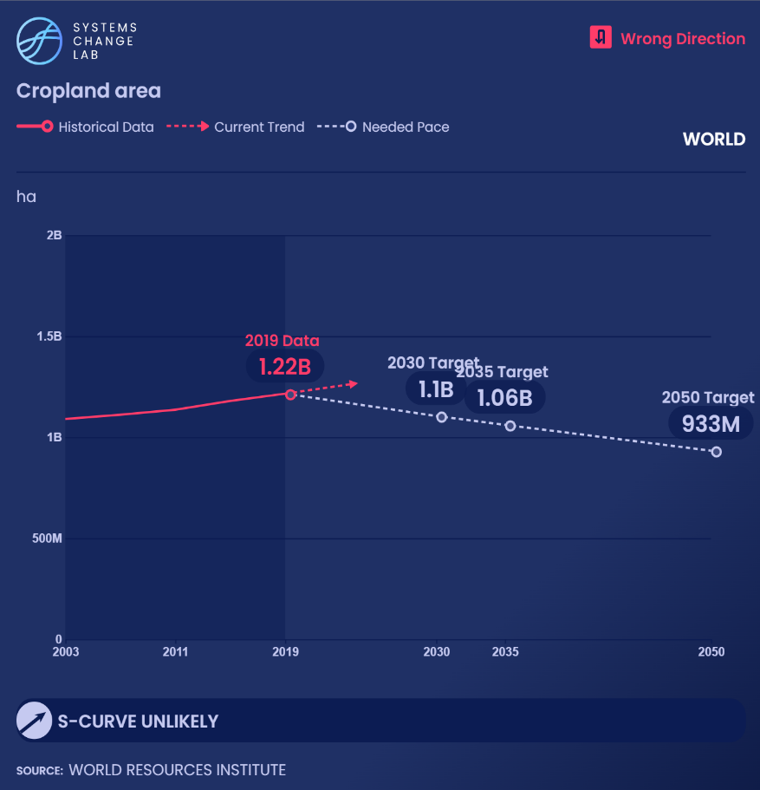

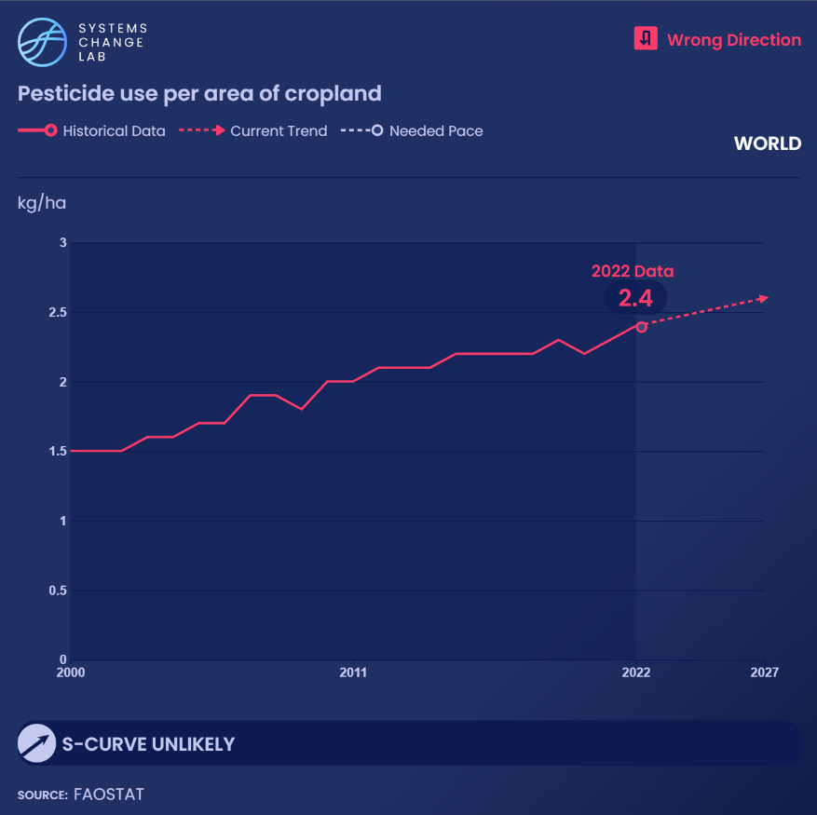
WHAT IS CONCERNING:
Environmental pressures are intensifying

Slide 16
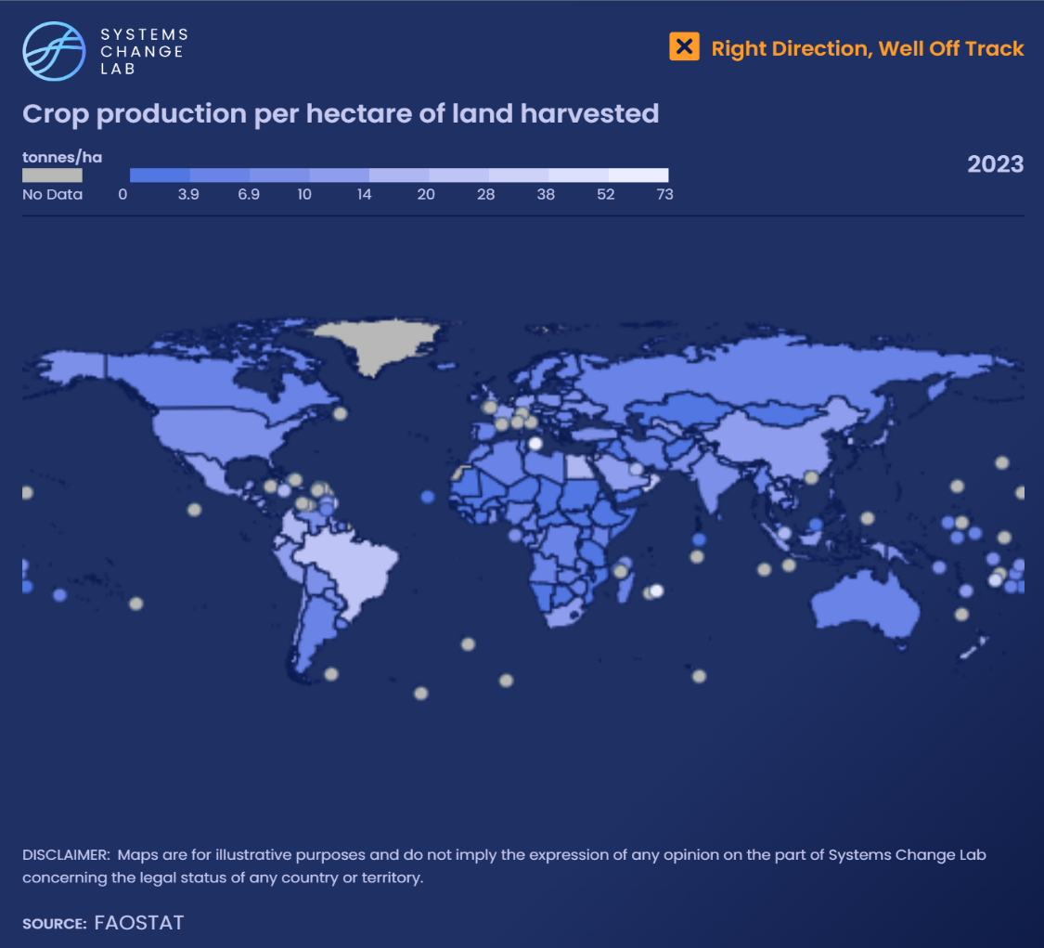
What could enable change
Climate-smart agricultural technologies
  Feed additives, genetics, feeds, water-efficient irrigation technologies, precision agriculture
Policy and economic incentives
  Reform harmful subsidies
  Strengthen policies promoting sustainable intensification
Access and equity
  Improve access to credit, markets, and technologies for smallholder farmers
  Address insecure land rights
  Close gender gaps
  Increase finance for R&D

Slide 17
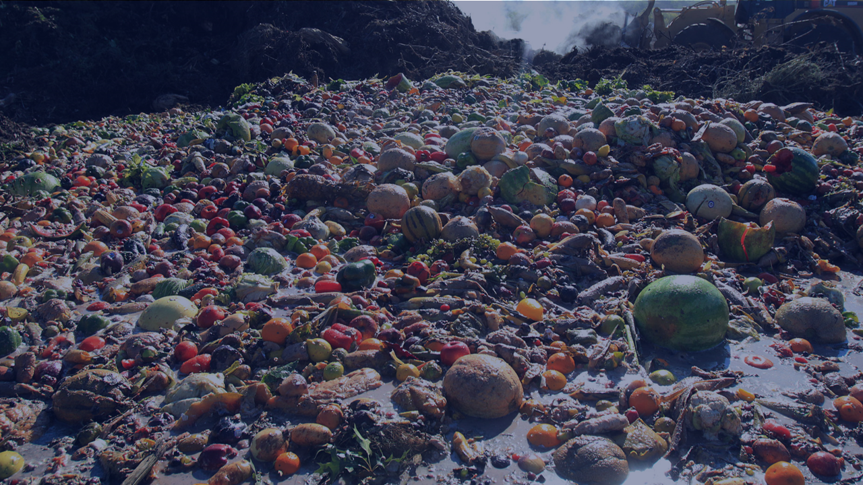
Reduce food loss and waste
SHIFT
Notes:
Photo by Kristen Goo via Flickr: : https://flickr.com/photos/149698595@N08/34068455870/in/photolist-TUvK1b-chVcj1-Vn2mpW-gF11Wu-2nkvmei-2pNivtS-XnR1or-S413wU-gF2oYn-2p7AwKQ-i4ZMnF-2hF3c83-2g9b5e6-gF1sBZ-Gjxrwh-hv7k4w-RnejN4-2kh2bMK-2hXcEdH-2hXfqh8-2hXeTFy-tp8ZSy-2hXgi7a-2hXf15F-5t1Mhe-dWXHAw-2a1Efs5-DnaD2o-9s3fnT-NMR7WB-2pFK9p7-NMR7E4-gF1ReT-9cJdwi-8Niu44-2h6dy5N-2kGCeN9-scJzHg-9wPW4t-2jpzyjW-KbGE85-abeWyB-VbY9yh-2p7ubE4-2k4Yzie-2hKJ1NW-Dvp7b5-o8AQPz-e6sA7d-2iEkTAN

Slide 18
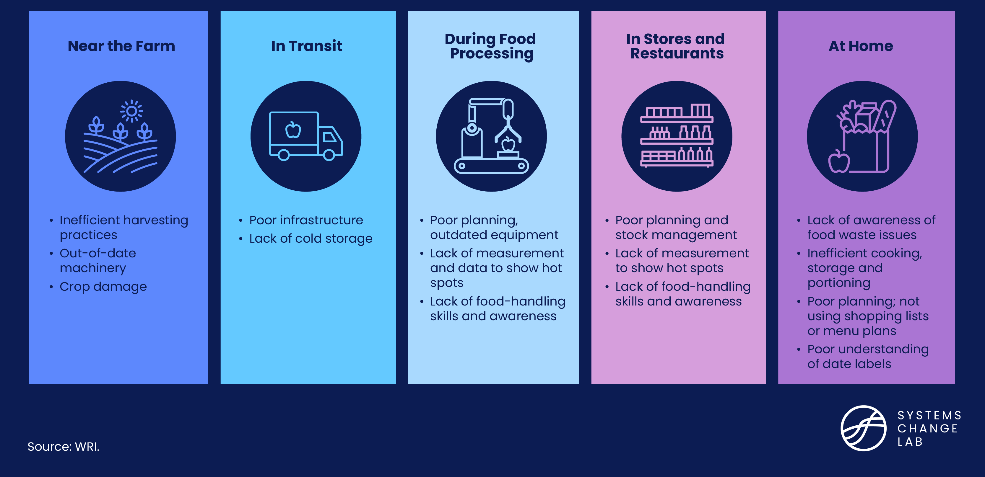
Main drivers of food loss and waste

Slide 19
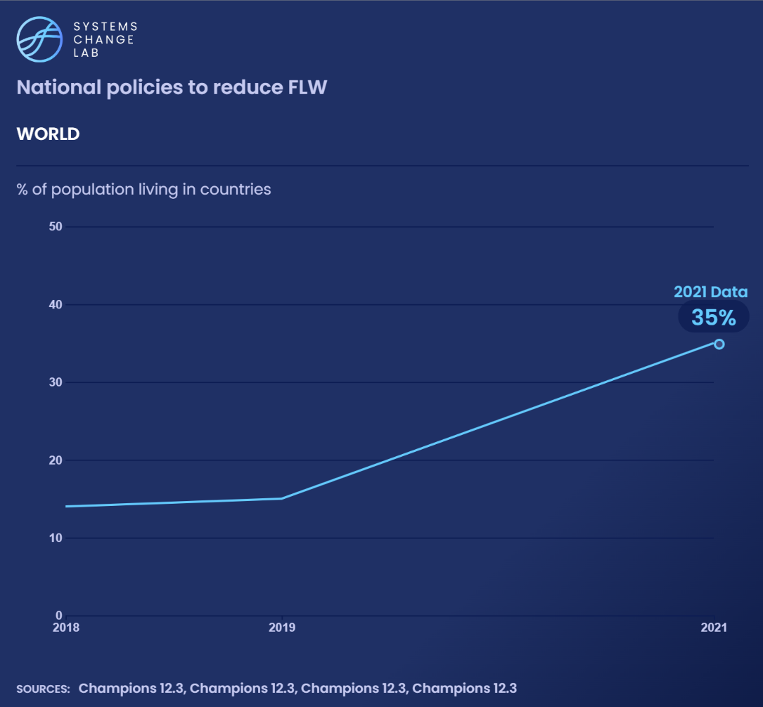
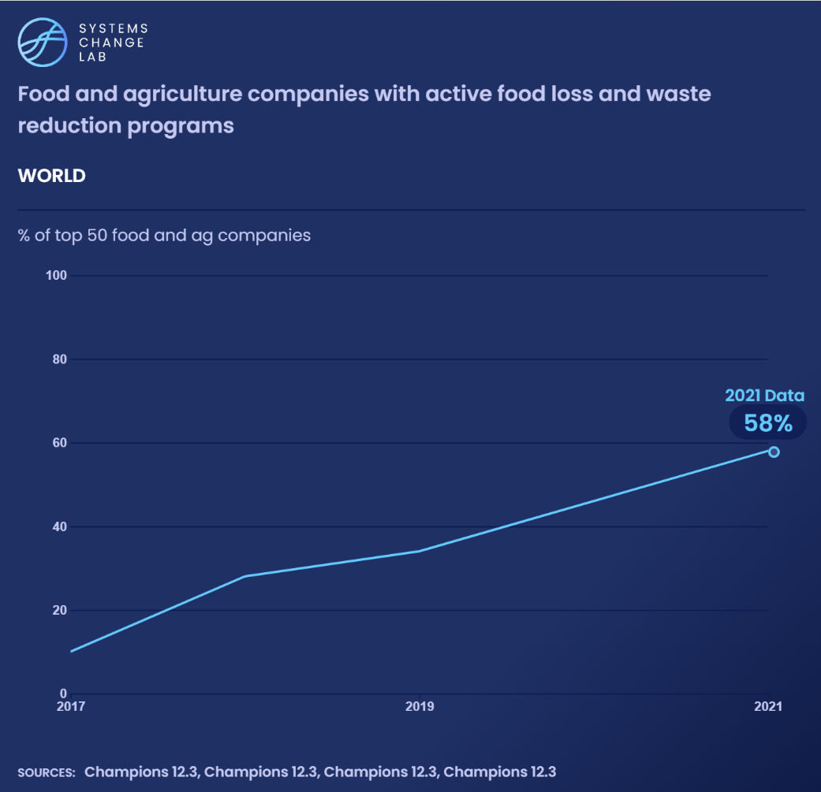
WHAT IS PROMISING:
Countries and companies are beginning to take action

Slide 20
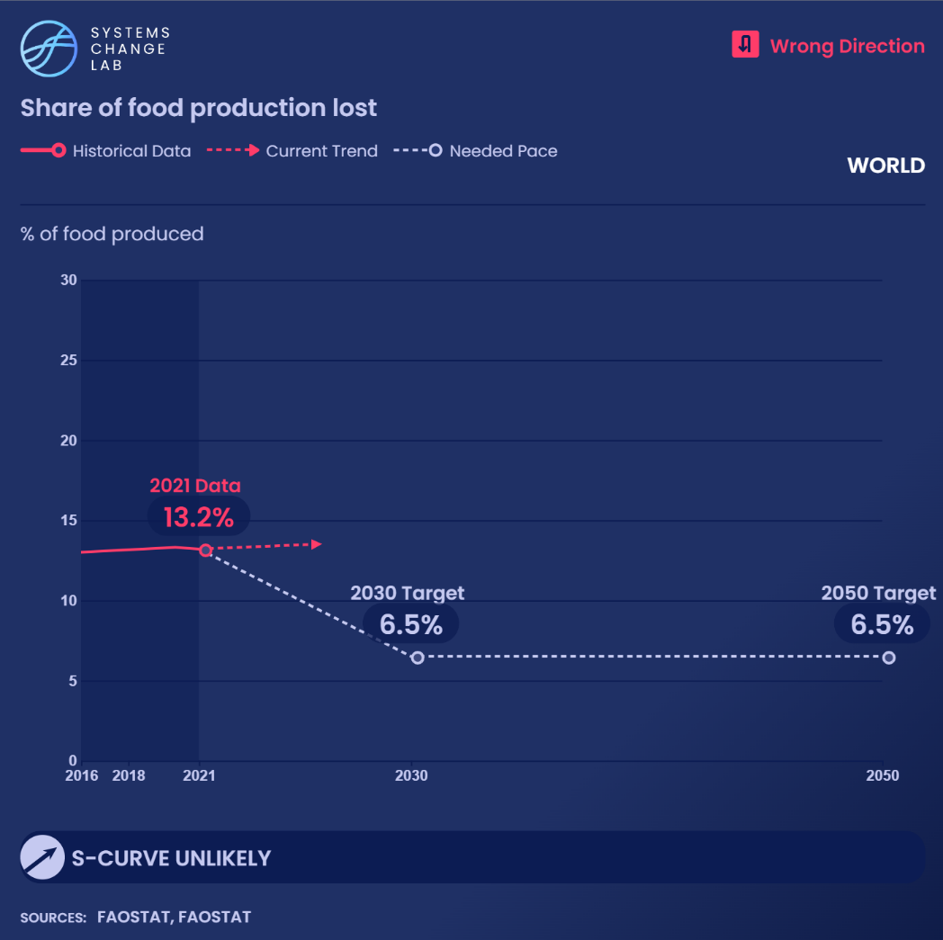
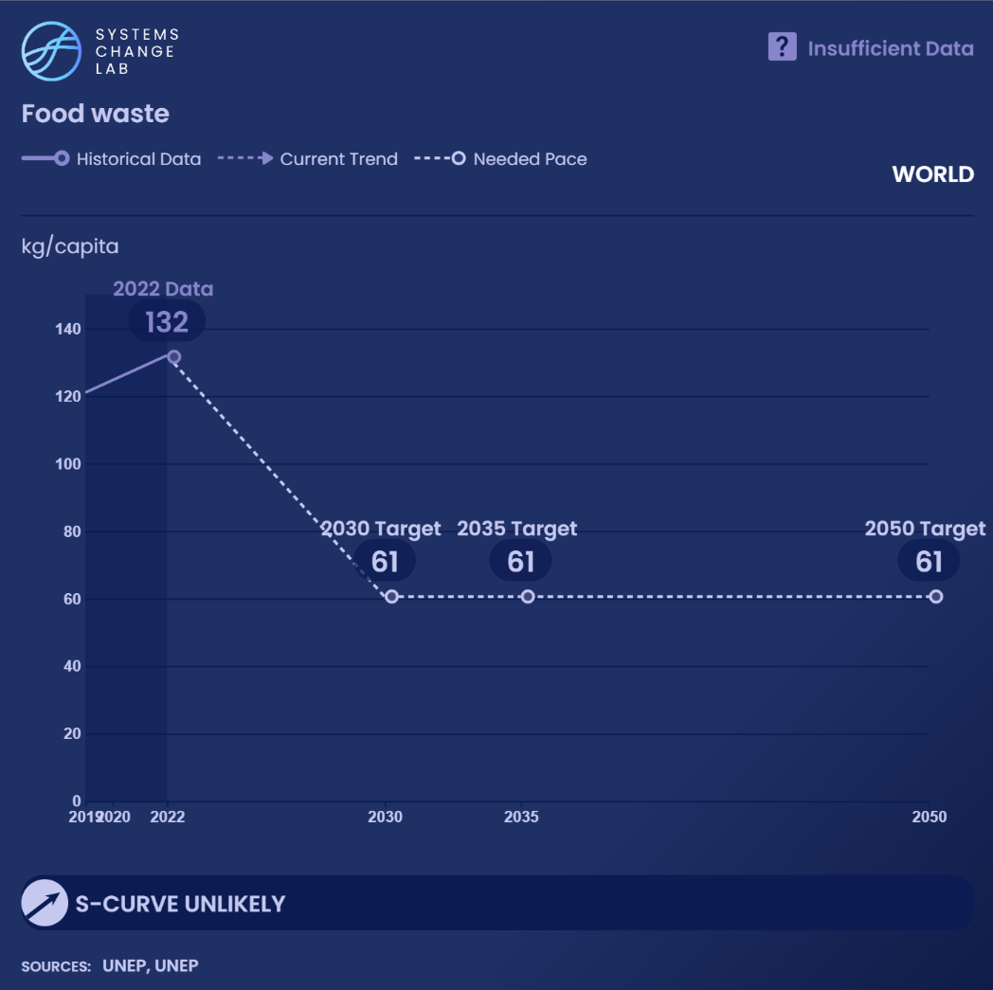
WHAT IS CONCERNING:
The world is not on track to halve food loss and waste

Slide 21
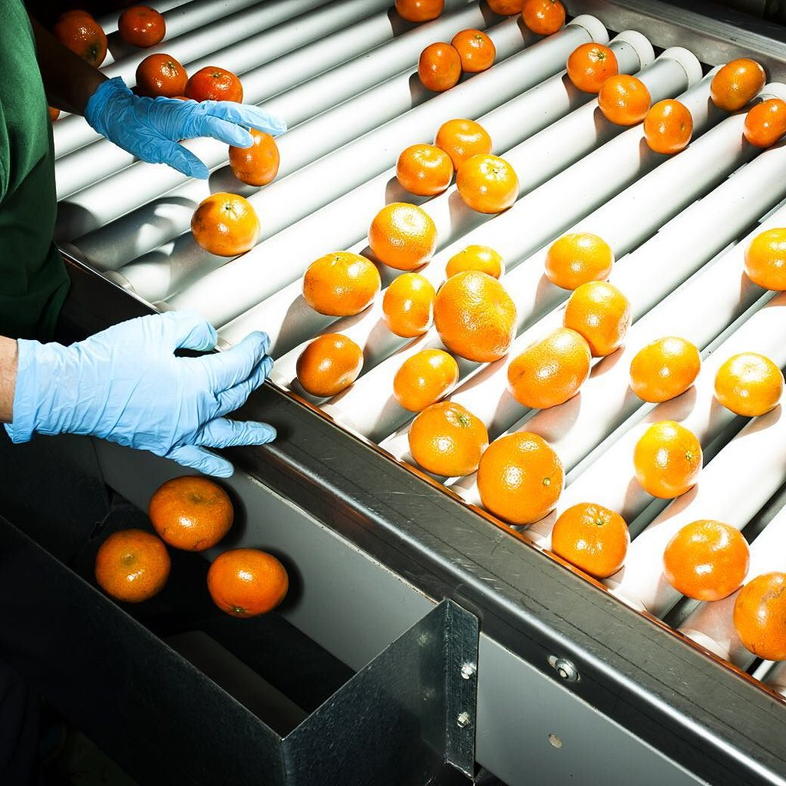
What could enable change
More public policies aimed at reducing food loss and waste, such as:
  Standardizing food labeling
  Changing food liability laws
  Expanding public-private partnerships with food companies
  Investing in research and adoption of new technologies and practices
Improved access to markets, information and technologies
More comprehensive, consistent and accurate data
Notes:
Photo Credit: Irene Luoug via Flickr https://www.flickr.com/photos/132391405@N03/24167631104/in/photolist-CPBqJU-2nc7Cd3-r3P8AW-2iUVEnr-XtNkyP-NPFpRd-2hbuRdH-2npPmuD-aD7DNJ-5EuXj3-2iuEtxp-2nTpHhb-29SDiwb-2e6ixTn-hRegCb-9scSCW-2imSbpZ-dM5nhb-r3P6wf-ri3vr5-aR8Kje-aMvJwD-96kDvc-2TmZ9f-bpRNe1-p48ir6-2nzJ1AJ-biX22H-cvCxZh-2fKD8hj-2hB1Hic-2nxnUVL-7iBCns-72pKKT-2kZbL8z-aD3HbK-bCLJtR-6rv5nV-biWZz2-9cHX5C-2ov7Npx-aMvTLM-2jbJjQ5-8Z1PXG-ftPiSJ-D3nMro-TdAeuR-e8FMWW-a4AvMY-aMvQti

Slide 22

Ensure access to and adoption of healthier, more sustainable diets for all
SHIFT
Notes:
Photo by Graphic Node via Unsplash: https://unsplash.com/photos/people-standing-near-patio-umbrella-surrounded-with-fruits-and-vegetable-stalls-N-AC7tTcD-c

Slide 23
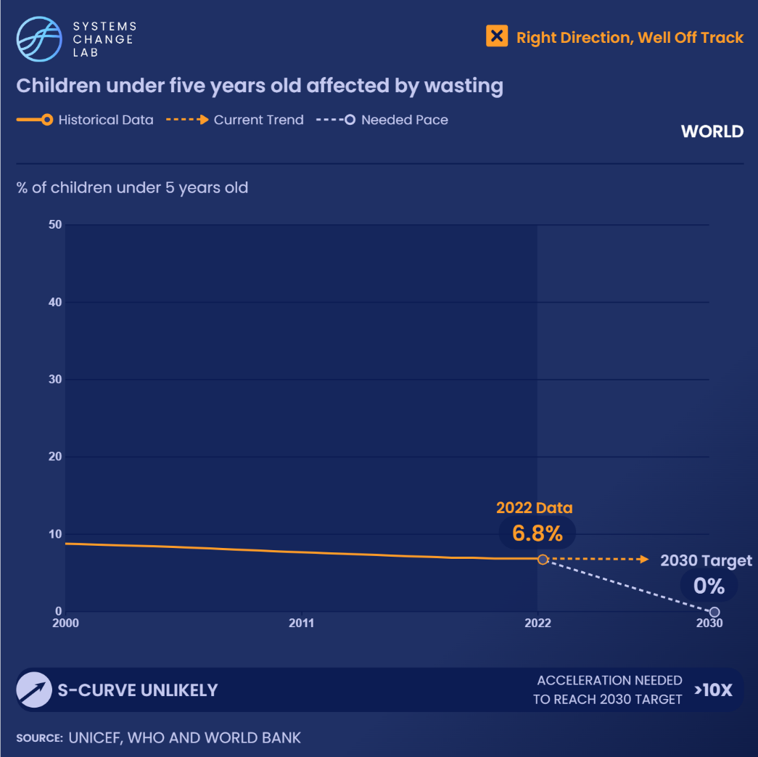
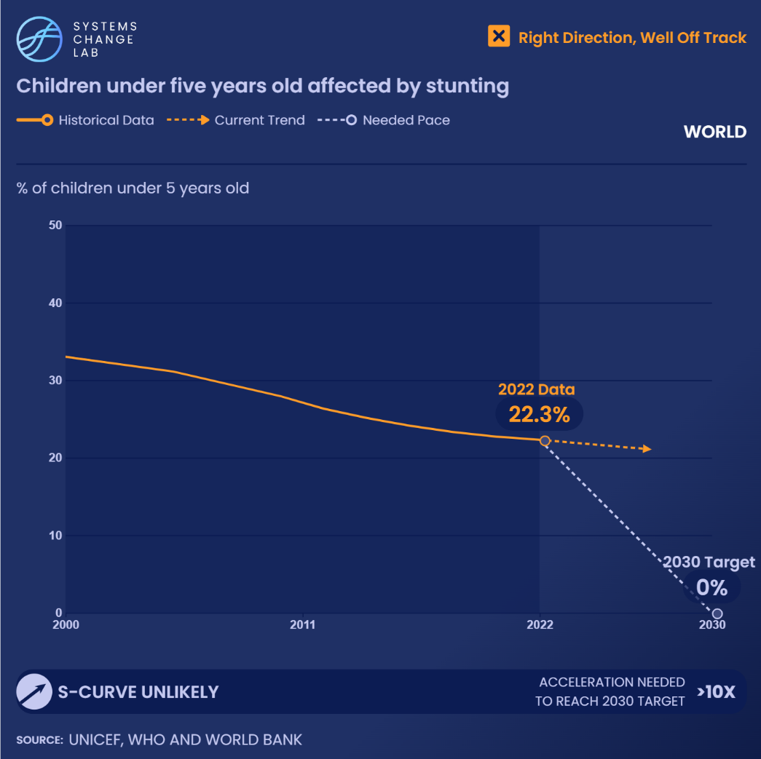
WHAT IS PROMISING:
Some progress on childhood undernutrition, yet much more needed
Notes:
Note: the most recent data available is from 2022. Given the substantial reductions in international aid in 2025, progress made is at serious risk of reversing.

Slide 24
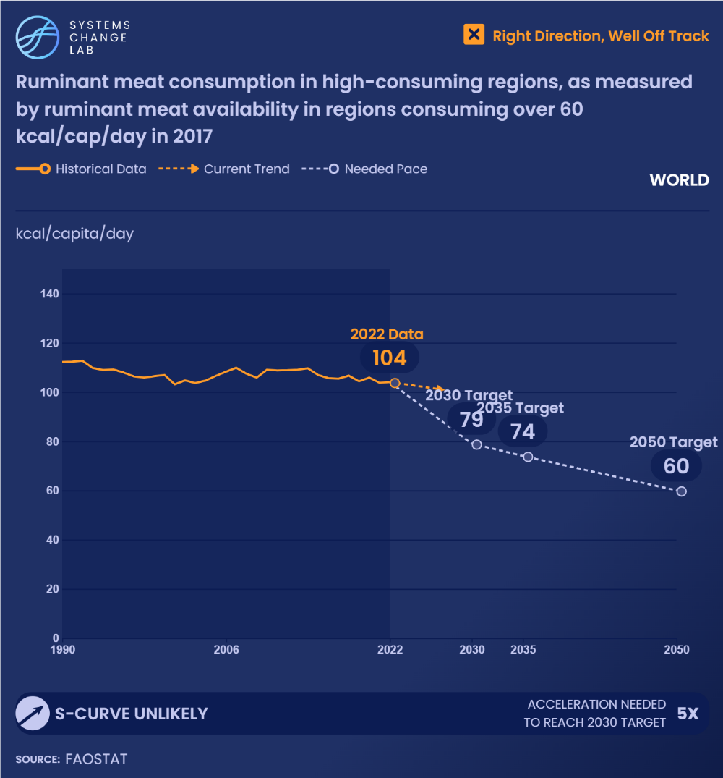
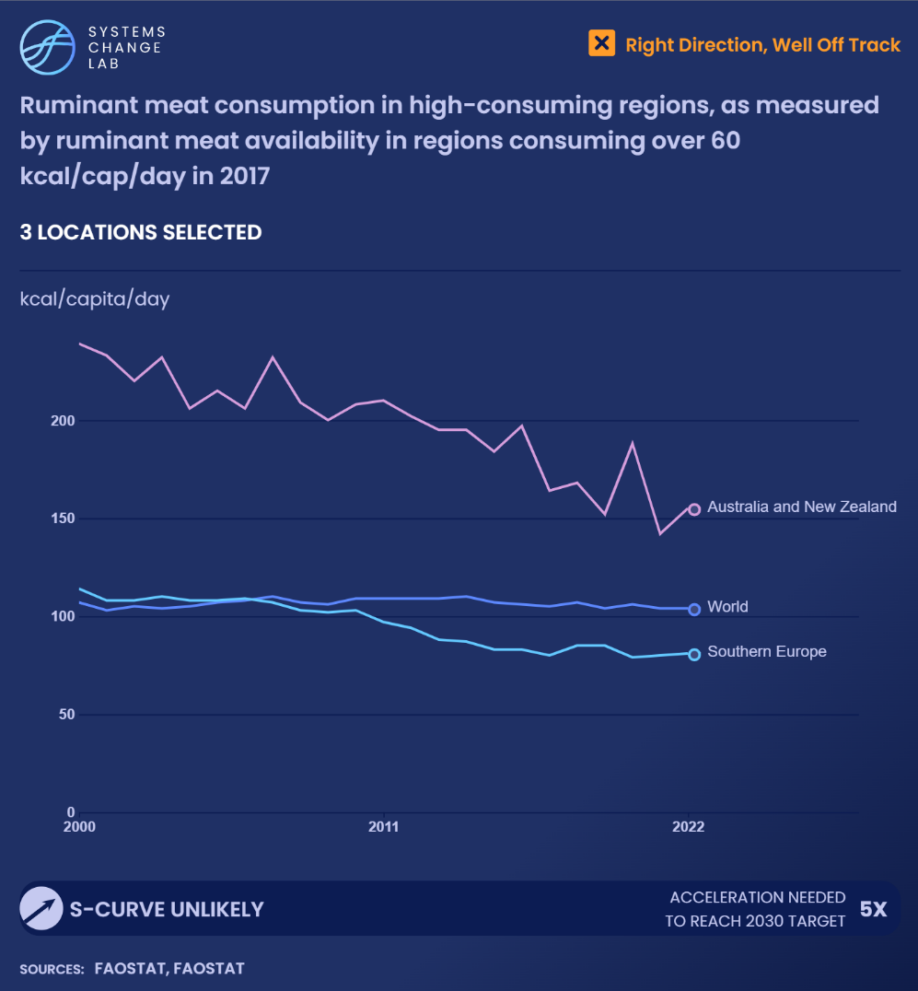
WHAT IS PROMISING:
Declining ruminant meat consumption in high-consuming regions

Slide 25
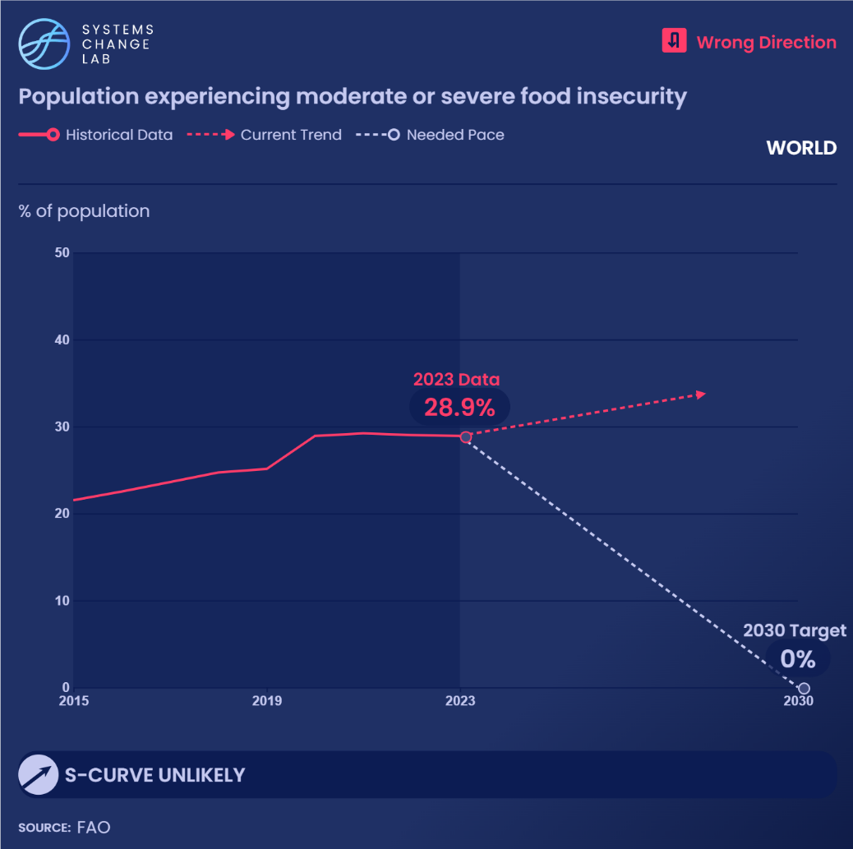
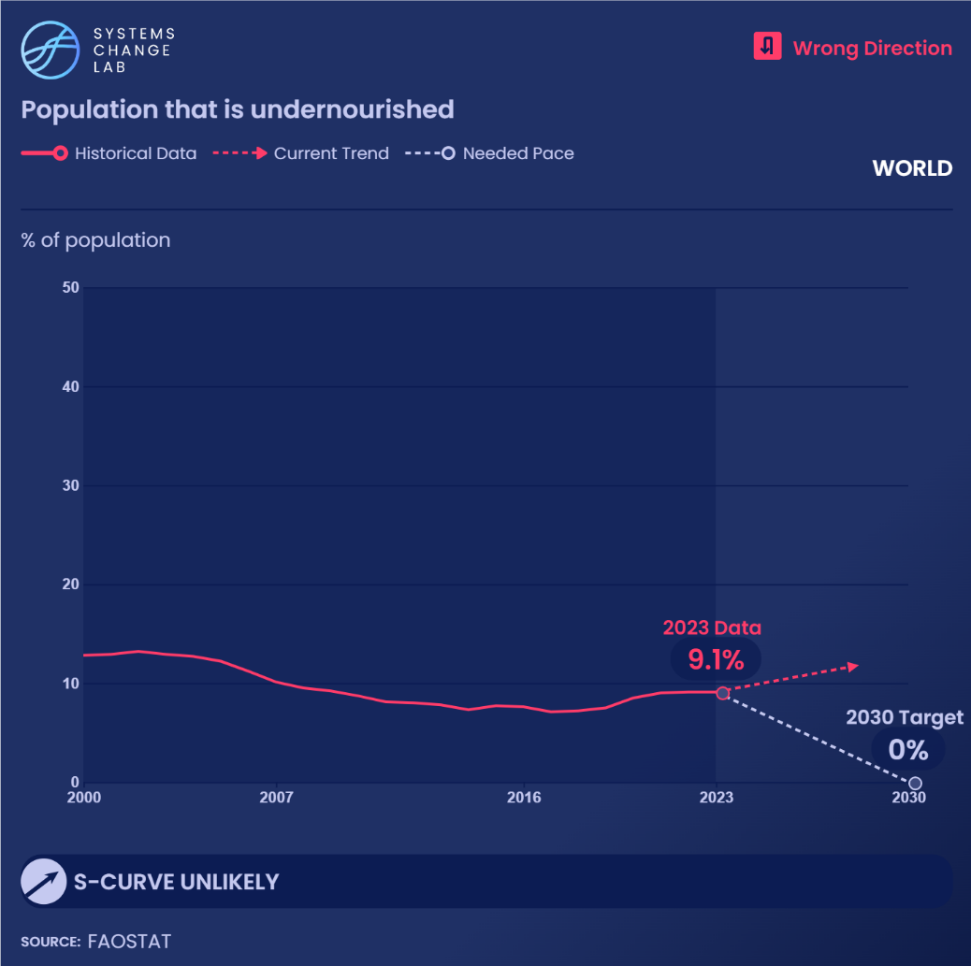
WHAT IS CONCERNING:
Food insecurity and hunger remain at highest rates in a decade
Notes:
Global efforts to make agricultural production and food consumption more sustainable must be paired with broader interventions to alleviate hunger and food insecurity, working toward UN Sustainable Development Goal 2.1 to end hunger and ensure all people have access to safe, nutritious and sufficient food all year round by 2030. While measures of food security reflect people’s experiences in accessing food, undernourishment or hunger reflect a chronically insufficient intake of calories to lead a healthy and active life.

Slide 26
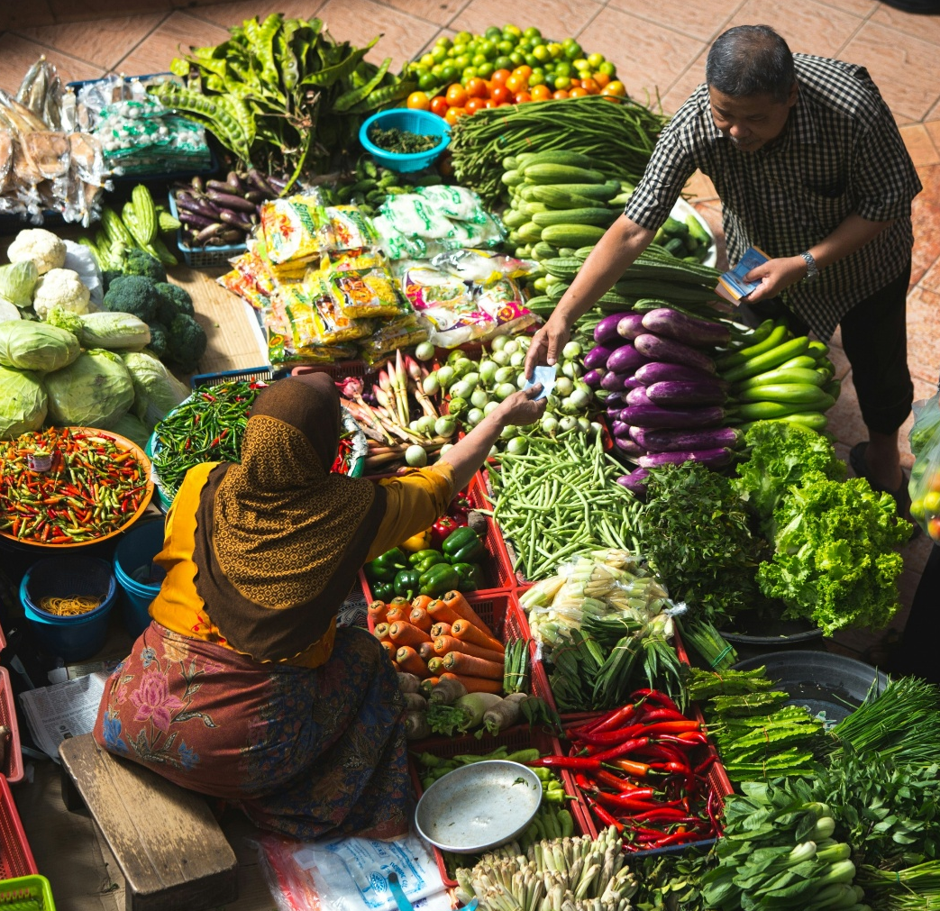
What could enable change
Comprehensive policies to advance healthy, sustainable diets, including:
  Restricting advertising of unhealthy or unsustainable foods
  Increasing agricultural subsidies for pulses, fruits and vegetables
  Integrating sustainability into national dietary guidelines
Improved accessibility and affordability of healthy and sustainable foods
Enhanced consumer knowledge and skills to prepare healthy, plant-rich meals
Increased price and taste parity and commercial availability of alternative proteins
Notes:
Photo Credit: Alex Hudson via Unsplash: https://unsplash.com/photos/person-standing-near-vegetables-m3I92SgM3Mk

Slide 27
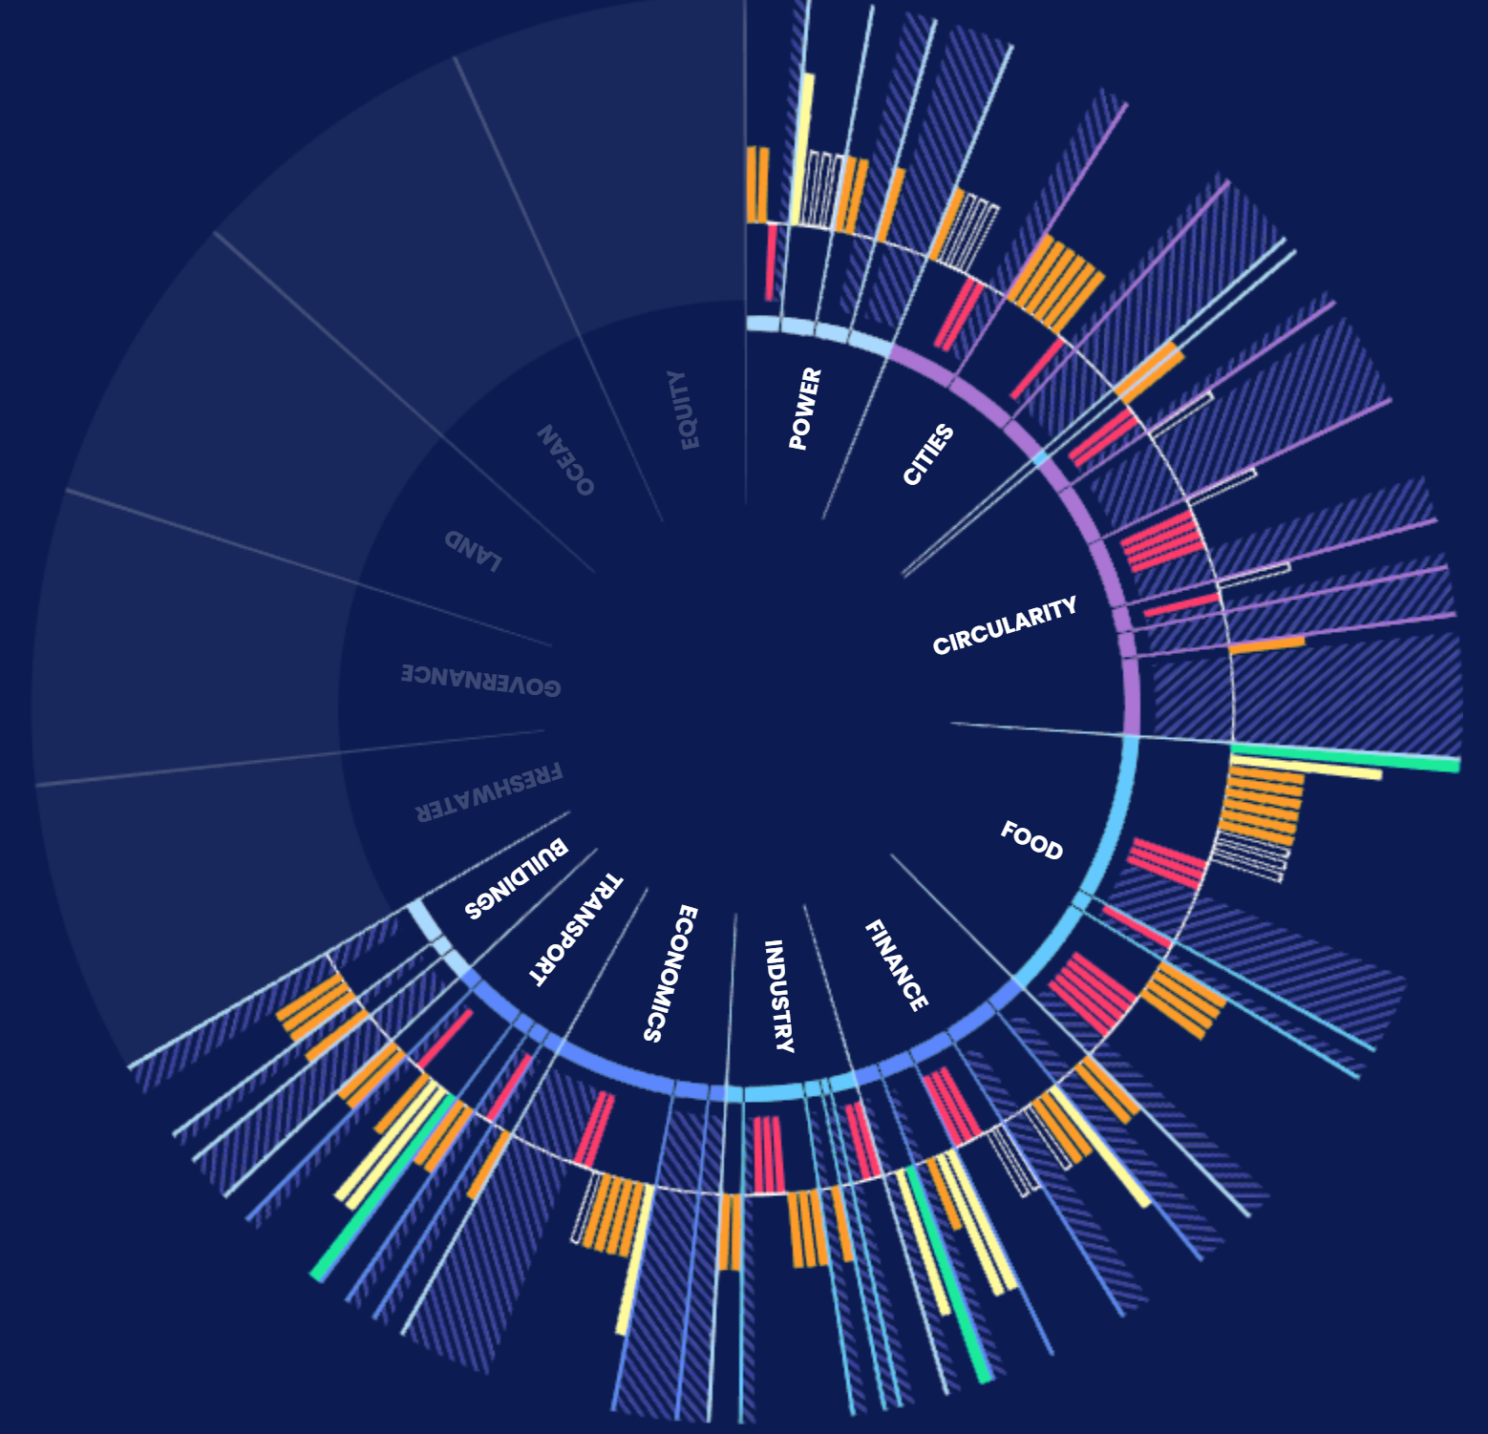
For more information
VISIT: SYSTEMSCHANGELAB.ORG/FOOD-AND-AGRICULTURE
EMAIL: CONTACT@SYSTEMSCHANGELAB.ORG

Slide 28
Quick tips on using the Systems Change Lab platform to create additional slides
Continue to learn how to find and highlight additional indicators

Slide 29
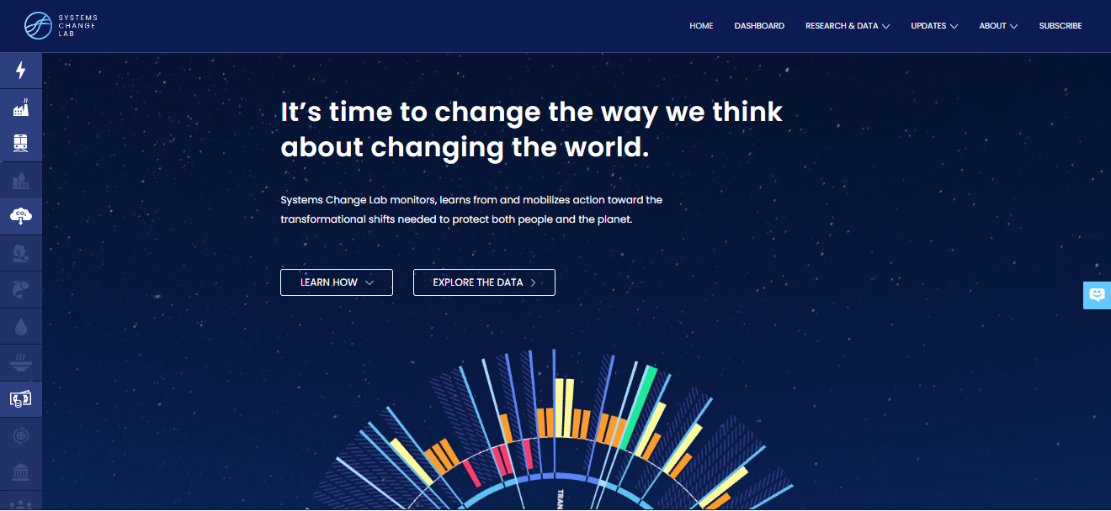
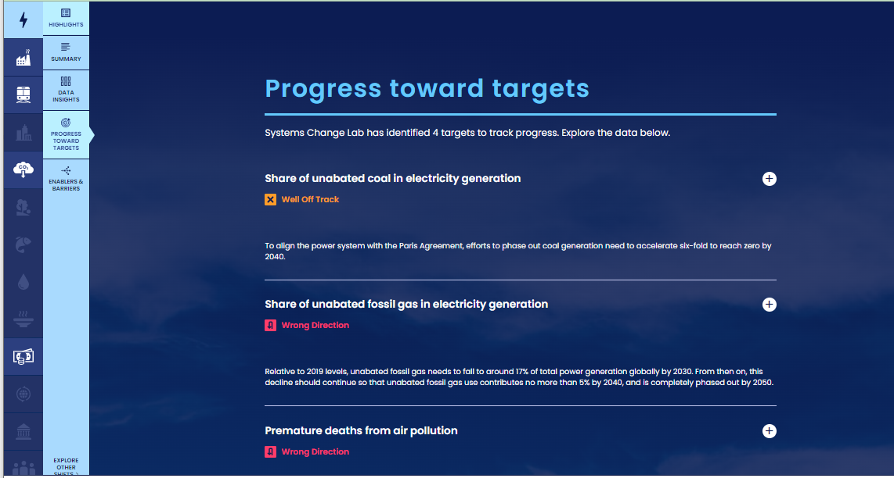
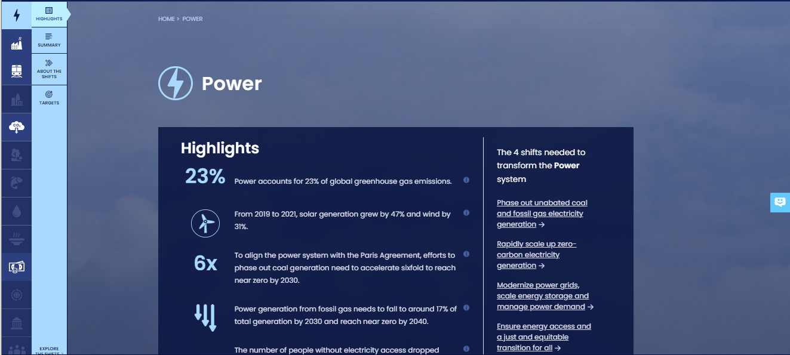
How to highlight a different indicator
Find your desired indicator on systemschangelab.org system pages
1. Select a system
3. Scroll down page to indicators and expand one
2. Select a shift

Slide 30



Alternatively, search for an indicator on the dashboard
1. Navigate to the dashboard
3. Search an indicator and then click explore data
2. Select grid view
4.
Notes:
Find your desired indicator on https://systemschangelab.org/
Look through System Page ( https://systemschangelab.org/power)
OR search the dashboard ( https://systemschangelab.org/dashboard) & select "EXPLORE DATA >" on your desired indicator

Slide 31

Pick a chart view and click the download button

Slide 32


Next, add the chart to your slide deck
1. Select "Insert" and "Pictures" on the toolbar
2. Select chart from the downloads folder and open

Slide 33

Add context from the indicator write-up as desired

