Slide 1


Economics
Last updated April 2025 | systemschangelab.org/economics
Notes:
Photo by Sangga Rima Roman Selia via Unsplash: https://unsplash.com/photos/people-inside-building-RUA9K_rEzq4

Slide 2

Systems Change Lab
It’s time to change the way we think about changing the world.
Systems Change Lab monitors, learns from and mobilizes action toward the transformational shifts needed to protect both people and the planet.
The data platform identifies and tracks key shifts in our global systems that, when achieved together, can spur transformational change.

Slide 3















Interconnected systems
Power
Industry
Transport
Cities
Buildings
Carbon Removal
Land & Forests
Ocean
Freshwater
Food &
Agriculture
Finance
Circular
Economy
Governance
Social Inclusion & Equity
Economics

Slide 4

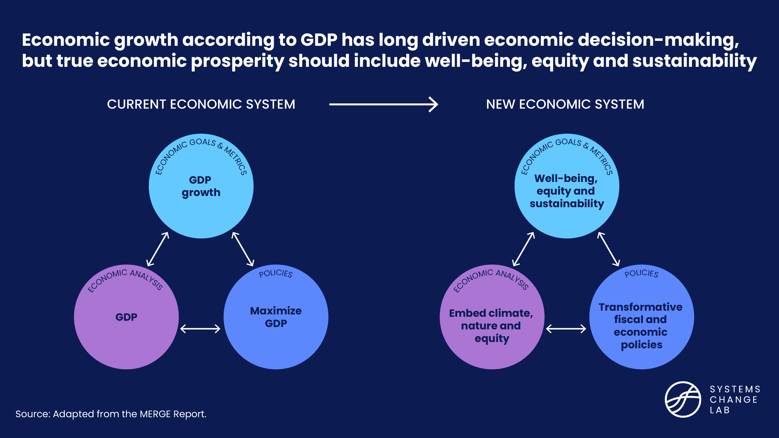
The economic system

Slide 5

The three shifts needed to
transform the economic system
Integrate new prosperity metrics into economic planning and policymaking
Transform economic policies to accelerate action for climate, nature and equity
Embed climate, nature and equity into economic analysis
Notes:
Integrate new prosperity metrics into economic planning and policymaking
Economic growth, measured primarily by GDP, has long been a central goal of economic planning and policymaking. While GDP growth has supported positive trends such as poverty reduction, it has been accompanied by societal costs like climate change, environmental degradation and increasing inequality.
Embed climate, nature and equity into economic analysis
Policies aimed at climate, nature and equity have major implications for traditional economic goals, and vice versa. However, the economic analysis toolkit used to understand the economy and evaluate policies is only beginning to incorporate them.
Transform economic policies to accelerate action for climate, nature and equity
Governments use economic policies to meet national development goals, and fiscal policies in particular are critical to address climate change, protect biodiversity and promote equity. Governments can better tax environmental harms and invest in the green economy.
Photo by World Economic Forum: https://www.flickr.com/photos/worldeconomicforum/54308681570/

Slide 6
Highlights
Global GDP grew over 7,000% between 1960 and 2024, and while it has contributed to positive societal gains, it has come at a high cost to well-being, equity and planetary sustainability.
Most countries are not achieving development within safe ecological and social limits: seven out of eight global earth system boundaries have been breached.
Over 71% of OECD countries have developed multidimensional well-being initiatives in an effort to move beyond GDP, but most are not yet using these to inform policy design and implementation.
A coalition of policymakers from 90 countries’ ministries of finance recently called for governments to place an “ever-greater emphasis” on mainstreaming climate action.
Each year, governments spend $1.7 trillion on environmentally harmful subsidies while the estimated need for public investment in climate measures and nature-based solutions is $1.3-$2.6 trillion and $439 billion, respectively, by 2030.

Slide 7
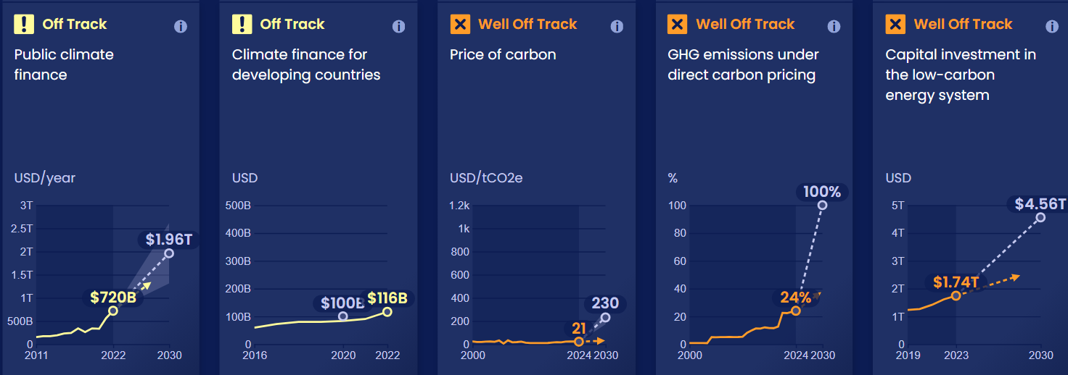
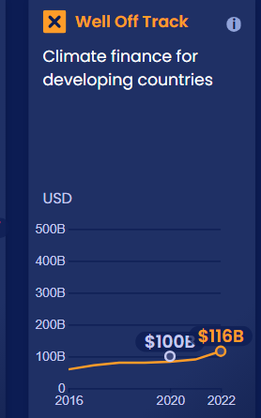
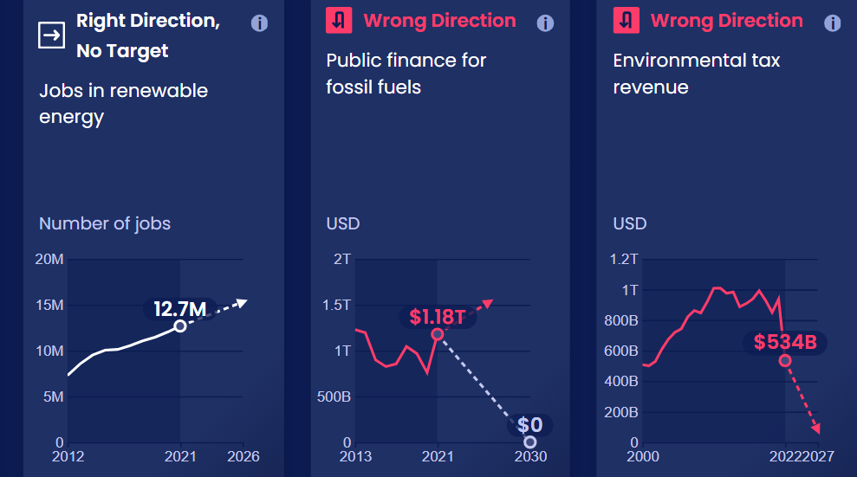
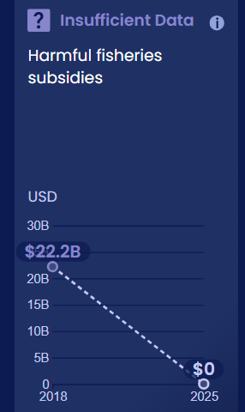
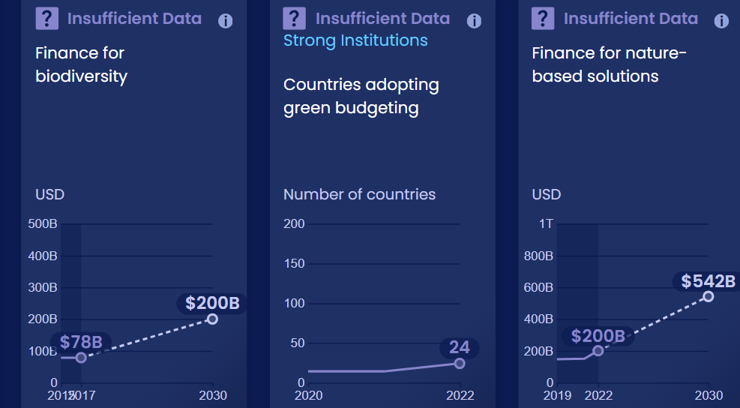
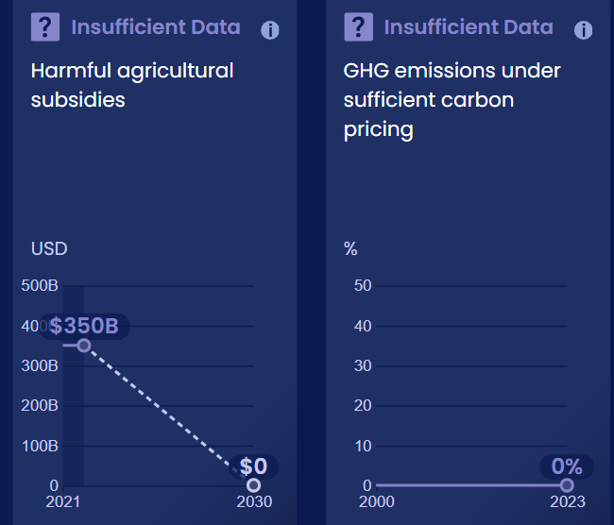
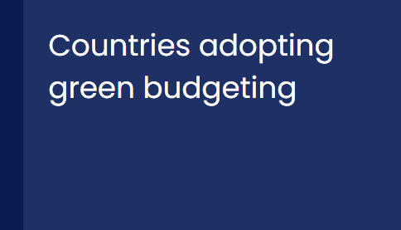
Progress toward targets
In this system, we have identified 21 outcome indicators. Out of the 21 indicators we've evaluated, 7 are moving in the right direction and none are on track.

Slide 8
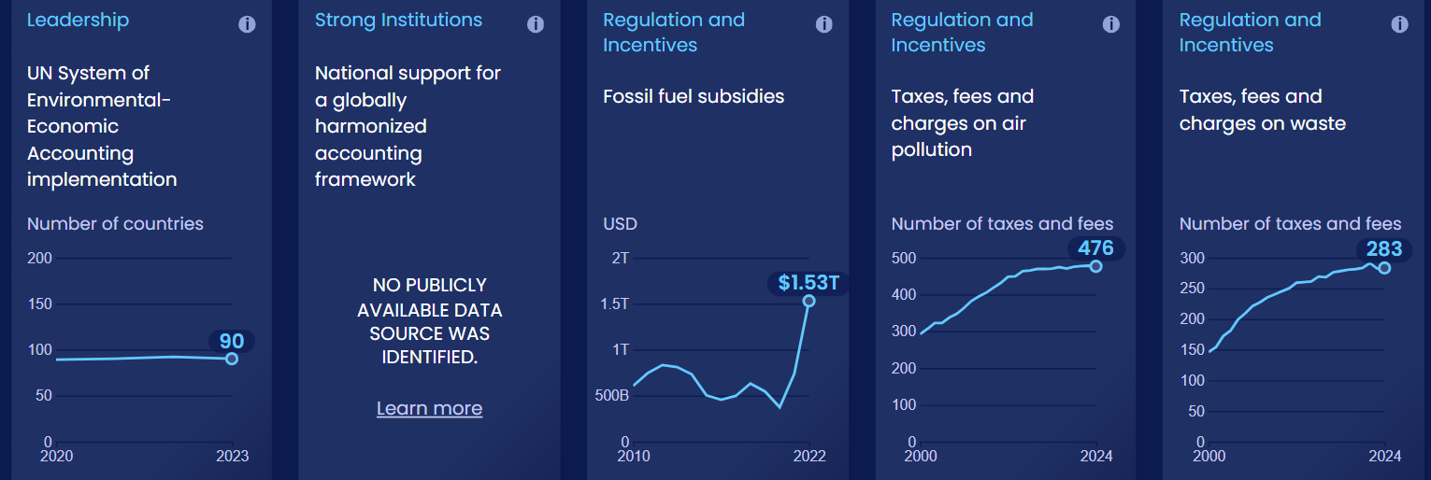
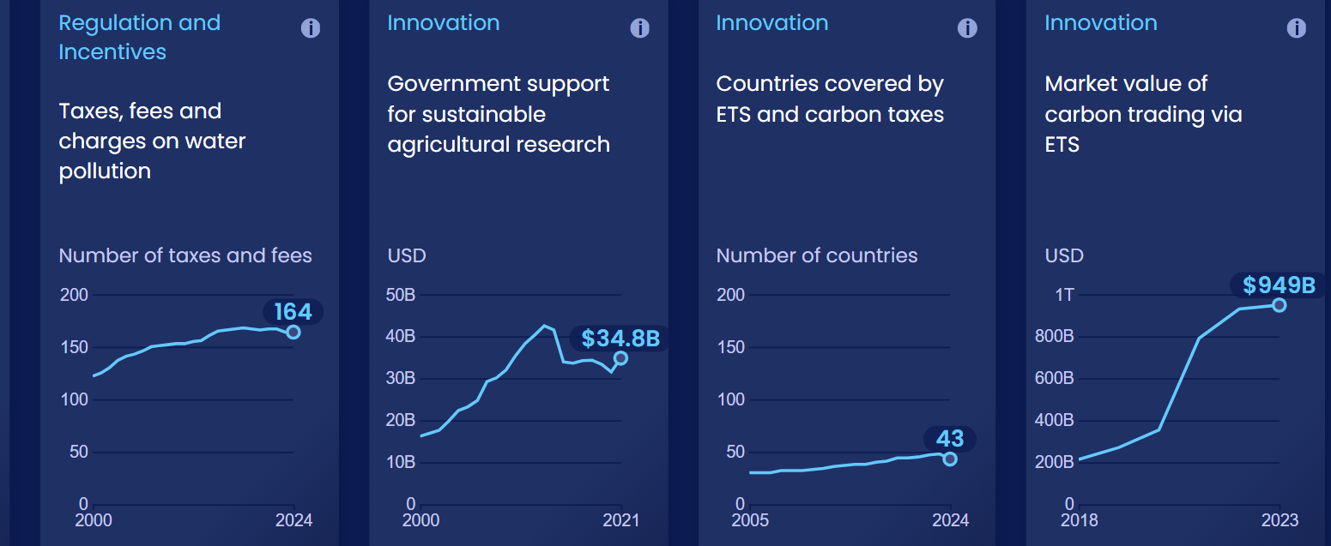
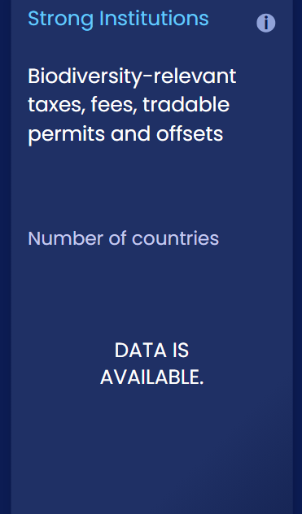
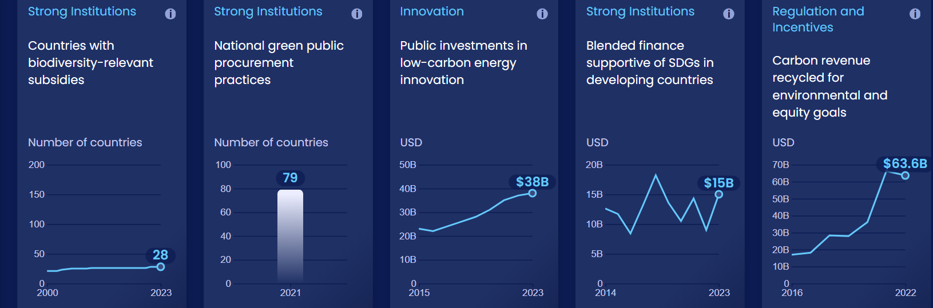
Enablers and barriers
In this system, we have identified 30 enablers and barriers to change.

Slide 9
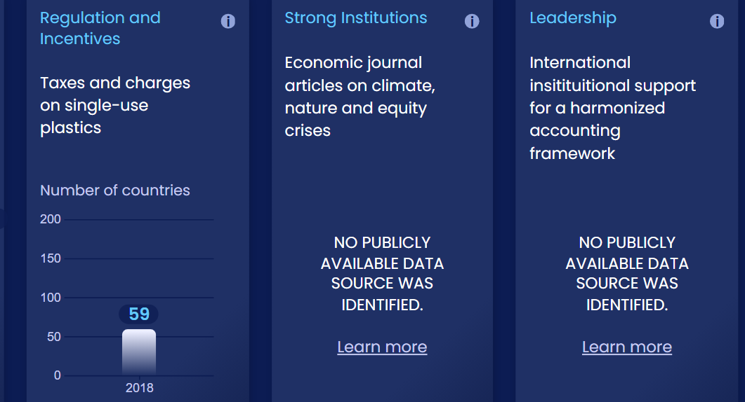
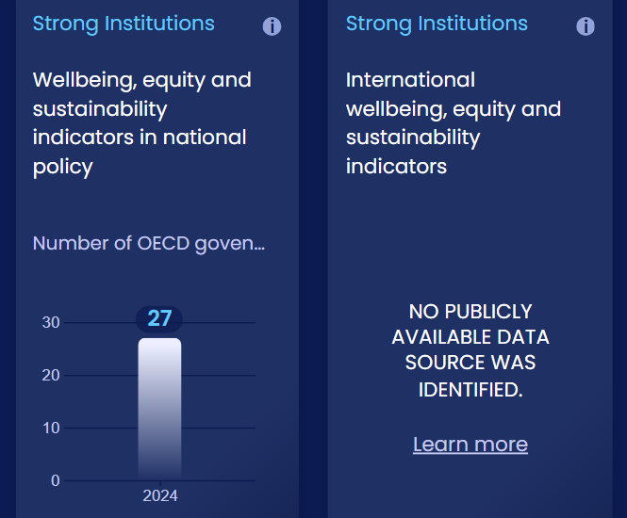
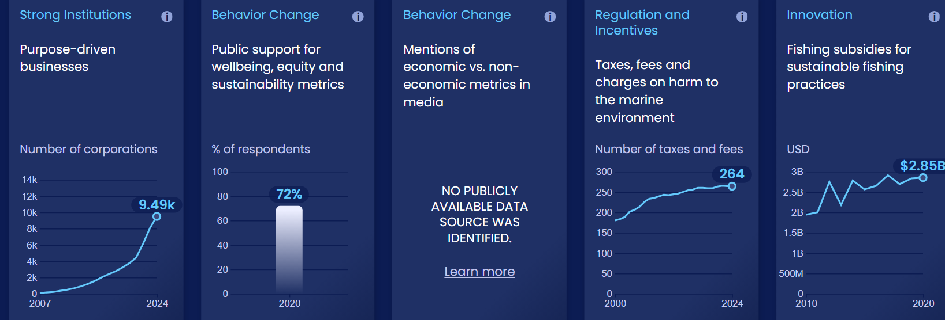
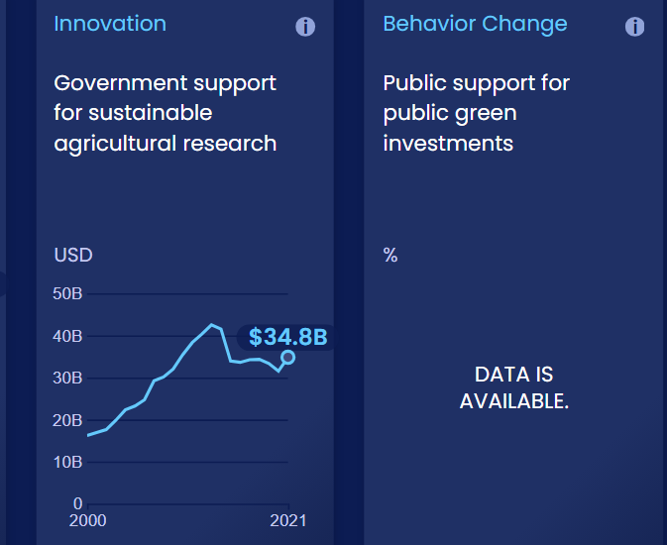
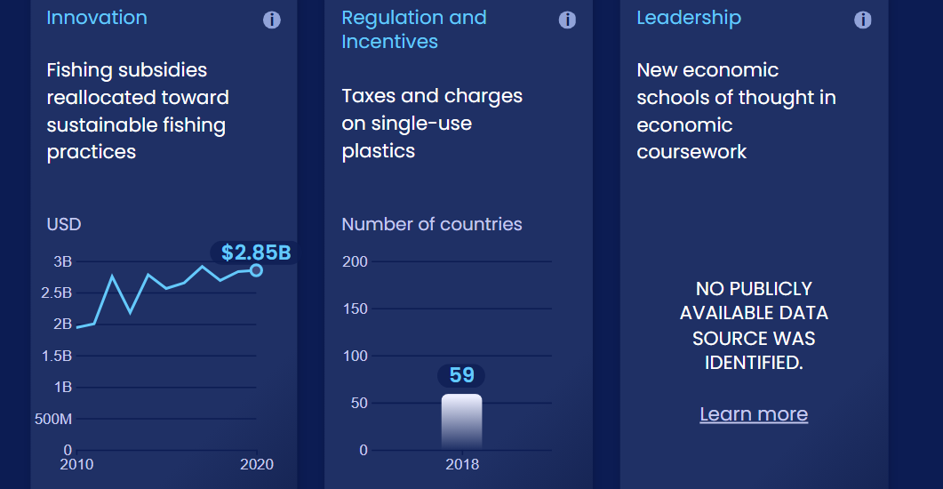
Enablers and barriers

Slide 10

Integrate new prosperity metrics into economic planning and policymaking
SHIFT
Notes:
Photo by Nicholas Sorrenti via Unsplash: https://unsplash.com/photos/a-bee-on-a-flower-in-the-sun-zFg_JUKnuN0

Slide 11
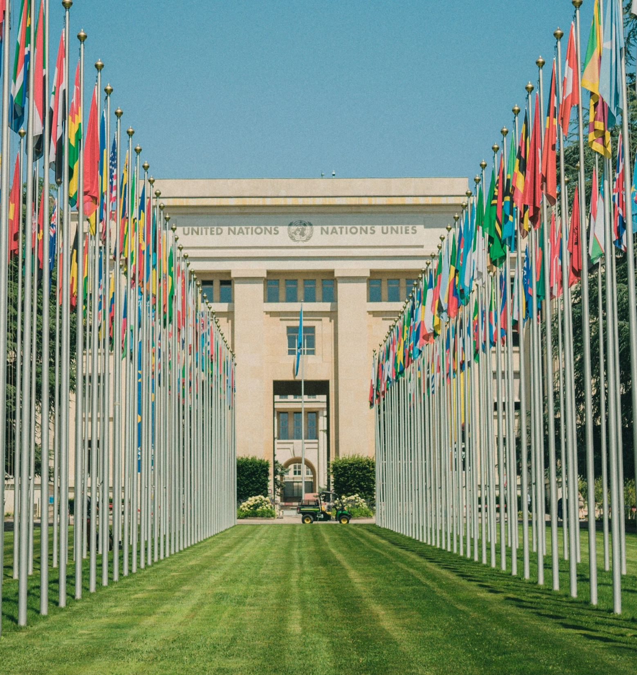
The UN’s System of National Accounts (SNA) is the international standard for measuring economic progress, with GDP as the primary metric.
The SNA must be revised to include dimensions of wellbeing, equity and sustainability.

Slide 12
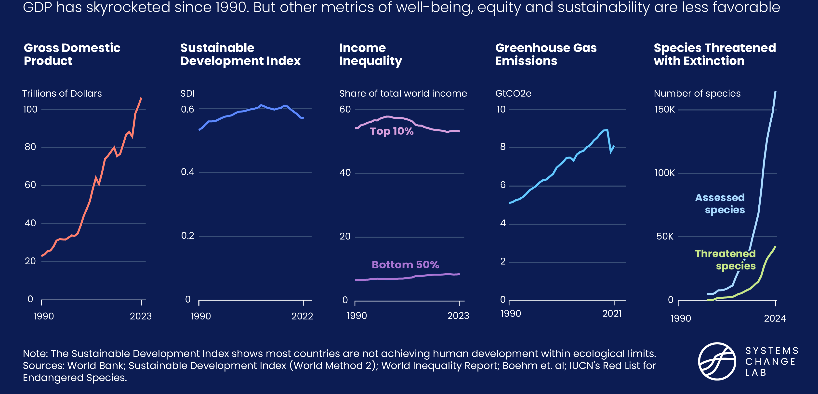
Growth in GDP has come at a high cost to people and planet

Slide 13
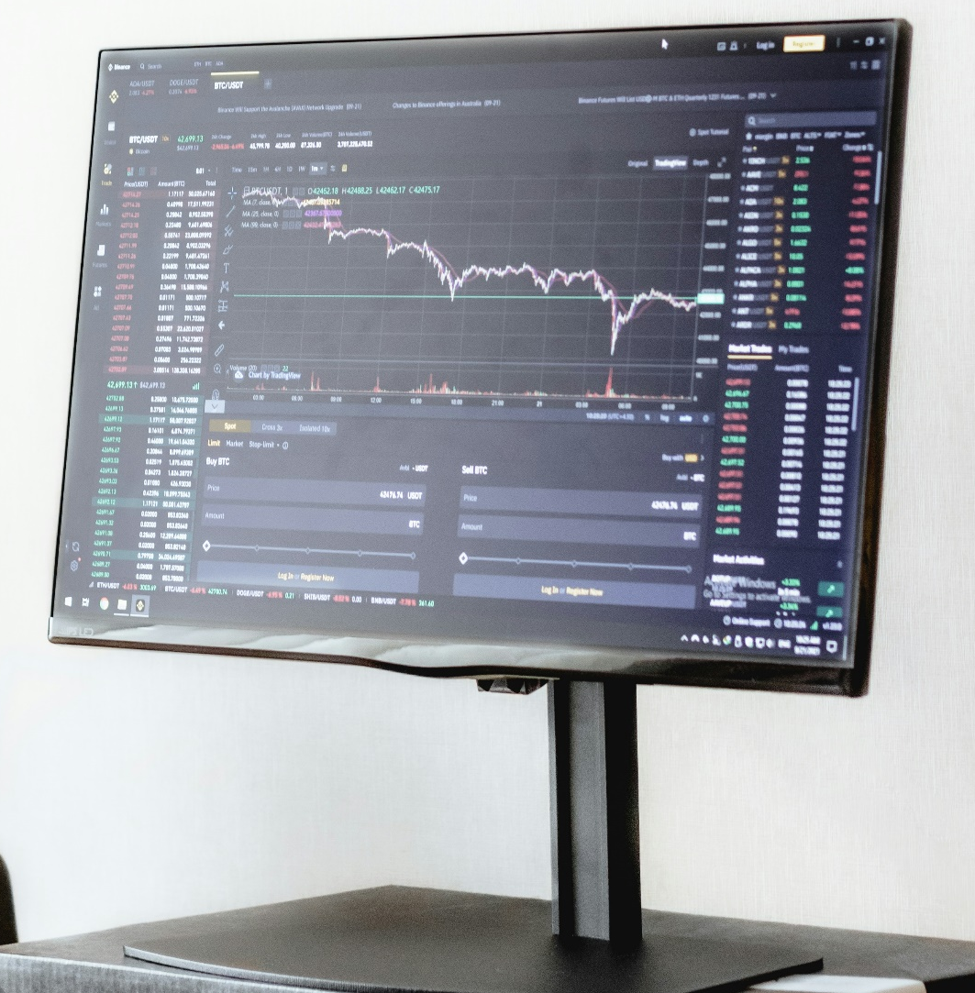
Though there is a growing consensus on the aspects of wellbeing, equity and sustainability that should drive economic policy, there is a no consensus on which specific metrics to use.
A harmonized dashboard of indicators that complement GDP must be accepted at the international level.

Slide 14
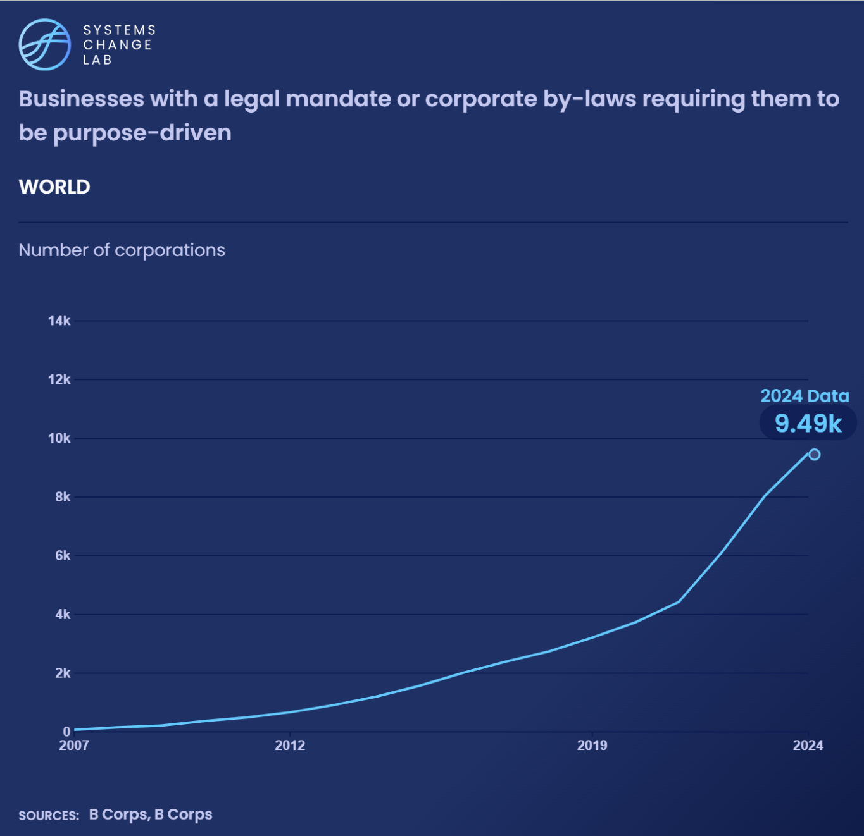
Increasingly , businesses are being called upon to reorient their priorities to align with well-being, equity and sustainability goals and adopt associated key performance metrics.

Slide 15
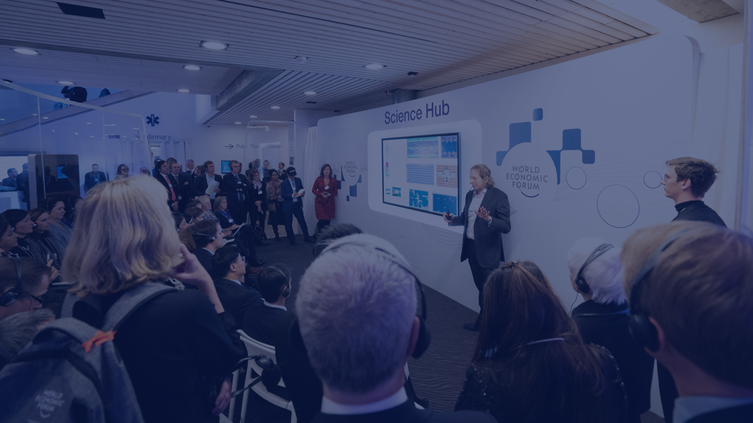
Embed climate, nature and equity into economic analysis
SHIFT
Notes:
Photo by Evangeline Shaw via Unsplash: https://unsplash.com/photos/people-gathering-inside-the-building-BdV23FLkmxQ

Slide 16
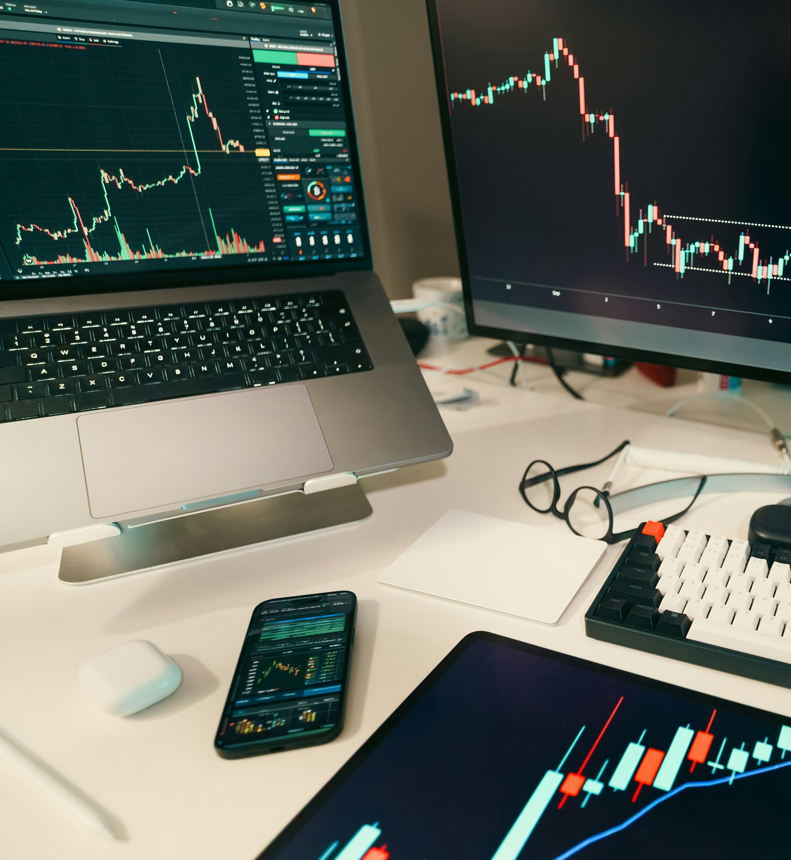

The analytical approaches to economics were not designed to consider the interactions between the economy, climate, nature and equity, and often assume low-carbon, nature preserving action comes at a cost.
New analytical methods highlight the economic gains of these actions as well as the cost of inaction.
Notes:
Photo: Jakub Żerdzicki via Unsplash: https://unsplash.com/photos/stock-charts-are-displayed-on-multiple-screens-VM_6EtTAfDQ

Slide 17
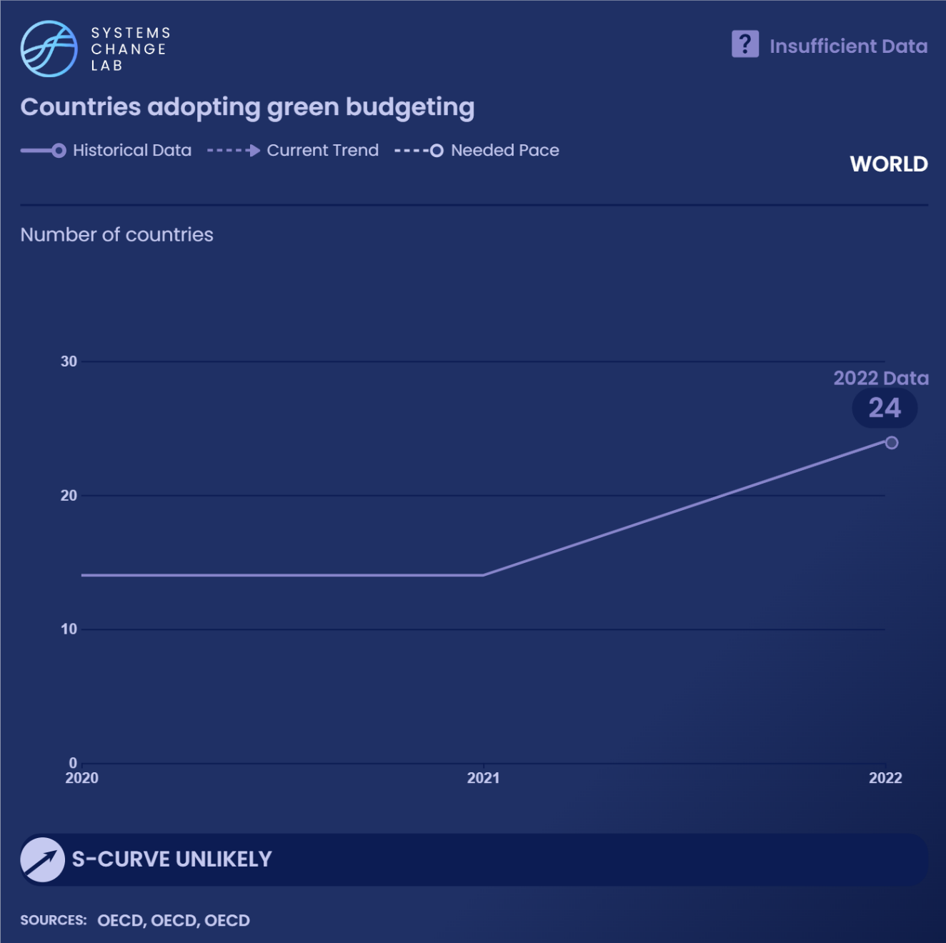
Green budgeting, according to the OECD, “refers to the use of budgetary policy-making tools to better understand environmental impact of spending choices, and ensure public budgets are aligned with climate and environmental objectives.”

Slide 18
The economics taught in universities equip economists with the tools needed to inform economic analysis, economic progress indicators and policy decisions.
These tools must have applications to climate, equity and nature challenges and that these skills are taught to students.
Notes:
Photo: Miguel Henriques via Unsplash: https://unsplash.com/photos/man-sitting-on-stage-E0bIdzi8zoQ

Slide 19

Transform economic policies to accelerate action for climate, nature and equity
SHIFT
Notes:
Photo by World Economic Forum via Flickr: https://www.flickr.com/photos/worldeconomicforum/52086276524/in/album-72177720299082712/

Slide 20
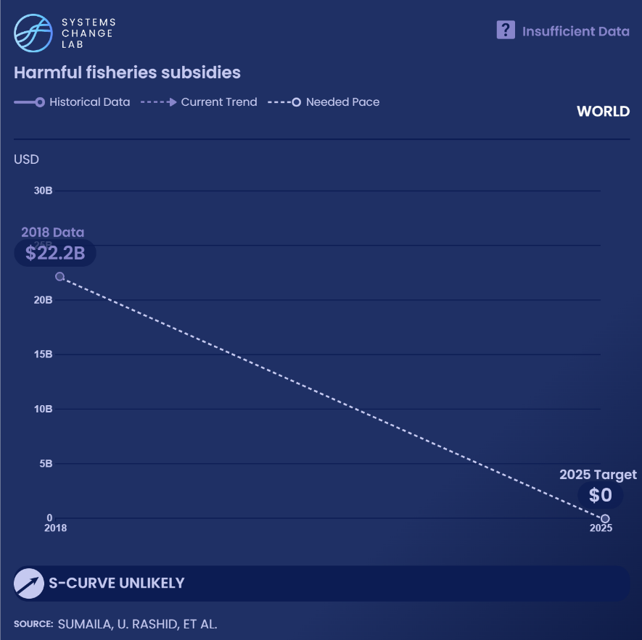
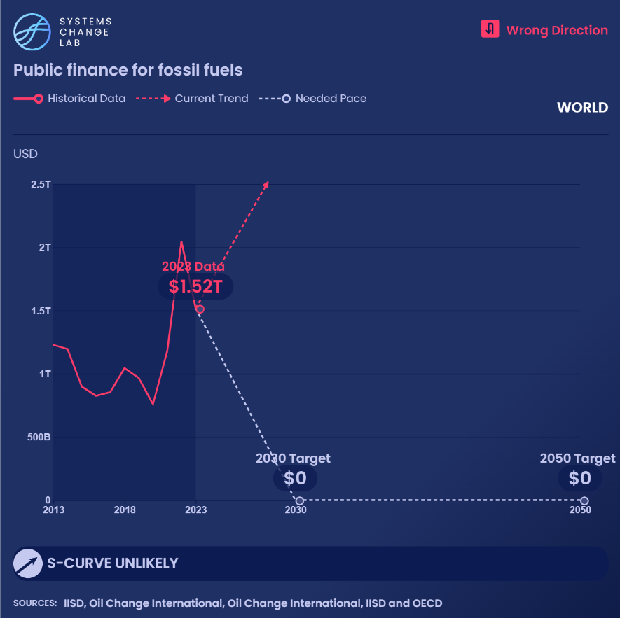
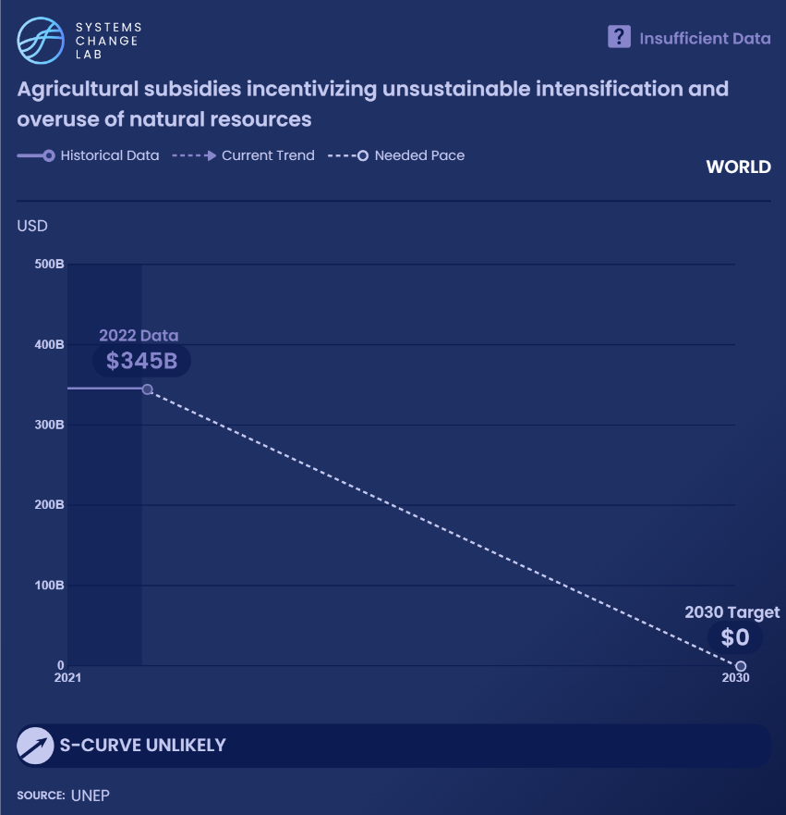
Harmful subsidies must be redirected to sustainable practices

Slide 21
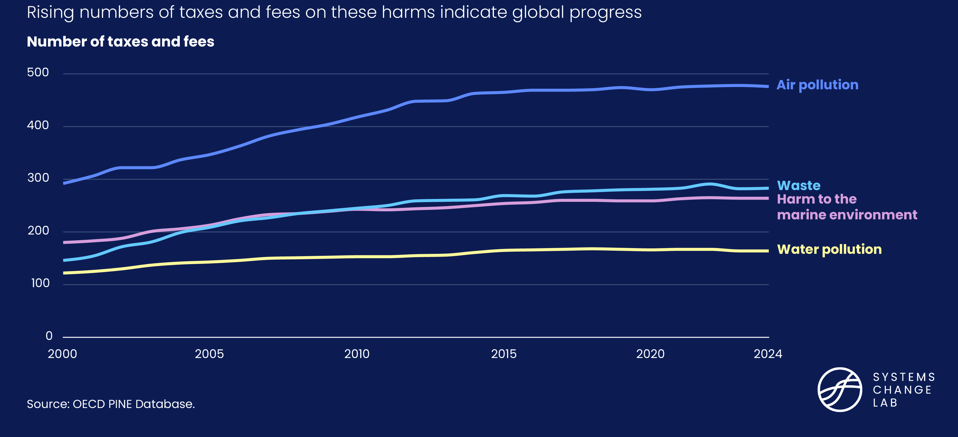
Pricing environmental harms can incentivize positive change

Slide 22
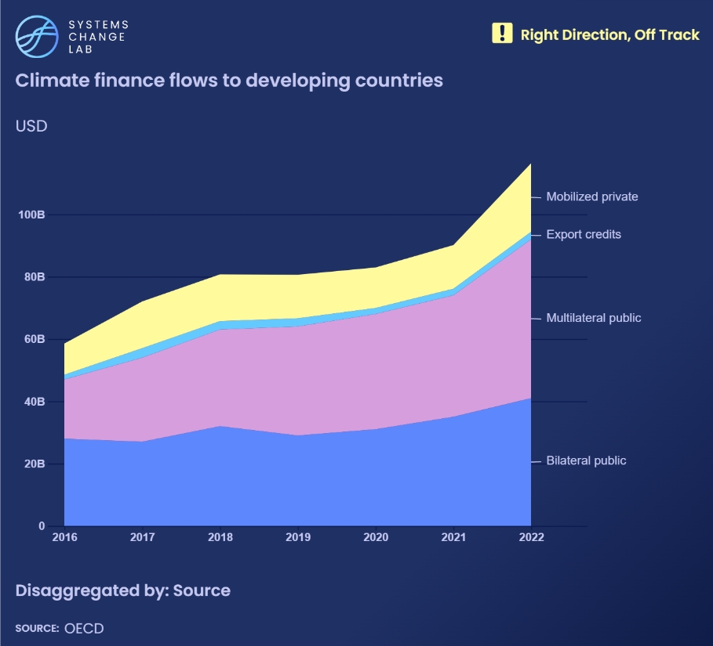
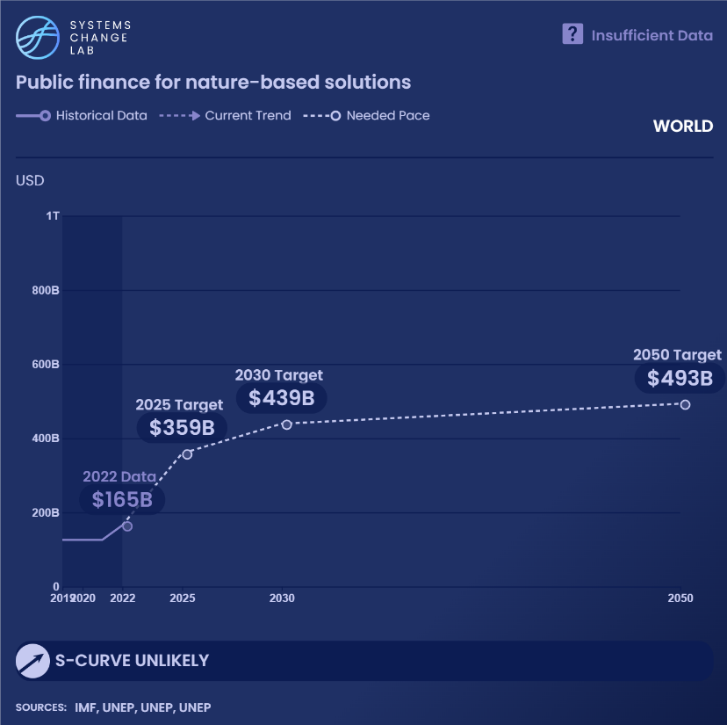
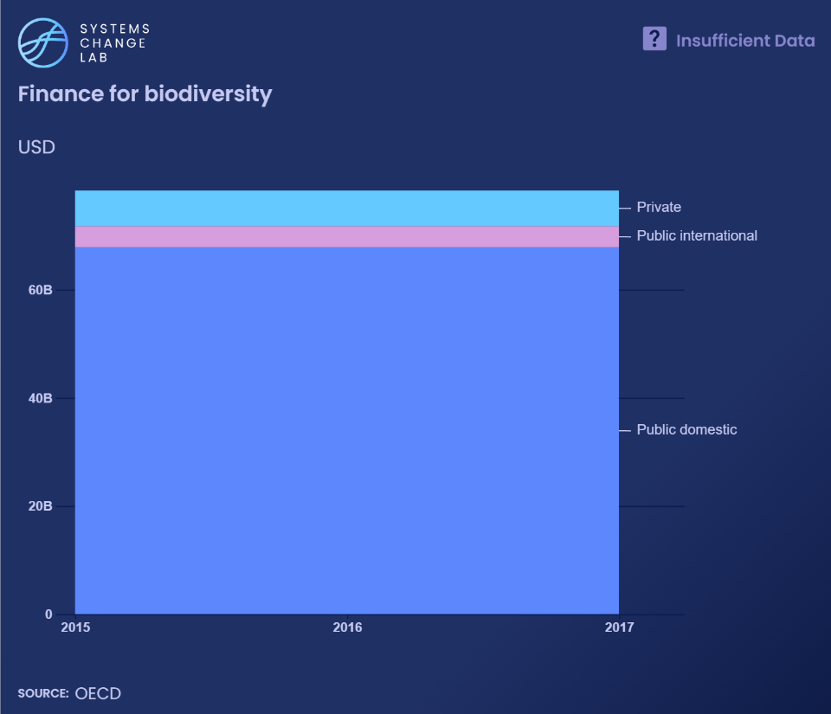
Public finance is crucial for innovation, equity and climate action

Slide 23
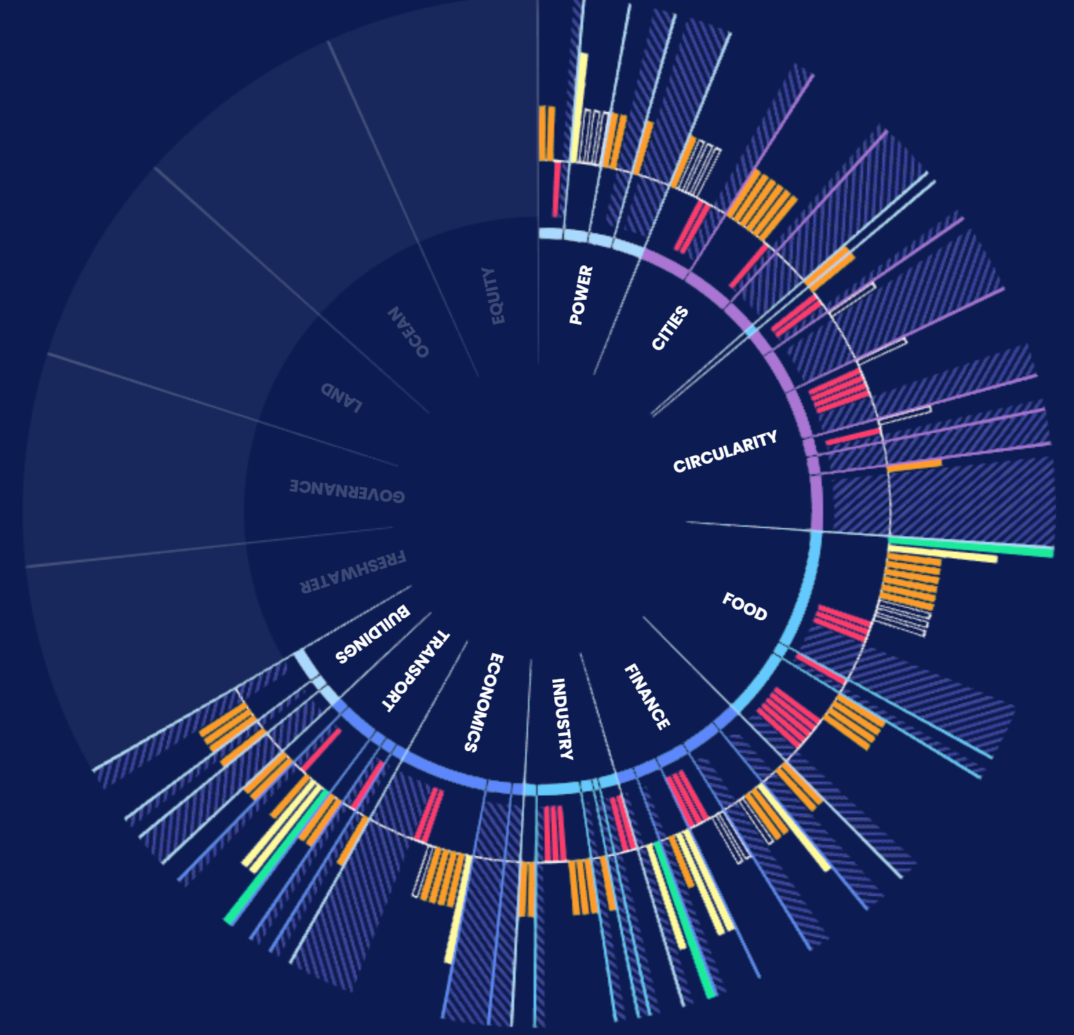
For more information
VISIT: SYSTEMSCHANGELAB.ORG/ECONOMICS
EMAIL: CONTACT@SYSTEMSCHANGELAB.ORG

Slide 24
Quick tips on using the Systems Change Lab platform to create additional slides
Continue to learn how to find and highlight additional indicators

Slide 25
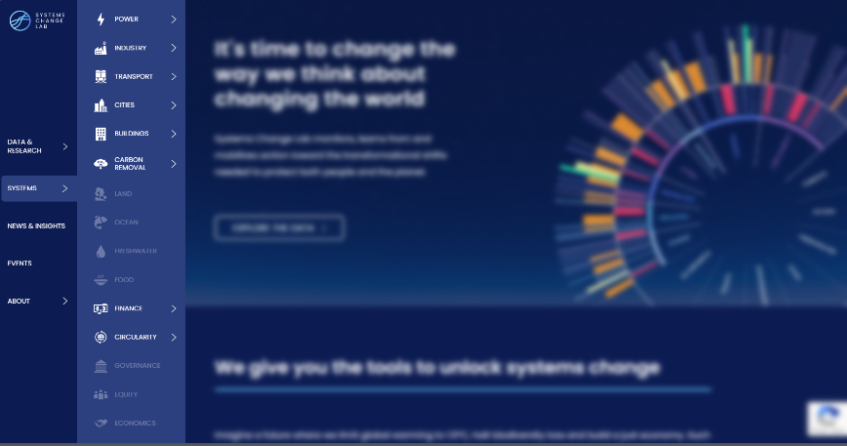
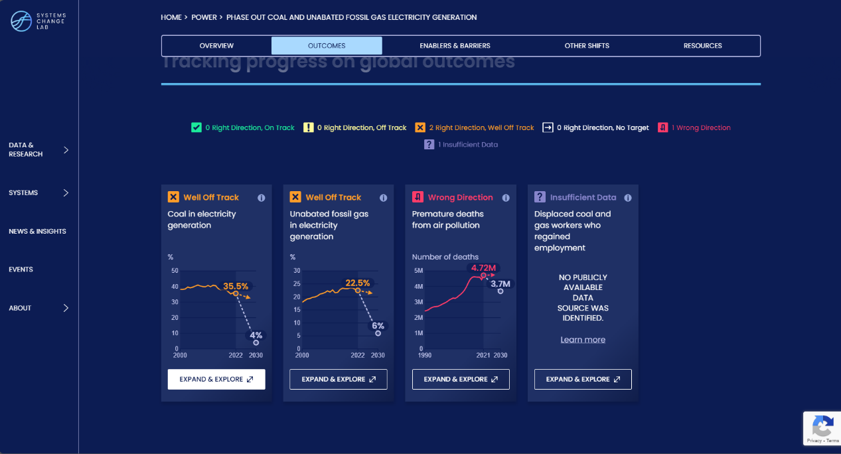
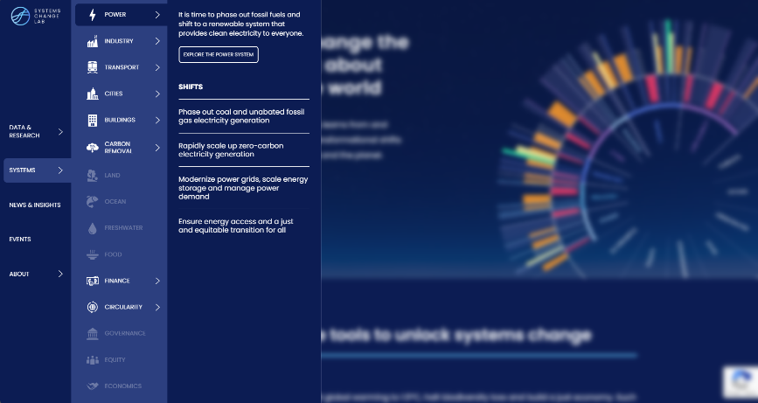
How to highlight a different indicator
Find your desired indicator on systemschangelab.org system pages
1. Select a system
3. Scroll down page to indicators and expand one
2. Select a shift

Slide 26
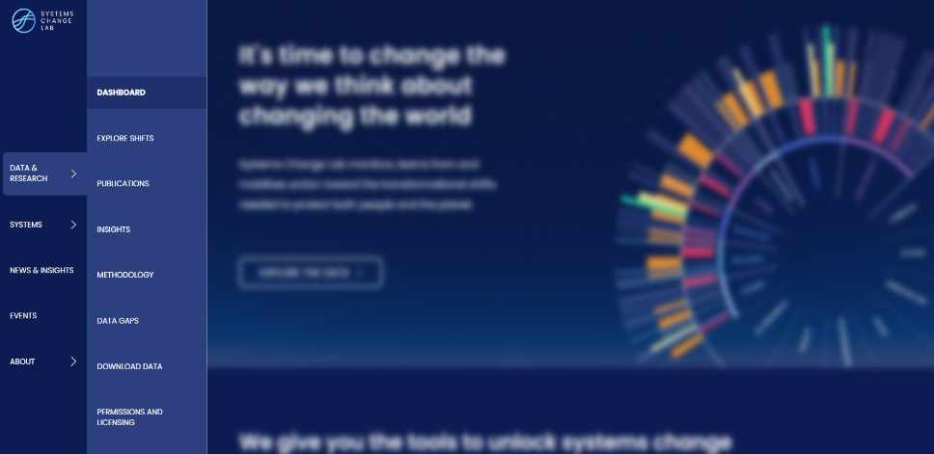
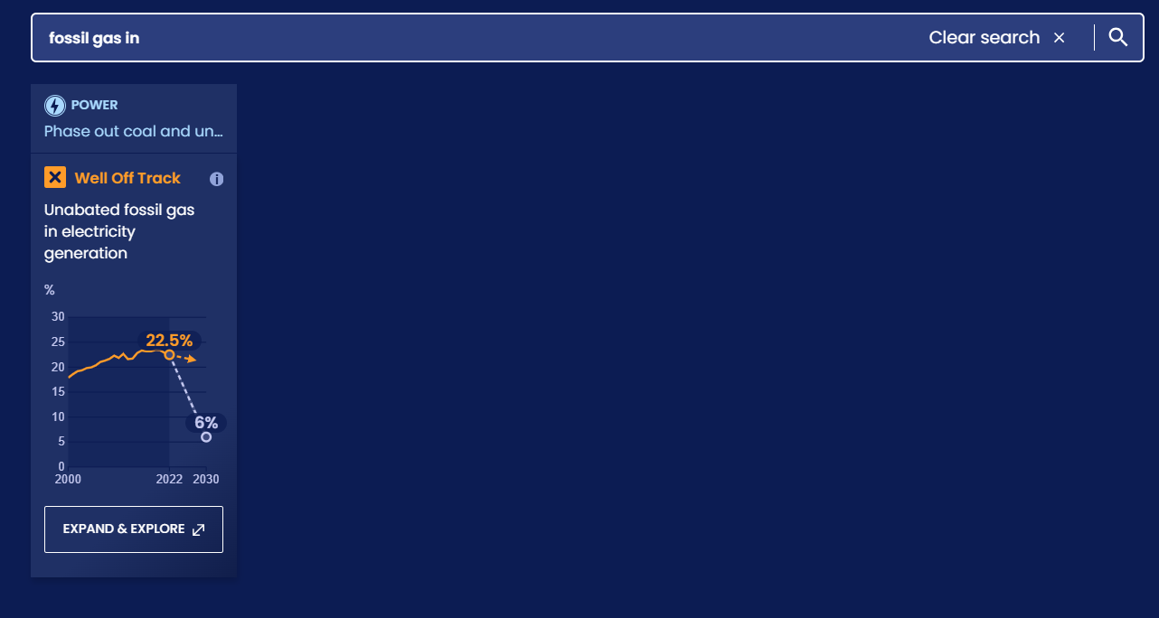
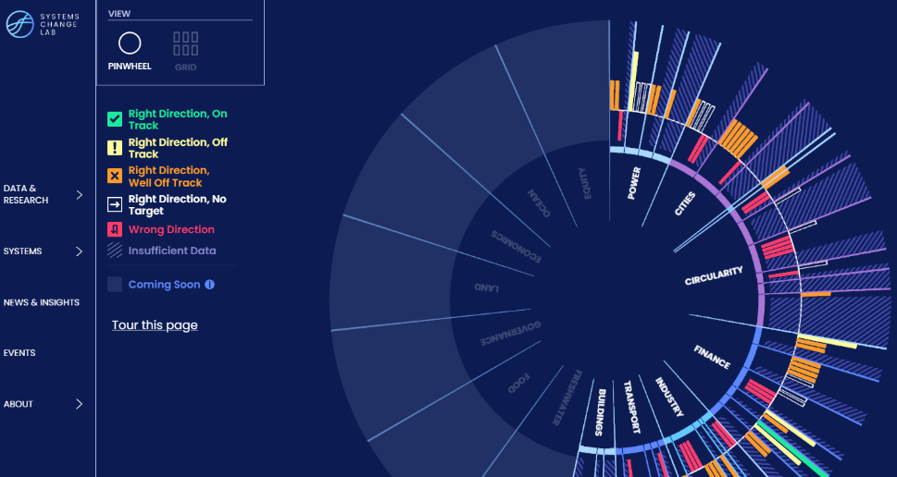
Alternatively, search for an indicator on the dashboard
1. Navigate to the dashboard
3. Search an indicator and then click expand & explore
2. Select grid view
4.
Notes:
Find your desired indicator on https://systemschangelab.org/
Look through System Page ( https://systemschangelab.org/power)
OR search the dashboard ( https://systemschangelab.org/dashboard) & select "EXPLORE DATA >" on your desired indicator

Slide 27
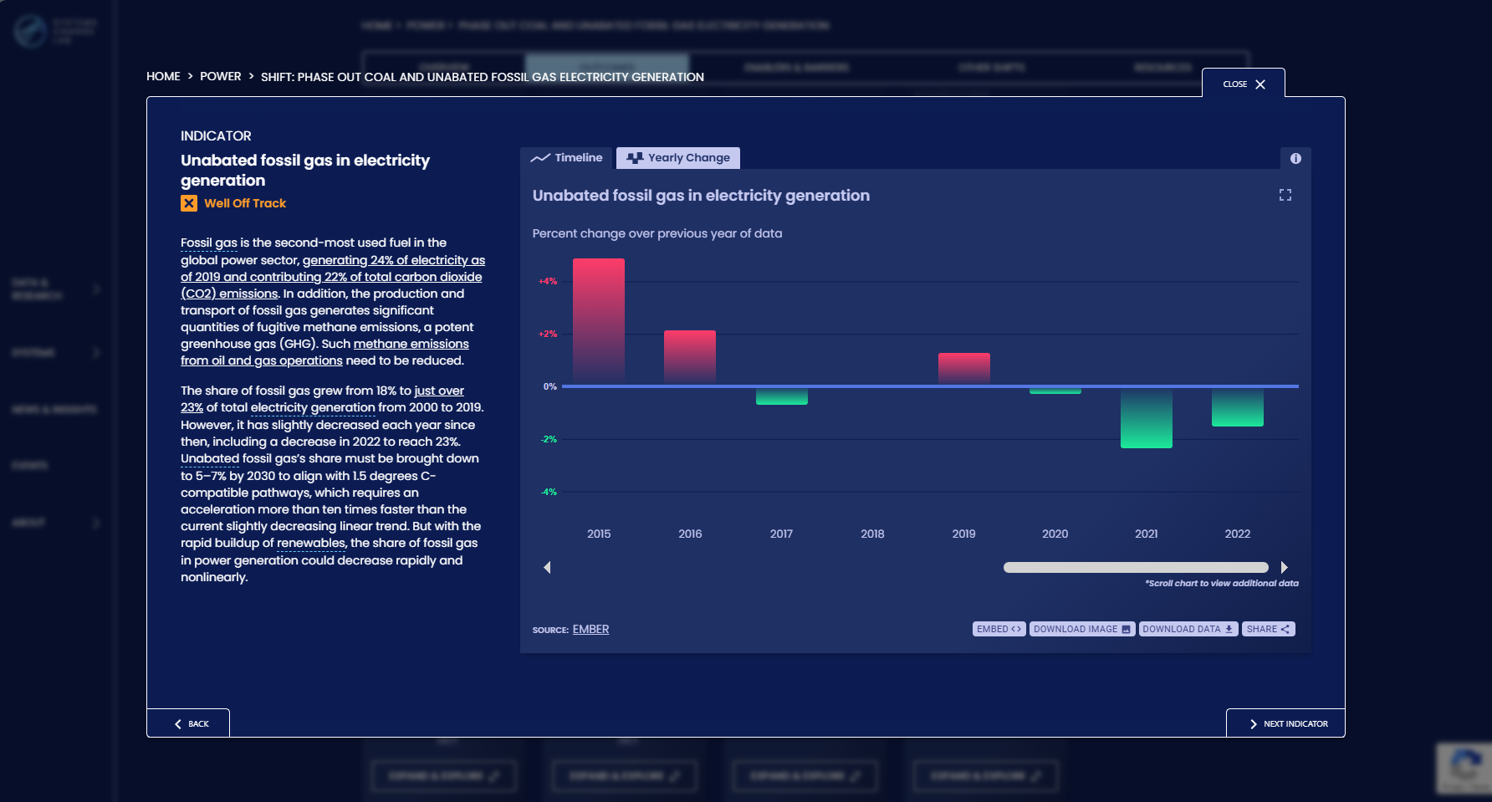
Pick a chart view and click the download button

Slide 28
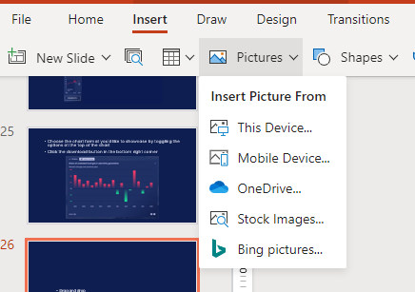
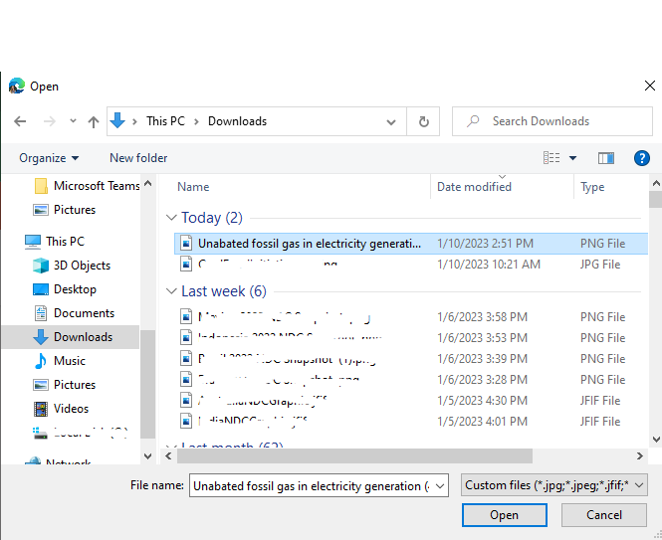
Next, add the chart to your slide deck
1. Select "Insert" and "Pictures" on the toolbar
2. Select chart from the downloads folder and open

Slide 29
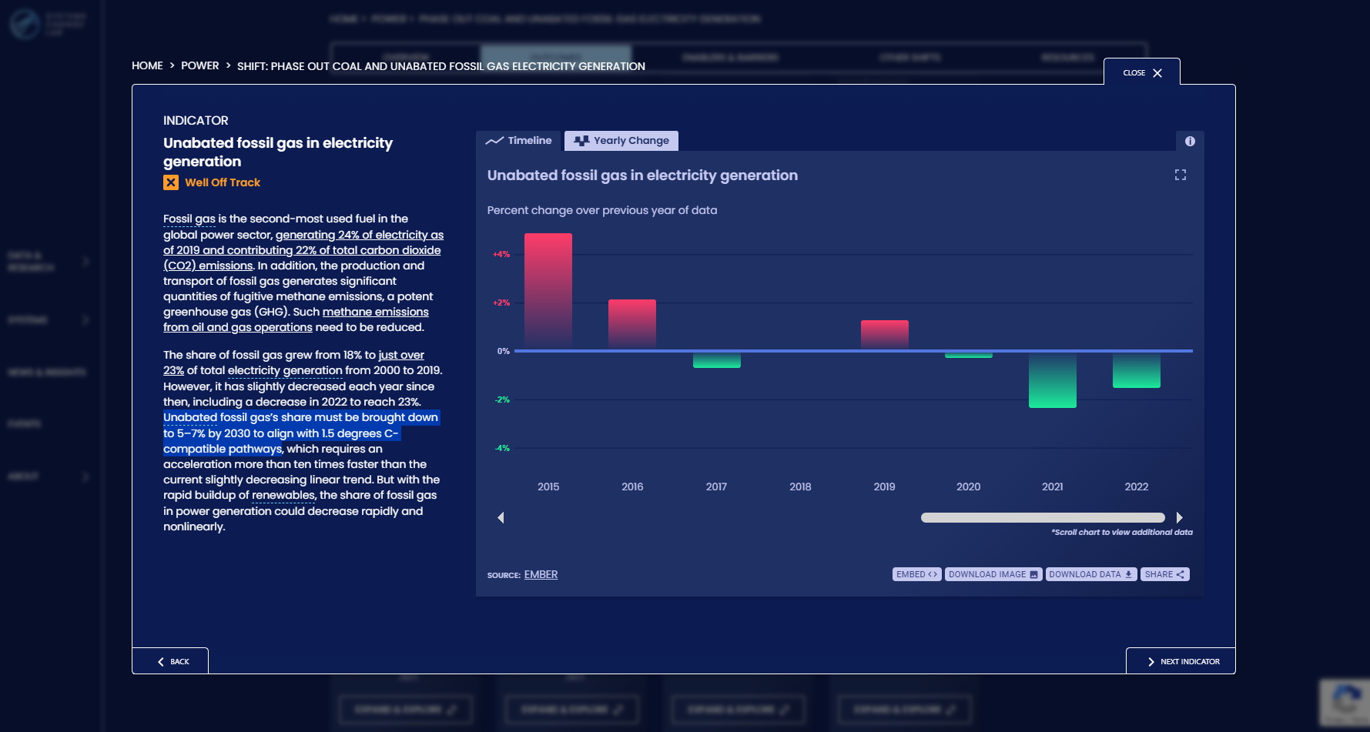
Add context from the indicator write-up as desired

