Slide 1
Transport
Last updated December 2024 | systemschangelab.org/transport
Notes:
Photo by Pema Lama: https://unsplash.com/photos/22taeRFsbo4

Slide 2
Systems Change Lab
It’s time to change the way we think about changing the world.
Systems Change Lab monitors, learns from and mobilizes action toward the transformational shifts needed to protect both people and the planet.
The data platform identifies and tracks key shifts in our global systems that, when achieved together, can spur transformational change.

Slide 3
Interconnected systems
Power
Industry
Transport
Cities
Buildings
Carbon Removal
Land & Forests
Ocean
Freshwater
Food &
Agriculture
Finance
Circular
Economy
Governance
Social Inclusion & Equity
Economics

Slide 4
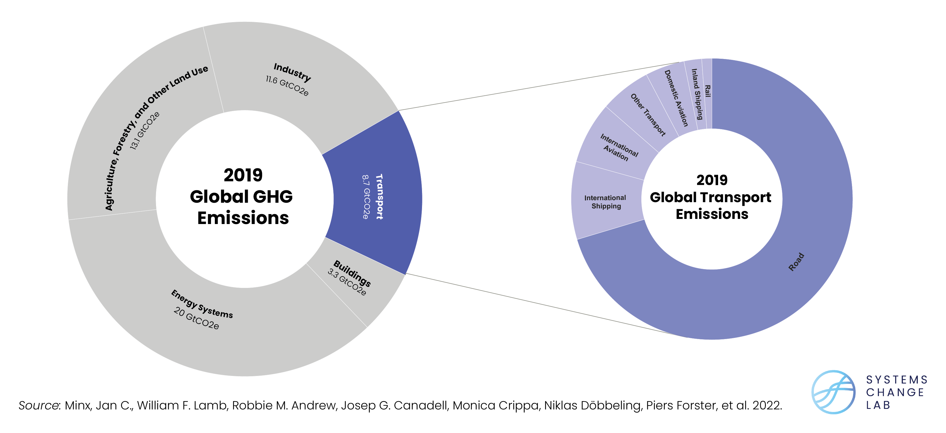
The transport system

Slide 5
The five shifts needed to transform the transport system
Guarantee reliable access to safe and modern mobility
Transition to zero-carbon cars and trucks
Reduce avoidable vehicle and air travel
Shift to public, shared and non-motorized transport
Transition to zero-carbon shipping and aviation
Notes:
Guarantee reliable access to safe and modern mobility
All people deserve access to safe transport and mobility options. It is important that the transition of the world’s energy systems to decarbonized travel modes is accomplished equitably in a way that provides opportunity for everyone.
Reduce avoidable vehicle and air travel
The most cost-effective means of reducing transport emissions is to avoid the need for motorized travel, utilizing city planning to bring opportunities closer to residents and encouraging less carbon-intensive modes of movement, such as public transport, walking and cycling.
Shift to public, shared and non-motorized transport
Achieving a sustainable, low-carbon transport system will require a comprehensive approach: avoiding unnecessary trips, shifting travel to more sustainable modes, improving transport technology and increasing access to jobs and opportunities.
Transition to zero-carbon cars and trucks
Global greenhouse gas emissions from passenger cars, trucks and buses made up almost three-quarters of total transport emissions in 2020, underlining the importance of a rapid transition away from fossil-fuel-powered vehicles.
Transition to zero-carbon shipping and aviation
Although both shipping and aviation are seen as “hard-to-decarbonize,” both sectors have pathways to a greener future. Decarbonizing shipping and aviation will require a combination of technological solutions, such as zero-emission fuels and batteries, alongside operational and efficiency improvements
Photo by William William: https://unsplash.com/photos/NndKt2kF1L4

Slide 6
Highlights
Transport accounts for 15% of global greenhouse gas emissions, and road transport alone accounted for seventy two percent of those greenhouse gas emissions in 2020.
The share of electric vehicles (EVs) in passenger car sales has begun to take off, reaching almost 9% in 2021 — double its share from the year before. With supportive policies and investments, EVs are becoming cost-competitive in many major markets.
From 2015 to 2020, over half of the top 50 emitting cities grew their transit infrastructure, but rapid transit in cities must grow 6x faster to enable a transition away from car use.
More than 200 pilot and demonstration projects for zero-emission shipping fuels are in development.

Slide 7
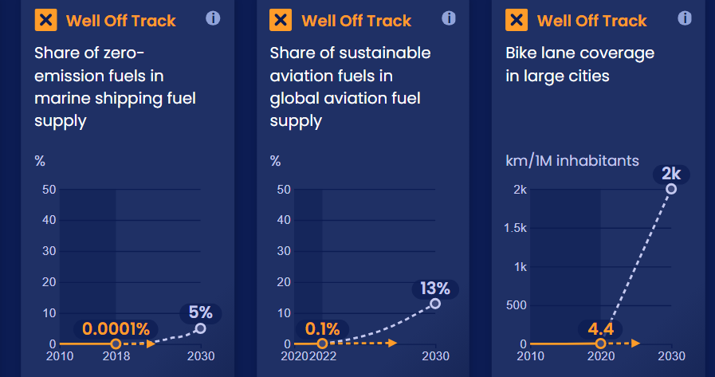
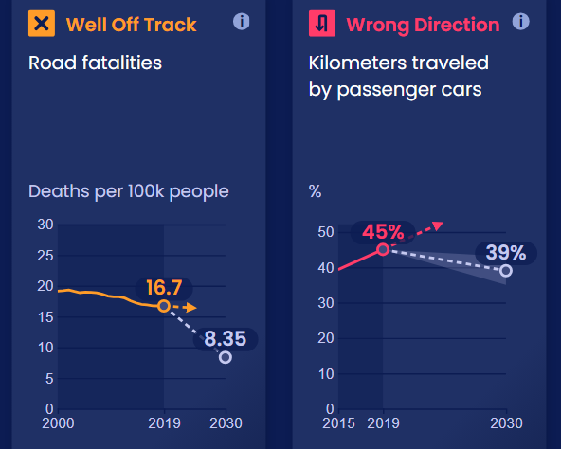
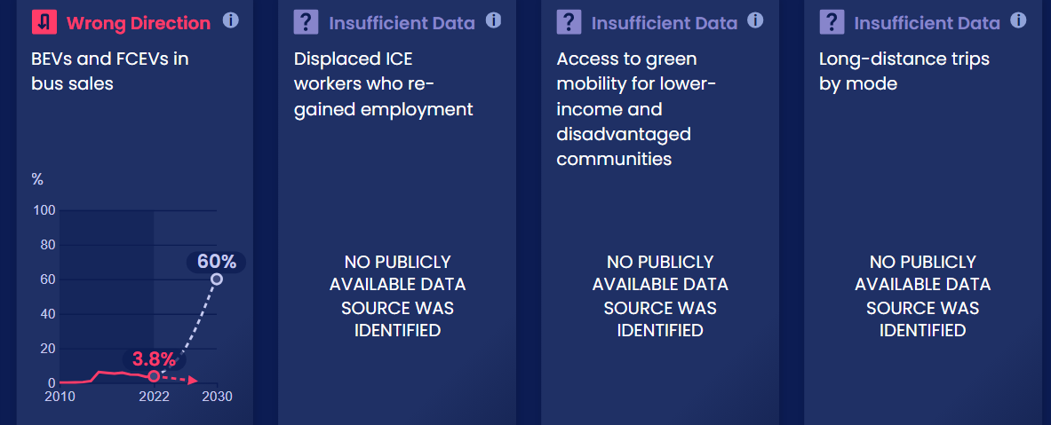
Progress toward targets
In this system, we have identified 14 target indicators. Out of the 14 targets we've evaluated, 9 are moving in the right direction and 1 is on track.

Slide 8
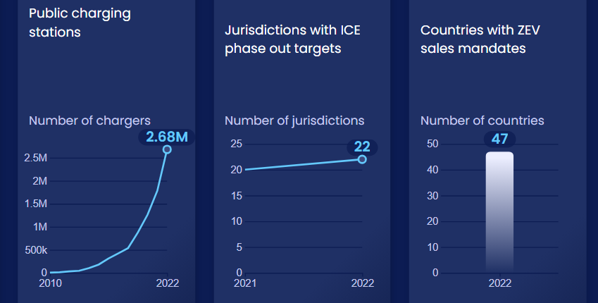
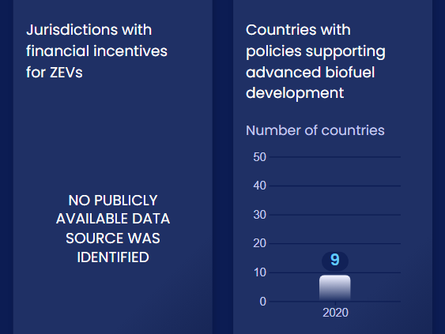
Enablers and barriers
In this system, we have identified 31 enablers and barriers to change.

Slide 9
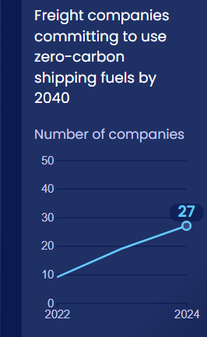
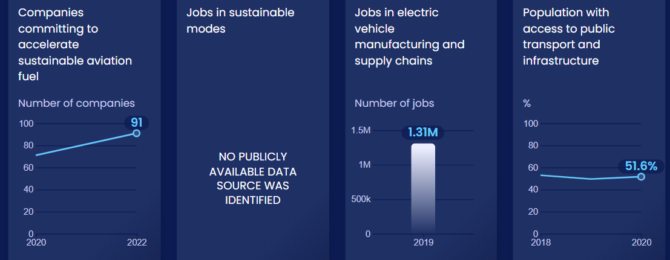
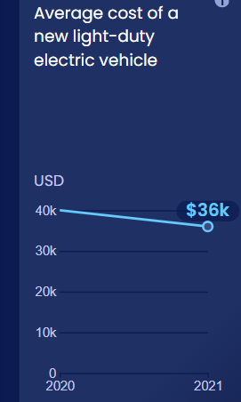
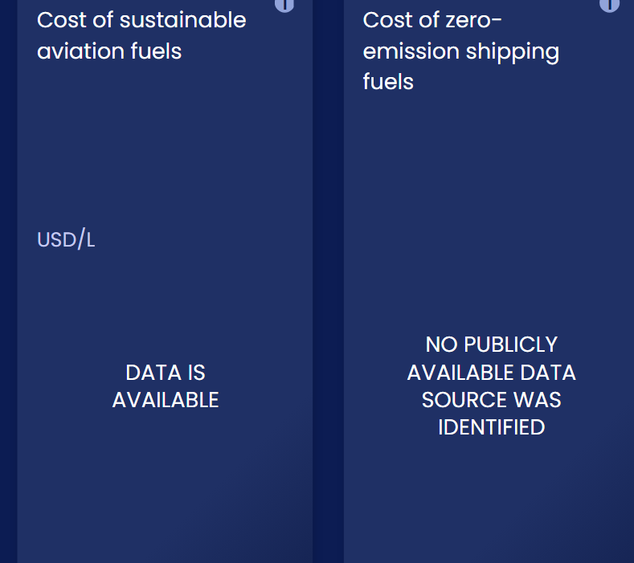
Enablers and barriers

Slide 10
Guarantee reliable access to safe and modern mobility
SHIFT
Notes:
Photo by Jiri Rezac / Climate Group: https://www.flickr.com/photos/theclimategroup/9314327704/in/album-72157634692605328/

Slide 11
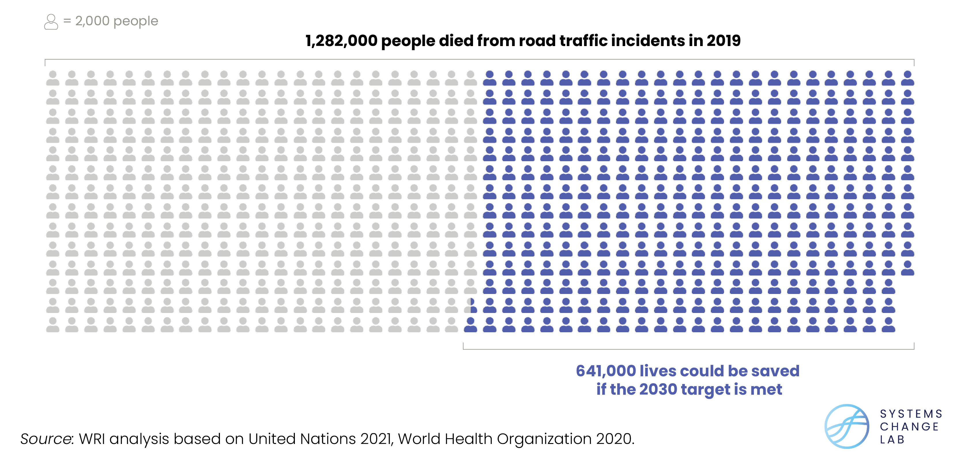
Progress must accelerate more than 10x to half traffic deaths
Notes:
In 2021, the United Nations set a target to halve the number of deaths and injuries from road traffic accidents by 2030. In 2019, this totaled about 17 deaths per 100,000 people. Recent progress needs to accelerate by more than 10x to meet the 2030 goal.
Heavy reliance on road transport and interaction between vehicles and cyclists or pedestrians brings the danger of road fatalities.
Annual global road fatalities were about 19 per 100,000 people from 2000–2003 and declined to 16.7 per 100,000 people in 2019 (the most recent year of data). The number includes pedestrian, cyclist, motor vehicle and other road injuries, with pedestrian and cyclist fatalities accounting for nearly half of the total. It has been shown that communities of color and lower-income communities are disproportionately affected by pedestrian fatalities.
In 2015, SDG 3.6 called for halving the number of global deaths and injuries from road traffic accidents between 2010 and 2020, but this goal was not reached. The number of fatalities per 100,000 people only fell about 8 percent from 2010 to 2019. In 2021, a renewed effort began to halve deaths from road accidents from 2021 levels by 2030. Recent progress needs to accelerate by more than 10x to meet the 2030 goal.

Slide 12
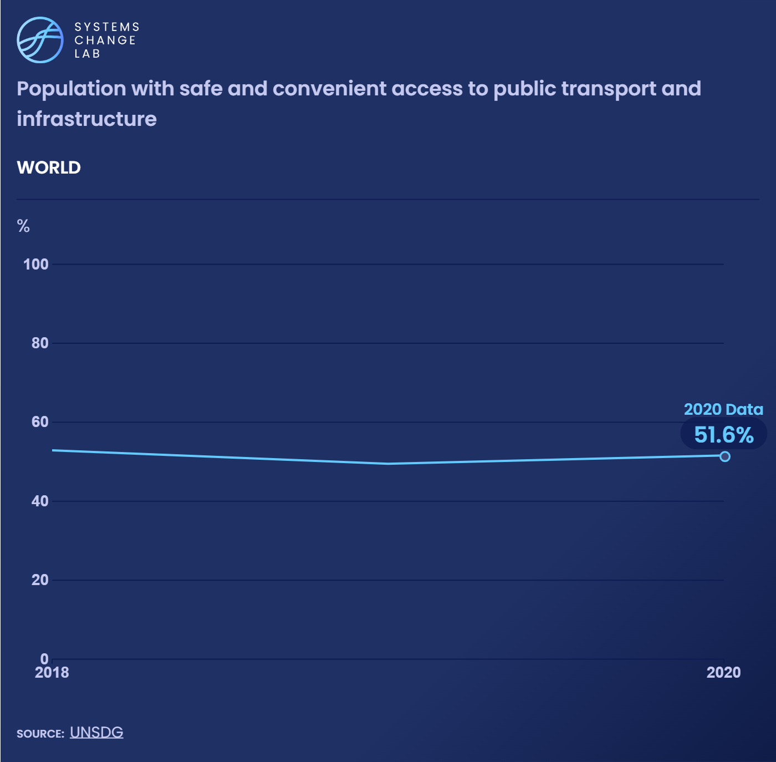
In the United States, over 22,000 neighborhoods are estimated to be “transportation disadvantaged,” meaning residents pay more than the average for transport and it takes longer to get where they need to go.
Notes:
Only 52% of the global urban population has safe and convenient access to public transport.
The proportion of the global urban population with safe and convenient access to public transport has stagnated at about 50% since 2018, reaching 52% in 2020. Access is lowest across Africa and west and central Asia, and highest in Australia, New Zealand, Europe and North America.
Low access to public transport means a higher reliance on lower-capacity, high-carbon modes of travel, including fossil fuel-powered cars or two- and three-wheelers. This means more air pollution and greenhouse gas (GHG) emissions, especially if stringent standards are not in place to control pollution.
Access to public transportation was impeded at the height of the COVID-19 pandemic, with lockdowns and labor shortages closing transit systems. While many public transport providers have seen ridership climb back, others are experiencing prolonged ridership reductions. At present, it’s unclear how changing mobility patterns and travel behaviors will continue to impact public transport, and what changes in system planning will be needed to adapt.

Slide 13
Reduce avoidable vehicle and air travel
SHIFT
Notes:
Photo by City Clock Magazine: https://www.flickr.com/photos/118304891@N02/15580281528/in/photolist-pJM1TA-23qhiKg-7TfeQE-2di3BCb-2nFPgbG-dQn5hJ-dQn57s-21PwDw3-Up6iWC-efpwXg-efvhtq-65Vai5-cUc8NQ-pCwPQV-7TfeQA-cUc8fu-5fyqW8-cUc8sj-cUc8ky-efvjrd-efvjah-efviUU-SmRePh-2ktw25k-WHLp6t-2nFN7ej-7TfeQs-252LeMo-7TfeQq-da9VVi-udwM9F-853zt4-aEVmSU-2ktzJe6-dVsK2h-2ktzJ3K-2ktAbN9-2ktAbTV-ExbPKi-3iGG-2ktAcDn-2ktzJbA-2ktw2aW-2ktAbPB-2ktzHjL-2ktzHfx-qLaFYP-2mkXhqy-naBFWp-a3RcUk

Slide 14
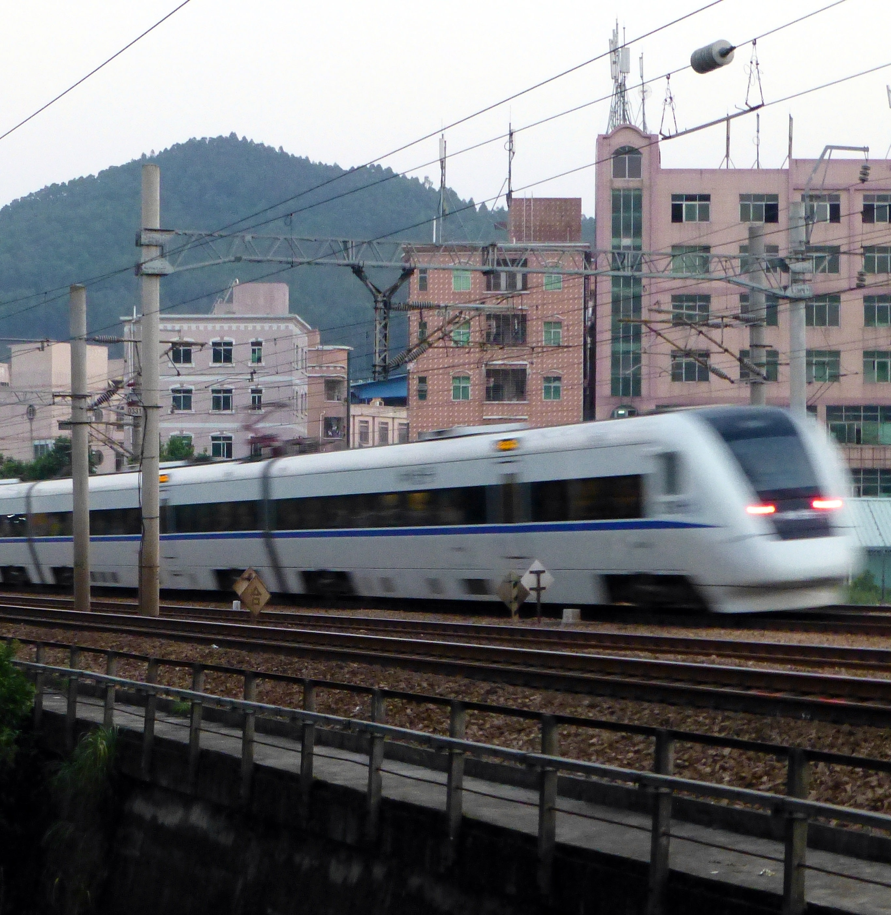
2019 estimate found that 15% of all regional trips taken by airplane could instead be served by high-speed rail.
China has about 60% of the world’s high-speed rail.
Notes:
China plans to extend it from 36,000 kilometers in 2020 to 70,000 kilometers by 2035 — almost as much as the country’s current conventional rail track.
Rising incomes and populations in developing and emerging economies are set to lead to stronger demand for more efficient, faster and cleaner transportation. Many developing nations have an opportunity to grow their economies with rail, investing early and reaping the benefits of a clean, efficient and affordable means of transport for both people and freight.
Rail systems are most cost and energy-efficient at full capacity, so strategic planning and implementation of new rail networks along the highest-traffic routes will maximize their low-emission and congestion-alleviation benefits. In 1995, there were 1.26 million km of rail around the world. By 2016, the most recent year for which we have data, this rose to 1.33 million km.
China has emerged as a global leader in high-speed rail infrastructure, with plans to double its high-speed rail network over the next 15 years and expand access to all cities with populations over 200,000. The more cities that are connected, the greater value rail will have, providing long-term economic, environmental and social benefits for citizens.

Slide 15
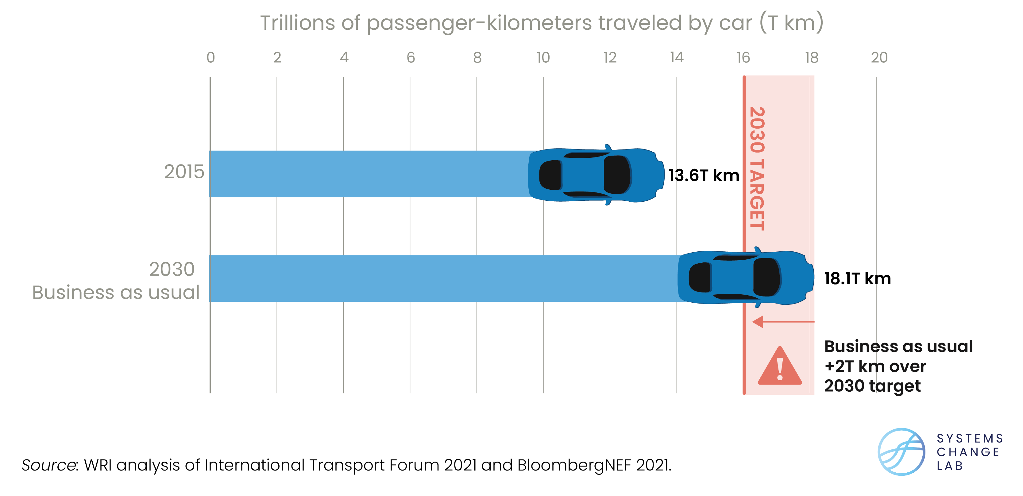
Distance traveled by cars is rising and needs to reverse
Notes:
The distance traveled by passenger cars increased from 39% to 44% between 2015 and 2020 — a trend that needs to be reversed. Globally, the share of kilometers traveled by passenger cars needs to fall to 34–44% by 2030.
For the transport sector to play a role in limiting global temperature rise to 1.5 degrees C (2.7 degrees F), high-income countries — the top 10 of which contribute 53% of global transport emissions and have high rates of motorization — will have to reduce light-duty vehicle (LDV) travel. Developing economies will also need and have the opportunity to reduce or slow the growth of vehicle travel and create sustainable transport systems not dependent upon cars.
While there is no extensive historical data available on the share of trips made by passenger cars, the data that do exist show a worrying trend. The global share of kilometers traveled by passenger cars increased from 39% in 2015 to 44% in 2020.
The cause of this increase is understandable: as populations and gross domestic products (GDPs) have grown, so has the number of people who own automobiles, and therefore the share of trips made by privately-owned cars. The trend in car ownership is expected to accelerate in developing countries as GDPs continue to grow. Countries with the highest GDPs per capita are more culpable for the current state of this indicator, while countries with lower GDPs per capita bear less of a responsibility.
By 2030, the global percentage of motor vehicle trips should decrease from its predicted 50% to between 34% and 44% (according to authors’ analysis based on BNEF scenarios). Economically developing countries across Asia, Africa and Latin America have room for modest growth in private motor trips if those in Europe and North America reduce their own private motor vehicle use.
Research shows that in the most congested cities in the United States, 48% of all car trips are less than three miles in length, and 20% are shorter than one mile. Walking, e-scooters and bikes could replace a significant portion of short trips, as could inclusive, accessible public transit for medium-length trips.
Given that travel behavior is heavily influenced by infrastructure and the availability of convenient, affordable and safe transportation options, it is the responsibility of policymakers to create an environment where sustainable alternatives are convenient and more attractive than private motor vehicles.

Slide 16
Shift to public, shared and non-motorized transport
SHIFT
Notes:
Photo by British Columbia Emergency Photography: https://www.flickr.com/photos/bcemergencyphotos/15661516724/in/photolist-pRXnhq-PHZBUe-XbEY59-EZ83qp-ThVuHB-2nw9HsX-2eNVk7j-rAPeTv-2iWTZ7x-2i5s4F9-SRuVc9-2mKHVU6-DjXh1j-2i8gHog-2eQU6Dr-2aXmRUL-Vz2Fbe-JD1eVd-2bDti8b-2i8fFbG-2duHvCn-UCiMm1-2iAvYfW-2iP8Dm4-2hJaDiD-28WUE39-2mYSWwB-2gHFd5u-2iRz6he-SMhGpU-2iNJk68-RXfyKh-2jm4VfB-2igzqPz-29cz9eC-2ghTsPF-2eTuXCz-E98Fxg-2eTuYNF-2hx76uR-4vj9Gv-ZaaP4s-2iLbsac-RbR9QT-24Vk897-2mudnHR-RbRaWR-2eSCA8S-BDLN4f-2jb7wGY

Slide 17
Rapid transit deployment needs to accelerate 6x faster
Notes:
Rapid transit in cities is growing, but needs to move 6x faster to build out the infrastructure needed to enable more people to transition away from car use. From 2015 to 2020, over half of the top 50 emitting cities grew their transit infrastructure.
Every $1 invested in public transportation generates $5 in economic returns, and every $1 billion in investments supports and creates approximately 50,000 jobs.
Buses and trains will be a crucial component of decarbonizing the transport sector. They currently release about a quarter of the emissions per passenger-kilometer (pkm) generated by ride-hailing services and about half of those from a private vehicle.
Across the world’s 50 highest-emitting cities, the number of kilometers (km) of rapid transit per 1,000,000 inhabitants has increased over time, from 16 in 2010 to 19 in 2020. These include metro, light rail and Bus Rapid Transit (BRT), which uses a dedicated lane to avoid the causes of delay that typically slow regular bus service. Europe outpaces the rest of the world in terms of its rapid transit-to-resident ratio, followed by Chile, Ecuador, South Korea and Tunisia.
To achieve a pathway compliant with the 1.5 degrees C (2.7 degrees F) target, rapid transit in cities should reach 38 km per 1,000,000 inhabitants by 2030. This requires the pace of change achieved over the last five years to increase by 6 times.
While the amount of public funding is not included in this metric, it is important that cities provide broader support to public transport systems, including rapid transit and bus services. Policies that address informal popular transport systems, such as minibuses, are also needed.

Slide 18
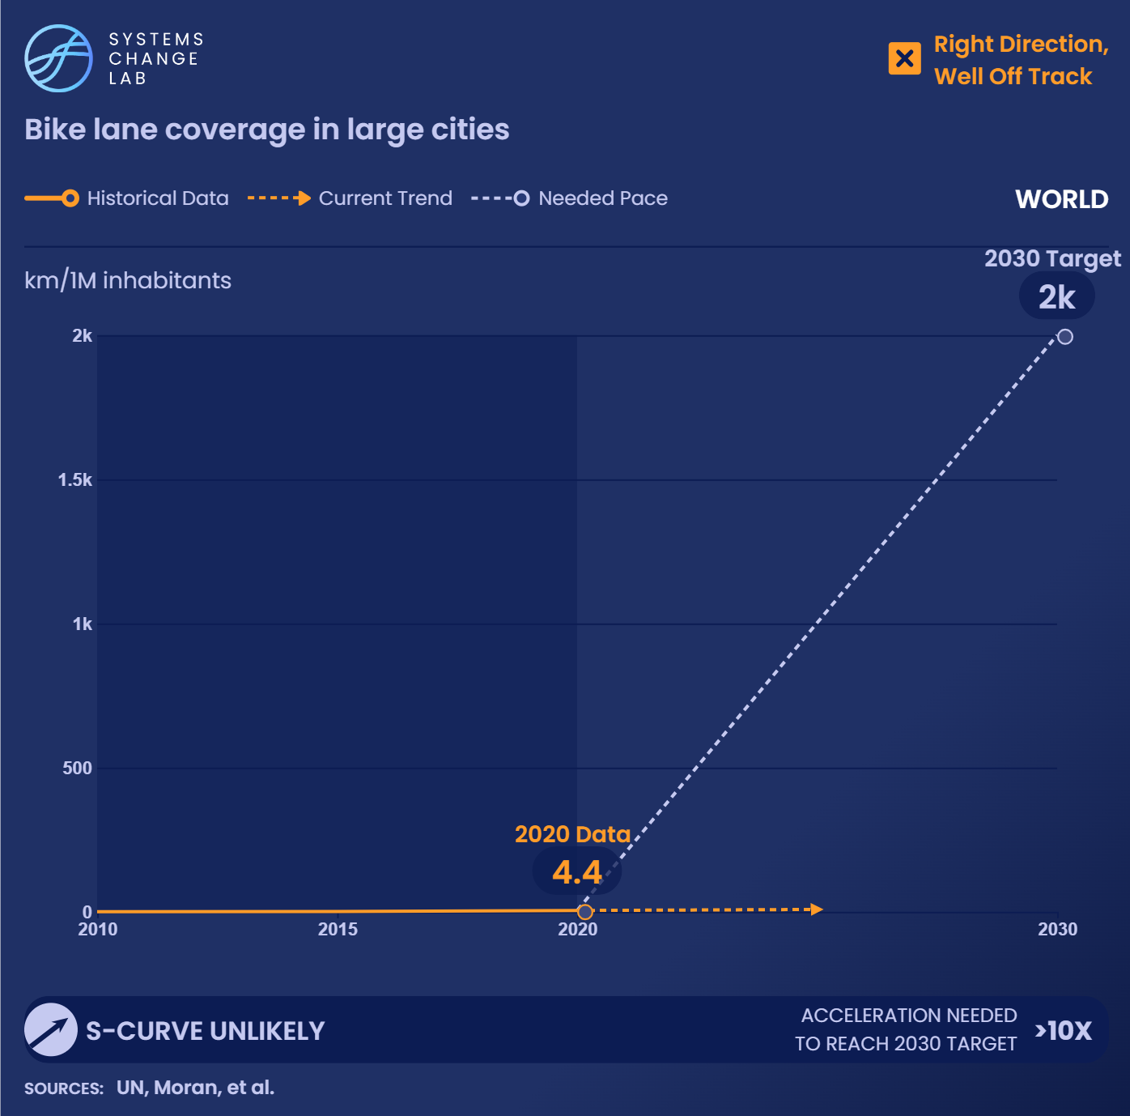
We need to accelerate progress in increasing bike lane coverage in cities more than 10 times to reach to 2 km/1M inhabitants by 2030 and be on a 1.5 degrees C pathway.
Notes:
Access to high-quality bike lanes is key because it can foster a shift to a near-zero carbon form of transport and improve the safety and health of residents. In a recent study of European cities, even occasional cyclists (once or twice a day) had 84% lower CO2 emissions per person from all daily travel than non-cyclists.
If 10% of the population were to change travel behavior from taking a car to cycling, transportation emissions would be expected to decrease by about 10%. Cycling is a clear tool for policymakers to use now to address climate change.
In 2022, there were approximately 0.0077 km of segregated bike lanes per 1,000 inhabitants in the top 50 emitting cities. This has been increasing steadily from 0.0001 km/1,000 inhabitants in 2010.
We need to increase this number to 2 km/1,000 inhabitants by 2030 to be on a 1.5 degrees C pathway. Progress will need to accelerate more than 10 times to meet this goal. Of course, building infrastructure will not guarantee people will use it, but it is a necessary condition, alongside other incentives for mode shift, to allow for better cycling access.
Bike use surged during the COVID-19 pandemic, and countries and cities can capitalize on that interest and prioritize cycling. European countries like Denmark, Germany and the Netherlands are world leaders in creating safe, convenient and accessible cycling conditions. Cities looking to expand cycling infrastructure can follow the example of Seville, Spain, where the local government expanded cycling infrastructure from 12 km of unconnected cycle paths in 2005 to 120 km of protected bike lanes in 2010. The expansion was coupled with a bike-sharing system, which helped boost the number of daily bike trips five-fold over three years.
Cities like Paris are setting bold aspirations for cyclability. Paris’s goals include making it possible to bike every street in the city and prioritizing pedestrians and cyclists over cars in the flow of traffic.

Slide 19
Transition to zero-carbon cars and trucks
SHIFT
Notes:
Photo by Ivan Radic: https://www.flickr.com/photos/26344495@N05/50982074047/in/photolist-2kF7sqF-dkSxRo-2khiY7Q-V9x7Ci-JQy863-2m3LStP-NELhpd-NELgjh-2nnrdKR-6tAbvy-2kwENJc-2nnrdL2-eeXAqf-2hkfCi8-edGo8k-2hZeevF-oDUCp1-2jX8f2B-2n13aFj-2n4nkMH-2kUCDqx-23NwCcr-v2qfL3-B4SYSW-bwJmEy-9FUKfq-2nnjKR5-2nnq7eq-2nnsymJ-TSvDYu-2kA4s7m-2nnq1PF-2nnq7hb-2nnsyqX-dbY4zS-2n865C8-2kwwrxW-2nnsymy-2kA8CAZ-bbmnEM-2kD1JoH-QzEMQg-2nnjKM2-2nnq1RE-aEJj6s-Doyr4w-2nnrdLc-qLb7yE-2nnsytx-2nnsyqM

Slide 20
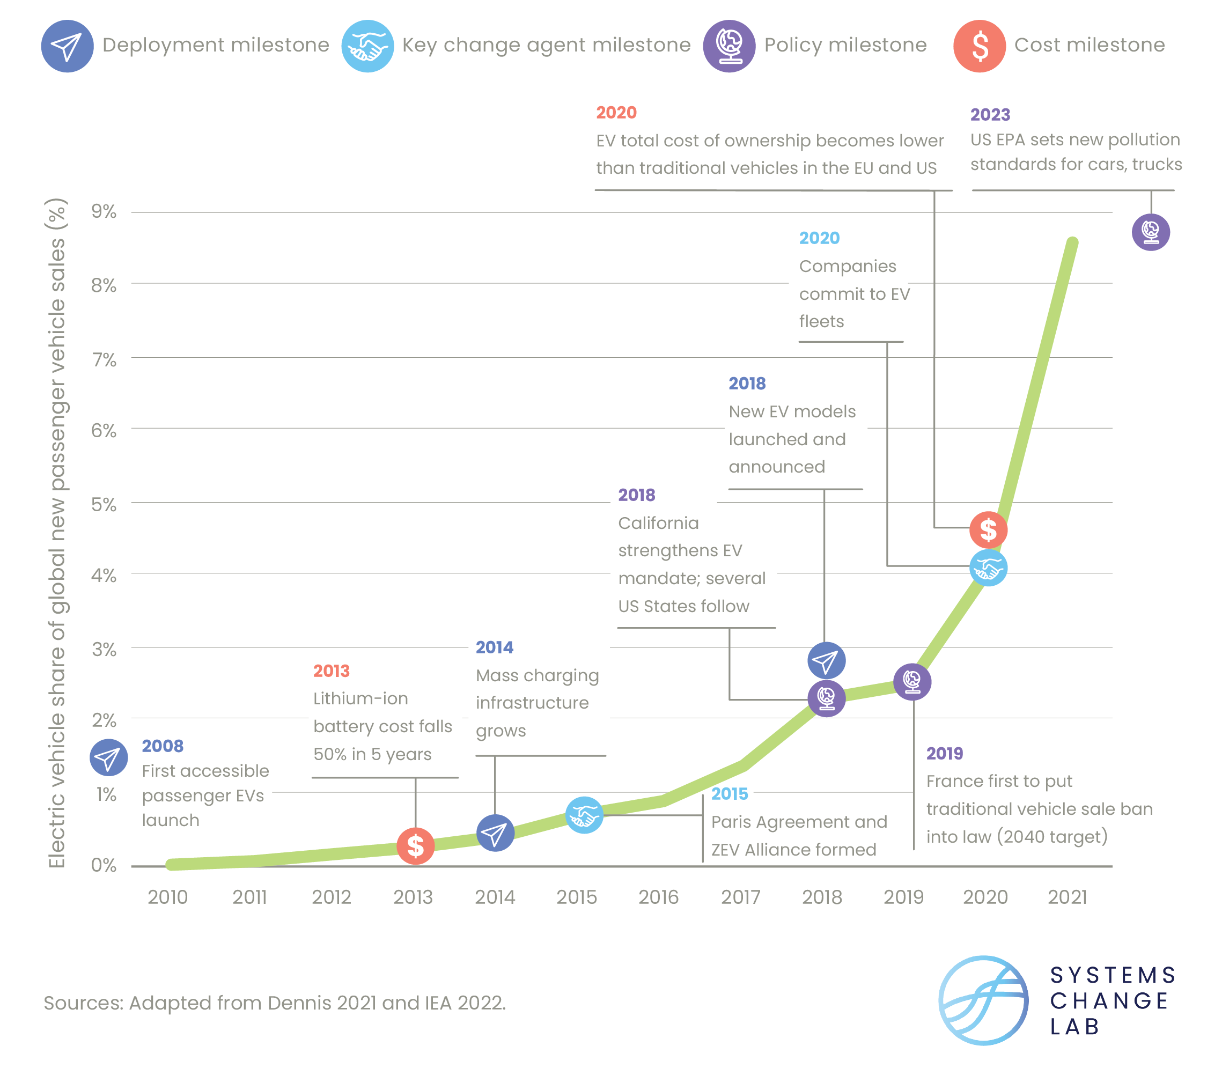
Key milestones in the exponential growth of EV sales
Notes:
The global share of electric vehicles (EVs) in passenger car sales has begun to take off, reaching almost 9% in 2021 — double its share from the year before. Passenger EVs are projected to displace close to a million barrels of oil per day by 2025.
Buses emitted about 6% of total CO2 emissions from transport in 2021. Switching to electric buses eliminates those emissions, as well as harmful tailpipe emissions such as fine particulate matter, black carbon and NO2. Buses are in the midst of an electrification revolution, and electric models comprised 44% of global bus sales in 2021. Global sales of zero emission buses have been dominated by demand from China over the last decade, with 97% of electric bus sales occurring there in 2019.
There are signs of an uptick in demand from key European countries, including Germany, France, the U.K., and Spain, and in India, which as of July 2022 was finalizing a tender for more than 5,500 electric buses. However, such demand will need to grow considerably and extend to many other countries if the share of zero emission bus sales is to reach 60% by 2030 and meet the 1.5 degrees C goal. This must increase to 100% by 2050.
Because of recent fluctuations in sales shares, the rate of progress made in increasing the share of BEVs and FCEVs in bus sales needs to be more than 10 times faster than it has been the last five years to reach 60% by 2030. However, China has proven that rapid progress is possible for zero-carbon buses and has single-handedly brought the 2030 target within reach.
Other countries have the potential for that same exponential progress. Therefore, we have chosen to upgrade the indicator from “well off track,” where it would be based purely on the last five years, to “off track.”
While the amount of public funding is not included in this metric, it is important that cities provide broader support to public transport systems, including rapid transit and bus services. Policies that address informal popular transport systems, such as minibuses, are also needed.

Slide 21
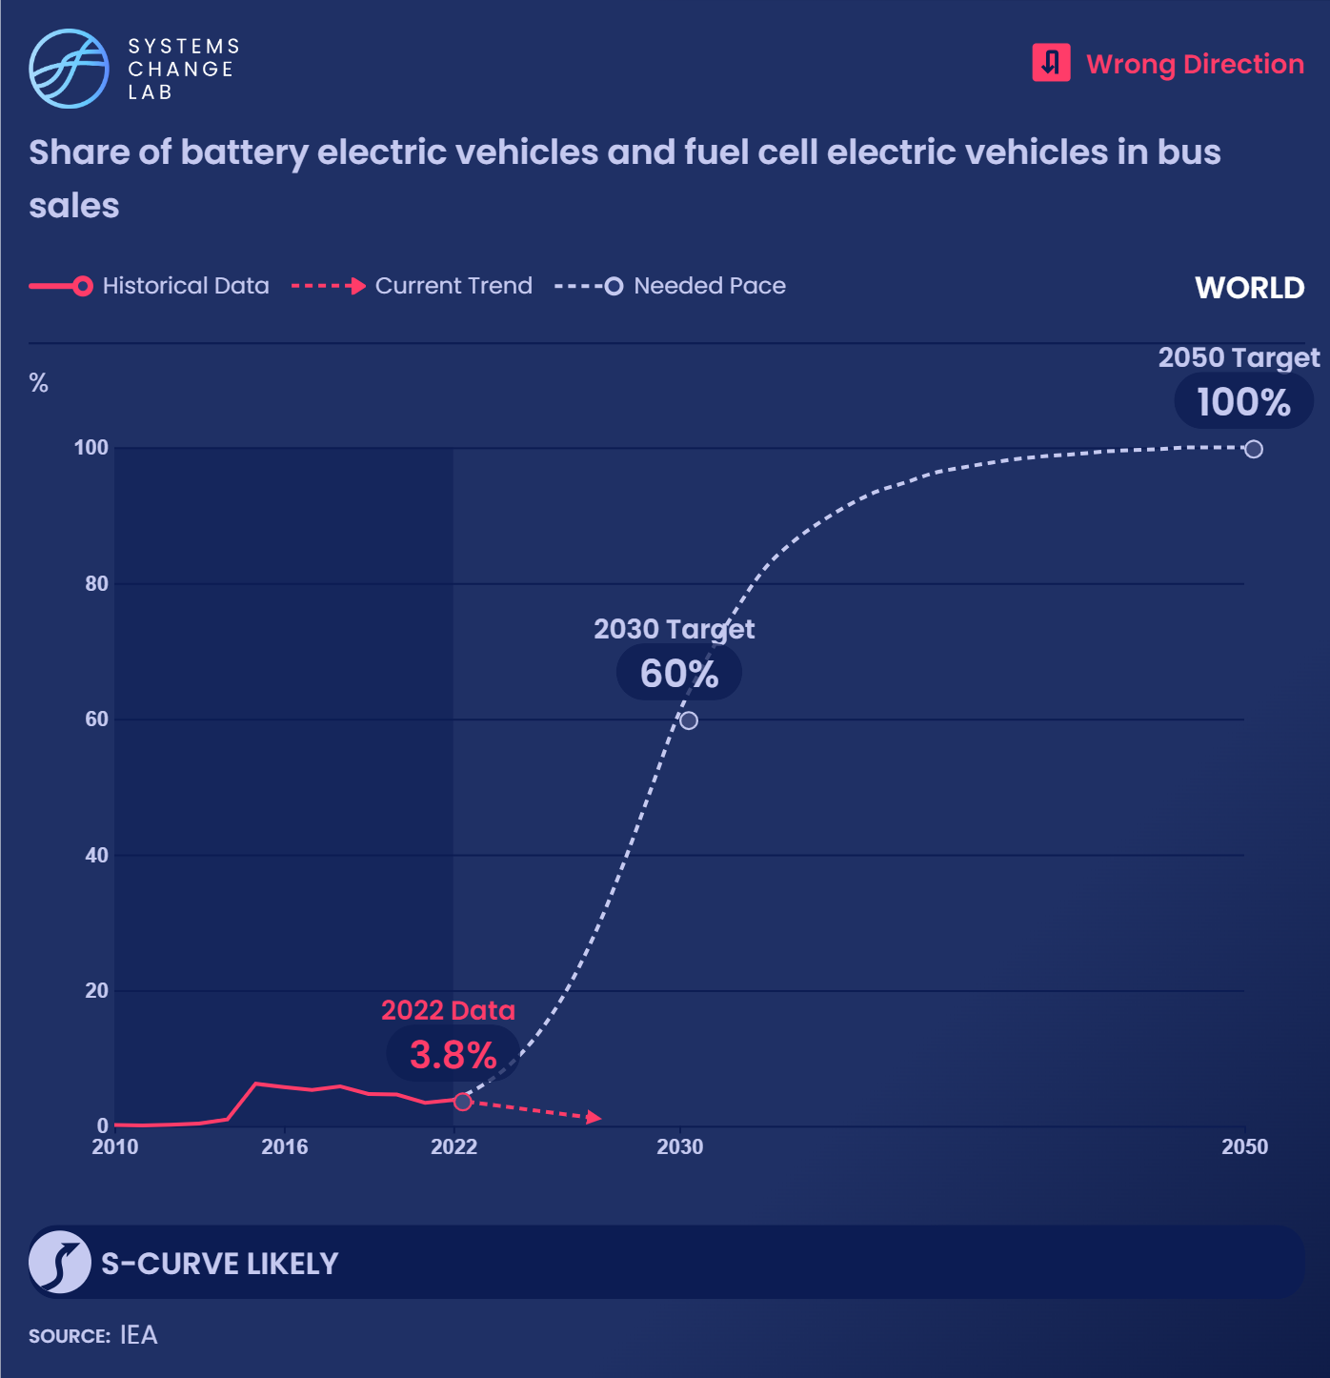
Global sales of zero-carbon buses rocketed from 2,000 in 2010 to 63,000 in 2022, though decreases in the last five years show this indicator moving in the wrong direction.
Notes:
Buses emitted about 6% of total CO2 emissions from transport in 2021. Switching to electric buses eliminates those emissions, as well as harmful tailpipe emissions such as fine particulate matter, black carbon and NO2.
Buses are in the midst of an electrification revolution, and electric models comprised 44% of global bus sales in 2021. Global sales of zero emission buses have been dominated by demand from China over the last decade, with 97% of electric bus sales occurring there in 2019.
There are signs of an uptick in demand from key European countries, including Germany, France, the U.K., and Spain, and in India, which as of July 2022 was finalizing a tender for more than 5,500 electric buses. However, such demand will need to grow considerably and extend to many other countries if the share of zero emission bus sales is to reach 60% by 2030 and meet the 1.5 degrees C goal. This must increase to 100% by 2050.
Because of recent fluctuations in sales shares, the rate of progress made in increasing the share of BEVs and FCEVs in bus sales needs to be more than 10 times faster than it has been the last five years to reach 60% by 2030. However, China has proven that rapid progress is possible for zero-carbon buses and has single-handedly brought the 2030 target within reach.
Other countries have the potential for that same exponential progress. Therefore, we have chosen to upgrade the indicator from “well off track,” where it would be based purely on the last five years, to “off track.”

Slide 22
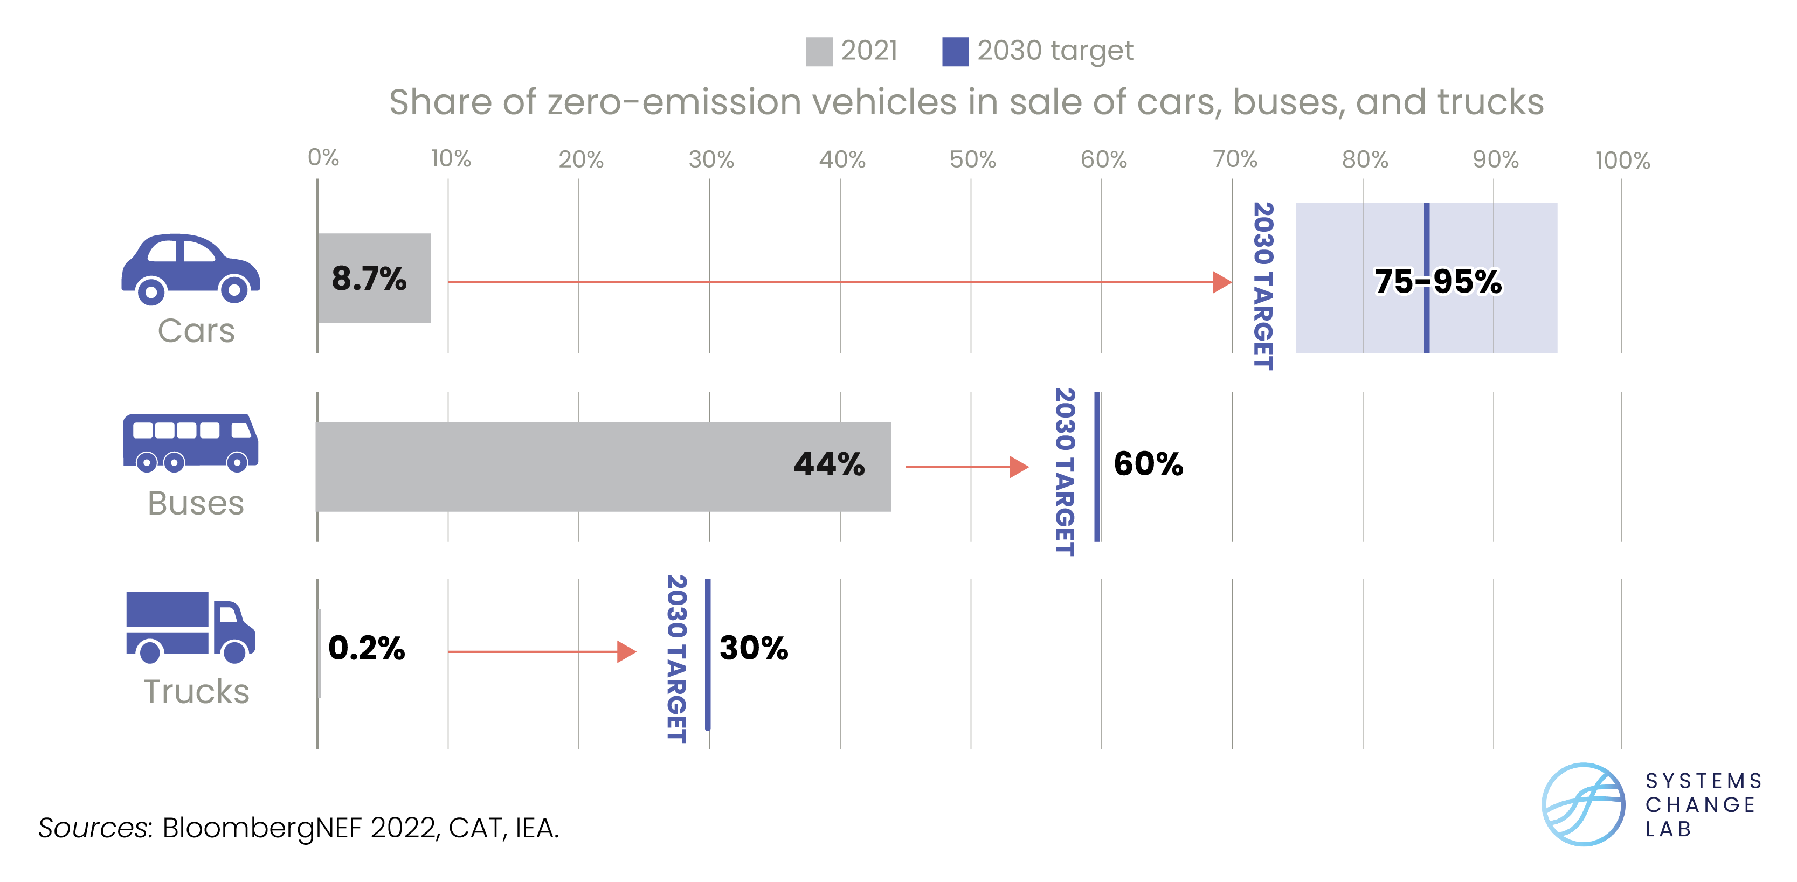
Zero-carbon car and bus sales are growing
Notes:
Buses emitted about 6% of total CO2 emissions from transport in 2021. Switching to electric buses eliminates those emissions, as well as harmful tailpipe emissions such as fine particulate matter, black carbon and NO2.
Buses are in the midst of an electrification revolution, and electric models comprised 44% of global bus sales in 2021. Global sales of zero emission buses have been dominated by demand from China over the last decade, with 97% of electric bus sales occurring there in 2019.
There are signs of an uptick in demand from key European countries, including Germany, France, the U.K., and Spain, and in India, which as of July 2022 was finalizing a tender for more than 5,500 electric buses. However, such demand will need to grow considerably and extend to many other countries if the share of zero emission bus sales is to reach 60% by 2030 and meet the 1.5 degrees C goal. This must increase to 100% by 2050.
Because of recent fluctuations in sales shares, the rate of progress made in increasing the share of BEVs and FCEVs in bus sales needs to be more than 10 times faster than it has been the last five years to reach 60% by 2030. However, China has proven that rapid progress is possible for zero-carbon buses and has single-handedly brought the 2030 target within reach.
Other countries have the potential for that same exponential progress. Therefore, we have chosen to upgrade the indicator from “well off track,” where it would be based purely on the last five years, to “off track.”

Slide 23
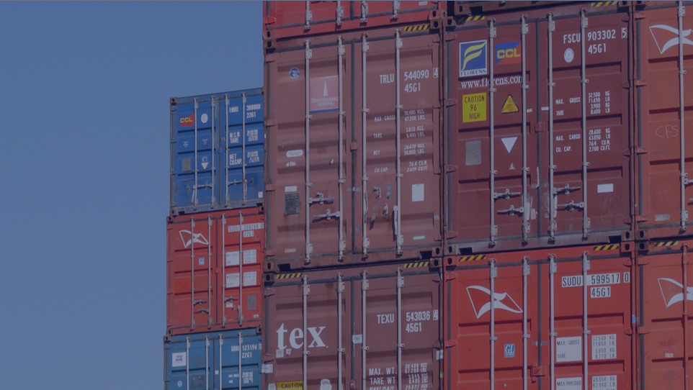
Transition to zero-carbon shipping and aviation
SHIFT
Notes:
Photo by Tina Marie: https://www.flickr.com/photos/skywhisperer/2287026763/in/photolist-4u6BnV-5GZZKz-qCHSe-Hz1vjj-fhmiKL-6g4kn5-nB9FKo-2v5bH-fDtUEH-ea3sBe-ea8y4C-hV5eaP-eR9J8J-vs5RGS-hV3DMM-hWw2c1-hV2SuK-4py1HB-hV5fux-wZBG9F-99p4HW-efgB6v-eQXmYD-7e6srd-wXi6AG-hV5xJo-hV3bmN-hV6dqt-BfzycZ-bprm3c-hV31oS-w3K1BX-w3AqAs-er2kBs-hV3CMk-xCqdHb-hV3NwR-KGsKGL-81mNXe-8qHe5T-qp7ow8-hV3FB1-bYecgY-u2ar8Z-hV3ovf-hV8o9K-scMkj4-hV4Ymk-hV4R8H-hV4Sc6

Slide 24
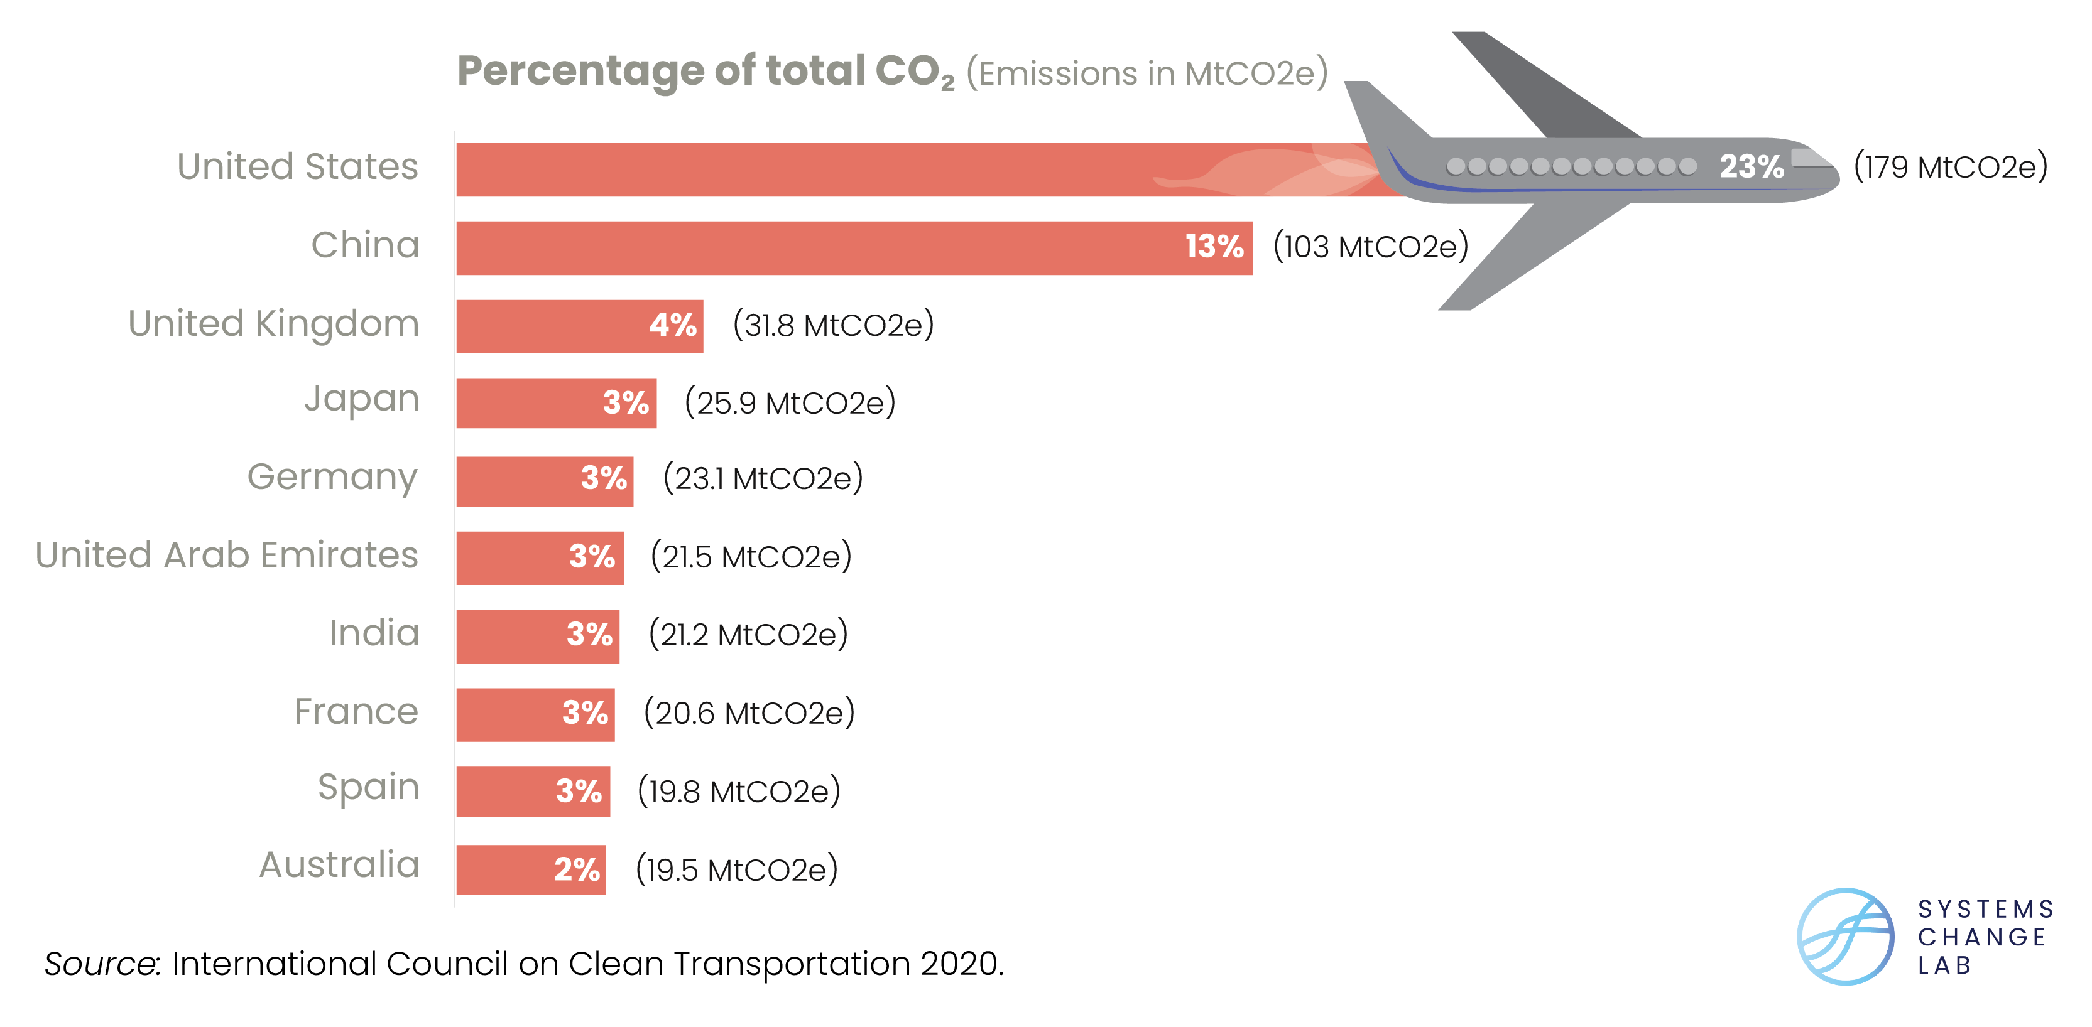
Carbon emissions from aviation by top departure countries
Notes:
2019 Data

Slide 25
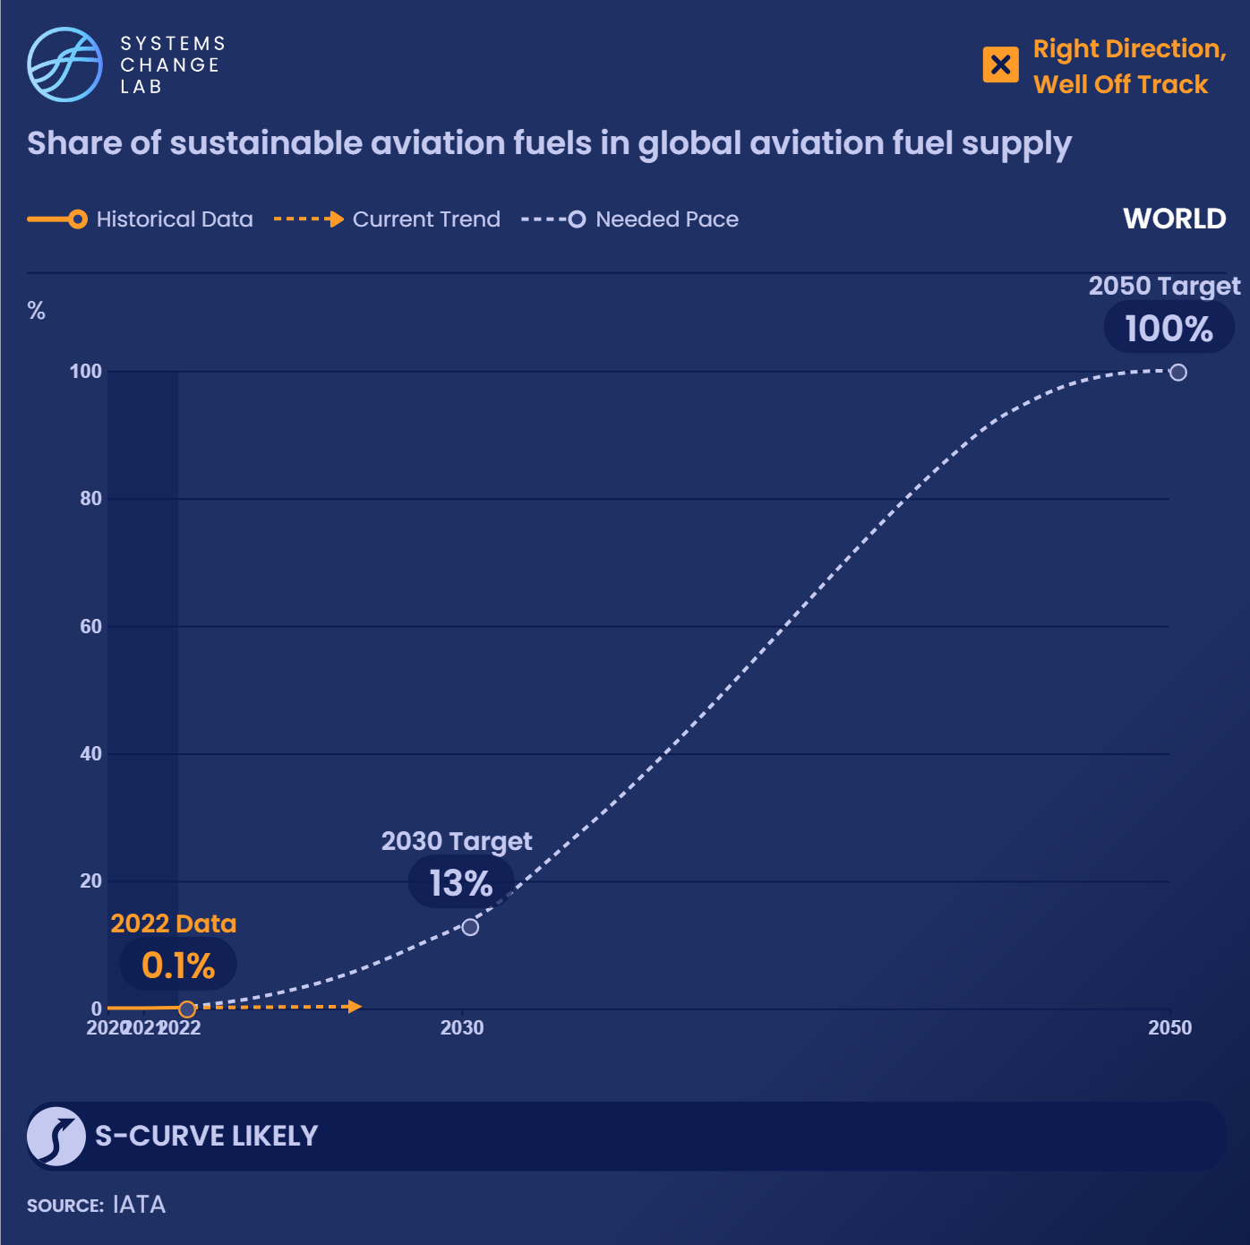
Sustainable aviation fuels (SAFs) still take a small share of the market — 0.1% in 2022 — but 91 companies have
committed to accelerating sustainable aviation fuel.
Notes:
These company commitments include research, advocacy, funding and other mechanisms.
The share of sustainable aviation fuels (SAF) — including fuels made from biomass, alcohol or electricity — in the global aviation fuel supply was less than 0.1% in 2020, the only historical data point currently available. If overall jet fuel demand rises with expected passenger growth in the coming decades, the absolute amount of SAF produced must also increase just to maintain share levels.
To stay on track for a 1.5 degree C scenario, the share of SAF needs to reach 13–18% in 2030 and 78-100% in 2050. There are signs that SAF supply and use are beginning to grow, and airlines have secured purchase agreements for 21 million metric tons of SAF, with delivery timelines ranging from six months to 20 years. About 70% of the 21 million metric tons were agreed to in 2021 or 2022. Additionally, companies with large aviation footprints are working with airlines to purchase SAF (see, for example, Deloitte and Microsoft).
SAF deployment is likely to follow an S-curve and the technology is in the emergence stage of adoption. If we begin to see more promising developments pick up, in addition to blending mandates like the European Union’s ReFuel EU proposal, the share of SAF in the global aviation fuel supply could begin to increase exponentially.
A coalition of 71 companies across the aviation supply chain is supporting the acceleration of SAFs through building the knowledge base for SAFs, advocating for supportive policy, and identifying new funding streams for development and deployment.
A key step in developing sustainable aviation fuels (SAFs) is proving to producers that demand for the fuel exists: it unlocks financing, draws more players to the field, and, ultimately, ensures that the fuel makes it into real-world use. The supply of aviation fuels typically comes from petroleum producers and refiners, and the SAFs that exist currently come from specialized producers and refiners as well. Demand for fuels typically comes from airlines and airports, but logistics companies also participate.
The most straightforward way to understand the state of demand for SAFs is to measure the number of companies committed to procuring these fuels for their planes. As of 2020, 71 companies were members of the Clean Skies for Tomorrow coalition. These companies include producers such as Shell and SkyNRG, airplane manufacturers such as Boeing, airport owners such as Dubai Airports and Corporación América Airports, airlines such as Lufthansa and Southwest, government agencies such as the Indian Renewable Energy Development Agency, and funders such as BlackRock and the Indian National Bank for Agriculture and Rural Development.
Because SAFs are nascent, demand is low, but it is reasonable to expect that it will increase as more options emerge. This indicator is a proxy for the broader private sector commitment to decarbonize aviation, for which there is no publicly available data.

Slide 26
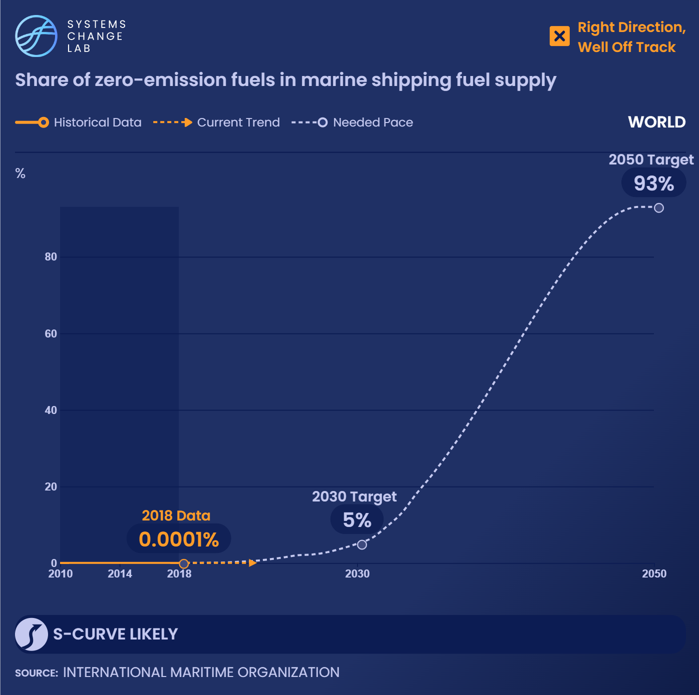
More than 200 pilot and demonstration projects for zero-emission shipping fuels are currently in development.
63 companies have signed deals to procure zero-emission ships.
Notes:
Though these ships are still in development, we are seeing signals that demand will exist for vessels that won’t emit carbon dioxide when they hit the market.
Zero-emission fuels (ZEF) for shipping include synthetic carbon-based fuels made from green hydrogen and captured carbon dioxide (CO2), such as e-methanol and Fischer-Tropsch Liquids, and direct use of green hydrogen and ammonia. Zero-emission fuels have not yet entered the maritime shipping fuel supply.
Scenarios aligned with a 1.5 degrees C pathway suggest that 5–17% of fuel used in maritime shipping will need to be zero-emission by 2030 and 84–93% of fuel by 2050. These fuels have not yet entered the market, but they are being tested and piloted for deployment in the near future. As of the beginning of 2022, there were over 200 pilot and demonstration projects to develop zero-emission shipping fuels. Given the lack of deployment but the signs of progress, we have categorized this indicator as going in the right direction but “well off track.” ZEF deployment is likely to follow an S-curve and the technology is in the emergence stage of adoption, so if the projects in development move to market and the policy levers are aligned, we may see quick growth in the uptake of these fuels.
Battery electric options are also in development for short-distance maritime shipping and travel, but are not included in this indicator. Biofuels such as biomethanol may provide some CO2 reductions compared to traditional heavy fuel oil or marine diesel oil, but they do not meet the definition of zero-emissions fuels.
Using zero-emission fuels in combustion engine ships will help lower emissions. So will developing new ship designs that allow for the use of 100% zero-emission fuels, electricity with batteries, green hydrogen, or other zero-emission solutions.
The most straightforward way to understand the state of demand for zero-emission ships is to measure the number of companies committed to procuring these vessels for use in their shipping activities. In 2021, 237 companies across the maritime shipping value chain signed onto the Call to Action for Shipping Decarbonization, which called on world leaders to commit to decarbonizing shipping and provide funding and policy support along the way. As of the end of 2021, 63 of those 237 companies had signed deals to procure zero-emission ships.
Because the zero-emission fuels that these ships will use are nascent, demand is low, but it is reasonable to expect that it will increase as more options emerge. Zero-emission ships are currently in the concept stage and are expected to be commercialized in the 2030s. It is likely that these commitments will provide certainty to manufacturers that demand exists, and as more options emerge and shipping companies understand that the technology is ready, it is reasonable to expect that commitments will increase. The number of signatories to the Call to Action is a proxy for the broader private sector commitment to procure zero-emission ships, for which there is no comprehensive, publicly available data.

Slide 27
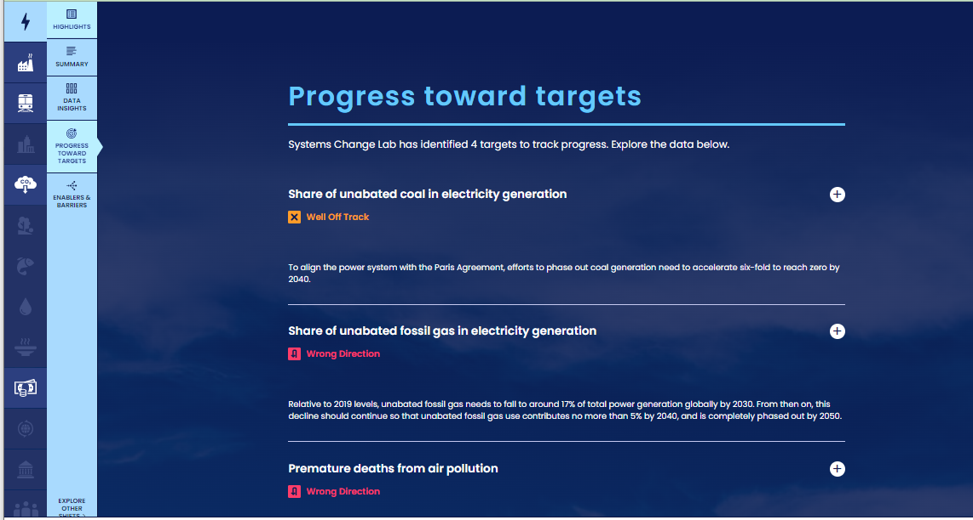
How to highlight a different indicator
Find your desired indicator on systemschangelab.org system pages
1. Select a system
3. Scroll down page to indicators and expand one
2. Select a shift

Slide 28
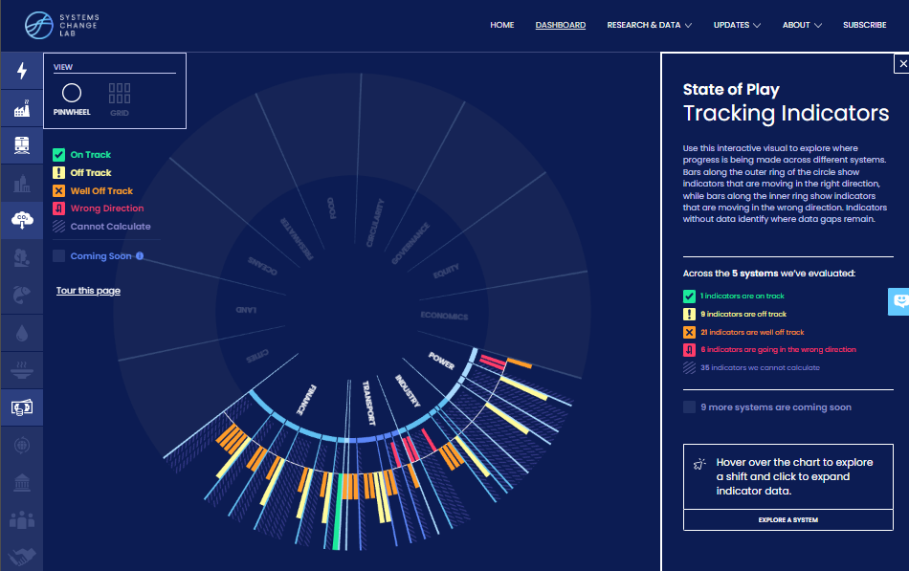
Alternatively, search for an indicator on the dashboard
1. Navigate to the dashboard
3. Search an indicator and then click explore data
2. Select grid view
4.
Notes:
Find your desired indicator on https://systemschangelab.org/
Look through System Page ( https://systemschangelab.org/power)
OR search the dashboard ( https://systemschangelab.org/dashboard) & select "EXPLORE DATA >" on your desired indicator

Slide 29
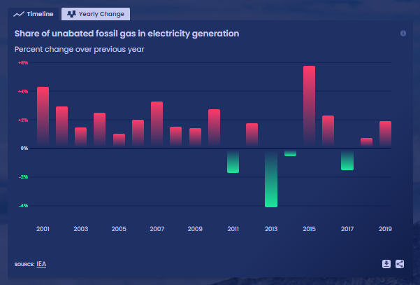
Pick a chart view and click the download button

Slide 30
Next, add the chart to your slide deck
1. Select "Insert" and "Pictures" on the toolbar
2. Select chart from the downloads folder and open

Slide 31
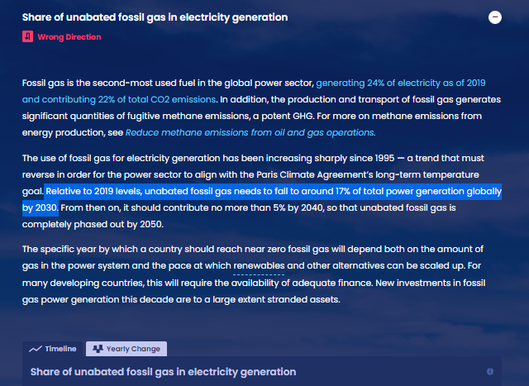
Add context from the indicator write-up as desired

Slide 32
For more information
VISIT: SYSTEMSCHANGELAB.ORG/TRANSPORT
EMAIL: CONTACT@SYSTEMSCHANGELAB.ORG

