Slide 1
Power
Last updated December 2024 | systemschangelab.org/power
Notes:
Photo by Hana Ott: https://unsplash.com/photos/4e4ZKnPbZAI

Slide 2
Systems Change Lab
It’s time to change the way we think about changing the world.
Systems Change Lab monitors, learns from and mobilizes action toward the transformational shifts needed to protect both people and the planet.
The data platform identifies and tracks key shifts in our global systems that, when achieved together, can spur transformational change.

Slide 3
Interconnected systems
Power
Industry
Transport
Cities
Buildings
Carbon Removal
Land & Forests
Ocean
Freshwater
Food &
Agriculture
Finance
Circular
Economy
Governance
Social Inclusion & Equity
Economics

Slide 4
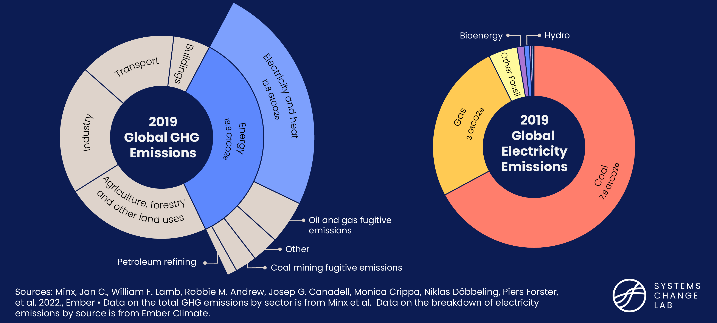
The power system

Slide 5
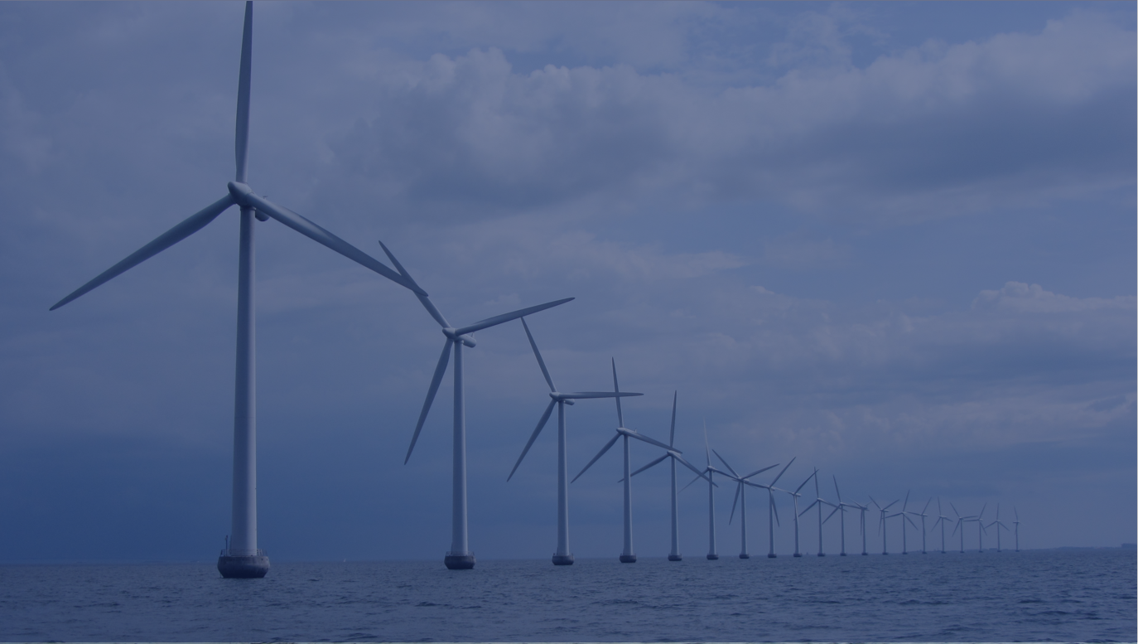
The four shifts needed to transform the power system
Phase out unabated coal and fossil gas electricity generation
Modernize power grids, scale energy storage and manage power demand
Rapidly scale up zero-carbon electricity generation
Ensure energy access and a just and equitable transition for all
Notes:
Phase out unabated coal and fossil gas electricity generation
Ending the current reliance on coal and fossil gas is crucial to achieving climate goals. This shift requires rapidly phasing out these fuels, relocating workers to new sectors, and eradicating public and private financing for fossil fuels, among other key actions.
Rapidly scale up zero-carbon electricity generation
Collectively, governments, businesses and households must prioritize a rapid transition to more sustainable forms of energy, unlocking myriad benefits such as lower CO2 emissions, cleaner air and a net-benefit to the global economy.
Modernize power grids, scale energy storage and manage power demand
Scaling up efforts on power transmission and distribution, demand-side response and storage will require new policies to mobilize capital for new infrastructure; it will also create the market conditions for demand management programs and technological innovation.
Ensure energy access and a just and equitable transition for all
Too many of the world's poorest communities have been negatively impacted by fossil fuel power or do not have energy access. The transition of the world’s energy systems toward decarbonized, highly electrified models must benefit all people equitably.
Photo by Ben Paulos: https://www.flickr.com/photos/benpaulos/48788589568/in/photolist-2hkhgUL-oNTMdT-eaR98M-21QQXzR-dqeuC2-pVGwot-24EiJHi-2hkj8oB-nJ85PZ-8NMPqm-21HMzqb-7vdjdj-7vo22e-pcT9jn-edrwbv-7v9vkk-2hTDiZs-7vrQV1-356FGZ-qZYZQD-Wk6Dwb-9Kd4bh-WnrG16-7jLasm-7jGie6-7vrQQo-7jGhNB-oYV6n9-xc6oWs-7jGfTp-7jGj1X-fAv6wi-bhXgMK-8rYKN9-pVwKS8-7vbdr4-q4cabr-7vf8By-7vf7db-7vbisn-7vbiFp-csjUVf-7vdk2J-7v9vcM-7v9vTR-Xm2ftQ-Jgcy4h-dcbmbA-cUwMFo-6tUqeB

Slide 6
Highlights
Power accounts for 25% of global greenhouse gas emissions.
The momentum of renewable energy shows no signs of slowing down: between 2021 and 2022, solar generation grew by 25% and wind by 14%.
To align the power system with the Paris Agreement, efforts to phase out coal generation need to accelerate sevenfold to reach near zero by 2030.
Power generation from fossil gas needs to fall to around 5-7% of total generation by 2030 and reach near zero by 2040.
The number of people without electricity access fell from 1.3 billion in 2000 to 680 million in 2021. To achieve universal access by 2030, current efforts need to accelerate by 1.6x.

Slide 7
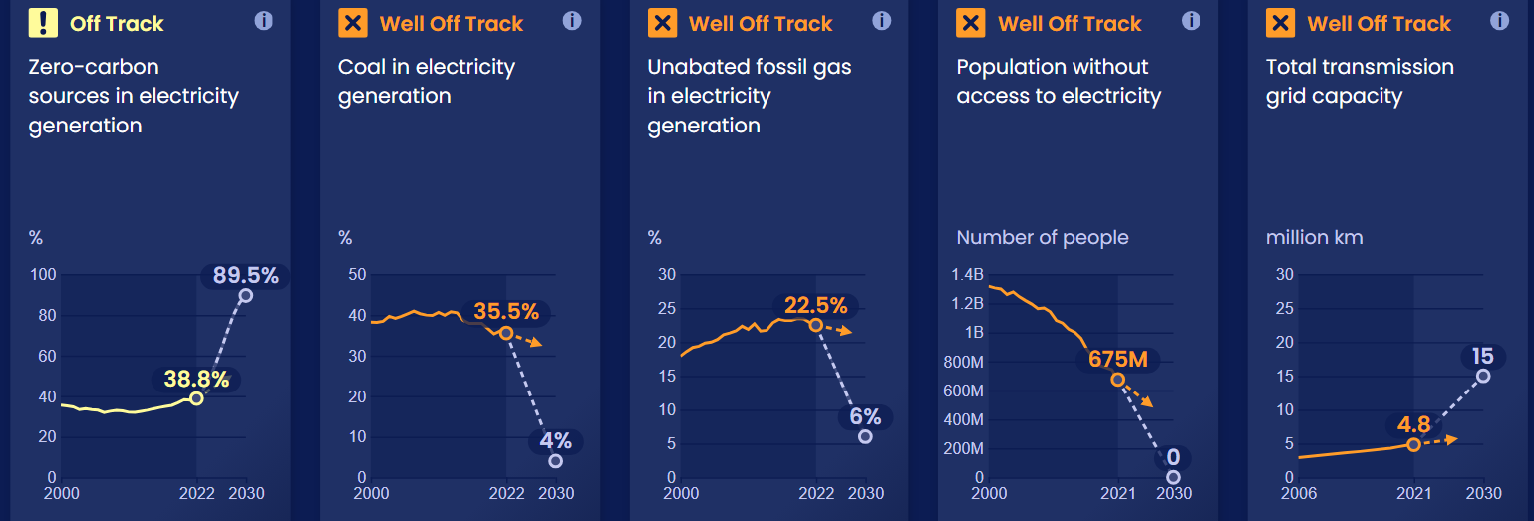
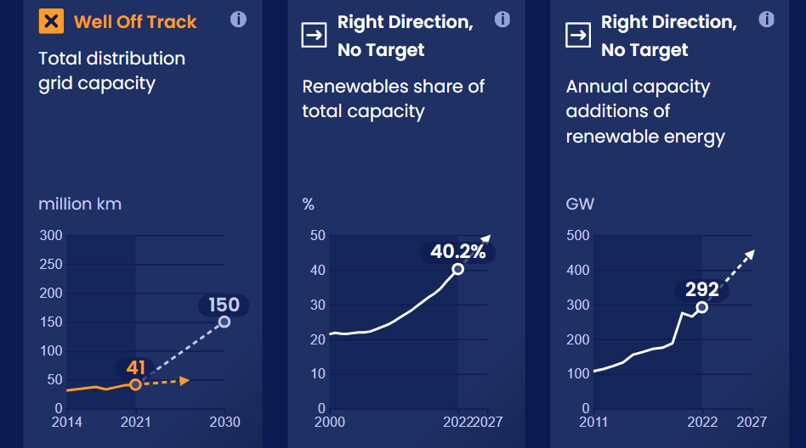
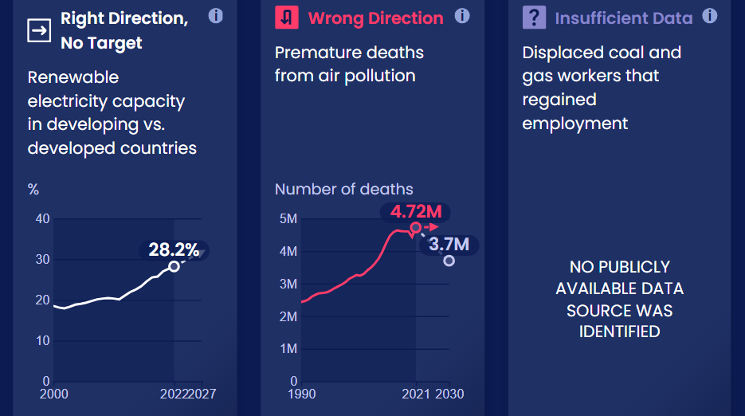
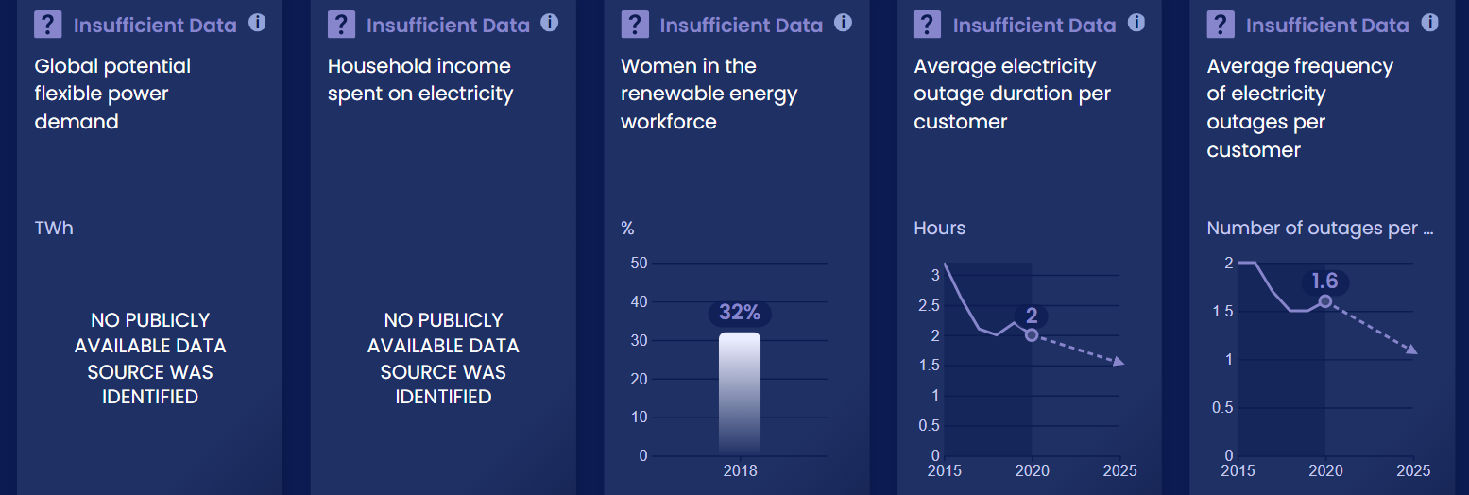
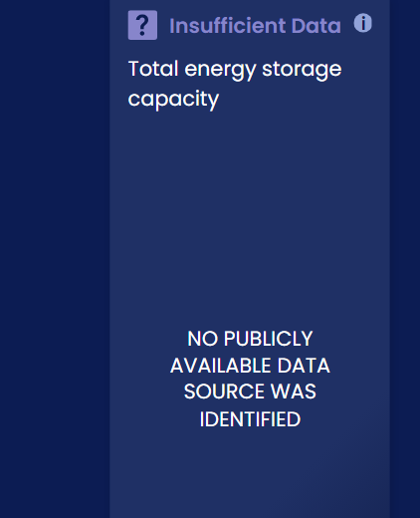
Progress toward targets
In this system, we have identified 17 target indicators. Out of the 17 targets we've evaluated, 9 are moving in the right direction and 0 are on track.

Slide 8
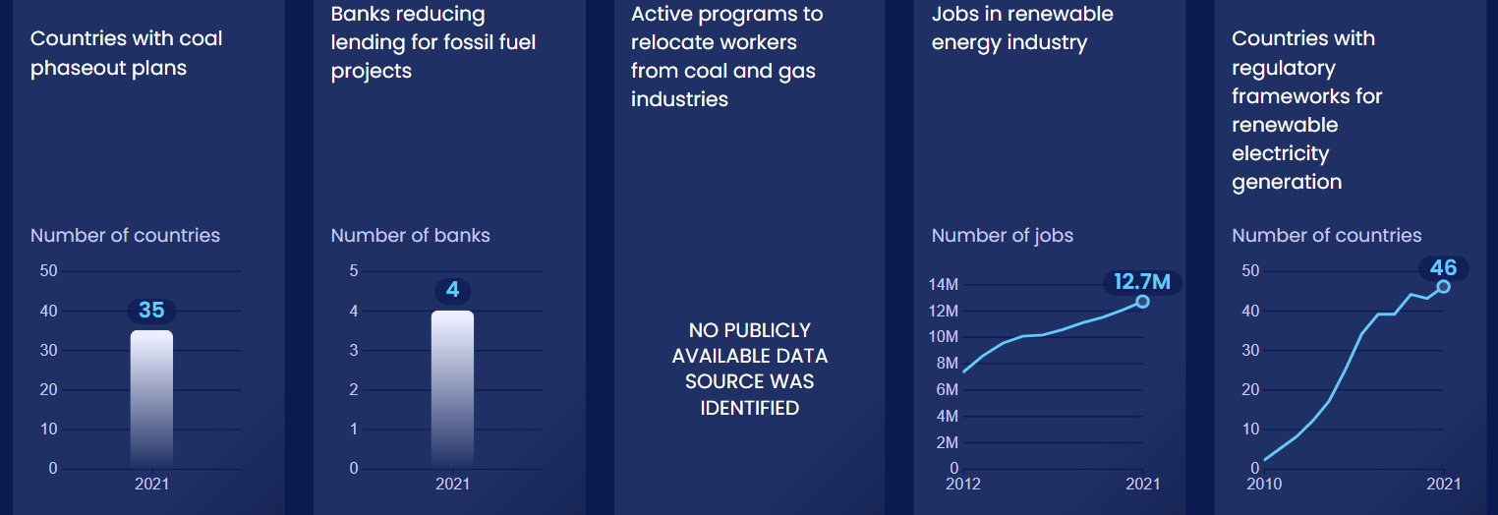
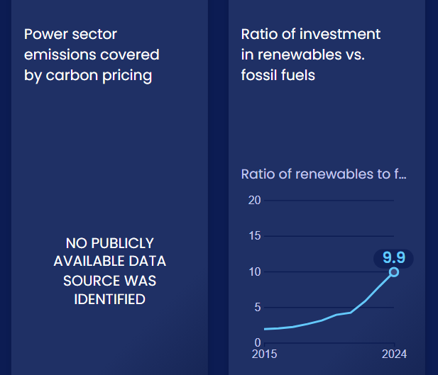
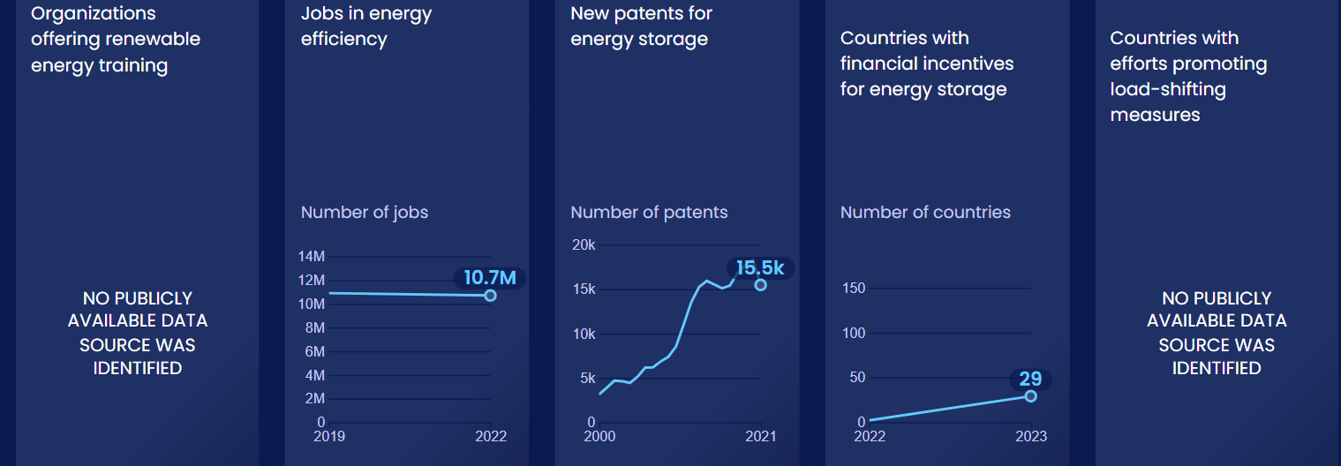
Enablers and barriers
In this system, we have identified 28 enablers and barriers to change.

Slide 9
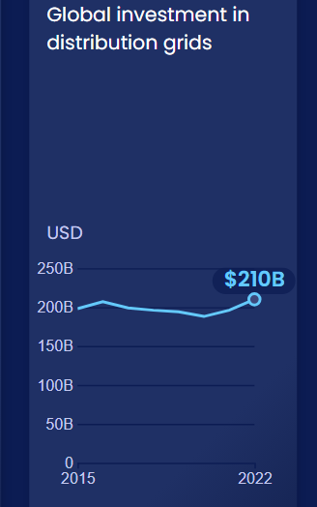
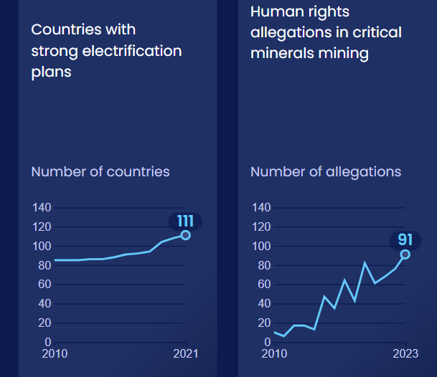
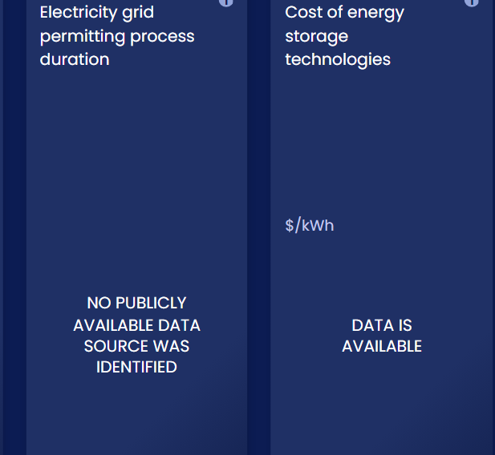
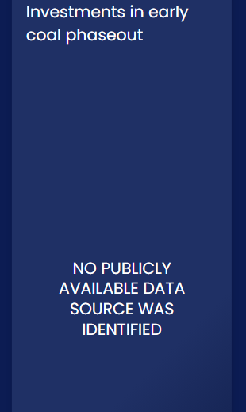
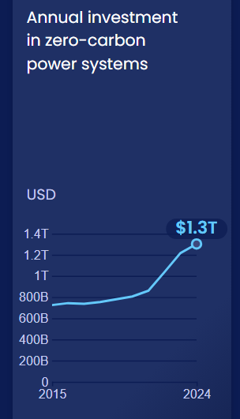
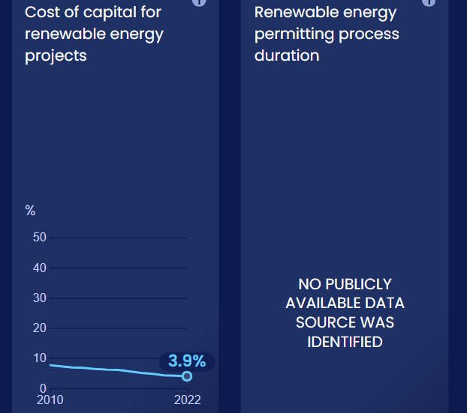
Enablers and barriers

Slide 10
Phase out unabated ​ coal and fossil gas ​ electricity generation​​
SHIFT
Notes:
Photo by Arnold Paul: https://www.flickr.com/photos/48722974@N07/4538083341/in/photolist-7V1S5e-2ng6ikq-21LPiZ9-2mtYgB5-2ng7xGT-gwmAC2-ySMBRW-2nfZXtH-2mu73ep-2ng6hgw-2itUraA-2mu893n-fq1QRL-2mu896t-2mQBsf6-2ng6sVp-9cMxq1-fiu974-24ECPez-2hcwFKX-xWKFVN-bVjdcF-yRtk4d-iFiov3-2itzocu-2iu5A6r-5ZJqbG-23cyaH9-2mu4wiq-2mu891J-2mu894j-gwmN7H-hyaHM3-2mu73A6-aDxYdX-2n13gB6-2kZXR3W-aDxT4g-oxQVNa-9iAxWB-aDxT1Z-2mu73ys-2mu3nLL-yBaNaS-xWU72M-T928LG-2inex8k-22RjdtX-2n7yiBc-2mDtyDG

Slide 11
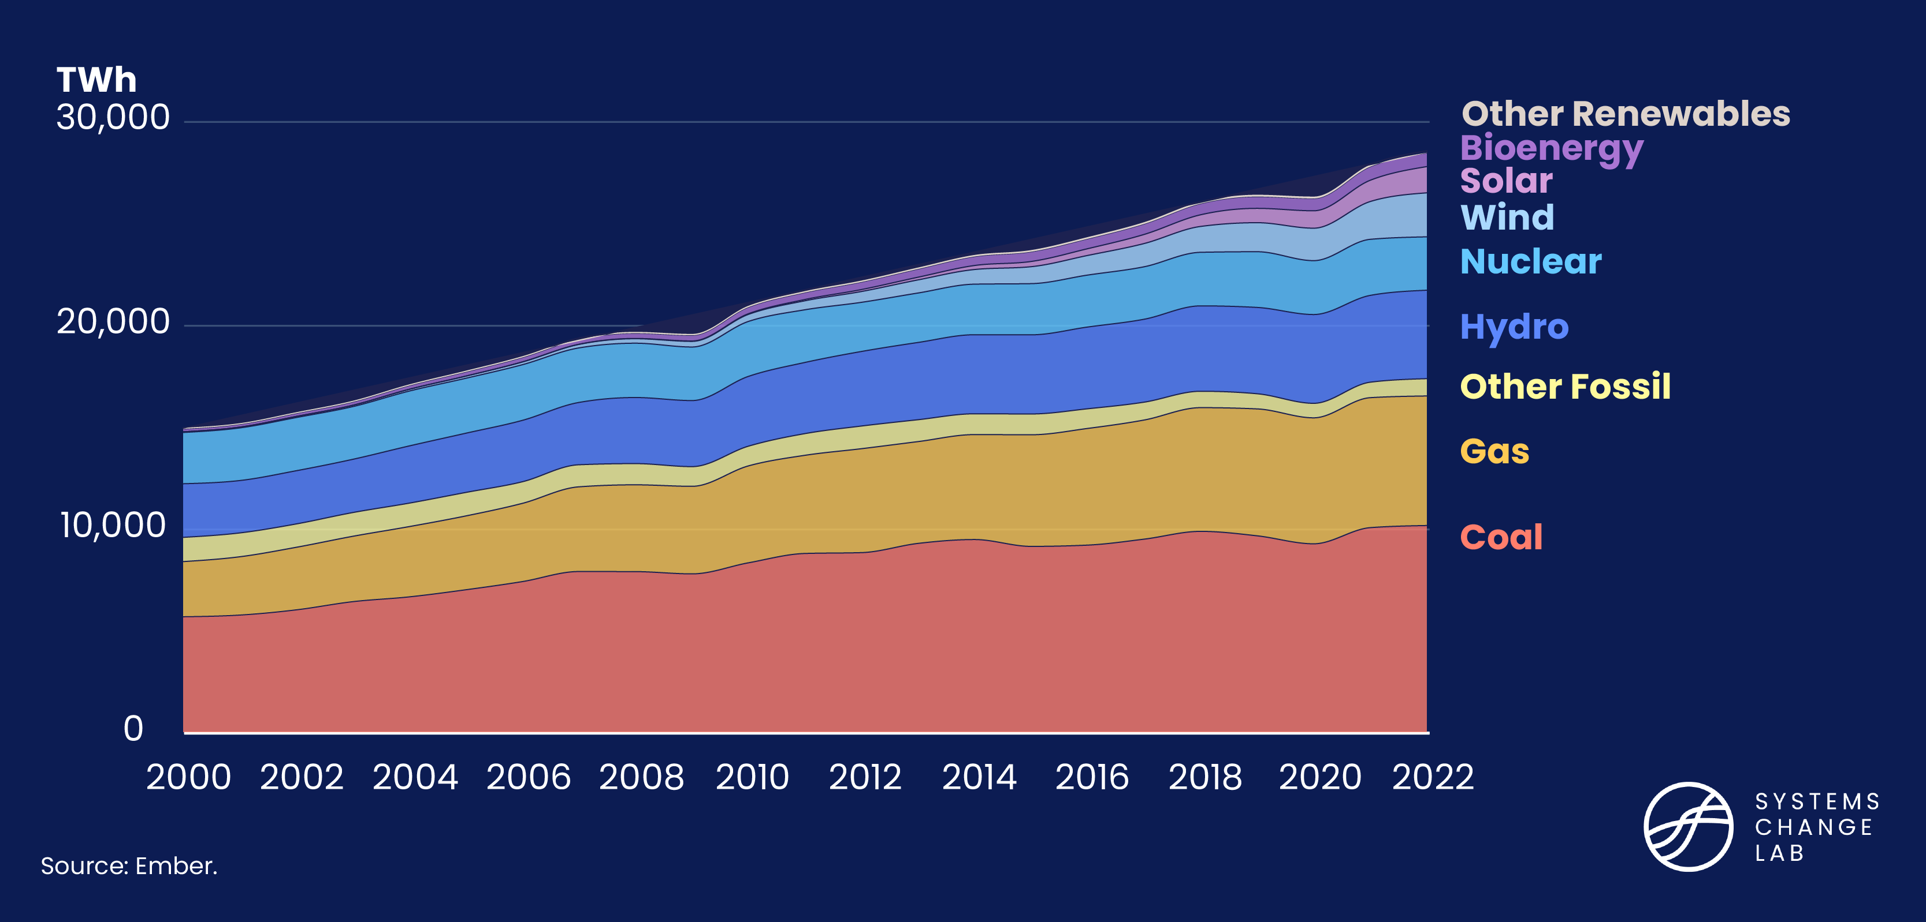
61% of electricity generation in 2020 is carbon intensive

Slide 12
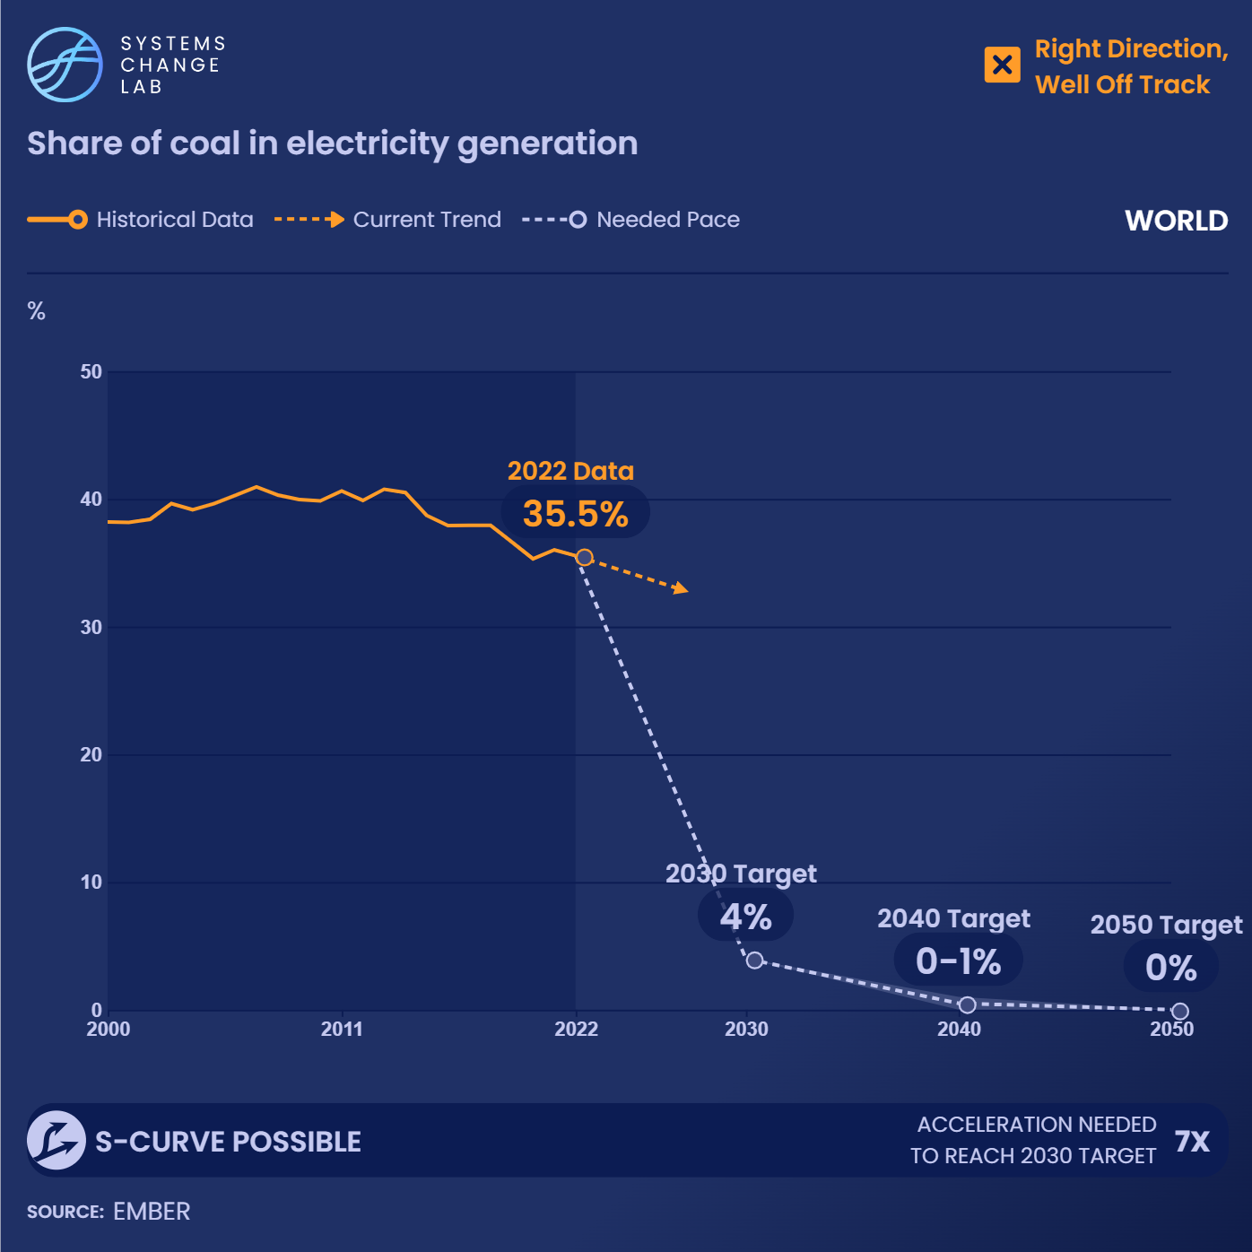
Of all the emissions generated by the global power sector, the burning of coal contributes the largest share, with coal consumption making up around 75% of power sector emissions.
Notes:
To align the power system with the Paris Agreement, efforts to phase out coal generation need to accelerate sixfold to reach near zero by 2030.
Of all the emissions generated by the global power sector, the burning of coal contributes the largest share. In fact, around 75% of power sector emissions are due to coal consumption. Therefore, the removal of coal from the global power fleet is fundamental to decarbonizing the power sector.
Globally, the share of coal in electricity generation peaked in 2013, reaching around 41.2%. Since then, it gradually decreased at an average of 1.8% per year. While this is a positive trend, the overall consumption of coal is actually rising. In absolute terms, coal use has risen by 20% since 2010, with total generation estimated at 10,042 terawatt hours (TWh) as of 2021.
We need a rapid, likely exponential, decline in coal consumption, and any new coal capacity additions run an increasingly high risk of becoming stranded assets under pathways that achieve the 1.5 degree C goal.
Globally, coal generation shares need to fall sharply to around 0-2.5% of total generation by 2030 and reach zero by 2040. To meet this goal and align the power system with the vision of the Paris Agreement, there must be a six-fold increase in the rate at which global coal generation shares are now falling.

Slide 13
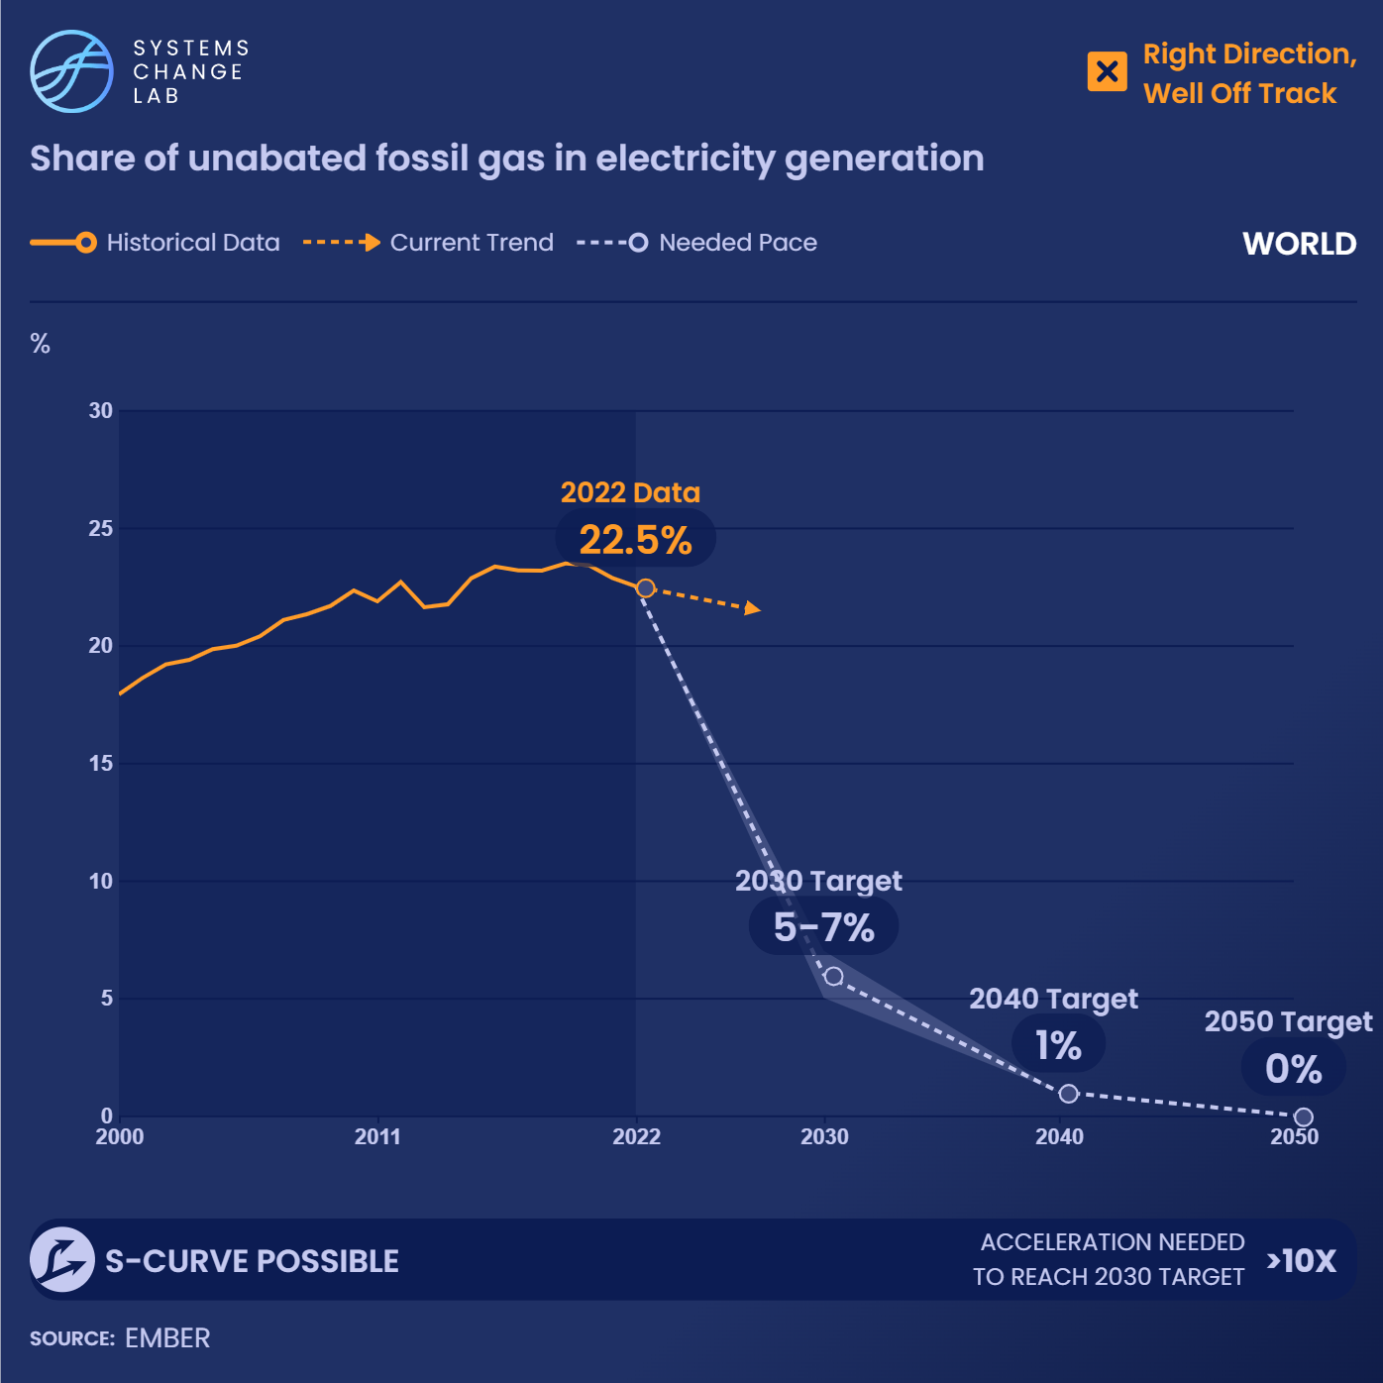
Fossil gas consumption in the power sector needs to fall to 5-7% of total power generation by 2030 and reach near zero by 2040.
Notes:
Fossil gas is the second-most used fuel in the global power sector, generating 24% of electricity as of 2019 and contributing 22% of total CO2 emissions. In addition, the production and transport of fossil gas generates significant quantities of fugitive methane emissions, a potent GHG. For more on methane emissions from energy production, see Reduce methane emissions from oil and gas operations.
The use of fossil gas for electricity generation has been increasing sharply since 1995 — a trend that must reverse in order for the power sector to align with the Paris Climate Agreement’s long-term temperature goal. Relative to 2019 levels, unabated fossil gas needs to fall to around 17% of total power generation globally by 2030. From then on, it should contribute no more than 5% by 2040, so that unabated fossil gas is completely phased out by 2050.
The specific year by which a country should reach near zero fossil gas will depend both on the amount of gas in the power system and the pace at which renewables and other alternatives can be scaled up. For many developing countries, this will require the availability of adequate finance. New investments in fossil gas power generation this decade are to a large extent stranded assets.

Slide 14
Only 35 countries have pledged to phase out coal power or to remain coal-free as of 2021. Currently, the three largest consumers of coal — China, India and the United States — do not have phase-out pledges.
Notes:
The evidence is overwhelming: coal power has no place in 1.5 degree C compatible pathways. To meet the ambitions of the Paris Agreement, global coal power should account for around 0-2.5% of total power generation by 2030 and be entirely phased out by 2040. Because the required pace of change to meet this goal is immense, it is vital that countries make strong commitments to remove coal. Such commitments should be backed by robust strategies.
As a means of assessing governmental commitments to decommissioning coal, this indicator tracks the number of countries with strategies in place to phase out coal power. Only 35 countries have pledged to phase out coal power or to remain coal-free as of 2021.
Several European countries, such as France, Spain and the United Kingdom, are aiming to phase out coal power by 2030, as are Canada and New Zealand. Currently, the three largest consumers of coal — China, India and the United States — do not have phase-out pledges. Meanwhile, other countries have targets that do not align with the Paris Climate Agreement. Germany, for instance, is the fourth largest consumer of coal and aims to phase out coal power by 2038.
Photo by Dominik Vanyi via Unsplash: photography of excavators at mining area photo – Free Mining Image on Unsplash

Slide 15
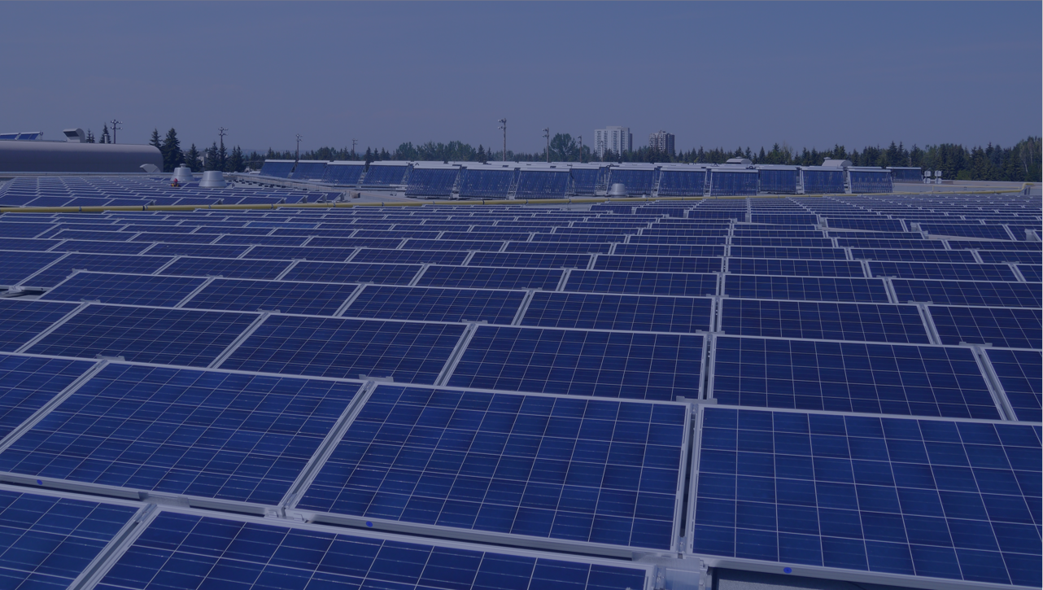
Rapidly scale up zero-carbon electricity generation
SHIFT
Notes:
Photo by Green Energy Futures: https://www.flickr.com/photos/greenenergyfutures/26366624930/in/photolist-GaVQZy-9PYJgf-bqzRBC-ysPFAs-FvBnUq-2kRFTR8-Kn7Xme-azaP4n-KWCgH-boAaUF-rSVoYh-sauPoK-sbD2Zz-LkFwFB-asnPMc-efxTWg-tsB97T-asqrbS-pfCqc3-KWCw4-nRRKZ4-asqjmE-efDEmo-8NMPqm-e1quAB-asqqNm-dSJnem-AYmGeS-aoYHjW-efDDLo-FvBiLq-efDEpf-efxTSP-efDEob-efDDPY-efDDDy-efDEiY-s8efB5-sakZWJ-efDDYE-2aPCBbU-efDDFo-rRaHXx-rSVZX5-cPch51-KjgdoG-rSU3J1-s8cpJY-efDDTU-efxUcv

Slide 16
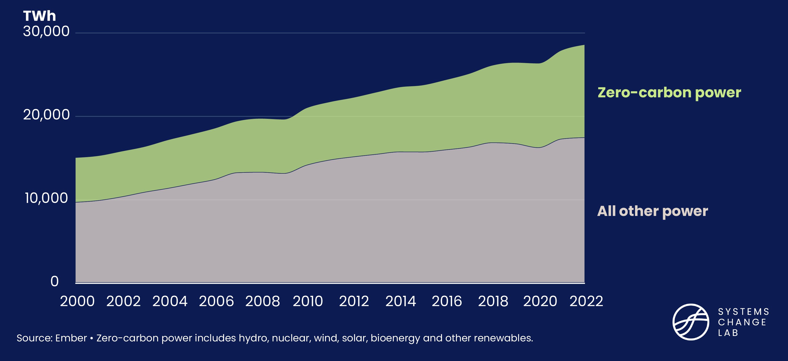
Total power generation is increasing alongside clean energy

Slide 17
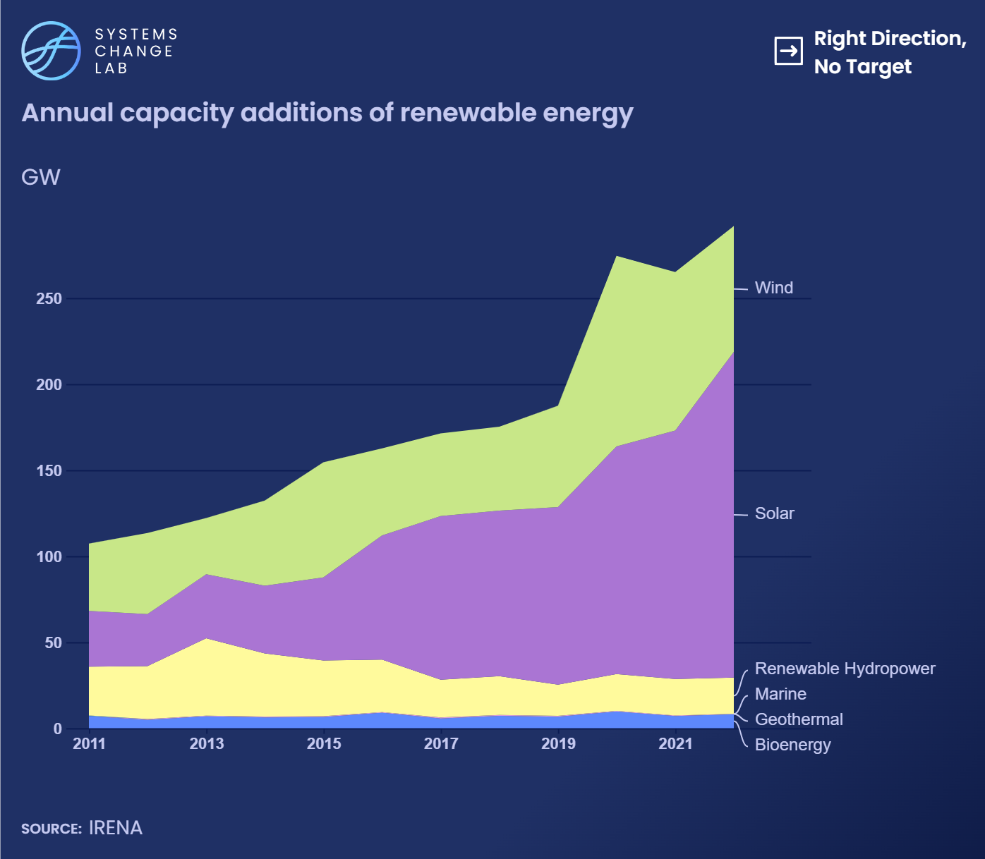
From 2021 to 2022, solar power generation grew by 25% and wind power generation grew by 14%.
Notes:
To achieve a zero-carbon power system by 2050, nearly all electricity will need to come from renewable technologies. Achieving this will require large-scale renewable energy capacity additions. To track momentum toward this goal, it is important to monitor annual capacity additions, which represent new installations of renewable power.
Annual capacity additions of renewables are generally increasing. Since 2011, at least 106 gigawatts (GW) of new clean power capacity have been added to the global power system each year. In 2021, 260 GW of new renewable power was added, primarily driven by expansions of renewable energy projects in China.
Since 2020 — which was a record-breaking year — new renewable energy capacity additions have exceeded 260 GW annually. However, major global instabilities, such as the COVID-19 pandemic and Russia’s invasion of Ukraine, have slowed this pace. Given supply chain disruptions and geopolitical issues, this indicator will need to be carefully monitored to ensure that the current slowdown does not significantly derail the scaling of annual renewable energy installations.

Slide 18
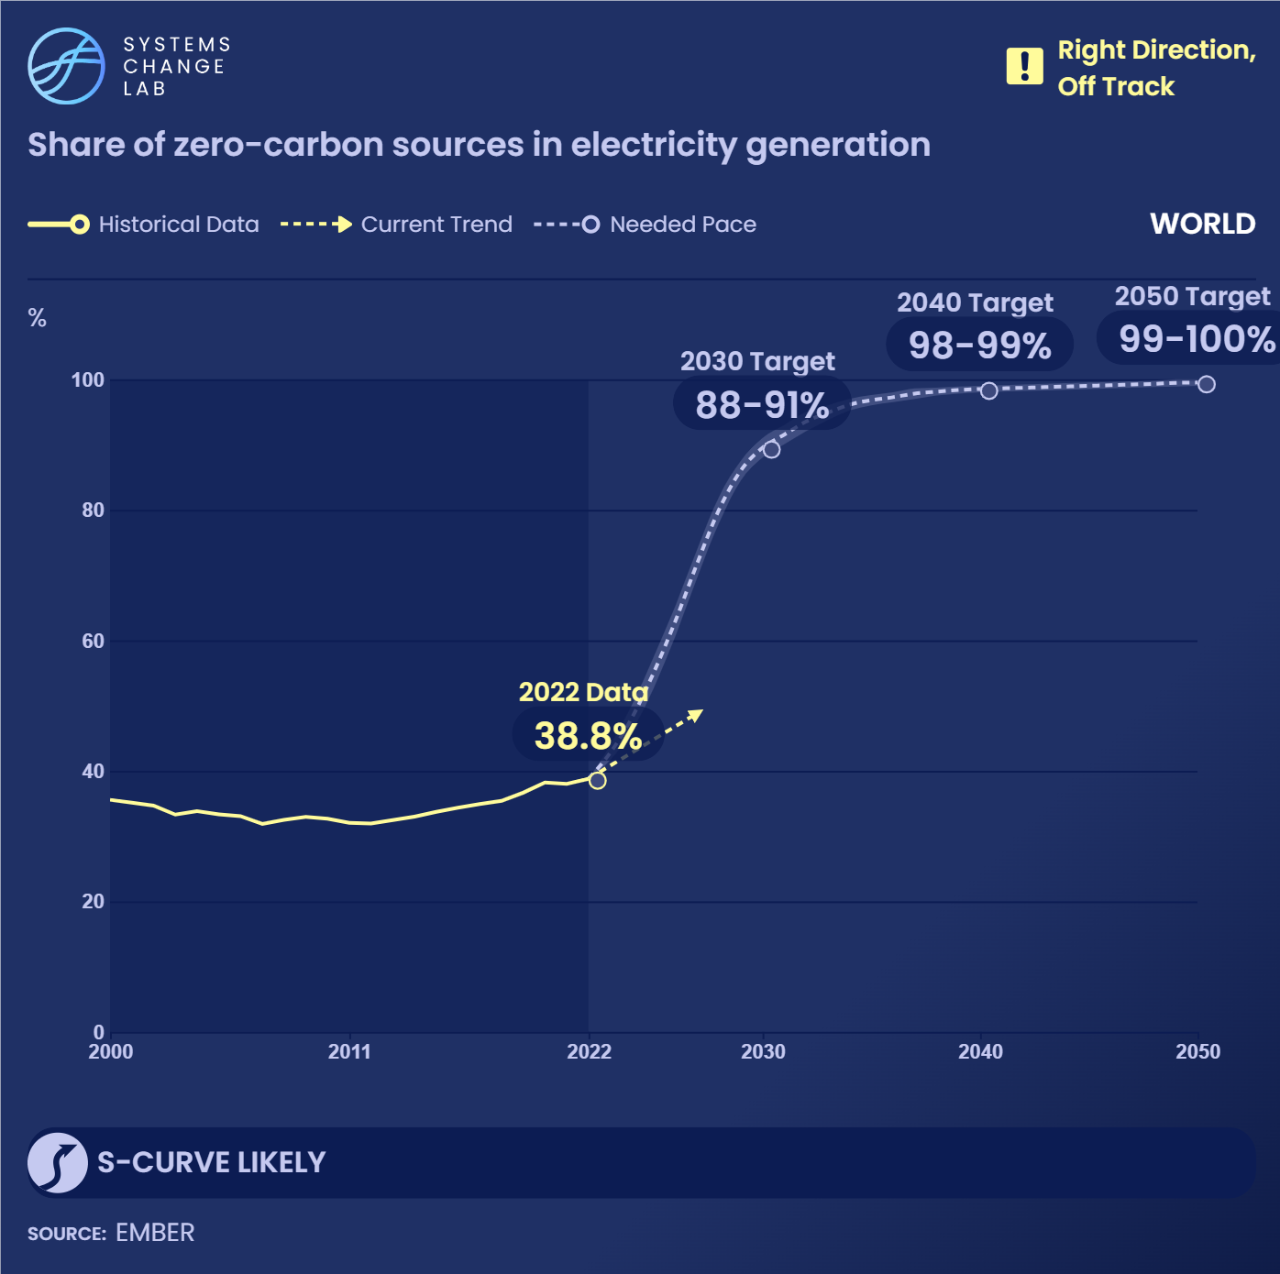
The share of zero-carbon sources in electricity generation increased by an average of 1.8% each year from 2012 to 2019. This shows progress, but efforts will need to accelerate at least sixfold by 2030.
Notes:
To decarbonize the power sector, fossil fuels need to be displaced by zero-carbon energy — technologies that can generate electricity without greenhouse gas (GHG) emissions. This indicator tracks solar, wind, hydro, biomass and nuclear power.
The share of zero-carbon power declined between 2000 and 2011 and has increased only marginally since, reaching 36% in 2019. Efforts will need to accelerate the growth in zero-carbon power about six-fold by 2030 to align with Paris Agreement compatible pathways. Growth in zero-carbon power is likely to follow an S-curve and the technology is in the breakthrough stage of adoption, so the rate of change will likely accelerate faster than the past five years, although this is not guaranteed. The share of zero-carbon power needs to reach 74–92% by 2030 and 98–100% by 2050.
Most of the growth in zero-carbon power since 1990 has been through the addition of new solar and wind capacity, particularly in Asia. Given the high costs and lead times of nuclear power projects — as well as their environmental and geopolitical concerns — the majority of future power installations are expected to be renewable energy, particularly solar and wind. Nuclear capacity peaked in the 1990s and has declined ever since, with shutdowns outpacing new installations.

Slide 19
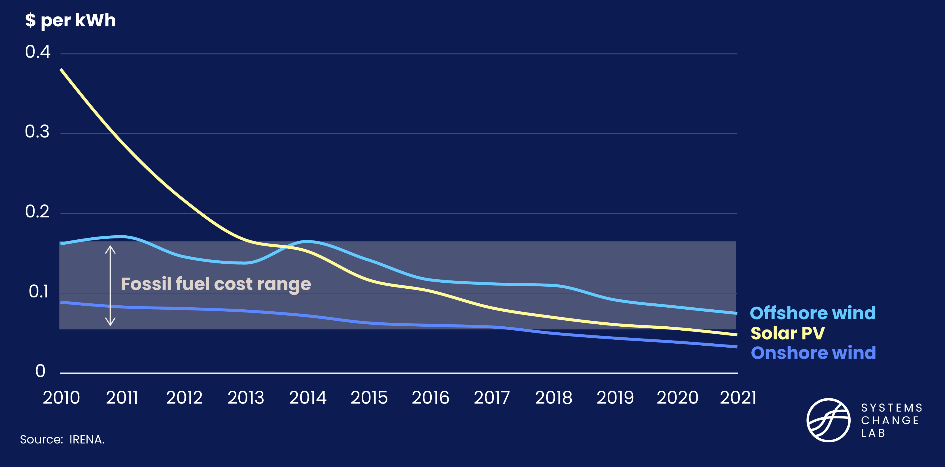
New wind and solar are cost-competitive with fossil fuels

Slide 20
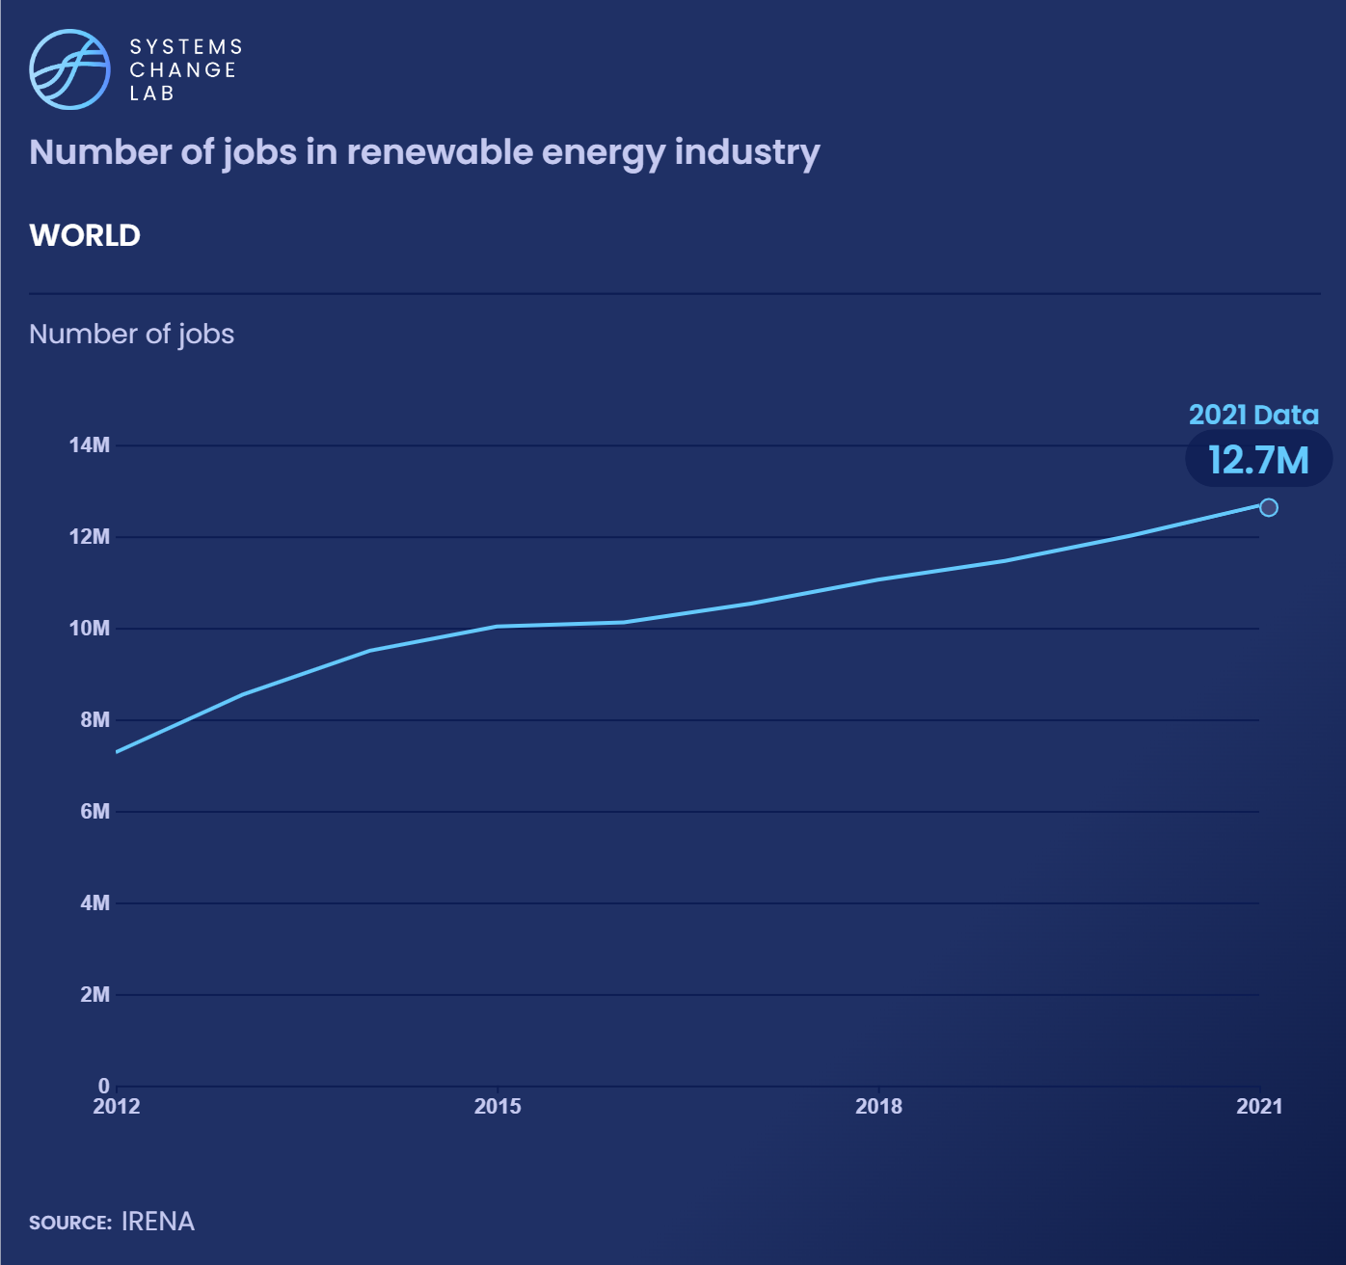
The increasing number of jobs for men and women in renewable energy shows that greener energy can create decent and productive work opportunities, which is central to a just transition.
Notes:
The increasing number of jobs for men and women in renewable energy shows that greener energy can create decent and productive work opportunities. This is central to a just transition strategy.
The renewable energy jobs created must be quality jobs and accomplish basic rights. New employment opportunities should provide men and women with decent work, meaning that they should offer fair compensation, safe working conditions, equal opportunities and social protection. These jobs must be free of forced and child labor, and provide employees the right to organize or discuss work-related issues, among other conditions. The biofuels sector, which includes a significant portion of rural employment, is likely to suffer from decent work deficits.
Global employment in renewable energy was estimated at 12 million in 2020, up from 7.3 million in 2012 when it was first measured. Women account for 32% of the global renewables workforce, but their participation varies widely among countries. Due to data and time limitations, we do not yet delve into the quality of these jobs, but this may be addressed in a future release of this platform.

Slide 21
Women account for one-third of the global renewables workforce, but their participation varies widely among countries.
Notes:
The increasing number of jobs for men and women in renewable energy shows that greener energy can create decent and productive work opportunities. This is central to a just transition strategy.
The renewable energy jobs created must be quality jobs and accomplish basic rights. New employment opportunities should provide men and women with decent work, meaning that they should offer fair compensation, safe working conditions, equal opportunities and social protection. These jobs must be free of forced and child labor, and provide employees the right to organize or discuss work-related issues, among other conditions. The biofuels sector, which includes a significant portion of rural employment, is likely to suffer from decent work deficits.
Global employment in renewable energy was estimated at 12 million in 2020, up from 7.3 million in 2012 when it was first measured. Women account for 32% of the global renewables workforce, but their participation varies widely among countries. Due to data and time limitations, we do not yet delve into the quality of these jobs, but this may be addressed in a future release of this platform.
Photo from UNDP Climate Flickr: https://www.flickr.com/photos/undpclimatechangeadaptation/51101763221/in/photolist-2jVRp37-2jVRp4V-2kJbtYH-2kRFTR8-2kPZmUg-BEnWvT-pto6hj-8svYBw-pdVqyY-pvo8ab-2kPZn75-2kQi52R-2kGMNxH-2kQi5bZ-2kJbtTY-2kPZmYe-2kJbtZj-2kQi56d-2kQi5bJ-2kGMNqU-2kGMNvU-2kPZmX7-2kPZmS2-2mkcaPa-2kQixVx-2kJbu2P-2m9reXF-rXzGJC-2kJ4K74-8ssWkk-8svYyj-ghFjtK-LqVCbQ-2kJ4KdB-8ssWCk-bSmShM-8ssWFR-bQjofV-2n7pJvC-24NyhcK-bDs9mU-bBpRNj-bQjkgT-hdynnS-8syD1r-2kyU9hF-dWXhZV-2kyQB1F-bDs9PC

Slide 22
Modernize power grids, scale energy storage and manage power demand
SHIFT
Notes:
Photo by Arby Reed: https://www.flickr.com/photos/19779889@N00/36405081436/in/photolist-XsZynS-edAMq7-2gpzNpc-75Wz5t-2hNDxyh-73cc41-JYMZzr-WVpgDE-4kuTVn-2m6kHrZ-2n15oQM-FJZPGZ-2aZBjaV-6gpJuQ-23hzYq5-2mPo3TG-2kJ4Lf7-2kd71Gy-PKYgok-22ChYDU-fRCAx-2krVK6V-WG2FP6-2mWM5DB-2mWK38p-2mZBedP-2ftRoM8-2mQHSTT-2mPtMNA-d5uAM9-AQoaPn-2navT6K-2mZEwrV-e3pAsr-2jwETDf-2m3i37H-6eFSxj-aWFkCc-2m9iKFs-2mXe2V6-62DiAD-dWrKF9-2kNoyQL-LXeYsz-ExJJVo-2k1eYpT-2iFJF4m-9UW3JB-fEcZcD-2nDLCit

Slide 23
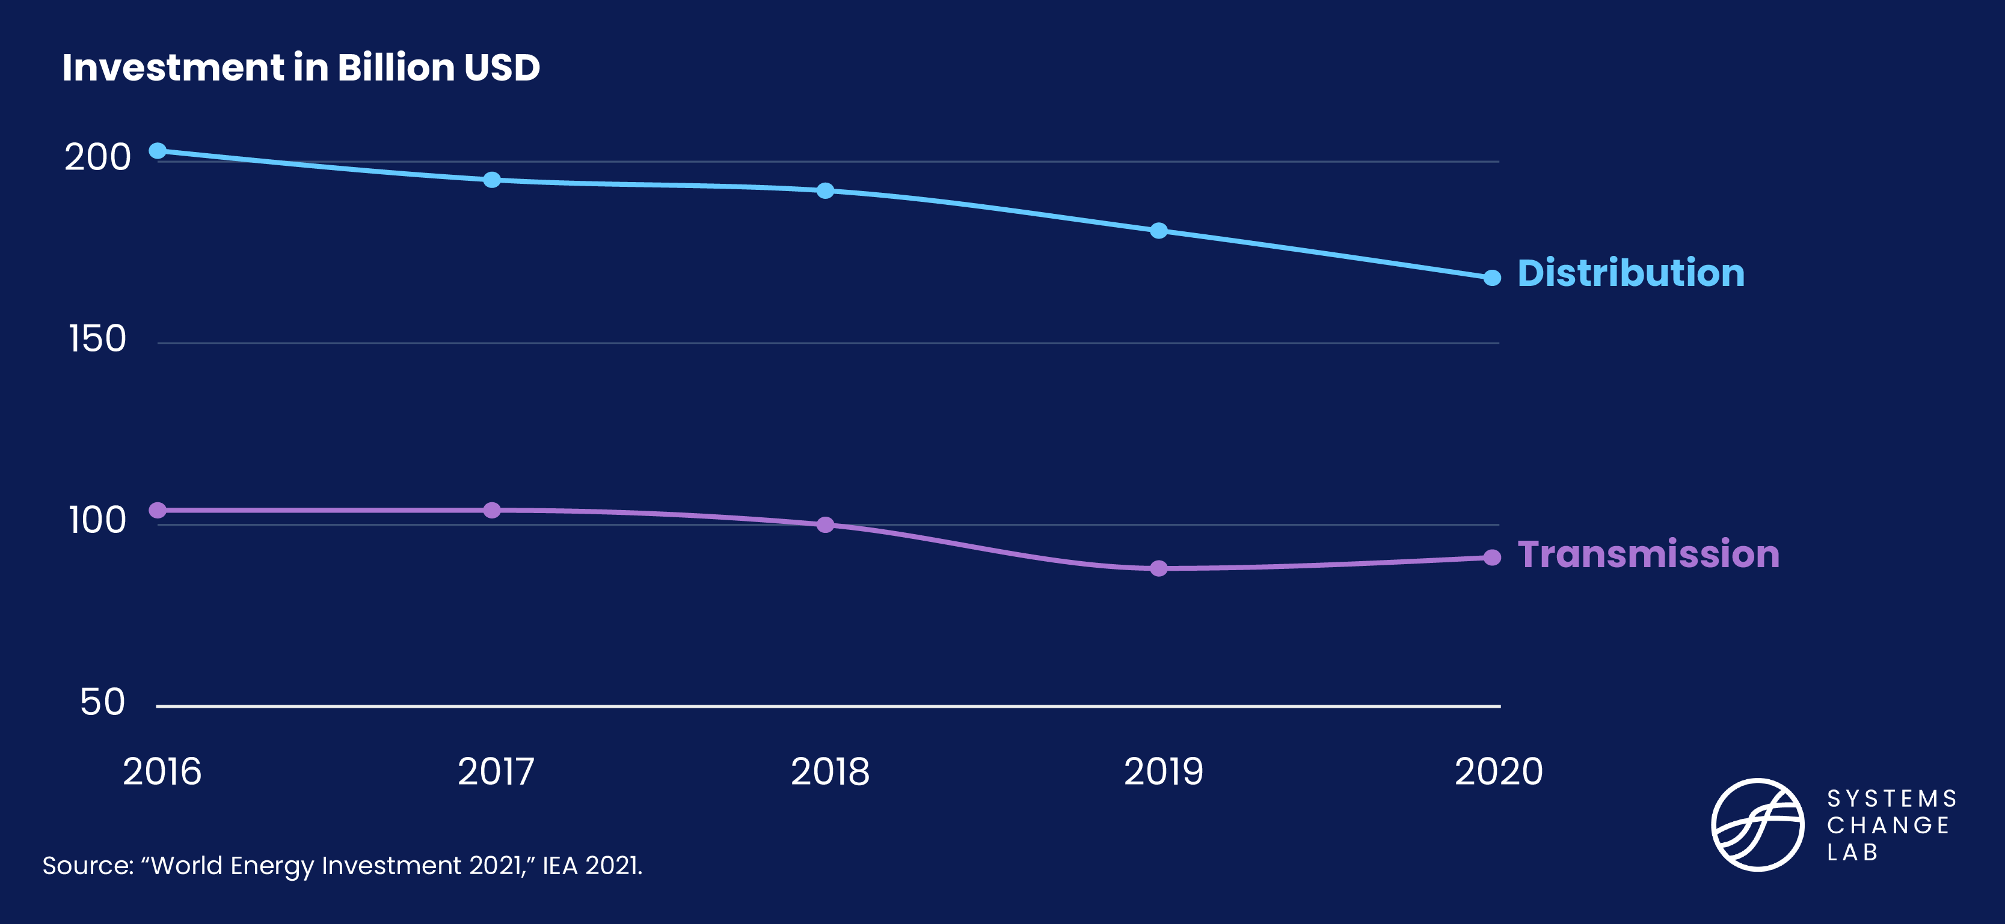
Transmission and distribution are key to providing power

Slide 24
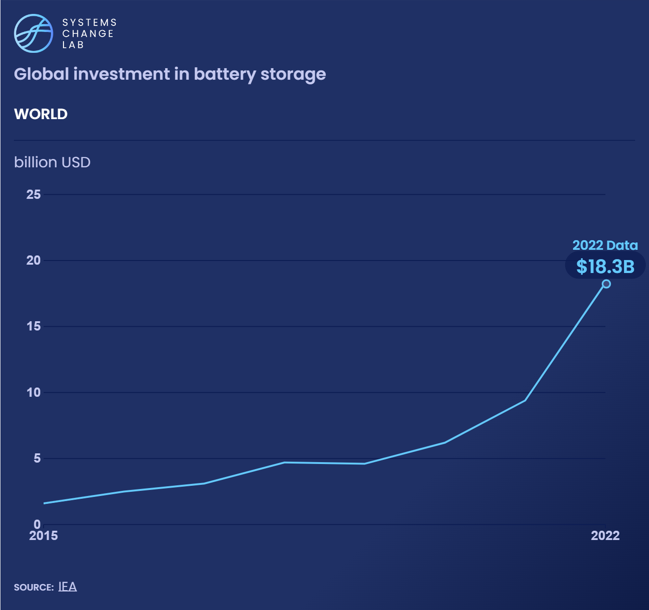
To align the global power sector with pathways compatible with the Paris Agreement, global investments in storage need to grow by 25% every year.
Notes:
Energy storage technologies, particularly battery storage, will form a critical component of new sustainable energy. Storage solutions will help to smooth out the intermittency in renewable energy supplies caused by weather variability and the lack of solar power at night.
In order to realize energy storage at scale, we will need technologies that are affordable to purchase and operate. This indicator tracks the price of lithium-ion (Li-ion) batteries — a relatively advanced and widely used battery technology — as a proxy for affordable storage.
Li-ion storage prices have been declining sharply since 2010, at a rate that surpasses the cost decreases of solar and wind technologies. In 2010, battery prices stood at around 1,220 dollars per kilowatt-hour ($/kWh), and in 2021 this decreased nearly tenfold to $132 per kWh.
Although the significance of these trends cannot be understated, battery technologies remain expensive and are particularly unaffordable for emerging economies. To realize the level of storage proliferation needed to achieve a net-zero power system, more financial support, as well as research and development, is needed to further dampen costs.
Battery storage technologies will form a vital component in the future zero-carbon power system. Large amounts of capital are expected to flow into storage solutions.
Monitoring the total investments into battery storage allows us to track the global investment priorities of governments and businesses, an important market signal of the clean energy transition. Over time, we expect this indicator to increase significantly.
Recently, annual investment into energy storage has risen substantially. In 2015, a combined $1.6 billion of financial commitments were made for energy storage, but this has been rising by an average of $2.3 billion each year.
Much of this growth has taken place in just the last few years. In 2020, total investment was just over $6 billion – this amount tripled to $18 billion in 2022.
Although these signs are encouraging, there is still a major gap in energy storage deployment. Since far more energy storage is needed by 2030 to align the global power sector with pathways compatible with the Paris Agreement, global investments in storage need to increase commensurately, though available data are currently insufficient to estimate by how much.

Slide 25
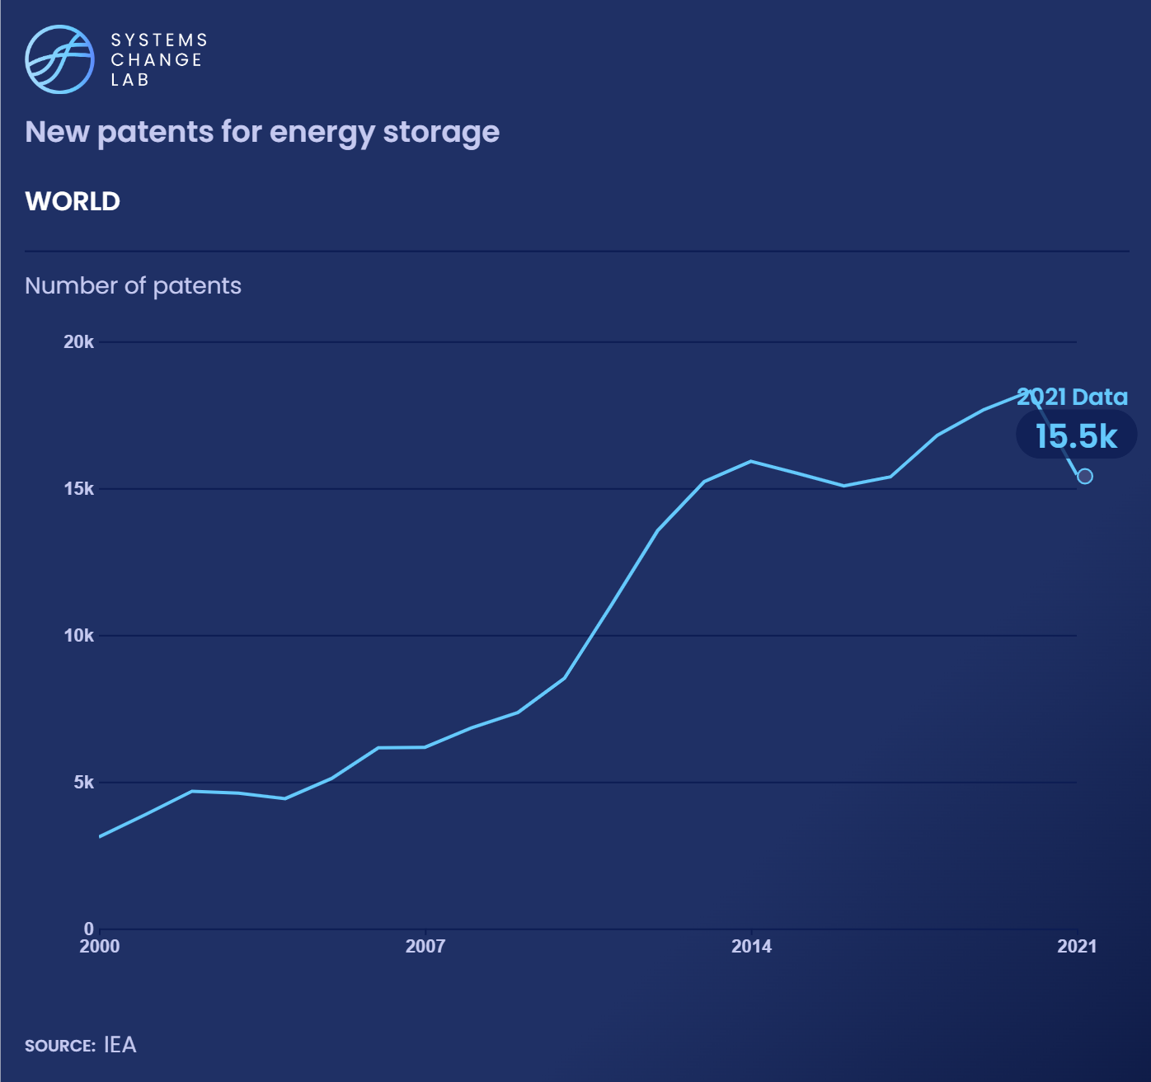
As of 2021, 15,456 new energy storage patents were submitted, a fourfold increase from 2000 and promising signal of innovation in the sector.
Notes:
Renewable energy technologies, such as solar and wind, will form the backbone of the future energy system. Because supplies from renewable energy are inherently variable, we need to be able to store energy for use at a later time.
Achieving high proportions of renewables will require technological innovation in energy storage techniques to bring down prices. Advances are also required to ensure energy storage technologies are produced and operated sustainably, and can be disposed of or recycled with minimal environmental impact at the end of their life.
While technological innovation can be measured using a range of different approaches, we track the number of patents filed for a given technology. This method is a proxy for market innovation and progress for energy storage technologies.
The number of patents filed related to energy storage technologies have increased considerably since 2000. As of 2021, 15,456 claimed priorities for energy storage patents were submitted, a 400% increase from 2000. This is a positive indication that storage players are operating and innovating in a stimulating market. Because storage technologies are still maturing, businesses and governments will need to provide strong support to unravel latent innovation.

Slide 26
Ensure energy access and a just and equitable transition for all
SHIFT
Notes:
Photo by Axel Fassio/CIFOR: https://www.flickr.com/photos/cifor/42726718744/in/photolist-286BAUy-bVNkQf-7bDUpo-bj6QRH-bVNkNu-CuTGS-7bAp4K-pHn6zt-2fzFrgF-7bAegP-NYokN6-28zYvnc-bVNkVs-NYomFi-LcXLVa-7bDP9b-NYom9M-M4bPgd-bj6Rgr-bj6Qqr-24bX3HG-3iuvBU-bVNm3f-bj6M16-2iYi6fb-28FSuRC-28FSuTG-28FSuRh-cAmAN5-7bAp52-oXuj5L-bVNkKo-2iYdXMK-bVNm4L-pWUb6a-eUttwp-6MJNi3-bj6LMg-NYokaT-bj6QKz-dyTf48-bj6RaH-cAmYW1-fVegP5-Saqts7-SRWf2f-24bX3Dy-9nAGod-bj7gMa-24bX3Sj

Slide 27
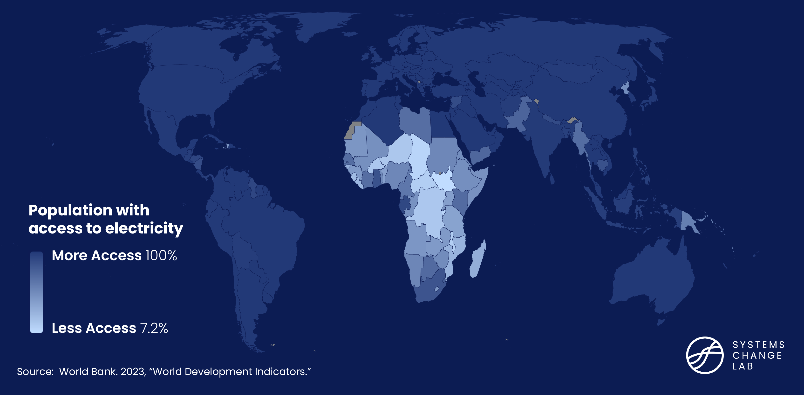
733 million people still lack access to electricity in 2020

Slide 28
In 2023, there were 91 allegations of human rights violations in critical minerals supply chains.
Eliminating human rights violations is key to securing supply chains for zero-carbon power.
Notes:
The clean energy transition is expected to bring a massive increase in the use and mining of critical minerals such as cobalt, copper, lithium, nickel, zinc and rare earths. It is estimated that under a net-zero scenario, the market for critical minerals will grow from about 8 million tonnes (Mt) in 2020 to over 40 Mt in 2050, with demand for lithium increasing 100-fold by 2050.
The human rights violations related to mining projects in general and critical mineral mining in particular are well documented.
The Transitions Minerals Tracker surveys allegations of human rights abuses in the mining of lithium, copper, cobalt, zinc, manganese and nickel. It records allegations against 51 indicators grouped in six categories: environmental impacts; impacts on the local community and attacks against civil society organizations; impacts on workers; governance and transparency; security issues and conflict zones; and issues related to the COVID-19 pandemic.
The database noted 11 allegations in 2010, but that number has grown as mining for critical minerals has increased. There were 61 recorded alleged violations in 2021.
The number of allegations of human rights violations in critical mineral extraction is one indicator of equity during the energy transition. Similar indicators focusing on one or more clean energy technologies also exist, but this is considered a better proxy because critical minerals are required for most clean energy technologies.
As the energy transition unfolds, progress on this indicator will be measured by a decreasing number of new allegations of human rights violations.

Slide 29
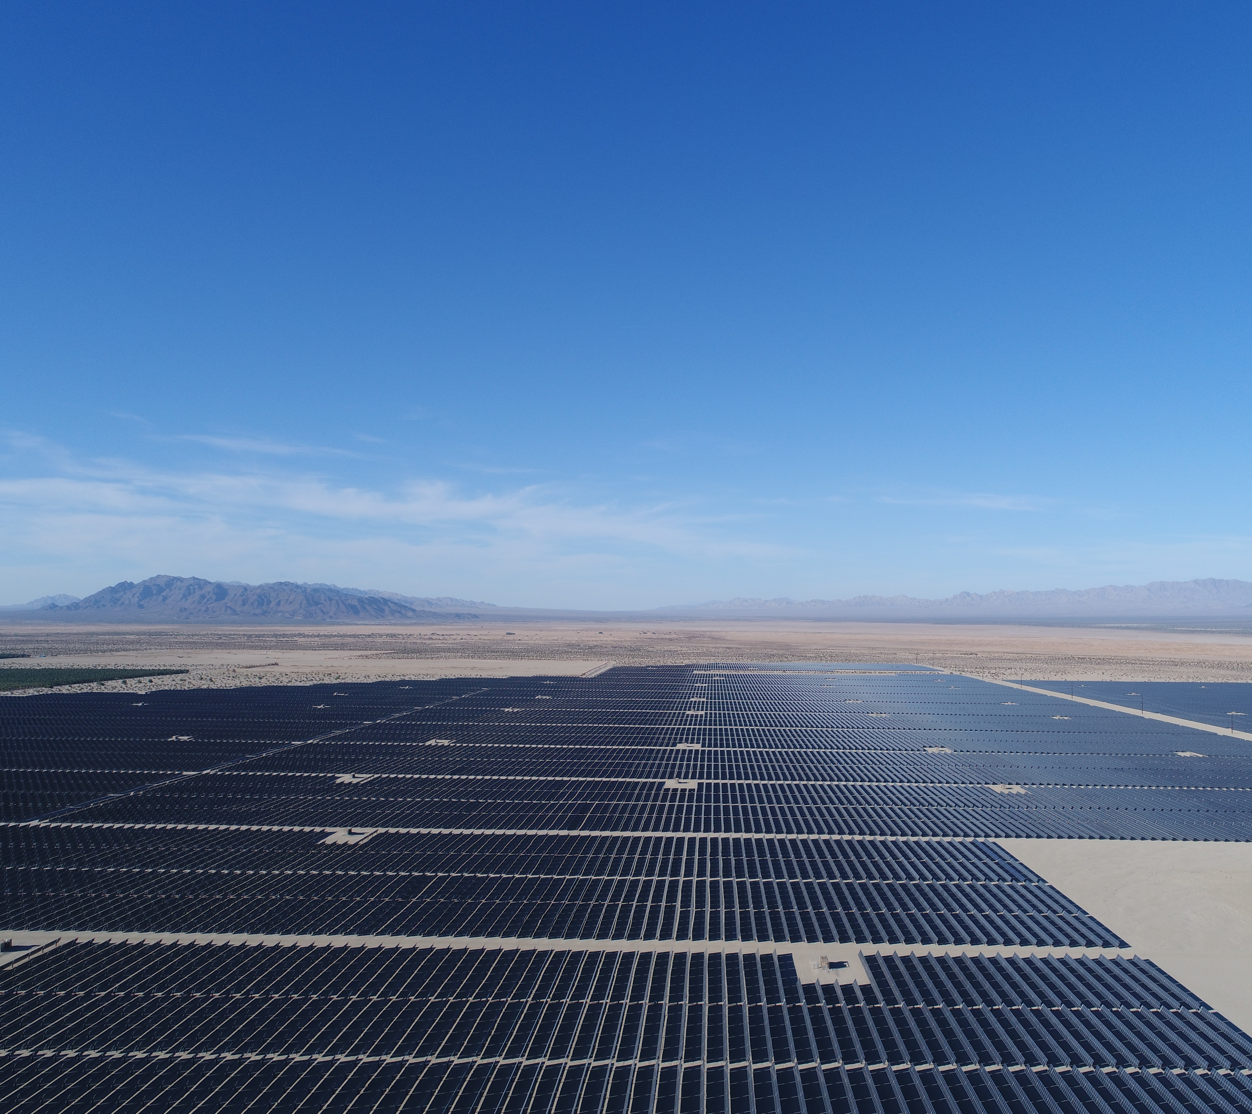
From 2011 to 2017, G20 countries directed $282 billion to developing economies for clean energy – less than 1% of the G20 countries’ investment in clean energy.
Notes:
Tracking the distribution of clean energy foreign direct investment (FDI) flowing from developed to developing countries provides insight into how public climate pledges translate into the private sector. It also shows which countries are capturing most of the investment — and benefits — of the transition.
From 2011 to 2017, the total FDI investment from the Group of Twenty (G20) members was about $4 trillion. Of this, $448 billion was for sustainable infrastructure, mostly clean energy, with $282 billion directed to emerging markets and developing economies. The investments were not evenly distributed, with nine countries out of 71 receiving 60% of the total. Crucially, low-income countries collectively received less than 1% of clean energy FDI.
While there is no specific target for the proportion of sustainable infrastructure FDI going to developing countries in 2030 and 2050, the flow of investment from developed to developing countries must increase and be equitably distributed rather than concentrated in a few nations.
There is currently no publicly available global dataset that measures FDI for sustainable infrastructure by country. Having a public record of annual FDI flows for sustainable infrastructure would demand accountability from developed countries to help developing countries finance their energy transitions.
Photo Credit: https://www.flickr.com/photos/blmcalifornia/52674062828/in/photolist-2k4GSxX-2i4FWQi-vrjsKX-2msNW2v-wsxr6p-2k7Dbj2-2ofCkK3-2o63mhS-GzRehb-qx1PEb-2nTMhN1-2mgps3R-2msKjgw-kLJ9yY-2msKjcD-2msE7B8-2msNW6y-Ahhn9C-GziQvw-2hik3gh-ysPFAs-Gtq853-CeZX9L-efDEmo-efxTWg-efDEpf-efDDDy-efDDFo-efDDTw-Rfkf2E-efDE63-ebsw9r-zrsLJc-efDEiY-efxUix-efxUqr-efDDTU-efxUcv-efDDX7-efDEcE-efDDYE-efDDZG-efxUhx-efDDSA-eby9LG-ebsw9x-eby9Lq-ebtHpg-ebswaT-ebswbZ

Slide 30
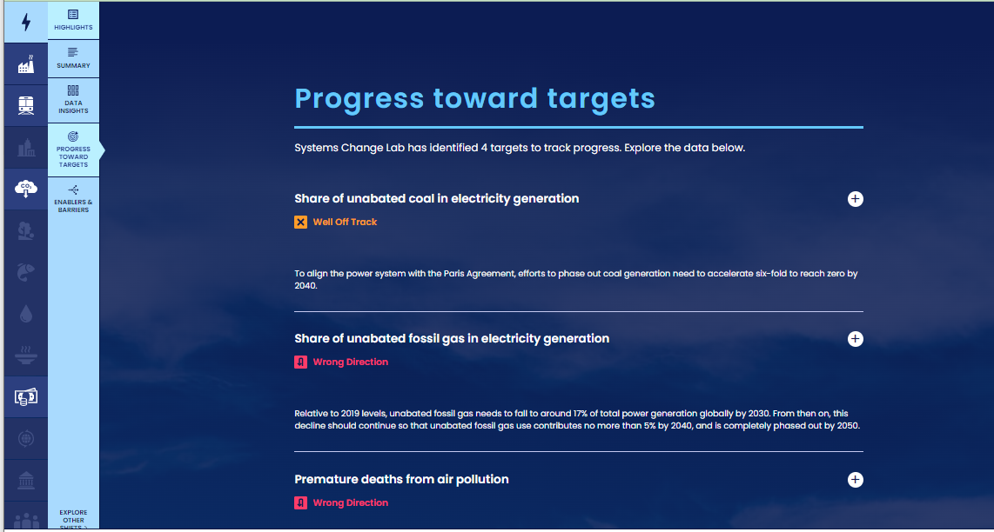
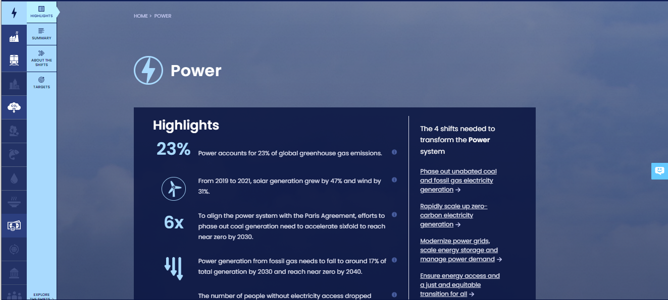
How to highlight a different indicator
Find your desired indicator on systemschangelab.org system pages
1. Select a system
3. Scroll down page to indicators and expand one
2. Select a shift

Slide 31
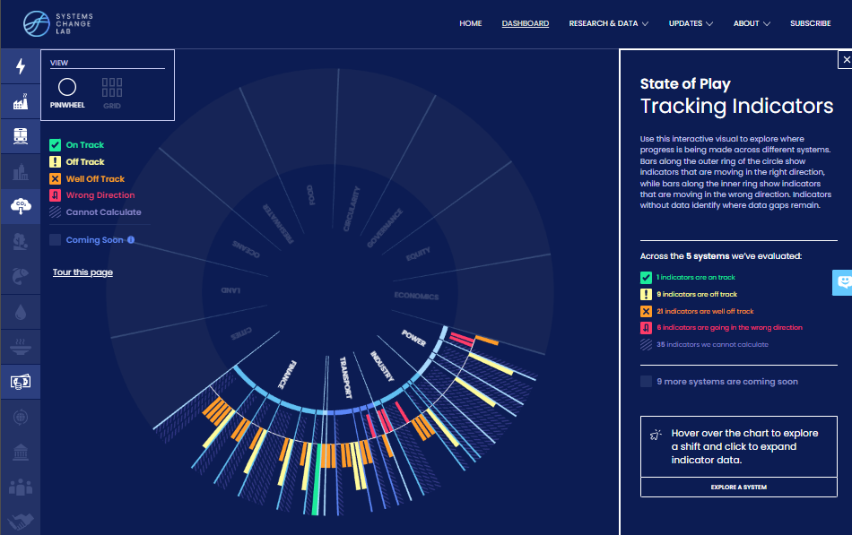
Alternatively, search for an indicator on the dashboard
1. Navigate to the dashboard
3. Search an indicator and then click explore data
2. Select grid view
4.
Notes:
Find your desired indicator on https://systemschangelab.org/
Look through System Page ( https://systemschangelab.org/power)
OR search the dashboard ( https://systemschangelab.org/dashboard) & select "EXPLORE DATA >" on your desired indicator

Slide 32
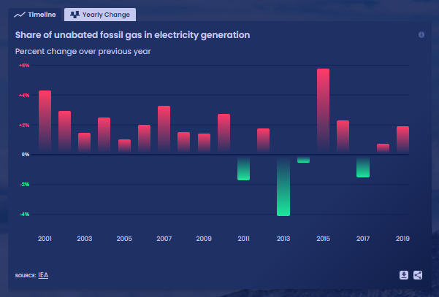
Pick a chart view and click the download button

Slide 33
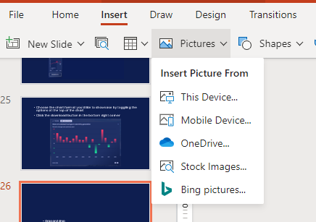
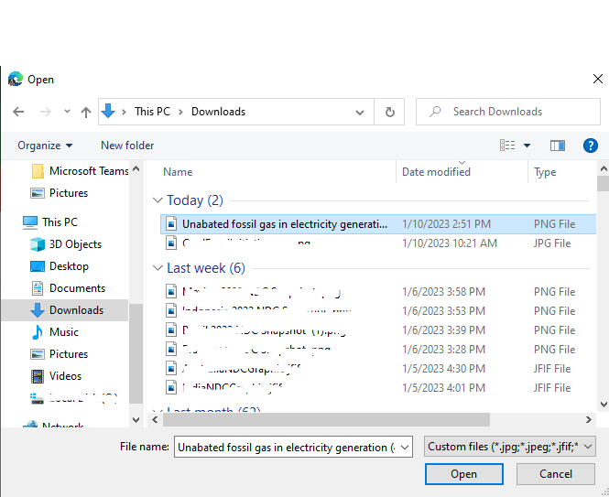
Next, add the chart to your slide deck
1. Select "Insert" and "Pictures" on the toolbar
2. Select chart from the downloads folder and open

Slide 34
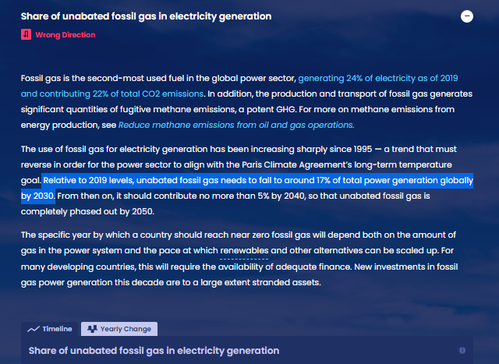
Add context from the indicator write-up as desired

Slide 35
For more information
VISIT: SYSTEMSCHANGELAB.ORG/POWER
EMAIL: CONTACT@SYSTEMSCHANGELAB.ORG

