Slide 1
Industry
Last updated December 2024 | systemschangelab.com/industry
Notes:
Photo by Vasily Iakovlev: https://commons.wikimedia.org/wiki/File:Reftinsky_reservoir_of_Sverdlovsk_region.jpg

Slide 2
Systems Change Lab
It’s time to change the way we think about changing the world.
Systems Change Lab monitors, learns from and mobilizes action toward the transformational shifts needed to protect both people and the planet.
The data platform identifies and tracks key shifts in our global systems that, when achieved together, can spur transformational change.

Slide 3
Interconnected systems
Power
Industry
Transport
Cities
Buildings
Carbon Removal
Land & Forests
Ocean
Freshwater
Food &
Agriculture
Finance
Circular
Economy
Governance
Social Inclusion & Equity
Economics

Slide 4
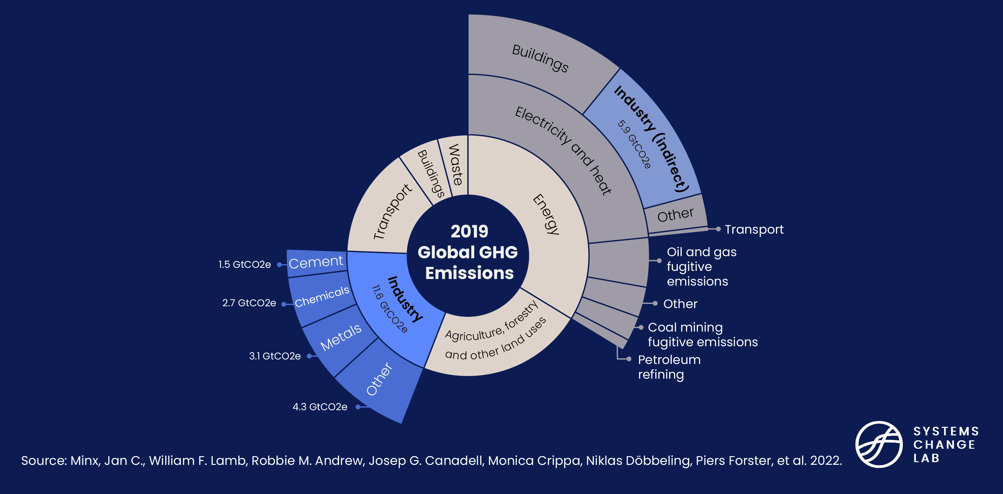
The industry system

Slide 5
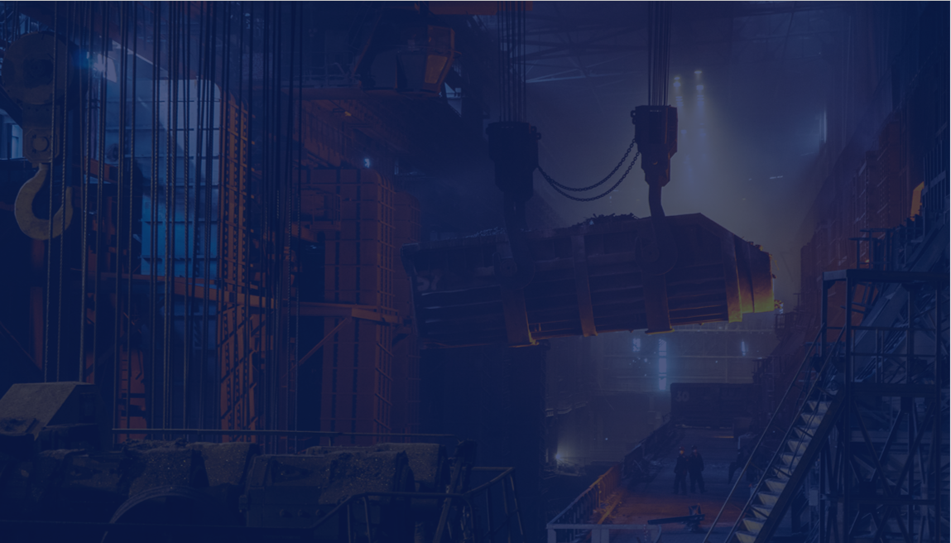
The five shifts needed to transform the industry system
Reduce demand for cement, steel and plastics
Commercialize new solutions for cement, steel and plastics
Improve industrial energy efficiency
Electrify industry
Reduce methane emissions from oil and gas operations as they are phased down
Notes:
Reduce demand for cement, steel and plastics
In order to curb rising demand for industrial products that increase greenhouse gas emissions, we need to mainstream material efficiency and circular economy principles in national and subnational climate policies and adopt a mix of instruments and regulations that incentivize efficient resource use.
Improve industrial energy efficiency
Energy efficiency, or energy use per unit of activity, is often considered the “first fuel” or “hidden fuel.” It has the potential to mitigate over 40% of energy-related greenhouse gas emissions by 2040 across all sectors. The efficiency potential in the industry sector is lower but could still mitigate 10-20% of industrial emissions.
Electrify industry
The industry sector is highly energy intensive, mainly because many industrial processes are reliant on heat. Direct greenhouse gas emissions from fossil fuel combustion in industry generated 7.1 gigatonnes of carbon dioxide equivalents in 2019. By sourcing that energy from electricity, which can be generated from renewable sources, GHG emissions can be substantially mitigated.
Commercialize new solutions for cement, steel and plastics
In most sectors, greenhouse gas emissions come from the combustion of fossil fuels. In these cases, energy efficiency, electrification and the direct use of renewable energy are prime solutions for decarbonization. Even though eliminating energy-related emissions will make an important contribution, process emissions resulting from chemical reactions make up a substantial part. To tackle those, new solutions and production methods are needed.
Reduce methane emissions from oil and gas operations as they are phased down
Methane is an extremely potent climate pollutant. In the short-term, it’s much more potent than carbon dioxide, which is the most common greenhouse gas. To cut methane emissions in oil and gas operations, better monitoring techniques must be adopted, and action should be taken to end flaring and venting and identify and fix methane leaks.
Photo by Ant Rozetsky: https://unsplash.com/photos/io7dX_1EFCg

Slide 6
Highlights
Emissions from industry have grown more than 70% since 1990, and today make up around a fifth of global direct emissions.
Roughly 40% of industrial emissions come from cement and steel production.
Steel demand grew by 12% from 2017 to 2021, and cement use grew by 25% from 2010 to 2019. Emerging economies are likely to drive even more demand in the future.
The share of electricity in the industry sector’s final energy demand rose between 2016 and 2021, and efforts need to accelerate by a factor of four to reach 35% by 2030.
Between 2010 and 2021, global green hydrogen production increased nine-fold, but remains quite low at 0.027 Mt in 2021, far from the 2030 target of 81 Mt.

Slide 7
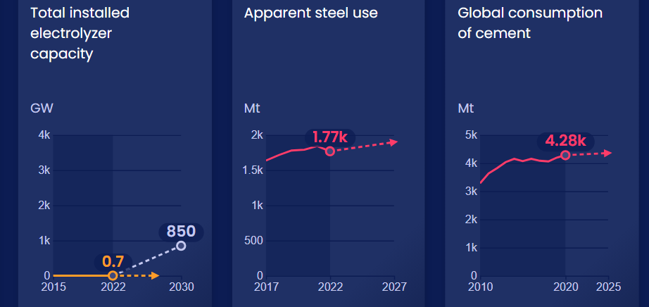
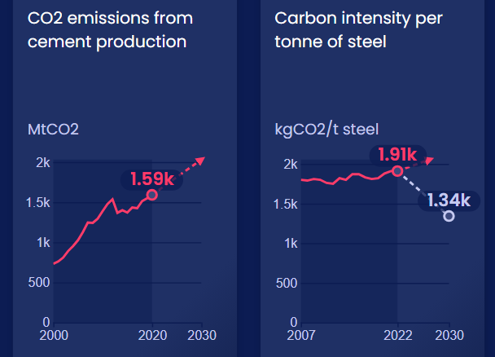
Progress toward targets
In this system, we have identified 15 target indicators. Out of the 15 targets we've evaluated, 11 have available data and benchmarks. Of these, 6 are moving in the right direction and 0 are on track.

Slide 8
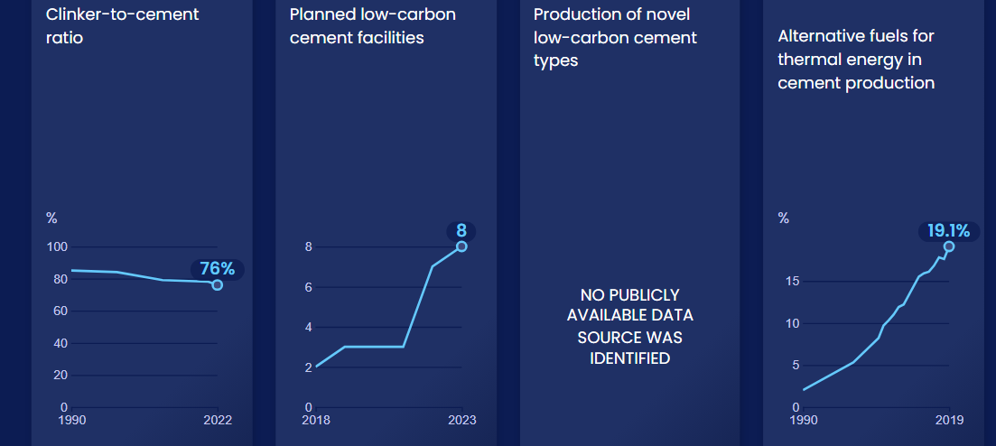
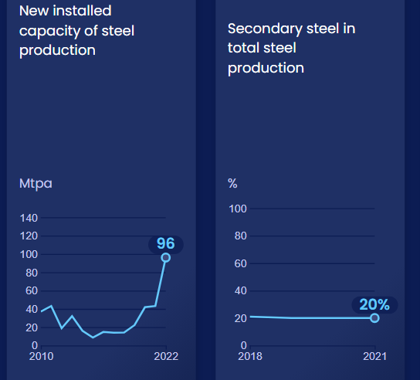
Enablers and barriers
In this system, we have identified 52 enablers and barriers to change.

Slide 9
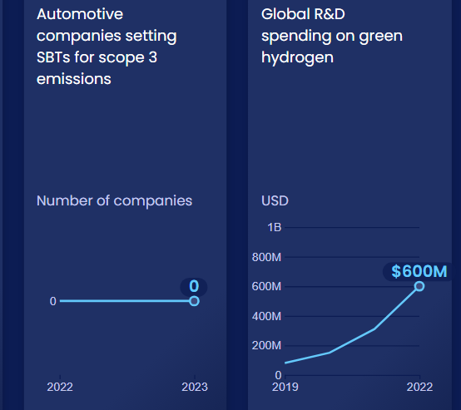
Enablers and barriers

Slide 10
Enablers and barriers

Slide 11
Reduce demand for cement, steel and plastics
SHIFT
Notes:
Photo by Macie J: https://www.flickr.com/photos/phaselockedloop/4040963279/in/photolist-7a5ZAF-34vrku-9pXU7N-532CvQ-zasK4-s8e86-wGvrY-uJzWa-aWNSE-5Z7eTB-oTTYH4-jxgwW-4igK6b-jZrox3-jZpyrV-bnC8T8-7cUtrL-2UpQDz-82JYV3-6ptxi-P5fRm-6K8aUb-82H3rK-hKCM-Sh6LtA-w8KGmU-37zj9R-Gd9GyD-4pu7WL-P4Uwjx-cAN1KY-5azZVt-8Fow44-83HUex-do9Ji6-do9JeH-do9Jbc-do9S4W-2mnM5SD-2igKFfZ-a7GfTf-zHrqjF-2iLKPx1-4oBpzz-okExqg-do9S8S-Wfrdcn-UXZt8a-NqsGW-AsFFNN

Slide 12
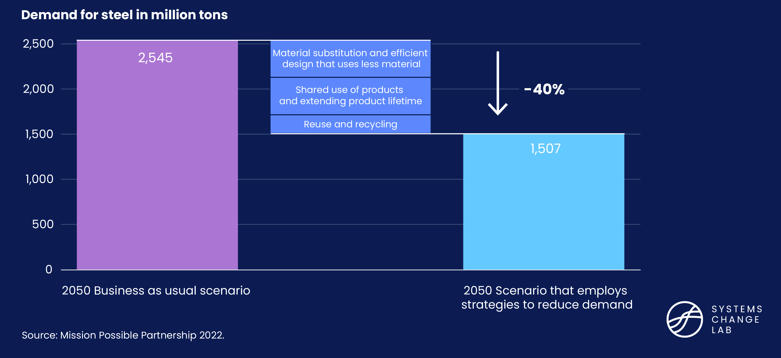
Circular economy measures could reduce steel demand
Notes:
The demand for energy-intensive materials has increased and rising urbanization and the need to build infrastructure is likely to drive the demand further. As demand for energy-intensive materials continues to rise, it is necessary to promote greater material efficiency and circular business strategies, which have lagged as a policy priority, to slow down the demand growth.
Demand for industrial materials such as cement and steel, which are the building blocks of our economy, tends to increase with rising urbanization, standard of living, and population. Global demand for cement more than doubled, and demand for steel nearly doubled.
Emerging economies are likely to experience higher growth in material use in the coming decades. Demand for steel and cement is also likely to increase in response to the massive expansion of clean energy and transport infrastructure that will be needed for a low-carbon future.
Due to the lack of publicly available data and appropriate Paris-compatible targets, we can’t calculate an acceleration factor or evaluate whether this indicator is on track.

Slide 13
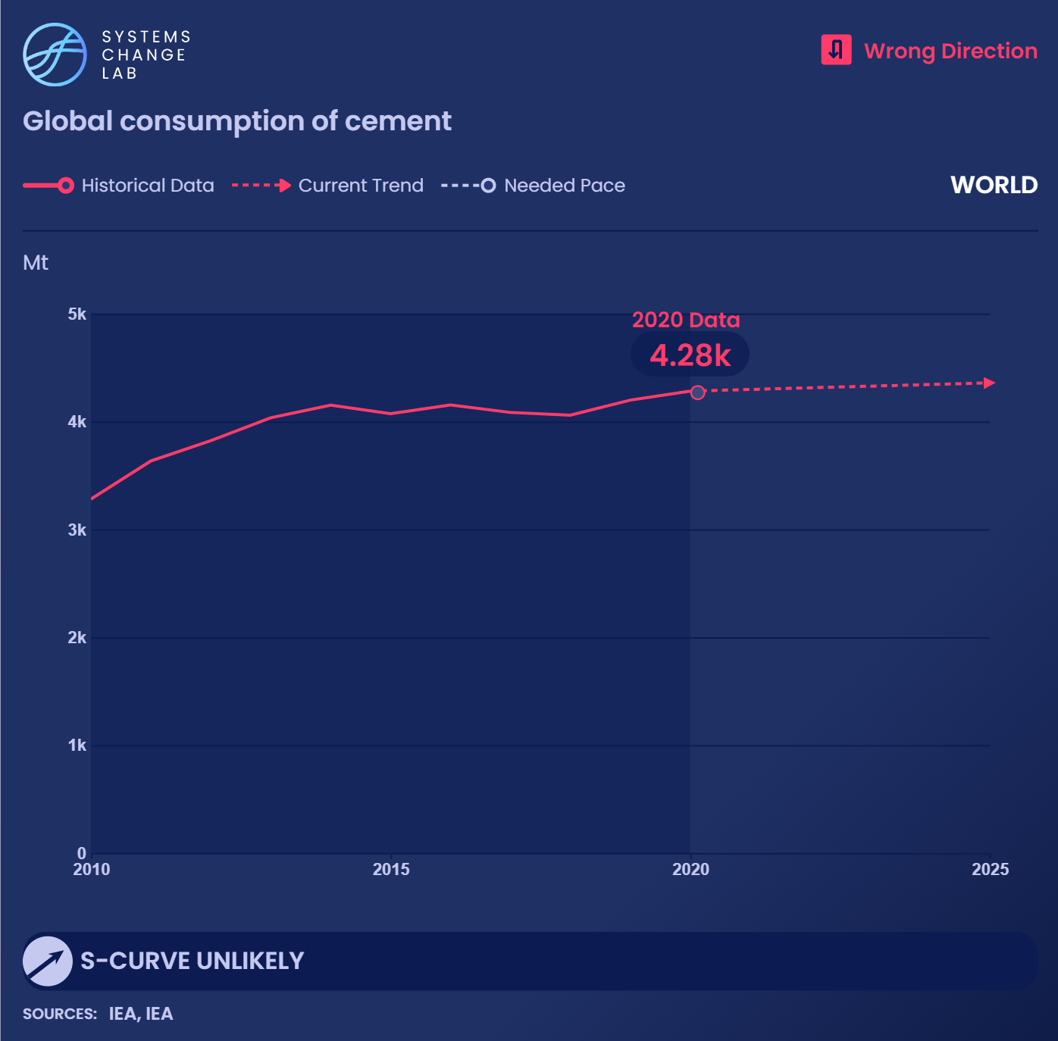
Accounting for around 7% of global carbon dioxide emissions, cement production increased almost 2.5 tines from 2000-2022, rising by 25% since 2010.
Notes:
Since we're evaluating global data, cement consumption is assumed to be equal to production. Cement production is a carbon-intensive process that accounts for about 7% of global CO2 emissions. World cement production has been increasing steadily, even growing slightly in 2020 during the pandemic.
Given its limited international trade, cement consumption is assumed to be equal to production. And since 2000, global cement production has almost tripled; in the past decade, it increased by 25%, from 3,280 Mt in 2010 to 4,100 Mt in 2019. Among the top consumers and producers are China (55% of global production) and India (8%), followed by Vietnam, the United States, Turkey and Indonesia (each at 2% or less).
Due to the lack of appropriate Paris-compatible targets, we can’t calculate an acceleration factor or evaluate whether this indicator is on track.

Slide 14
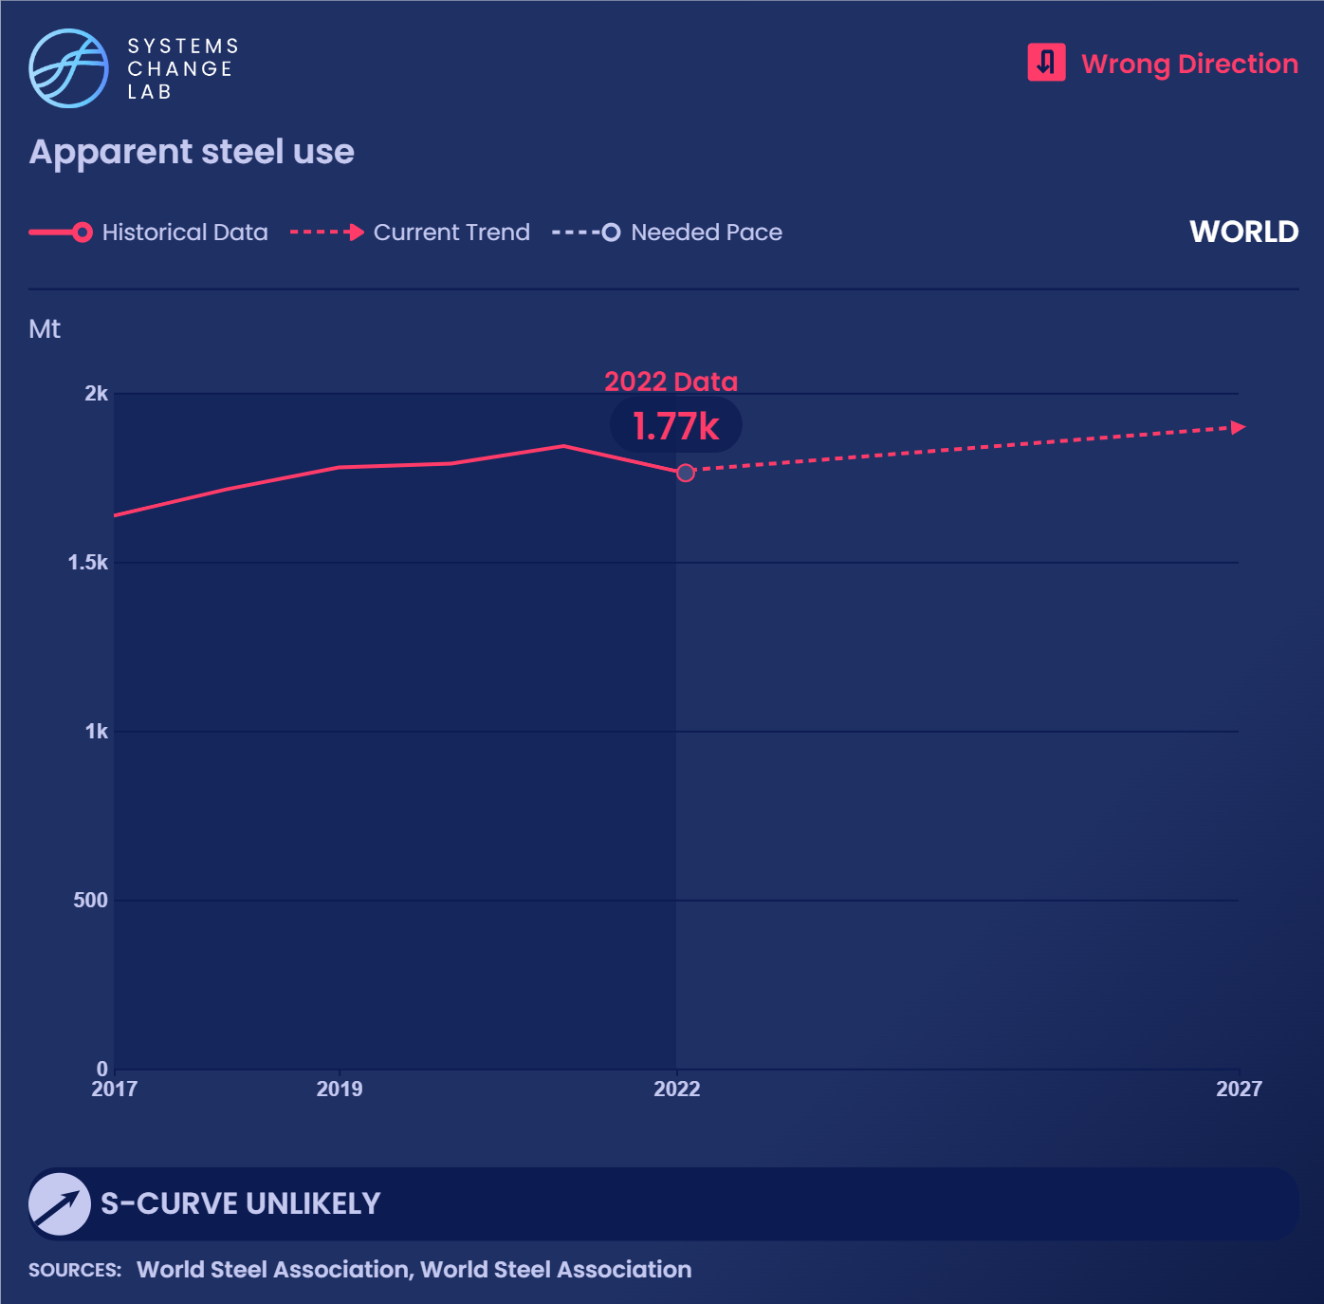
Steel production, accounting for about 7% of global carbon dioxide emissions, has increased by 8% from 2019 to 2022.
Notes:
Steel production is a carbon-intensive process that accounts for about 11% of global carbon dioxide (CO2) emissions. Monitoring steel use over time is a way to measure changes in demand. Apparent steel use, measured in million metric tons (Mt), is an indicator of steel demand and refers to production plus imports and minus exports.
The global market for steel is driven by demand from building and construction, machinery, and automotive sectors. Across the world, crude steel production and use has been increasing steadily. Apparent steel use increased 12% from 1,636 Mt in 2017 to 1,834 Mt in 2021.
Leading steel-producing countries as of 2021 include China (1,033 Mt), India (118 Mt), Japan (96 Mt), United States (86 Mt), Russia (76 Mt) and South Korea (79 Mt). These countries are also the top six consumers — China (952 Mt), India (106 Mt), United States (97 Mt), Japan (58 Mt), South Korea (56 Mt) and Russia (44 Mt).
Due to the lack of appropriate Paris-compatible targets, we can’t calculate an acceleration factor or evaluate whether this indicator is on track.

Slide 15
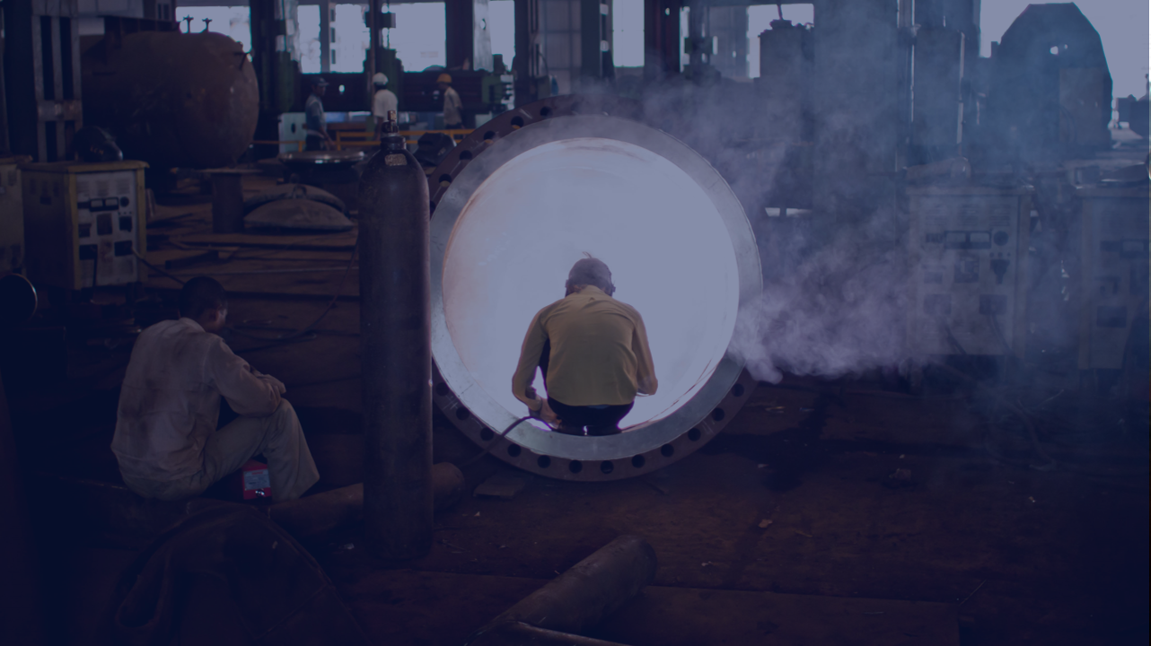
Improve industrial energy efficiency
SHIFT
Notes:
Photo by Jay Hariani: https://www.flickr.com/photos/jhariani/4800492023/in/photolist-8jcM2R-qgyo2o-2mMXfd2-2fWbXRv-21uNUB3-ZXK7kL-CEKFzn-MEniyd-2n64aq2-2n7ZYC5-RfghrM-DwvniT-24xecuC-2n6aL4L-2mZYULF-J5KyUT-2mpwczh-2n16vGs-TiCW43-2ndsbo6-2n64ajv-c8AqKU-27Ua5Bp-nEXRYc-2ndA67b-qWXtz1-2f3xpd4-2n69BKH-whqwQJ-J5UHZ4-2ncZEGh-2ncZEJ6-248KapZ-2mZYUB2-2n15fna-2mPs46F-24xebVS-nFey83-2n64afT-2jADBMD-iKrUr5-2n18ec5-4YT2zC-qBd17-2k6ffQP-ZEgRtM-2mzdtCh-2hkrabF-2n15fih-2jdqV6J/

Slide 16
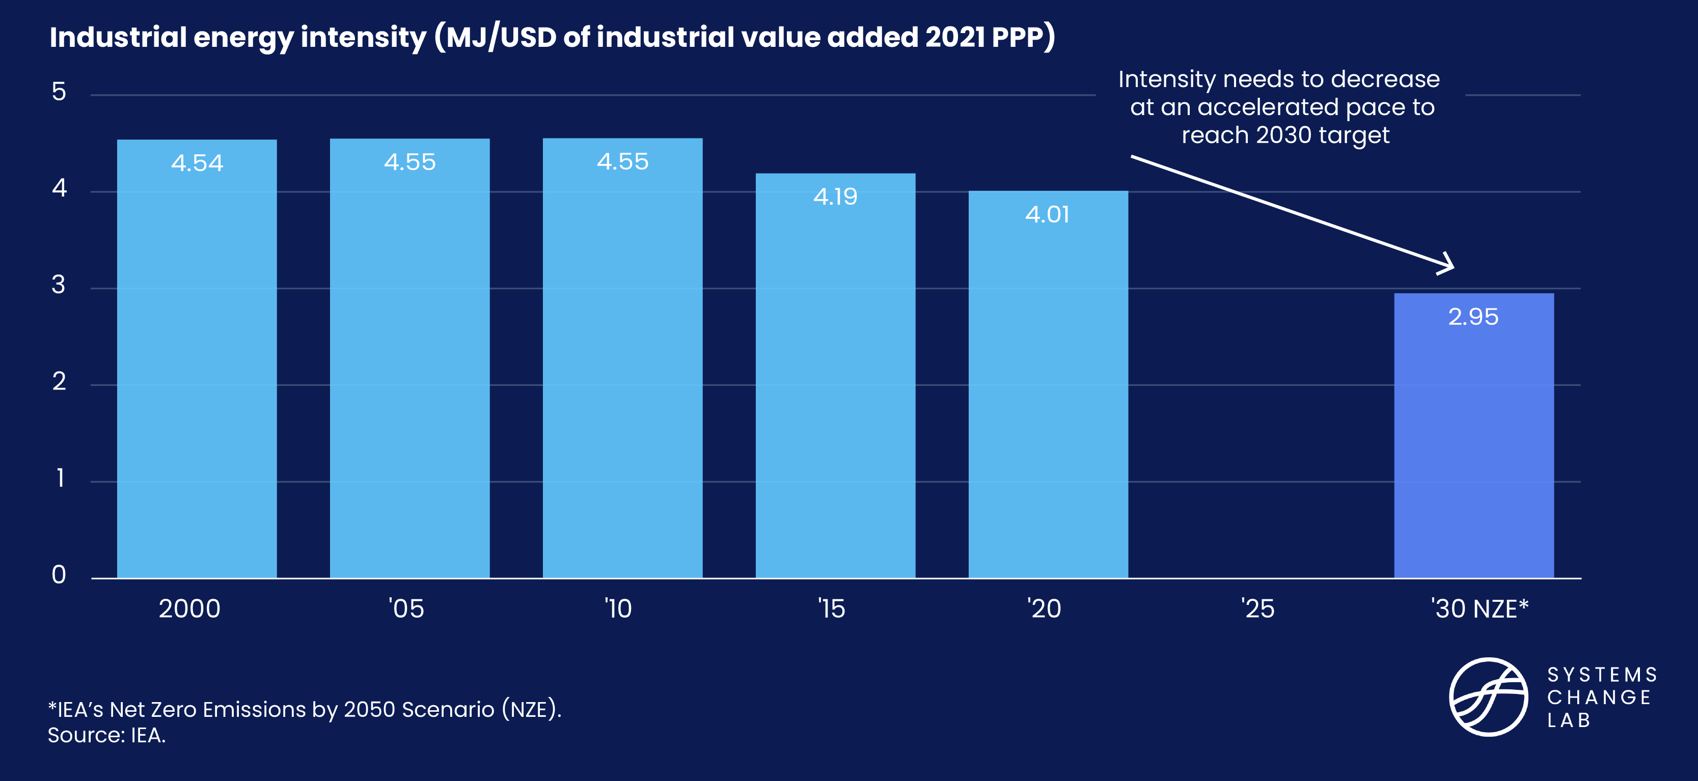
Industrial energy intensity needs to decline by over 26%

Slide 17
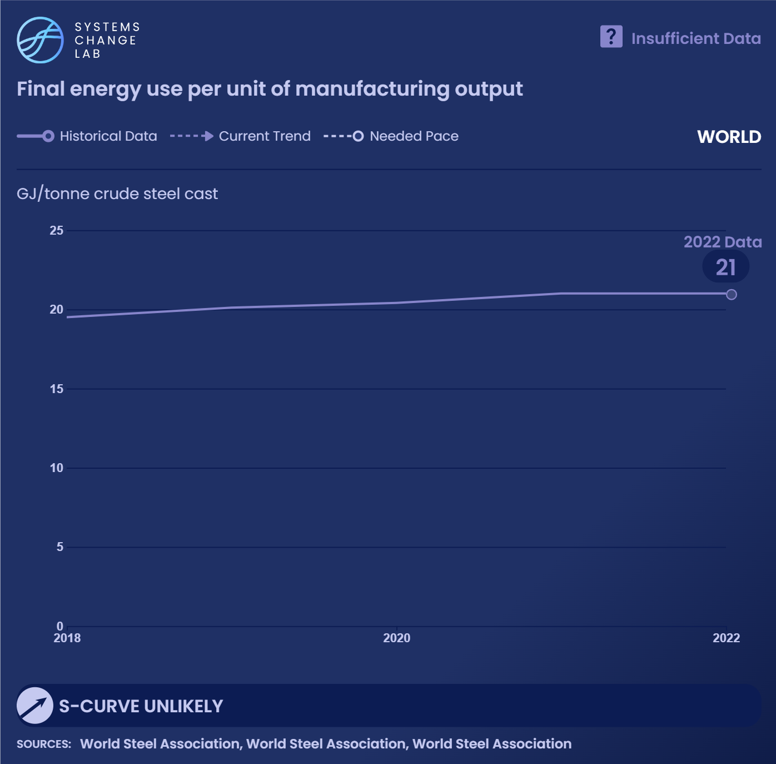
Updating and retrofitting industrial plants to become more efficient can reduce 10–20% of industrial emissions while also delivering economic benefits through reduced fuel expenditures.
Notes:
Efficiency gains and emissions reductions from industrial retrofits in the near term should be balanced with adoption of new decarbonization technologies in the long term.
The industry sector’s energy use was responsible for 38% of global final energy use in 2020. From 2010 to 2019, industry energy consumption increased by an average of 1% every year. The continued rise in industrial production from energy-intensive industry subsectors is one of the key drivers of energy consumption growth over the past decade.
Deploying the best available technologies, upgrading industrial equipment, and increasing investments in efficiency measures can help limit the growth in energy use by lowering demand. Due to the lack of data and of appropriate Paris-compatible targets, we can’t calculate an acceleration factor or evaluate whether this indicator is on track. The chart shows data for the steel sector only.

Slide 18
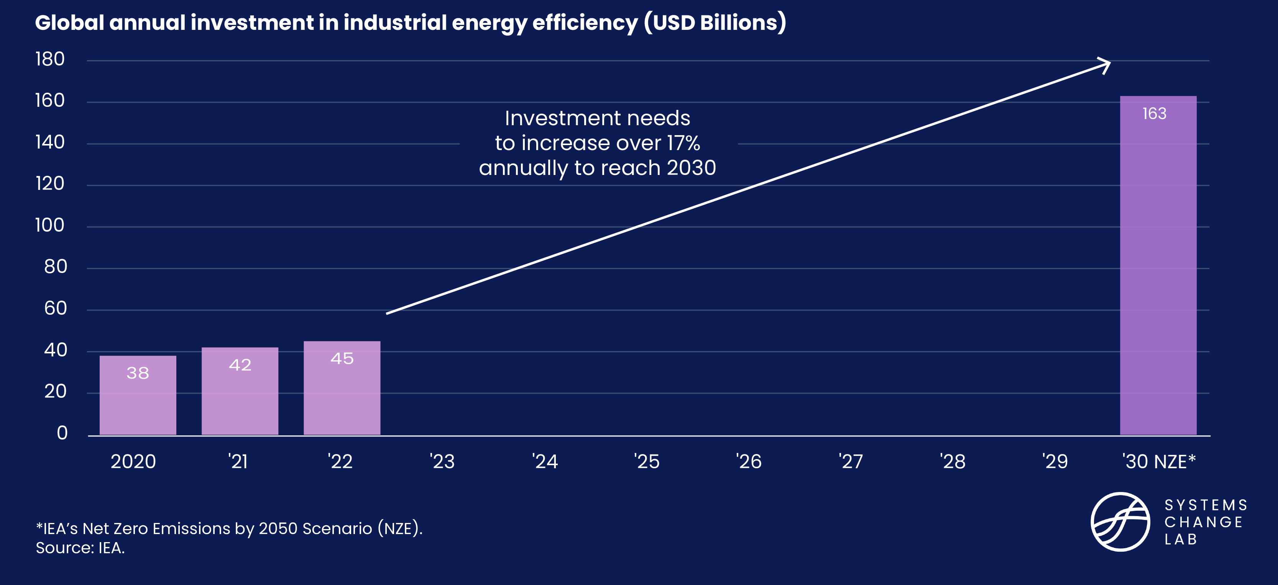
Investment in efficiency needs to significantly scale up

Slide 19
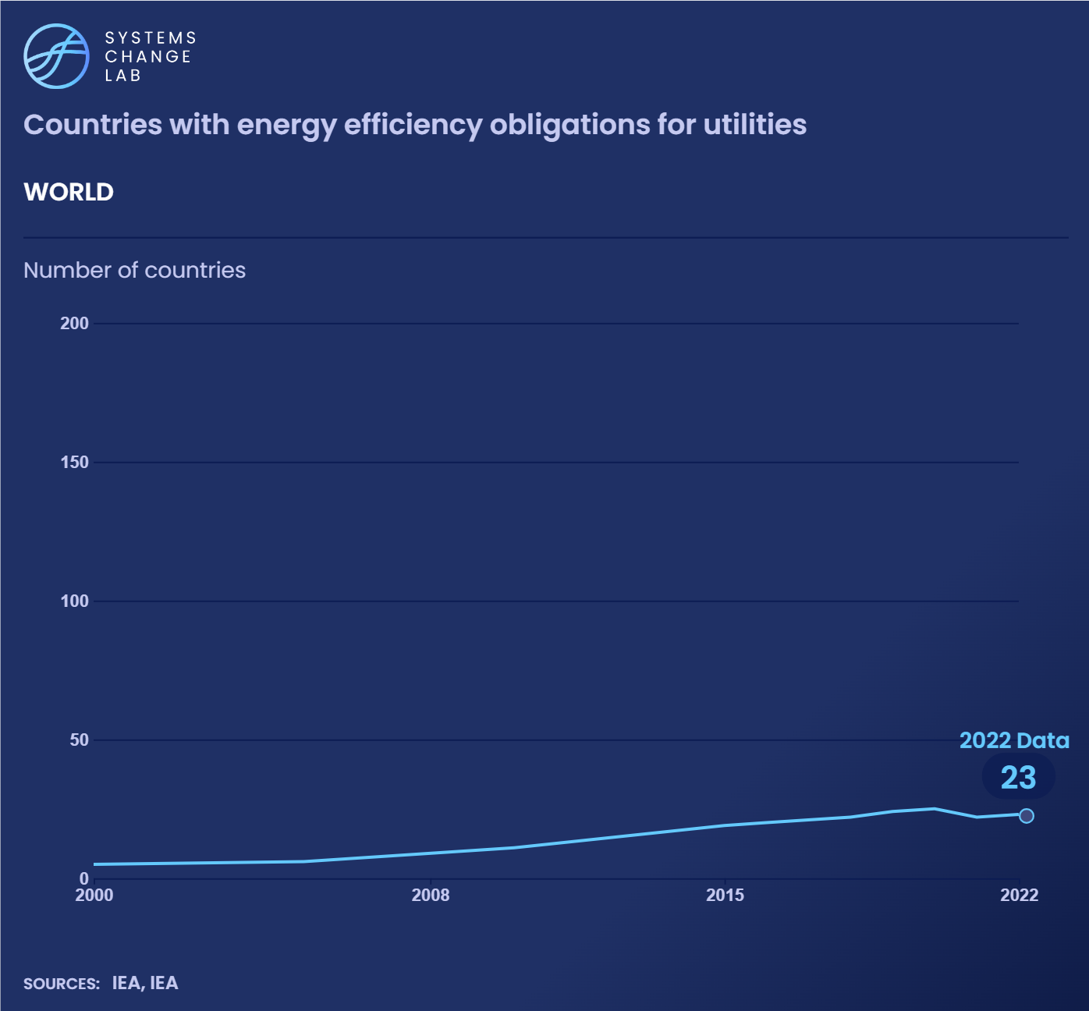
Mandatory targets and standards for industrial energy efficiency covered almost one-fifth of global energy use, as of 2022.
Notes:
There is an opportunity to increase the percentage of final energy use in industry that is currently covered by efficiency policies, adopt new standards and implement best practices. As of 2021, 24 countries had energy efficiency obligations for utilities, up from 5 in 2000.
Governments may formulate energy efficiency obligation schemes that require utilities to achieve a set amount of energy savings over a defined time period through efficiency measures in energy users, such as industry or buildings. Industrial energy efficiency obligation schemes can cover the cost of energy audits, offer rebates toward efficient equipment or pay for large efficiency projects.
In 2021, 24 countries, including 14 in the European Union, had nearly 50 energy efficiency obligation programs that covered almost one-fifth of global energy use. These programs encourage efficiency measures across a variety of end uses.

Slide 20
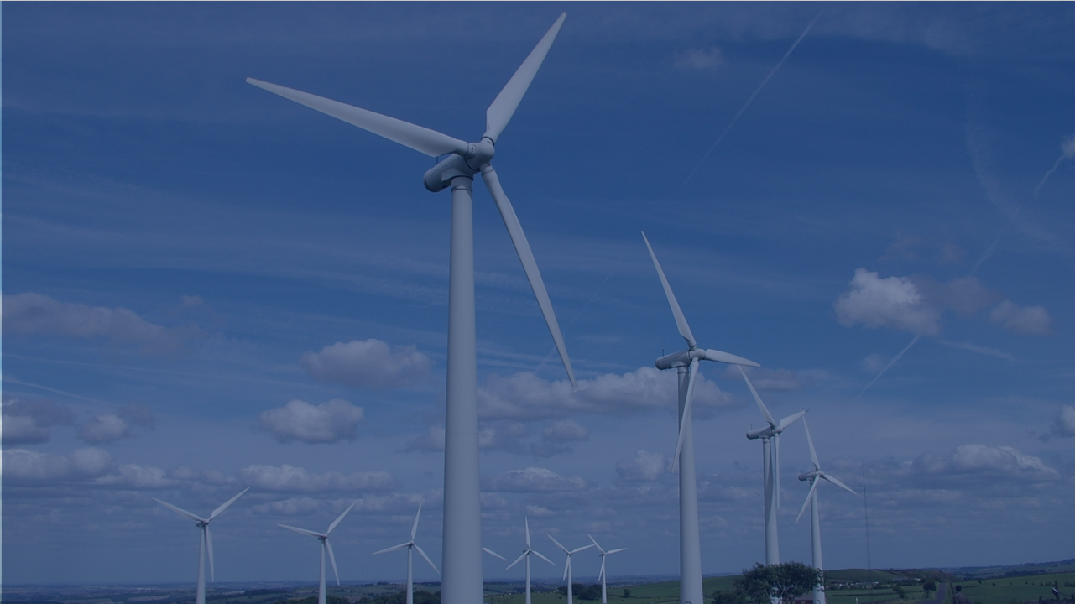
Electrify industry
SHIFT
Notes:
Photo by Nuala: https://www.flickr.com/photos/nualabugeye/753268301/in/photolist-29yGqv-Nfaj4Y-NhRod6-5epYUS-MSeCd-yXYL9q-2HwWgj-6BJKE8-5aamBz-MsAJaF-rbPgvF-Nqvp14-87EEBT-87HNGL-HGDspq-MsAWEv-87JaZw-6GhaHR-2HsELi-Rdw14o-niWjhi-5Jf3tb-5aakTz-4rzpWy-wD3Fan-8e8dLZ-dvw162-52eQ3U-4rztkf-5Fi9wC-xkJoHN-cx44Su-5aamp2-87ECxr-5AGK5U-4AKwce-q8jvpE-o6JPzX-favQg2-52zr33-4Y7bG6-kPvGoX-MrfvjD-DExZz-dXA3ra-gp2Pm-8hYBNF-dXF3JN-5cszNM-6twsf

Slide 21
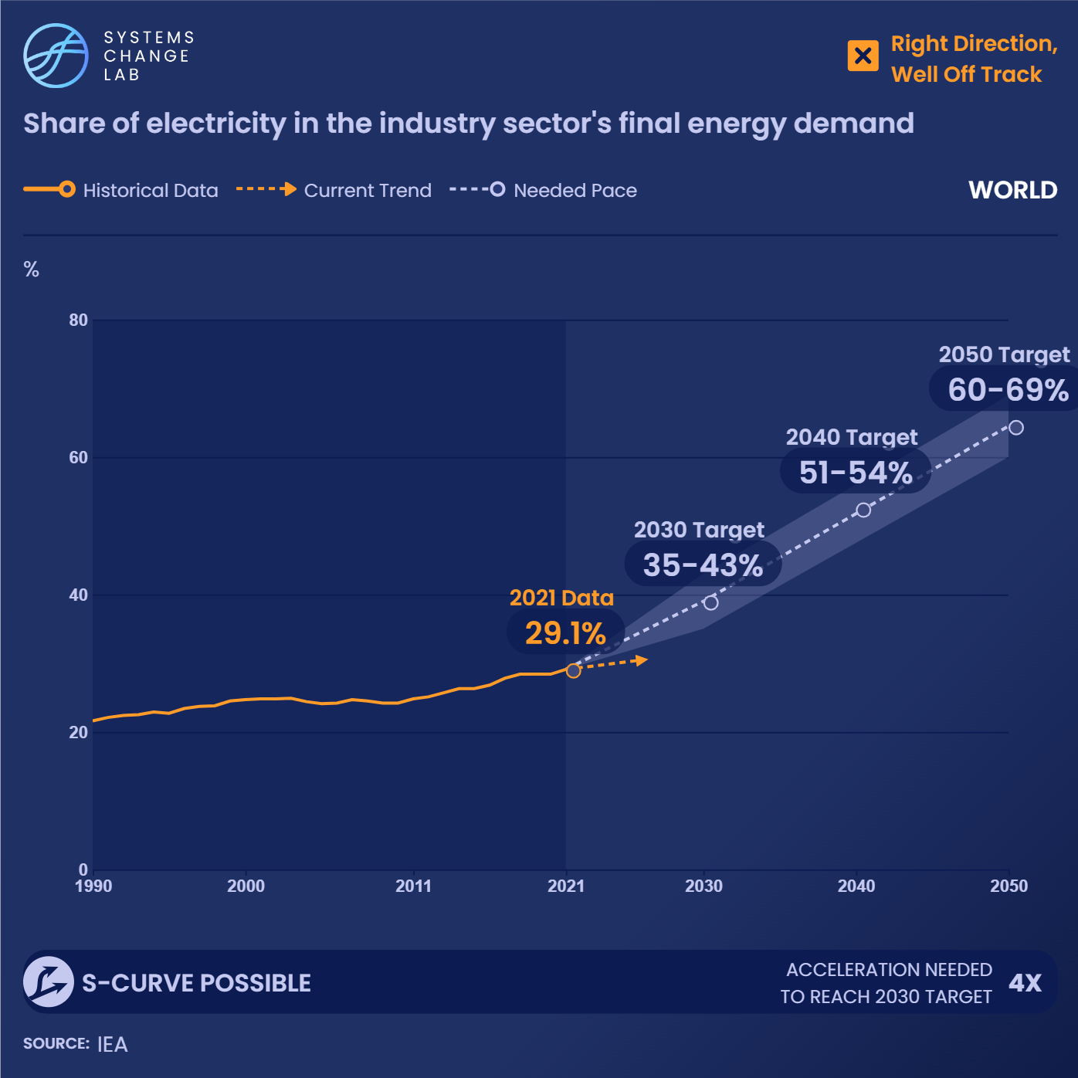
50% of the fuel used for energy in industry could be electrified today by already-commercialized technologies.
Notes:
Electrifying industry offers significant potential for short-term emission reduction. The share of electricity in industry’s final energy demand is increasing steadily and needs to accelerate by a factor of 1.7 to reach 35% by 2030. Many current industrial processes are highly dependent on fossil fuels. Shifting to electric technologies can reduce this reliance and limit energy-related emissions from industry.
The share of electricity in the industry sector’s final energy demand grew from 26.9% to 28.4% between 2016 and 2020, an increase of almost 0.4 percent per year. If the trend continues, the global electrification rate will be off track to achieve the near term-target of 35% by 2030. To reach the 2030 target, the recent rate of change will need to accelerate by a factor of 1.7.

Slide 22
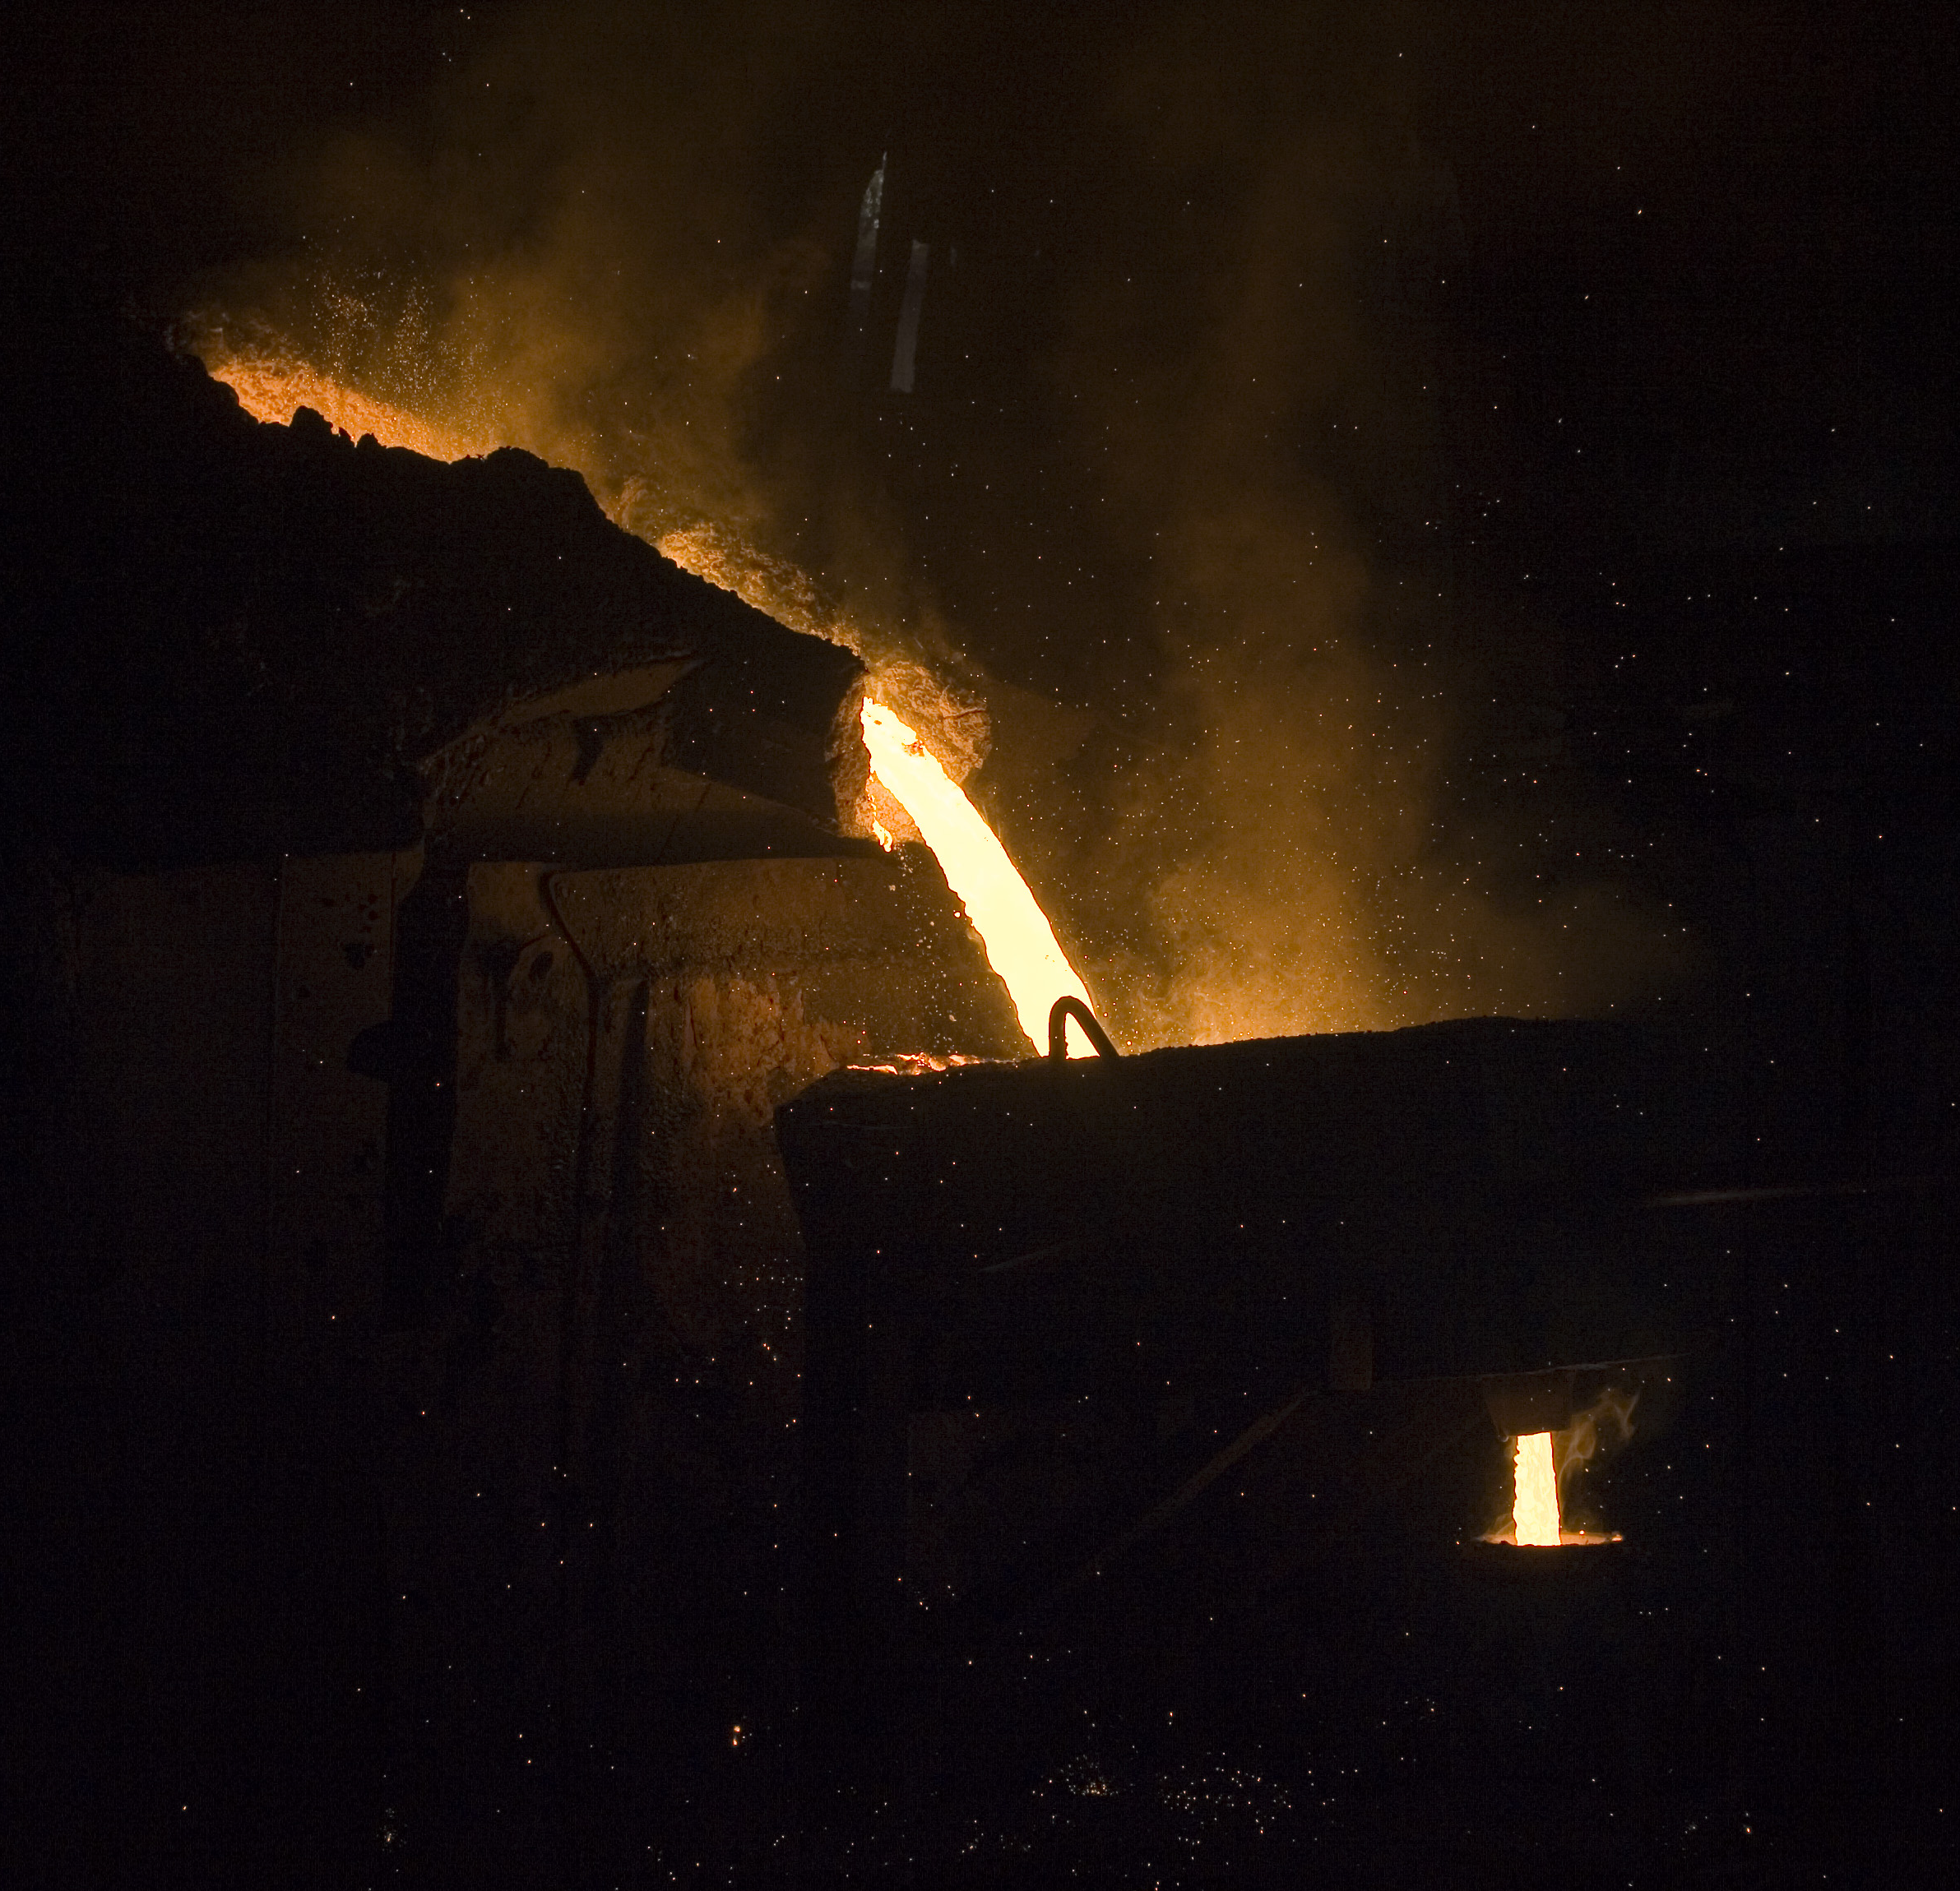
While commercial technologies exist to electrify low- and medium-temperature industrial heat and can be immediately deployed, technical development is needed to electrify high-temperature heat.
Notes:
Global direct energy-related emissions in industry was 7.1 gigatonnes of carbon dioxide equivalent in 2019. Although the electrification of high-temperature heat (above 1000 degrees C, or 1832 degrees F) is technically feasible, it is still in the early stages. The electrification of high-temperature heat will be particularly important in industries where alternatives to reduce the need for high-temperature heat are challenging, technically and structurally, to fully eliminate, such as in cement and steel production. To speed up its development, increased investment in research and development (R&D) is required. By tracking that spending, we can get an idea of progress toward solutions and whether spending levels are sufficient.
Photo by Ken: https://www.flickr.com/photos/littledragon/1579326091/in/photolist-3pysCc-3pCVLN-2o1X7dF-5c77Hr-3pyqsB-37xo8-3pDcKJ-3pDokE-5bnxwX-aTjL1F-ssNv8K-3pCAi5-3py3rX-aMYddz-sberxC-C14x5X-2iVWGe2-rvPv6S-Q2ELxf-ssPLDM-s9umf4-26cRbE1-bP4sjX-2m4C6gS-2nbBpLu-2mko3Wd-F15Muu-2jm8EwE-ssEbQQ-FTMHFn-qq6F1-2mkjaBx-5bnxCv-3pCGPQ-2gcWYaF-HdRxqb-2jocDLS-8X6x-73uYSx-2nhG16u-2jqJUsB-2nowodV-KVNkgh-2kqYL9T-2nhAE8V-JDZApa-2nxN67u-9obQEN-FnH7v8-2nj7Ez4

Slide 23
Commercialize new solutions for cement, steel and plastics
SHIFT
Notes:
Photo by Clare Kiernan / UBC: https://www.flickr.com/photos/ubcpublicaffairs/34195172424/in/photolist-vcW8rL-4SQK6-5xNgR1-7M3PjV-ctEmw-dq8Fv-7EArHH-9tquHs-bjNMFZ-U6Hcqm-9xykkt-R8NRei-7Y81um-U6HcP7-FQY4aG-C3s9iH-Eho7m-GrCwDE-2me9uqP-5skxoo-DzEp2p-rrPrsw-68nng1-vuvBdx-9gJw19-o8EbhY-fGj2c-vuSbrH-sCYPDy-vuvBfX-uxEGXD-8et3Fa-Lkted5-fnvUyy-6ceWxx-KUcYDR-6YFeke-vd4ucF-28qaqZY-DJnKeg-57u4in-EsoaWz-2e8pZgZ-qEmiA-MyKEkC-bxyfcK-pPSEb9-MqaGXX-4ka8vA-6XzKzx

Slide 24
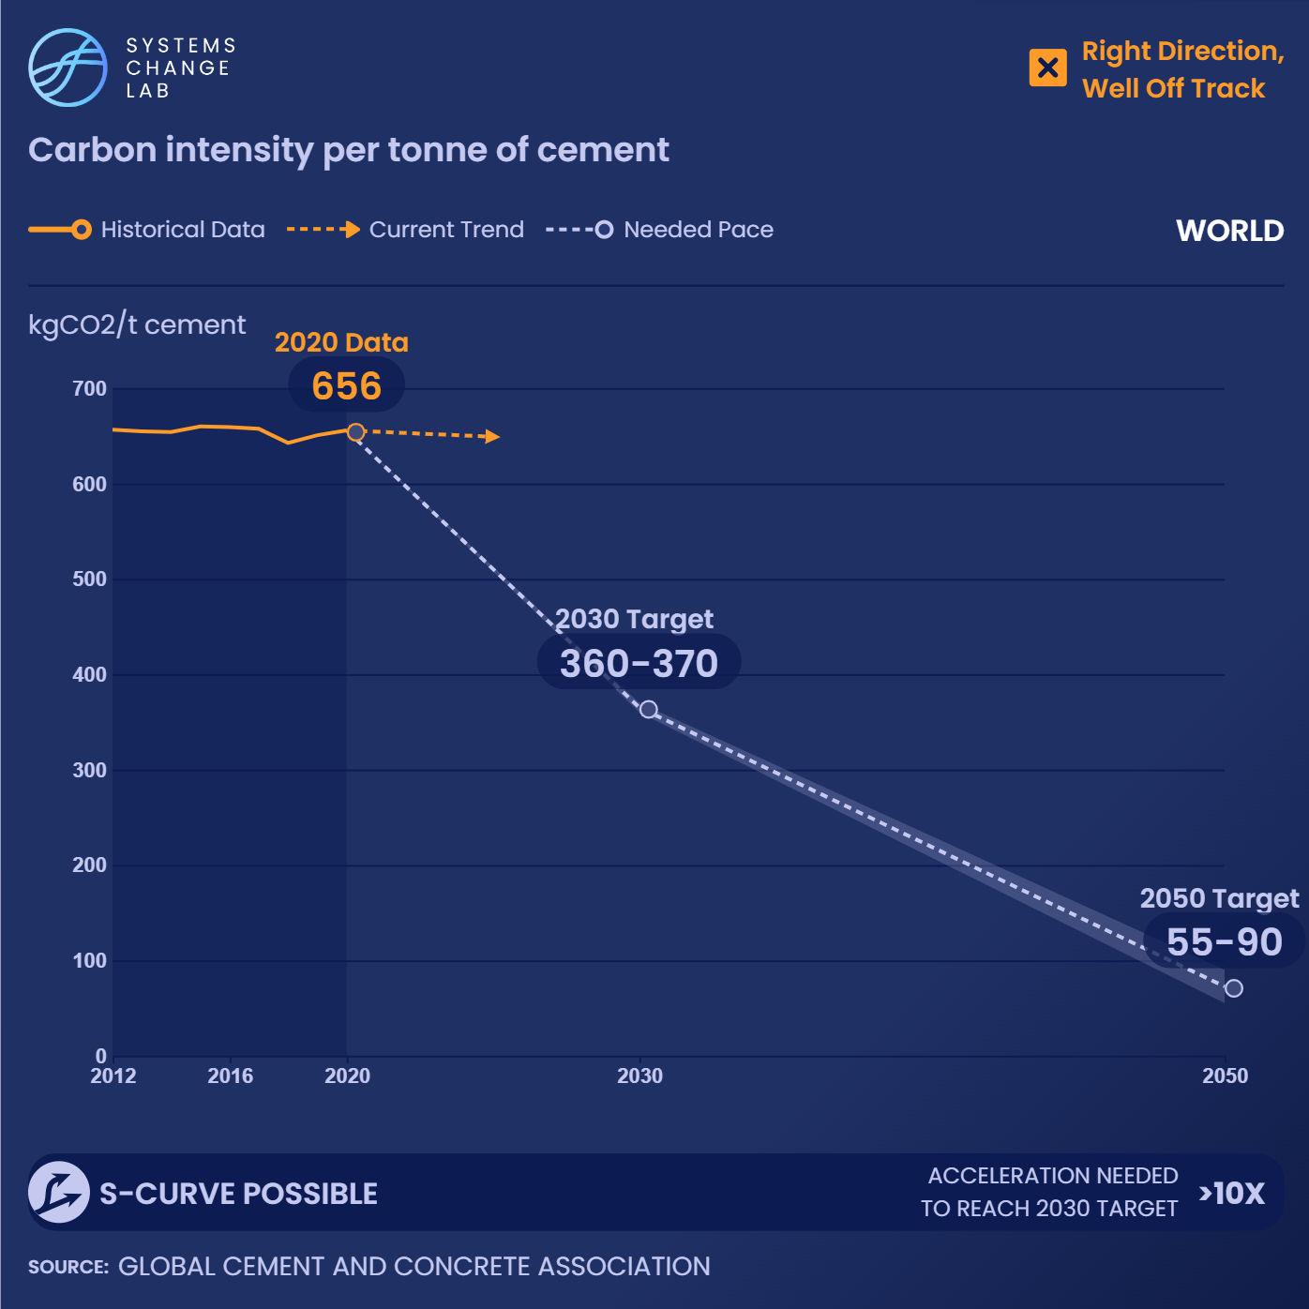
The carbon intensity of global cement production has declined in the last couple of decades, but the rate of change has leveled off in recent years.
Notes:
The carbon intensity is decreasing on average, by 1.3% from 2005 to 2012 and by 0.3% from 2013 to 2019, respectively. However, improvements need to accelerate by a factor of more than 10 to reach the Paris-compatible 2030 target.
The carbon intensity of cement measures the average amount of CO2 emitted for each ton of cement produced. That includes direct emissions from fuel combustion, process emissions and indirect emissions from electricity consumption. The carbon intensity of global cement production declined continuously in the last couple of decades, however, the rate of change has leveled off in recent years as the energy efficiency of the equipment used for cement production nears optimum levels.
Even if the decline in carbon intensity continues at the pace set between 2015 and 2019, it would still decrease only marginally and fall far short of the 2030 and 2050 climate targets. Targets compatible with the Paris Agreement's long-term temperature objective require the carbon intensity of cement to reach 360–370 kg CO2/metric ton in 2030 and 55–90 kg CO2/ metric ton in 2050, with an aspirational target of net zero emissions in 2050.
Given these targets, this indicator is well off track. For industry to follow a 1.5 degrees C-compatible pathway, improvements in the carbon intensity of cement need to accelerate by a factor of more than 10.

Slide 25
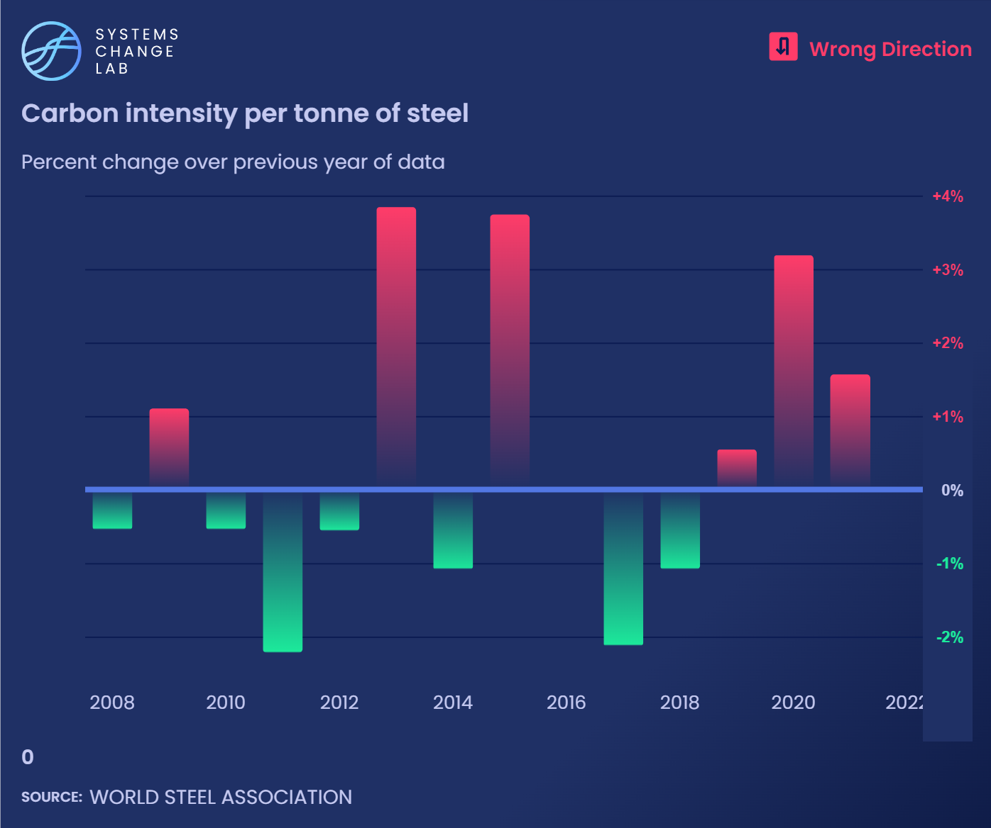
If recent trends continue, the carbon intensity of global steel production will continue to rise and the 2030 and 2050 targets will not be reached.
Notes:
The carbon dioxide intensity of global steel production has remained fairly steady, declining by 1% annually between 2015 and 2018 and then rising by 2% annually from 2018 to 2020.
The carbon intensity of steel measures the average amount of CO2 emitted per metric ton of steel produced, and considers both primary and secondary steel production. Primary steel production refers to steel produced through the reduction of iron ore which is then processed into steel, while secondary steel production refers to the recycling of scrap steel into useful steel again. It includes direct emissions from fuel combustion, process emissions and indirect emissions from electricity consumption.
The carbon intensity of global steel production has remained fairly steady, declining by 1% annually between 2015 and 2018 and then rising by 2% annually from 2018 to 2020. It reached 1,890 kg CO2 / metric ton in 2020. The average rate of change over the last five years suggests that global efforts to reduce it are heading in the wrong direction, likely the result of an increased share of blast furnace-based steel production.
If recent trends continue, the carbon intensity of global steel production will continue to rise and the 2030 and 2050 targets will not be reached; the targets require that the carbon intensity declines to 1335-1350 kg CO2 / metric ton of steel and 0-130 kg CO2 / metric ton of steel, respectively.

Slide 26
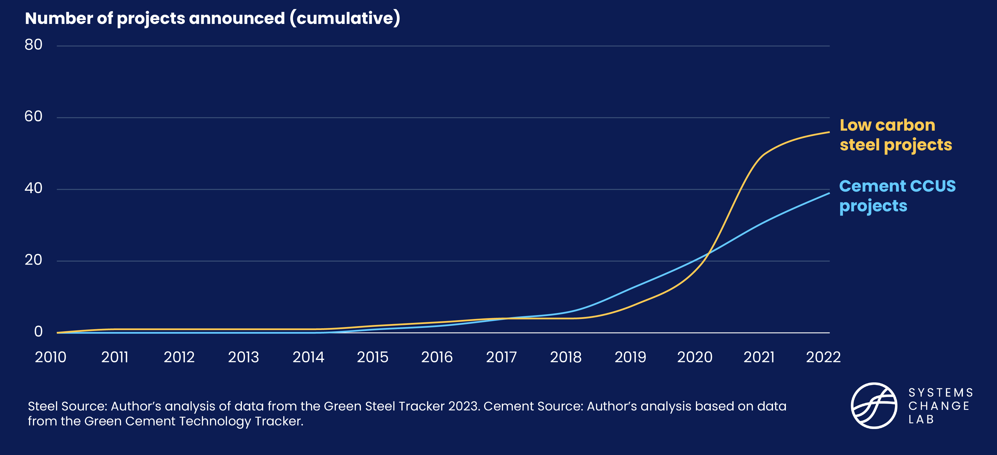
Announced projects for new solutions are increasing
Notes:
According to announced low-carbon steel projects, 19 full-scale plants are planned to be put in operation by 2030, but that is still far from the 71 needed by 2030 to be Paris compatible. The number of low-carbon steel projects in the pipeline are increasing.
Because the production of low-carbon steel will require the development and application of new technology, tracking the number of announced low-carbon steel facilities provides an indication of how the sector is progressing. By zeroing in on the type of technologies being considered, we can evaluate the development of specific approaches.
The number of announced low-carbon steel projects has increased rapidly in recent years — nine in 2019, 21 in 2020 and 51 in 2021.

Slide 27
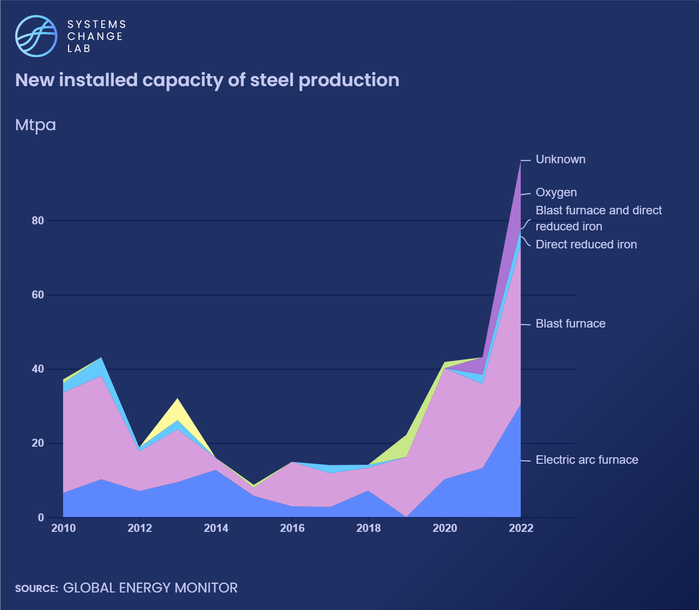
The economic lifetime of steel plants is long — approximately 40 or more years, so newly added plants are likely to stay in use for a significant period of time.
More than half of added steel capacity between 2010 and 2020 (about 58%) was blast furnace (BF) based.
Notes:
The continuous rise in BF-based steel capacity could increase steel sector CO2 emissions and emission intensity.
The economic lifetime of steel plants is long — approximately 40 or more years. That means that newly added plants are likely to stay in use for a significant period of time. New coal-intensive plants will continue to generate large amounts of emissions unless they are retrofitted with low-carbon technology or become stranded assets.
By tracking new installed steel capacity each year, we get an indication of the size of the challenge. More than half of added steel capacity between 2010 and 2020 (about 58%) was blast furnace (BF) based, followed by scrap-based steel electric arc furnace (EAF) based production at about 28%. The continuous rise in BF-based steel capacity could increase steel sector CO2 emissions and emission intensity.

Slide 28
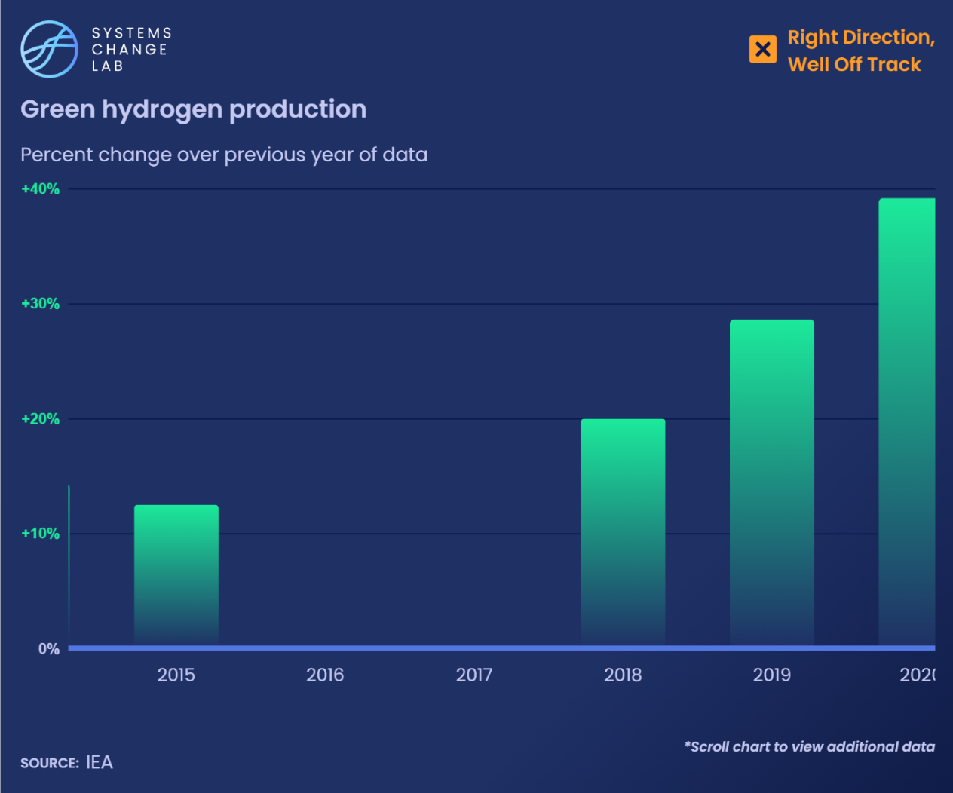
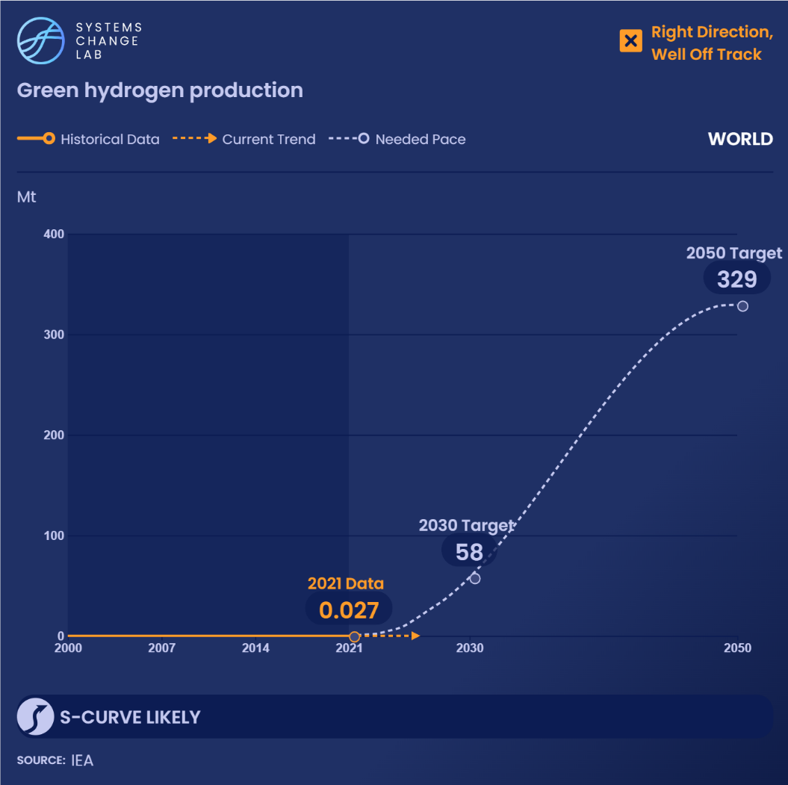
Global green hydrogen production increased ninefold between 2010 and 2021. Current annual green hydrogen production globally is only 0.05% of what is required in 2030 to achieve the target.
Notes:
Because there are various ways to produce hydrogen — through the use of fossil fuels, fossil fuels with carbon capture and storage, electrolyzers with dedicated clean or grid electricity, and more — tracking the production of green hydrogen is important to evaluate what methods are gaining ground. Even if green hydrogen production increases, fossil-based hydrogen production could grow at a faster pace, which would result in rising emissions.
Global green hydrogen production has grown rapidly in recent years, though it started at very low levels. Between 2010 and 2020, global green hydrogen production increased almost 7-fold, from 0.003 megatonnes (Mt) in 2010 to 0.023 Mt in 2020. However, the current rate of change is insufficient, and needs to accelerate significantly to reach the 2030 target of 81 Mt. By 2050, green hydrogen production should reach 320 Mt annually.

Slide 29
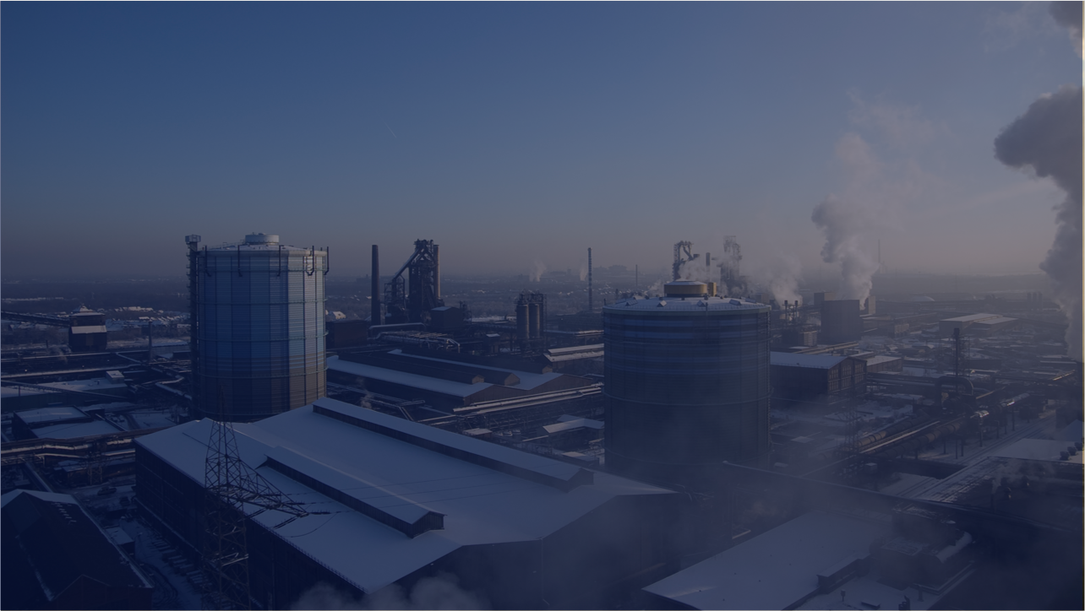
Reduce methane emissions from oil and gas operations as they are phased down
SHIFT
Notes:
Photo by Felix Montino: https://www.flickr.com/photos/felixmontino/3183293774/in/photolist-5Ridkq-7vkVYJ-YhyagQ-7nfwkF-9r4BQg-9r4BNM-3pTAmo-KbE3EJ-49Siq5-6NbQ6c-GBXUb1-5wvw5L-b5Ed9z-9PrzdW-qpsLzn-5XQ9Tf-7njrEd-7njrAE-7njqW9-AUgx4-bc5SSP-6mFSA-5XQ4oN-2VCcZ-bQHrM-5XQ8Bh-9fK4iE-5XKSgV-5XQ6bd-5XKQGZ-rmeXhT-5XKRsz-r4Ft67-5XQ8F7-8brGh-5XQ8mE-5XKREK-5RdVsa-rm7zUx-5XKPfp-r4ED1h-TbFbKH-5XQ9iu-auDQu-r2Vw8F-5XQ5Mf-2449XuC-r4ECNU-2kNGVqd-8ZcgM

Slide 30
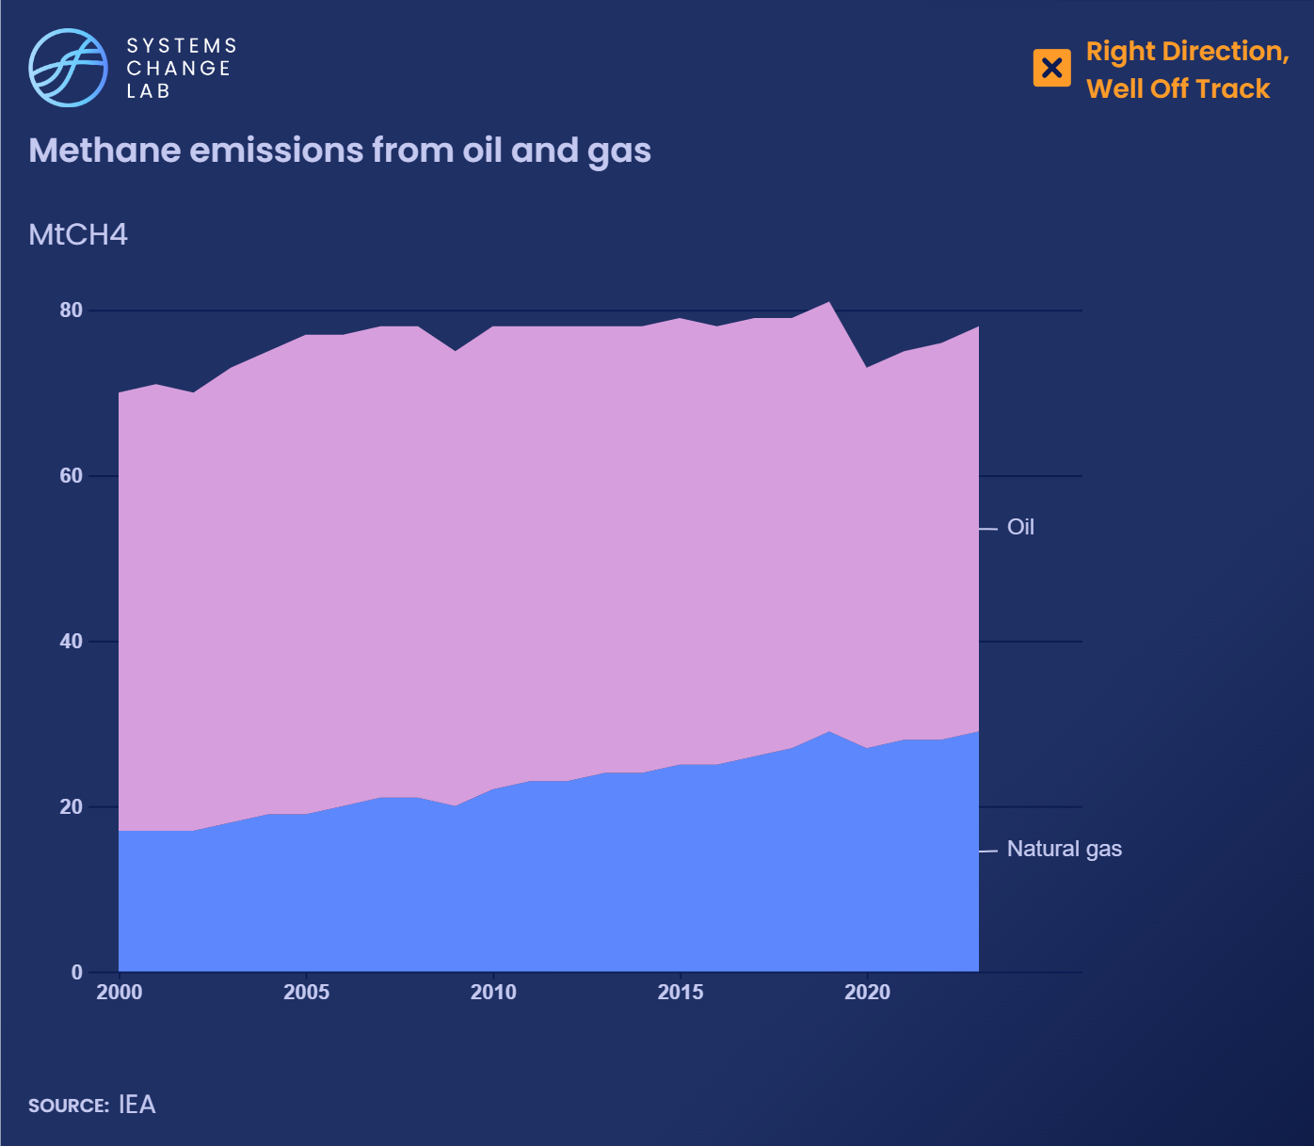
Methane emissions from oil and gas have been on the rise, reaching 78 million metric tons (Mt) in 2023. To meet climate goals, they need to fall to 17 Mt by 2030.
Notes:
New oil and gas exploration is not consistent with a 1.5 degree C future. Methane emissions from oil and gas increased from 66 million tonnes (Mt) in 2000 to 82.5 Mt in 2021 (with a brief drop to 80 Mt in 2020 during the COVID-19 pandemic).
The top methane emitters in 2021 included Russia (14 Mt), the United States (14 Mt), and Iran (6 Mt). Norway, one of the top producers of oil and gas, boasted the lowest methane emissions from oil and gas operations at less than half a million tonnes.
To achieve a 1.5 degrees C-aligned future, the International Energy Agency indicates global methane emissions from oil and gas must be reduced to 18 Mt by 2030. This will require concerted efforts to reduce production and consumption of oil and gas and lower methane intensity in the oil and gas that is produced.
Methane emissions from oil and gas must peak and decrease quickly to hit the 2030 target of 18 Mt.

Slide 31
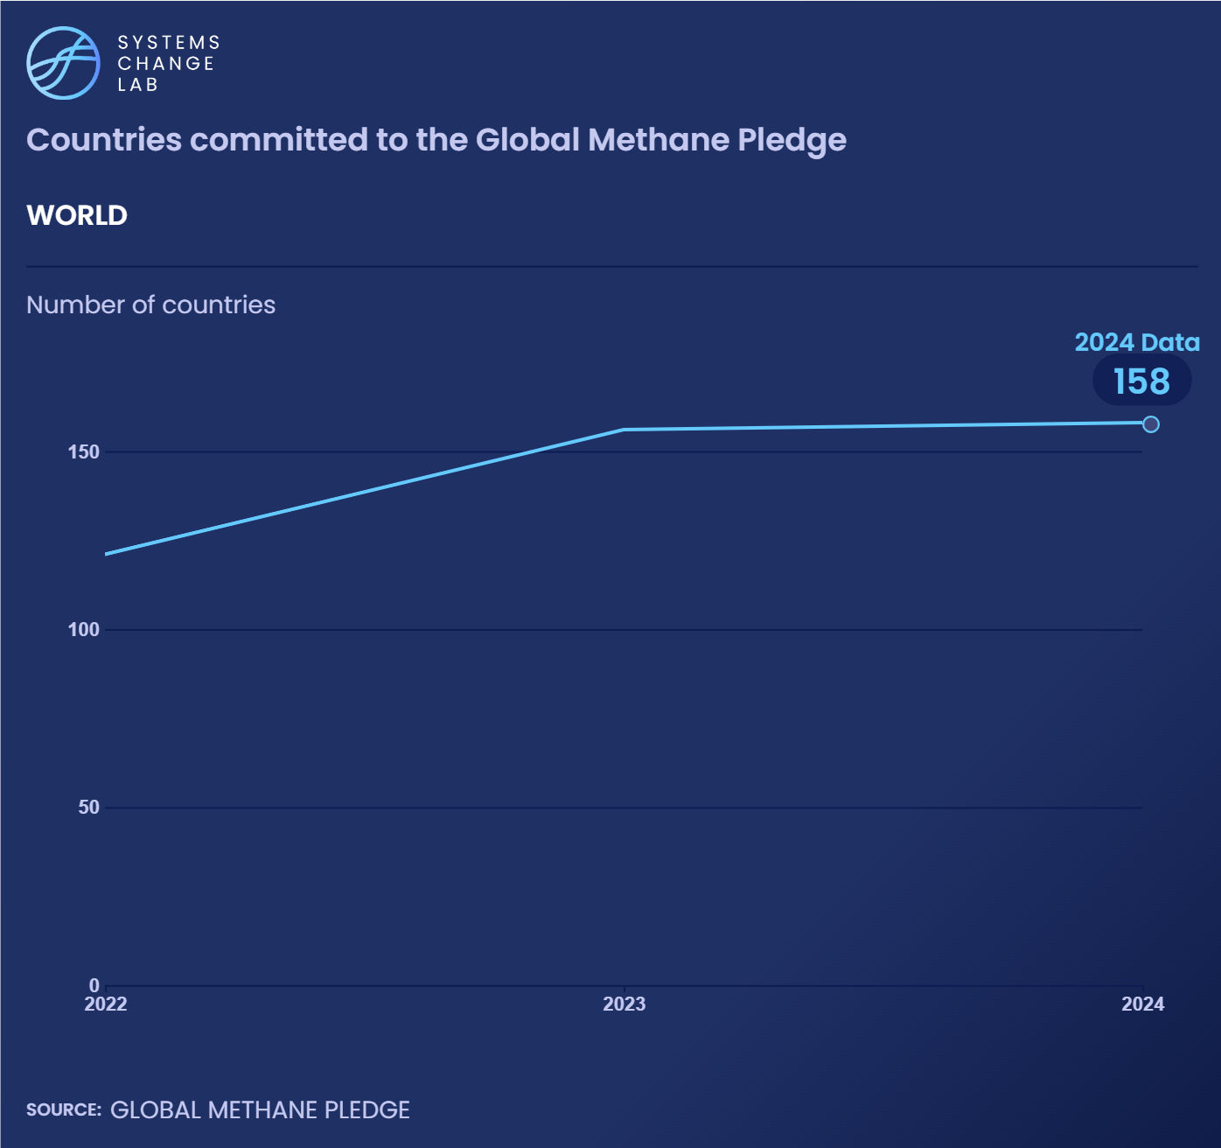
As of March 2024, 158 countries had signed the Global Methane Pledge, which aims to reduce methane emissions across all sectors by at least 30% by 2030.
Notes:
In 2021, the Global Methane Pledge was unveiled at COP26 through a partnership between the United States and the European Union and other parties to the Paris Agreement. Through it, parties agree to take voluntary actions to collectively reduce global methane emissions (including emissions from the energy, waste and agricultural sectors) by 30% below 2020 levels by 2030.
It is worth noting that this is an average across all methane-emitting systems — in 1.5 degrees C pathways, energy systems must reduce methane emissions by around 60% while other systems like agriculture see reductions of less than 30%.
As of August 1, 2022, 121 countries had endorsed this pledge, including countries that had not submitted an official Nationally Determined Contribution (NDC) to the United Nations Framework Convention on Climate Change (UNFCCC).
Under this initiative, more than $328 million has been pledged to drastically reduce methane emissions from three key economic sectors: fossil fuel energy, waste and agriculture.

Slide 32
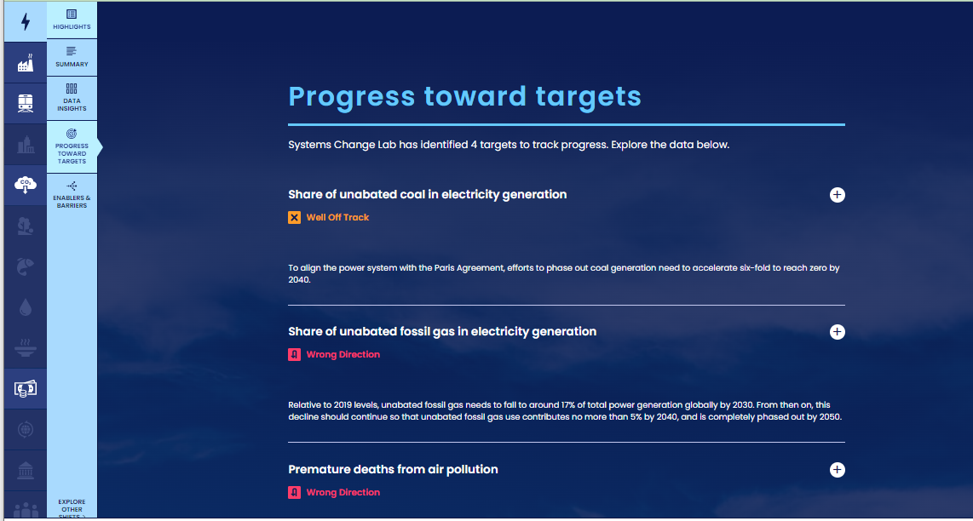
How to highlight a different indicator
Find your desired indicator on systemschangelab.org system pages
1. Select a system
3. Scroll down page to indicators and expand one
2. Select a shift

Slide 33
Alternatively, search for an indicator on the dashboard
1. Navigate to the dashboard
3. Search an indicator and then click explore data
2. Select grid view
4.
Notes:
Find your desired indicator on https://systemschangelab.org/
Look through System Page ( https://systemschangelab.org/power)
OR search the dashboard ( https://systemschangelab.org/dashboard) & select "EXPLORE DATA >" on your desired indicator

Slide 34
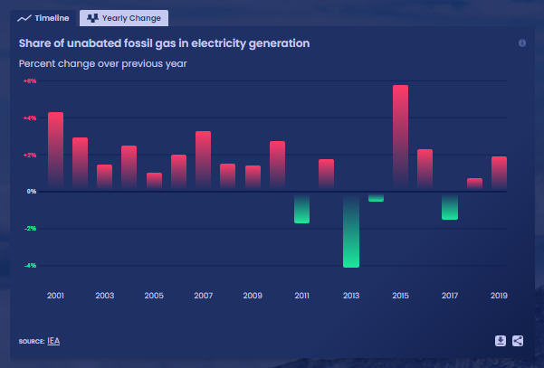
Pick a chart view and click the download button

Slide 35
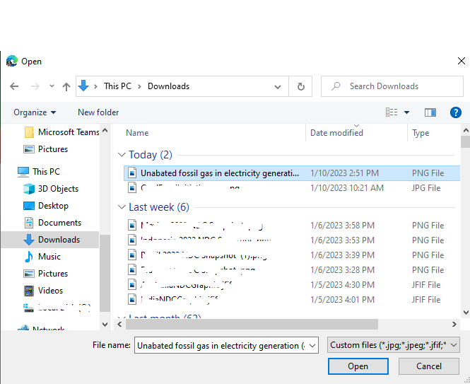
Next, add the chart to your slide deck
1. Select "Insert" and "Pictures" on the toolbar
2. Select chart from the downloads folder and open

Slide 36
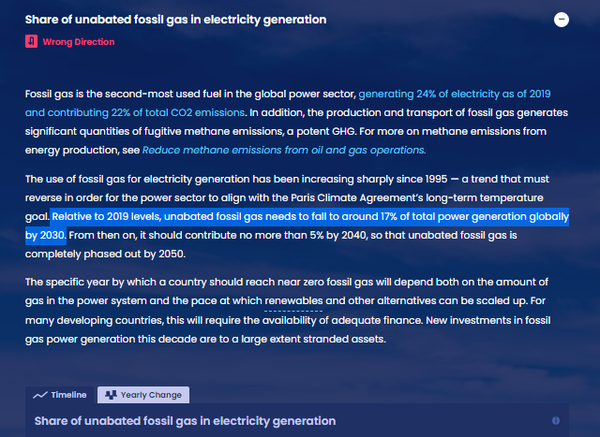
Add context from the indicator write-up as desired

Slide 37
For more information
VISIT: SYSTEMSCHANGELAB.ORG/INDUSTRY
EMAIL: CONTACT@SYSTEMSCHANGELAB.ORG

