Slide 1


Finance
Last updated December 2024 | systemschangelab.org/finance
Notes:
Photo by Sean Pollock: https://unsplash.com/photos/PhYq704ffdA

Slide 2

Systems Change Lab
It’s time to change the way we think about changing the world.
Systems Change Lab monitors, learns from and mobilizes action toward the transformational shifts needed to protect both people and the planet.
The data platform identifies and tracks key shifts in our global systems that, when achieved together, can spur transformational change.

Slide 3















Interconnected systems
Power
Industry
Transport
Cities
Buildings
Carbon Removal
Land & Forests
Ocean
Freshwater
Food &
Agriculture
Finance
Circular
Economy
Governance
Social Inclusion & Equity
Economics

Slide 4

The six shifts needed to transform the finance system
Measure, disclose and manage climate- and nature-related financial risks
Extend economic and financial inclusion to underserved and marginalized groups
Scale up public finance for climate and nature
Price greenhouse gas emissions and other environmental externalities
Scale up private finance for climate and nature
Eliminate harmful subsidies and financing
Notes:
Measure, disclose and manage climate- and nature-related financial risks
Measurement of climate- and nature-related risks helps companies target investments and interventions that advance sustainable business transformation, greenhouse gas emissions reductions and climate adaptation efforts, and are needed for other market stakeholders — like financial institutions and regulators — to deploy capital efficiently and monitor and manage risks at a portfolio or systemic level. Risk integration by itself will not set the global economy on a path to net-zero GHG emissions, but it will accelerate the movement of capital in response to other system shifts.
Scale up public finance for climate and nature
To unleash the power of the public sector in achieving climate and biodiversity goals, we need government leadership that reflects the urgency of climate action, persistent demand for accelerated change from civil society, public financial institutions designed for these goals, and coordinated monetary and fiscal policy to support large public investments.
Scale up private finance for climate and nature
Because the private sector accounts for roughly two-thirds of economic activity in most economies, it must participate in the transition to net-zero emissions around mid-century and protect nature. Financial and non-financial corporations are making commitments and setting targets to align their financial portfolios and balance sheets with net-zero and broader sustainability objectives. These financial commitments need to cause real-world changes that support decarbonization and protect nature and biodiversity.
Extend economic and financial inclusion to underserved and marginalized groups
A just transition toward a decarbonized, sustainable economy will result in more inclusivity and fairness than the high-carbon, unsustainable economy it leaves behind. It will give underserved and/or marginalized groups new economic opportunities for high-quality employment and enable their participation in the benefits of thriving, sustainable industries. A just transition will also offer further options to expand financial inclusion, extending financial services to all people, especially underserved and/or marginalized groups.
Price greenhouse gas emissions and other environmental externalities
Setting prices on pollution and harmful activities can be an effective instrument to tackle the unintended impacts of society’s consumption and production decisions. Governments can “price” environmental impacts by directly taxing activities that cause them, or by creating market-based mechanisms like emissions trading schemes.
Eliminate harmful subsidies and financing
Public and private investments and public subsidies continue to support activities incompatible with a sustainable future — the development of new fossil fuel reserves, overfishing, land-degrading agricultural practices and more. These financial flows must stop and be redirected to support a sustainable, decarbonized economy.
Photo by UN Climate Change: https://www.flickr.com/photos/unfccc/4165399407/in/album-72157622562921605/

Slide 5
Highlights
Public and private annual climate finance flows totaled $1.4 trillion in 2022, a 27% increase compared to 2021.
In 2021, public finance in support of fossil fuels increased to over $1 trillion. This trend will need to reverse and fall by an average of $120 billion per year to meet the 2030 phaseout target.
Investments in nature-based solutions should triple by 2030 and increase
fourfold by 2050.
Climate equality requires developed countries to meet or exceed their
$100 billion per year commitment to support developing countries: in 2021,
there was still a $17 billion gap.

Slide 6
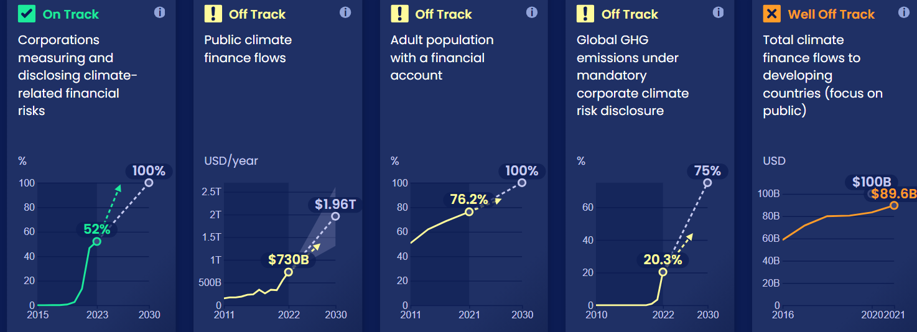
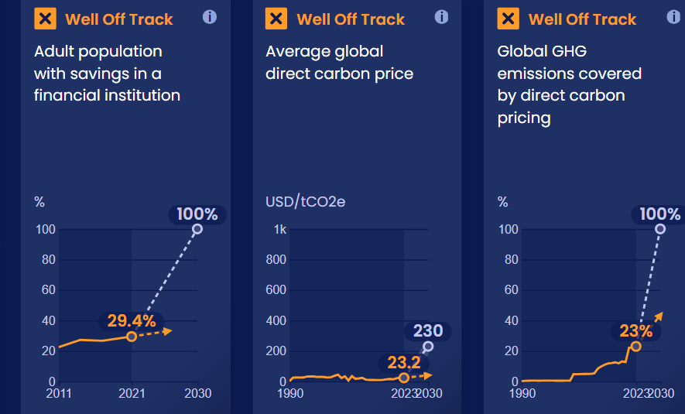
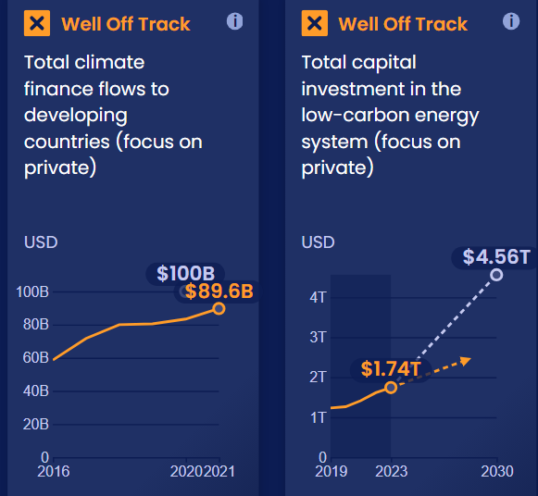
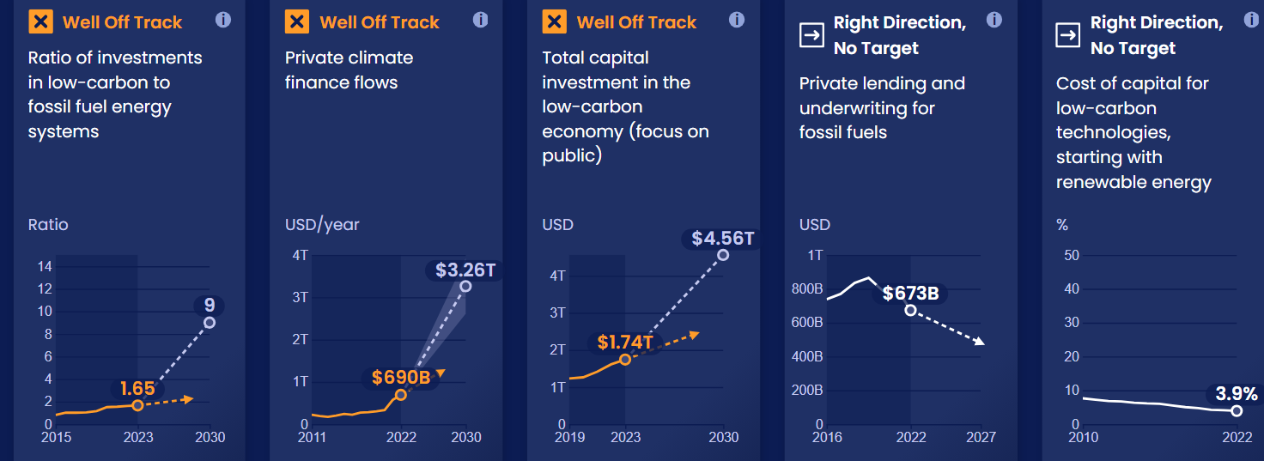
Progress toward targets
In this system, we have identified 30 target indicators. Out of the 30 targets we've evaluated, 15 are moving in the right direction and 1 is on track.

Slide 7
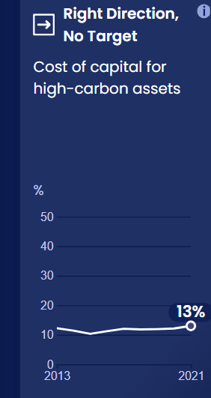
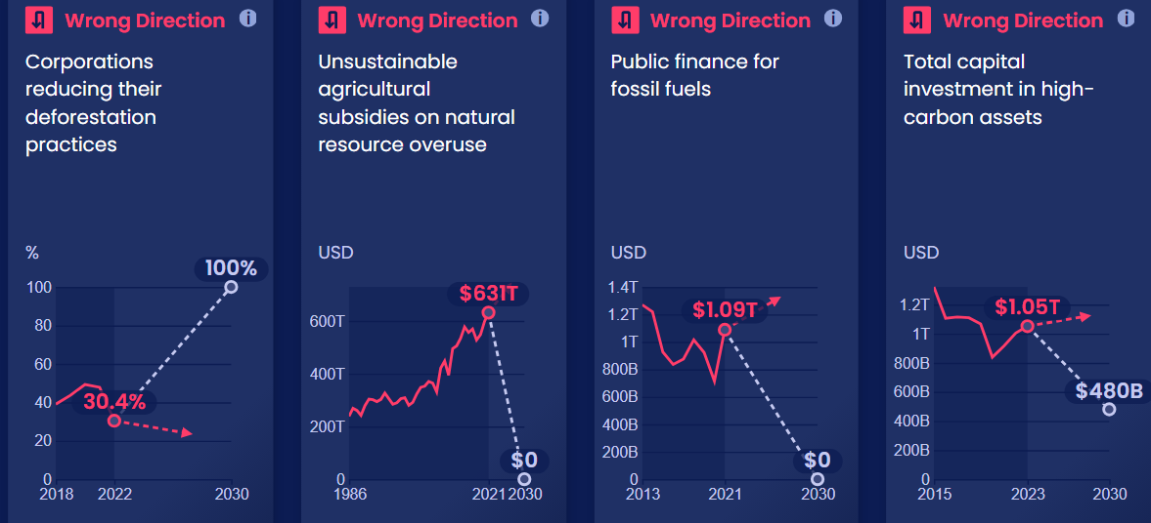
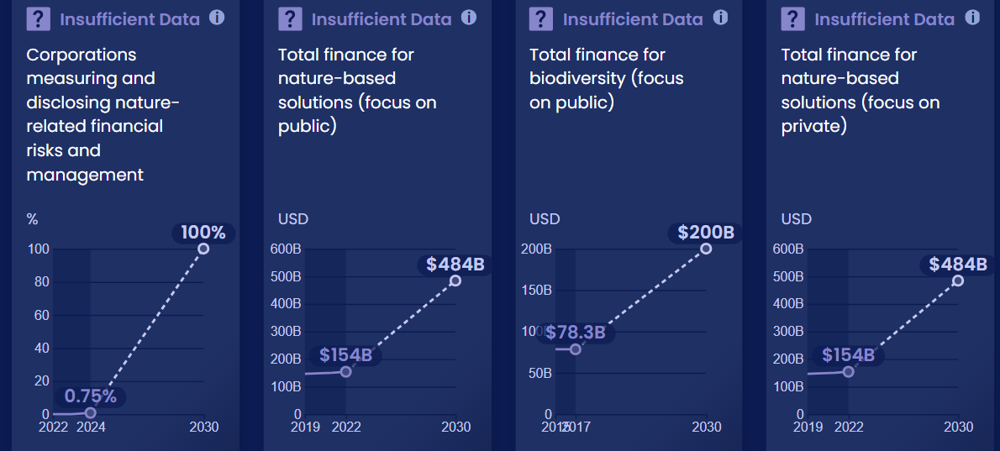
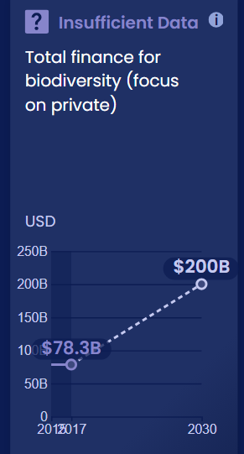
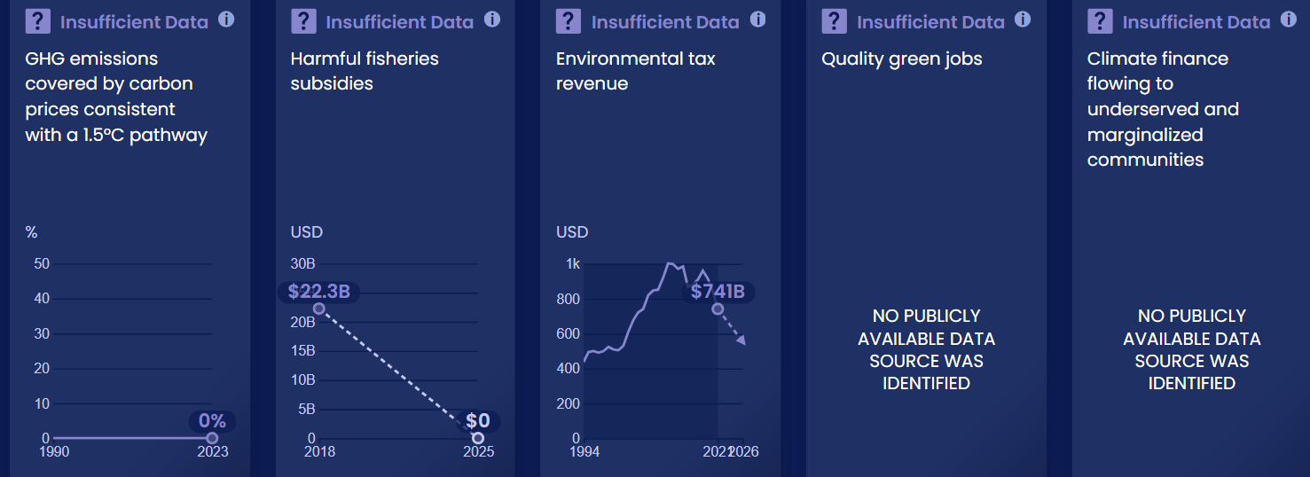
Progress toward targets

Slide 8
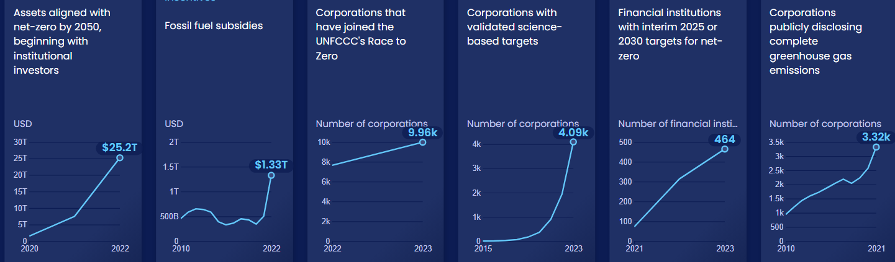
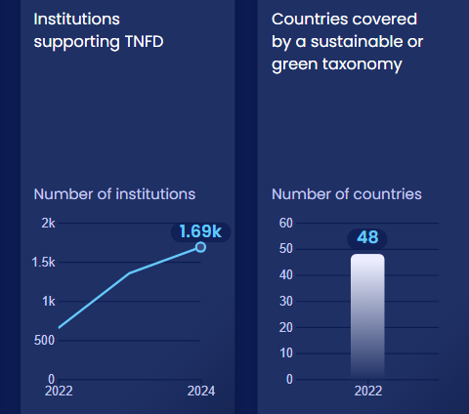
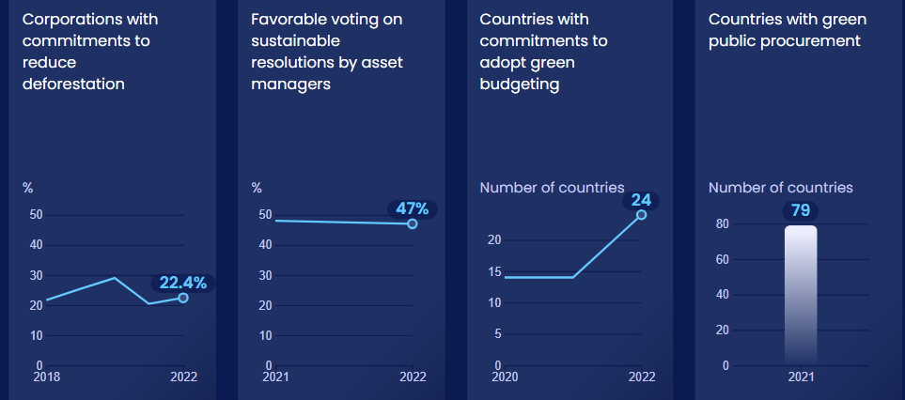
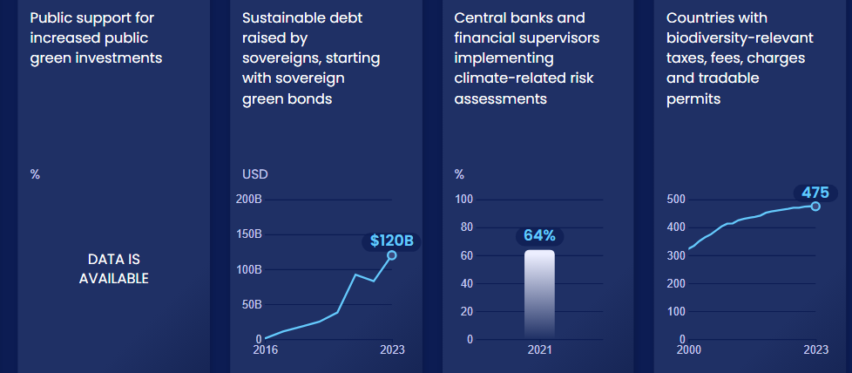
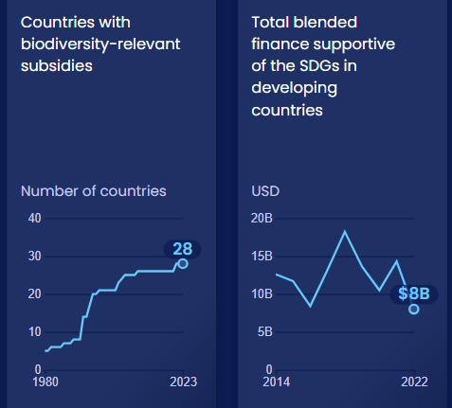
Enablers and barriers
In this system, we have identified 54 enablers and barriers to change.

Slide 9
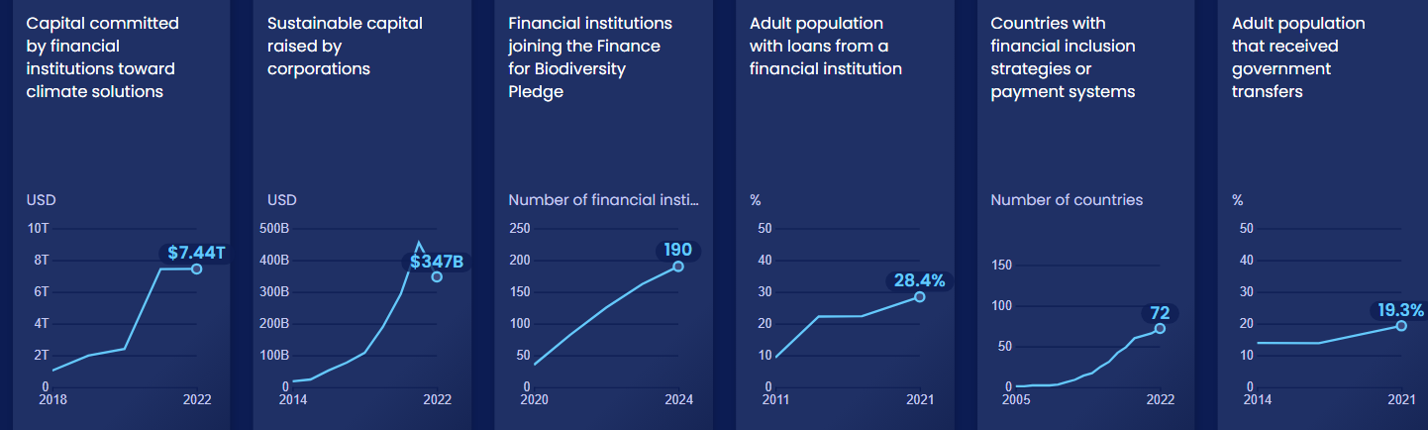
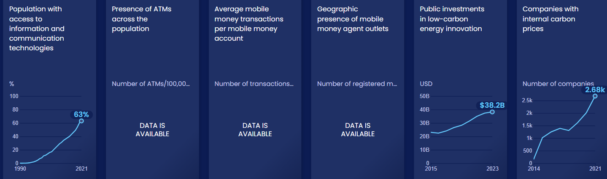
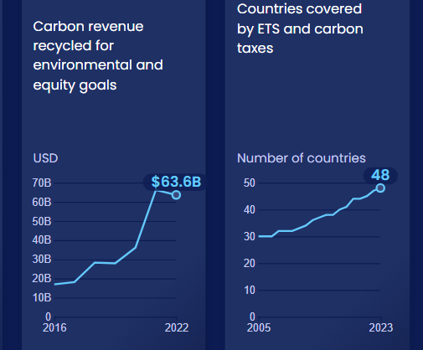
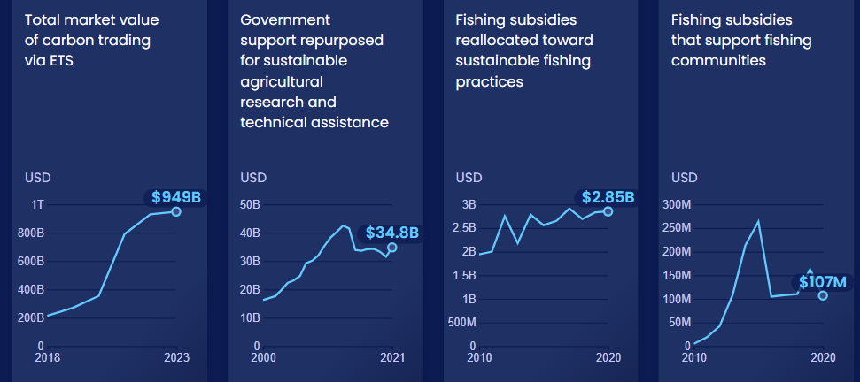
Enablers and barriers

Slide 10
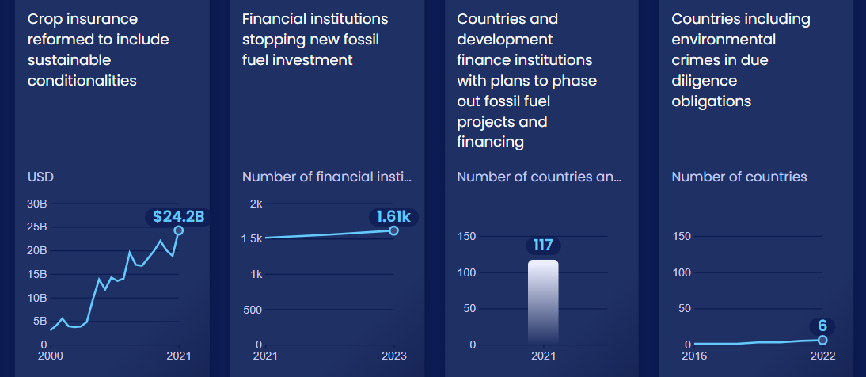
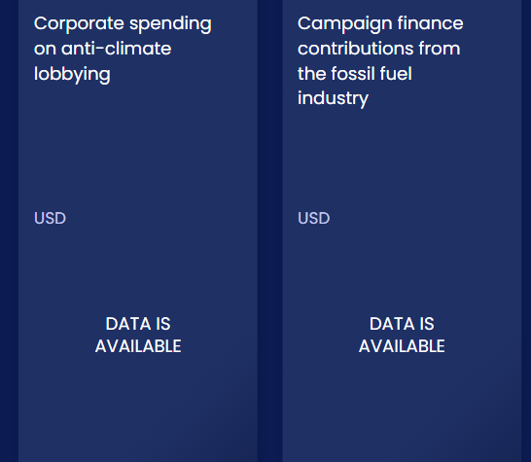
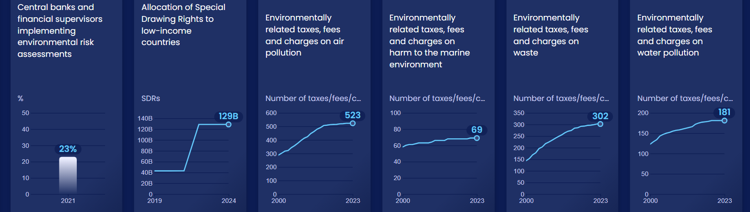
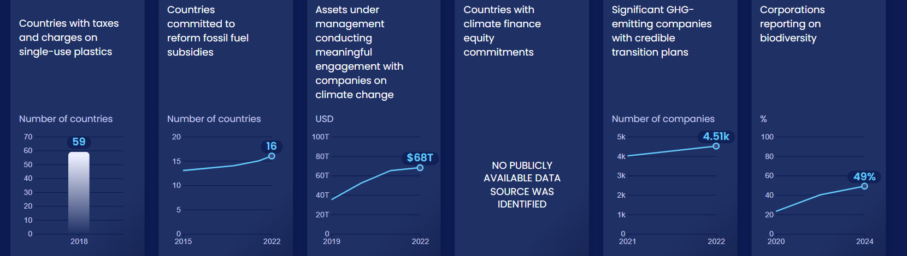
Enablers and barriers

Slide 11

Measure, disclose and manage climate- and nature-related financial risks
SHIFT
Notes:
Photo by Markus Winkler: https://unsplash.com/photos/IrRbSND5EUc

Slide 12
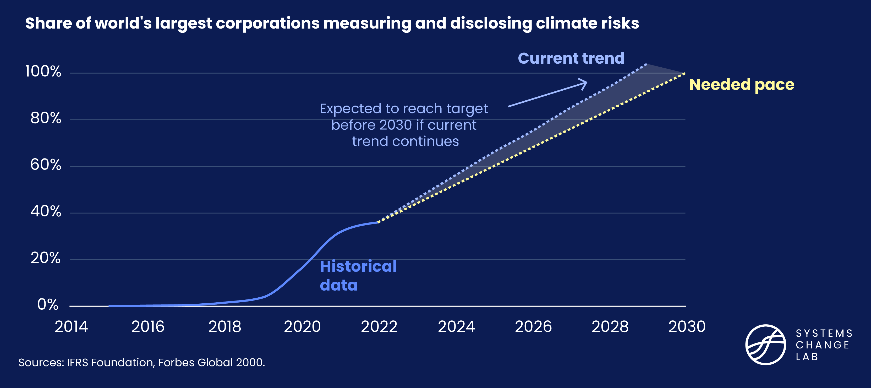

36% of the large corporations have set climate disclosures
On Track
Notes:
Investors, creditors, regulators and other market participants use standardized financial disclosures to obtain important information about a corporation's performance and future prospects. However, financial disclosures do not sufficiently integrate climate-related risks and opportunities.
The industry-led Taskforce on Climate-related Financial Disclosures (TCFD) provides the most widely adopted framework for incorporating climate-related risks and opportunities into financial and non-financial corporate reporting. However, it is only a high-level framework.
Regulators in the United States and Europe are designing robust and detailed mandatory climate reporting regimes that align with the TCFD framework. In the interim, voluntary sustainability standard-setters and reporting platforms like the Sustainability Accounting Standards Board (SASB), CDP and the International Sustainability Standards Board (ISSB) are providing more specific standards aligned with the TCFD’s recommendations.
Measuring corporate reporting against available voluntary standards that align with the TCFD framework provides a consistent and comparable way to determine the uptake of the disclosure of climate risks and their management across markets while mandatory regimes are being implemented.
In 2021, 1,378 corporations reported using SASB standards. That number grew to 1,755 corporations by September 2022. Of the Forbes Global 2000 list, about 36% reported using SASB standards in 2022, up from about 32% in 2021. This puts this indicator on track to reach the 2030 target of 100% coverage as long as reporting continues at the current pace. The number of corporations reporting to CDP and under ISSB’s International Financial Reporting Standards (IFRS) Sustainability Disclosure Standards, or any forthcoming mandatory reporting regimes, will be tracked as data becomes available.

Slide 13
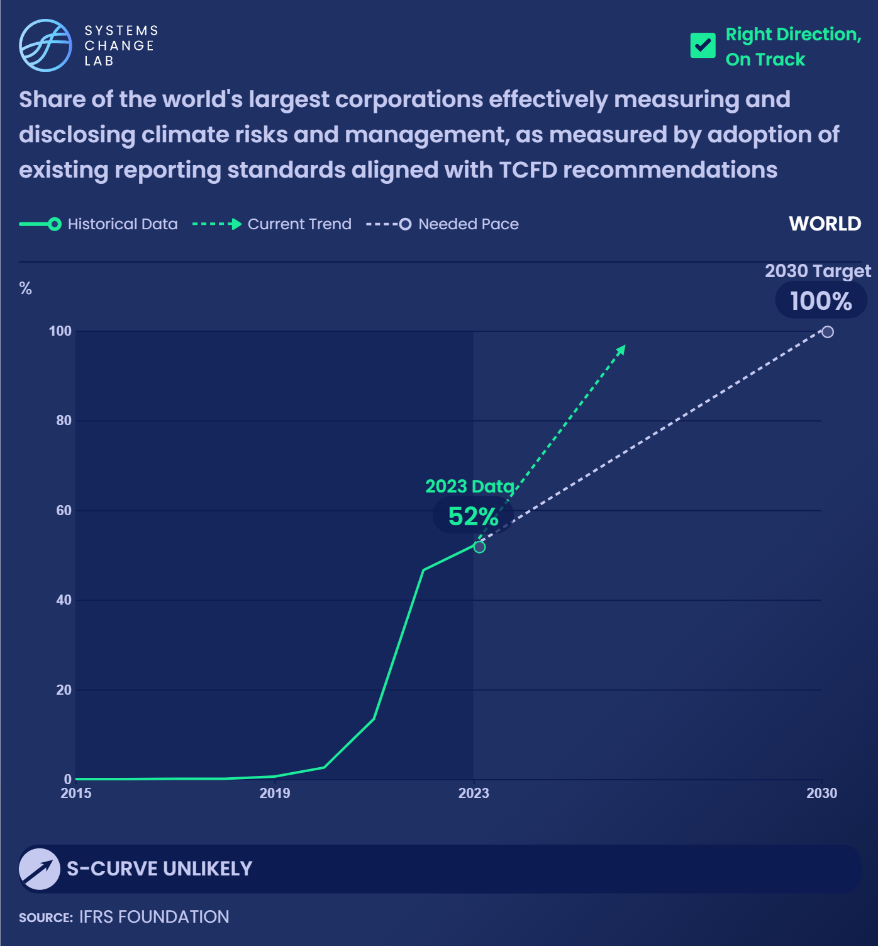
In 2023, about 52% of companies on the Forbes Global 2000 list reported using Sustainability Accounting Standards Board standards, up from about 47% in 2022.
Notes:
As long as reporting continues to increase at the current pace, this is on track to reach 100% coverage by 2030.
Investors, creditors, regulators and other market participants use standardized financial disclosures to obtain important information about a corporation's performance and future prospects. However, financial disclosures do not sufficiently integrate climate-related risks and opportunities.
The industry-led Taskforce on Climate-related Financial Disclosures (TCFD) provides the most widely adopted framework for incorporating climate-related risks and opportunities into financial and non-financial corporate reporting. However, it is only a high-level framework.
Regulators in the United States and Europe are designing robust and detailed mandatory climate reporting regimes that align with the TCFD framework. In the interim, voluntary sustainability standard-setters and reporting platforms like the Sustainability Accounting Standards Board (SASB), CDP and the International Sustainability Standards Board (ISSB) are providing more specific standards aligned with the TCFD’s recommendations.
Measuring corporate reporting against available voluntary standards that align with the TCFD framework provides a consistent and comparable way to determine the uptake of the disclosure of climate risks and their management across markets while mandatory regimes are being implemented.
In 2021, 1,378 corporations reported using SASB standards. That number grew to 1,755 corporations by September 2022. Of the Forbes Global 2000 list, about 36% reported using SASB standards in 2022, up from about 32% in 2021. This puts this indicator on track to reach the 2030 target of 100% coverage as long as reporting continues at the current pace. The number of corporations reporting to CDP and under ISSB’s International Financial Reporting Standards (IFRS) Sustainability Disclosure Standards, or any forthcoming mandatory reporting regimes, will be tracked as data becomes available.

Slide 14
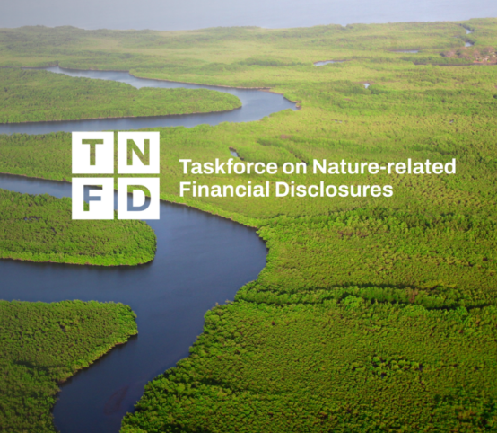
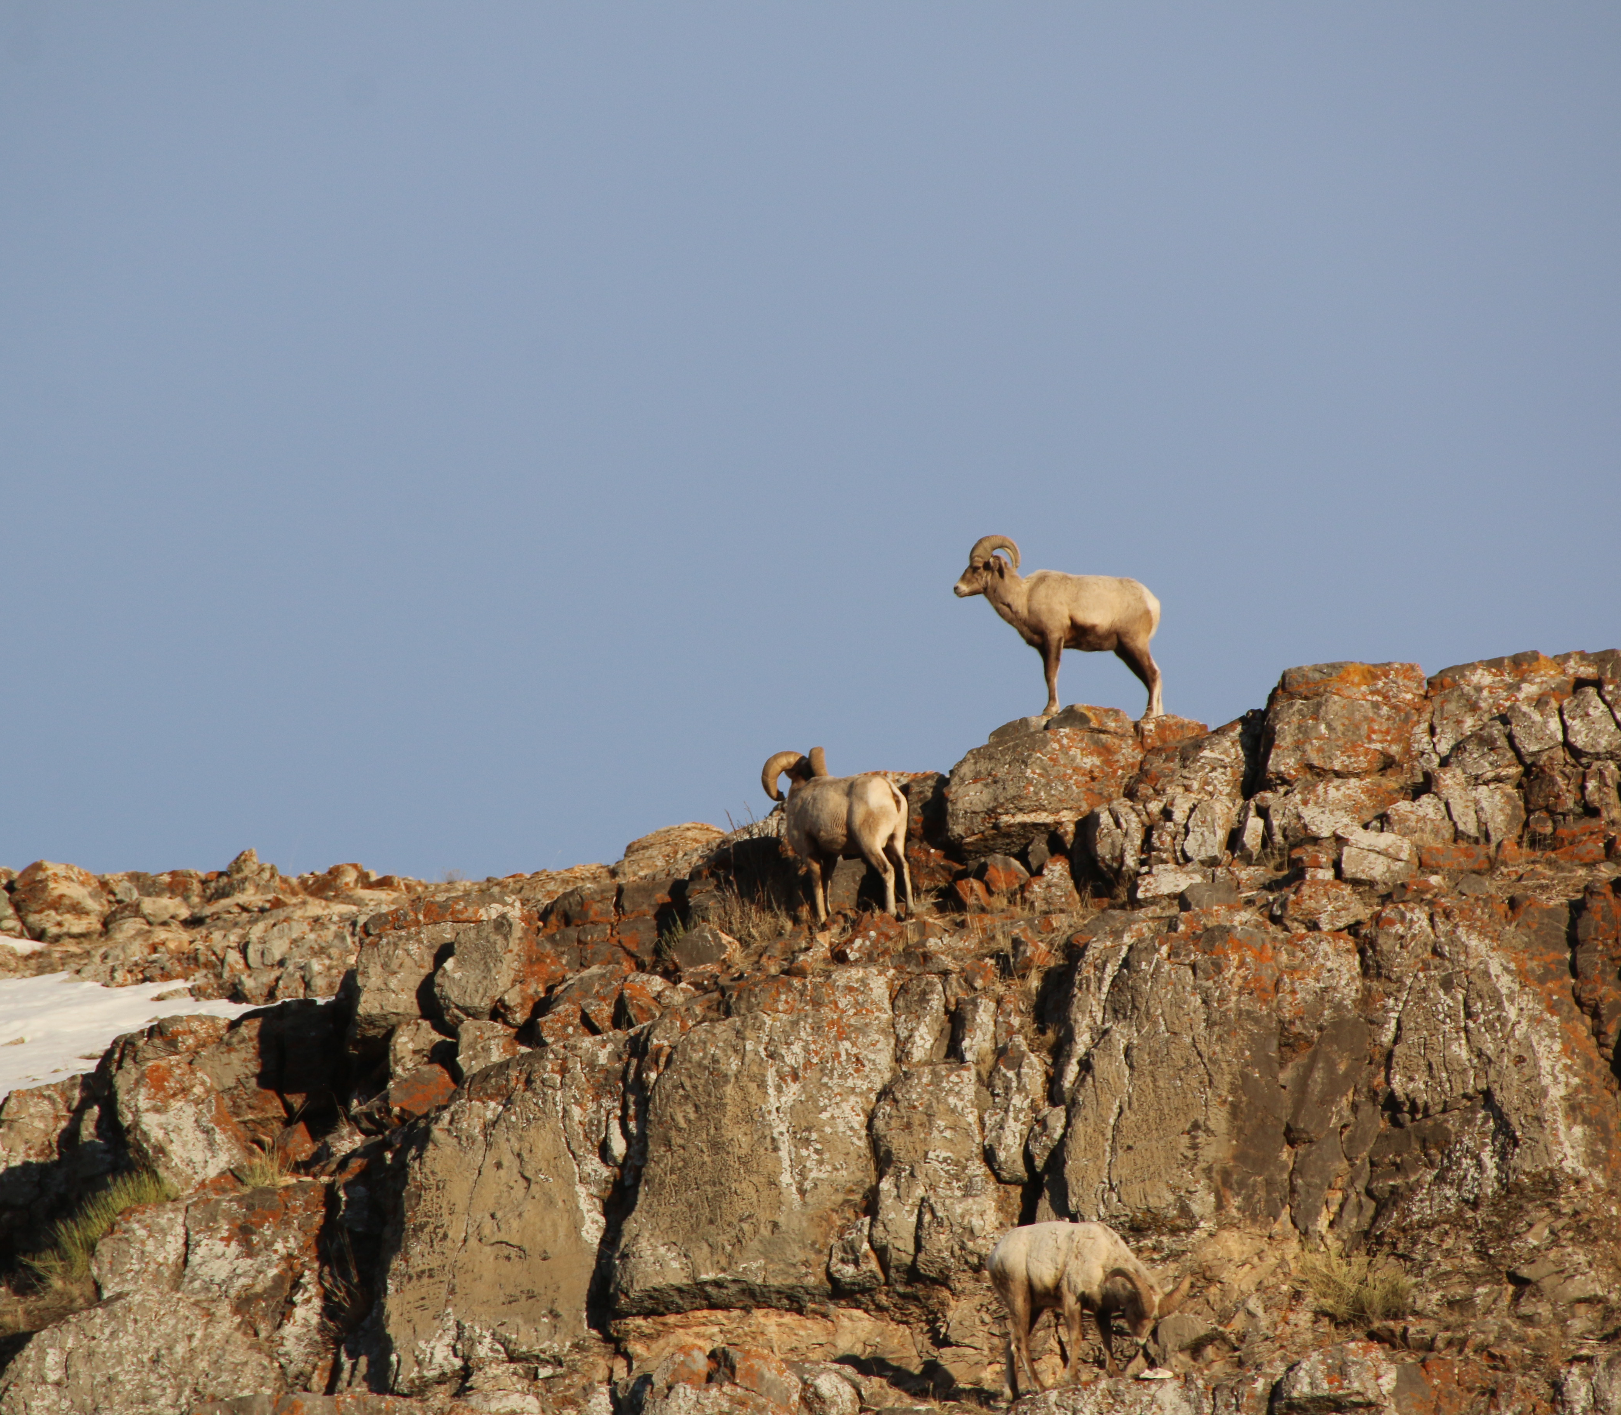
As of December 2024, 1,688 institutions supported the Taskforce on Nature-related Financial Disclosures
Notes:
As of September 2022, 653 organizations supported the Taskforce on Nature-related Financial Disclosures and its framework to report risks and impacts on nature, demonstrating strong demand for greater transparency and standardization.
As of 2021, twenty-three percent of members from the Network for Greening the Financial System have begun implementing environmental risk assessments.
Deforestation, biodiversity loss, ecosystem degradation and other nature-related risks need to be factored into corporate and financial decision-making. The Taskforce on Nature-related Financial Disclosures (TNFD) will provide a standard framework that corporations can use to measure and disclose nature-related financial risks. Adherence to this framework will provide firms with data to assess and manage their nature-related risk exposure and adjust their operational and investment decisions.
Since the TNFD framework is still under development, it is not yet possible to measure adoption and impact. As of September 2022, 653 organizations supported the project.
The Network for Greening the Financial System (NGFS) is a consortium dedicated to enhancing the role of the financial system to manage risks and mobilize capital for green and low-carbon investments. Made up of 114 central banks and financial supervisors and 18 observers, the NGFS provides best practices for climate and environmental risk management.
Environment-related risks associated with biodiversity loss could destabilize the natural system that modern society depends on, damage the economy and threaten financial stability. Environmental risk assessments help ensure that central banks monitor risks and safeguard economies and financial markets against disruption. According to the NGFS, as of 2021, 23% of its members have begun examining the role of environmental risks in their economies and financial sectors. This provides a good initial indication of progress and more granular indicators will be tracked in the future.
Picture by TNFD

Slide 15
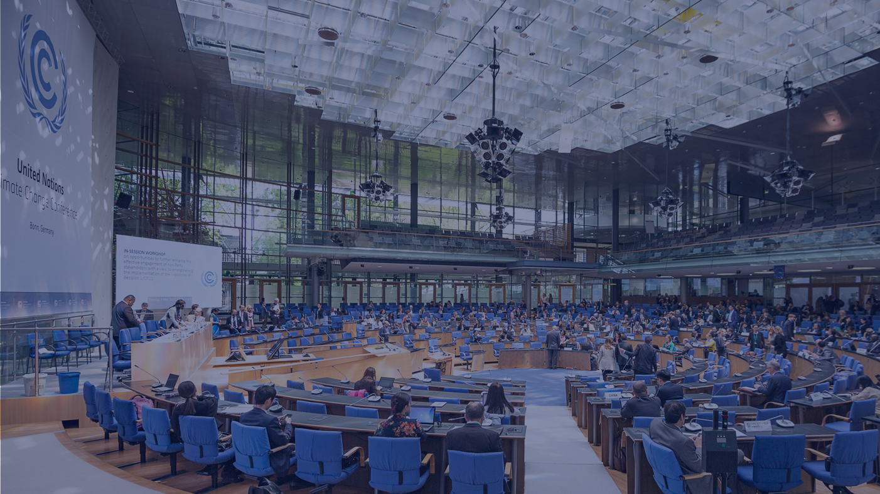
Scale up public finance for climate and nature
SHIFT
Notes:
Photo by UN Climate Change: https://www.flickr.com/photos/unfccc/33744990153/in/photostream/

Slide 16
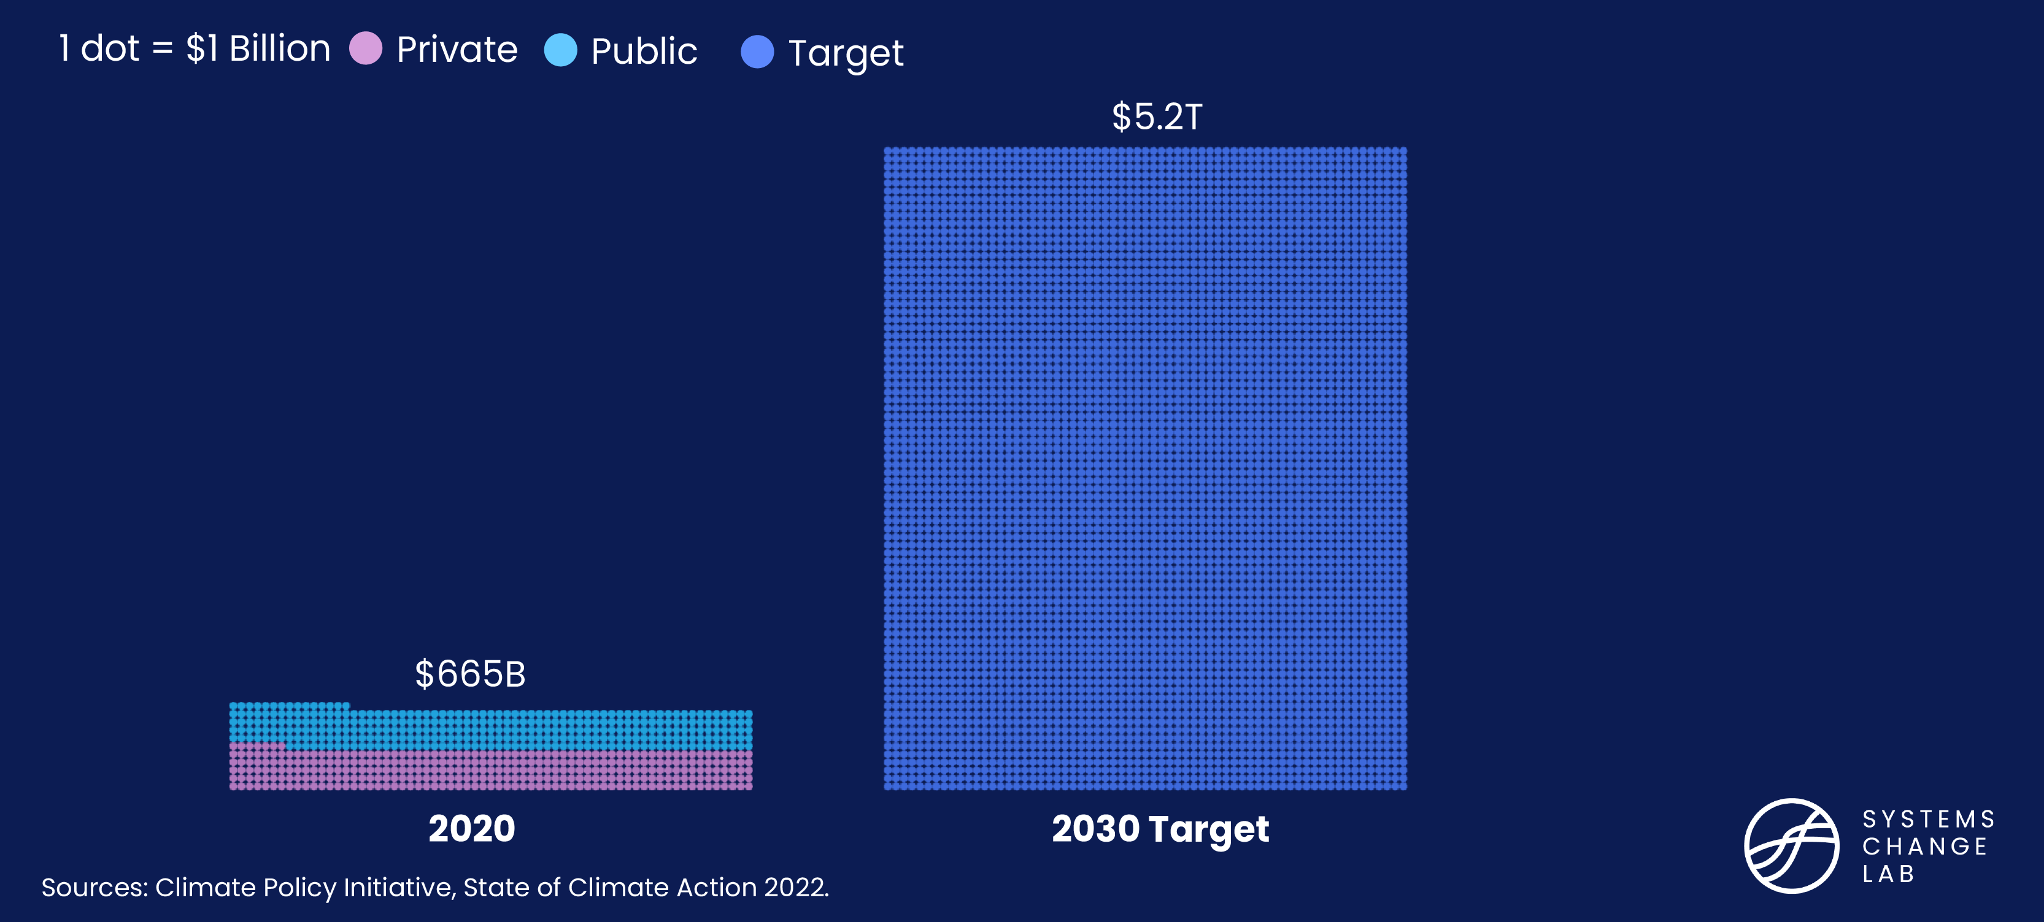
Climate finance needs to increase more than 10x

Slide 17
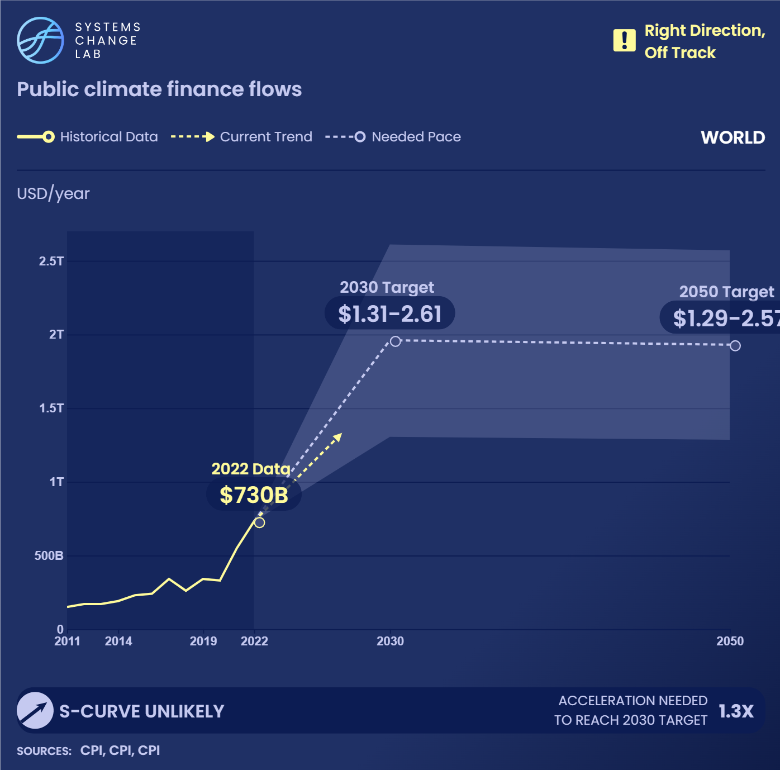
Public climate finance will need to expand two to four times to reach $1.31 to 2.61 trillion per year by 2030.
Notes:
Such an increase will require growing at an average rate of $166 billion per year between 2020 and 2030.
Scaling up public climate finance is necessary to ensure a rapid transition to a decarbonized, resilient world. It plays a vital role especially in areas where private finance is unwilling or not well suited to meet climate objectives at the speed and scale necessary, such as public services and infrastructure (for example, transportation and energy networks); research, development and deployment of new low-carbon technologies; and ecosystem protection. Public climate finance can also be employed to ensure equitable outcomes and a just transition.
It is difficult to determine the precise ideal breakdown between public and private finance needed to meet climate goals, given that this depends on social and political choices about the ideal mix of market and state intervention in economies. Historical data show about an equal split between public and private climate finance while projections suggest that a quarter of global climate investment will need to come from public sources to meet climate goals.
In 2020, public climate finance flows amounted to around $300 billion, having increased by about $15 billion per year, on average, between 2016 and 2020. Public climate finance is delivered through different channels and actors, most notably development financial institutions (DFIs) — national and multilateral — and state-owned financial institutions.
Despite these recent increases, investments remain well off track. Public climate finance will need to expand four to nine times to reach the estimated $1.31 to 2.61 trillion per year target for 2030. Reaching the $2 trillion per year midpoint of the target range will require an average investment of $166 billion per year between 2020 and 2030 — a striking 11-fold increase compared to historical rates.

Slide 18
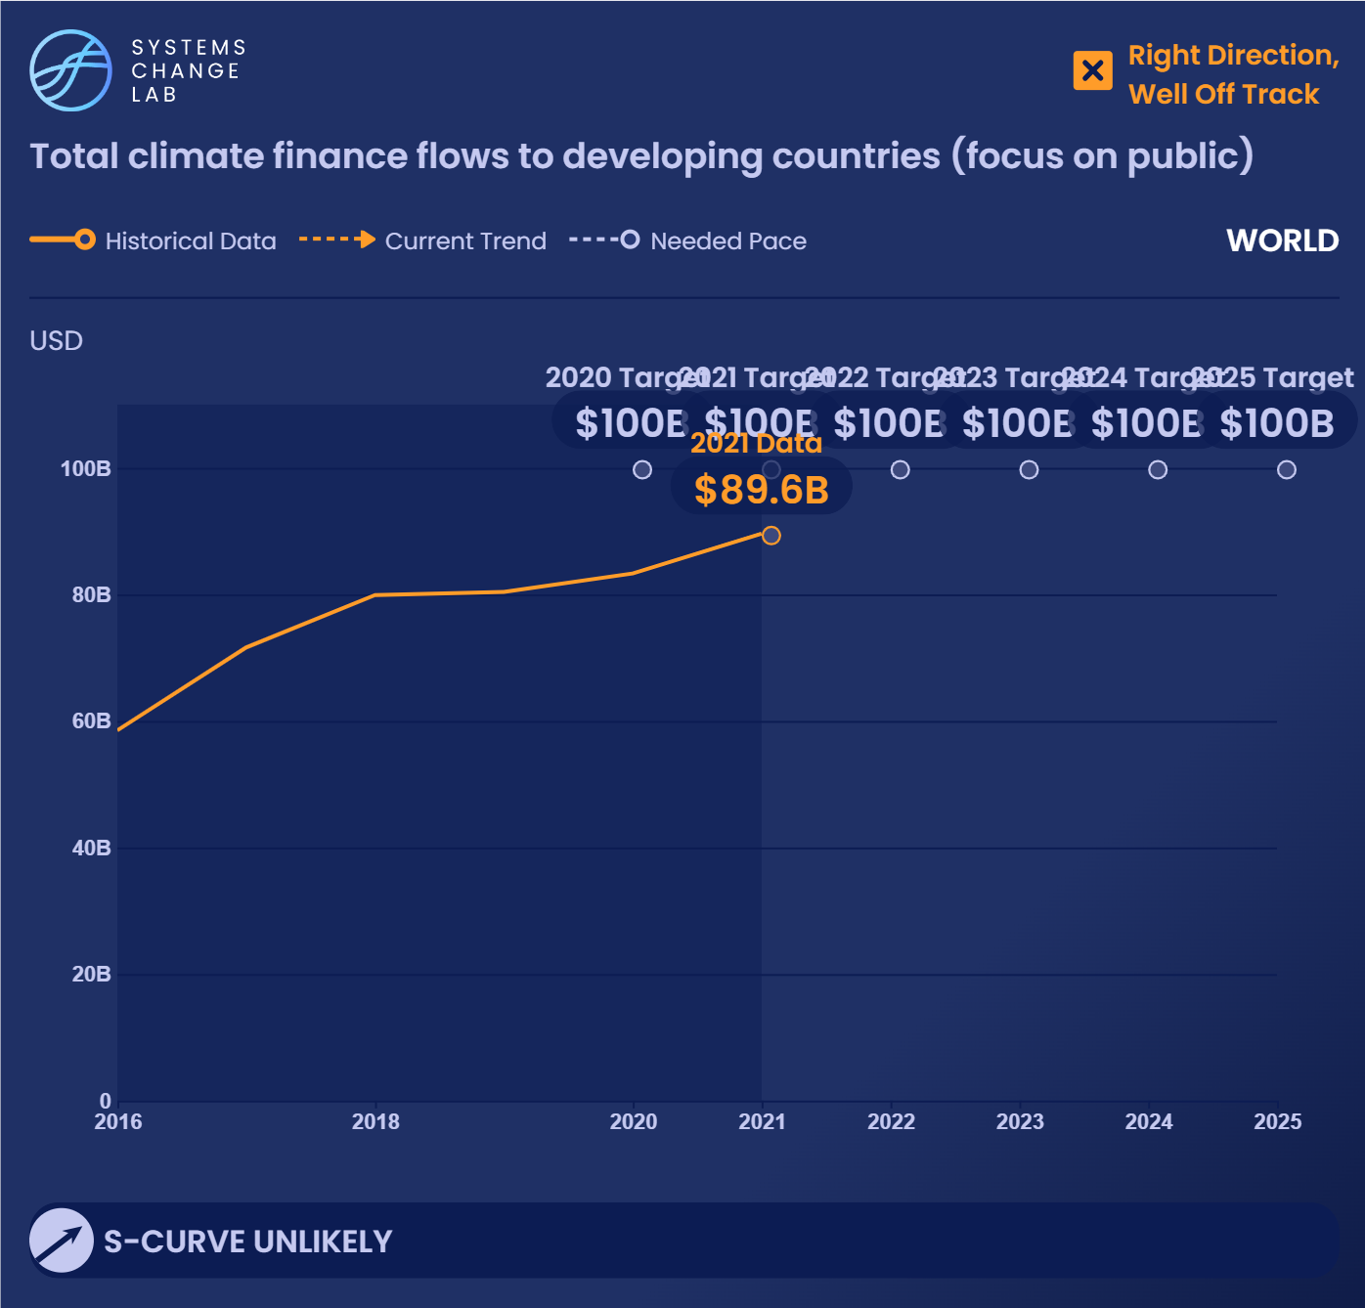
In 2021, developed countries provided about $89.6 billion in climate finance to developing countries, still falling short of the $100 billion goal.
Notes:
Developing countries contribute the least to climate change but are most vulnerable to its impacts: food insecurity, land and water scarcity, coastal flooding and more. Most of these countries are under-resourced and will continue to suffer loss and damage from climate impacts for which they are not prepared. In addition, they often lack the resources needed to invest in and gain the benefits of a low-carbon, greener economy.
To reduce climate inequities stemming from the disproportionate impacts of GHG emissions and expand the benefits afforded by a low-carbon economy, developed nations must increase public climate finance to developing countries.
In 2020, developed countries provided about $83 billion in climate finance to developing countries, with $68 billion from public sources, $13 billion from mobilized private sources and $2 billion from export credits. Out of that $68 billion in public climate finance, 55% was for mitigation, 37% for adaptation and 8% for cross-cutting purposes. The share of funding dedicated to adaptation grew from 20% in 2016 to 37% in 2020.
The total $83 billion is still below the $100 billion annual target agreed to at the fifteenth session of the Conference of Parties (COP15) in 2009 to support developing countries on climate mitigation and adaptation. This goal has been extended until 2025 and negotiations toward a more ambitious goal for post-2025 have begun.
The mandate states that the new collective quantified goal (NCQG) will be set from a floor of $100 billion per year, and that it should factor in the needs and priorities of developing countries. Negotiations include mitigation and adaptation needs as per the prior goal, as well as “loss and damage” funding for residual damages — the economic costs that cannot be prevented through adaptation.
Some estimates put developing countries’ economic costs from these residual damages at $290–580 billion in 2030. There should be a balance between climate finance allocated for mitigation and adaptation, with some experts calling for a 50-50 split.
The target for this indicator will be updated once negotiations on a new 2025 goal are finalized. Once data becomes available, a breakdown by country and recipient will reveal which countries are meeting their pledges and which have not received the funding they need.

Slide 19
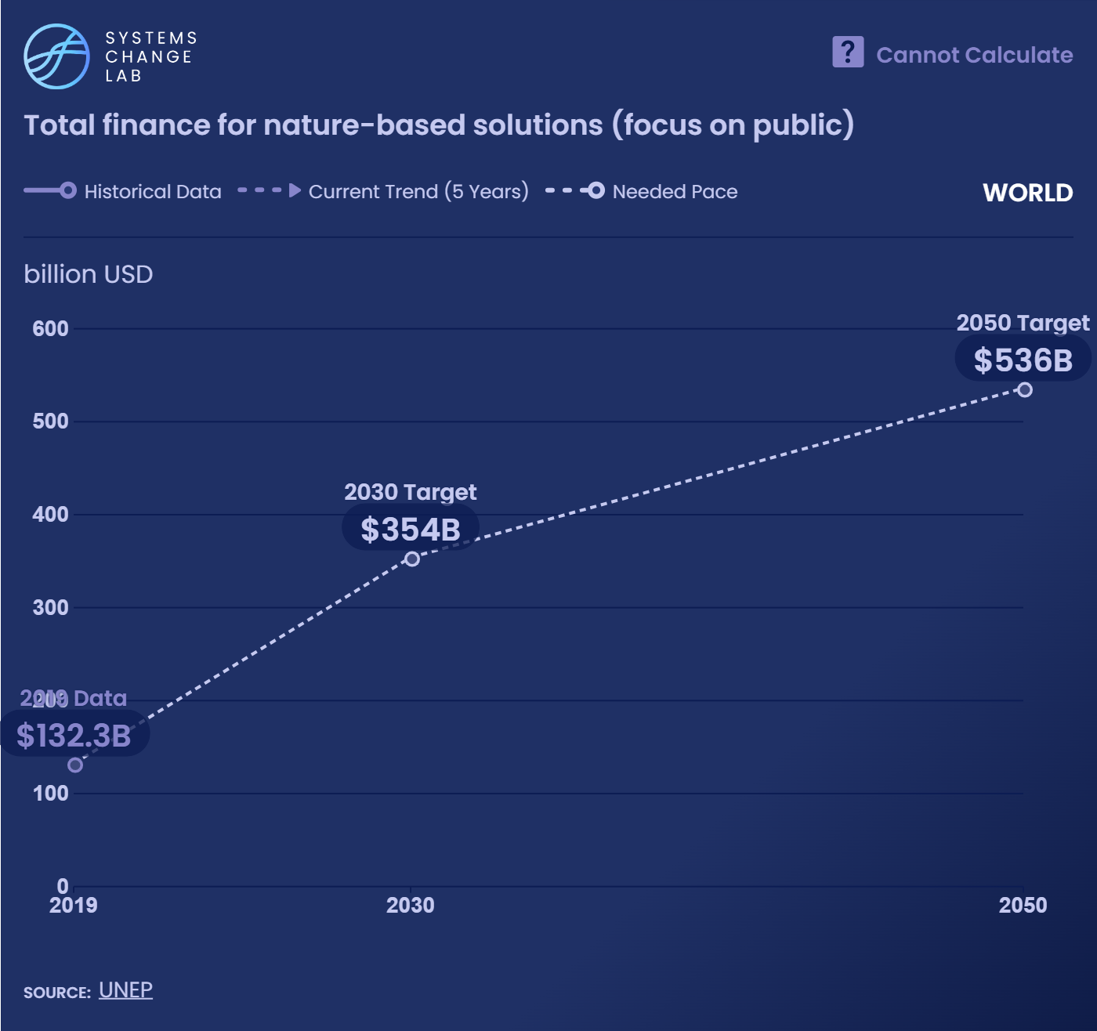
The world is investing $154 billion in nature-based solutions each year, with public finance contributing 83% of the total.
Notes:
Nature-based solutions are actions that restore, preserve or manage ecosystems to address climate change and protect nature. Nature-based solutions such as protecting coral reefs and mangrove restoration can help reduce GHG emissions, boost ecosystem health and address environmental issues like soil erosion, biodiversity loss and deforestation.
Currently, approximately $132 billion is directed toward nature-based solutions each year, with public finance contributing 86% of this total. However, this level of investment isn’t enough to reach our climate goals. Estimates suggest that total investments in nature-based solutions need to triple by 2030 and increase fourfold by 2050. This would yield $354 billion by 2030 and $536 billion by 2050 to reach climate and biodiversity goals, and will require growing at an average rate of $20 billion per year between 2019 and 2030. This number likely underestimates the total need, since more work is needed to quantify the need for marine nature-based solutions.
At the same time, investing in nature offers the opportunity to generate $10 trillion in business value and create 395 million jobs.

Slide 20

Scale up private finance for climate and nature
SHIFT
Notes:
Photo by Rafael Matsunaga https://www.flickr.com/photos/rednuht/479370088/in/photolist-JmU2w-CU85ey-y6K5z-a7Ffiy-25VfKNz-6gmKhL-C2xnqm-2jFXpPN-a7Ffnw-6gmJSL-LnwxVW-2iCtvBU-2mN9p4C-6f24So-snzBqK-7gi33H-2iYPHiV-c5xLDJ-5X6D5d-a7dht-SWdxrm-m1SAV-8JPP4-aV5KXz-5ss5HP-7bEFCv-7bJuVb-7bJuC3-7bJuso-7bEEZp-7bEEW8-7bJuo1-7bJuc3-7bJuDC-7bEEAZ-7bEFjz-7bEECp-7bJuWW-7bEExK-7bEEze-dtKhge-7bJu5L-7bJuT7-9jCN5r-7bJuLQ-7YvSFf-9jFVYG-24xarjA-91LSvi-91PE5J

Slide 21
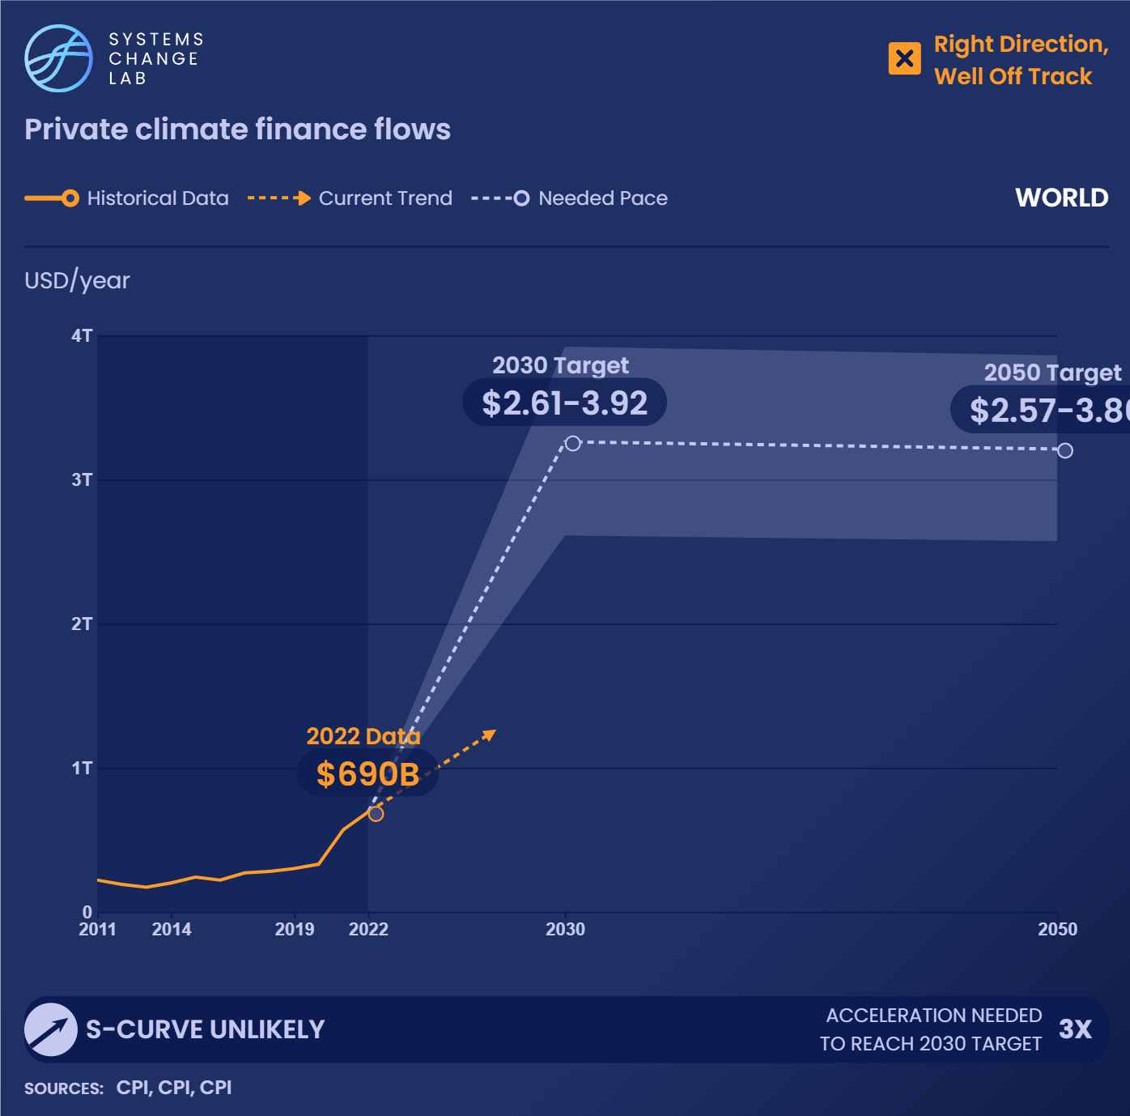
Private climate finance will need to grow more four to six times to reach between $2.61 and $3.92 trillion per year by 2030.
Notes:
Since the private sector comprises the largest share of the global economy, it is vital that private investment decisions align with a 1.5 degree C-compatible emissions path that supports resilience, inclusion and the protection of nature. Private finance will need to play an essential role in investing in climate solutions, bringing them to scale and financing low-carbon transition plans for carbon-intensive sectors.
All types of private finance must participate — from high-risk, high-return venture capital needed to commercialize low-carbon innovation to the low-risk, high-volume market for public debt. Private finance will also need to shift away from economic activities and sectors that are incompatible with decarbonized economies and the protection of nature. Unlocking private finance will require voluntary measures by private firms and additional public sector investment, as well as new standards to shift private capital away from unsustainable activities and move it toward sustainable ones.
It is difficult to determine the precise ideal breakdown between public and private finance needed to meet climate goals, given that this depends on social and political choices about the ideal mix of market and state intervention in economies. Projections suggest that about three-quarters of global climate investment will need to come from private sources. The Climate Policy Initiative (CPI) estimates that historically, there has been an even split between private and public climate finance.
Private climate finance flows amounted to around $340 billion in 2020, growing $23 billion per year on average between 2016 and 2020. Despite the recent increases, this number needs to grow. To reach our climate goals, global private climate finance will need to accelerate by more than 10 times to reach the estimated $2.61 to 3.92 trillion per year target for 2030. To reach the $3.3 trillion per year midpoint of the target range, it will require growing at an average rate of $292 billion per year between 2020 and 2030 — over 12 times faster than historic growth rates.

Slide 22
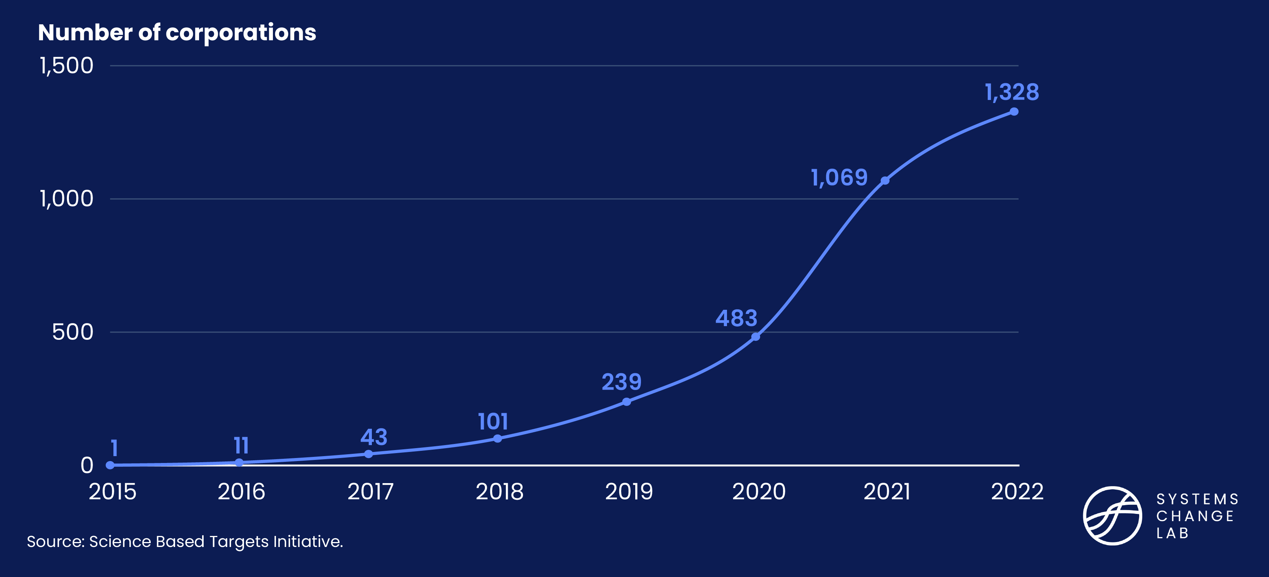
Firms with validated science-based targets are growing

Slide 23
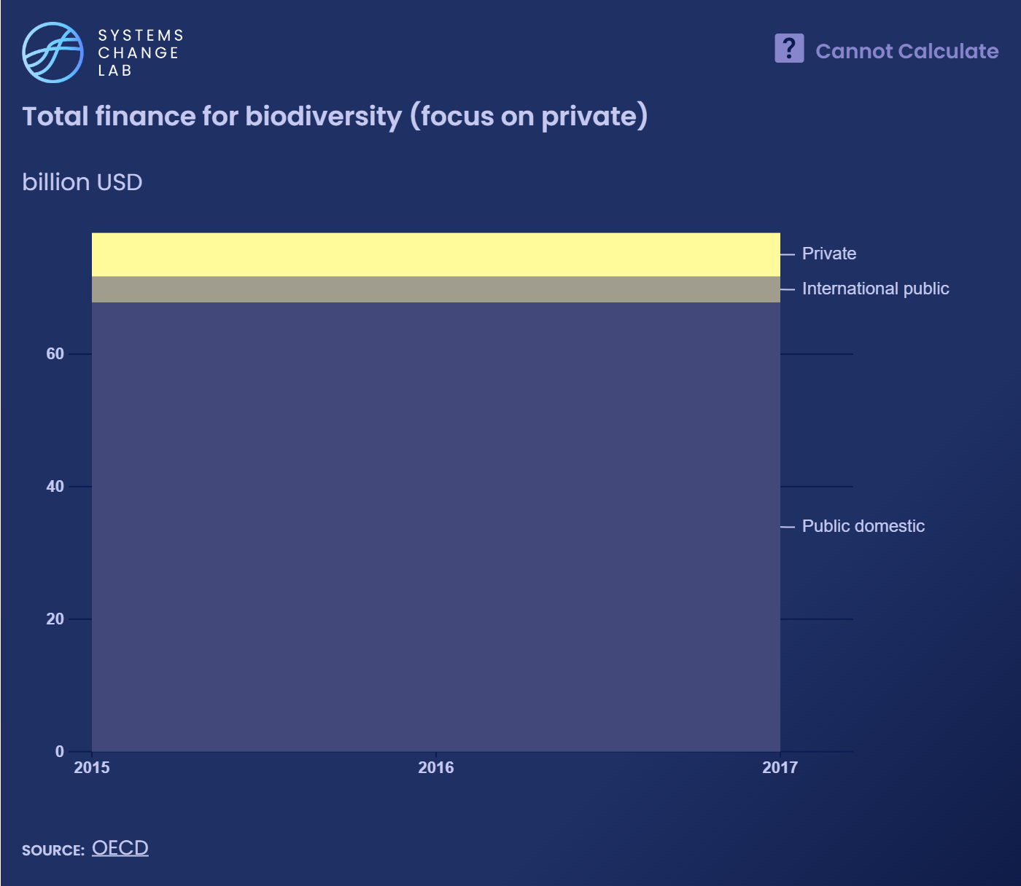
Global biodiversity finance totaled about $78 billion each year between 2015 and 2017, with the private sector contributing at least $6.6 billion.
Notes:
The private sector must make a major financial contribution to help halt biodiversity loss and preserve wildlife and natural habitats. The post-2020 global biodiversity framework by the Convention on Biological Diversity identified the need to increase financial resources to at least $200 billion per year by 2030 and suggested increasing international financial flows to developing countries by at least $10 billion per year.
Business sectors that directly rely on biodiversity will experience losses in profitability and risk their long-term survival unless biodiversity is protected. For example, $235–577 billion in annual global food production is dependent upon the contribution of animal pollinators, and coral reefs generate $36 billion in ecotourism every year. Finance can protect biodiversity using different instruments, from direct government expenditures and incentives for environmentally sustainable practices to philanthropic and private investments in nature-based solutions.
Leveraging private finance will be essential to reach these goals, yet recent trends fall short. Between 2015 and 2017, global biodiversity finance totaled $78.3 billion per year, with private sources contributing at least $6.6 billion per year. Total biodiversity finance will need to almost triple to reach $200 billion by 2030, and will require growing by $10 billion per year between 2017 and 2030.

Slide 24

Extend economic and financial inclusion to underserved and marginalized groups
SHIFT
Notes:
Photo by Radek Kucharski https://www.flickr.com/photos/137294100@N08/51959026548/in/photolist-2narAnj-gyNi9-2iw7pp4-LbyYiT-MhPqBE-XkKvXF-2iHCGyu-38swSt-8u4ksg-ruioYq-aynJ2F-brHTTW-ayqjXJ-9UY5g4-5fV7W4-ayqtBq-CRiLo-5RGhp9-93wpxR-mAPf6G-kdFkA-7qXHV9-5FGxGm-7J14eg-4vjGK8-8cZbCf-rvkSe-6ZBFPH-2VmDP-5FCgka-urTDh-95ivfv-ayqvqs-2qgz59-8B9zmH-5FGxp1-5FGxt3-3k1Na1-2mkvHdd-8JBmpv-ayqozw-aynQGT-dcHKHA-jFuh-2hKnUyJ-5FGxkh-rsSLj-8BWaPN-84eakc-27oAVJL

Slide 25
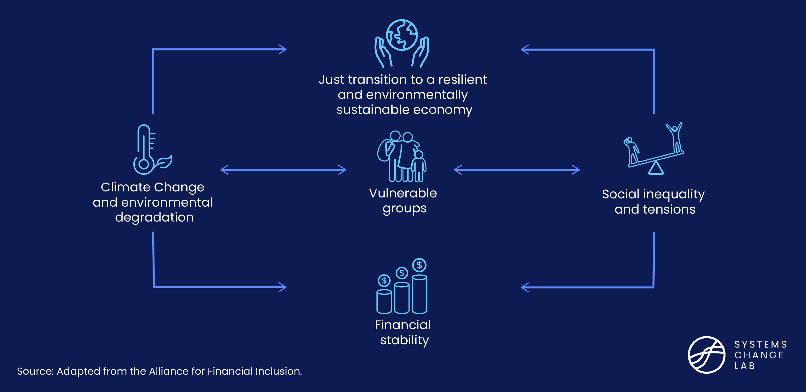
Connecting green finance and financial inclusion

Slide 26
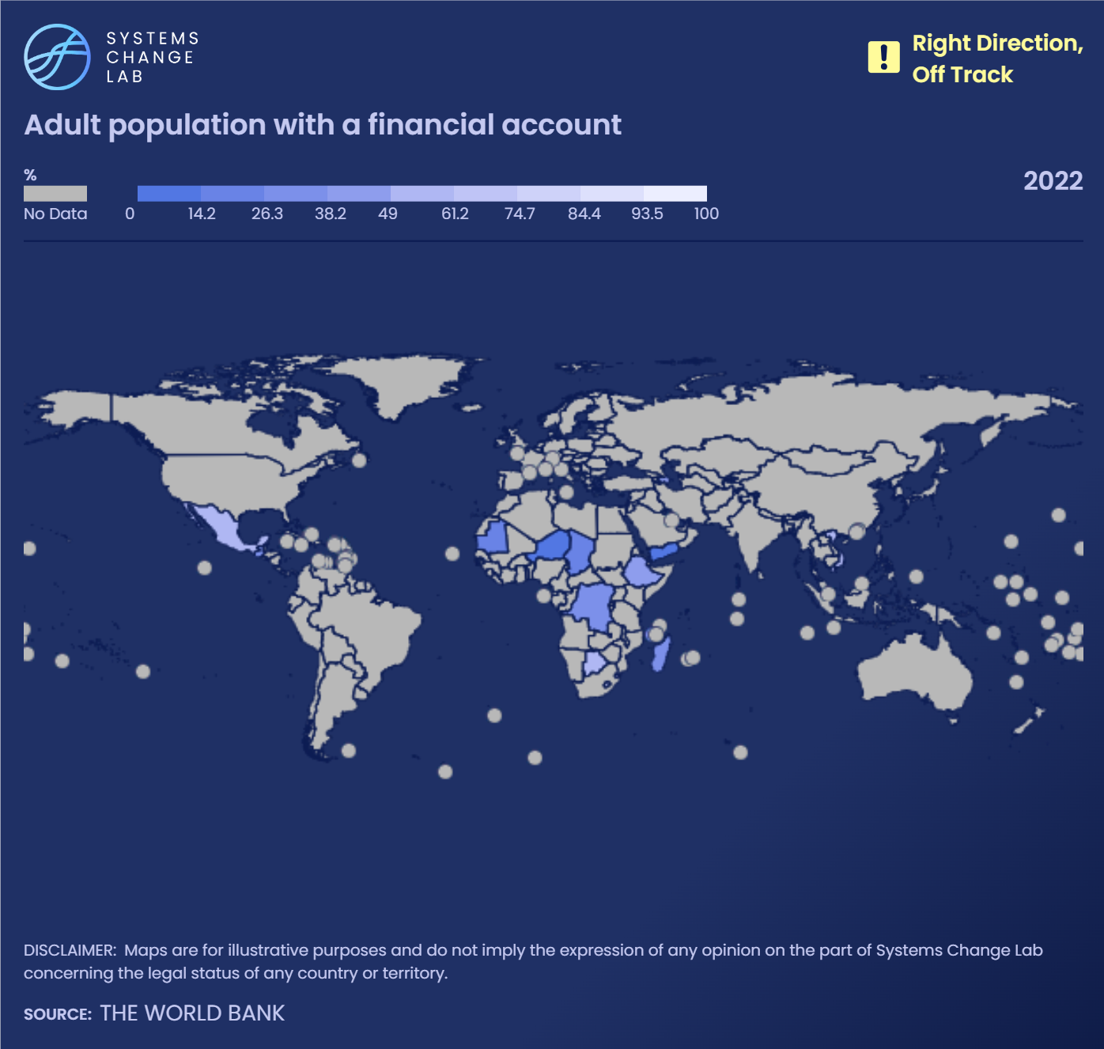
Seventy-six percent of adults worldwide had access to a financial account in 2021, an eight-percentage point increase since 2017. To reach 100% by 2050, growth must accelerate 1.4x faster.
Notes:
The proportion of the population with an open bank account is an important indicator of financial inclusion and resilience. An estimated 1.4 billion adults worldwide do not have an account at a regulated financial institution or with a mobile money provider. These adults, defined by the World Bank as those aged 15 or older, are considered “unbanked.”
Access to financial services can be challenging for people who live in rural areas far from a physical branch, as well as people who may not have enough money to start or maintain an account due to deposit or balance minimums. Women also experience a financial inclusion gender gap and may face significant barriers to access financial services.
Financial services aren’t restricted to private financial institutions. The public sector often offers banking and credit products, and these can accomplish public and social goals beyond profit-making.
According to the World Bank, in 2021, 76% of adults worldwide had access to a bank account, mobile money service or other financial institution, a slight increase from 68% in 2017. To reach the 100% target by 2030, this access will need to grow at about 1.4 times the historical rate between 2021 and 2030.

Slide 27
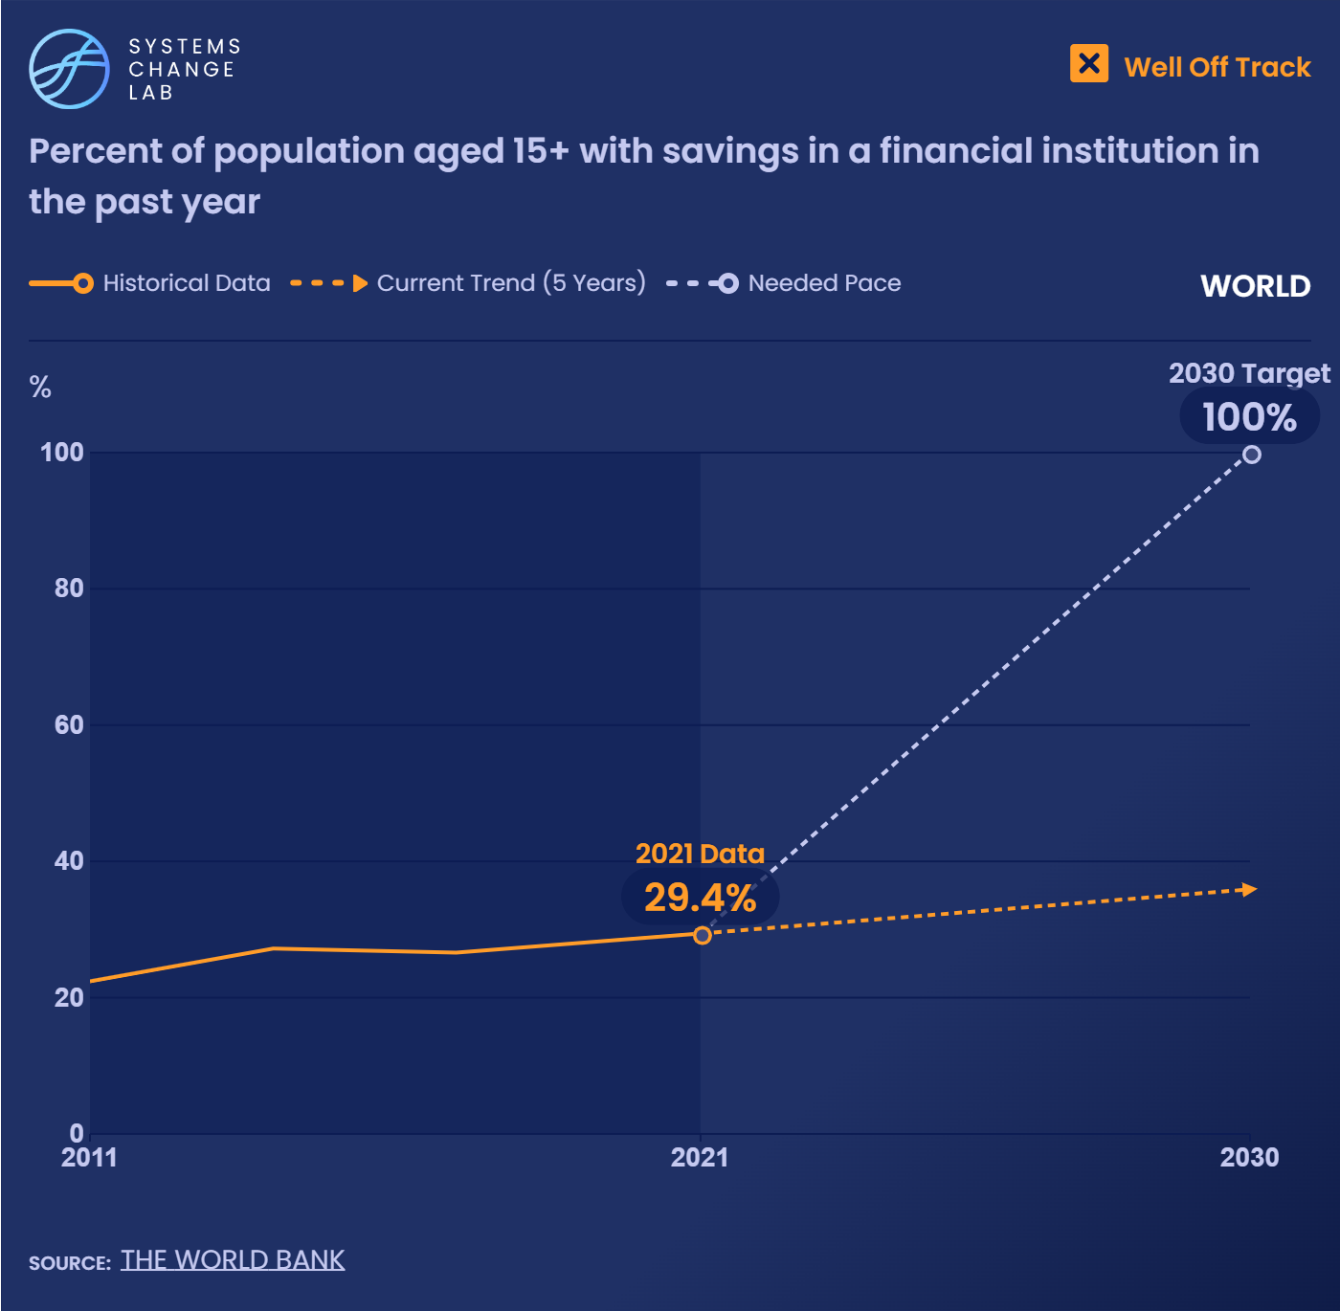
About 29% of adults worldwide saved formally at a financial institution in 2021, a slight increase from 27% in 2017.
Notes:
To reach 100% by 2050, growth must increase more than 10x faster.
Having savings in a public or private financial institution can help a person become more financially secure. Savings can also help households bounce back after natural disasters or invest in climate-resilient technology, providing a buffer against the effects of climate change and environmental degradation. Households with savings under the formal financial system also benefit from government regulations and insurance that can protect their assets, helping ensure financial stability.
However, trust in financial institutions and governments runs low in some countries. In these areas, leaders must earn the public’s trust by building a fair, resilient financial system. Increasing the number of adults with formal savings will require easier access to financial services, a growth in government cash transfer policies, and expanded economic opportunities.
According to the World Bank, 29% of adults worldwide saved formally at a financial institution in 2021, a slight increase from 27% in 2017. To reach 100% coverage by 2030, the share will need to grow more about eleven times faster than the historic rate.

Slide 28
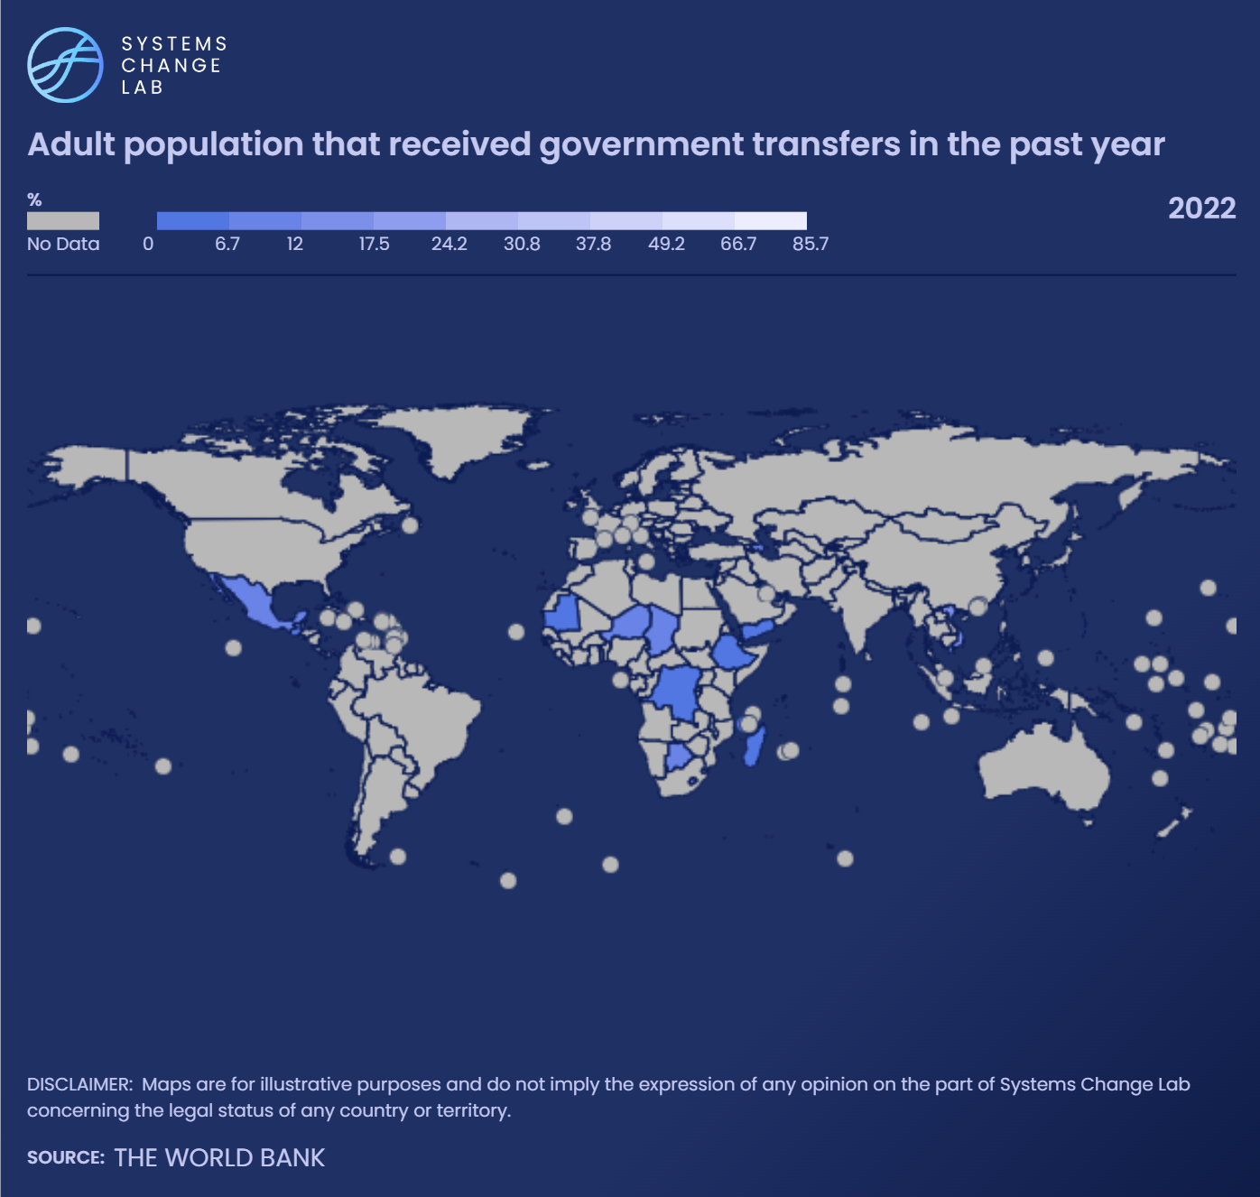
In 2021, 19% of adults worldwide received government transfers
in 2021.
Notes:
These transfers are a critical lifeline for vulnerable communities that can be used to build resilience against the harmful impacts of climate change.
Government transfers (especially cash transfers) are a critical lifeline for vulnerable communities. They can foster greater financial inclusion and serve as an entry point into the formal financial system. Other forms of transfer payments related to welfare, such as education-related and unemployment benefits, can also promote economic resiliency and financial inclusion. Cash assistance coupled with other financial inclusion programs, such as savings programs in a regulated financial system, can further increase economic benefits to communities. Some countries are even integrating climate considerations into broader social protection programs — which include cash transfers — in order to build resilience and protect the vulnerable from the harmful impacts of climate change.
Transfer payments can also help build trust in the government’s financial infrastructure. While many transfer payment systems are based on economic needs, some advocate that universal payments build social solidarity. Government cash transfers can potentially provide opportunities for households to consider investments that could increase their climate adaptation capacity. According to the World Bank, 19% of adults worldwide received government transfers in 2021, an increase from 14% in 2017.

Slide 29
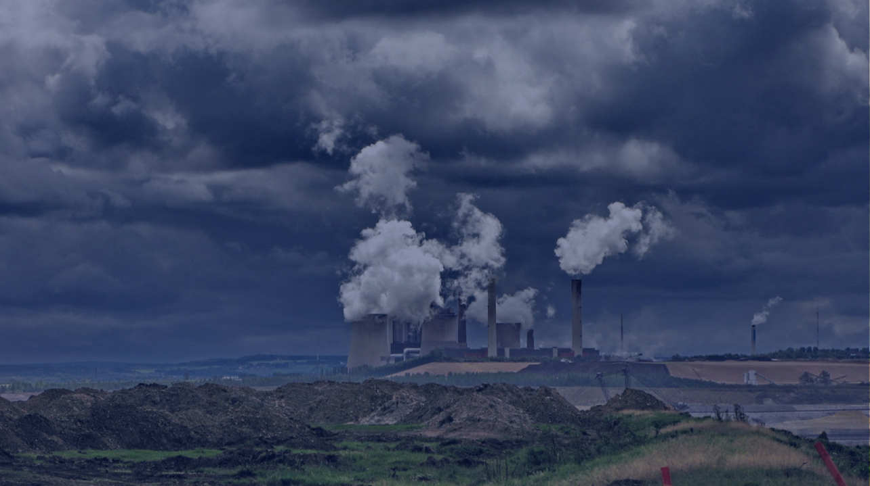
Price greenhouse gas emissions and other environmental externalities
SHIFT
Notes:
Photo via Flickr: https://www.flickr.com/photos/axelhartmann/1182980503/in/photolist-2Nx5Tz-2i5yYZ5-7Ecczy-8AoLSx-21LPiem-2fqPxsM-2LgZVi-29c9WnD-297R9Rs-286Nae3-fdLKUk-27Per9T-26rrUFs-9Q1Znc-26rsHMb-27PfhL8-2mu88NV-M4r8jQ-2inewQB-2mu4wjT-26rpDLS-2nfZWoB-9Q1UL6-286SNVN-2mtYgS5-27as1Zu-JD1KsA-4Btu7U-8WCn8Y-2ng7wUF-2mu88V3-2ng8V6d-2ng7wrS-2ng6gHs-2ng8TMB-pezE2e-6UMSpa-TgxjaC-7V1S5e-2ng6ikq-21LPiZ9-2mtYgB5-2ng7xGT-gwmAC2-ySMBRW-2nfZXtH-2mu73ep-2ng6hgw-2itUraA-2mu893n

Slide 30
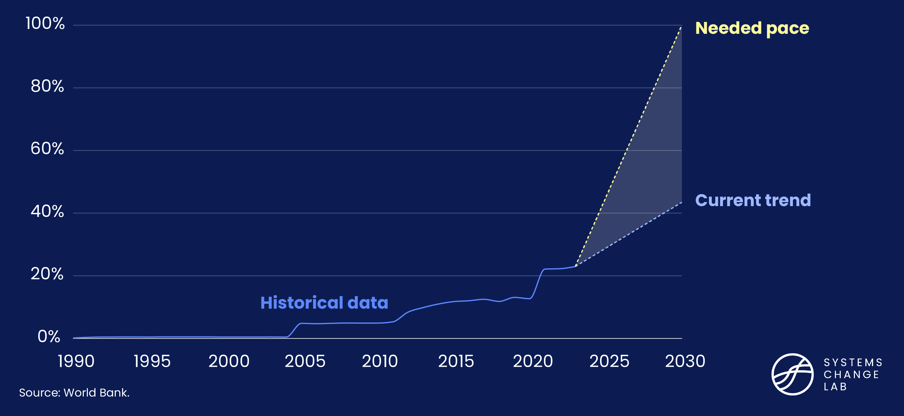
Direct carbon pricing needs to accelerate 3x

Slide 31
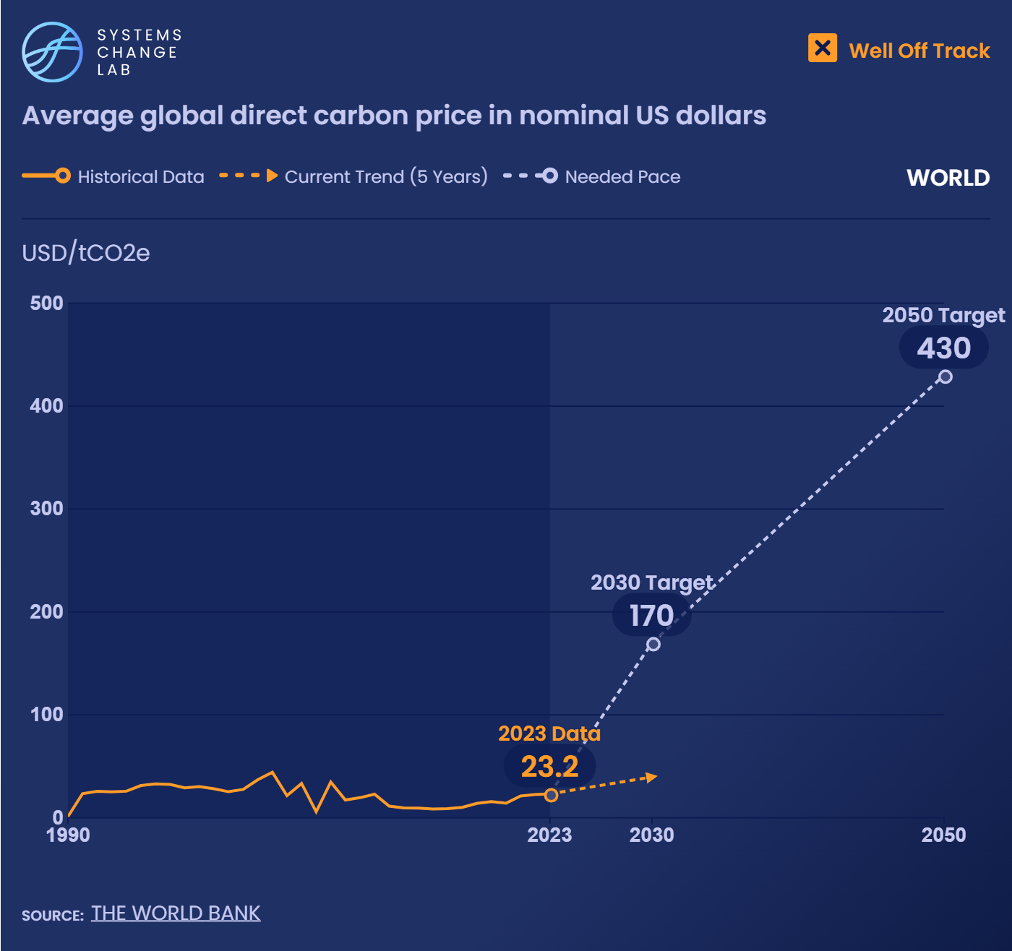
The global weighted-average carbon price is currently about $23.2/tCO2e.
Notes:
Estimates from the latest Intergovernmental Panel on Climate Change report state that the carbon price within jurisdictions with pricing systems must be at least $170 per metric ton of carbon dioxide equivalent (tCO2e) by 2030 to limit warming to 1.5 degrees C.
Under existing carbon pricing regimes, the global weighted-average carbon price is currently about $23 per metric ton of CO2 equivalent (tCO2e). Estimates from the latest Intergovernmental Panel on Climate Change (IPCC) report state that a much higher global carbon price will be required to limit warming to 1.5 degrees C (2.7 degrees F) — at least $170/tCO2e by 2030 (approximately a seven-fold increase of the global average) and at least $430/tCO2e by 2050 (nearly a 19-fold increase).
Put another way, the average price for carbon will need to increase by roughly $30 per year between 2023 and 2030 to reach the target. This would mean an acceleration of more than 10 times the historic rate. These targets will not be met by direct carbon pricing alone. They will be reached by a combination of direct pricing and complementary policies that implicitly price carbon by incentivizing a transition from high-carbon activities to low-carbon activities. Nevertheless, they underscore that the gap between current direct prices and the incentives needed to reach the 1.5 degrees C (2.7 degrees F) goal is still enormous.

Slide 32
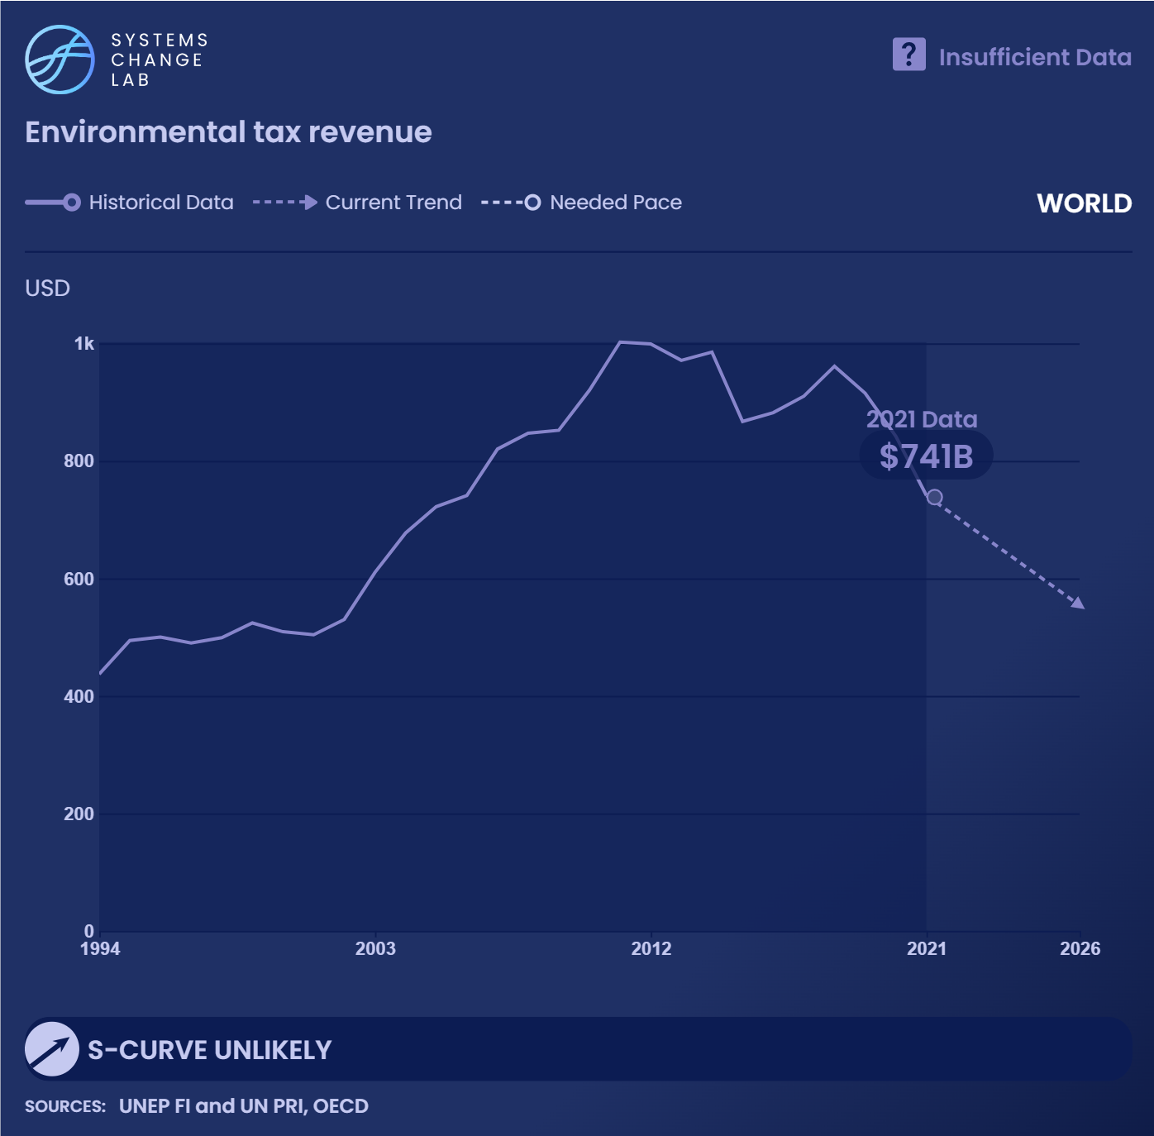
Environmentally-related taxes for air pollution, natural resource use and waste amounted to $741 billion globally in 2021.
Notes:
The production and consumption of goods and services often create waste and pollution, harming the ecosystems that sustain human society.
When these environmental harms are not reflected in the cost of goods and services, producers and consumers shift the costs of their harmful activities to society at large. These socialized costs are often referred to as “externalities.” Externalities create inefficient use of resources from an economic perspective. More importantly, their damage is often inequitable, disproportionately impacting under-resourced, under-represented communities.
According to Principles for Responsible Investment (PRI) and the UN Environment Programme Finance Initiative (UNEP-FI), global environmental externalities that result from air pollution, natural resource use and waste are expected to reach $7.8 trillion annually by 2050. Governments can intervene and reduce negative externalities by implementing environmental taxes on activities that generate such external damages. Taxes help internalize environmental costs.
Data from the Organisation for Economic Co-Operation and Development (OECD) indicates that environmentally related taxes for air pollution, biodiversity and the ocean amounted to $261 billion globally in 2018. As environmental tax regimes expand and enforcement improves, revenue from these regimes should increase. Then, as they encourage behavior to shift away from harmful activities, revenue should eventually decline.

Slide 33
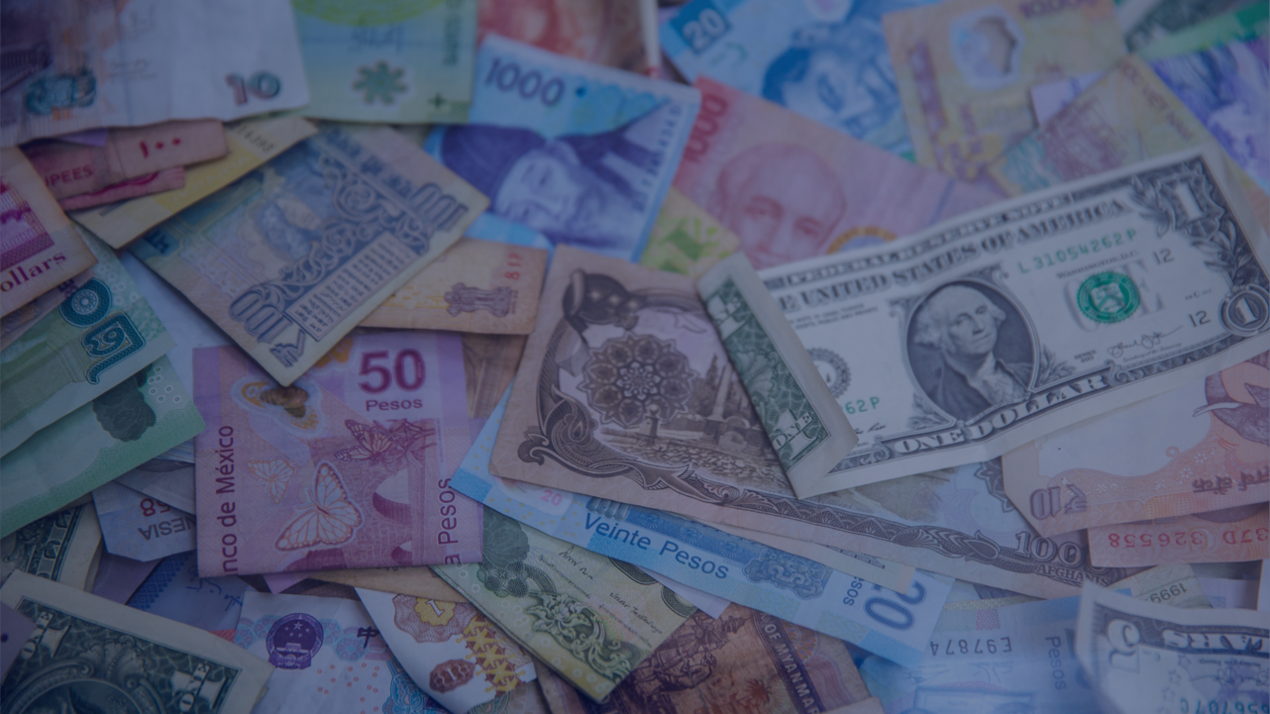
Eliminate harmful subsidies and financing
SHIFT
Notes:
Photo by Jason Leung https://www.flickr.com/photos/axelhartmann/1182980503/in/photolist-2Nx5Tz-2i5yYZ5-7Ecczy-8AoLSx-21LPiem-2fqPxsM-2LgZVi-29c9WnD-297R9Rs-286Nae3-fdLKUk-27Per9T-26rrUFs-9Q1Znc-26rsHMb-27PfhL8-2mu88NV-M4r8jQ-2inewQB-2mu4wjT-26rpDLS-2nfZWoB-9Q1UL6-286SNVN-2mtYgS5-27as1Zu-JD1KsA-4Btu7U-8WCn8Y-2ng7wUF-2mu88V3-2ng8V6d-2ng7wrS-2ng6gHs-2ng8TMB-pezE2e-6UMSpa-TgxjaC-7V1S5e-2ng6ikq-21LPiZ9-2mtYgB5-2ng7xGT-gwmAC2-ySMBRW-2nfZXtH-2mu73ep-2ng6hgw-2itUraA-2mu893n

Slide 34
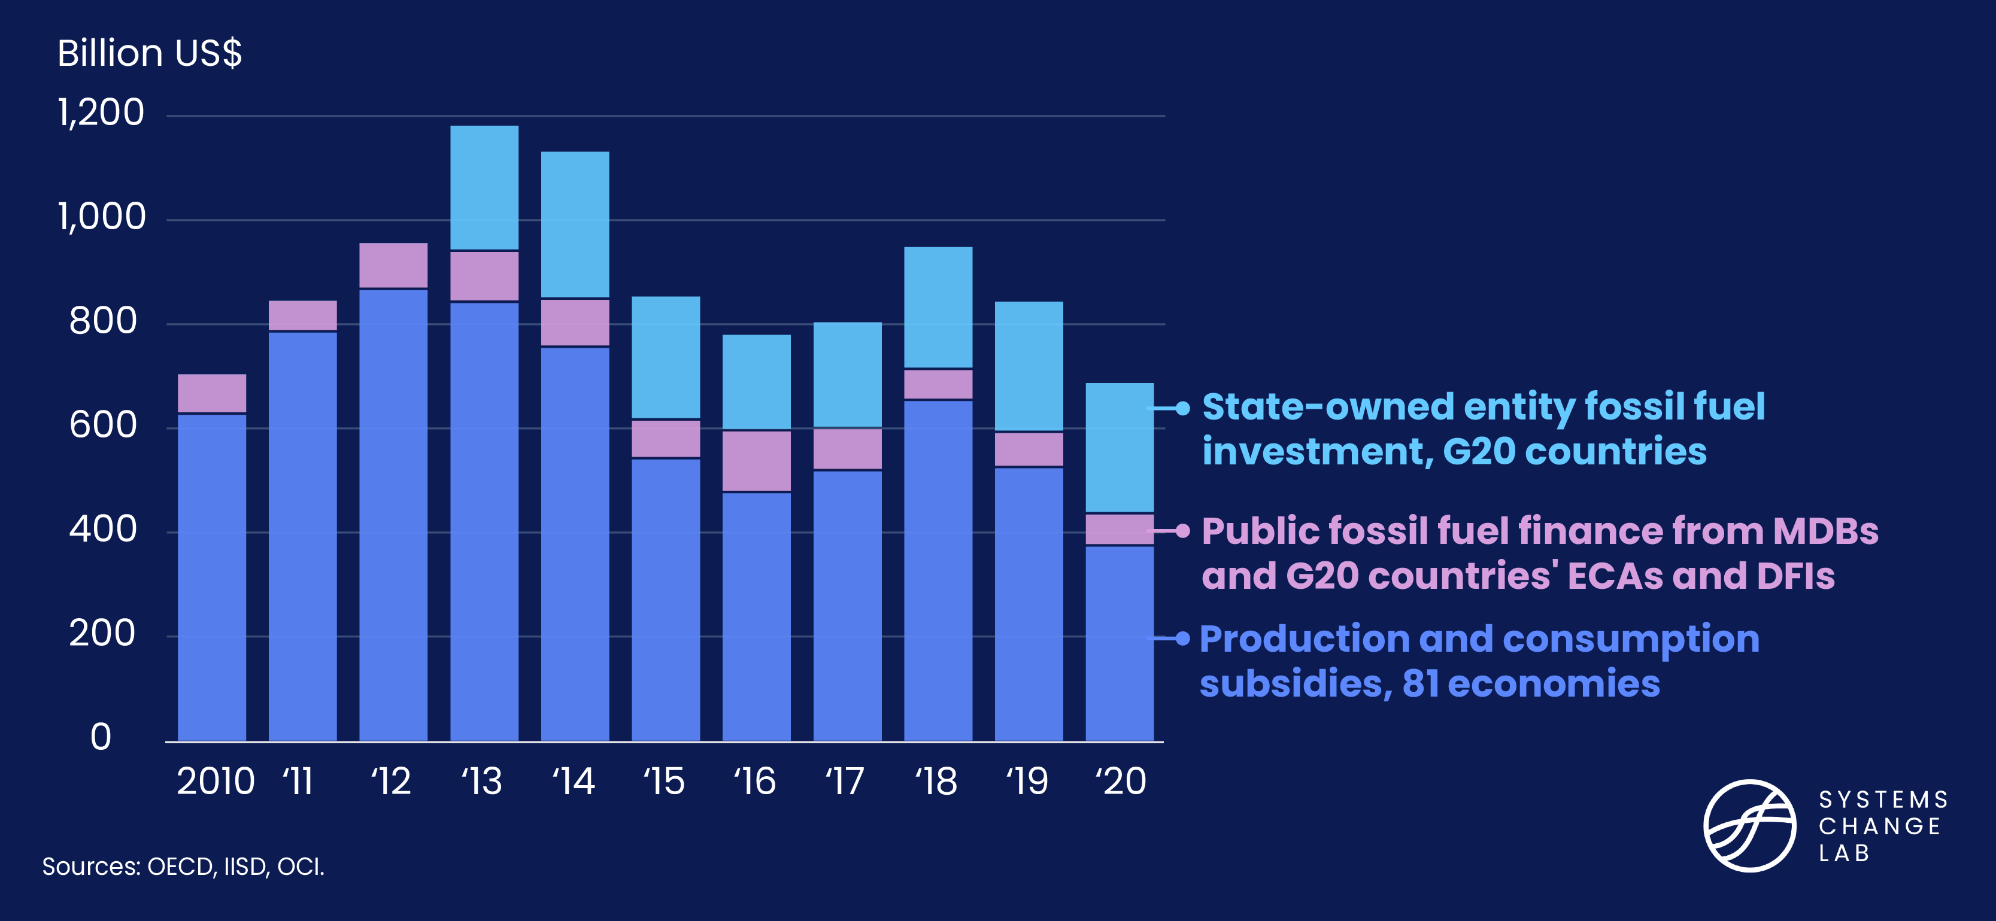
Public financing for fossil fuels needs to decrease 5x faster
Notes:
In 2020, public financing for fossil fuels totaled about $690 billion. It will need to fall by an average of $69 billion per year to meet the 2030 phaseout target.
Public finance, whether on concessional or commercial terms, plays a critical role in propping up fossil fuel industries, especially coal. It materializes via production and consumption subsidies, financing from development finance institutions and export credit agencies, and capital expenditures and project financing from state-owned enterprises. It is estimated that 93% of coal power plants are well insulated from market forces and benefit from public support through long-term supply contracts, tariffs and other means.
In order to meet Paris Agreement goals, public funders need to act swiftly to eliminate finance for coal power generation and phase out oil and gas investment, redirecting investment and job growth toward clean energy and providing economic transition for affected communities. Although leaders of the G20 countries, comprising the world’s 20 largest economies, pledged to stop public financing for new coal power plants overseas by 2021, no commitment was made to stop using coal domestically. And the G7 countries have not been able to agree on fully ending public finance for fossil fuel energy.
In 2020, public finance for fossil fuels totaled $687 billion, with $375 billion directed to subsidies, $62 billion to financing of projects, and $250 billion to capital expenditures. This number will need to fall by an average of $69 billion per year between 2020 and 2030 to meet the 2030 phaseout target, almost five times the historic rate of decrease.

Slide 35
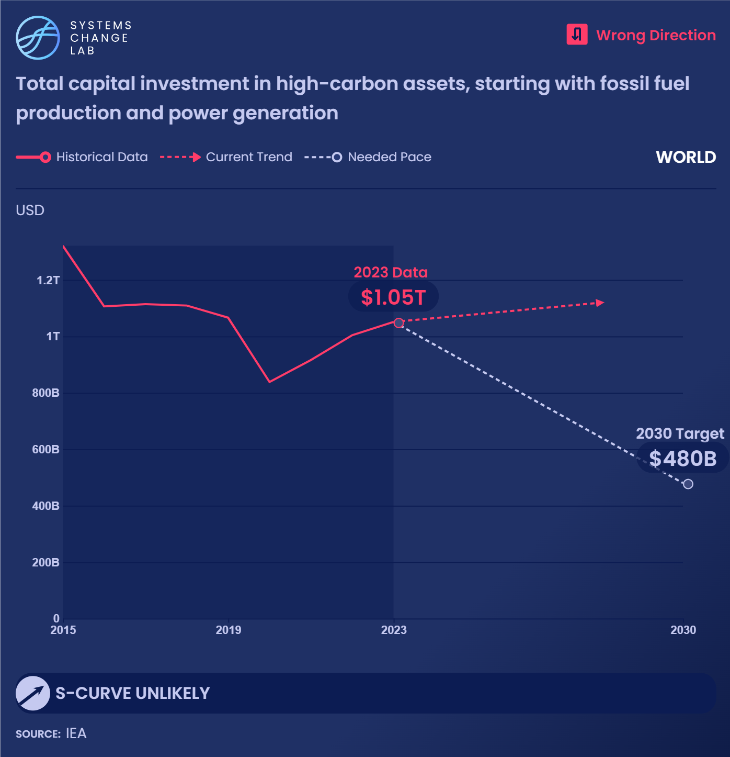
Capital investments in fossil fuel production and fossil fuel-based power generation reached $1.04 trillion in 2023.
Notes:
Any investment in new fossil fuel supply development is incompatible with achieving net-zero greenhouse gas emissions around mid-century.
Capital plans articulate the investments that corporations intend to make in physical fixed assets (plants, properties and equipment) and ongoing operations. These are the investments that drive future production and emissions. Capital expenditure in fixed assets for fossil fuel production and consumption is particularly important, because investments in new fossil fuel infrastructure today effectively lock in higher carbon emissions in the future.
According to the International Energy Agency’s (IEA) Net Zero Emissions by 2050 scenario, global energy demand and net-zero carbon emissions can both be met by mid-century.
This will require funding for the development of new fossil fuel supply to be eliminated and major sources of demand for fossil fuels — such as fossil fuel-based power generation and transportation — to be phased out. Corporations need to take the critical step of aligning their capital plans with net-zero pathways by eliminating capital investments in new fossil fuel production and coal power generation and phasing out capital investments in other high-carbon infrastructure. Instead, they must scale up sustainable, clean alternatives.
Data on unaligned capital investment plans will be tracked once it is available. In the meantime, total capital investments can be used as a proxy to track the level of investments being made in fossil fuel production and power generation.
Capital investments in fossil fuel production and fossil fuel-based power generation totaled $897 billion in 2021, up 15% from the previous year. Capital investments for oil and gas supply (up/mid/downstream) reached $673 billion in 2021 (up 17% from the previous year), and investments in coal supply totaled $105 billion (more than 10% higher than 2020). Investments are expected to increase in 2022 as tight supply and high prices attract new projects.
Capital investment in fossil fuel power generation reached about $119 billion in 2021 and is expected to reach similar levels in 2022. Not all capital investments are intended for expansion of new supply; a portion is allocated toward maintenance. Capital investments in fossil fuel production and power generation need to fall by an average of $100 billion each year, twice as fast as the historic rate, to meet the 2030 target.

Slide 36
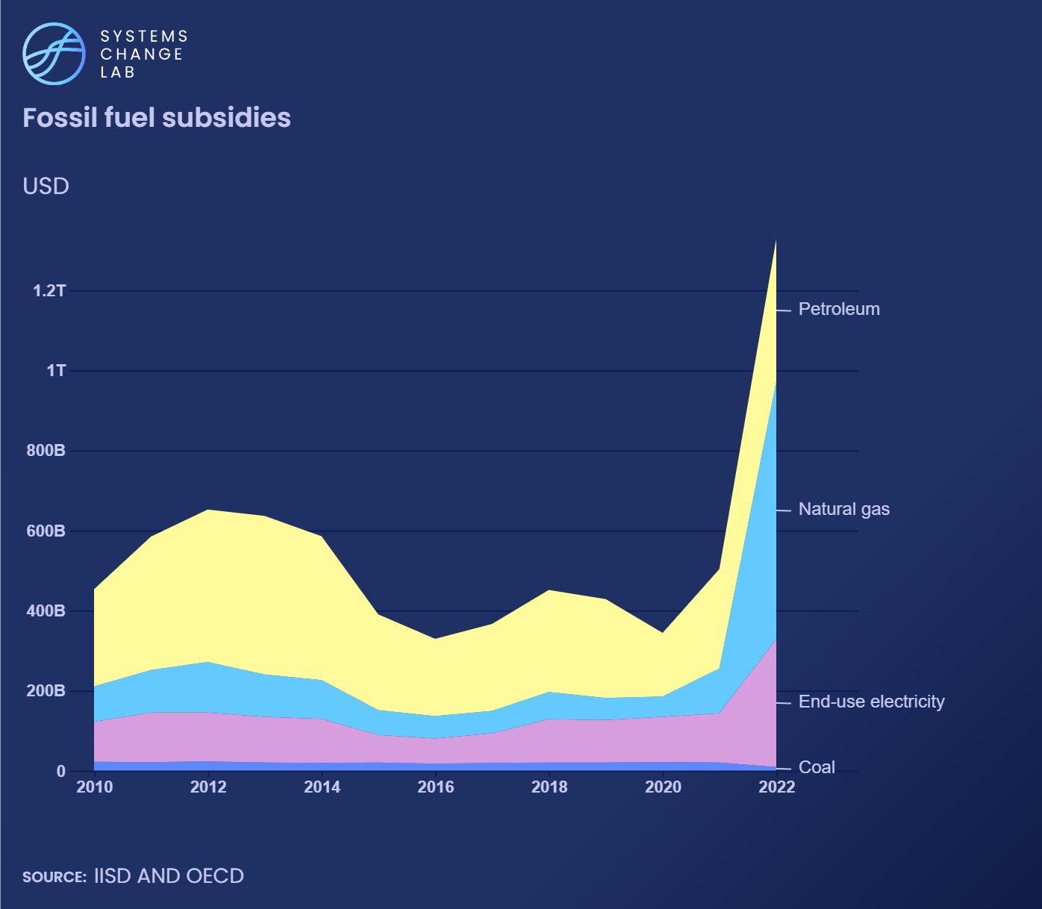
Fossil fuel subsidies reached the highest recorded level ever in 2022, and need to be phased out rapidly to be eliminated globally by 2030.
Notes:
Subsidies are non-market benefits governments give to individuals, businesses or institutions. According to the Intergovernmental Panel on Climate Change (IPCC), removing fossil fuel subsidies could lower global emissions between 1% and 10% by 2030 while reducing government spending.
Phasing out fossil fuel subsidies is necessary to ensure that the production and consumption of fossil fuels are not inflated by government support. Without subsidies, these activities would be subject to market competition, with their costs reflected in their prices. (Fully reflecting their costs also entails pricing their harmful emissions.)
Studies of fossil fuel consumption subsidies across many countries have shown that they are regressive: the richest households capture most of the benefits. Nonetheless, eliminating some subsidies can raise energy costs in ways that do impact lower-income groups. Rebates and financial support can help relieve the burdens created by changes in energy costs when subsidies are withdrawn. These support mechanisms can be funded by revenue that is generated by removal of fossil fuel subsidies.
The Fossil Fuel Subsidy Tracker estimates that global fossil fuel subsidies reached $375 billion in 2020, with $203 billion directed to petroleum, $63 billion to natural gas, $89 billion to end-use electricity, and about $20 billion to coal. This represents a 29% decrease from 2019. However, though global data is not yet available, subsidies are expected to have risen again in 2021 as major economies almost doubled support for fossil fuels in response to the sharp increase in energy prices caused by Russia’s invasion of Ukraine.
G20 countries have reiterated commitments to phase out inefficient fossil fuel subsidies since 2009 and the G7 has announced its goal to phase them out by 2025. Yet, these commitments have not translated into reductions at the scale needed to meet the phaseout targets as subsidies have remained near historical levels. Fossil fuel subsidies need to be phased out globally by 2030 to meet climate targets. In order to achieve this, they will need to fall by an average of $38 billion per year between 2020 and 2030, almost double the historic rate of decrease.

Slide 37
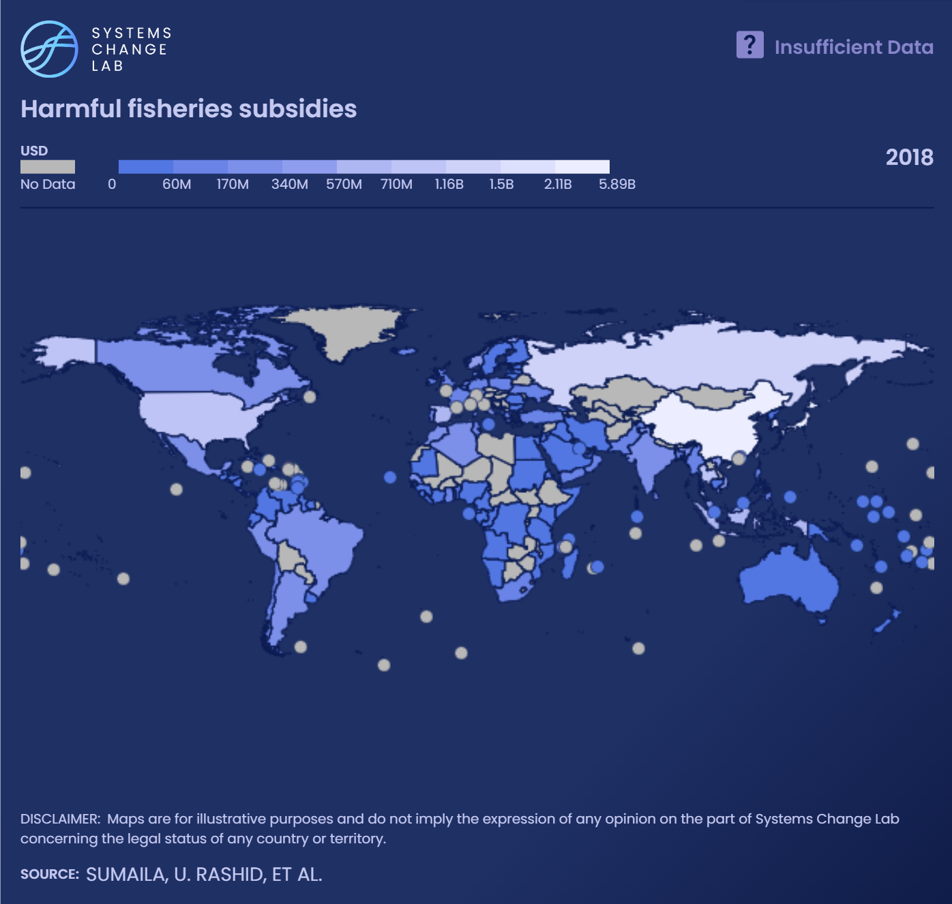
Harmful fisheries subsidies reached about $22 billion globally in 2018. It is estimated that 34% of the world’s fish stocks are fished beyond their biological limits.
Notes:
Harmful fisheries subsidies include any monetary or in-kind government support to the fishing industry that contributes to overfishing or illegal, unreported and unregulated fishing.
The intent of these subsidies is to supplement income or lower costs for fishing operations, but they can have significant negative impacts on fish stocks. Additional payments can allow fishing fleets to fish more, at greater distances, and for longer amounts of time. Harmful fisheries subsidies contribute to overcapacity — more labor, and more and better equipment than the fisheries can support — that further exacerbates fishing beyond sustainable limits.
According to the Food and Agriculture Organization (FAO), about 34% of the world’s fish stocks are fished beyond their biological limits. Harmful fisheries subsidies were estimated to total around $22.2 billion globally in 2018, with China, the European Union, Japan, Russia, South Korea, Thailand and the United States providing two-thirds of these subsidies.
The Pew Trusts estimate that if all subsidies were eliminated, fish biomass could increase by at least 12.5% globally by mid-century. One of the targets under the United Nations Sustainable Development Goals (SDGs) aimed to prohibit these subsidies by 2020, but an agreement was postponed in part due to COVID-19. In June 2022, members of the World Trade Organization reached a milestone agreement to curb harmful fisheries subsidies.
Harmful fisheries subsidies will need to fall by an average of about $3 billion per year between 2018 and 2025 to meet the 2025 phase-out target.

Slide 38
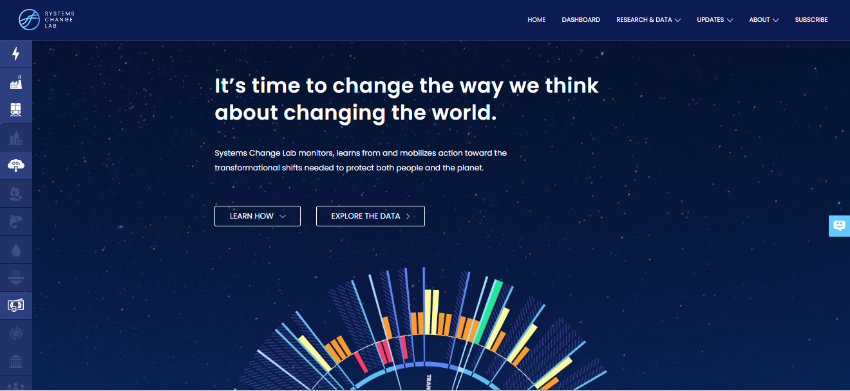
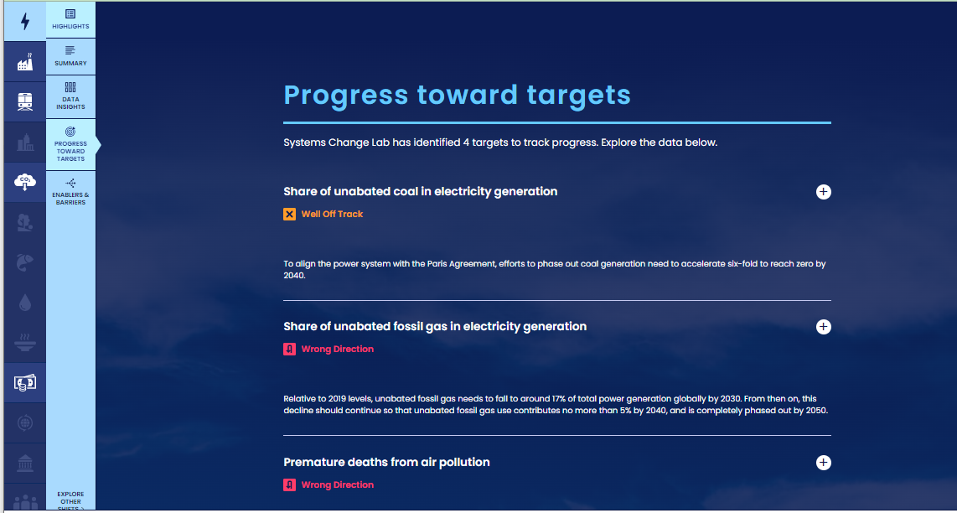
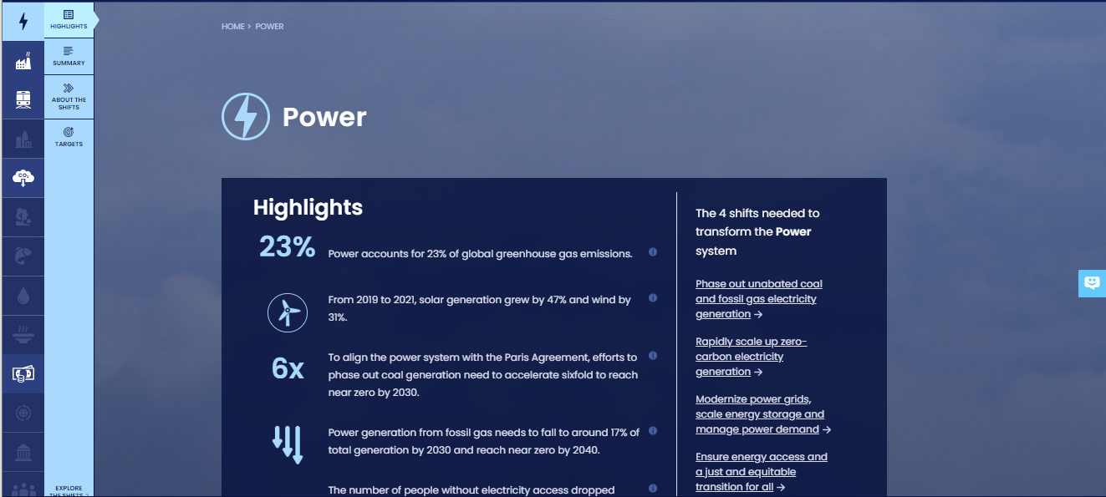
How to highlight a different indicator
Find your desired indicator on systemschangelab.org system pages
1. Select a system
3. Scroll down page to indicators and expand one
2. Select a shift

Slide 39



Alternatively, search for an indicator on the dashboard
1. Navigate to the dashboard
3. Search an indicator and then click explore data
2. Select grid view
4.
Notes:
Find your desired indicator on https://systemschangelab.org/
Look through System Page ( https://systemschangelab.org/power)
OR search the dashboard ( https://systemschangelab.org/dashboard) & select "EXPLORE DATA >" on your desired indicator

Slide 40

Pick a chart view and click the download button

Slide 41


Next, add the chart to your slide deck
1. Select "Insert" and "Pictures" on the toolbar
2. Select chart from the downloads folder and open

Slide 42

Add context from the indicator write-up as desired

Slide 43

For more information
VISIT: SYSTEMSCHANGELAB.ORG/FINANCE
EMAIL: CONTACT@SYSTEMSCHANGELAB.ORG

