Slide 1
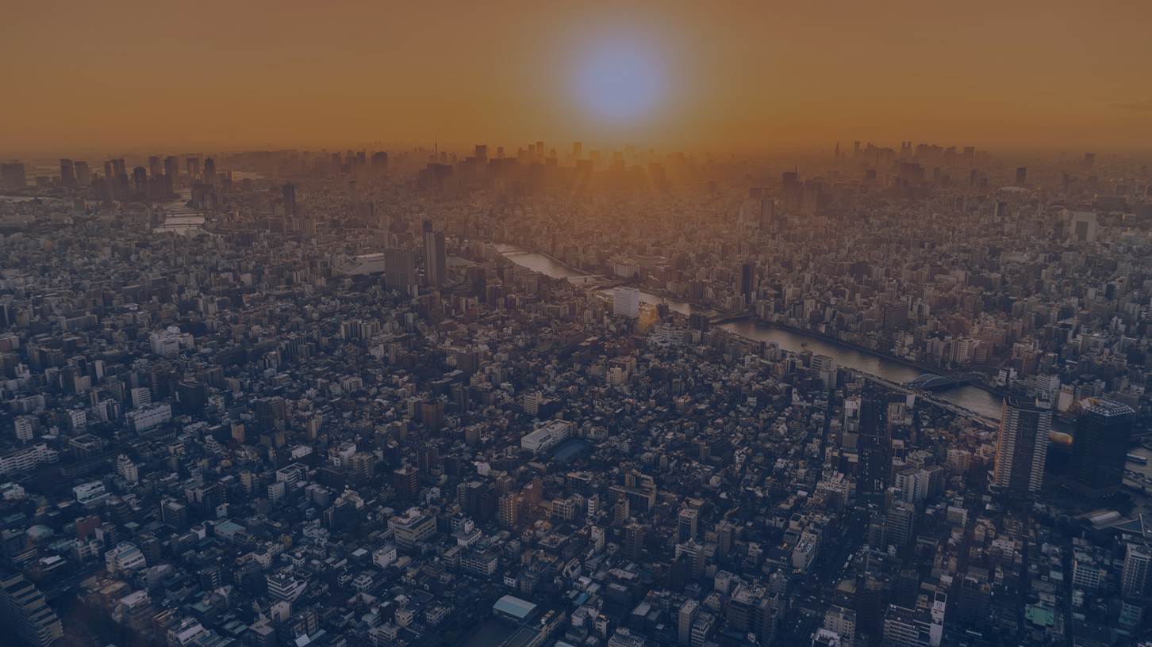
Cities
Last updated August 2024 | systemschangelab.org/cities
Notes:
Photo by Arto Marttinen via Unsplash: https://unsplash.com/photos/aerial-view-of-city-during-golden-hour-6xh7H5tWj9c

Slide 2
Systems Change Lab
It’s time to change the way we think about changing the world.
Systems Change Lab monitors, learns from and mobilizes action toward the transformational shifts needed to protect both people and the planet.
The data platform identifies and tracks key shifts in our global systems that, when achieved together, can spur transformational change.

Slide 3
Interconnected systems
Power
Industry
Transport
Cities
Buildings
Carbon Removal
Land & Forests
Ocean
Freshwater
Food &
Agriculture
Finance
Circular
Economy
Governance
Social Inclusion & Equity
Economics

Slide 4
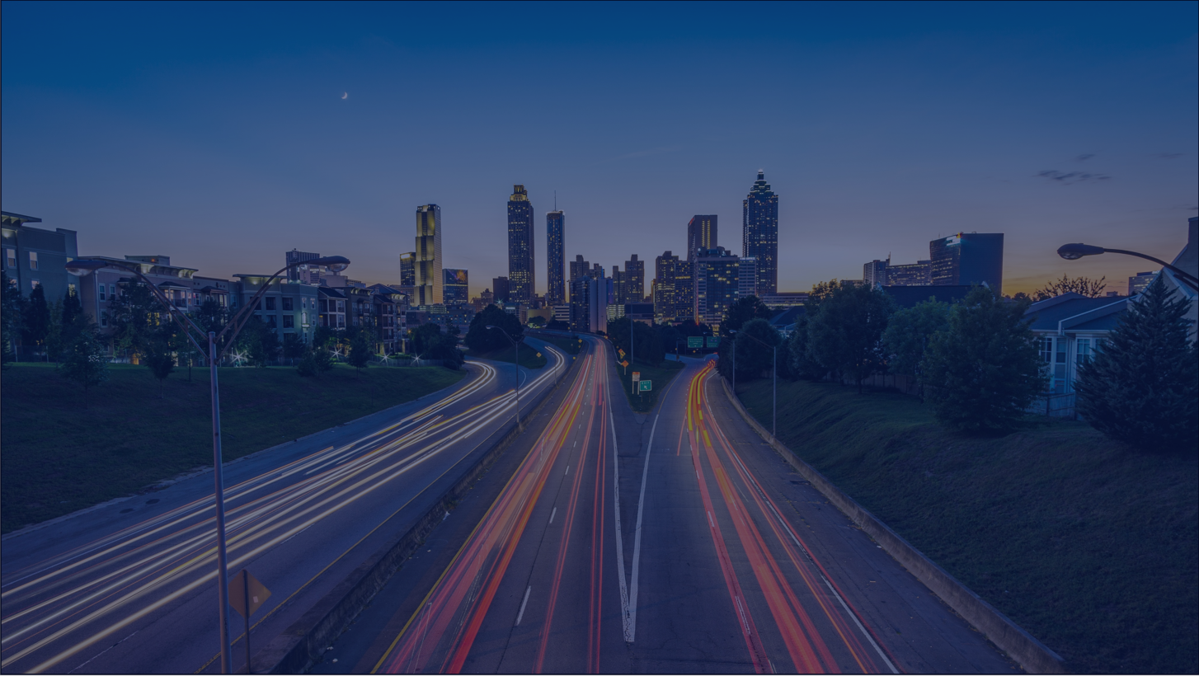
The three shifts needed to transform the cities system
Plan urban land use to reduce emissions and increase climate resilience
Improve urban waste management and transition to zero-waste cities
Increase access to resilient and affordable urban services and infrastructure
Notes:
Plan urban land use to reduce emissions and increase climate resilience
Land use planning that limits urban sprawl and promotes efficient utilization of urban land with higher densities, better connectivity to infrastructure and services, and preservation and enhancement of green and blue spaces is a critical lever for climate action. It can help achieve lower greenhouse gas (GHG) emissions, more equitable access to opportunities and better resilience to climate risks. Unmanaged urban land expansion in growing cities can be damaging to the climate, local ecosystems, nature and equitable access to essential urban services and opportunities.
Increase access to resilient and affordable urban services and infrastructure
The world’s urban population continues to rise, yet already one in three city dwellers — over 1 billion people — live in slums and lack reliable, safe or affordable access to basic urban services and infrastructure, such as running water and sanitation, electricity, decent housing, transport to work and school, and waste management. Persistent inequities in access to these urban services as well as health, education, and green space disproportionately burden poor and marginalized communities, contribute to poverty, increase exposure to climate risks and hamper resilience. Delivering basic services equitably to all urban residents can serve both climate mitigation and adaptation goals when done in ways that limit greenhouse gas emissions and foster climate resilience.
Improve urban waste management and transition to zero-waste cities
The world is rapidly urbanizing, but the modes of collection and disposal of solid and liquid waste in many cities, especially in developing countries, are haphazard: an estimated 93% of waste in cities of the least developed countries is disposed of through open, unregulated dumping. Satellite data confirms that methane leakage from these sites is taking place on a significant scale and on a continuing and growing basis. However, every city has an opportunity to customize a strategy for methane capture while simultaneously offering citizens cleaner and healthier living environments.
Photo by Joey Kyber via Unsplash: https://unsplash.com/photos/timelapse-photo-of-highway-during-golden-hour-45FJgZMXCK8

Slide 5
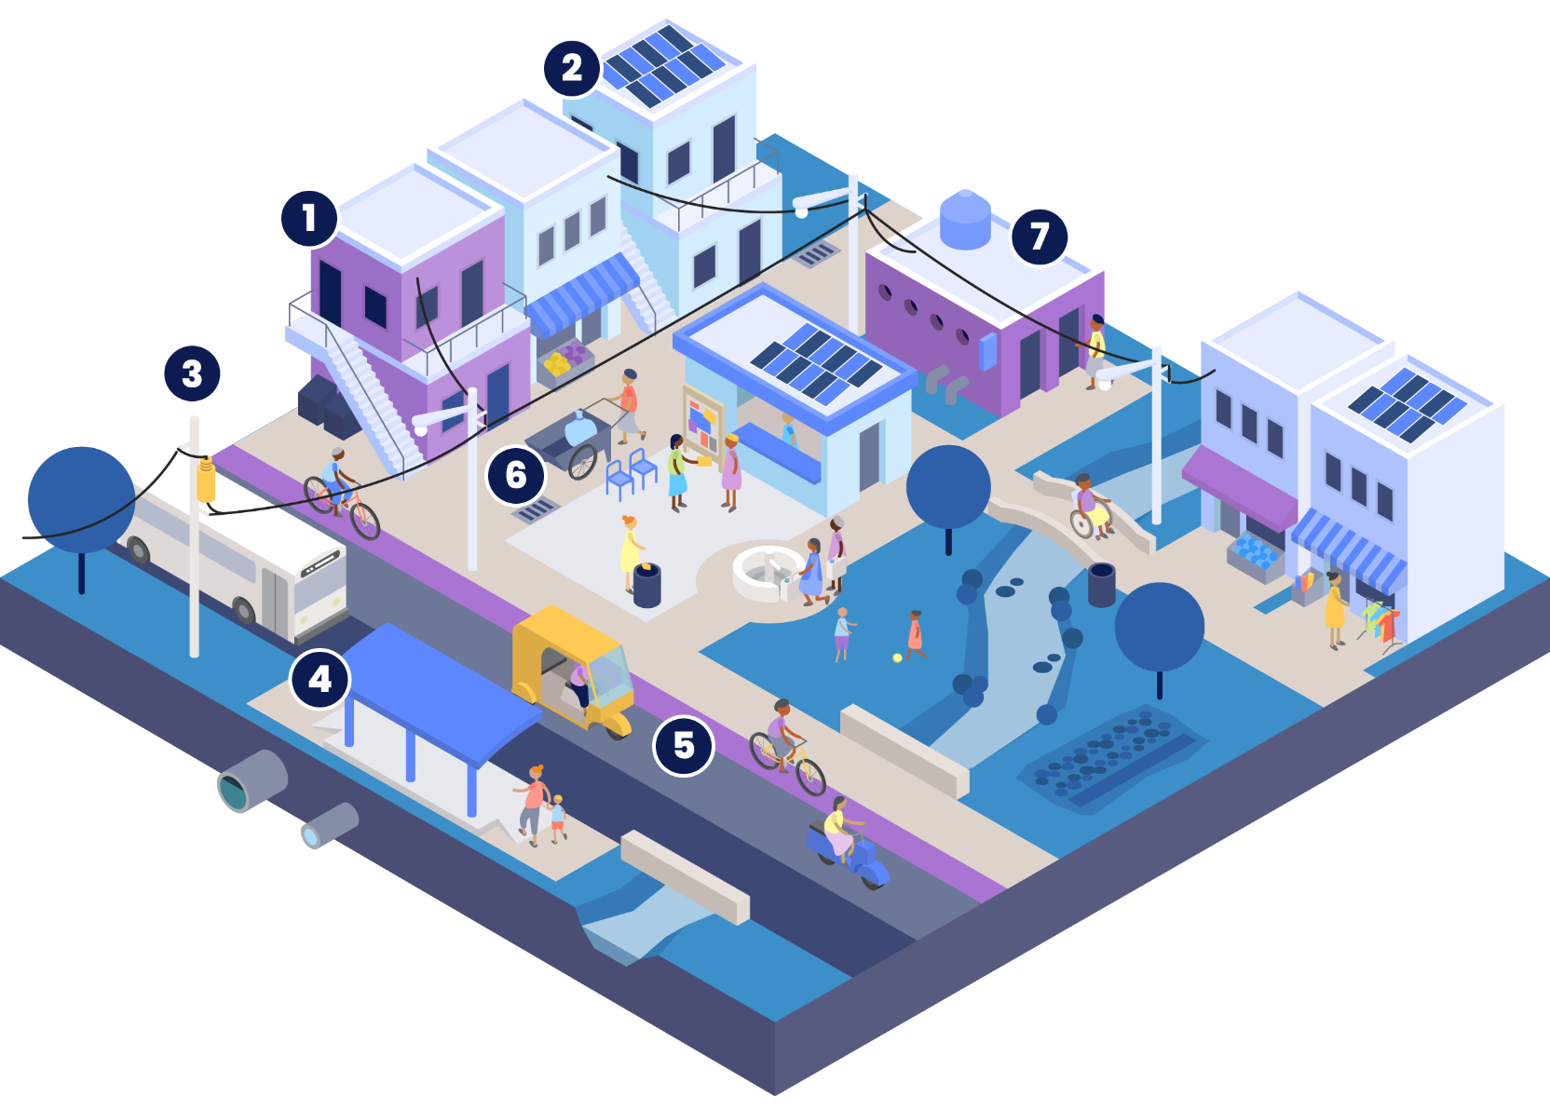
Designing sustainable cities
Integrated spatial planning can improve living conditions and expand access to services and opportunities in cities. For instance, 1) smaller lot sizes and mid-rise buildings help facilitate higher density, affordability, and livability. 2) Rooftop solar or 3) connections to the electricity grid can improve the productivity and living conditions of residents.
Safe, reliable and affordable mobility can facilitate access to opportunities and jobs. This can be done with 4) public transit access and 5) safer streets for pedestrians, cyclists and integrating informal transit. While improving 6) waste management and expanding access to services such as 7) managed sanitation can lead to healthier environments.
Source: Seven Transformations for More Equitable and Sustainable Cities, WRI Ross Center for Sustainable Cities.

Slide 6
Highlights
2.5 billion more people are expected to live in cities and urban areas by 2050.
Over 70% of global CO2 equivalent emissions are attributable to cities and urban activities, but cities often have lower emissions per capita due to their efficiency.
By 2050, 800 million people in coastal cities will be exposed to sea level rise of at least 0.5 meters and over 1.6 billion people in cities will suffer from extreme heat.
An estimated 1.2 billion urban dwellers lack reliable, safe and affordable access to basic urban services.
2.1 billion tonnes of municipal waste was produced by cities in 2023, and the volumes are projected to increase to 3.8 billion tonnes by 2050.

Slide 7
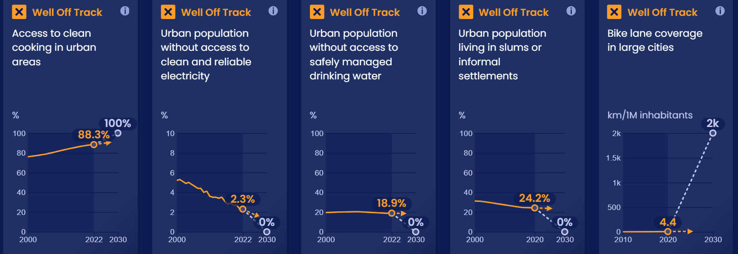
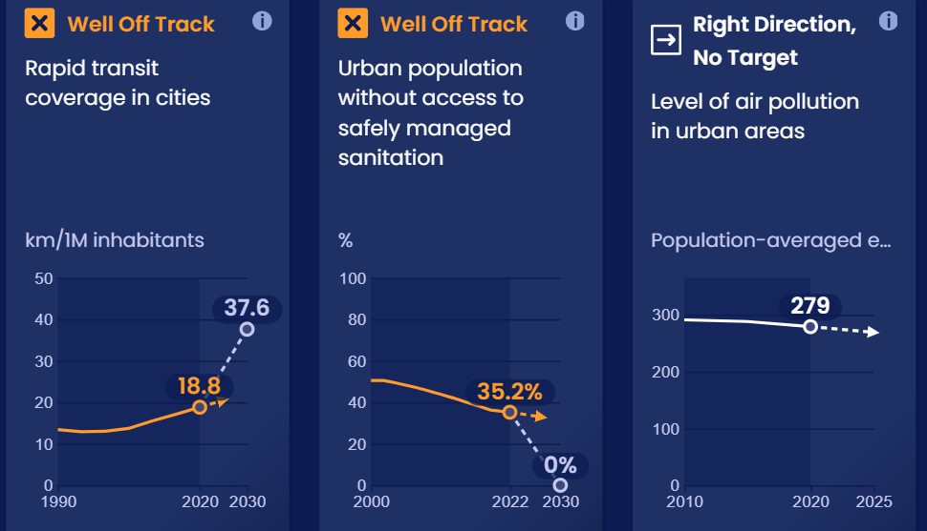
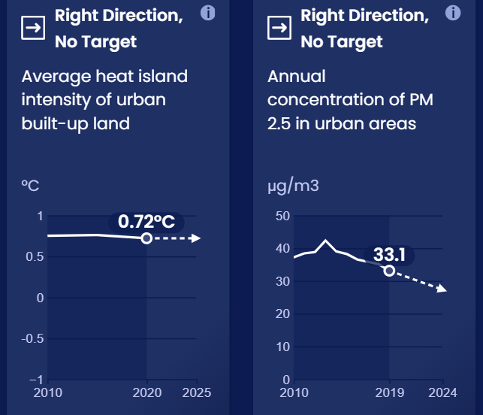
Progress toward targets
In this system, we have identified 21 outcome indicators. Out of the 21 targets we've evaluated, 13 have available data and benchmarks. Of these, 10 are moving in the right direction and 0 are on track.

Slide 8
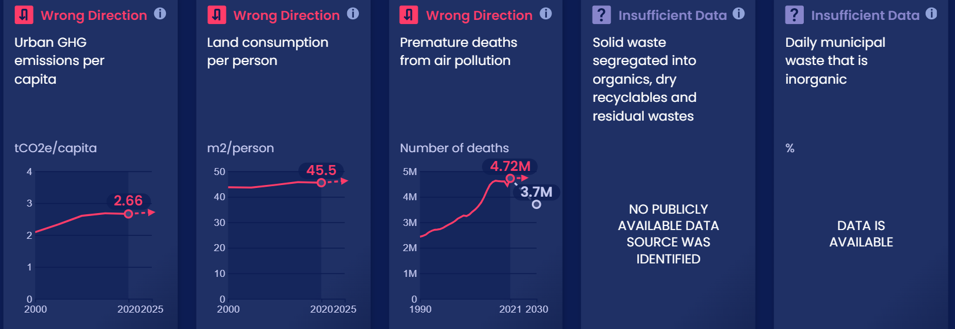
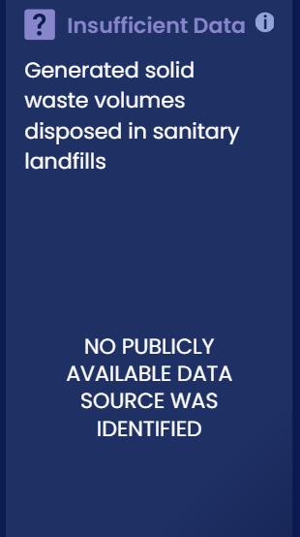
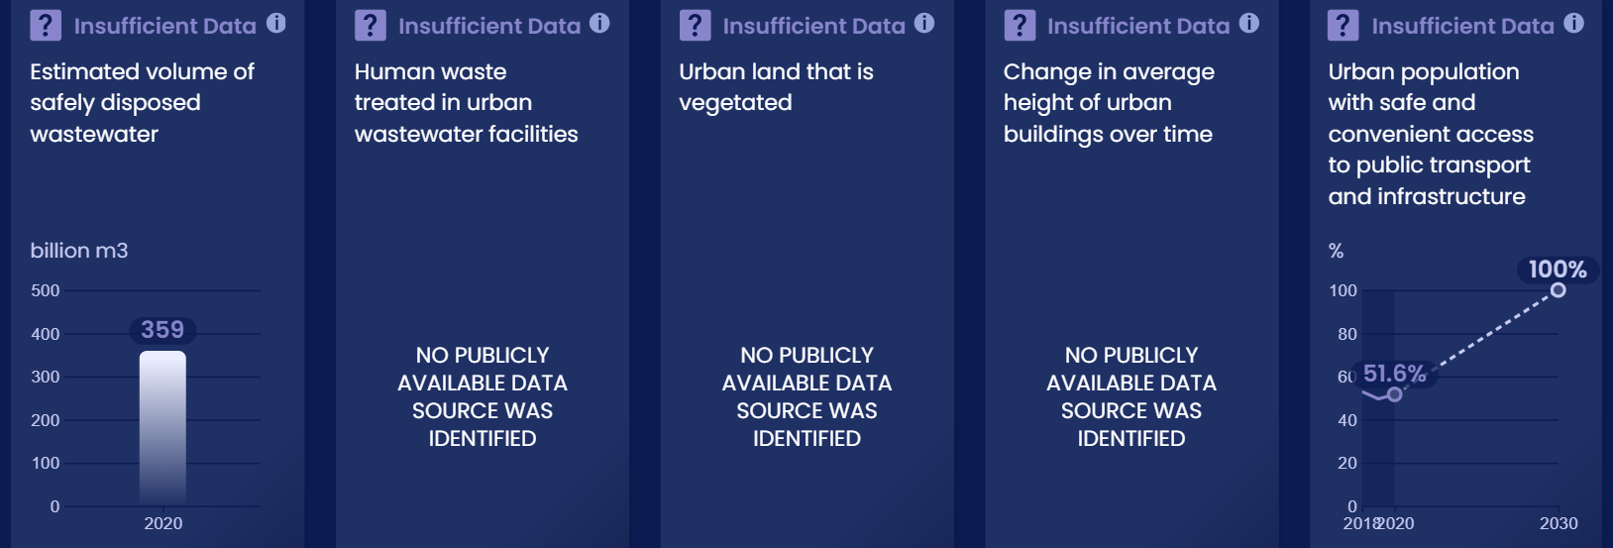
Progress toward targets

Slide 9
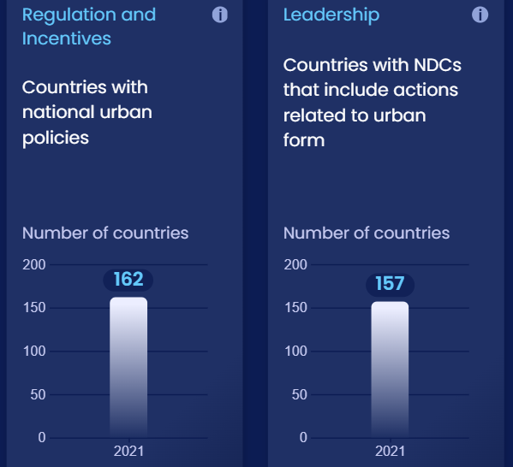
Enablers and barriers
In this system, we have identified 26 enablers and barriers to change. Of these, 21 do not have global, publicly available data.

Slide 10
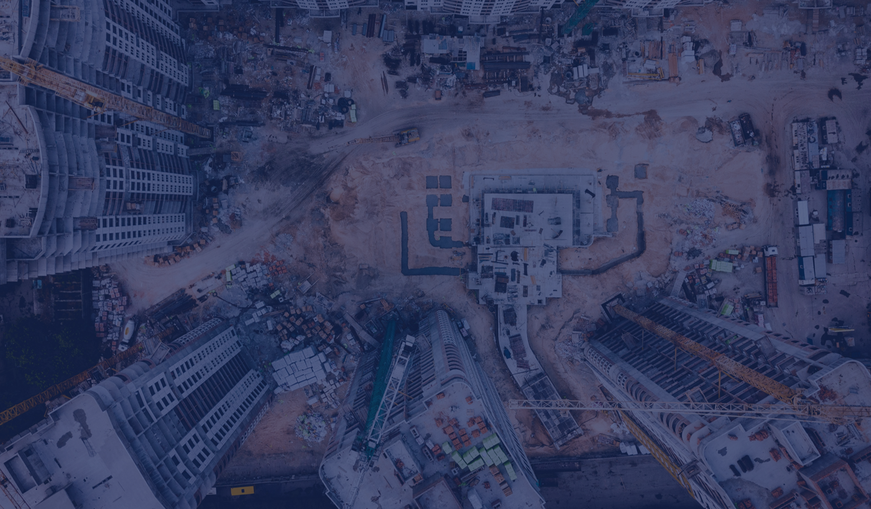
Plan urban land use to reduce emissions and increase climate resilience
SHIFT
Notes:
Photo by Ivan Bandura: https://unsplash.com/photos/aerial-photography-of-white-high-rise-concrete-building-Wv2U24G2F78

Slide 11
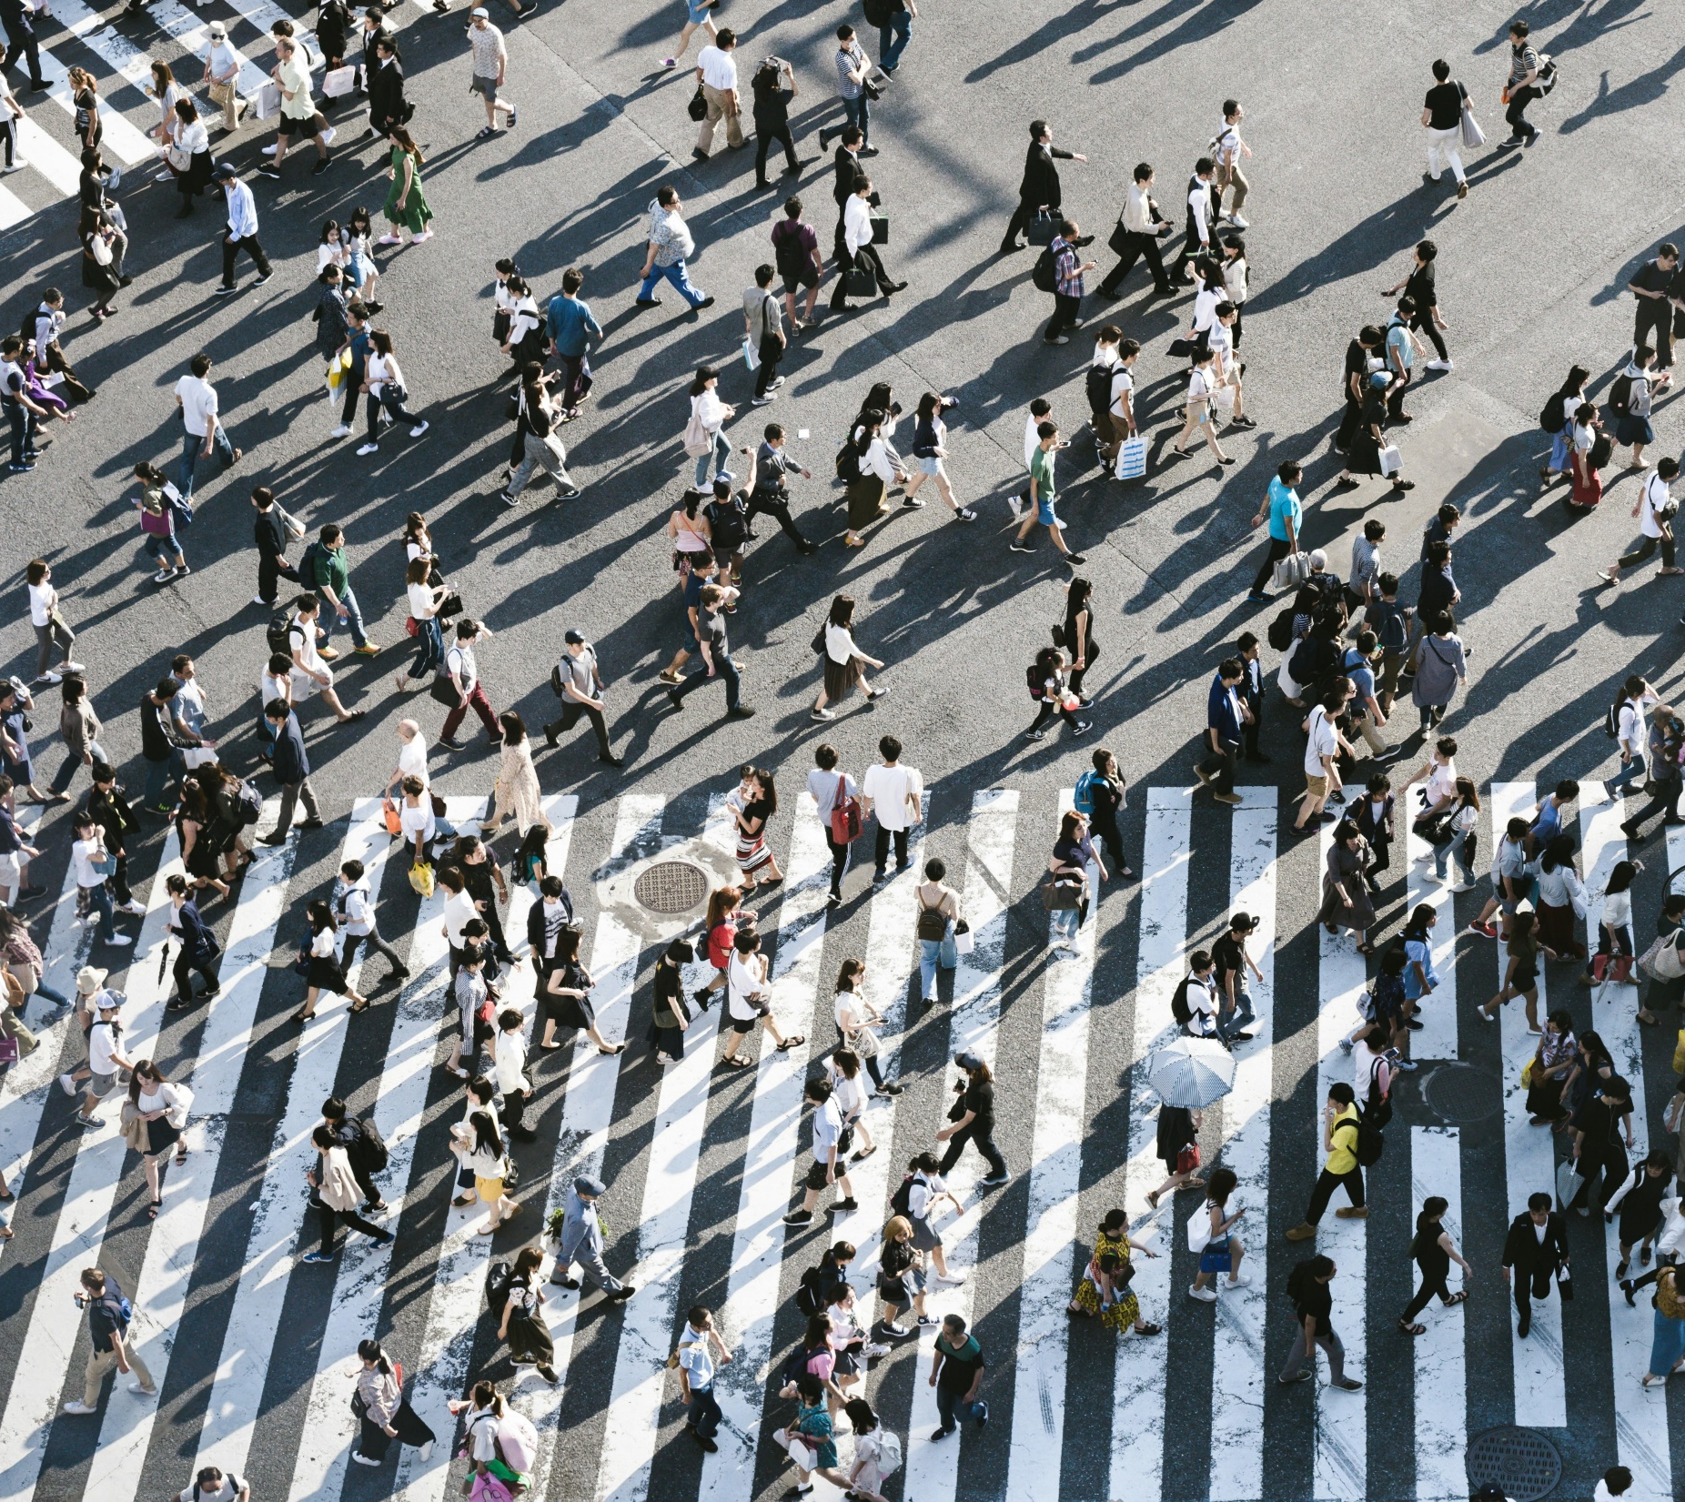
Urban areas could triple between 2015 and 2050, requiring urban planning that promotes equity and climate resilience.
Notes:
Photo by Ryoji Iwata via unsplash: https://unsplash.com/photos/aerial-view-of-people-walking-on-raod-IBaVuZsJJTo
In addition to natural population increase, cities often grow to accommodate migrants coming from rural areas or other regions and countries, often in search of economic opportunities or to escape economic deprivation and climate impacts. Rapid outward expansion is greatest in lower-income cities, where population growth is also the highest. Close to 90% of urban growth by 2050 is projected to occur in Asia and Africa, where vulnerability to climate risks is also the highest.
As cities grow, many expand outward into more fertile agricultural land, and ecologically sensitive areas like forests and wetlands. The resulting expansion of built areas can encroach on natural lands and habitats important for climate resilience and biodiversity. At the same time, expanded built areas increase impervious surfaces in cities (such as roads, buildings and concrete), which absorb heat and radiate it back into the urban environment, leading to higher localized heat intensity.
There is value to densifying the built environment rather than growing outward, as this shortens distances between locations and ensures more efficient and cost-effective provision of infrastructure, which in turn improves accessibility. Much empirical evidence illustrates how a city’s spatial expansion and reduced population density increases its per capita costs to provide public services, as well as the social costs associated with higher emissions, congestion, pollution, loss of productivity and unsustainable consumption of land and natural resources.
However, density does not automatically imply very tall buildings, as these are associated with higher construction and other costs, even if the land costs may be lower. Increased density can also lead to increased housing costs, which can exacerbate inequities within cities. For residential housing in particular, cities must balance both livability and affordability as they plan for denser urban environments.
This indicator, land consumption per person, measures how much land (in square meters) is used per person. In 2020, the global average land consumption per person in urban areas was 45.5 square meters per person. This shows a slight decrease from 45.7 square meters per person in 2015. However, from 2000 to 2015, land consumption per person had increased from 43.7 square meters per person to 45.7. Over time, ideally the land consumption per person will decrease or at least remain level, as it did between 2015 and 2020.

Slide 12
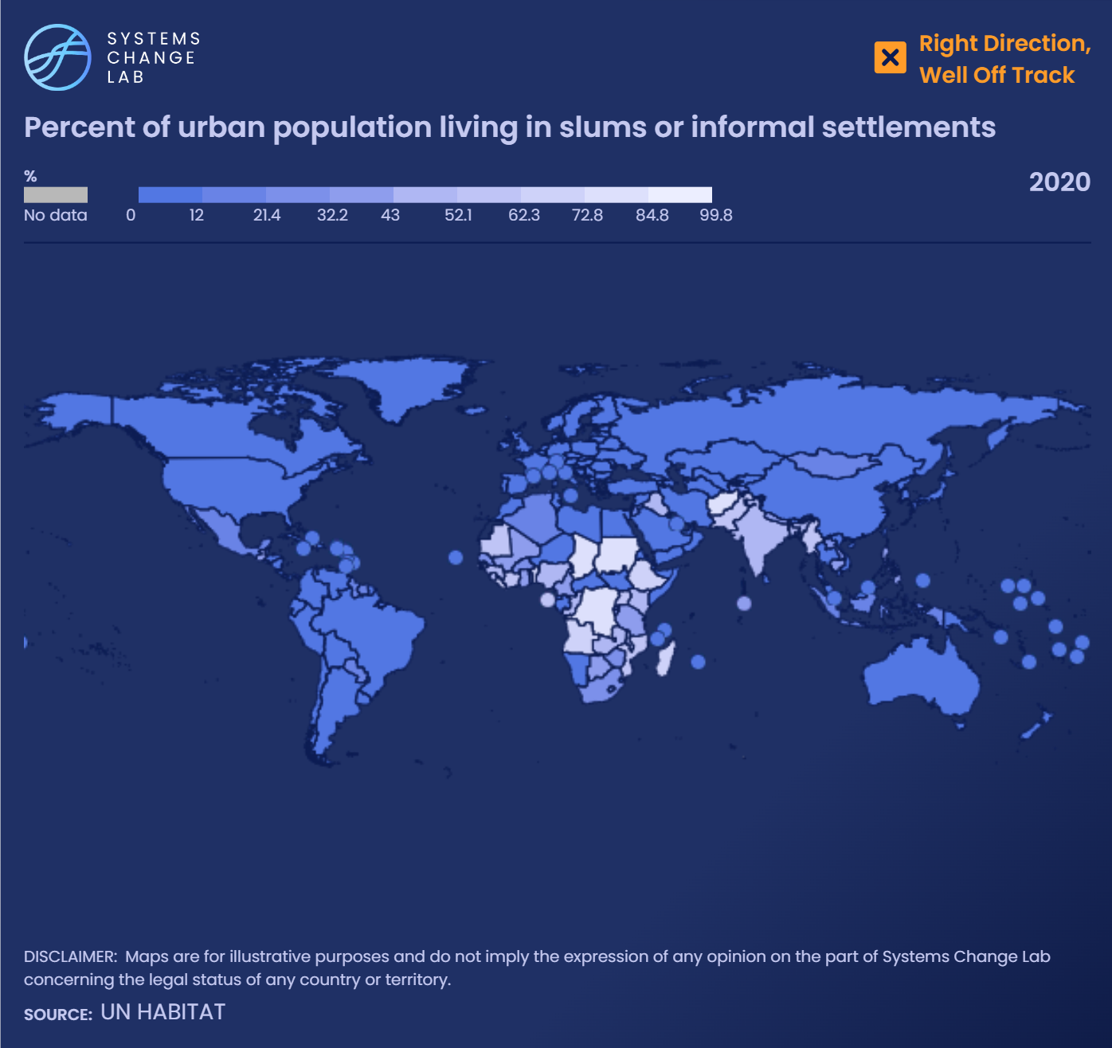
In 2020, 24.2% of the urban population globally lived in slums or informal settlements. A 1% increase in urban population growth will increase the incidence of slums in Africa and Asia by 2.3% and 5.3%, respectively.
Notes:
It is estimated that at least 1 billion people globally live in informal settlements or slums — unplanned areas that fall outside of legal and regulatory systems — and the actual number is likely much higher.
These communities lack access to adequate basic services and infrastructure like good quality housing, water, sanitation, energy or transportation, and are often located in parts of the city that are under-served and highly vulnerable to environmental and climate risks.
Local governments often overlook the deprivations faced by residents of informal settlements, who are typically from the lowest socioeconomic classes, lack legal property rights and remain uncounted in formal surveys and censuses. These settlements are unplanned areas that fall outside legal and regulatory systems and highlight the immense inequalities in access to services and infrastructure in cities.
Rapid urbanization, ineffective planning, lack of affordable housing and lack of effective housing policy are some of the reasons cited for slum formation in developing countries. If this type of growth continues, cities in developing countries could see the rise of mega-slums that are vastly under-served. Research shows that a 1% increase in urban population growth will increase the incidence of slums in Africa and Asia by 2.3% and 5.3%, respectively.
In 2020, 24.2% of the urban population globally lived in slums or informal settlements. Sustainable Development Goal (SDG) 11.1.1 aims to ensure access for all to adequate, safe and affordable housing and basic services and upgrade slums by 2030, thereby setting a target for this indicator of 0% by 2030. While this number has been trending downward, from 31.2% in 2000, the world would need to accelerate progress to decrease the incidence of slums by more than 10 times the current pace to reach 0% by 2030. However, 2 billion more people are expected to live in slums in the next 30 years.

Slide 13
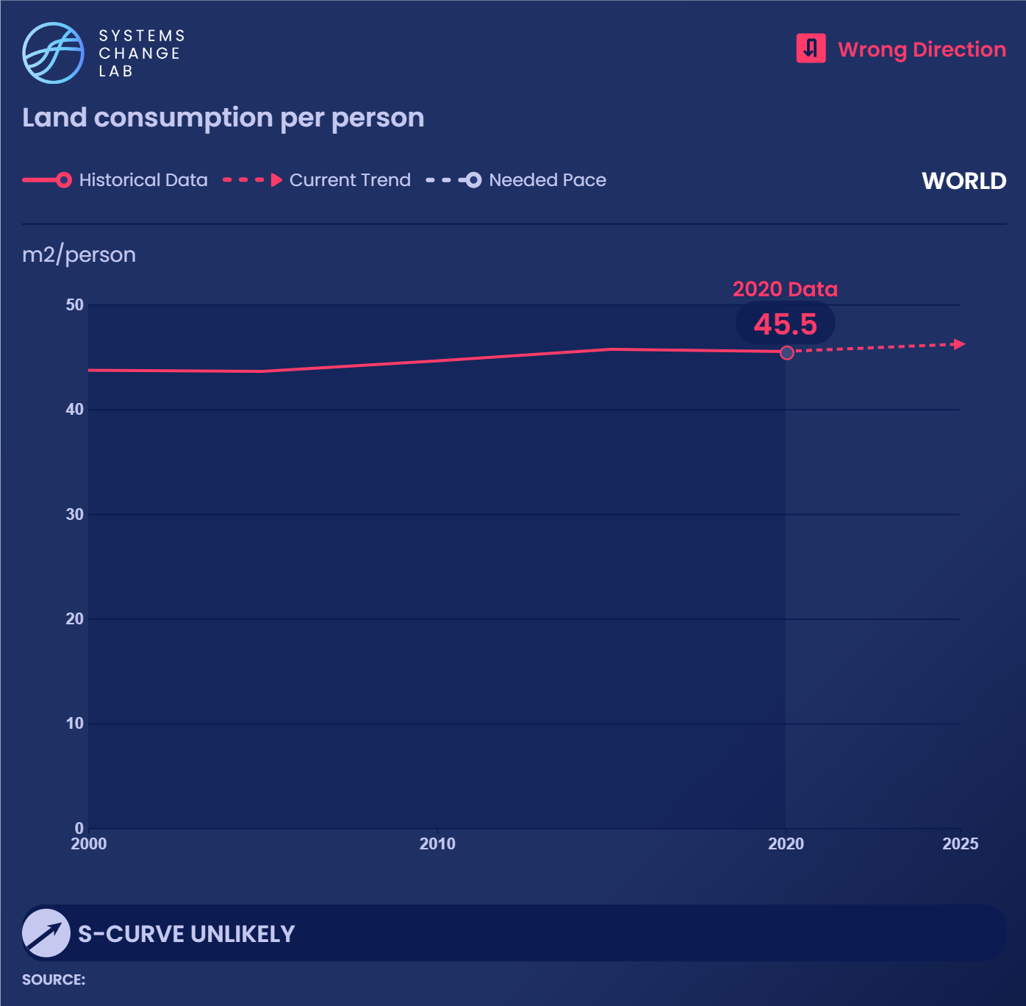
Lower land consumption per person can decrease per capita emissions and protect fertile agricultural lands and ecologically sensitive areas like wetlands and forests.
Notes:
In addition to natural population increase, cities often grow to accommodate migrants coming from rural areas or other regions and countries, often in search of economic opportunities or to escape economic deprivation and climate impacts. Rapid outward expansion is greatest in lower-income cities, where population growth is also the highest. Close to 90% of urban growth by 2050 is projected to occur in Asia and Africa, where vulnerability to climate risks is also the highest.
As cities grow, many expand outward into more fertile agricultural land, and ecologically sensitive areas like forests and wetlands. The resulting expansion of built areas can encroach on natural lands and habitats important for climate resilience and biodiversity. At the same time, expanded built areas increase impervious surfaces in cities (such as roads, buildings and concrete), which absorb heat and radiate it back into the urban environment, leading to higher localized heat intensity.
There is value to densifying the built environment rather than growing outward, as this shortens distances between locations and ensures more efficient and cost-effective provision of infrastructure, which in turn improves accessibility. Much empirical evidence illustrates how a city’s spatial expansion and reduced population density increases its per capita costs to provide public services, as well as the social costs associated with higher emissions, congestion, pollution, loss of productivity and unsustainable consumption of land and natural resources.
However, density does not automatically imply very tall buildings, as these are associated with higher construction and other costs, even if the land costs may be lower. Increased density can also lead to increased housing costs, which can exacerbate inequities within cities. For residential housing in particular, cities must balance both livability and affordability as they plan for denser urban environments.
This indicator, land consumption per person, measures how much land (in square meters) is used per person. In 2020, the global average land consumption per person in urban areas was 45.5 square meters per person. This shows a slight decrease from 45.7 square meters per person in 2015. However, from 2000 to 2015, land consumption per person had increased from 43.7 square meters per person to 45.7. Over time, ideally the land consumption per person will decrease or at least remain level, as it did between 2015 and 2020.

Slide 14
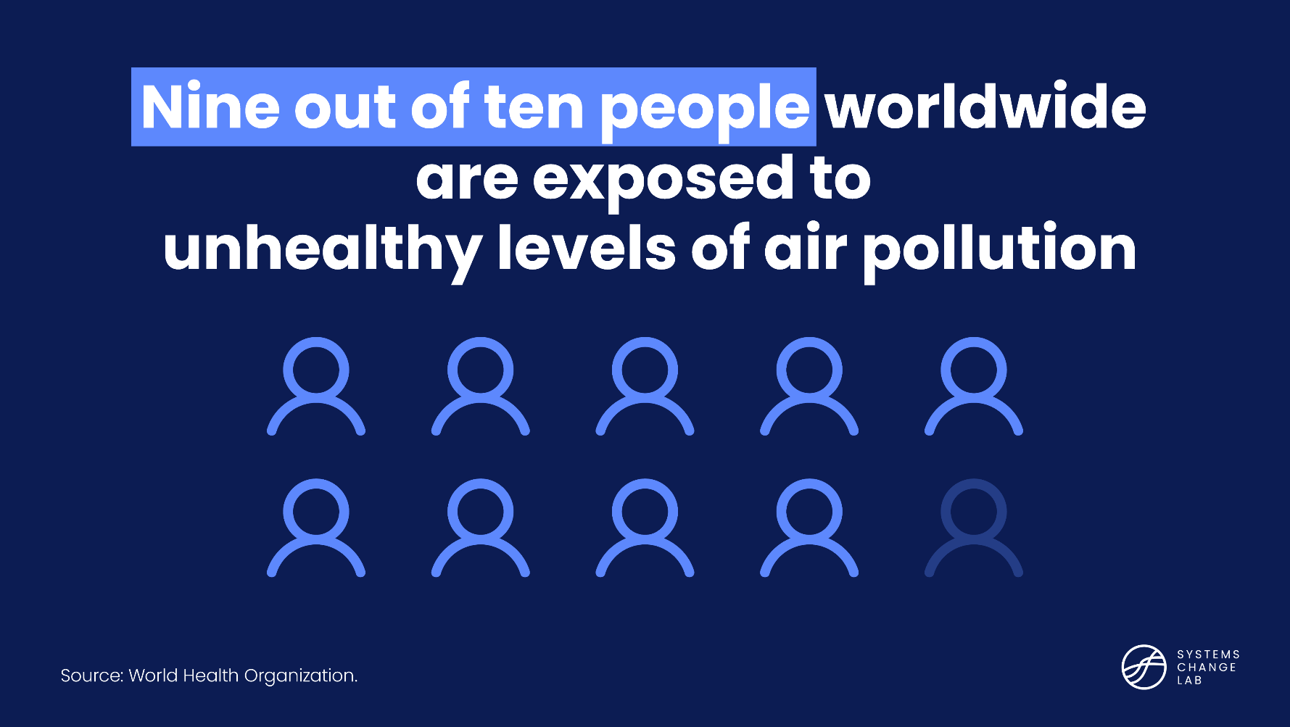
Air pollution is one of the largest environmental health risks
Source: World Health Organization and The Global Health Cost of PM2.5 Air Pollution: A Case for Action Beyond 2021, World Bank.
Notes:
Air pollution is one of the greatest environmental risks to health, with ambient (outdoor) air pollution estimated to have caused 4.2 million premature deaths worldwide in 2019. Over 80% of those premature deaths occurred in low- and middle-income countries. A World Bank report estimated that the cost of the health damage caused by air pollution amounts to $8.1 trillion a year, equivalent to 6.1% of global gross domestic product (GDP).
Although air pollution and climate change are often addressed separately in global and local contexts, air pollutants and greenhouse gasses frequently come from the same sources, including coal-fired power plants and fossil-fueled vehicles.
This indicator measures the number of days that exceeded the World Health Organization (WHO) thresholds for six pollutants in urban areas: nitrogen dioxide (NO2), sulfur dioxide (SO2), ozone (O3), carbon monoxide (CO), fine particulate matter (PM 2.5) and coarse particulate matter (PM10). The indicator is based on exceedance days in one year for any of the six pollutants in urban areas. For the country totals, it sums the number of exceedance days in all urban areas within the country in a given year (here shown as 2020, the most recent year of data available). The global number is an average of the number of exceedance days in all the countries. There was an average of 279 exceedances in urban areas in 2020. This is down from 288 exceedance days in 2015 and 292 days in 2010.
However, the WHO global air quality guidelines call for 0 exceedance days, so while the number of exceedance days has been trending downward over the past 10 years, much progress is still needed. Given the difficulty of reaching the air quality guidelines, the WHO has a series of interim targets that can be used as milestones on the way to achieving the guidelines in the future.
Limitations: This indicator does not show how much the pollutants have exceeded the WHO thresholds. An urban area could decrease the concentration of air pollutants, but still exceed the WHO threshold; for example, this instance would be shown as an exceedance day, and the progress in the right direction would not be captured. The level of concentration of each pollutant, rather than just the exceedance days, is important for determining public health outcomes, and a future indicator will be added to address this.

Slide 15
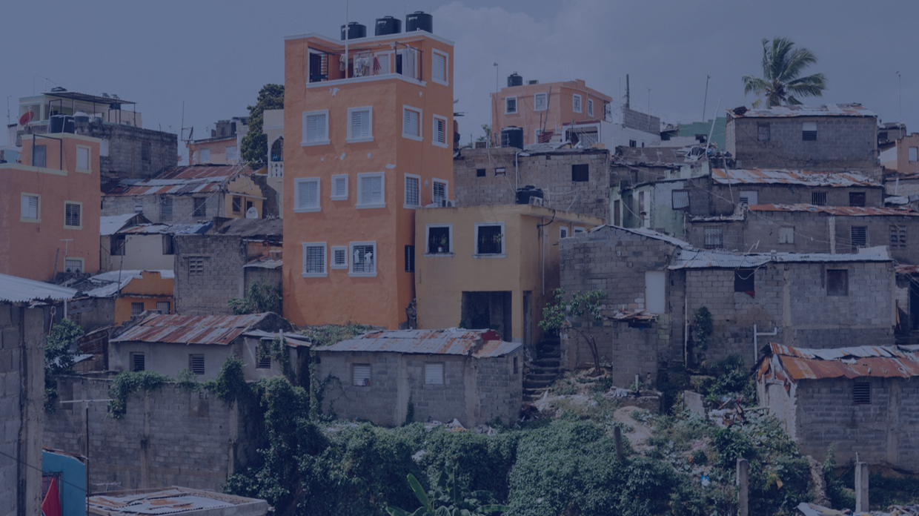
Increase access to resilient and affordable urban services and infrastructure
SHIFT
Notes:
Photo by Ric hard Cordones: https://unsplash.com/photos/brown-and-white-concrete-buildings-during-daytime-sYoZ2tZjC0Y

Slide 16
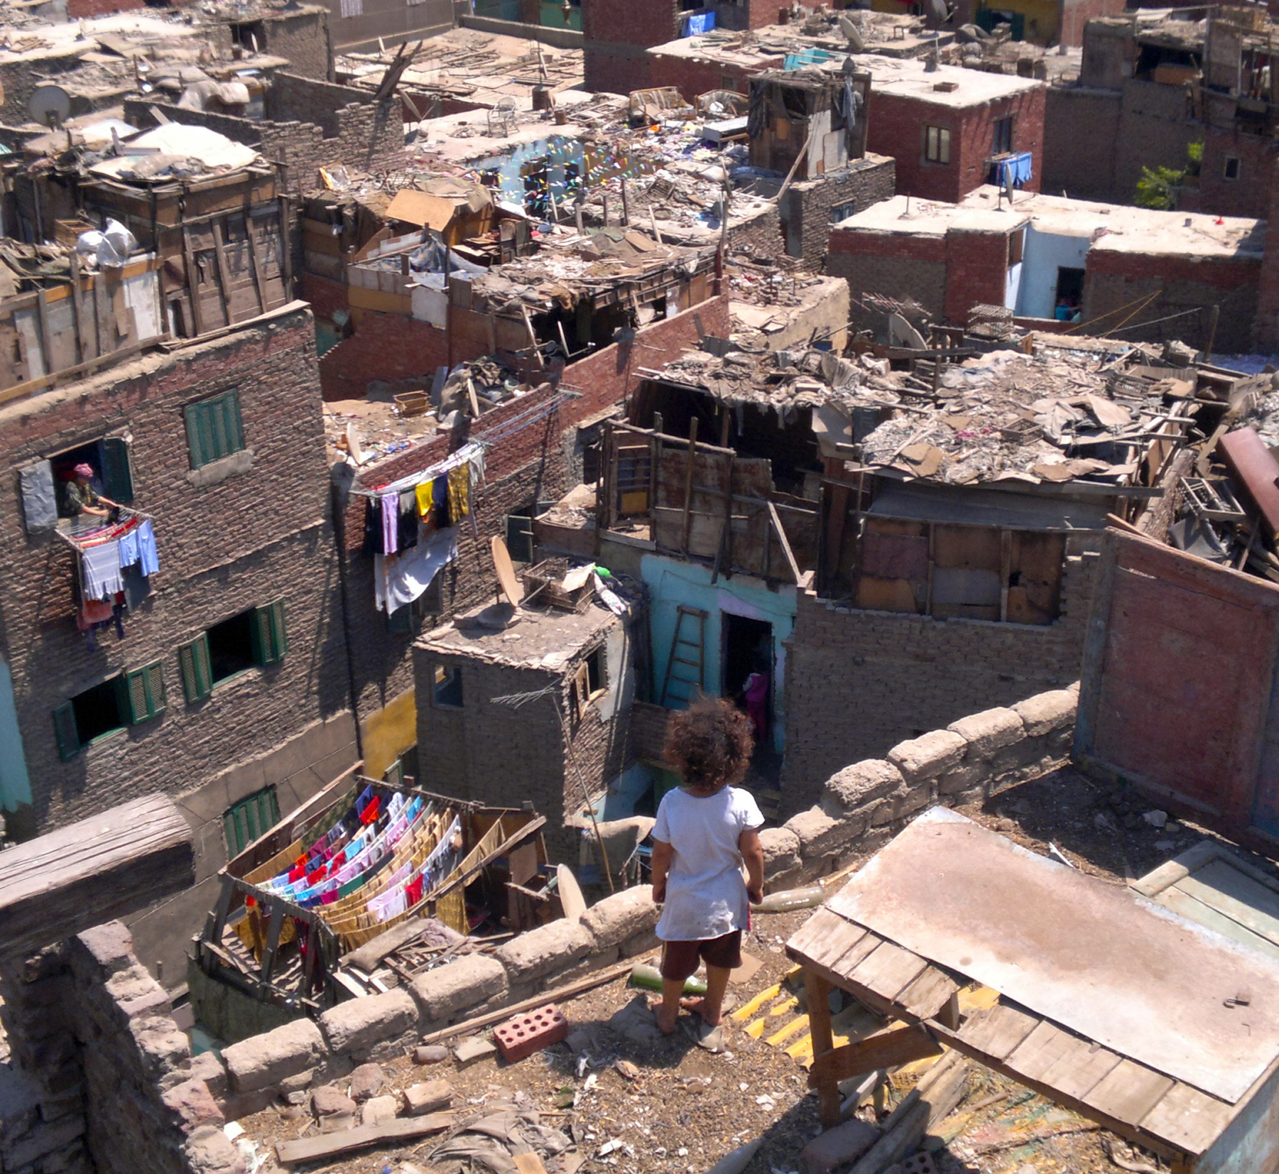
1 out of 3 city dwellers globally live in slums and lack access to affordable, secure housing and basic services. In low-income countries, this rises to nearly 2 out of 3.
Notes:
It is estimated that at least 1 billion people globally live in informal settlements or slums — unplanned areas that fall outside of legal and regulatory systems — and the actual number is likely much higher.
These communities lack access to adequate basic services and infrastructure like good quality housing, water, sanitation, energy or transportation, and are often located in parts of the city that are under-served and highly vulnerable to environmental and climate risks.
Local governments often overlook the deprivations faced by residents of informal settlements, who are typically from the lowest socioeconomic classes, lack legal property rights and remain uncounted in formal surveys and censuses. These settlements are unplanned areas that fall outside legal and regulatory systems and highlight the immense inequalities in access to services and infrastructure in cities.
Rapid urbanization, ineffective planning, lack of affordable housing and lack of effective housing policy are some of the reasons cited for slum formation in developing countries. If this type of growth continues, cities in developing countries could see the rise of mega-slums that are vastly under-served. Research shows that a 1% increase in urban population growth will increase the incidence of slums in Africa and Asia by 2.3% and 5.3%, respectively.
In 2020, 24.2% of the urban population globally lived in slums or informal settlements. Sustainable Development Goal (SDG) 11.1.1 aims to ensure access for all to adequate, safe and affordable housing and basic services and upgrade slums by 2030, thereby setting a target for this indicator of 0% by 2030. While this number has been trending downward, from 31.2% in 2000, the world would need to accelerate progress to decrease the incidence of slums by more than 10 times the current pace to reach 0% by 2030. However, 2 billion more people are expected to live in slums in the next 30 years.
Photo Credit: Tadamun via Flickr: https://www.flickr.com/photos/tadamun_info/10458318116/in/photolist-gWaBBA-FSMH9x-2oiha2b-F4cDjS-c4d8gA-R89hDf-FWitnb-F4bF4A-FYDzQD-FSKqMt-Du4ZYu-EgmbF7-DupMGV-2o2TT4H-EptAdu-FQuvww-F49Zjs-EptAyQ-EptAbq-DTiQDg-EiyDwK-EiyDF2-EiyDyP-DupMPP-2oigRvM-DZFfBu-EptAUj-2oigR7a-DTiRdH-EgmcaU-HEYyJn-EgmcoE-RQ6HUG-EiyEde-ErNjwt-DTiRjz-EgmbZd-EptBku-PEi41K-EgmcxY-DupNJ4-DZFfL7-DupNKB-ErNk2g-e5DH6d-DupNAi-DZFg6L-DTiRS8-ErNjMZ-EiyEoz

Slide 17
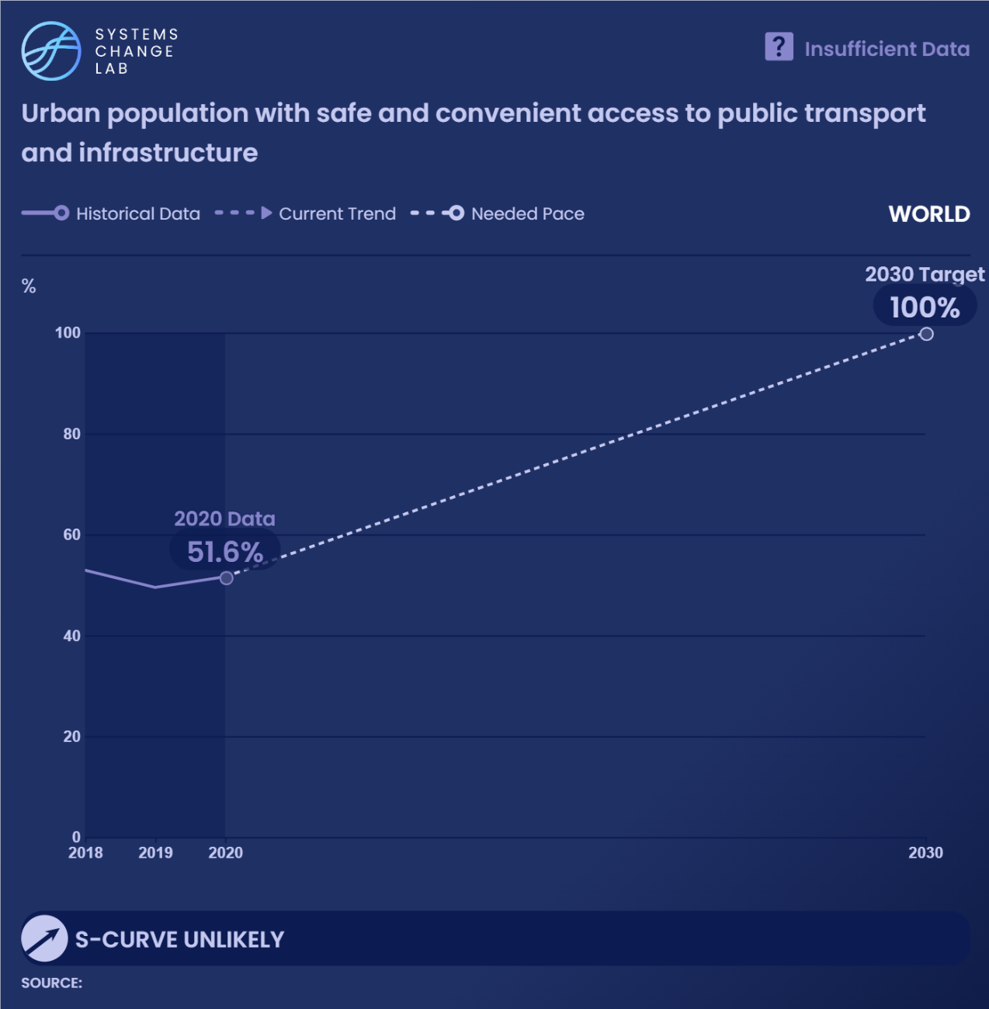
Improving access to public transport will not only improve livelihoods and equity outcomes, but also mitigate climate change by reducing emissions.
Notes:
As of 2020, only 51.6% of the world’s urban population had convenient access to public transport. In Sub-Saharan Africa and Central and Southern Asia, only 31% and 34% of the population, respectively, had convenient access to transport in urban areas.
Because transport emissions account for 15% of global greenhouse gas (GHG) emissions, improving access to public transport will not only improve livelihoods and equity outcomes, but also mitigate climate change by reducing emissions. Additionally, access to high quality transport can reduce road fatalities, as cities with higher public transit use have lower traffic fatality rates.
This indicator measures access to public transport as the share of the population within 500 meters walking distance of low-capacity transport systems (buses and trams) and 1,000 meters distance to high-capacity systems (trains, subways and ferries).
The data for this indicator used only public transport stops that are mapped, which may include both formal and informal public transport stops. Many cities in developing countries have informal transport systems that are not mapped and therefore are not included in this dataset.

Slide 18
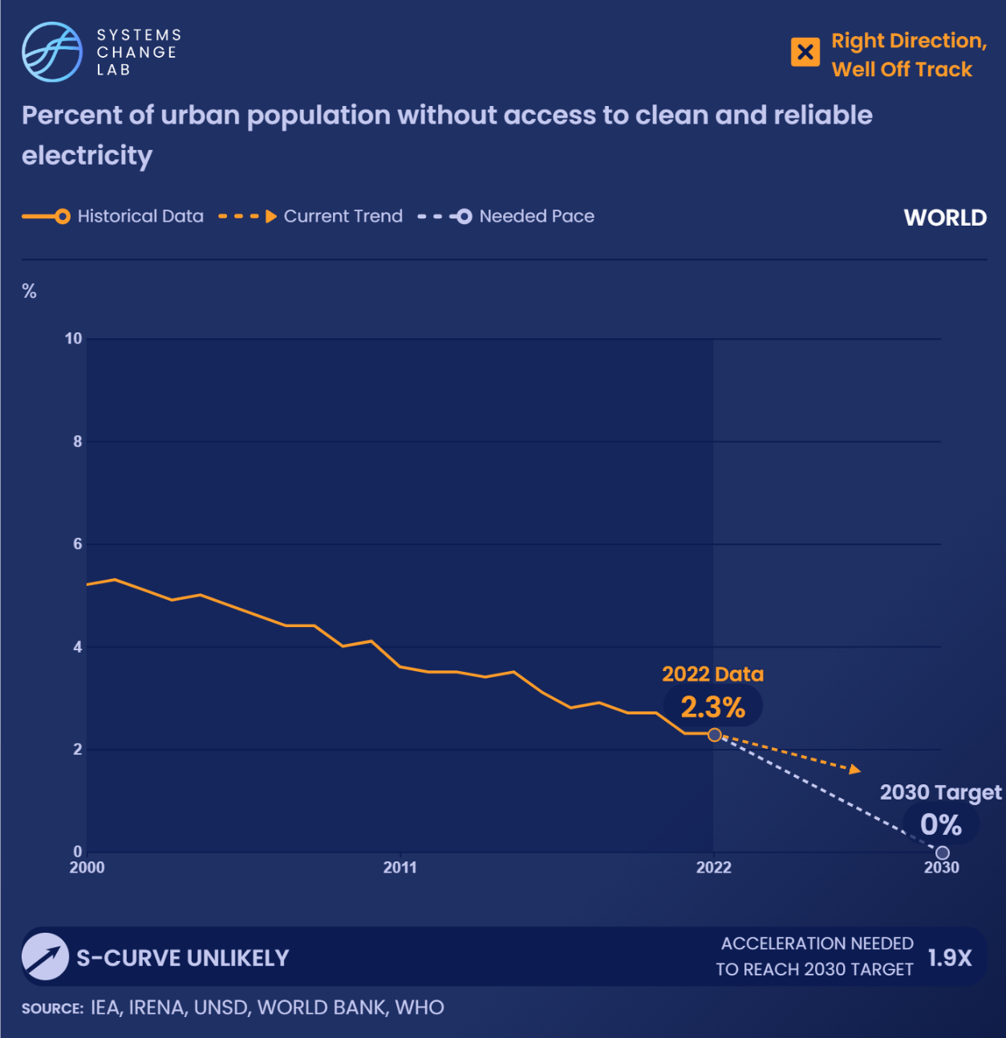
Access to electricity is vital to economic productivity and livelihoods, yet millions of urban residents around the world do not have access to clean, reliable energy.
Notes:
Access to electricity is vital to economic productivity and livelihoods, yet millions of urban residents around the world do not have access to clean, reliable energy.
Since 2000, the percentage of people in urban areas without access to electricity has decreased. In 2000, over 5% of urban residents lacked access to electricity; in 2022, 2.3% — still over 100 million people — did not have access.
Between 2019 and 2021, rural areas underwent rapid electrification, outpacing population growth. At the same time, progress flattened in urban areas, partly because they had already achieved higher access rates and partly because rapid urbanization had increased energy consumption and offset access gains.
Cities have a major role to play in how energy is provided and consumed, but in doing so they must face the dual challenge of expanding access to electricity while also meeting increased energy demands. Cities can improve access to clean, affordable and reliable energy by scaling up distributed renewable energy sources, such as solar.
For example, in cities in Kenya, Tanzania and Uganda, community solar has increased access to energy, while lowering costs for households. This lowers air pollution and carbon emissions.
While access to electricity has improved in the last 20 years, the world is still off track to achieve Sustainable Development Goal 7, ensuring access to affordable, reliable, sustainable and modern energy for all. Progress needs to double in urban areas and needs to be 1.6 times faster in all areas (not just urban) to reach energy access for all by 2030.

Slide 19
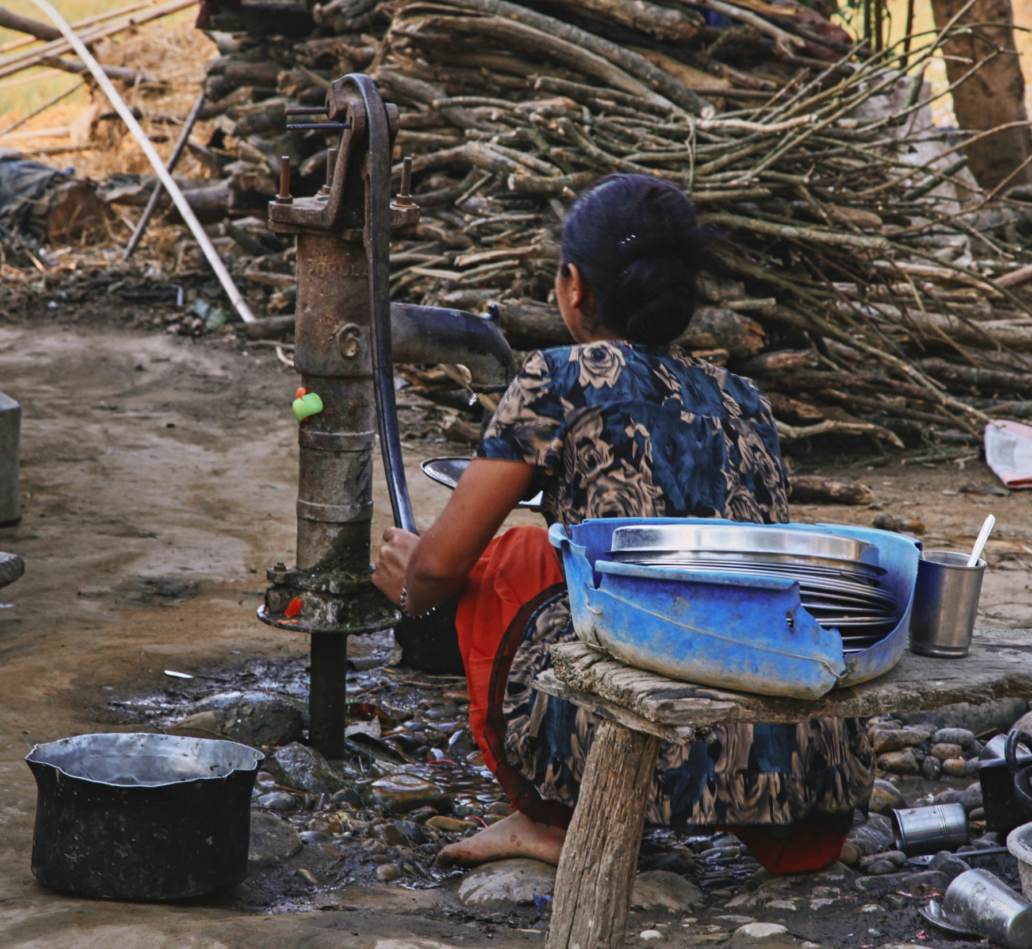
Analysis of data from 15 cities in developing countries show that on average, almost half of all households still lacked access to safe and reliable piped utility water, suggesting that global datasets overestimate the state of water access in these cities.
Notes:
According to the World Health Organization, as of 2022, 18.9% of the world’s urban population did not have access to safely managed drinking water. This is only a slight decrease from 19.5% in 2000. Safely managed drinking water is defined as being accessible on premises, available when needed and free from contamination.
However, analysis of data from 15 cities in developing countries show that on average, almost half of all households still lacked access to safe and reliable piped utility water, suggesting that global datasets overestimate the state of water access in these cities and do not take water quality or intermittency of water availability into account. Households that are not connected must rely on self-provision or private water vendors, which can be up to 50 times more expensive than public water.
Sustainable Development Goal 6 aims to ensure access to water and sanitation for all by 2030. In order to reach this target by 2030, progress in urban areas needs to be made more than 10 times faster than recent trends. However, it will become increasingly difficult for cities and water utilities to provide water in urban areas due to climate change — over 650 million people in over 500 cities are expected to see at least a 10% decline in freshwater availability by 2050.

Slide 20
Improve urban waste management and transition to zero-waste cities
SHIFT
Notes:
Photo by Ivan Bandura: https://unsplash.com/photos/an-overhead-view-of-a-street-with-a-lot-of-water-6wSevhW1Dzc

Slide 21
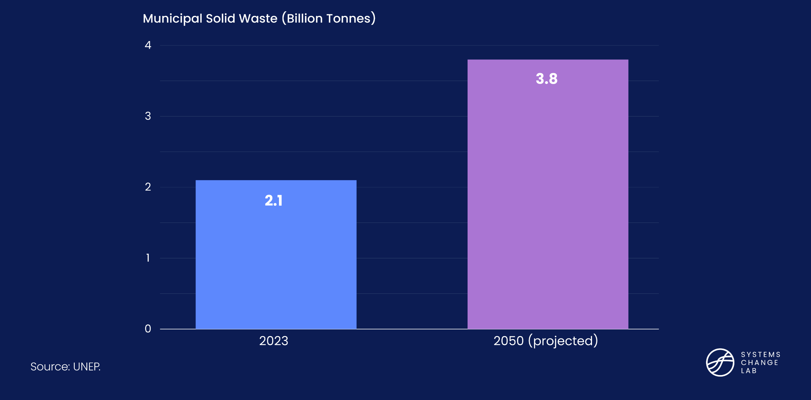
Waste produced by cities is projected to double by 2050
Notes:
In 2023, more than half of the world’s population lived in cities, and urbanization is accelerating especially in developing countries. Coupled with growing income levels and increased consumerism, global waste generation rates are expected to grow at twice the rate of population growth between now and 2050. If these trends continue, global solid-waste-related emissions will increase from 1.6 billion tonnes of carbon dioxide equivalent (CO2e) in 2023 to 2.6. billion tons of CO2e by 2050 unless effective zero-waste policies and programs are implemented

Slide 22
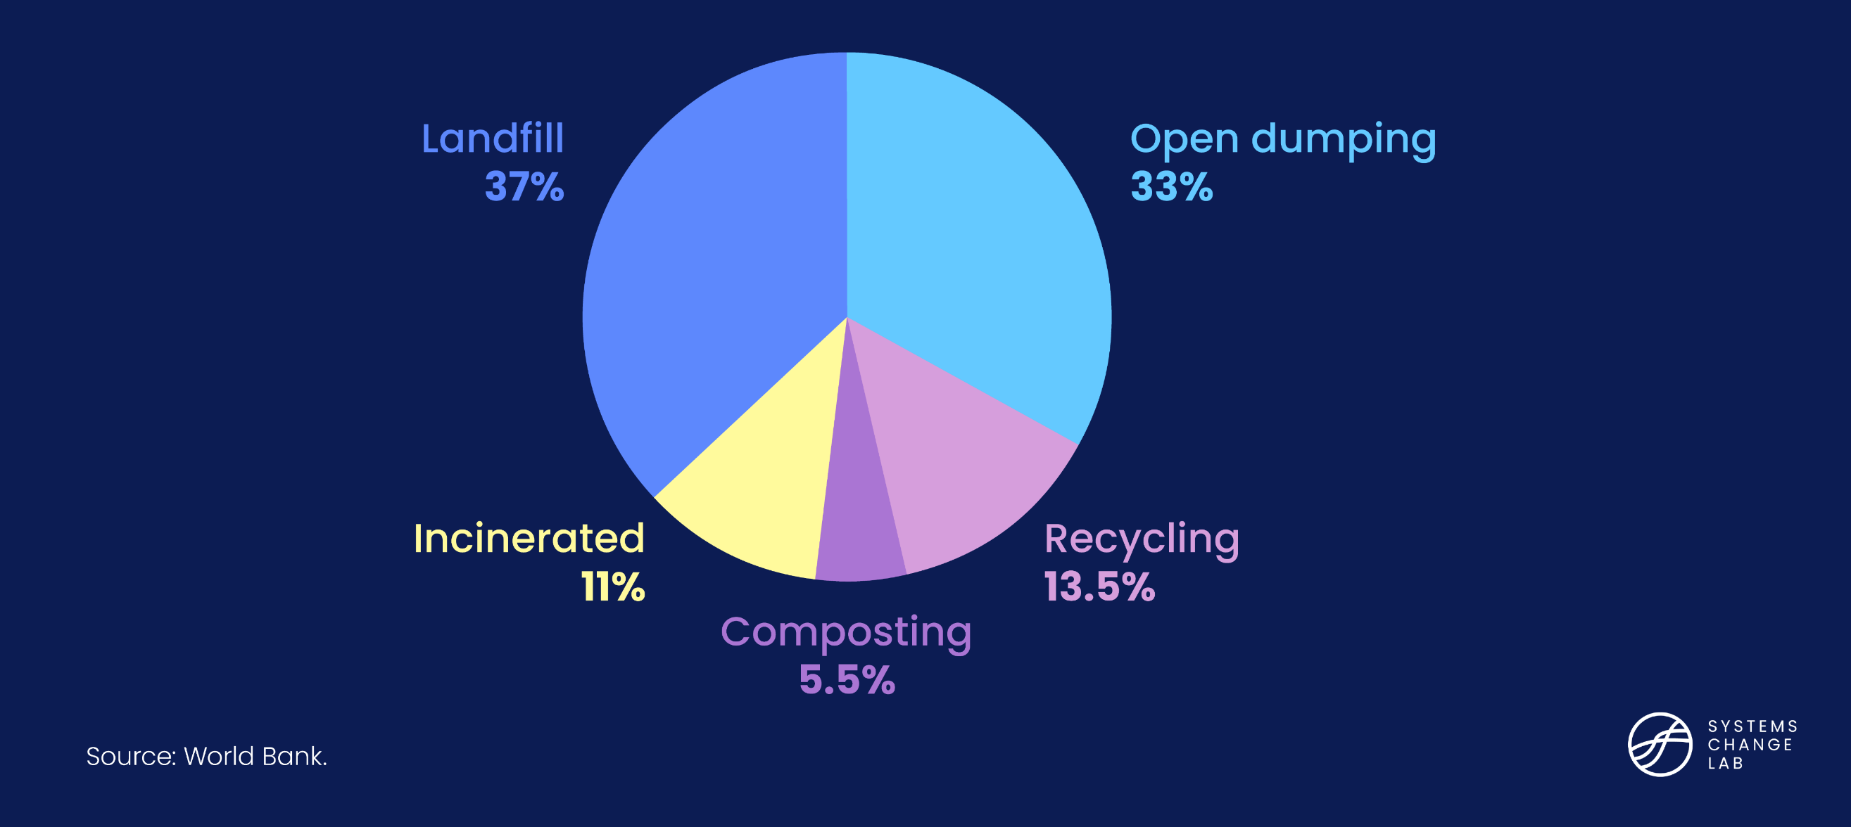
Where does global waste go?
Notes:
A successful shift toward zero-waste outcomes requires policies that encourage circularity in resource usage while minimizing residual waste disposal.
Ideally, residual wastes should be disposed of through sanitary landfills that are designed to safeguard against land and water pollution, with complementary investments in landfill gas collection systems that can capture greenhouse gasses like methane and nitrous oxide, as is common practice in most high-income countries.
However, in cities in developing countries, the predominant practice is the open dumping of waste, which leads to land and water pollution. In cities in most of the low-income countries of sub-Saharan Africa and South Asia, for instance, 93% of waste is disposed of through open dumping.
The current state of play can be described in terms of sustainable waste management by level of development. While waste collection by municipal agencies (or those designated by the municipality) in low-income countries is already grossly inadequate, poor waste management practices further endanger both the local ecosystem and the global commons. Waste disposal that takes place mainly through open dumpsites is harmful to the local ecosystem due to subsequent land and water pollution, and to the global commons through continuous methane emissions. Recycling is also considerably more limited in low-income countries compared to what is achieved in high-income countries.
Adequate waste management practices are almost exclusively seen in high- and upper-middle-income countries.

Slide 23
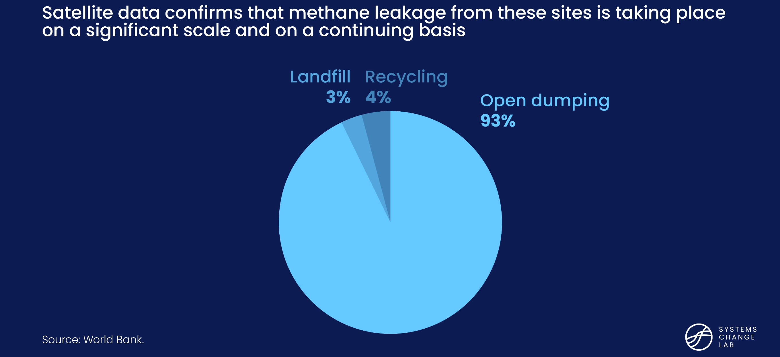
Low-income countries generally rely on open dumping
Notes:
A successful shift toward zero-waste outcomes requires policies that encourage circularity in resource usage while minimizing residual waste disposal.
Ideally, residual wastes should be disposed of through sanitary landfills that are designed to safeguard against land and water pollution, with complementary investments in landfill gas collection systems that can capture greenhouse gasses like methane and nitrous oxide, as is common practice in most high-income countries.
However, in cities in developing countries, the predominant practice is the open dumping of waste, which leads to land and water pollution. In cities in most of the low-income countries of sub-Saharan Africa and South Asia, for instance, 93% of waste is disposed of through open dumping.
The current state of play can be described in terms of sustainable waste management by level of development. While waste collection by municipal agencies (or those designated by the municipality) in low-income countries is already grossly inadequate, poor waste management practices further endanger both the local ecosystem and the global commons. Waste disposal that takes place mainly through open dumpsites is harmful to the local ecosystem due to subsequent land and water pollution, and to the global commons through continuous methane emissions. Recycling is also considerably more limited in low-income countries compared to what is achieved in high-income countries.
Adequate waste management practices are almost exclusively seen in high- and upper-middle-income countries.

Slide 24
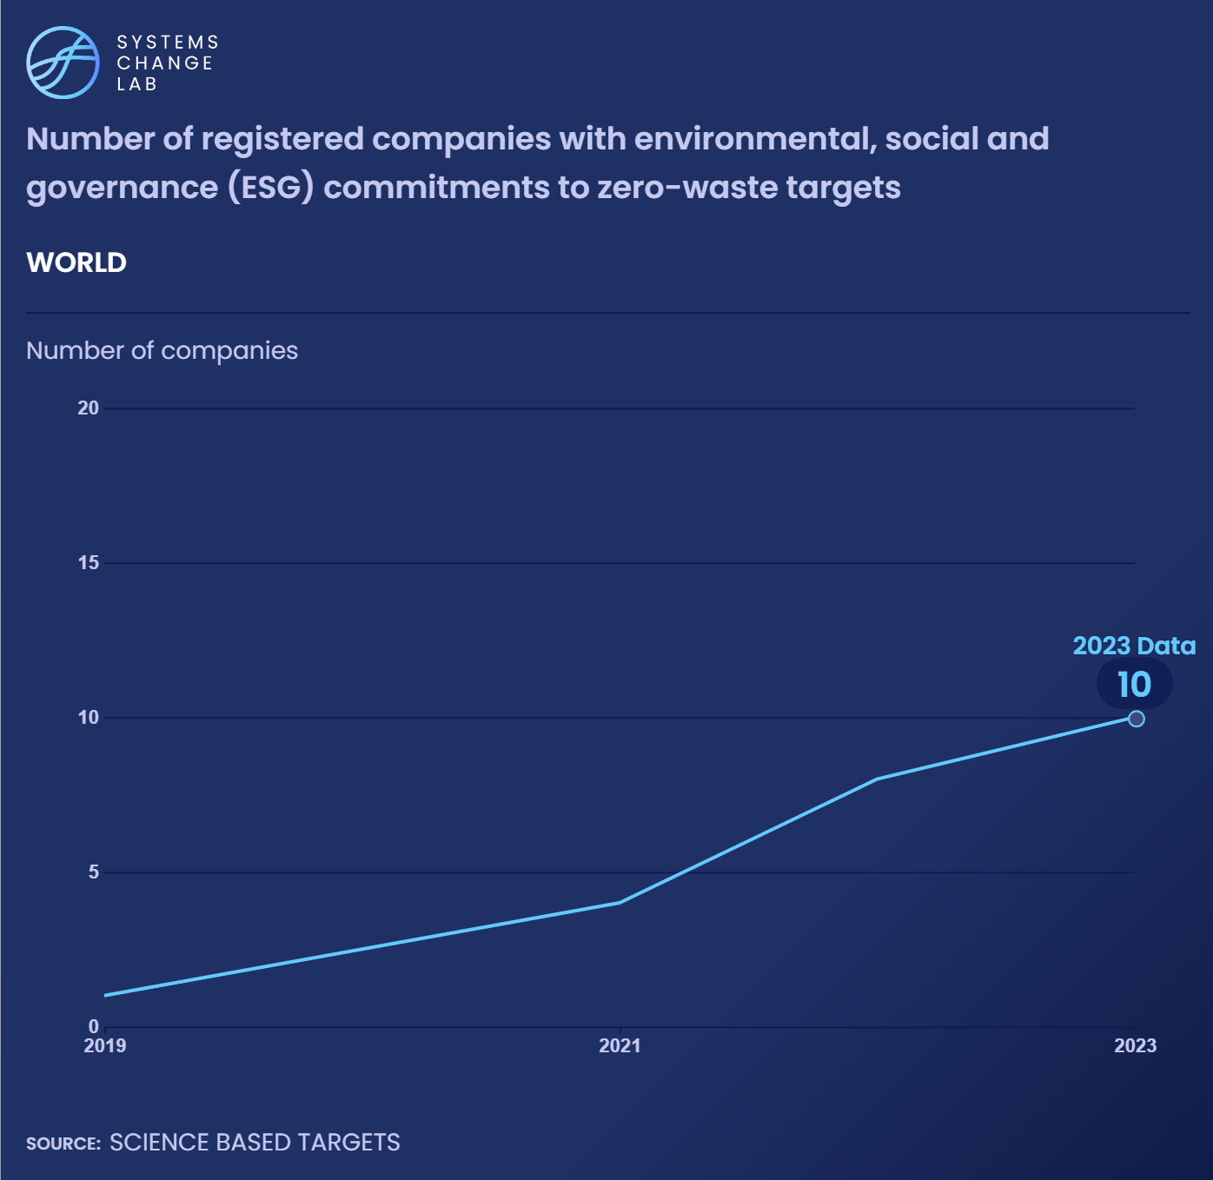
Transitioning to and maintaining zero-waste outcomes presents a win-win situation for cities, enabling them to contribute to climate mitigation while also offering citizens and regional ecosystems cleaner and healthier living environments.
Notes:
As of 2023, 10 of the largest multinational companies have made environmental, social and governance (ESG) commitments, as these are determined by the Science Based Targets initiative.
The current practice is to only list individual company commitments to zero wastes from its environmental, social and governance (ESG) budget; such companies include Unilever, Proctor and Gamble, Pepsi Cola and Coca Cola. To get a complete picture on private sector engagement to achieve zero-waste targets, it is necessary to account for the overall increase in registered companies including zero-waste targets in their ESG monitoring indicators is required. Since 2019, the number of companies has been steadily increasing.
Ensuring these funding sources are vetted through fully validated zero-waste indicators enables cities to access financing from these kinds of business enterprises.

Slide 25
Explore
the Data
Notes:
Cities Shift 3 QR Code for Vijay

Slide 26
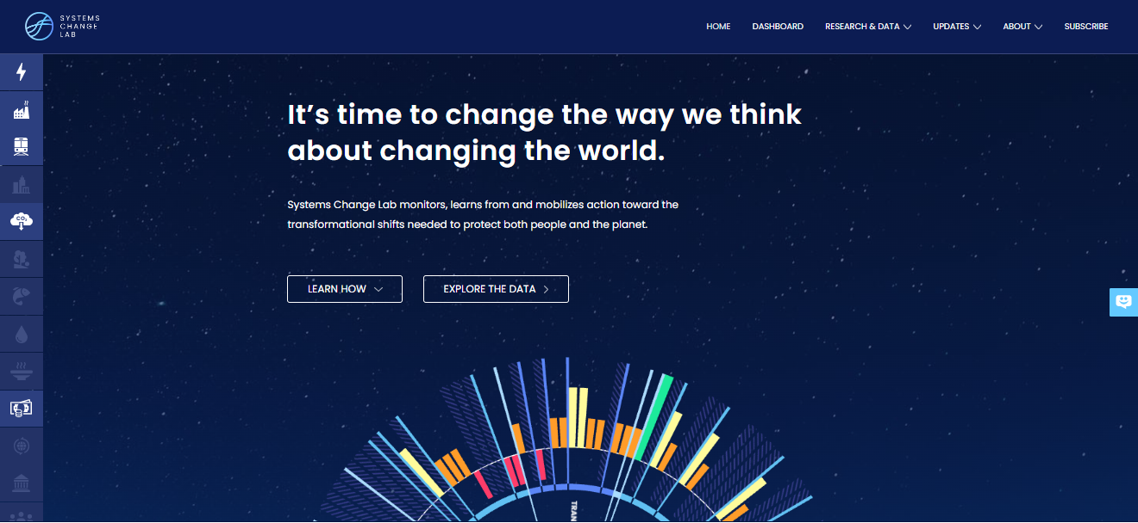
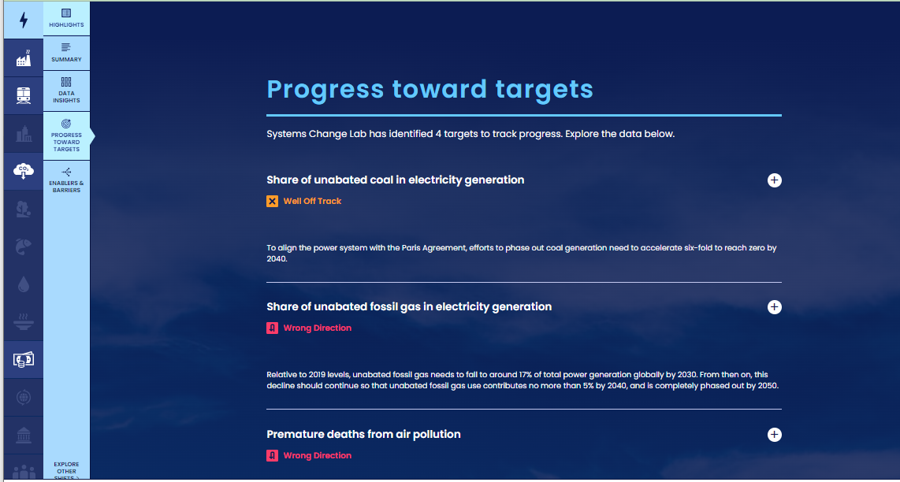
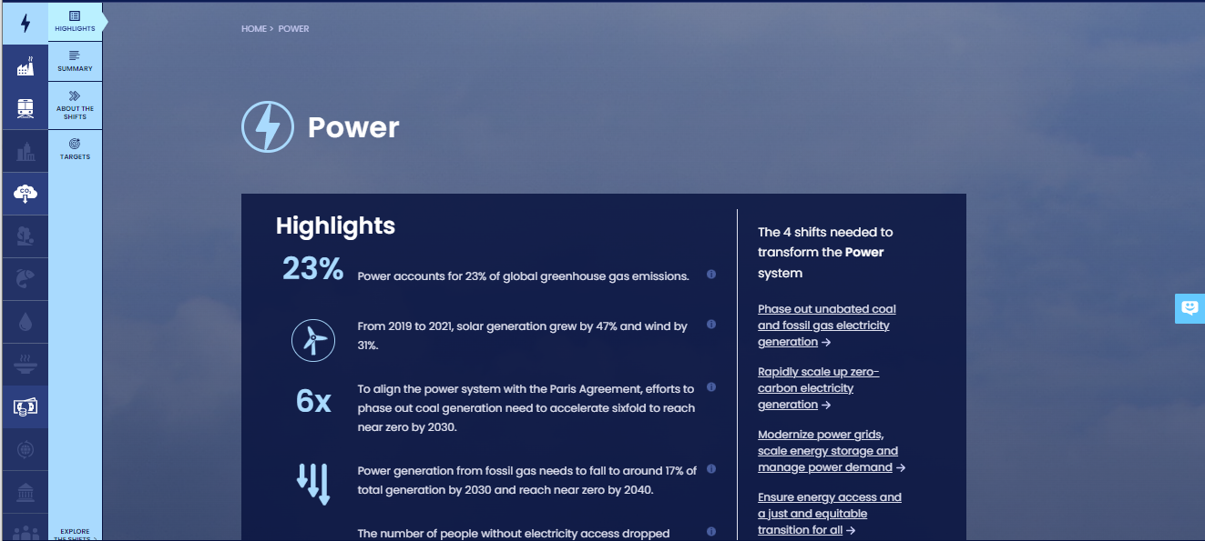
How to highlight a different indicator
Find your desired indicator on systemschangelab.org system pages
1. Select a system
3. Scroll down page to indicators and expand one
2. Select a shift

Slide 27
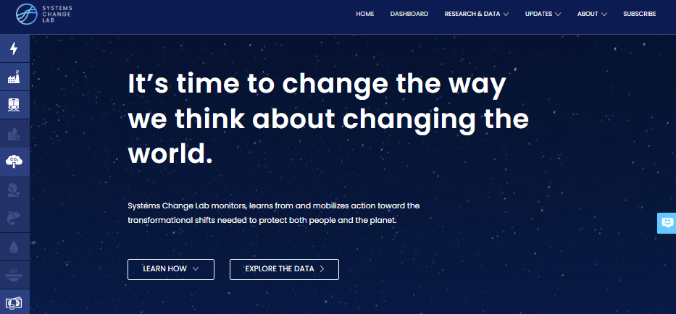
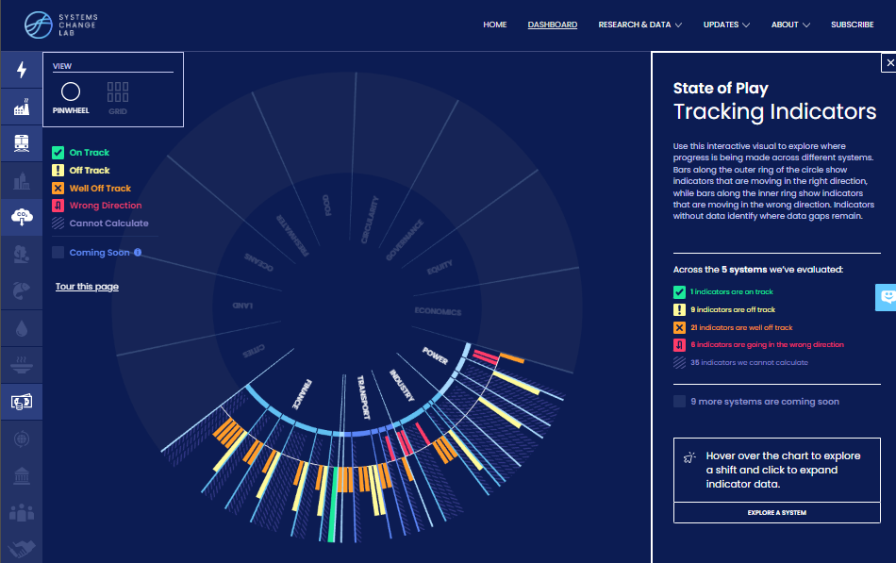
Alternatively, search for an indicator on the dashboard
1. Navigate to the dashboard
3. Search an indicator and then click explore data
2. Select grid view
4.
Notes:
Find your desired indicator on https://systemschangelab.org/
Look through System Page (https://systemschangelab.org/power)
OR search the dashboard (https://systemschangelab.org/dashboard) & select "EXPLORE DATA >" on your desired indicator

Slide 28
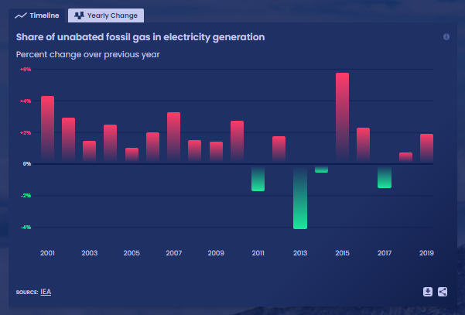
Pick a chart view and click the download button

Slide 29
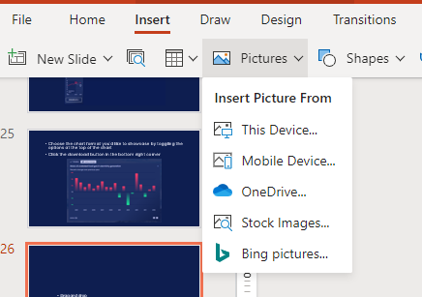
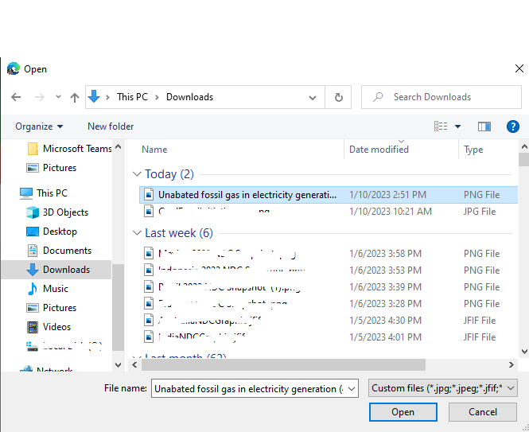
Next, add the chart to your slide deck
1. Select "Insert" and "Pictures" on the toolbar
2. Select chart from the downloads folder and open

Slide 30
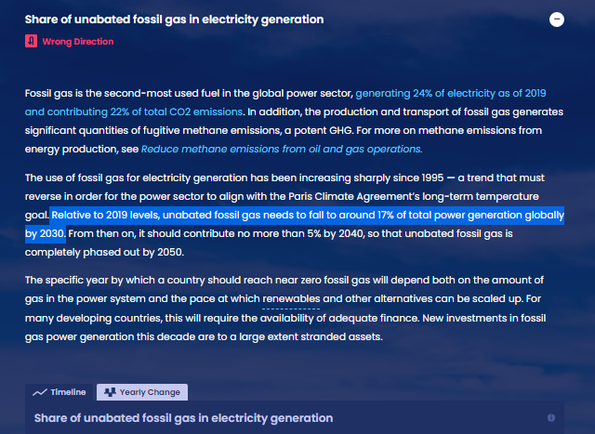
Add context from the indicator write-up as desired

Slide 31
For more information
VISIT: SYSTEMSCHANGELAB.ORG/CITIES
EMAIL: CONTACT@SYSTEMSCHANGELAB.ORG

