Slide 1
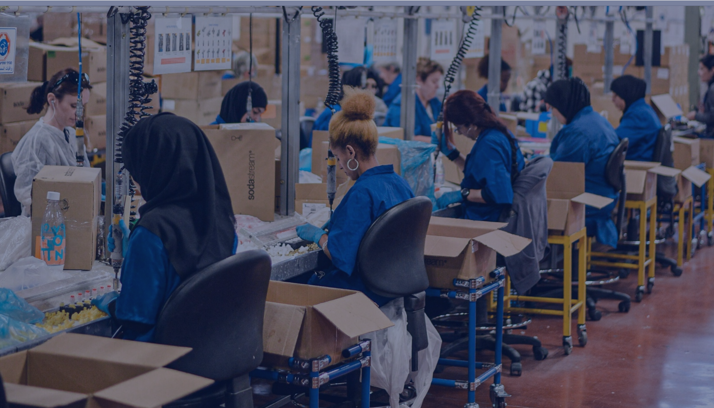
Circular Economy
Last updated December 2024 | systemschangelab.org/circular-economy
Notes:
Photo by Payton Kramer: Breadth 6 | Figure/Ground & color interaction - For this ass… | Flickr

Slide 2
Systems Change Lab It’s time to change the way we think about changing the world.
Systems Change Lab monitors, learns from and mobilizes action toward the transformational shifts needed to protect both people and the planet.
The data platform identifies and tracks key shifts in our global systems that, when achieved together, can spur transformational change.

Slide 3
Interconnected systems
Power
Industry
Transport
Cities
Buildings
Carbon Removal
Forests & Land
Oceans
Freshwater
Food & Agriculture
Finance
Circular
Economy
Governance
Social Inclusion & Equity
Economics

Slide 4
What is a circular economy?
"An economic system whereby the value of products, materials and other resources in the economy is maintained for as long as possible, enhancing their efficient use in production and consumption, thereby reducing the environmental impact of their use, minimizing waste and the release of hazardous substances at all stages of their life cycle, including through the application of the waste hierarchy."
— EU Regulation 2020/852 on the establishment of a framework to facilitate sustainable investment

Slide 5
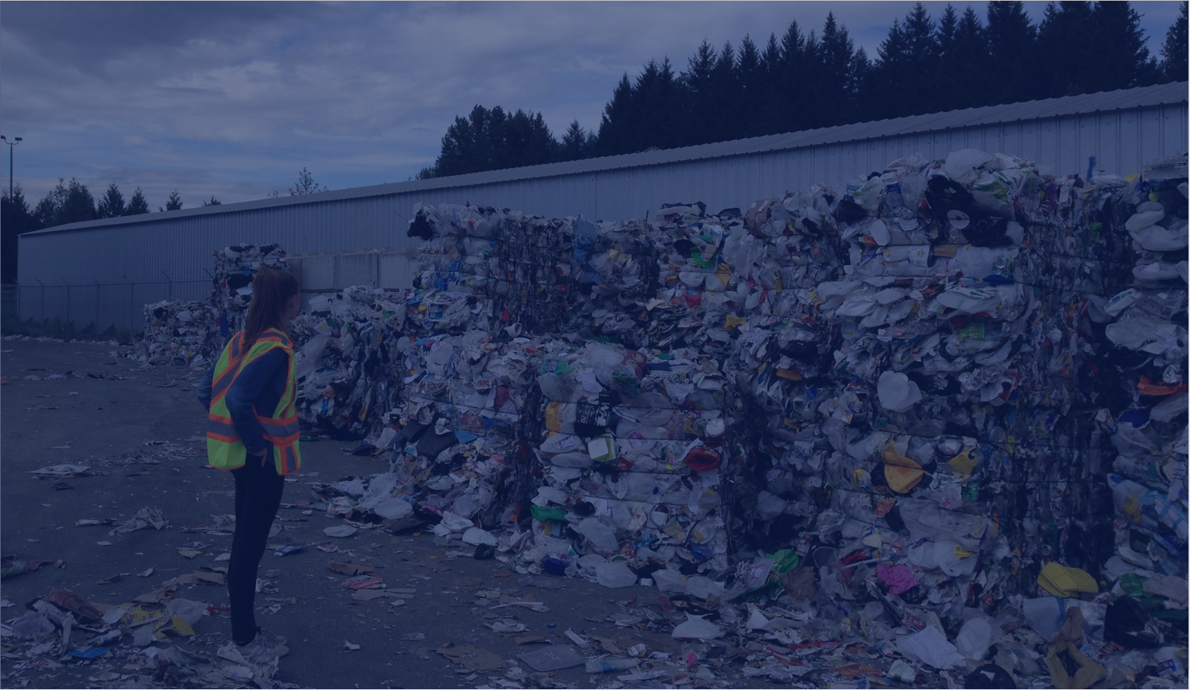
The six shifts needed to transition to a circular economy
Decrease overconsumption
Make production more resource efficient
Use recycled, reused and renewable materials and components
Use products longer
Increase the quantity and value of resources at end of use
Minimize environmental and social harms in resource extraction
Notes:
Phase out unabated coal and fossil gas electricity generation
Ending the current reliance on coal and fossil gas is crucial to achieving climate goals. This shift requires rapidly phasing out these fuels, relocating workers to new sectors, and eradicating public and private financing for fossil fuels, among other key actions.
Rapidly scale up zero-carbon electricity generation
Collectively, governments, businesses and households must prioritize a rapid transition to more sustainable forms of energy, unlocking myriad benefits such as lower CO2 emissions, cleaner air and a net-benefit to the global economy.
Modernize power grids, scale energy storage and manage power demand
Scaling up efforts on power transmission and distribution, demand-side response and storage will require new policies to mobilize capital for new infrastructure; it will also create the market conditions for demand management programs and technological innovation.
Ensure energy access and a just and equitable transition for all
Too many of the world's poorest communities have been negatively impacted by fossil fuel power or do not have energy access. The transition of the world’s energy systems toward decarbonized, highly electrified models must benefit all people equitably.
Photo by Ben Paulos: https://www.flickr.com/photos/benpaulos/48788589568/in/photolist-2hkhgUL-oNTMdT-eaR98M-21QQXzR-dqeuC2-pVGwot-24EiJHi-2hkj8oB-nJ85PZ-8NMPqm-21HMzqb-7vdjdj-7vo22e-pcT9jn-edrwbv-7v9vkk-2hTDiZs-7vrQV1-356FGZ-qZYZQD-Wk6Dwb-9Kd4bh-WnrG16-7jLasm-7jGie6-7vrQQo-7jGhNB-oYV6n9-xc6oWs-7jGfTp-7jGj1X-fAv6wi-bhXgMK-8rYKN9-pVwKS8-7vbdr4-q4cabr-7vf8By-7vf7db-7vbisn-7vbiFp-csjUVf-7vdk2J-7v9vcM-7v9vTR-Xm2ftQ-Jgcy4h-dcbmbA-cUwMFo-6tUqeB

Slide 6
Highlights
Increasing resource use is the main driver of the triple planetary crisis: climate change, biodiversity loss and pollution.
In 9 of the 15 countries with the largest material footprints, material resource consumption per capita is increasing. Global material resource consumption should decline by more than half by 2050.
Recycling rates and use of recycled materials are both increasing, but slowly. Closing the loop of global material use needs to be significantly accelerated.
There is data to indicate that some product lifetimes are increasing slowly, but the status for most products is unknown.

Slide 7
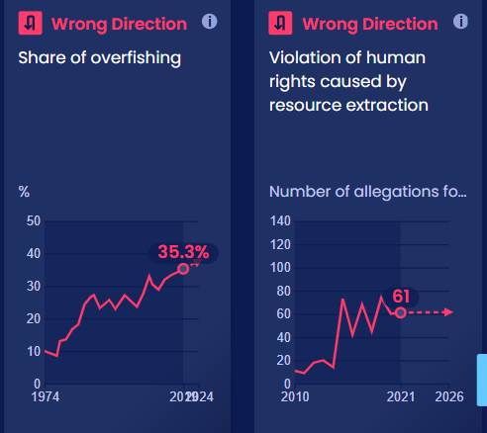
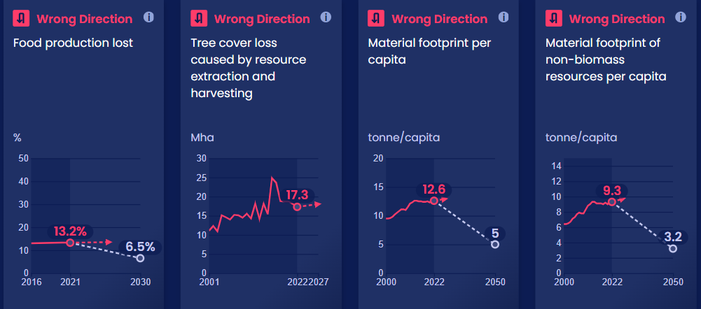
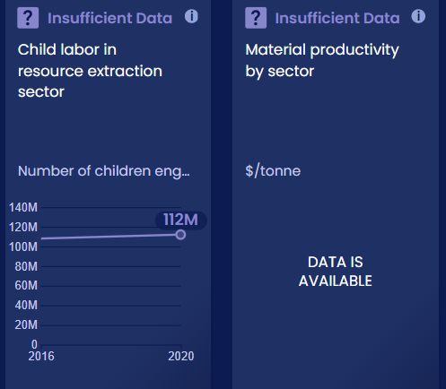
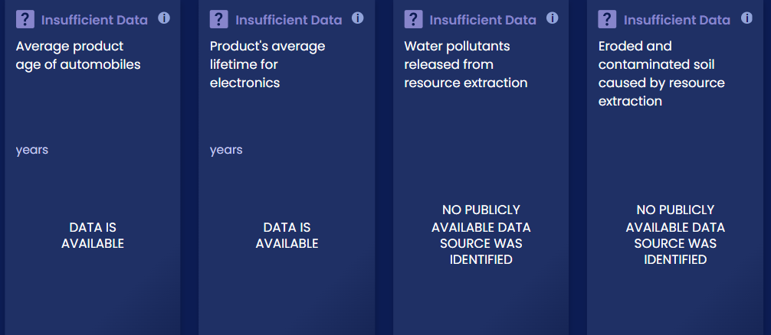
Progress Toward Targets
In this system, we have identified 34 outcome indicators. Out of the 34 targets we've evaluated, 5 are moving in the right direction and 0 are on track.

Slide 8
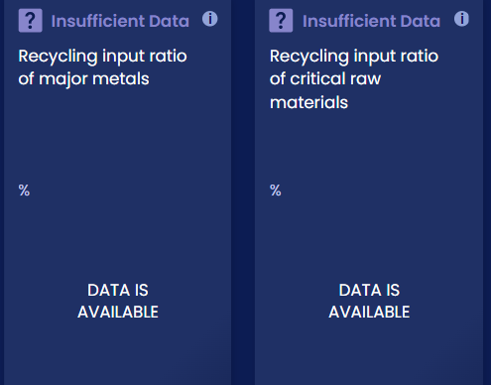
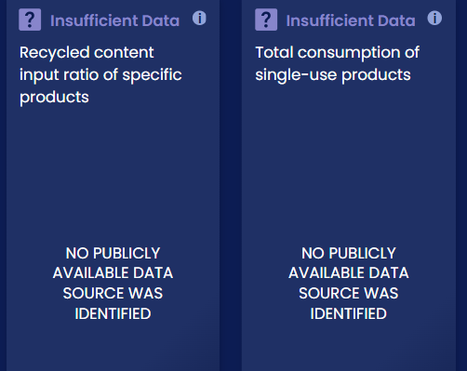
Progress Toward Targets
In this system, we have identified 34 outcome indicators. Out of the 34 targets we've evaluated, 5 are moving in the right direction and 0 are on track.

Slide 9
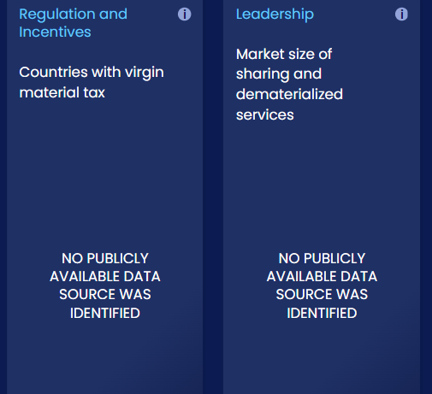
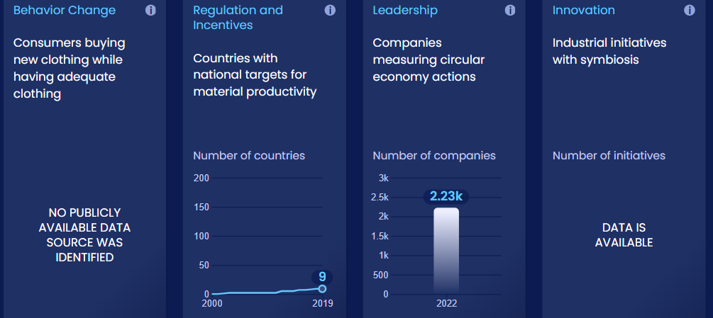
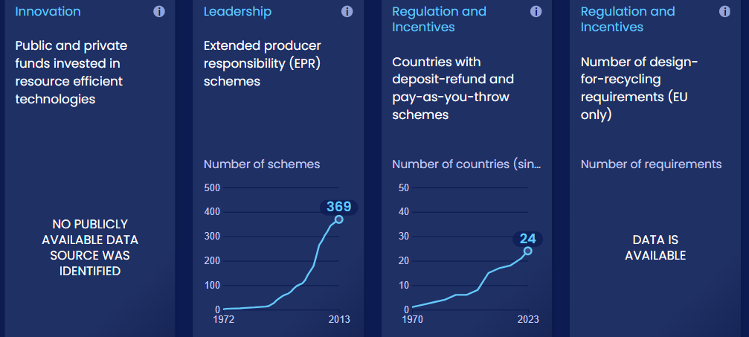
Enablers and Barriers
In this system, we have identified 33 enablers and barriers to change.

Slide 10
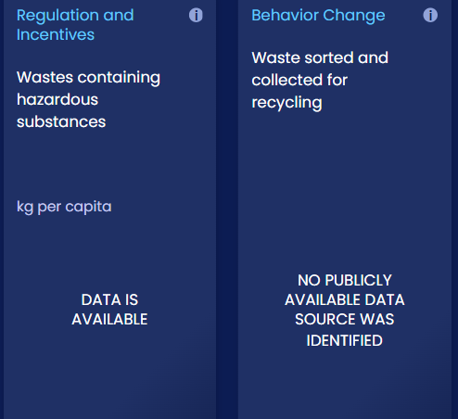
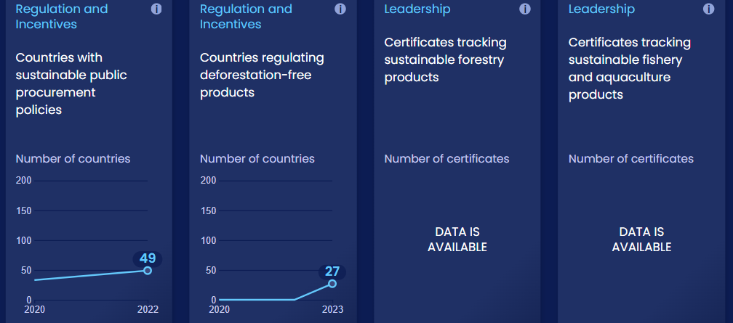
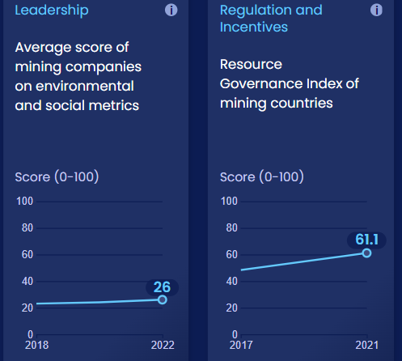
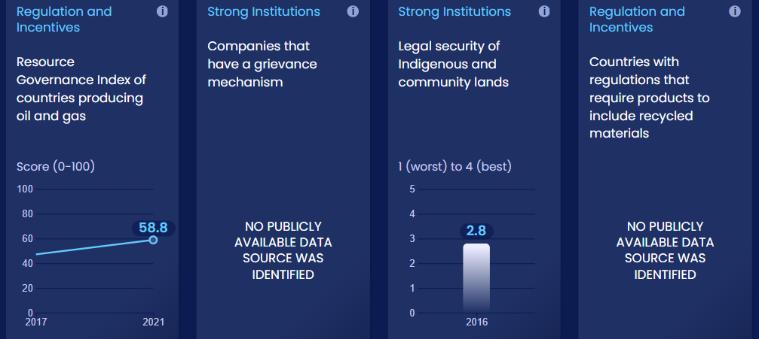
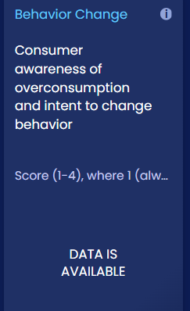
Enablers and Barriers
In this system, we have identified 33 enablers and barriers to change.

Slide 11
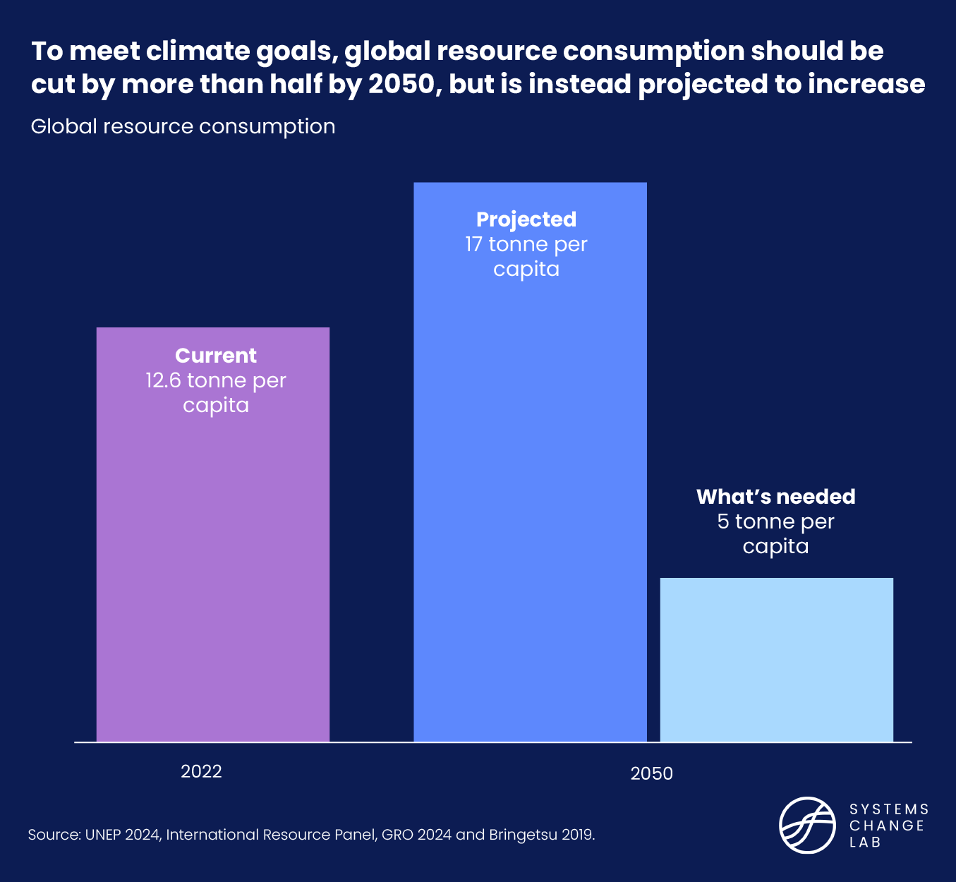
Global resource consumption should be cut by more than half by 2030, but is instead projected to increase

Slide 12
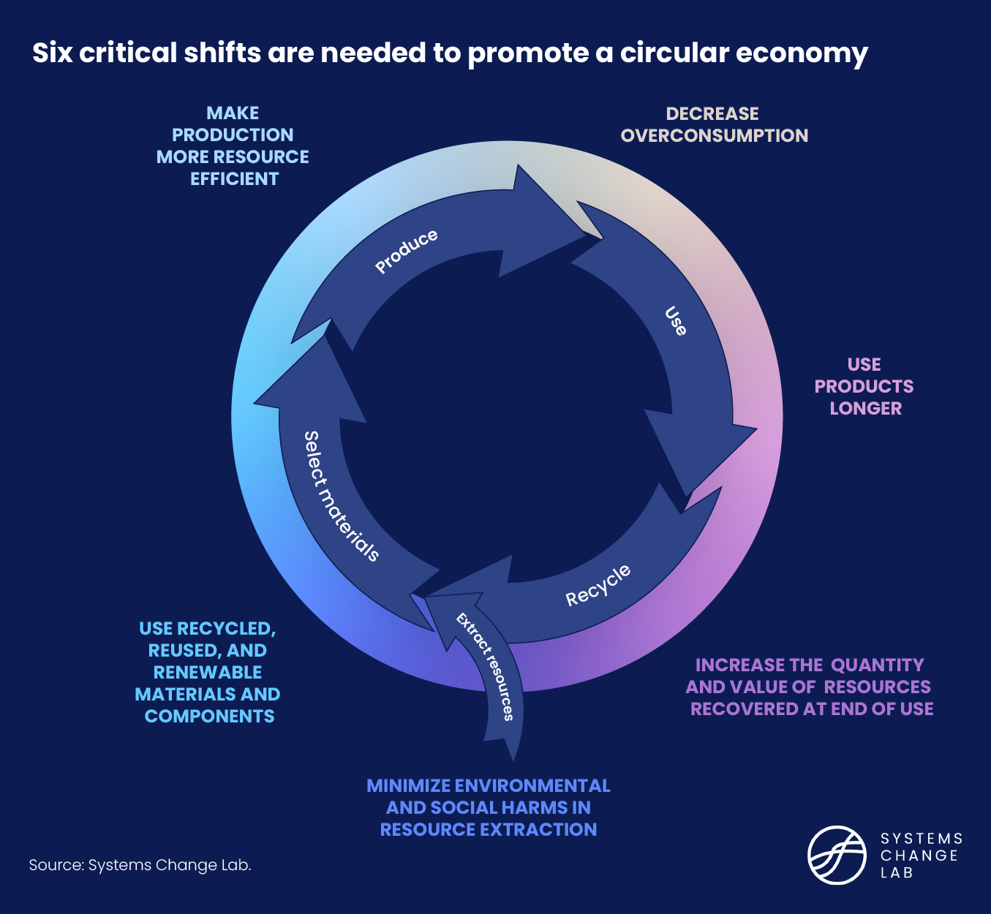
The six shifts needed to transform the circular economy system
Notes:
(General ideas)
To cover all life stages of materials.
To link life stages so as to formulate material circulation.
e.g. Recycling at the end-of-life stage must be paired with an increased use of recycled materials.
(Specific reasons)
The first priority of 3Rs, “reduce”, is important: Narrowing the loop
To reduce material use in both consumption and production
To ensure that human activities fit within the global capacity of the environment (overconsumption), with attention to equitable access (underconsumption).
Sharing unnecessary resources (Use and provision of functions rather than materials)
The longer use of products is another key aspect: Slowing the loop
Products and their materials must be kept in circulation at their highest value for as long as possible: Closing the loop.
Recovering and retaining the value of the materials and components in end-of-life products
Using them to make new products, replacing virgin, non-renewable materials
Resources that are truly renewable should be used for products from the biosphere.
Reduction of environmental impacts
Relevant reports and definitions were considered.
General ideas
To cover all life stages of materials.
To link life stages so as to formulate material circulation.
Specific reasons
The first priority of 3Rs, “reduce”, is important: Narrowing the loop
To ensure that human activities fit within the global capacity of the environment.
Products and their materials must be kept in circulation at their highest value as long as possible: Closing the loop
Recovering and retaining the value of the materials in end-of-use products
Using them to make new products, replacing virgin, non-renewable materials
The longer use of products is another key aspect: Slowing the loop

Slide 13
Decrease overconsumption
SHIFT
Notes:
Photo by Jiri Rezac / Climate Group: MUMBAI | INDIA MUMBAI 28MAY10 - Victoria train station in Mu… | Flickr

Slide 14
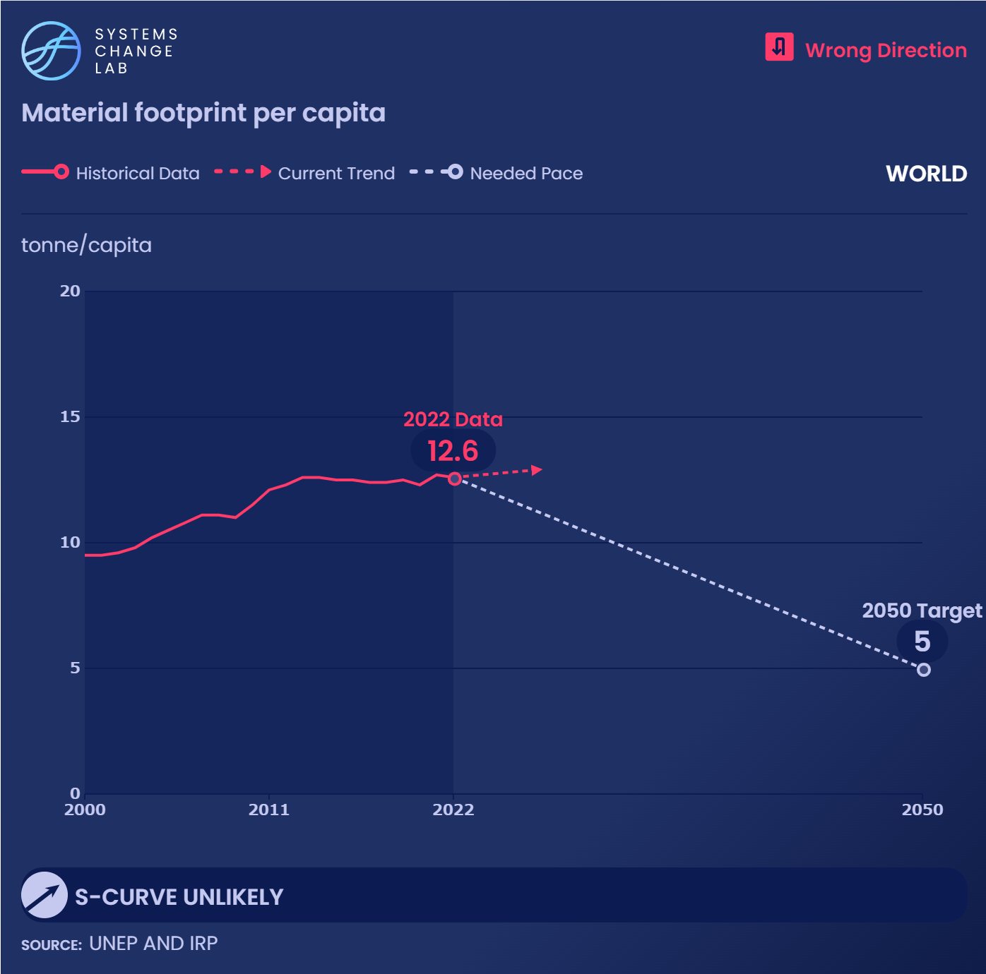
Global material resource consumption per capita stagnated at 12-13 tonnes per year from 2011.
By 2050, material footprint per capita must decrease by more than half to meet a target that our planet and growing population can sustain.

Slide 15
Equitable resource use deserves more attention
26%
55%
High
26% of the world population living in the highest per-capita material footprint countries consumed 55% of the global material footprint.
50% in the lowest footprint countries consumed 19% of the global material footprint.
50%
19%
Low
Population
Material resource use
2022

Slide 16
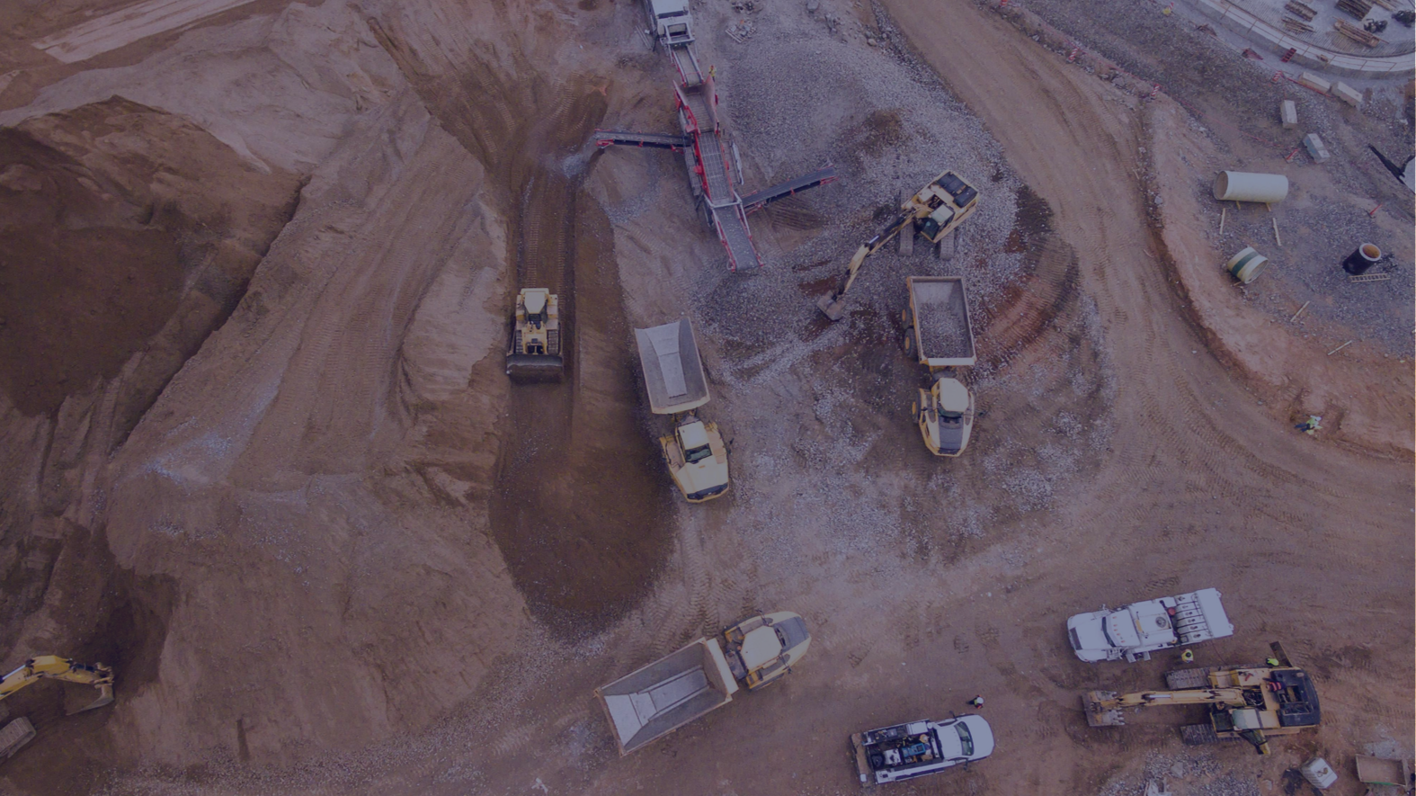
Minimize environmental and social harms in resource extraction
SHIFT
Notes:
Photo by Jiri Rezac / Climate Group: MUMBAI | INDIA MUMBAI 28MAY10 - Victoria train station in Mu… | Flickr

Slide 17
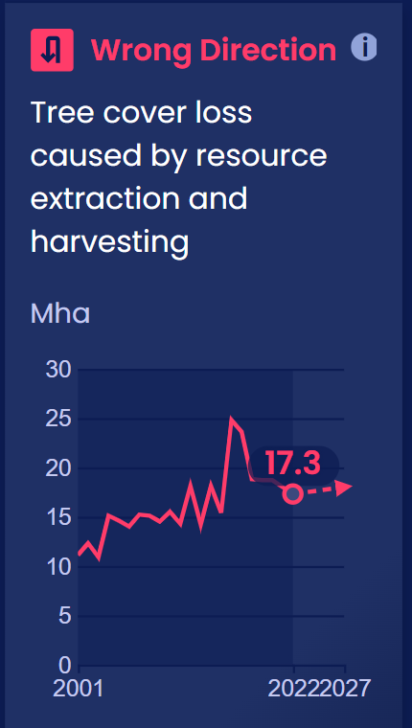
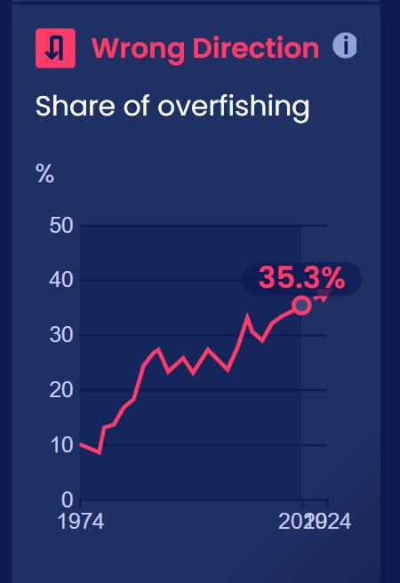
Human activities surpass what ecosystems can provide
Global tree cover loss by resource extraction continues to increase.
Global per capita consumption of fish has more than doubled since the 1960s, while fishery resources have declined. The share of overfishing reached a record high in 2019.
2019
Notes:
Indicator Copy from SCL Platform: For the transport sector to play a role in limiting global temperature rise to 1.5 degrees C (2.7 degrees F), high-income countries — the top 10 of which contribute 53% of global transport emissions and have high rates of motorization — will have to reduce light-duty vehicle (LDV) travel. Developing economies will also need and have the opportunity to reduce or slow the growth of vehicle travel and create sustainable transport systems not dependent upon cars.
While there is no extensive historical data available on the share of trips made by passenger cars, the data that do exist show a worrying trend. The global share of kilometers traveled by passenger cars increased from 39% in 2015 to 44% in 2020.
The cause of this increase is understandable: as populations and gross domestic products (GDPs) have grown, so has the number of people who own automobiles, and therefore the share of trips made by privately-owned cars. The trend in car ownership is expected to accelerate in developing countries as GDPs continue to grow. Countries with the highest GDPs per capita are more culpable for the current state of this indicator, while countries with lower GDPs per capita bear less of a responsibility.
By 2030, the global percentage of motor vehicle trips should decrease from its predicted 50% to between 34% and 44% (according to authors’ analysis based on BNEF scenarios). Economically developing countries across Asia, Africa and Latin America have room for modest growth in private motor trips if those in Europe and North America reduce their own private motor vehicle use.
Research shows that in the most congested cities in the United States, 48% of all car trips are less than three miles in length, and 20% are shorter than one mile. Walking, e-scooters and bikes could replace a significant portion of short trips, as could inclusive, accessible public transit for medium-length trips.
Given that travel behavior is heavily influenced by infrastructure and the availability of convenient, affordable and safe transportation options, it is the responsibility of policymakers to create an environment where sustainable alternatives are convenient and more attractive than private motor vehicles.

Slide 18
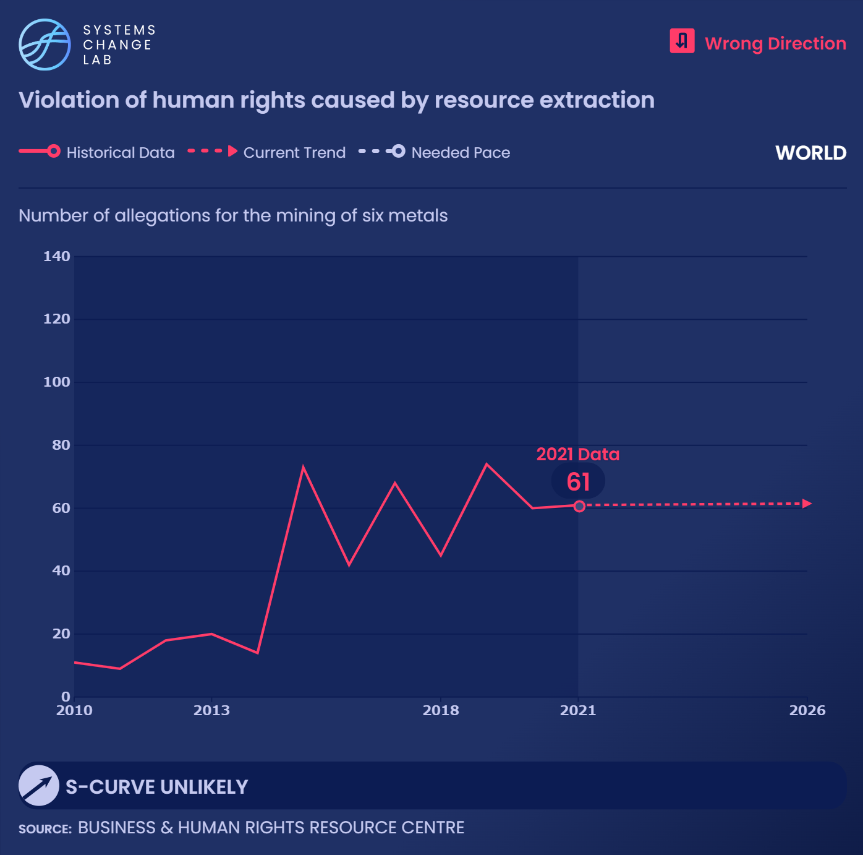
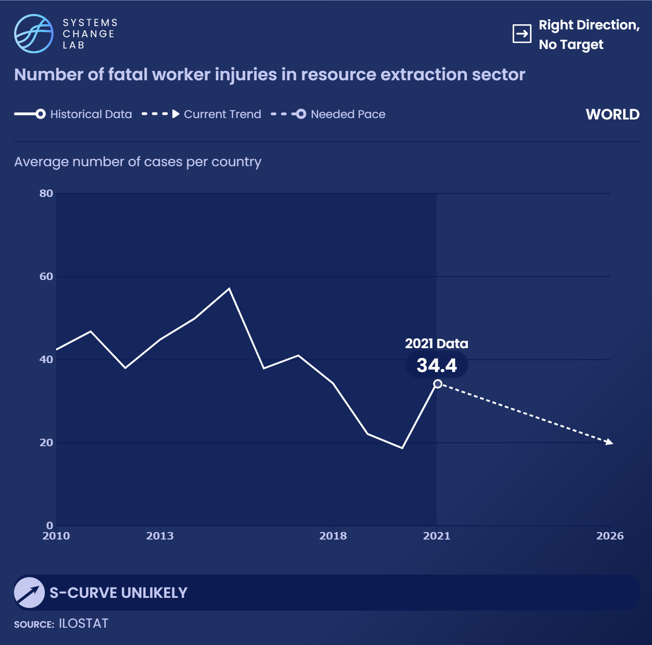
Resource extraction still causing social issues
Human rights violations
are unchanged
Child labor is unchanged
Fatal worker injuries are declining

Slide 19
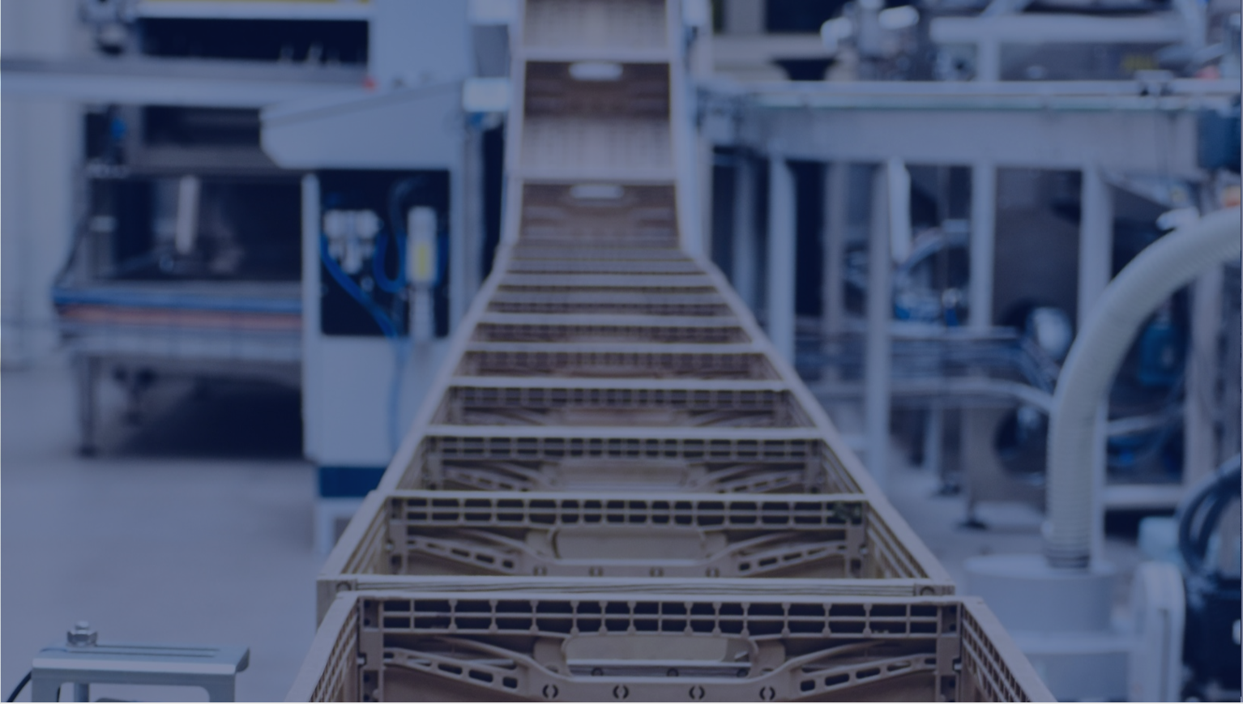
Make production more resource efficient
SHIFT
Notes:
Photo by Jiri Rezac / Climate Group: MUMBAI | INDIA MUMBAI 28MAY10 - Victoria train station in Mu… | Flickr

Slide 20
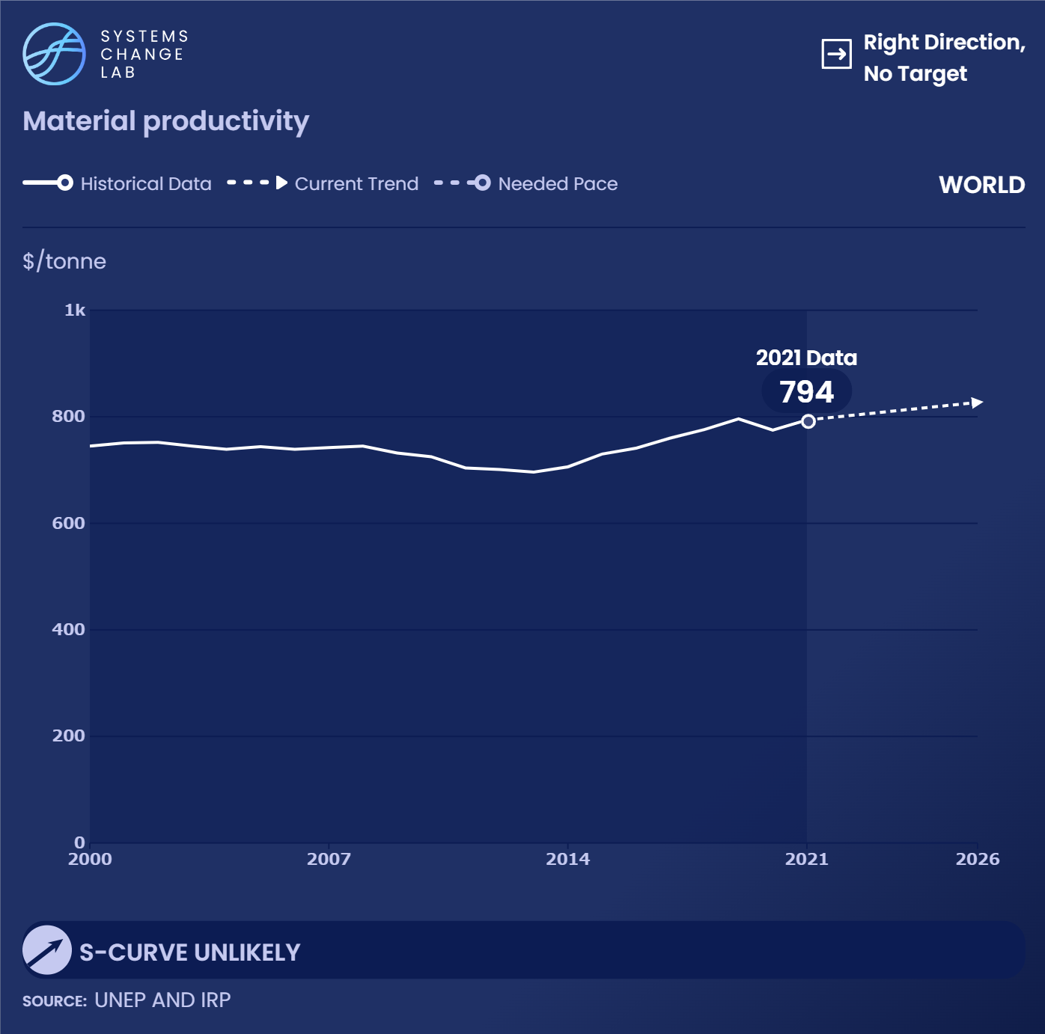
79%
Global material productivityincreased by only 6% while the global GDP increased by 79%.
6%
Material productivity
GDP
From 2000 to 2021

Slide 21
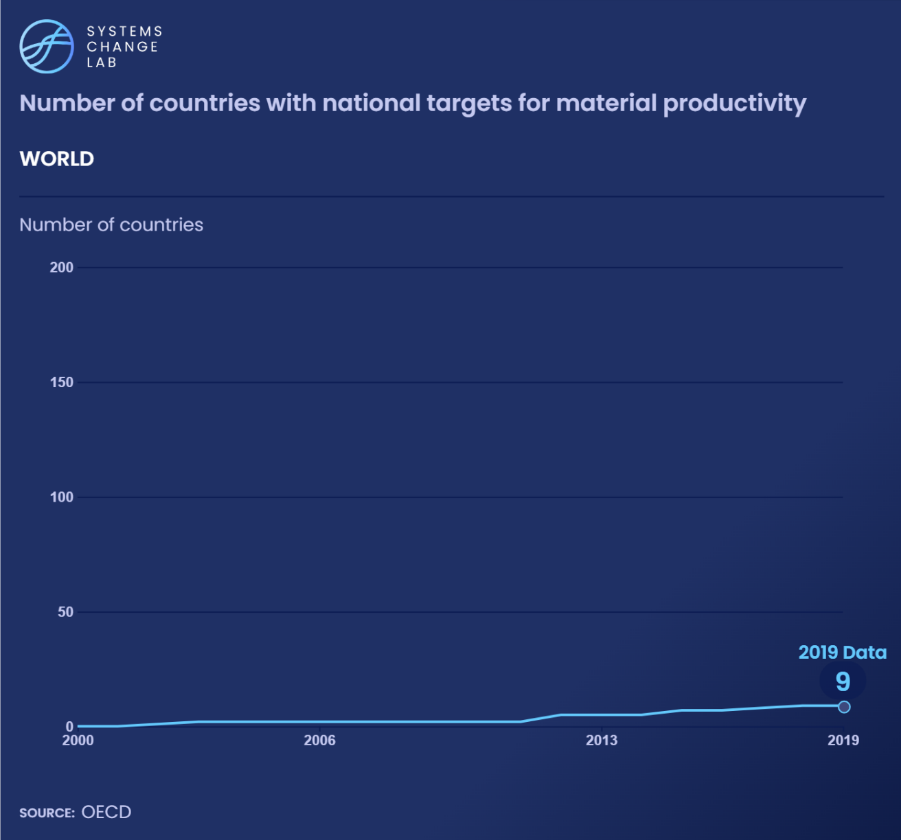
Target setting by countries and companies is one of many ways to increase material productivity

Slide 22
Use recycled, reused and renewable materials and components
SHIFT
Notes:
Photo by City Clock Magazine: Mexico City Walking (City Clock) | Pedestrians crossing the … | Flickr

Slide 23
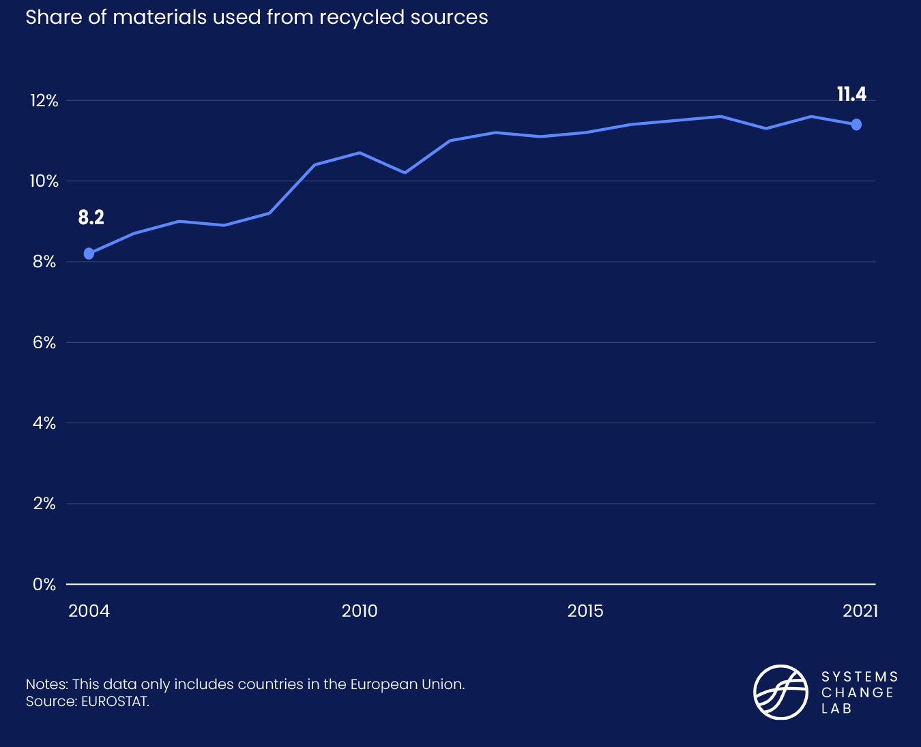
The share of recycled materials used must accelerate
Increasing the share of content that is reused, recycled, and renewable is critical in closing material loops.
In the European Union, the share increased from 11% in 2010 to only 12% in 2021.
Notes:
Increasing the share of content that is reused, recycled, and renewable is critical in closing material loops
In the European Union, the share increased from 11% in 2010 to only 12% in 2021.

Slide 24
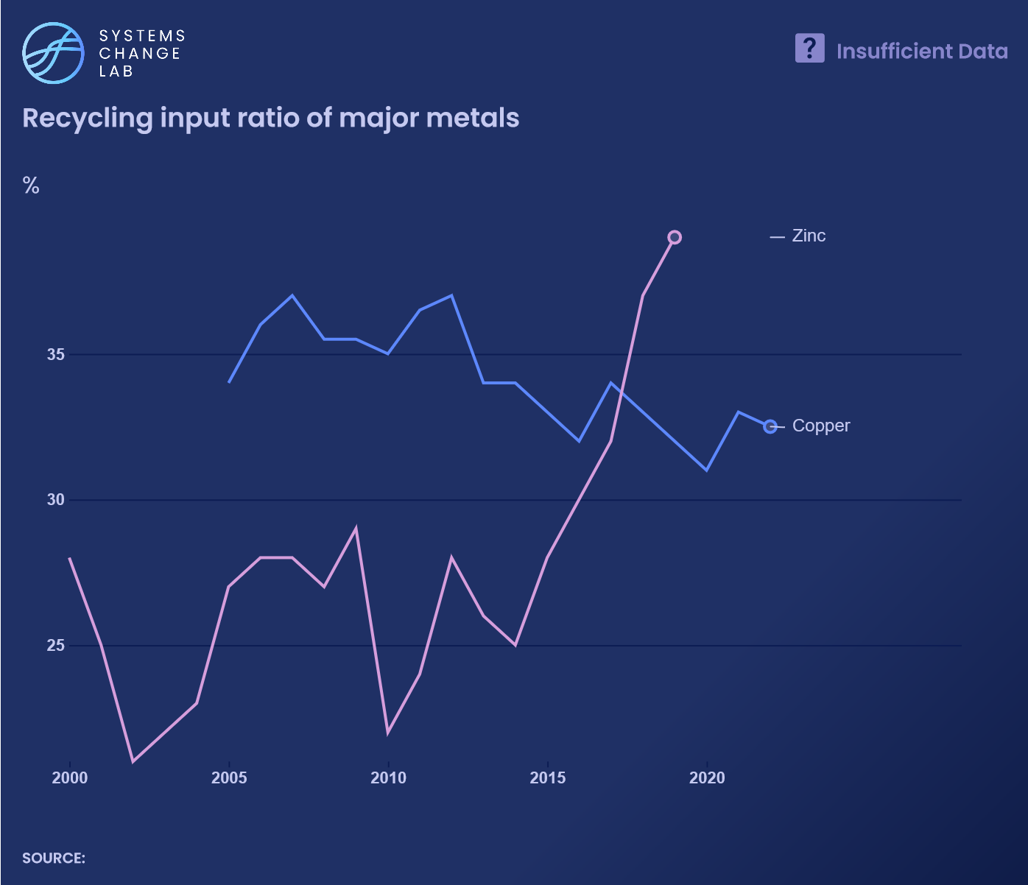
Metal consumption is outpacing the availability of recycled materials.
While has increased demand for copper, the share of recycled content in copper decreased from 37% in 2007 to 32.5% in 2022 — a trend that needs to reverse.

Slide 25
Use products longer
SHIFT
Notes:
Photo by City Clock Magazine: Mexico City Walking (City Clock) | Pedestrians crossing the … | Flickr

Slide 26
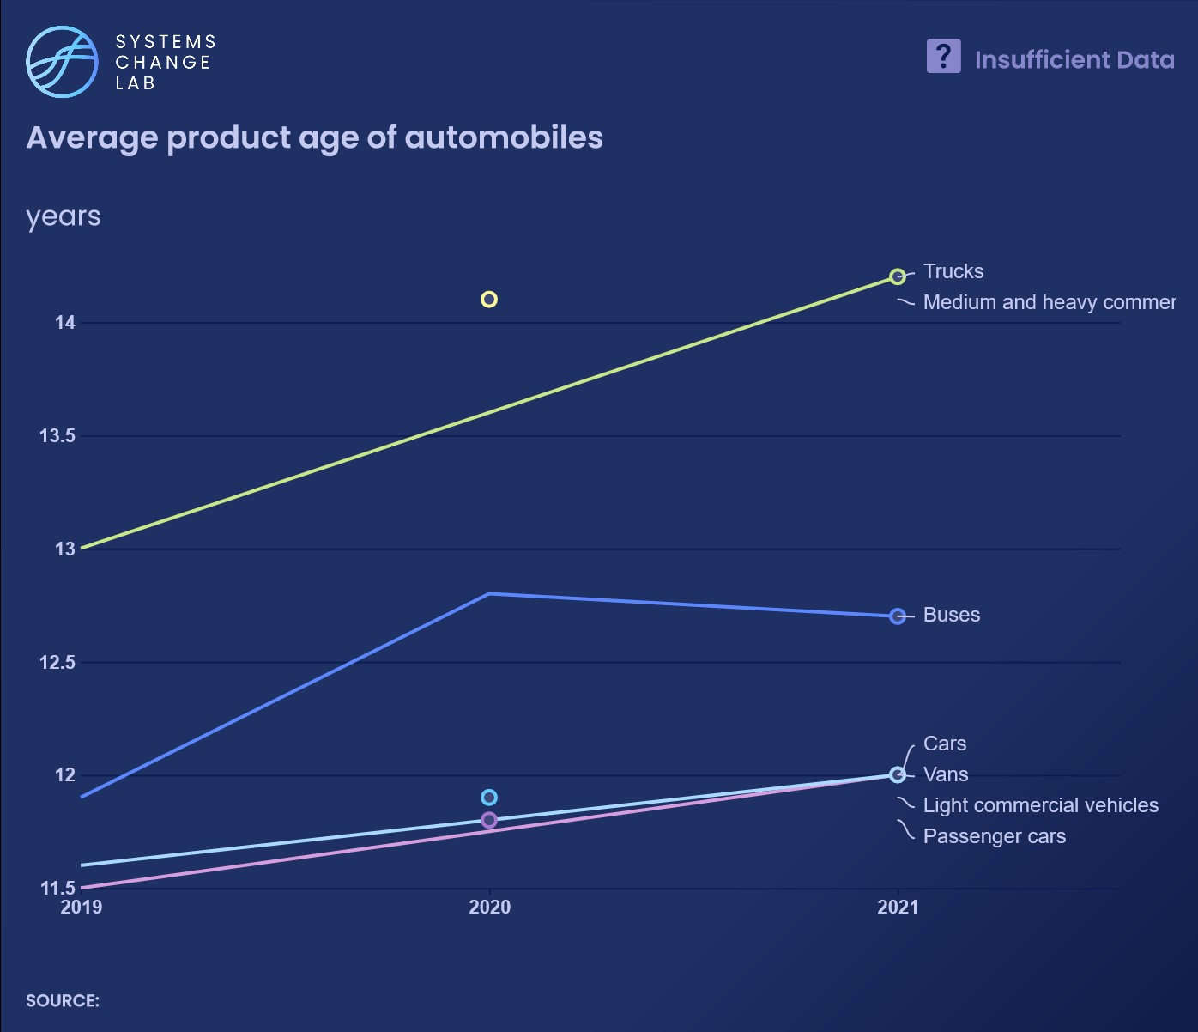
Products need to last longer and users need to use longer, though global data is limited
Notes:
Products need to last longer and users need to use longer.
Reliability, maintaining usefulness, and ease of repair are important factors
In general, global data is limited
Average age of automobiles is increasing
Actual lifetime of some electronic products is increasing; but still falls short of consumer expectation

Slide 27
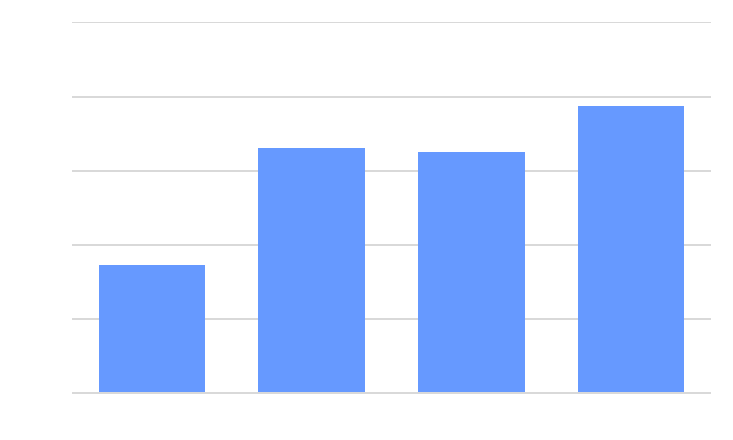
Ratio of actual lifetime to expected lifetime of products (European data)
Actual lifetime still falls short of consumer expectation.
Smartphone
TV
Washing Machine
Vacuum Cleaner
Source: European Environmental Agency (2020) Europe’s consumption in a circular economy: the benefits of longer-lasting electronics. The graph made by SCL.

Slide 28
Increase the quantity and value of resources recovered at end of use
SHIFT
Notes:
Photo by City Clock Magazine: Mexico City Walking (City Clock) | Pedestrians crossing the … | Flickr

Slide 29
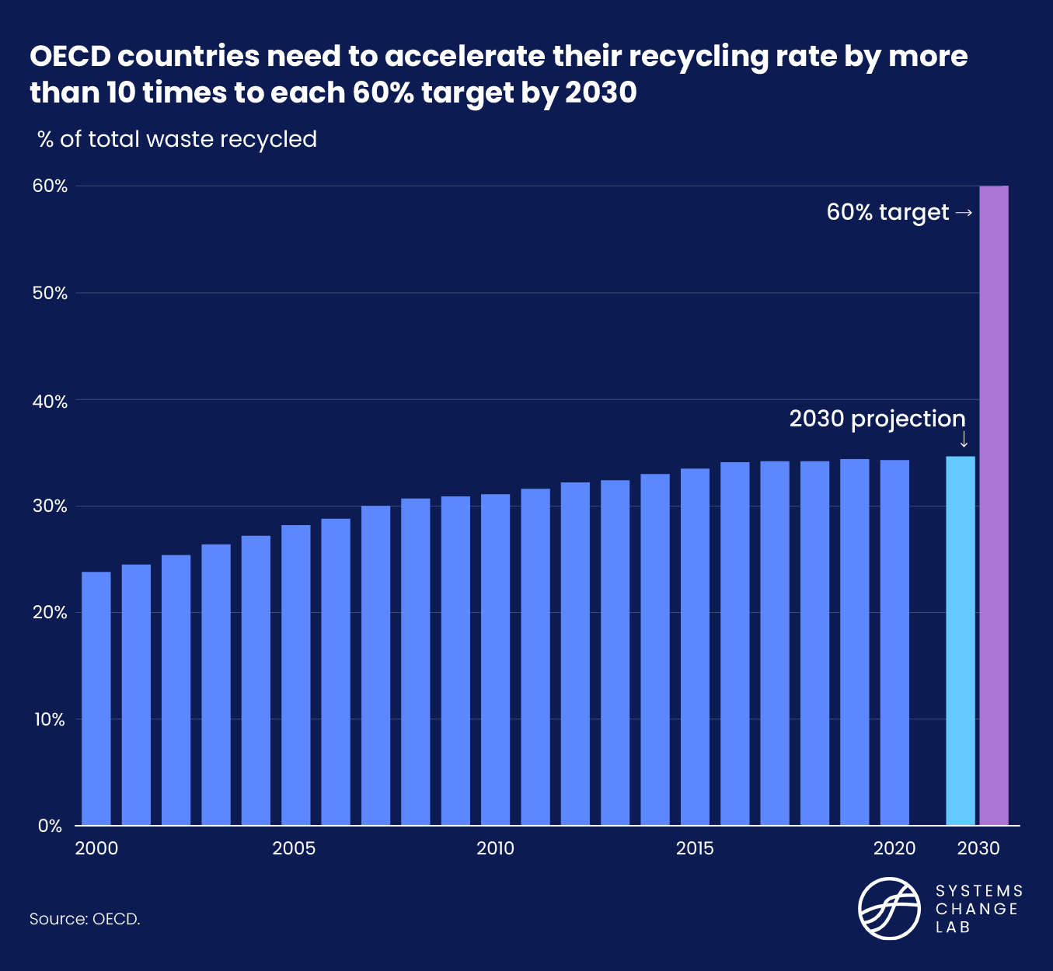
Recovery for reuse, recycling and regeneration is important to create materials for closing the loop.
Recycling rates are increasing but need to accelerate.

Slide 30
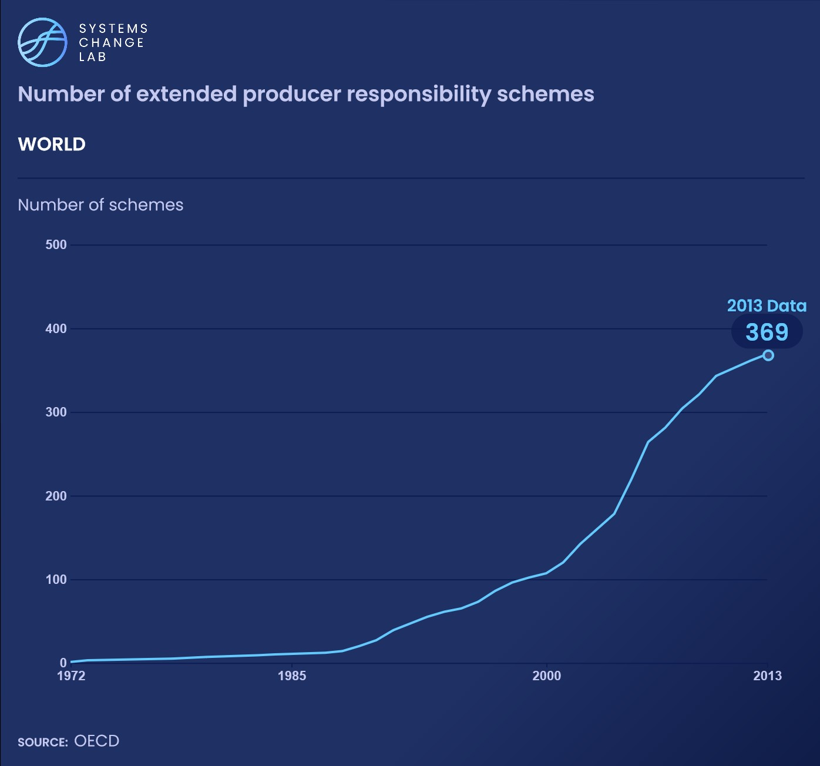
Different methods like extended producer responsibility, deposit-refund and pay-as-you-throw schemes are being used to encourage recovery for reuse and recycling.
Design for recycling needed to improve recycling potential.

Slide 31
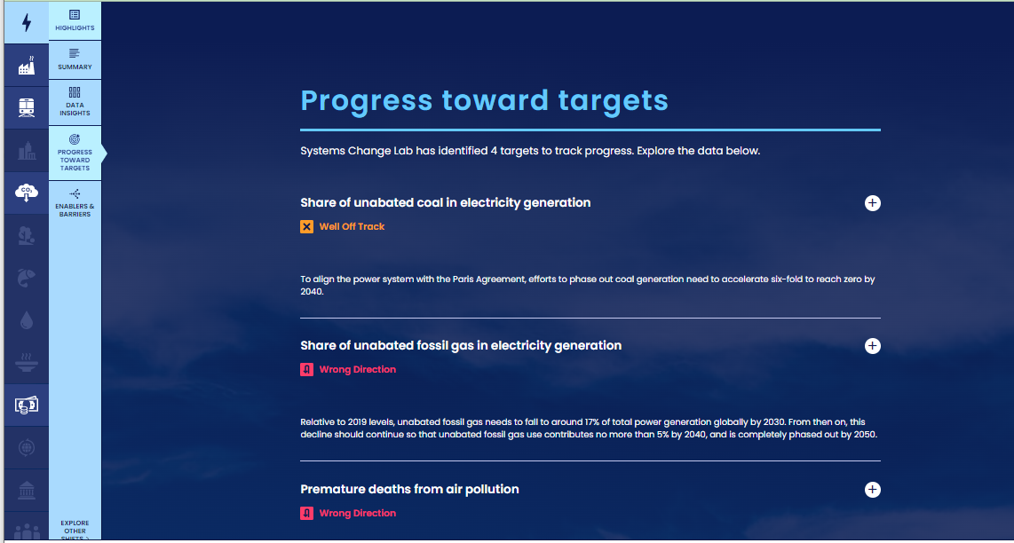
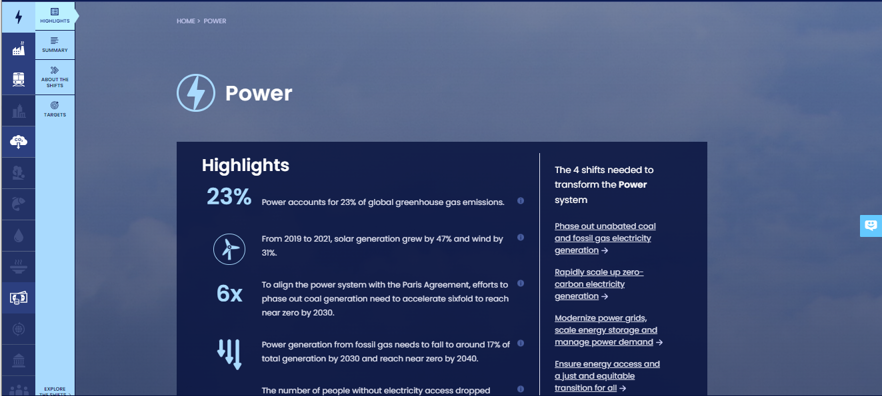
How to highlight a different indicator
Find your desired indicator on systemschangelab.org system pages
1. Select a system
3. Scroll down page to indicators and expand one
2. Select a shift

Slide 32
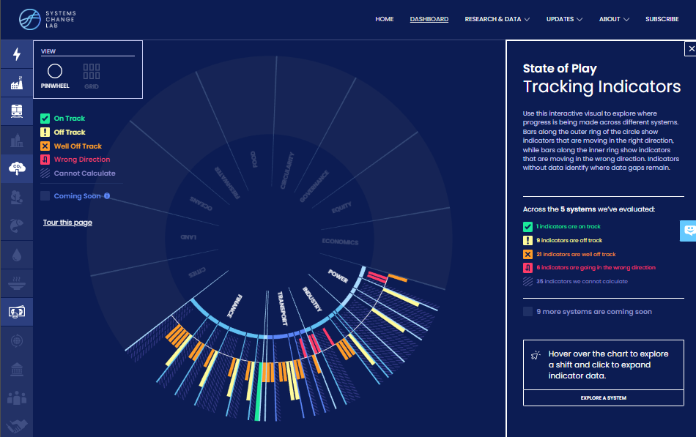
Alternatively, search for an indicator on the dashboard
1. Navigate to the dashboard
3. Search an indicator and then click explore data
2. Select grid view
4.
Notes:
Find your desired indicator on https://systemschangelab.org/
Look through System Page ( https://systemschangelab.org/power)
OR search the dashboard ( https://systemschangelab.org/dashboard) & select "EXPLORE DATA >" on your desired indicator

Slide 33
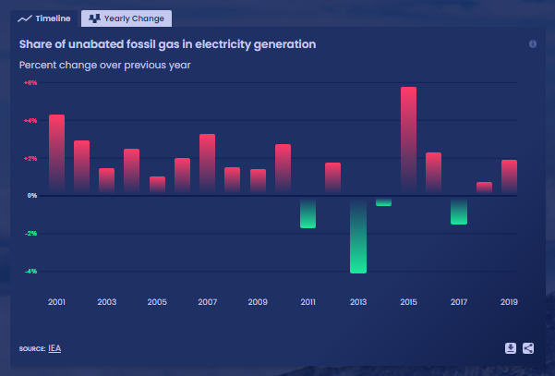
Pick a chart view and click the download button

Slide 34
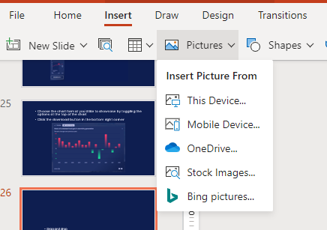
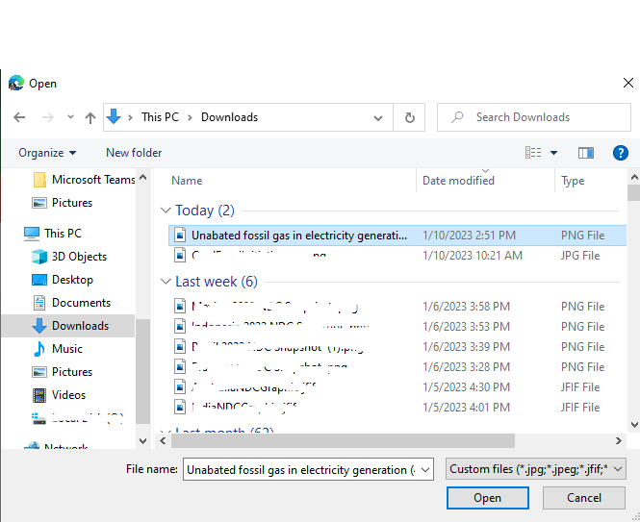
Next, add the chart to your slide deck
1. Select "Insert" and "Pictures" on the toolbar
2. Select chart from the downloads folder and open

Slide 35
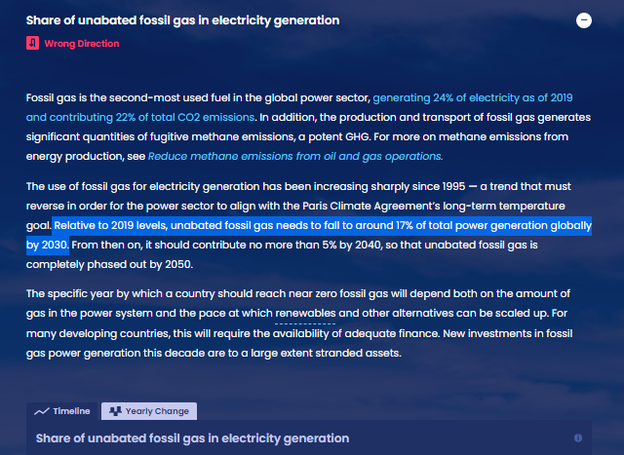
Add context from the indicator write-up as desired

Slide 36
For more information
VISIT: SYSTEMSCHANGELAB.ORG/CIRCULAR-ECONOMY
EMAIL: CONTACT@SYSTEMSCHANGELAB.ORG

