Slide 1
Buildings
Last updated December 2024 | systemschangelab.org/buildings
Notes:
Photo by Kevin Matos via Unsplash: https://unsplash.com/photos/low-angle-photography-of-four-high-rise-buildings-Nl_FMFpXo2g

Slide 2
Systems Change Lab
It’s time to change the way we think about changing the world.
Systems Change Lab monitors, learns from and mobilizes action toward the transformational shifts needed to protect both people and the planet.
The data platform identifies and tracks key shifts in our global systems that, when achieved together, can spur transformational change.

Slide 3
Interconnected systems
Power
Industry
Transport
Cities
Buildings
Carbon Removal
Land & Forests
Ocean
Management
Freshwater
Food &
Agriculture
Finance
Circular
Economy
Governance
Social Inclusion & Equity
Economics

Slide 4
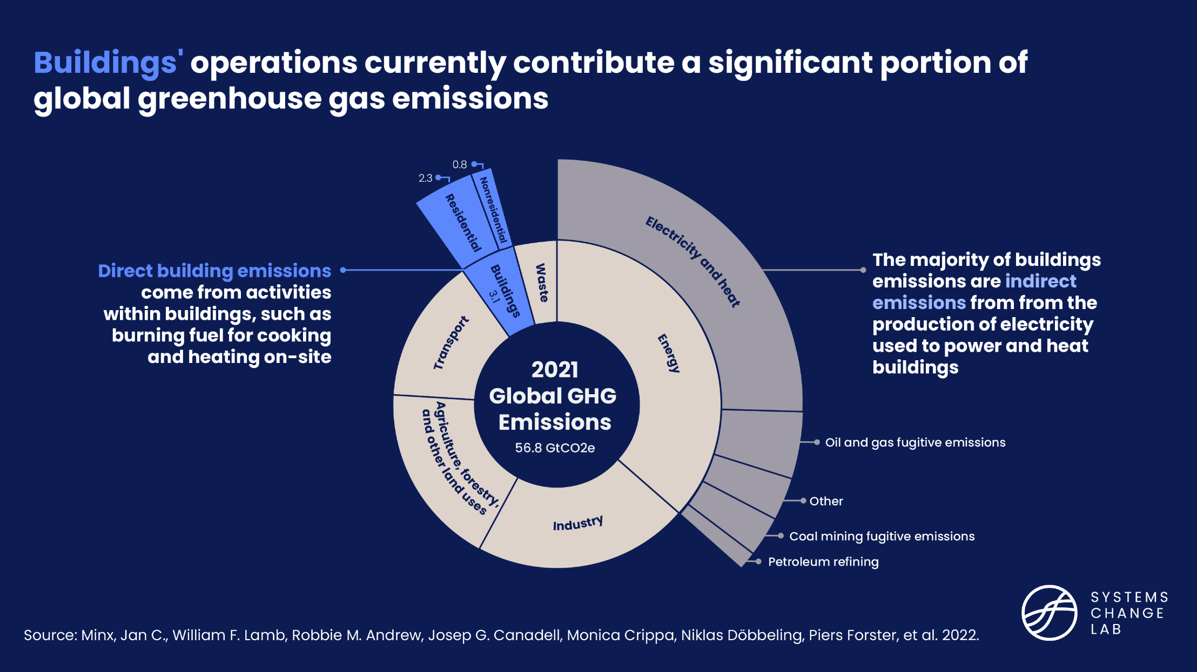
The built environment
Add buildings emissions graphic

Slide 5
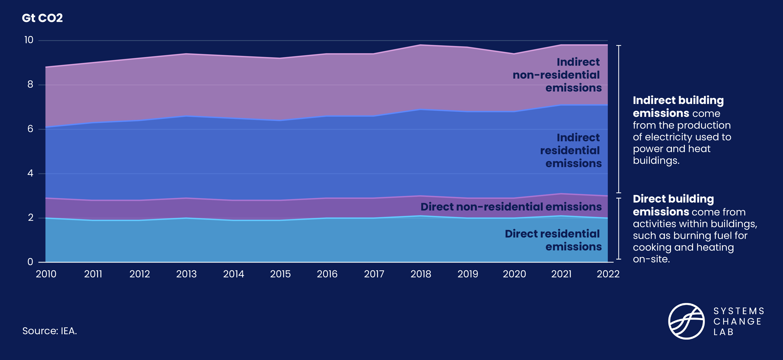
Indirect emissions make up 75% of buildings’ CO2 emissions
Add buildings emissions graphic

Slide 6
The three shifts needed to transform the buildings system
Construct zero-carbon buildings
Decarbonize building energy use
Optimize building energy consumption
Notes:
Construct zero-carbon buildings
The construction of new buildings contributes 10% of global carbon dioxide emissions. Addressing the emissions embodied in building materials provides a unique opportunity to drive progress across the buildings, circular economy, cities, power and industry systems. Embodied emissions can be reduced by changing the way we design and construct buildings, as well as improving material efficiency and using alternative building materials. This shift mainly applies to the formal housing sector, with different considerations for informal construction.
Optimize building energy consumption
Energy demand from buildings can be reduced through changes in occupant behavior, passive design strategies and the use of energy-efficient appliances and equipment. In addition to mitigating climate change, reducing the energy intensity of buildings can provide more comfortable living and working spaces, lessen energy poverty and increase energy resiliency, energy security and price stability, while also creating jobs.
Decarbonize building energy use
Buildings use energy for services, including heating, cooling, cooking, lighting, powering electronics and appliances, and much more. Achieving a 1.5 degrees C future will require these services to be delivered by highly efficient systems powered by zero-carbon electricity.
Photo by Blake Wheeler via Unsplash: https://unsplash.com/photos/aerial-photography-houses-zBHU08hdzhY

Slide 7
Highlights
The global floor area of buildings is expected to almost double from 2020 to 2050.
The average global carbon intensity of buildings has decreased since 2000, and although it is heading in the right direction, progress need to increase 4x to achieve the 2030 target.
Heat pumps are a key technology for decarbonizing heating and encouragingly, the number installed globally increased to roughly 180 million in 2020.
The construction sector generates one-third of the world’s solid waste.
The energy intensity of building operations declined by 5% from 2018 to 2022 but should decrease three times faster to meet 2030 climate targets.

Slide 8
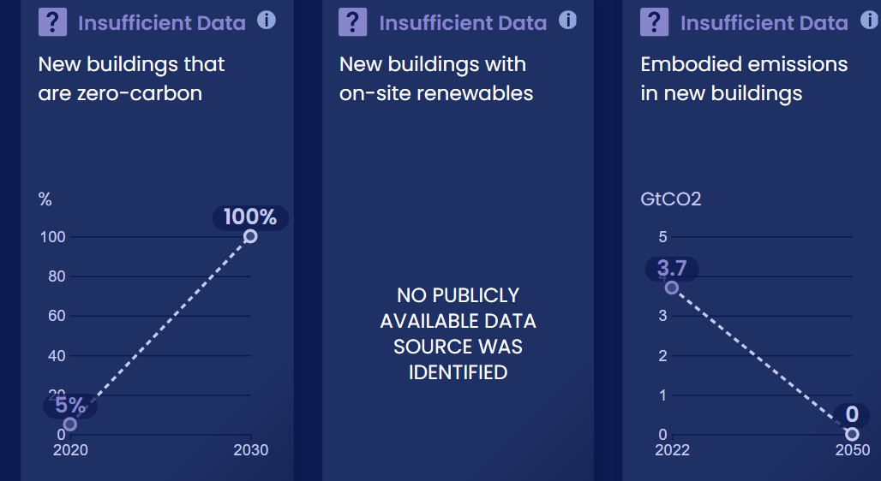
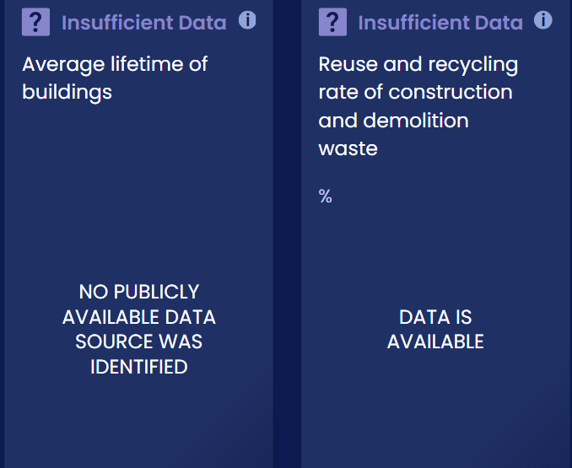
Progress toward targets
In this system, we have identified 10 outcome indicators. Out of the 10 targets we've evaluated, 4 have available data and benchmarks. Of these, all 4 are moving in the right direction, but 0 are on track.

Slide 9
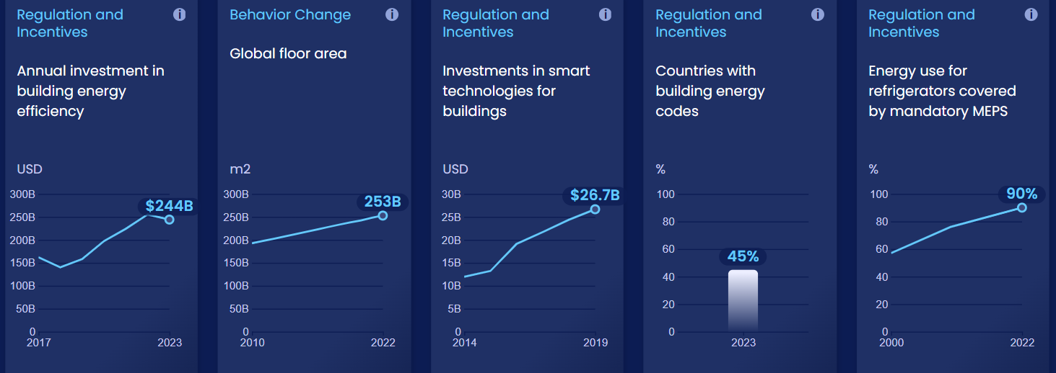
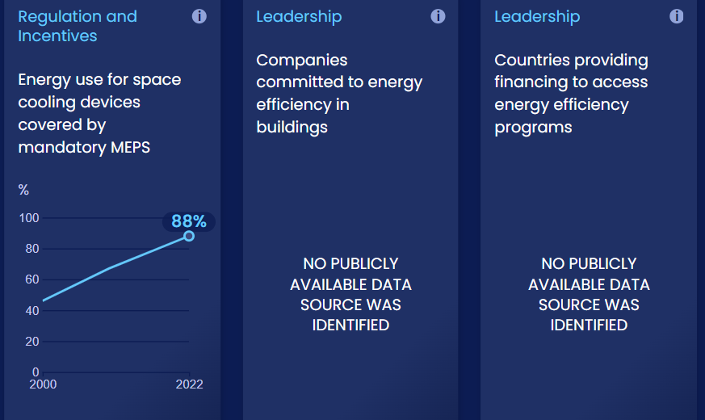
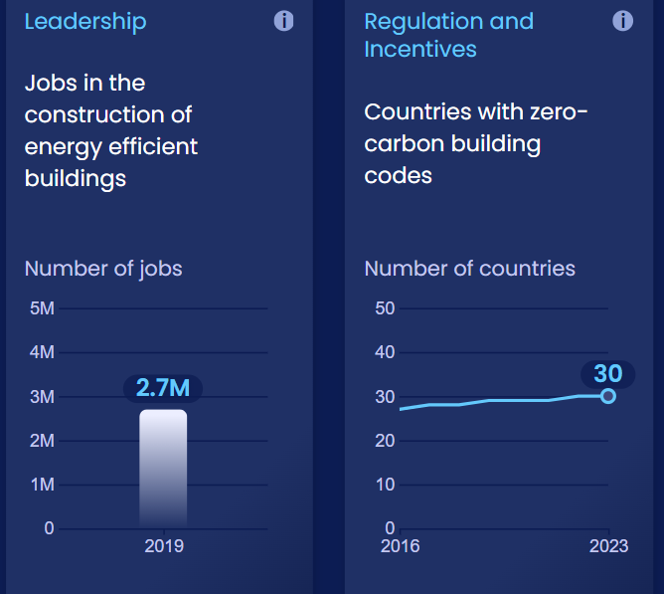
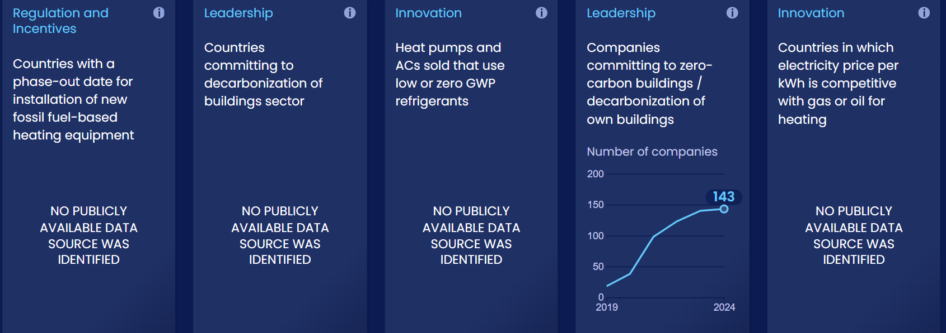
Enablers and barriers
In this system, we have identified 25 enablers and barriers to change.

Slide 10
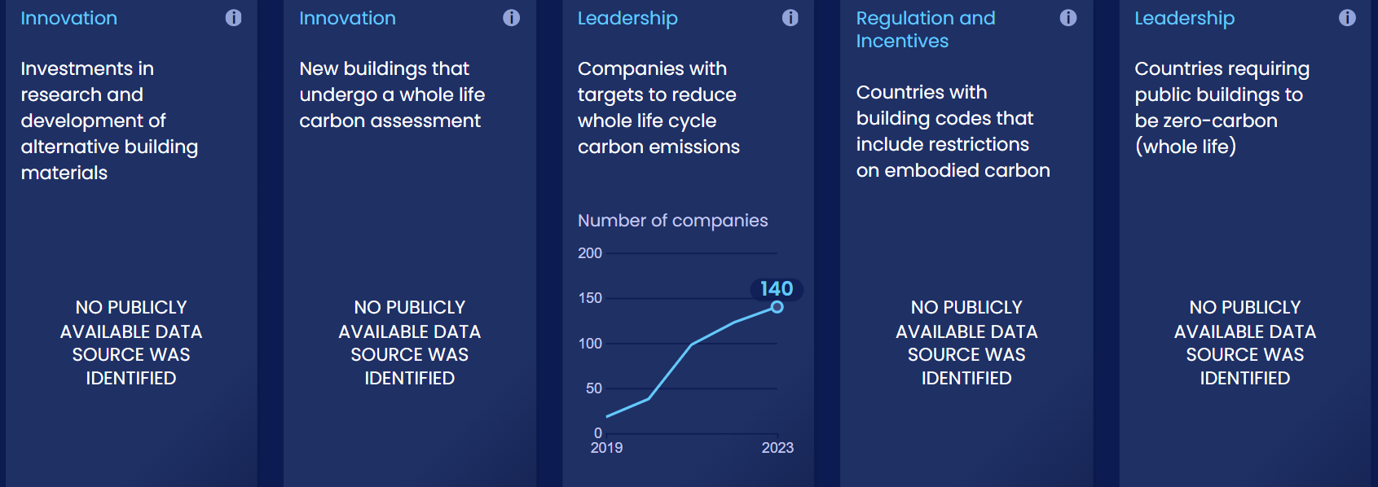
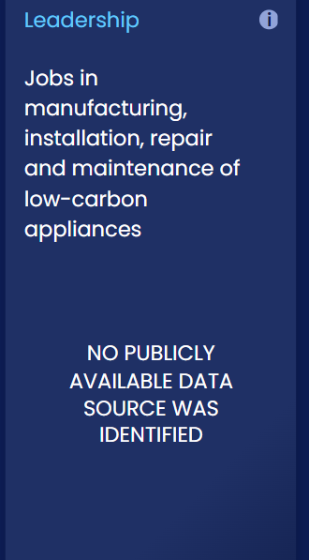
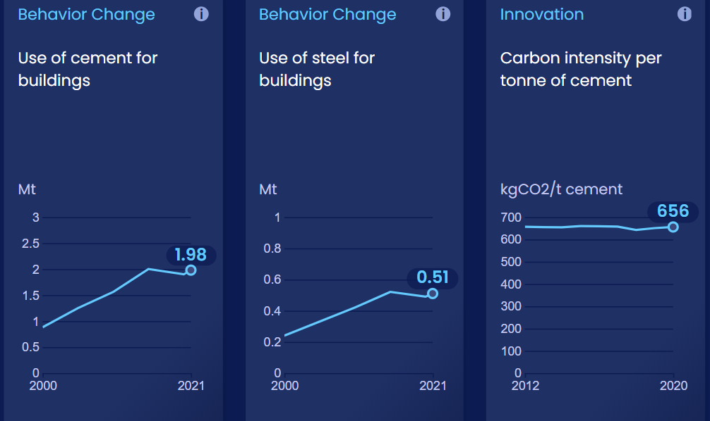
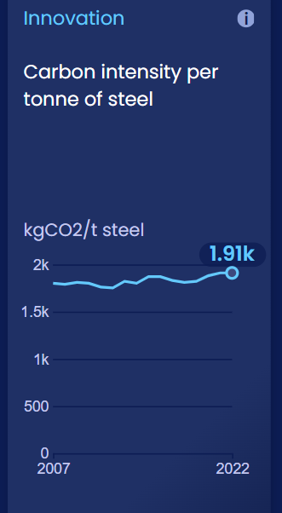
Enablers and barriers

Slide 11
Construct zero-carbon buildings
SHIFT
Notes:
Photo by Zac Wolf: https://unsplash.com/photos/shallow-focus-photo-of-gray-concrete-building-under-cloudy-sky-a5cTQOYfuwc?utm_content=creditCopyText&utm_medium=referral&utm_source=unsplash

Slide 12
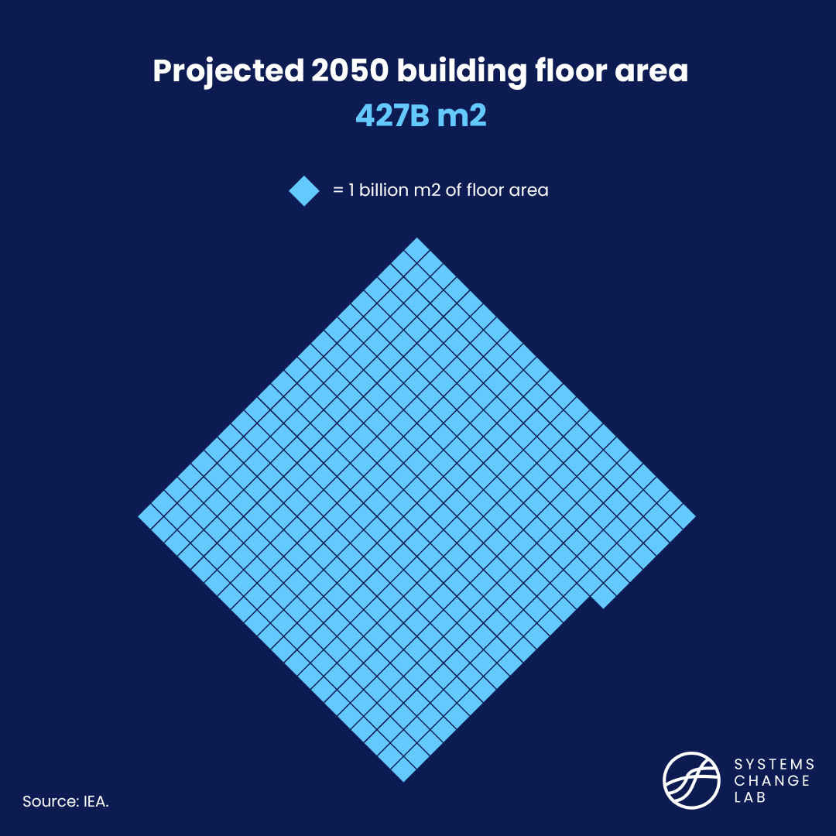
Global floor area of buildings is expected to double by 2050
Notes:
The demand for energy-intensive materials has increased and rising urbanization and the need to build infrastructure is likely to drive the demand further. As demand for energy-intensive materials continues to rise, it is necessary to promote greater material efficiency and circular business strategies, which have lagged as a policy priority, to slow down the demand growth.
Demand for industrial materials such as cement and steel, which are the building blocks of our economy, tends to increase with rising urbanization, standard of living, and population. Global demand for cement more than doubled, and demand for steel nearly doubled.
Emerging economies are likely to experience higher growth in material use in the coming decades. Demand for steel and cement is also likely to increase in response to the massive expansion of clean energy and transport infrastructure that will be needed for a low-carbon future.
Due to the lack of publicly available data and appropriate Paris-compatible targets, we can’t calculate an acceleration factor or evaluate whether this indicator is on track.

Slide 13
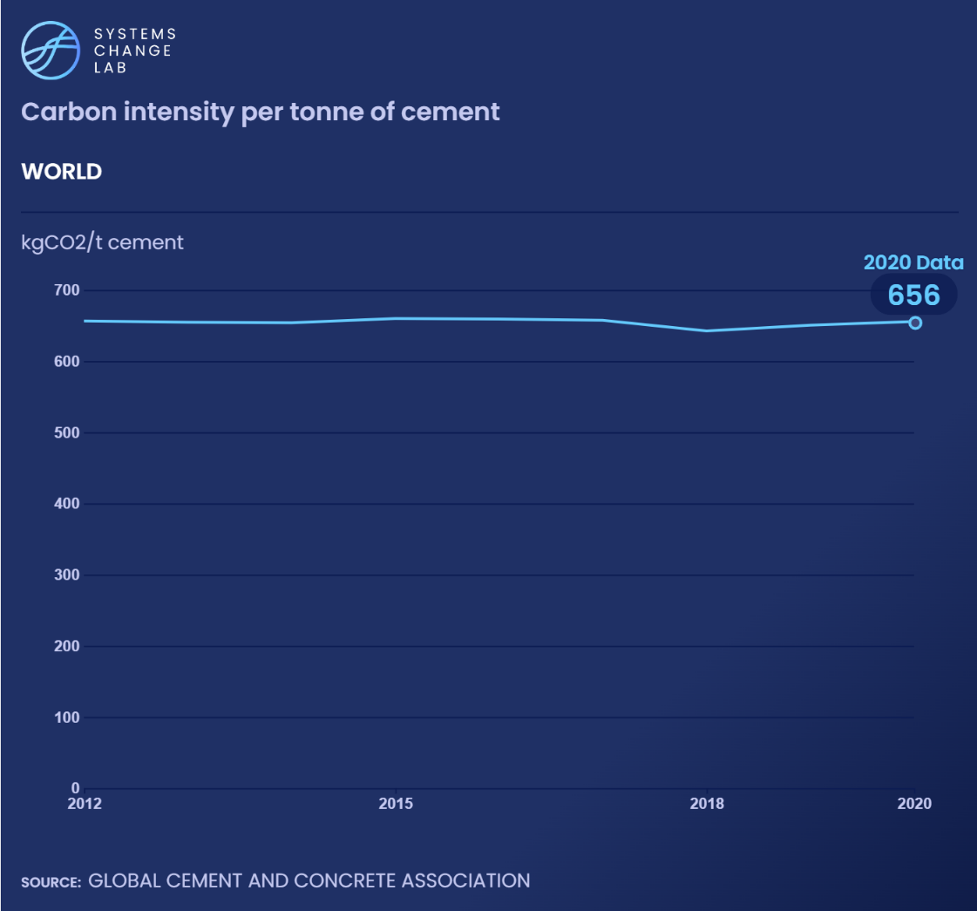
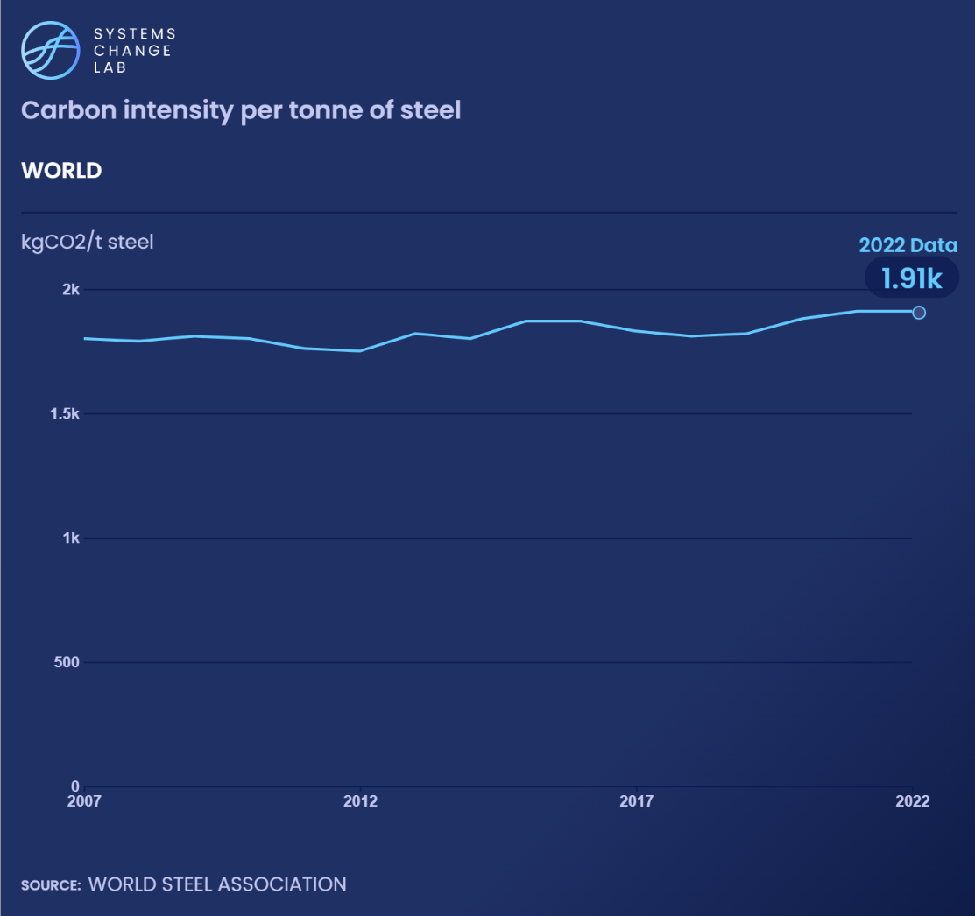
Decarbonizing cement and steel can curb buildings emissions
Notes:
The demand for energy-intensive materials has increased and rising urbanization and the need to build infrastructure is likely to drive the demand further. As demand for energy-intensive materials continues to rise, it is necessary to promote greater material efficiency and circular business strategies, which have lagged as a policy priority, to slow down the demand growth.
Demand for industrial materials such as cement and steel, which are the building blocks of our economy, tends to increase with rising urbanization, standard of living, and population. Global demand for cement more than doubled, and demand for steel nearly doubled.
Emerging economies are likely to experience higher growth in material use in the coming decades. Demand for steel and cement is also likely to increase in response to the massive expansion of clean energy and transport infrastructure that will be needed for a low-carbon future.
Due to the lack of publicly available data and appropriate Paris-compatible targets, we can’t calculate an acceleration factor or evaluate whether this indicator is on track.

Slide 14
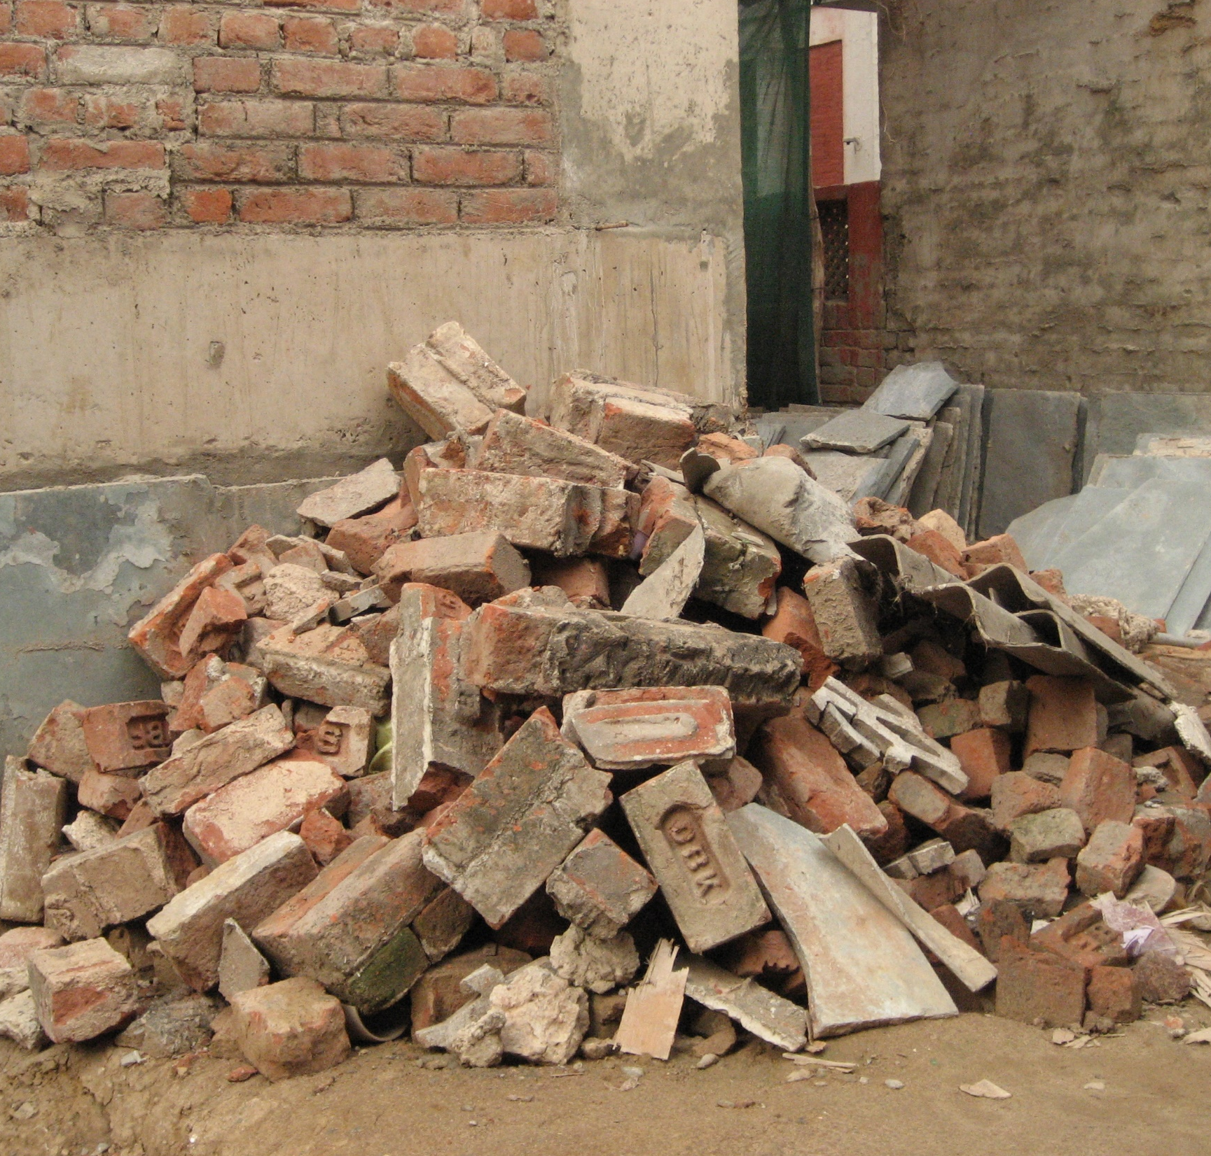
The reuse and recycling of construction and demolition waste can help reduce the need for virgin materials such as concrete and steel for new buildings, as well as the emissions that would be generated from producing these materials.
Notes:
Photo by Housing Revolution team via Flickr: https://www.flickr.com/photos/housingrevolution/5923103180/in/photolist-a2psdC-7QRzMR-vEonME-AL8keS-qGyNkU-2gcEuoi-FdFXdL-i7BgeR-Ded8b-E3zh9H-2iC5EbB-W61rLT-2jeKaM4-7SBPUJ-aoTQJD-z5QKts-pkqhHg-2fjGeH8-2k8P7ED-2hvn15Z-r1NJWa-BWL7xo-TSRtvu-2cWghhe-VajT32-BPto8U-znqHGe-TSRtVN-2hvoiz6-2jVZTha-z5QjaG-E6qhUM-nPRQwf-6pMXoe-27as1Zu-7Tx3yN-2hvr5ws-7AsH4f-2nbAAkb-SpEDQR-6yDXBN-SQsgtu-ev2ej8-h9A9wZ-q5FS1F-h9yUk7-a2pq3u-ehXkNn-mj9ezX-2meyKgE
Since we're evaluating global data, cement consumption is assumed to be equal to production. Cement production is a carbon-intensive process that accounts for about 7% of global CO2 emissions. World cement production has been increasing steadily, even growing slightly in 2020 during the pandemic.
Given its limited international trade, cement consumption is assumed to be equal to production. And since 2000, global cement production has almost tripled; in the past decade, it increased by 25%, from 3,280 Mt in 2010 to 4,100 Mt in 2019. Among the top consumers and producers are China (55% of global production) and India (8%), followed by Vietnam, the United States, Turkey and Indonesia (each at 2% or less).
Due to the lack of appropriate Paris-compatible targets, we can’t calculate an acceleration factor or evaluate whether this indicator is on track.

Slide 15
Optimize building energy consumption
SHIFT
Notes:
Photo by Tommy Kwak: https://unsplash.com/photos/brown-and-white-houses-on-green-grass-field-during-daytime-jX5Nx1kSM8I?utm_content=creditCopyText&utm_medium=referral&utm_source=unsplash

Slide 16
The energy intensity of buildings must decline 3x faster
Notes:
The demand for energy-intensive materials has increased and rising urbanization and the need to build infrastructure is likely to drive the demand further. As demand for energy-intensive materials continues to rise, it is necessary to promote greater material efficiency and circular business strategies, which have lagged as a policy priority, to slow down the demand growth.
Demand for industrial materials such as cement and steel, which are the building blocks of our economy, tends to increase with rising urbanization, standard of living, and population. Global demand for cement more than doubled, and demand for steel nearly doubled.
Emerging economies are likely to experience higher growth in material use in the coming decades. Demand for steel and cement is also likely to increase in response to the massive expansion of clean energy and transport infrastructure that will be needed for a low-carbon future.
Due to the lack of publicly available data and appropriate Paris-compatible targets, we can’t calculate an acceleration factor or evaluate whether this indicator is on track.

Slide 17
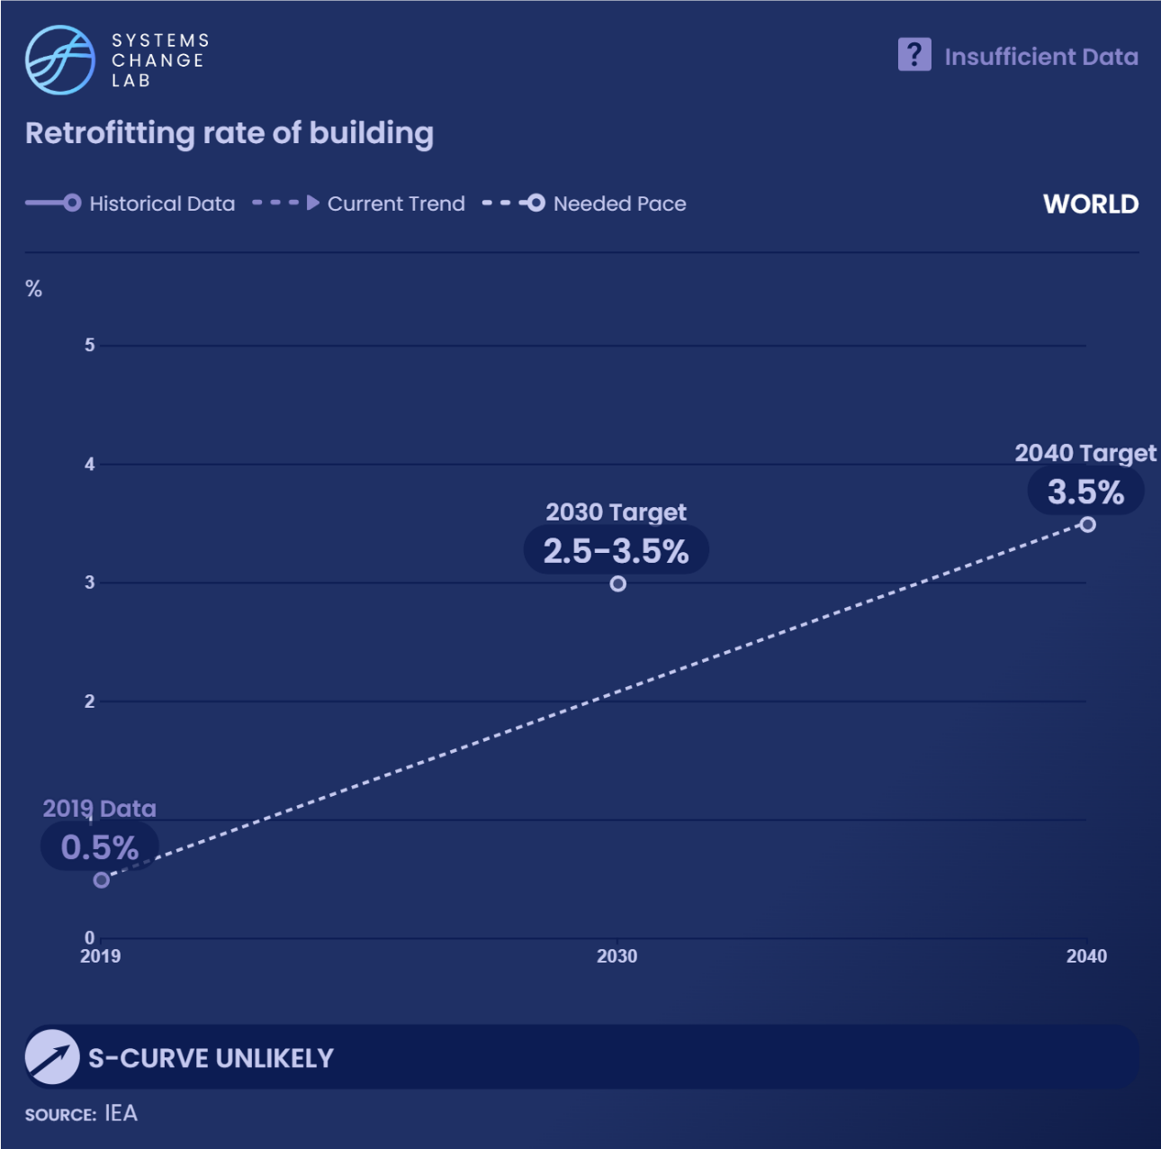
Existing buildings need to undergo deep retrofits to be zero-carbon in operation by 2050. Currently, less than 1% of buildings are renovated each year, which needs to increase to between 2.5% and 3.5% per year by 2030.
Notes:
Efficiency gains and emissions reductions from industrial retrofits in the near term should be balanced with adoption of new decarbonization technologies in the long term.
The industry sector’s energy use was responsible for 38% of global final energy use in 2020. From 2010 to 2019, industry energy consumption increased by an average of 1% every year. The continued rise in industrial production from energy-intensive industry subsectors is one of the key drivers of energy consumption growth over the past decade.
Deploying the best available technologies, upgrading industrial equipment, and increasing investments in efficiency measures can help limit the growth in energy use by lowering demand. Due to the lack of data and of appropriate Paris-compatible targets, we can’t calculate an acceleration factor or evaluate whether this indicator is on track. The chart shows data for the steel sector only.

Slide 18
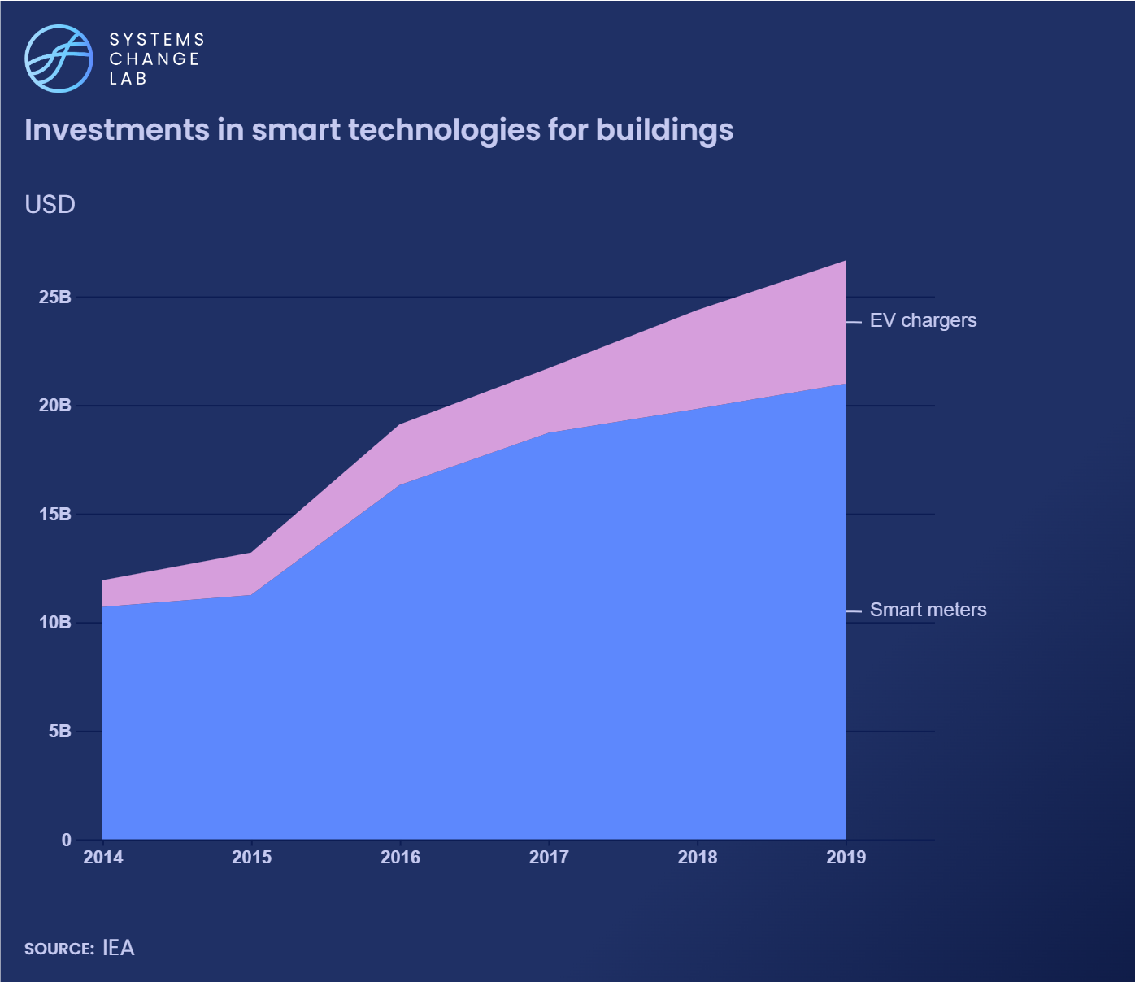
Investments in smart meters and electric vehicle chargers grew from $12 billion in 2014 to $27 billion in 2019. Increased deployment of these technologies can help buildings use energy more efficiently.
Notes:
Efficiency gains and emissions reductions from industrial retrofits in the near term should be balanced with adoption of new decarbonization technologies in the long term.
The industry sector’s energy use was responsible for 38% of global final energy use in 2020. From 2010 to 2019, industry energy consumption increased by an average of 1% every year. The continued rise in industrial production from energy-intensive industry subsectors is one of the key drivers of energy consumption growth over the past decade.
Deploying the best available technologies, upgrading industrial equipment, and increasing investments in efficiency measures can help limit the growth in energy use by lowering demand. Due to the lack of data and of appropriate Paris-compatible targets, we can’t calculate an acceleration factor or evaluate whether this indicator is on track. The chart shows data for the steel sector only.

Slide 19
Decarbonize building energy use
SHIFT
Notes:
Photo by Florencia Potter: https://unsplash.com/photos/white-and-beige-building-facade-pK0J0kFTiz8

Slide 20
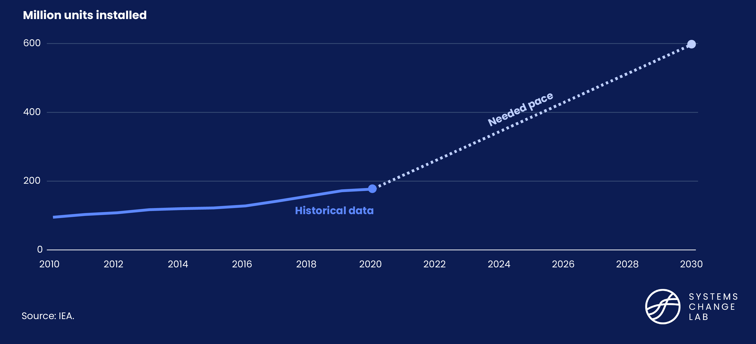
Despite progress, heat pump installation must accelerate
Notes:
According to announced low-carbon steel projects, 19 full-scale plants are planned to be put in operation by 2030, but that is still far from the 71 needed by 2030 to be Paris compatible. The number of low-carbon steel projects in the pipeline are increasing.
Because the production of low-carbon steel will require the development and application of new technology, tracking the number of announced low-carbon steel facilities provides an indication of how the sector is progressing. By zeroing in on the type of technologies being considered, we can evaluate the development of specific approaches.
The number of announced low-carbon steel projects has increased rapidly in recent years — nine in 2019, 21 in 2020 and 51 in 2021.

Slide 21
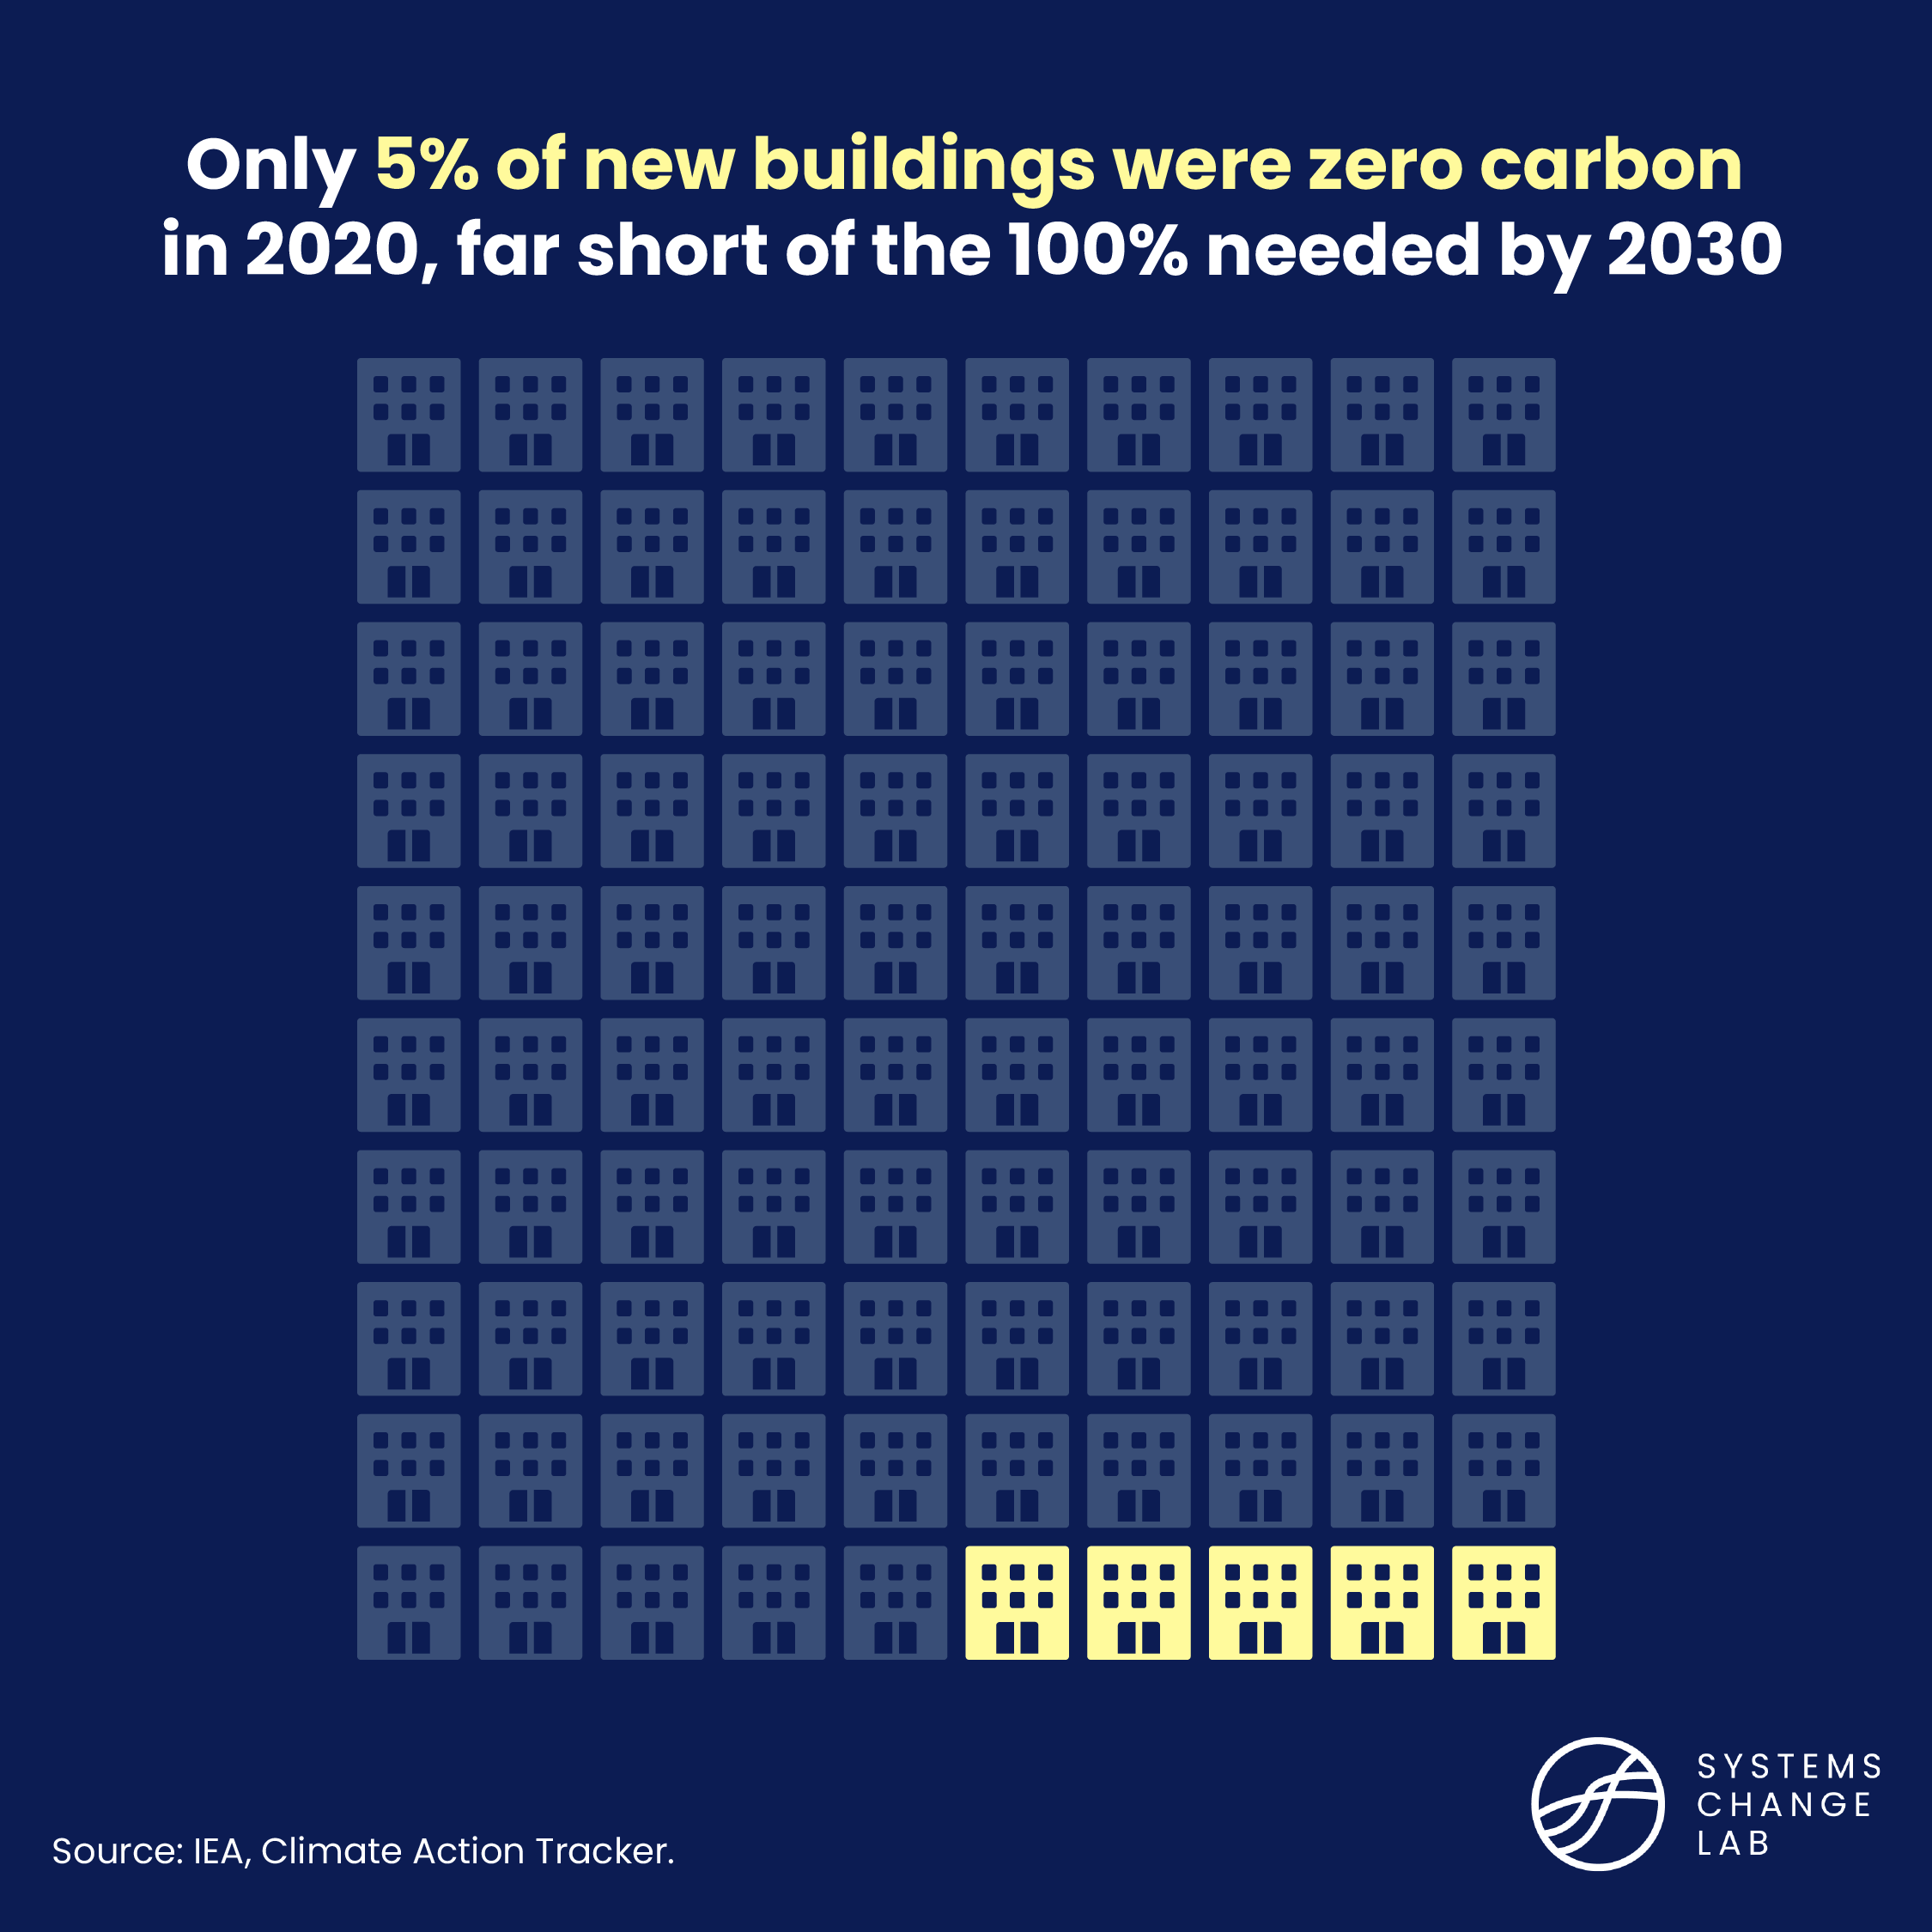
By 2030, 100% of new buildings should be zero-carbon
Notes:
The demand for energy-intensive materials has increased and rising urbanization and the need to build infrastructure is likely to drive the demand further. As demand for energy-intensive materials continues to rise, it is necessary to promote greater material efficiency and circular business strategies, which have lagged as a policy priority, to slow down the demand growth.
Demand for industrial materials such as cement and steel, which are the building blocks of our economy, tends to increase with rising urbanization, standard of living, and population. Global demand for cement more than doubled, and demand for steel nearly doubled.
Emerging economies are likely to experience higher growth in material use in the coming decades. Demand for steel and cement is also likely to increase in response to the massive expansion of clean energy and transport infrastructure that will be needed for a low-carbon future.
Due to the lack of publicly available data and appropriate Paris-compatible targets, we can’t calculate an acceleration factor or evaluate whether this indicator is on track.

Slide 22
In 2022, district heating provided about 9% of global heating demand for buildings and industry. However, 90% of district heating comes from fossil fuels.
Notes:
Electrifying industry offers significant potential for short-term emission reduction. The share of electricity in industry’s final energy demand is increasing steadily and needs to accelerate by a factor of 1.7 to reach 35% by 2030. Many current industrial processes are highly dependent on fossil fuels. Shifting to electric technologies can reduce this reliance and limit energy-related emissions from industry.
The share of electricity in the industry sector’s final energy demand grew from 26.9% to 28.4% between 2016 and 2020, an increase of almost 0.4 percent per year. If the trend continues, the global electrification rate will be off track to achieve the near term-target of 35% by 2030. To reach the 2030 target, the recent rate of change will need to accelerate by a factor of 1.7.

Slide 23
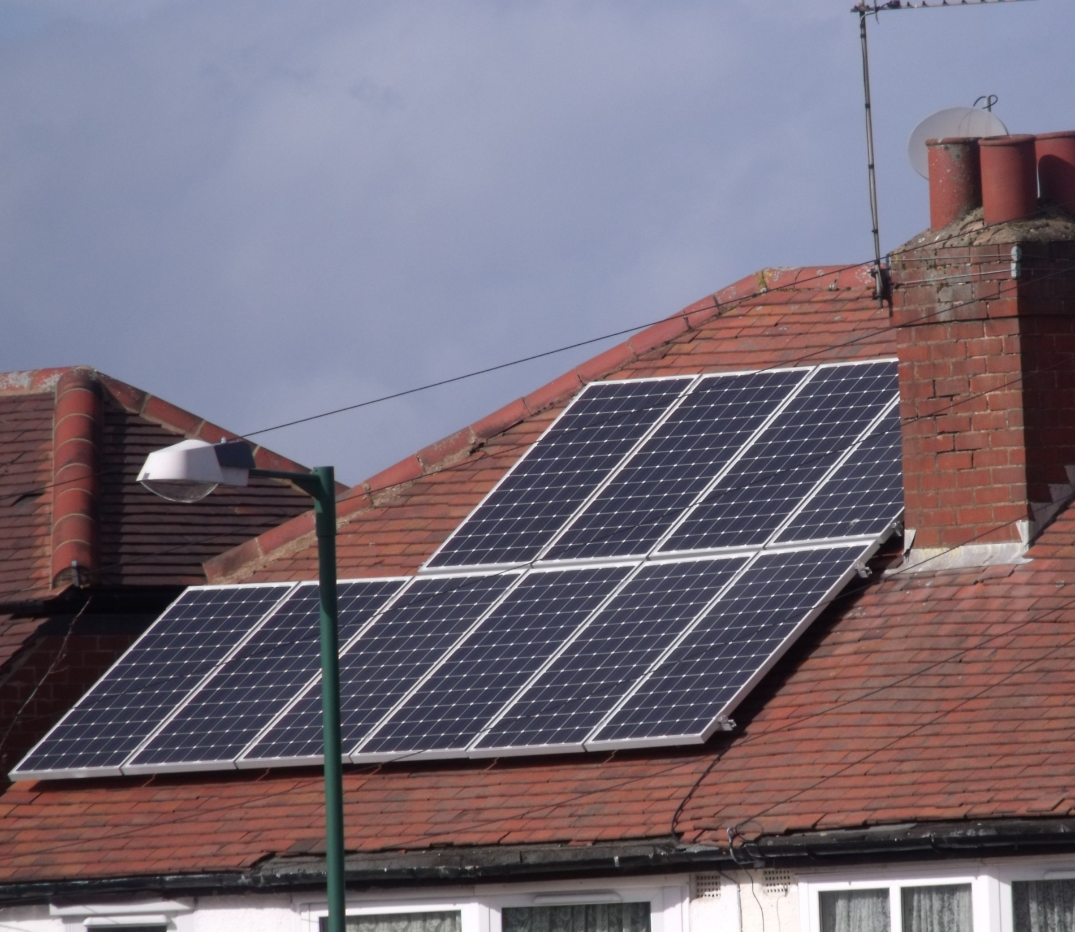
As of July 2024, 143 companies, 29 cities and 6 states and regions had pledged to decarbonize their buildings as fast as possible by 2030.
Notes:
Photo by Elliott Brown via Flickr: https://www.flickr.com/photos/ell-r-brown/6949115457/in/photolist-bA52Vt-NvPe3J-qBQyz-shXNCh-deyLve-75M8q8-aYFTRT-aoFjqQ-cebgus-xbeowW-cLtyH5-bddLtc-8fZ38a-8nBymR-NwbSM4-vSjzUR-dxjJZr-ayBg64-4yBxw6-fmZkQn-4oeXW-y848wY-9NmRPf-8vnTS1-deyLFk-aXU6h4-aYG7F4-3jk4Xn-dxqchY-eEuEew-HJ98qf-pPvdR3-aoCxZT-4r1RY1-7H911c-deyS8z-oH5ghj-q7f2cM-9Nj6mK-aPpbXa-bddNLc-4r1qUc-3gYgCS-2PtS44-gRYugM-ahrTZU-6Qmbra-dch4KR-h7FMav-dbCxrb
Cement production is a carbon-intensive process that accounts for about 7% of global CO2 emissions. World cement production has been increasing steadily, even growing slightly in 2020 during the pandemic.
Given its limited international trade, cement consumption is assumed to be equal to production. And since 2000, global cement production has almost tripled; in the past decade, it increased by 25%, from 3,280 Mt in 2010 to 4,100 Mt in 2019. Among the top consumers and producers are China (55% of global production) and India (8%), followed by Vietnam, the United States, Turkey and Indonesia (each at 2% or less).

Slide 24
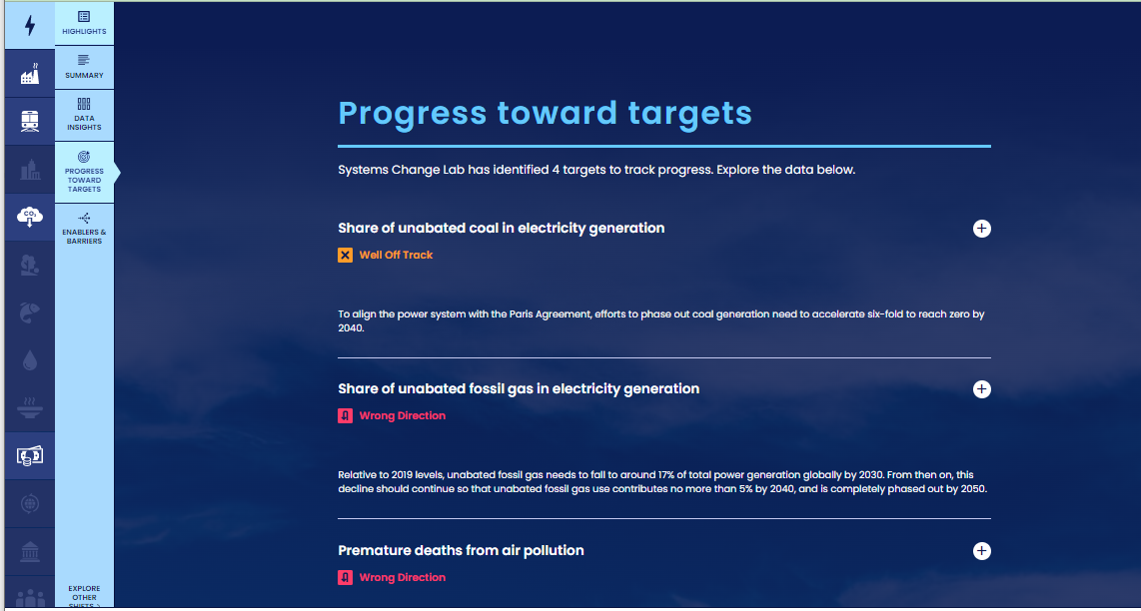
How to highlight a different indicator
Find your desired indicator on systemschangelab.org system pages
1. Select a system
3. Scroll down page to indicators and expand one
2. Select a shift

Slide 25
Alternatively, search for an indicator on the dashboard
1. Navigate to the dashboard
3. Search an indicator and then click explore data
2. Select grid view
4.
Notes:
Find your desired indicator on https://systemschangelab.org/
Look through System Page ( https://systemschangelab.org/power)
OR search the dashboard ( https://systemschangelab.org/dashboard) & select "EXPLORE DATA >" on your desired indicator

Slide 26
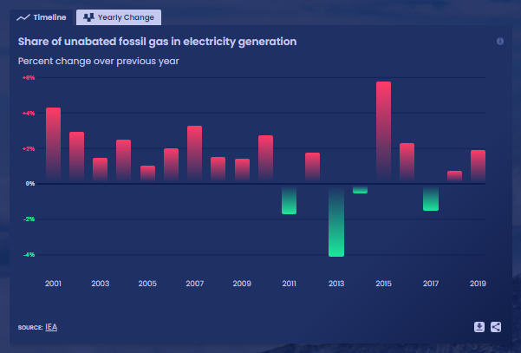
Pick a chart view and click the download button

Slide 27
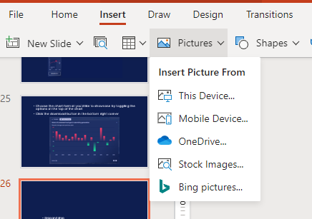
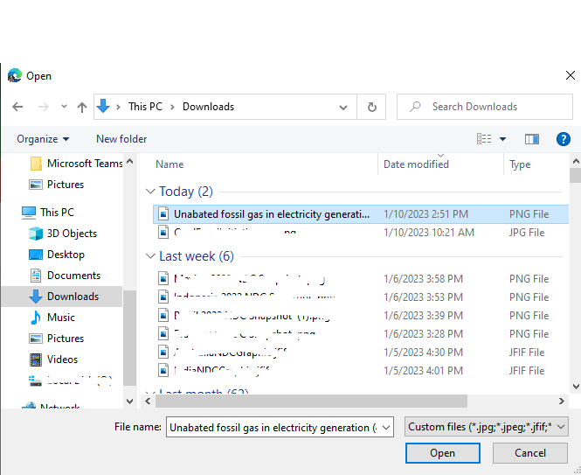
Next, add the chart to your slide deck
1. Select "Insert" and "Pictures" on the toolbar
2. Select chart from the downloads folder and open

Slide 28
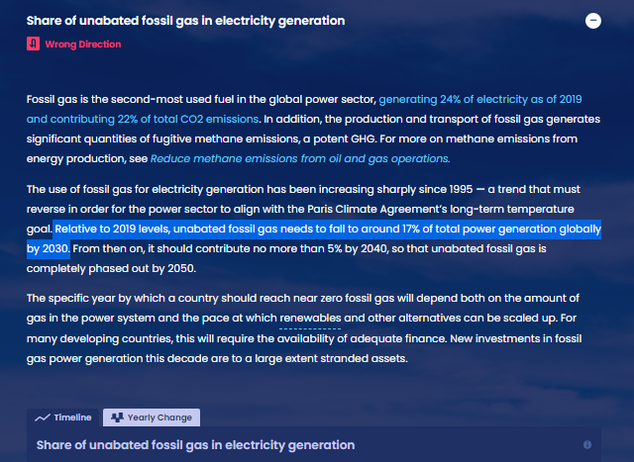
Add context from the indicator write-up as desired

Slide 29
For more information
VISIT: SYSTEMSCHANGELAB.ORG/BUILDINGS
EMAIL: CONTACT@SYSTEMSCHANGELAB.ORG

