Slide 1
Technological
Carbon Removal
Last updated August 2023 | systemschangelab.org/technological-carbon-removal
Notes:
Photo by Climeworks: https://www.dropbox.com/sh/gugqeqb3csawqdy/AADzUYTDVEbxXrA4ynjhSWHaa/Images/Climeworks%20direct%20air%20capture%20plant%20in%20Hinwil%2C%20Copyright%20Climeworks.jpg?dl=0

Slide 2
Systems Change Lab
It’s time to change the way we think about changing the world.
Systems Change Lab monitors, learns from and mobilizes action toward the transformational shifts needed to protect both people and the planet.
The data platform identifies and tracks key shifts in our global systems that, when achieved together, can spur transformational change.

Slide 3
Interconnected systems
Power
Industry
Transport
Cities
Buildings
Carbon Removal
Land & Forests
Ocean
Management
Freshwater
Food
Finance
Circular
Economy
Governance
Social Inclusion & Equity
New
Economics

Slide 4
SHIFT
Scale up technological carbon removal
Notes:
Photo by Climeworks: https://www.dropbox.com/sh/gugqeqb3csawqdy/AADzUYTDVEbxXrA4ynjhSWHaa/Images/Climeworks%20direct%20air%20capture%20plant%20in%20Hinwil%2C%20Copyright%20Climeworks.jpg?dl=0

Slide 5
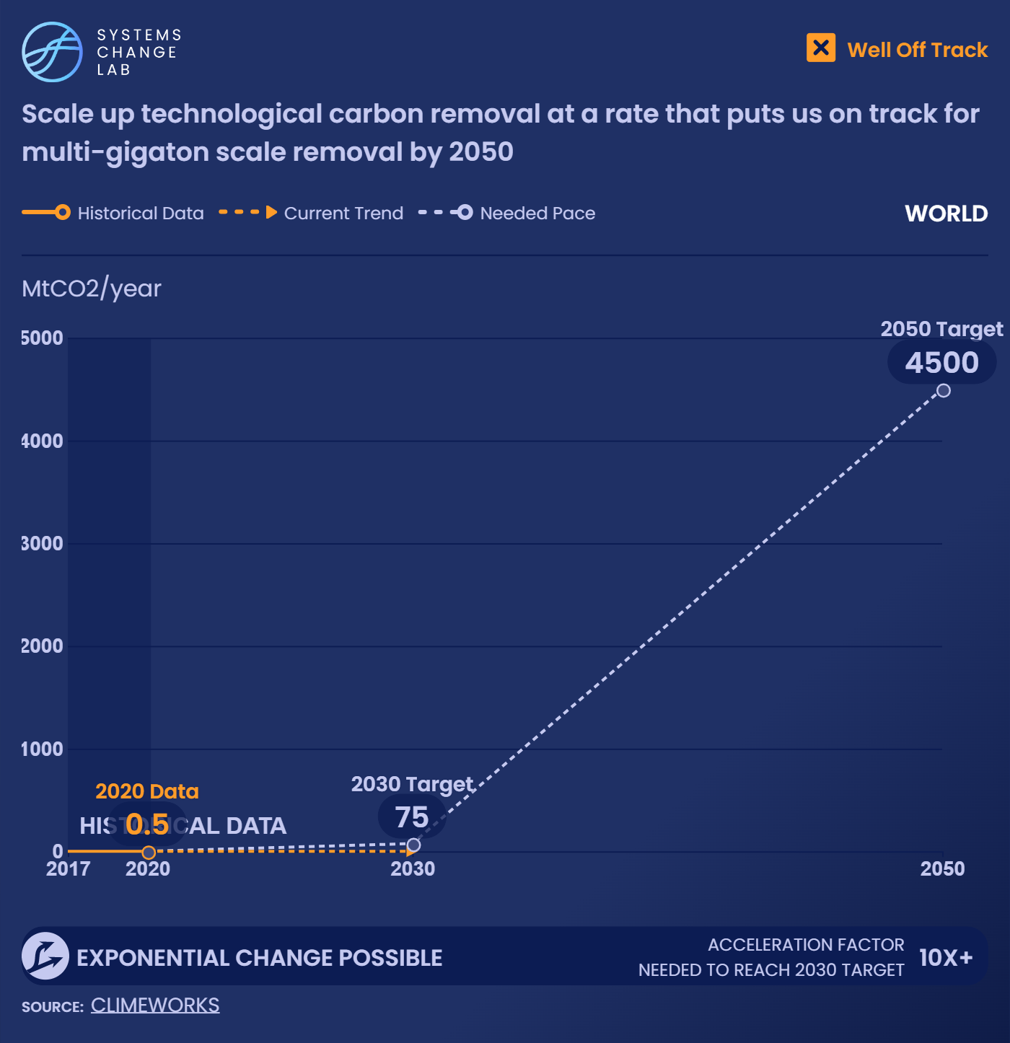
Progress toward targets
To stay on track with climate goals, both rapid emissions cuts and carbon dioxide removal (CDR) will be needed.
Technological carbon removal needs to ramp up rapidly to around 75 MtCO2/year by 2030, and 4,500 MtCO2/year by 2050.
Notes:
To be defined as carbon removal, carbon dioxide (CO2) must be captured from the atmosphere, not at a point source like a cement plant. (The latter would count as emissions reduction rather than carbon removal, since it prevents emissions from entering the atmosphere.) Carbon dioxide removed from the atmosphere must then be permanently sequestered, including through injection into deep underground geological formations, creation of stable carbonate minerals or use in durable products (e.g., concrete).
A key indicator for tracking progress on carbon removal is identifying how many metric tons (tonnes, t) of CO2 have been captured from the air through technological carbon removal approaches and stored permanently.
Today, that number stands at less than 1 million tonnes of CO2 per year (MtCO2/yr). DAC capacity is about 8,000 tCO2/yr (0.008 MtCO2/yr), but only half of that captured CO2 is stored permanently, largely through the 4,000 tCO2/yr (0.004 MtCO2/yr) Orca DAC plant in Iceland operated by Climeworks. This is similar in volume to the annual emissions from 870 cars. For bioenergy with carbon capture and storage (BECCS), one ethanol facility with carbon capture and storage (CCS), located in Illinois, stored 0.52 MtCO2/yr in 2020, the latest year of data available.
Estimates indicate that approximately 19,000 additional tonnes of CO2 removal (0.019 MtCO2) were delivered in 2020 through voluntary carbon removal purchases. However, data is incomplete and includes only what is reported publicly. This brings total carbon removal to an estimated 0.541 MtCO2 in 2020 — less than 1% of the amount of carbon removal expected to be needed by 2030.
Scaling up technological carbon removal at a rate that puts us on track for multi-gigatonne scale removal by 2050 and aligns with climate goals means we will likely need 75 MtCO2/year of carbon removal by 2030 and 4,500 MtCO2/year by 2050.
The recent rate of progress in scaling up technological carbon removal needs to accelerate significantly to reach 75 MtCO2/year by 2030. However, interest and investment in carbon removal is accelerating rapidly, so the rate of change will likely go faster in the future compared to what is happening today.

Slide 6
Enablers and barriers
72 companies
are purchasing
carbon removal
credits
7 governments
are investing
in CDR research
and development
5 governments
are funding
CDR enabling
infrastructure
6 governments
are providing
CDR deployment
and support
Notes:
In this system, we have identified 8 enablers and barriers to change. Some enabling conditions for this system include approaches such as increasing funding for research, development and deployment of carbon removal technologies, expanding complementary infrastructure, and developing robust governance structures that include prioritization of equity and sustainability.

Slide 7
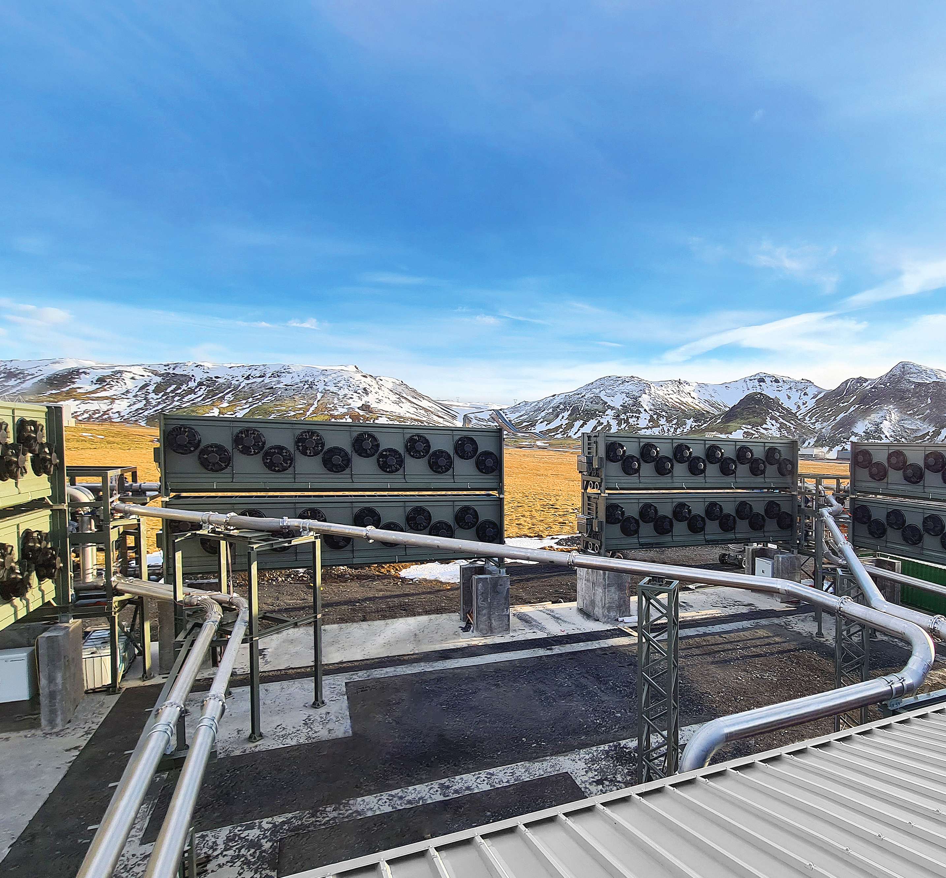
In 2022, a coalition of companies committed to purchase $925 million of permanent carbon removal between 2022 and 2030. In 2023, additional companies joined, bringing the total commitment to over $1 billion.
Notes:
The largest direct air capture plant in operation today removes 4,000 metric tons of carbon dioxide per year (tCO2/yr). Nine months after the plant began operations, Climeworks announced a nearly 10x scale up that broke ground in mid-2022. A handful of other million-ton scale plants are in the development pipeline, in addition to the 4 million ton DAC hubs in the U.S. Along with federal funding, private investment will need to assume a major role in the scale-up of carbon removal technologies. As more corporations put forward net-zero pledges, many will turn to these technologies to meet their targets.
Some companies and organizations are already purchasing tonnes of carbon dioxide removal or making commitments to do so later. Although data is incomplete, public records indicate that about $55 million in carbon removal tonnes have been purchased since 2020. Private capital through investment funds is beginning to flow: Lowercarbon Capital raised $350 million to invest in carbon removal start-ups, and Bill Gates’ Catalyst fund aims to leverage $15 billion to advance four technologies, including DAC. Frontier, run by a coalition of technology companies, is an advance market commitment to purchase $925 million in permanent carbon removal by 2030.
However, it’s crucial to make sure that corporate commitments don’t result in an overreliance on carbon removal and that companies reduce emissions as much as possible and don’t use carbon removal as a replacement for emissions reduction. The level of emissions reduction versus carbon removal will vary by company — a company producing cement will likely have a harder time reducing emissions than a company with emissions predominantly from electricity.
Along these lines, the Science Based Targets initiative released corporate net-zero guidance in late 2021 that companies on the path to net-zero must reduce at least 90% of their emissions and use carbon removal only for the remaining 5–10%. Additionally, it’s important for carbon removed to be sequestered over very long durations. Based on available data, 72 companies have purchased tonnes of carbon removal as of mid-2022. We have not yet assessed the permanence and quality of these tonnes.
Photo via ClimeWorks

Slide 8
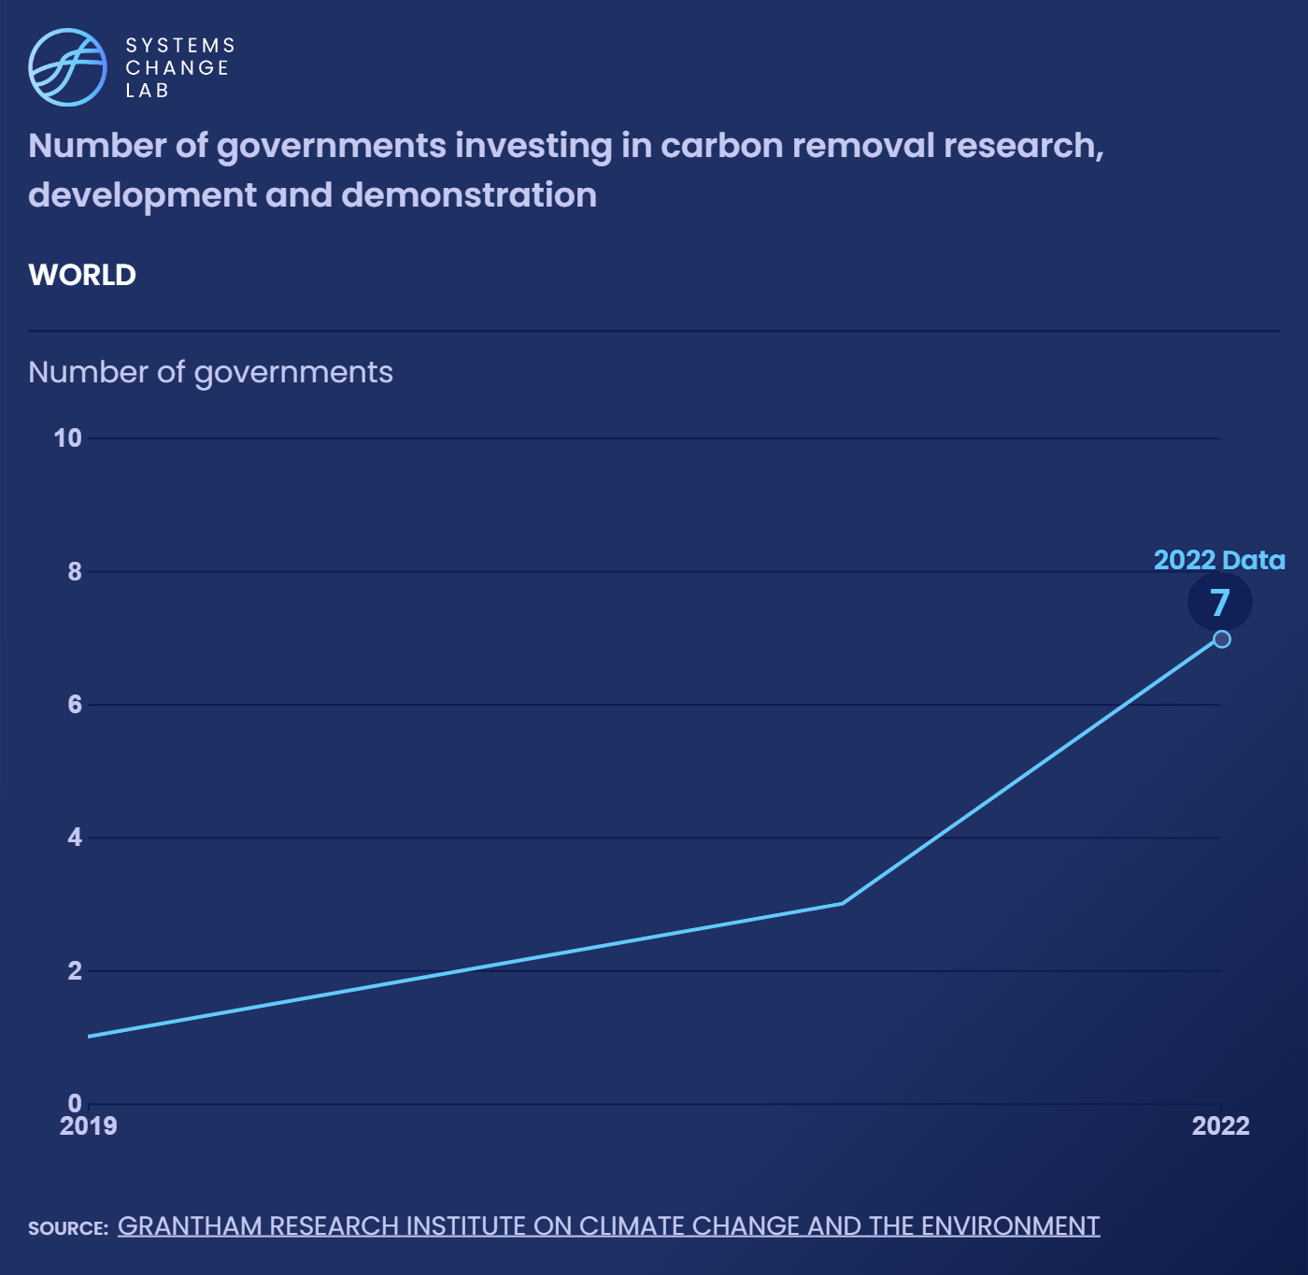
Activity around CDR has skyrocketed in the past three to four years, particularly in the U.S.
The amount of CDR is expected to accelerate as private and public investments and new policies translate into projects on the ground.
Notes:
Government investment in research, development and demonstration (RD&D) is necessary to develop a wide range of carbon removal technologies and optimize the ones we have today. With a diverse portfolio of carbon removal technologies, we can minimize risks associated with any one approach and reduce overall costs.
A handful of countries have already increased federal funding for development of carbon removal technologies, including Australia, Canada, Japan, the United Kingdom and the United States, but much more will be needed. Based on available data, seven countries are providing government RD&D for carbon removal in 2022, up from one in 2019.

Slide 9
Based on public documentation and announcements, at least six countries
supported CDR deployment in 2022, including Australia, Canada, Germany, Iceland, Switzerland and the United States.
Notes:
Government support for deployment of carbon removal technologies is important because carbon removal technologies are costly, and opportunities for direct revenue are limited since carbon removal is ultimately a public good.
Deployment support can come through a variety of channels, such as investment or production tax credits, loans, grants, tax-advantaged financing structures, government procurement of products made with captured CO2, or direct government procurement of carbon removal, among others.
Governments in developed economies have a particular responsibility to scale up carbon removal capacity given their higher levels of total historical emissions.
For example, the United States’ 45Q tax credit, created in 2008, provides support for carbon that is sequestered geologically or used in products. The credit value for DAC increased in 2022 from $35–50/tCO2 to $130–180/tCO2. The U.S. Federal Carbon Removal Leadership Act would also require increasing levels of government procurement of tonnes of removed carbon. In 2022, Canada created an investment tax credit that covers 60% of investments for carbon removal infrastructure.
Based on public documentation and announcements, at least six countries — Australia, Canada, Germany, Iceland, Switzerland and the United States — are providing carbon removal deployment support in 2022.

Slide 10
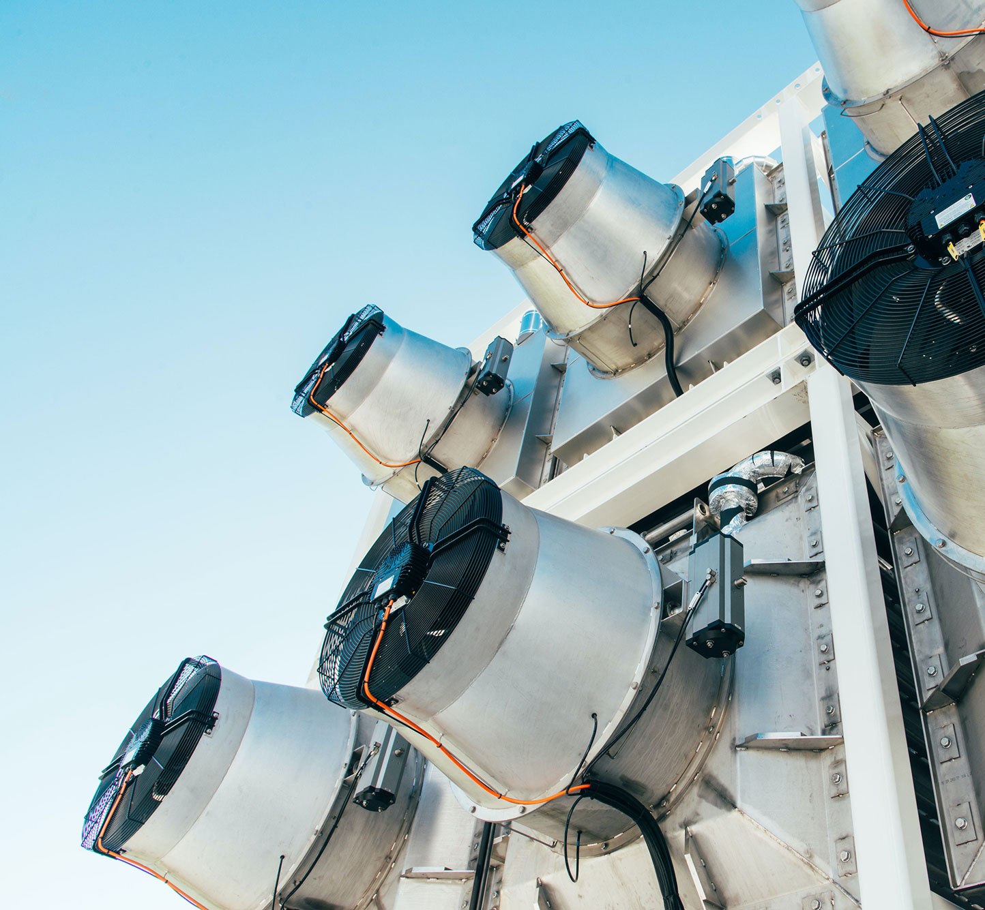
U.S. federal funding provided $3.5 billion for direct air capture (DAC) hubs in 2021 — the largest ever influx of funding for carbon removal — along with an expanded tax credit to support deployment in 2022.
Notes:
Government support for deployment of carbon removal technologies is important because carbon removal technologies are costly, and opportunities for direct revenue are limited since carbon removal is ultimately a public good.
Deployment support can come through a variety of channels, such as investment or production tax credits, loans, grants, tax-advantaged financing structures, government procurement of products made with captured CO2, or direct government procurement of carbon removal, among others.
Governments in developed economies have a particular responsibility to scale up carbon removal capacity given their higher levels of total historical emissions.
For example, the United States’ 45Q tax credit, created in 2008, provides support for carbon that is sequestered geologically or used in products. The credit value for DAC increased in 2022 from $35–50/tCO2 to $130–180/tCO2. The U.S. Federal Carbon Removal Leadership Act would also require increasing levels of government procurement of tonnes of removed carbon. In 2022, Canada created an investment tax credit that covers 60% of investments for carbon removal infrastructure.
Based on public documentation and announcements, at least six countries — Australia, Canada, Germany, Iceland, Switzerland and the United States — are providing carbon removal deployment support in 2022.
Photo via ClimeWorks

Slide 11
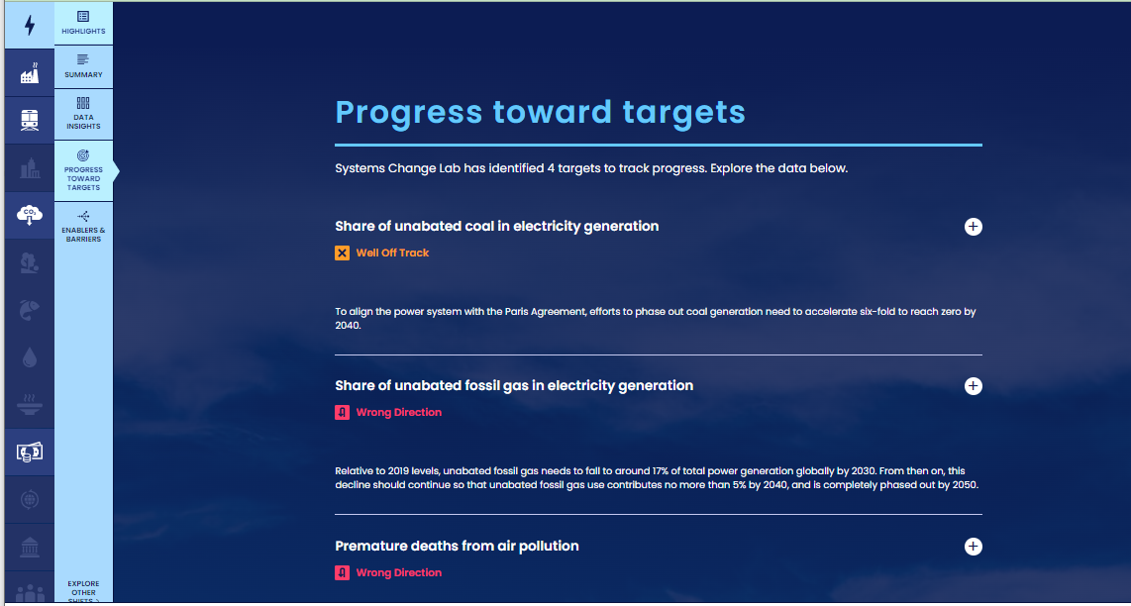
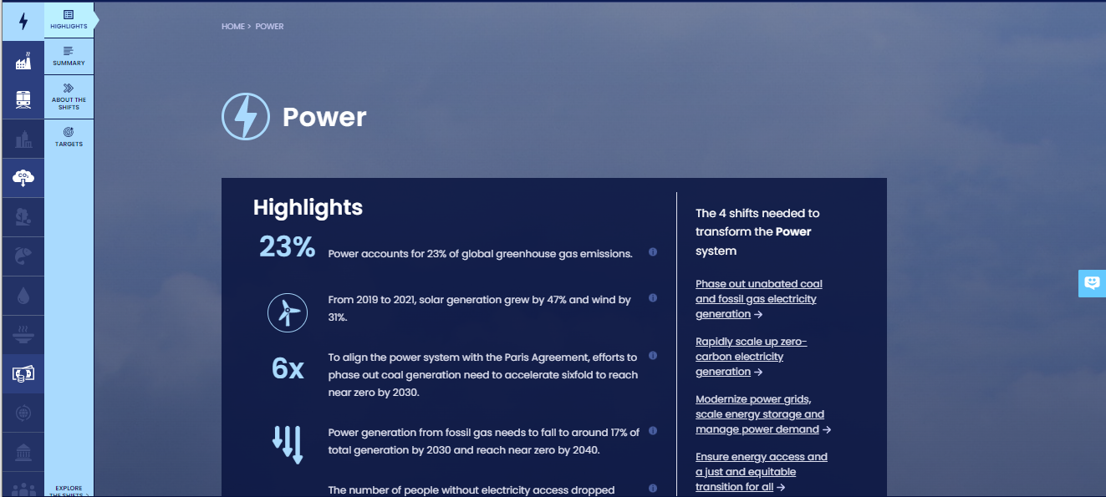
How to highlight a different indicator
Find your desired indicator on systemschangelab.org system pages
1. Select a system
3. Scroll down page to indicators and expand one
2. Select a shift

Slide 12
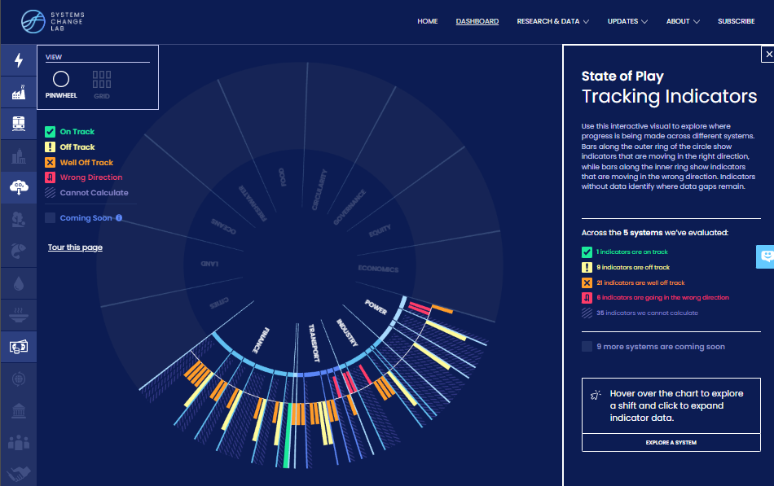
Alternatively, search for an indicator on the dashboard
1. Navigate to the dashboard
3. Search an indicator and then click explore data
2. Select grid view
4.
Notes:
Find your desired indicator on https://systemschangelab.org/
Look through System Page ( https://systemschangelab.org/power)
OR search the dashboard ( https://systemschangelab.org/dashboard) & select "EXPLORE DATA >" on your desired indicator

Slide 13
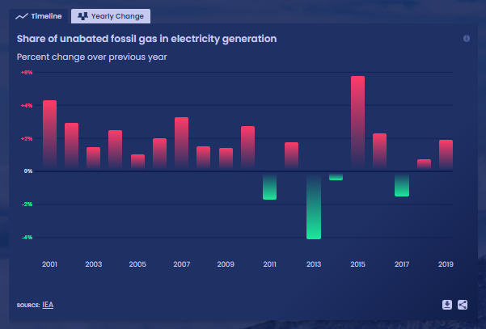
Pick a chart view and click the download button

Slide 14
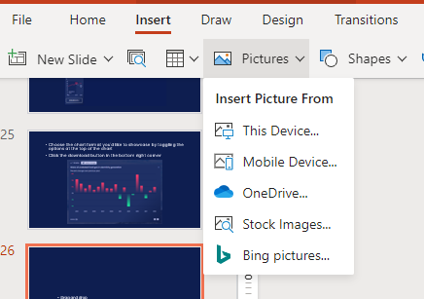
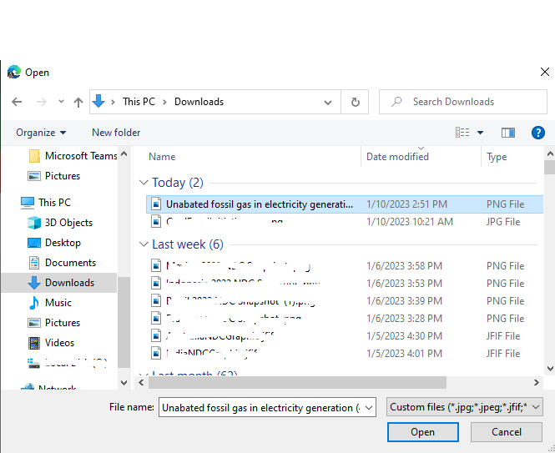
Next, add the chart to your slide deck
1. Select "Insert" and "Pictures" on the toolbar
2. Select chart from the downloads folder and open

Slide 15
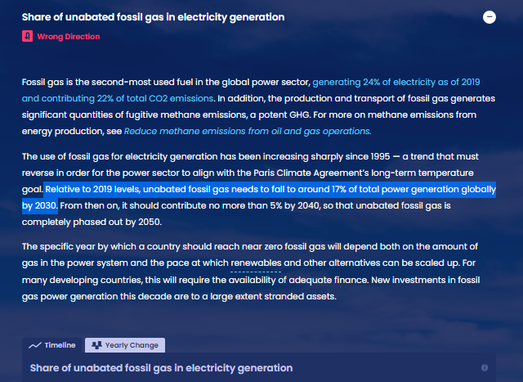
Add context from the indicator write-up as desired

Slide 16
For more information
VISIT: SYSTEMSCHANGELAB.ORG/TECHNOLOGICAL-CARBON-REMOVAL
EMAIL: CONTACT@SYSTEMSCHANGELAB.ORG

